Slide 1
ARCHY 483 Analysis of Stone Artefacts
Spring 2019
Lecture 2 Attribute & debitage analysis

Slide 2
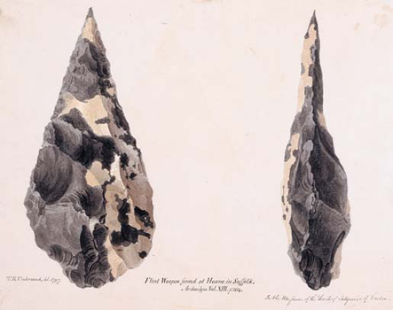
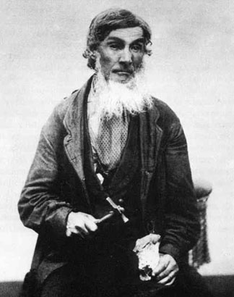
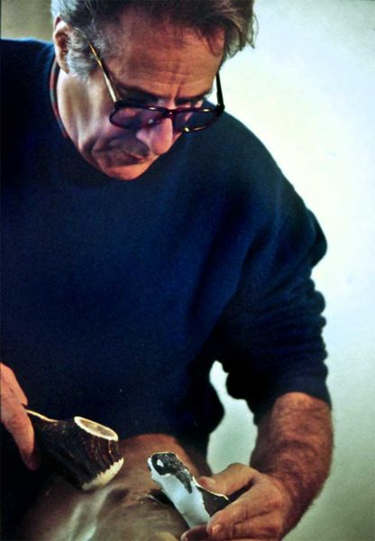
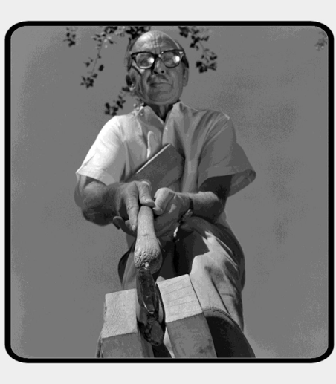
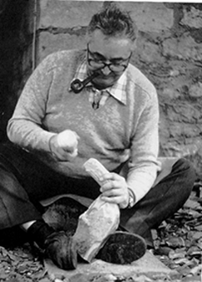
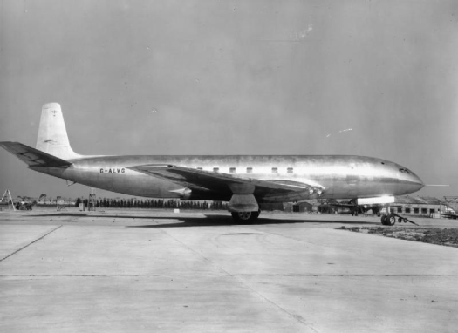
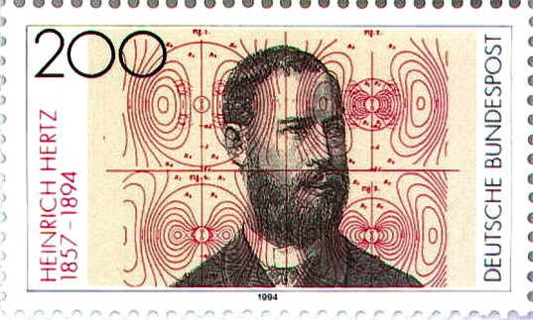
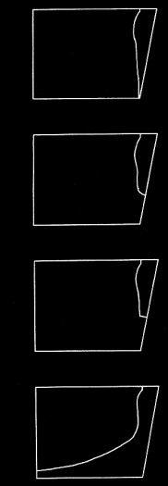

Slide 3
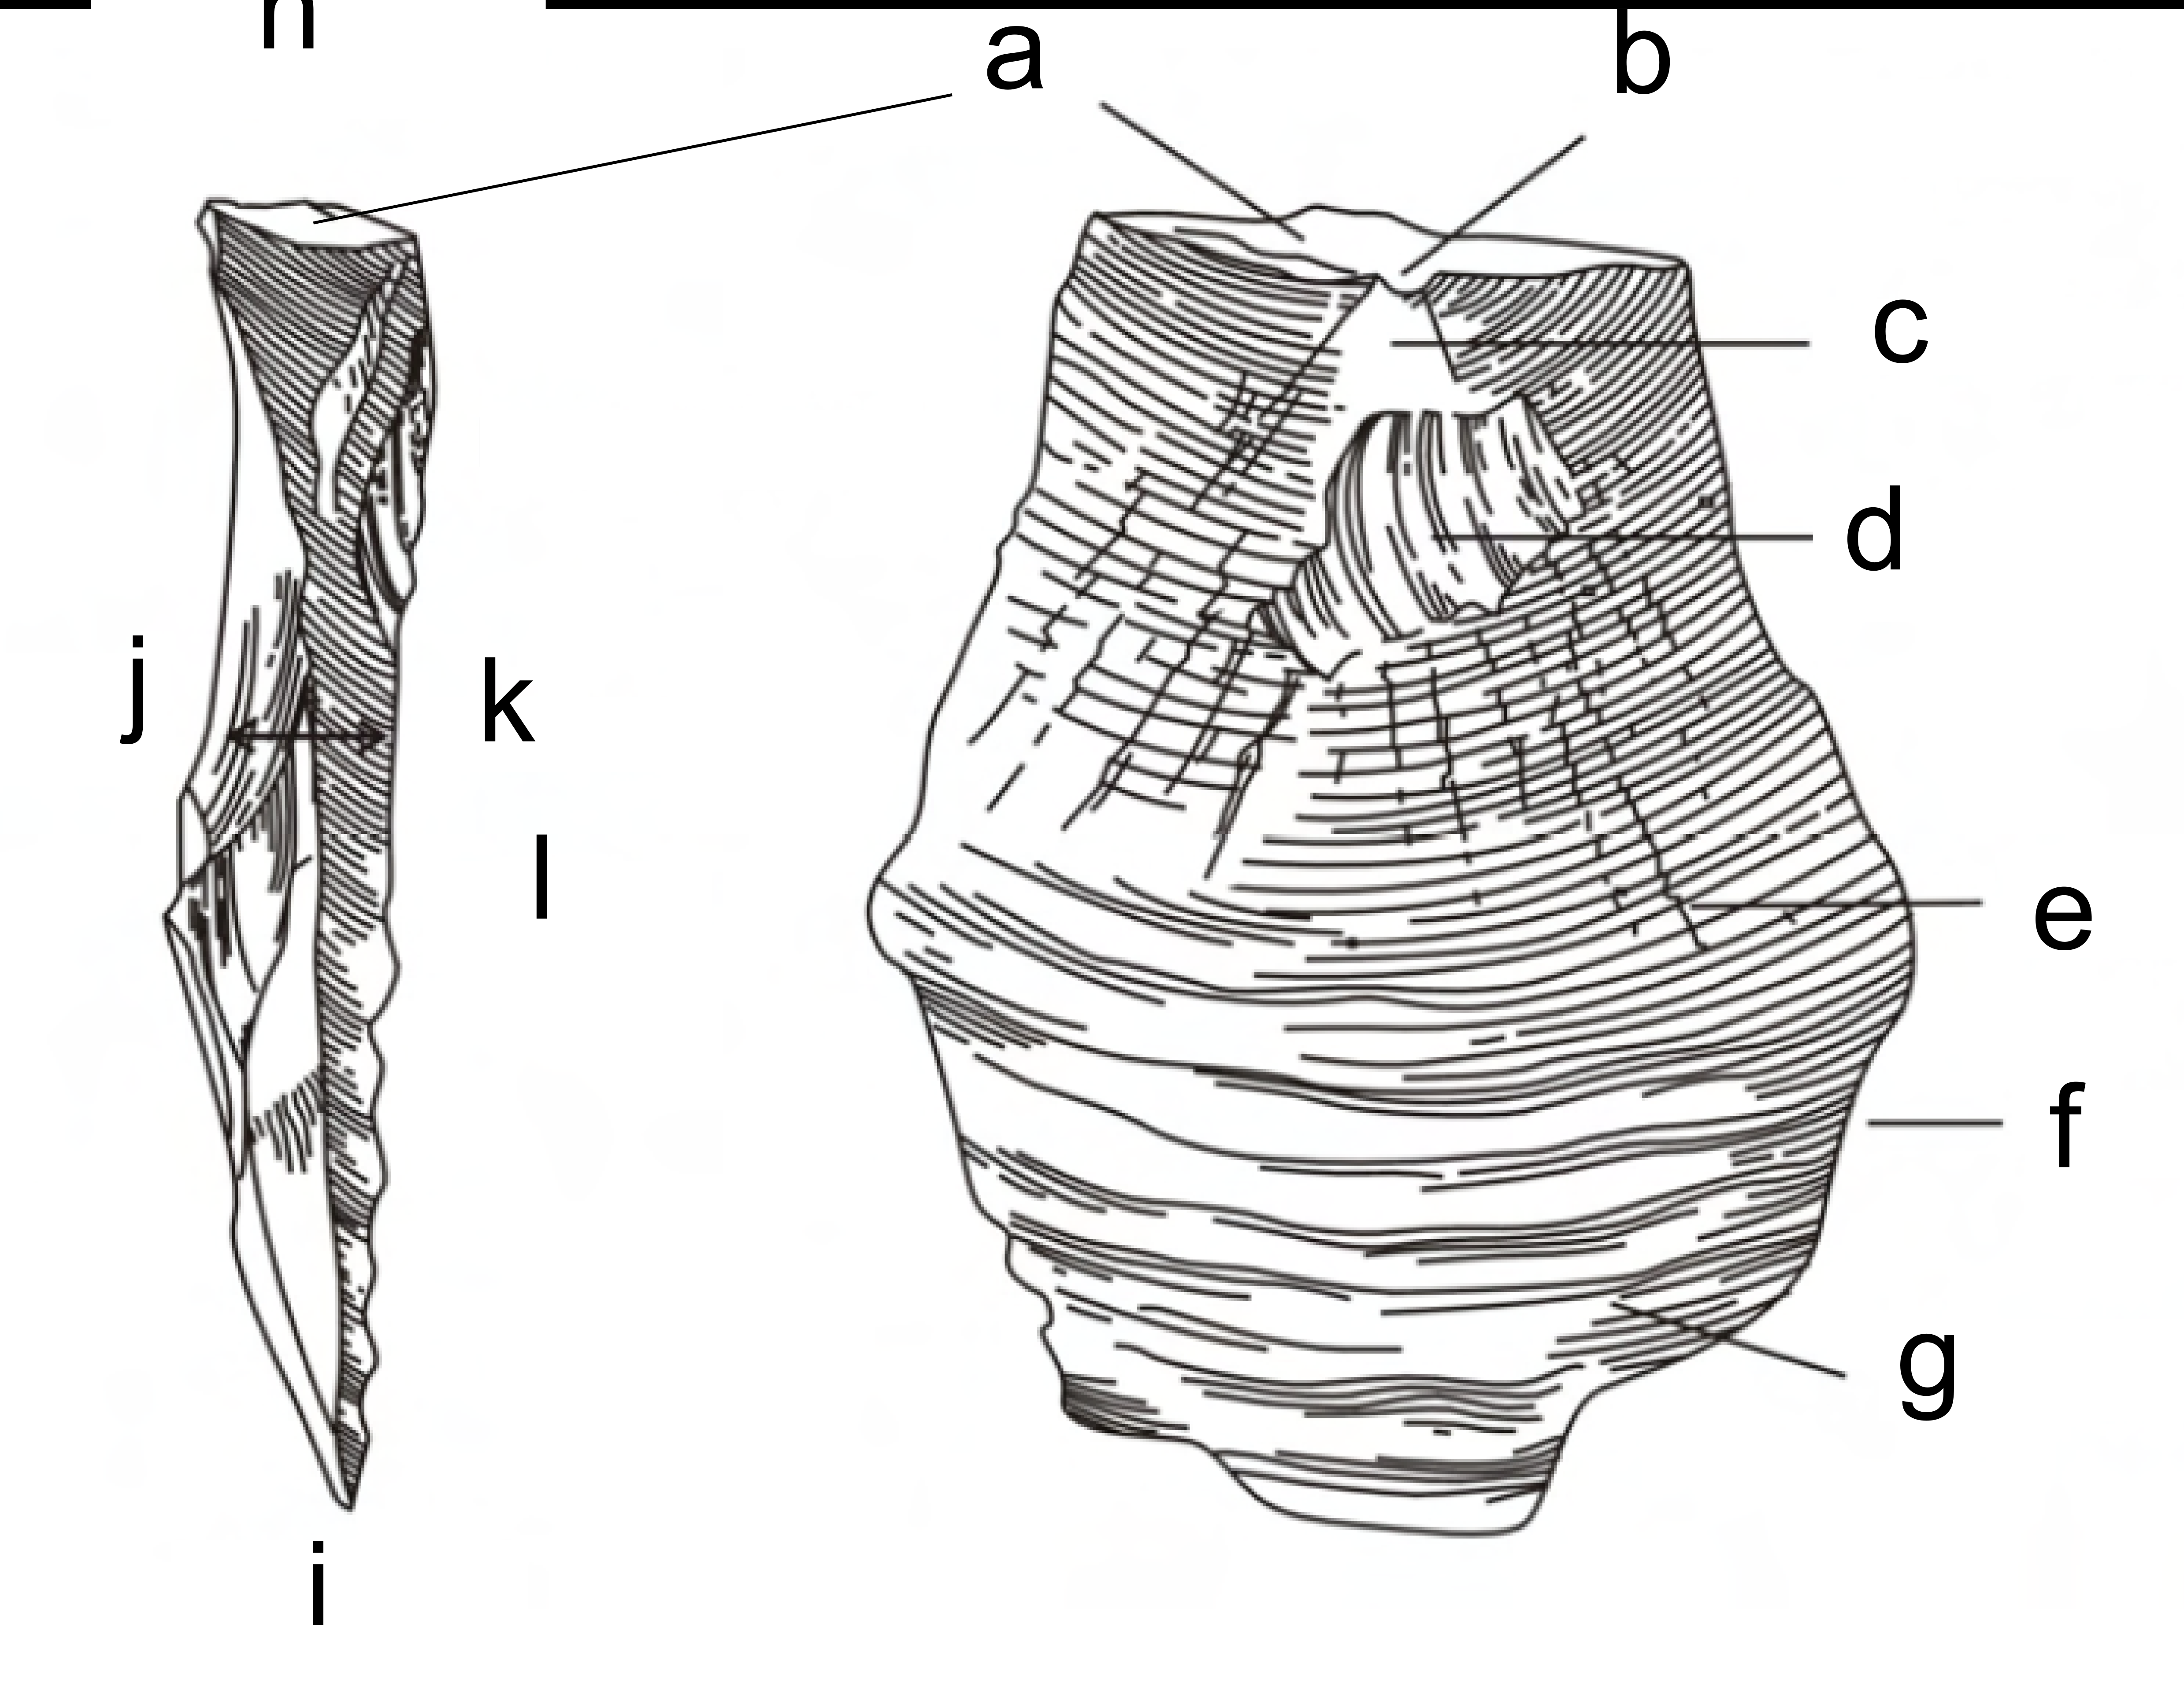

Slide 4
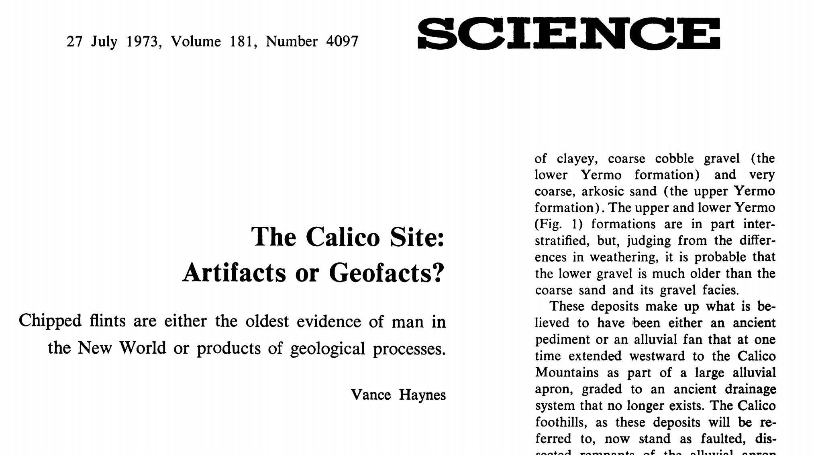
Q1: What is the one key word for telling the difference between artefacts and geofacts?

Slide 6
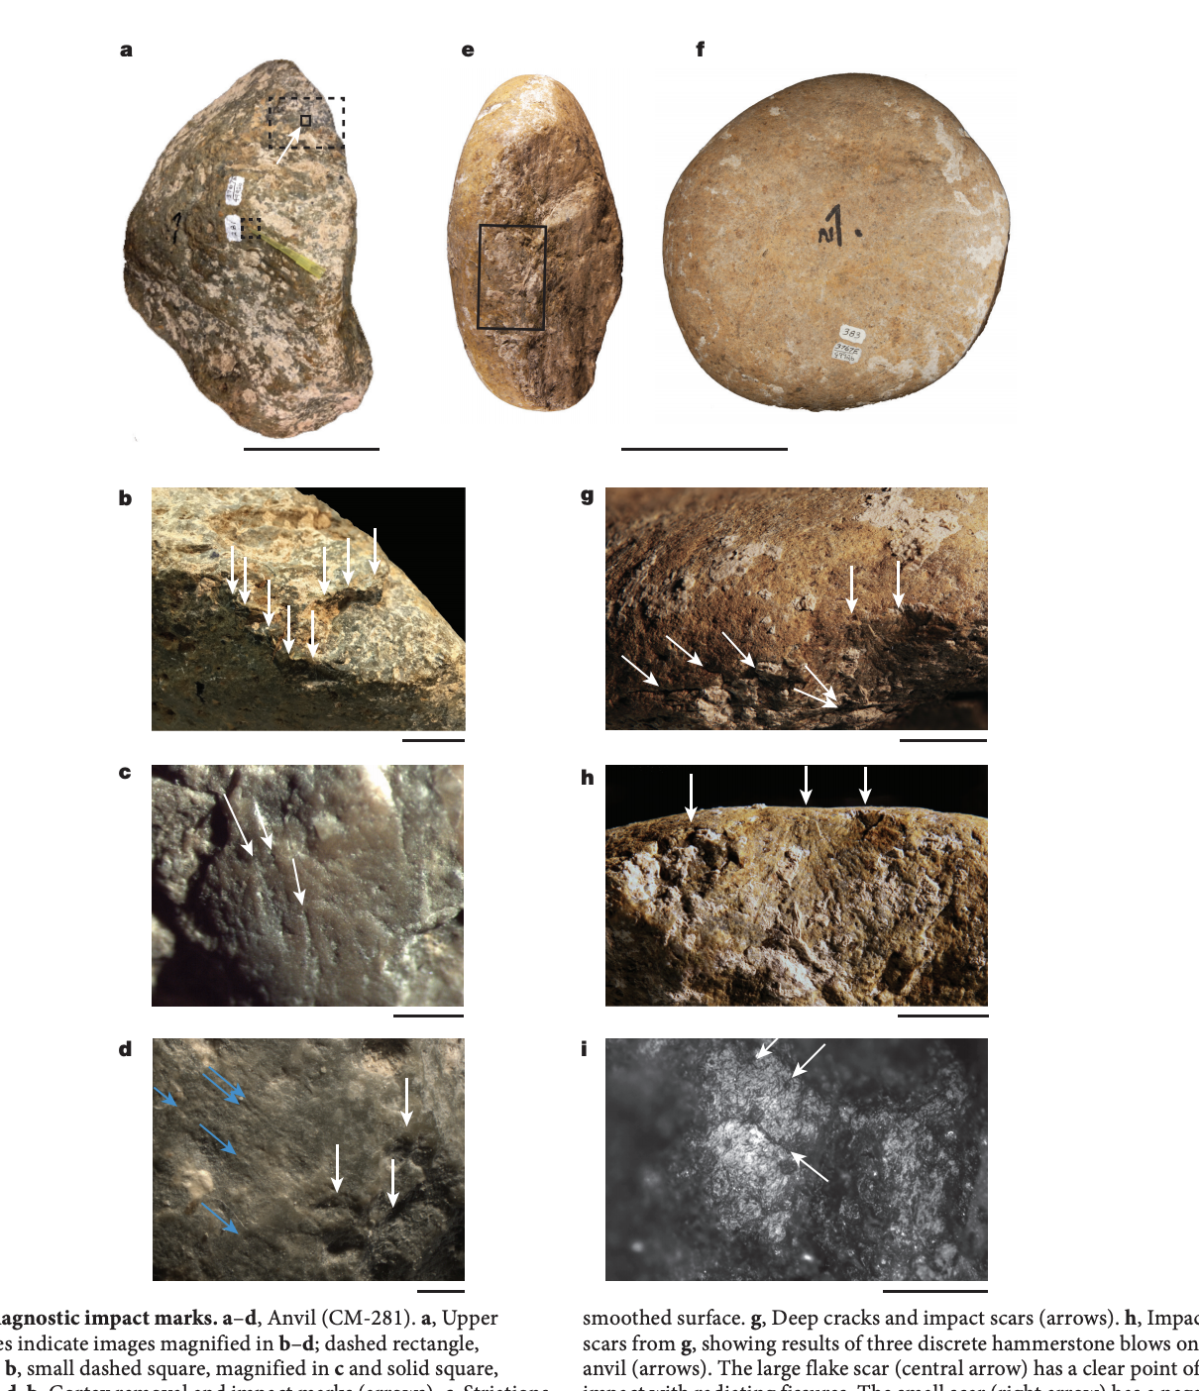
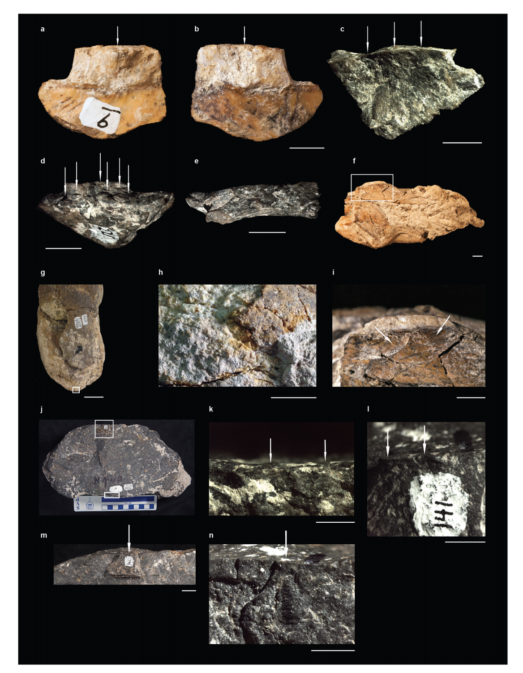

Slide 7
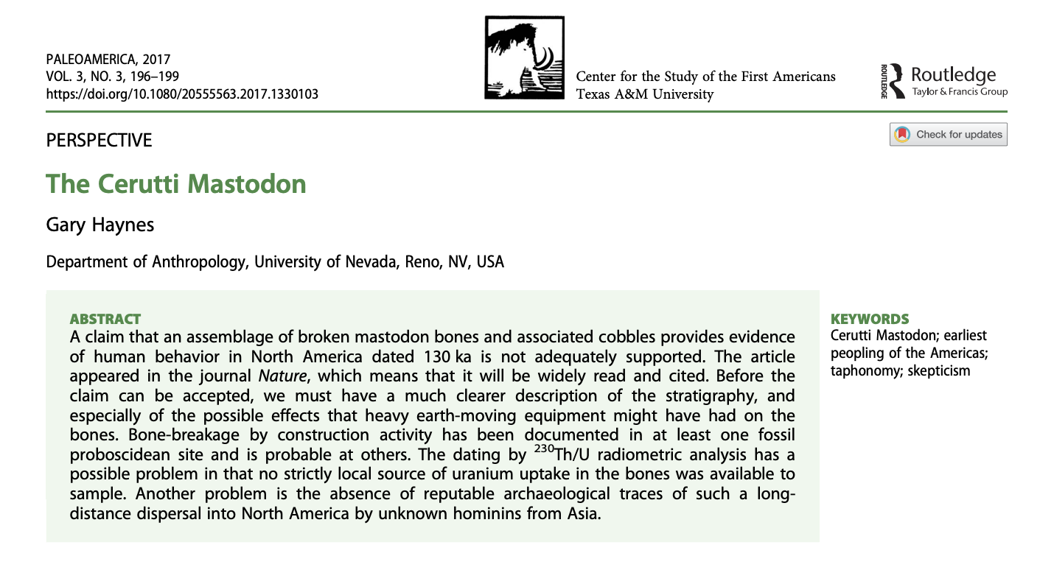

Slide 8
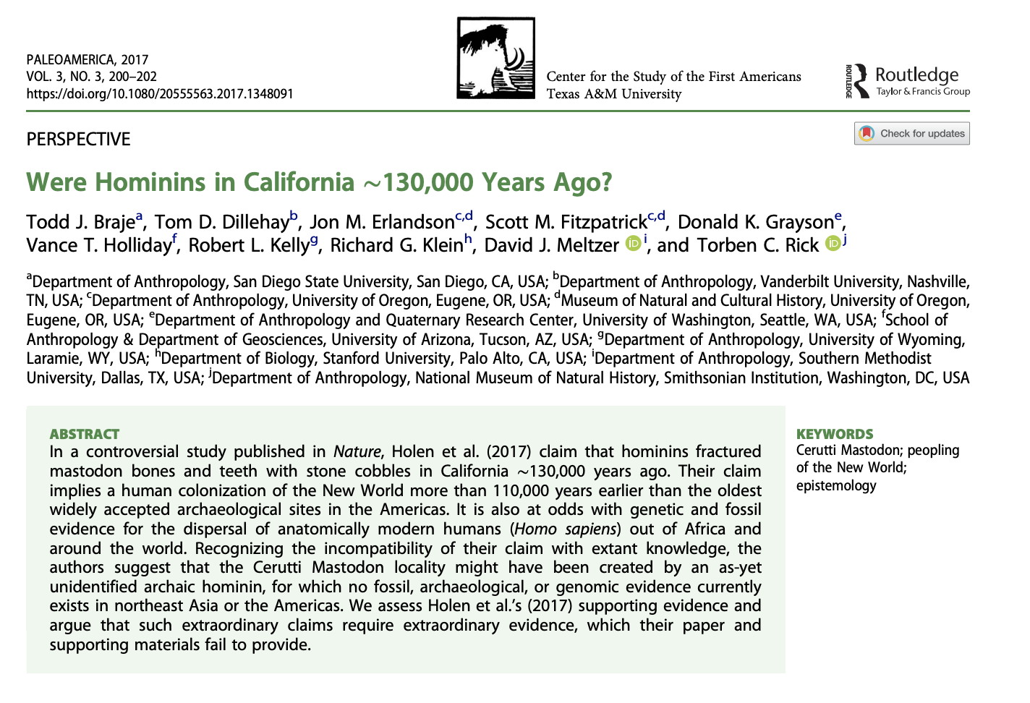

Slide 9
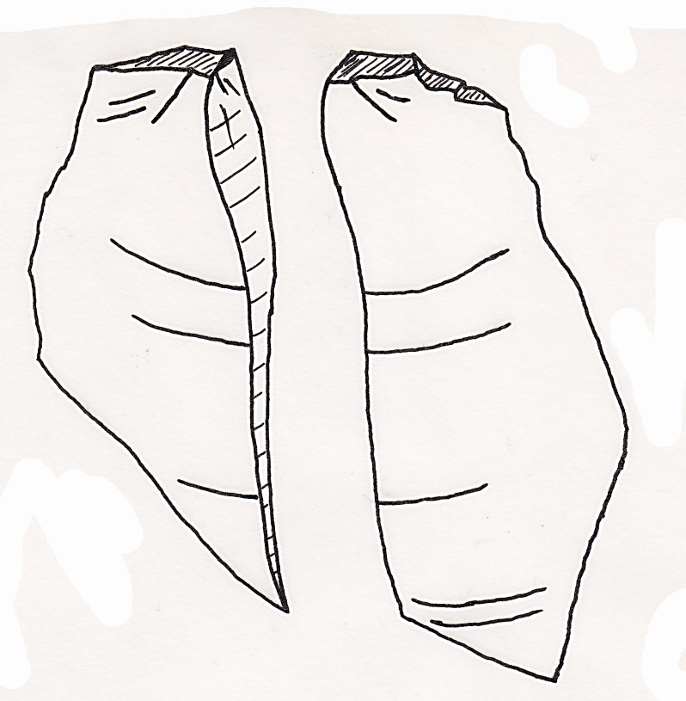
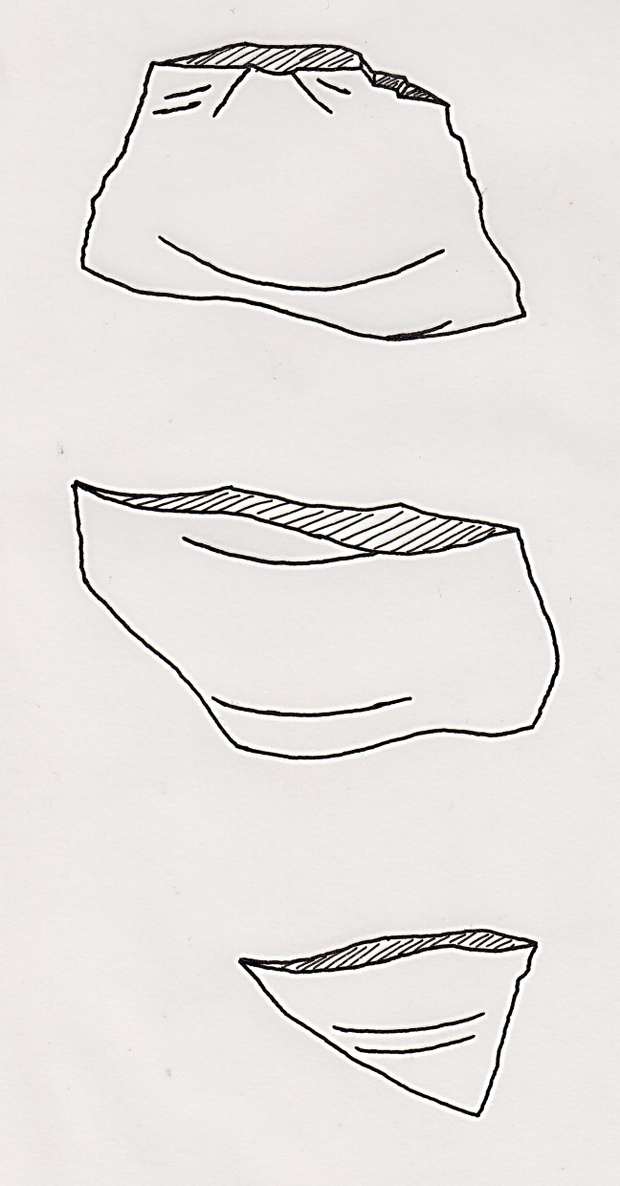
Q2: What are these and what are two reasons why we record them?

Slide 10
Q3: What was the problem with the Comet’s windows, and what is the solution that we see in modern aeroplanes?

Slide 11
What are we going to do today?
Measurement & quantification
Bipolar & heat treatment
Raw materials
Cores
Chaîne opératoire

Slide 12
Measurement and quantification

Slide 13
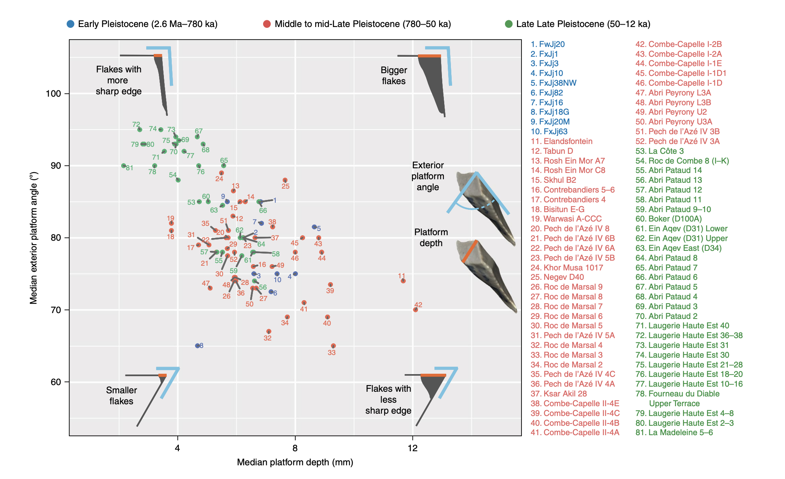
Simple measurements of stone artefacts can reveal profound regularities

Slide 14
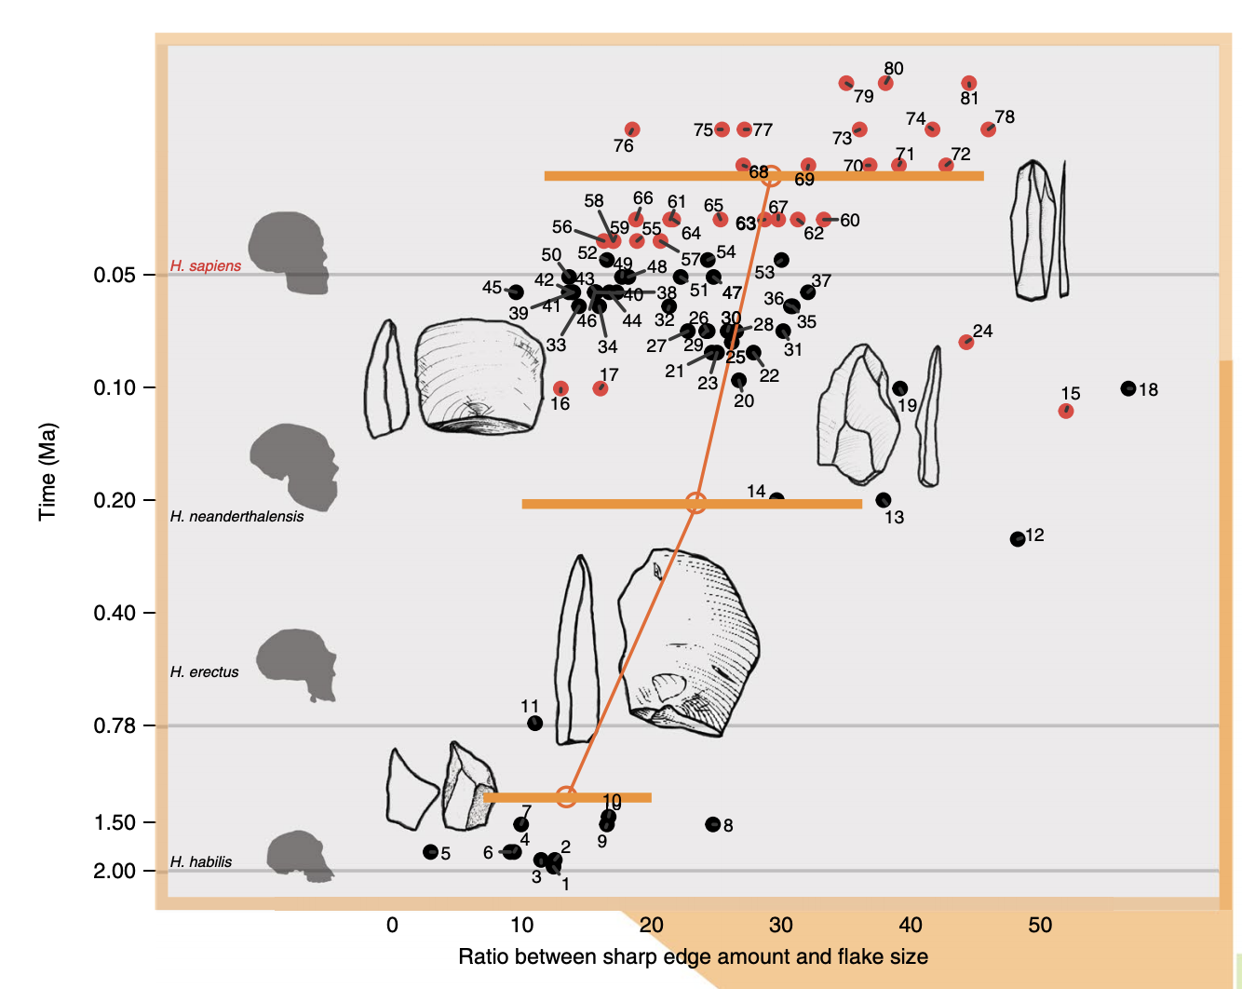

Slide 15
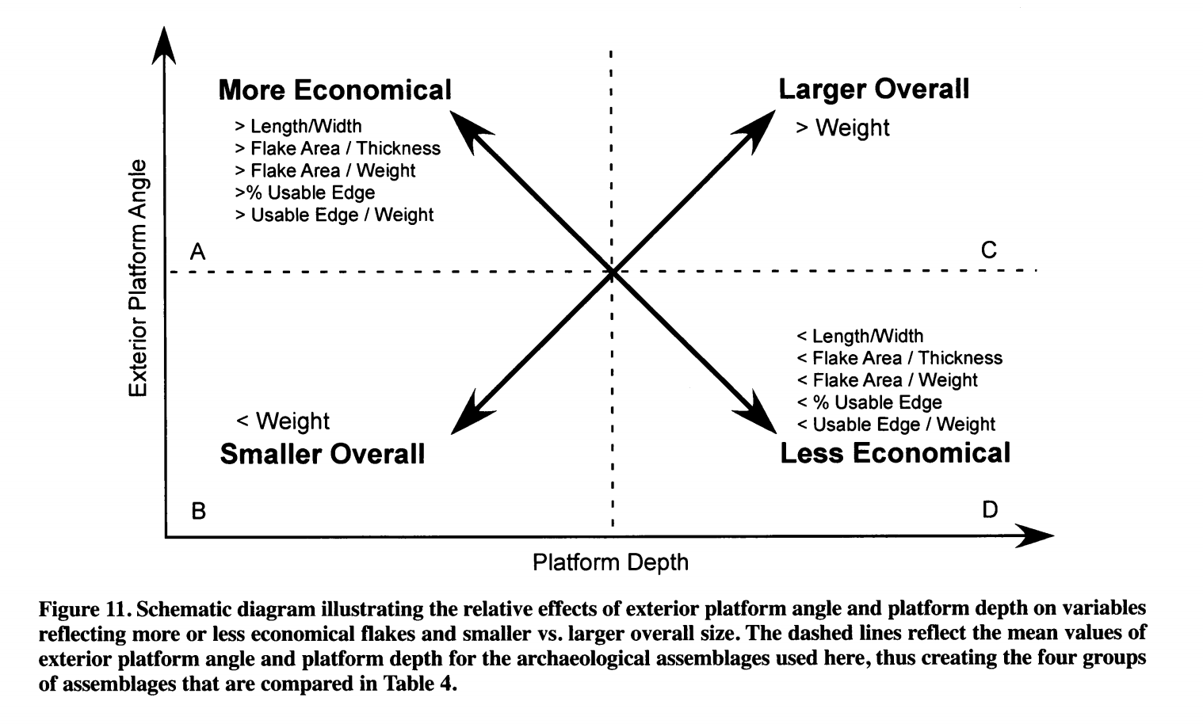

Slide 16
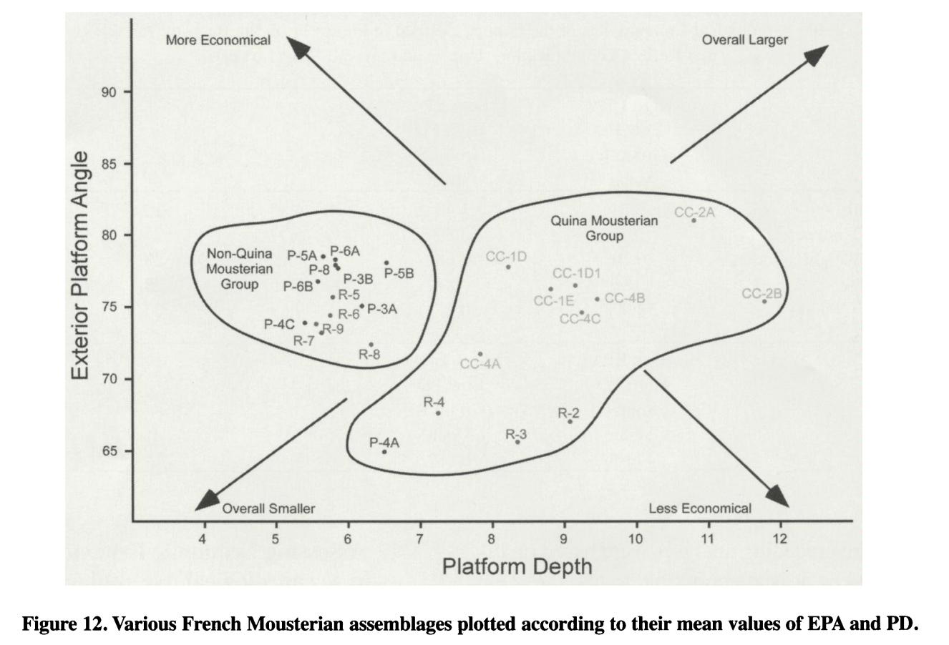
Lin, Sam C., et al. "On the utility and economization of unretouched flakes: the effects of exterior platform angle and platform depth." American Antiquity 78.4 (2013): 724-745.

Slide 17
What do other archaeologists do? Are there standard sets of measurements and observations?
Contractual obligations (or less binding obligations to the field)
History driven observations
Question driven observations
How do circumstances constrain what we record?

Slide 18
There are many ways to take even the most basic flake measurements

Slide 21
How to devise your measurement protocol
Read recent previous work in your region to discover what’s normal
Read elsewhere to discover what the smart people are doing
Combine results of 1 & 2 to make sense for your specific objectives
Write it down with enough specific detail so that it can be…

Slide 23
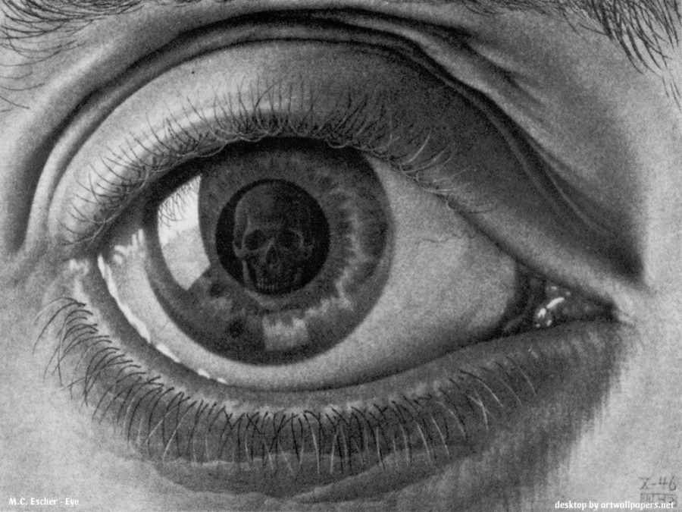
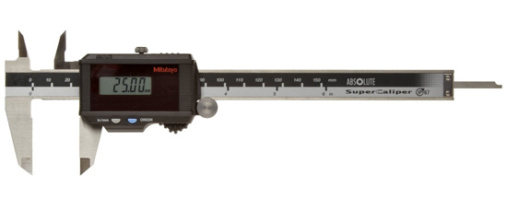
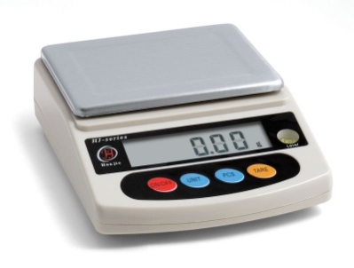
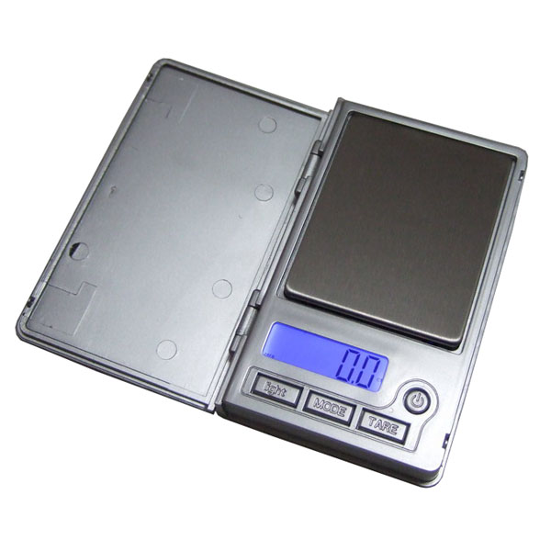
Basic stone artefact recording equipment
Notes:
The study of Lithic technology is the recording of data found in an assemblages of humanly induced fractured stone and attempting to explain how and why it was fractured.
My methodology has focused on recording the size and shape of artefacts, to decipher how and why stone artefacts were made and how this technology relates to the way people lived, particularly their subsistence practices.
I have record these data using callipers, goniometer, balances and 3D laser scanning – to end up with a data base of numbers relating to artefacts morphologies or size and shape
The collections and assemblages I have worked on are from museums, previous excavations and my own excavations and surface collections.

Slide 24
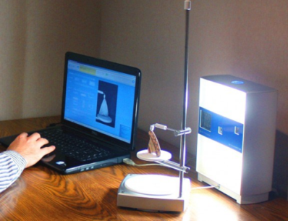
Less basic stone artefact recording equipment

Slide 25
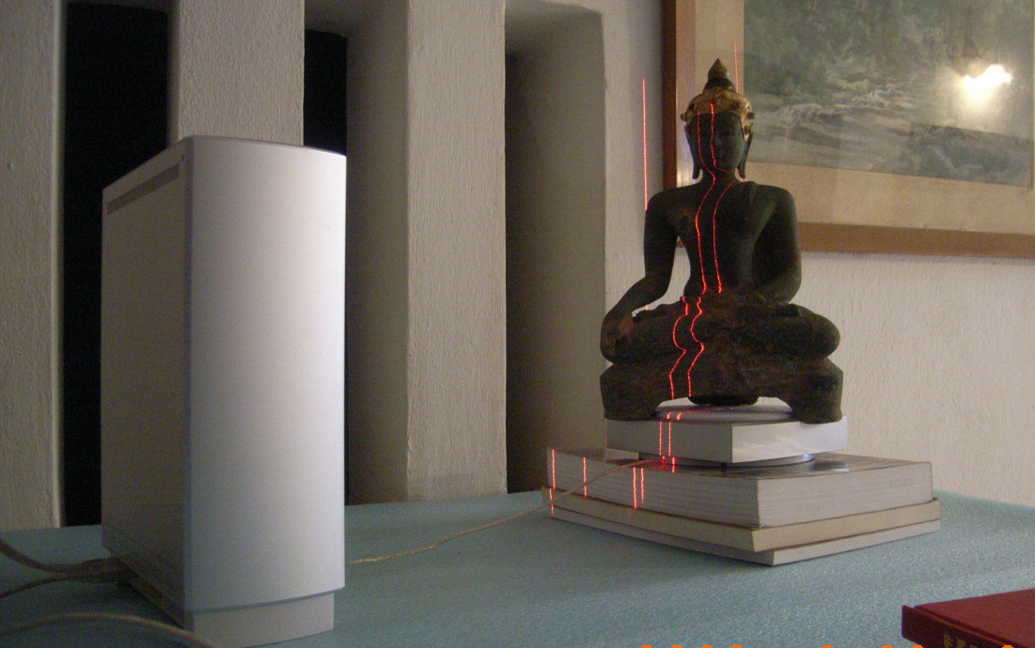
Less basic stone artefact recording equipment

Slide 26
3D laser scanning by triangulation

Slide 27
Estimating original ﬂake mass from 3D scans of platform area
Clarkson & Hiscock / Journal of Archaeological Science 38 (2011) 1062-1068
Dihedral platform Focalised platform Plain ﬂat platform

Slide 29
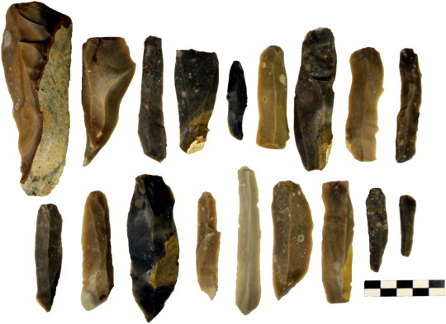
Muller, A., & Clarkson, C. (2014). Estimating original flake mass on blades using 3D platform area: problems and prospects. Journal of Archaeological Science, 52, 31–38. doi:10.1016/j.jas.2014.08.025

Slide 30
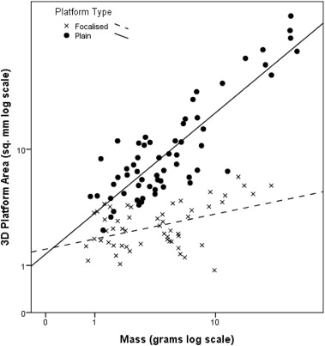

Slide 31
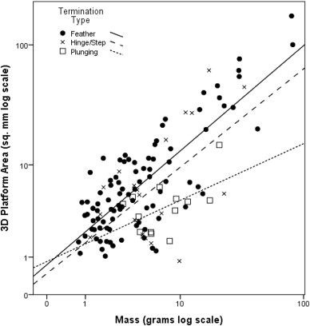

Slide 32
3D scan measurements of flake platform area seem to be useful for estimating original flake mass

Slide 33
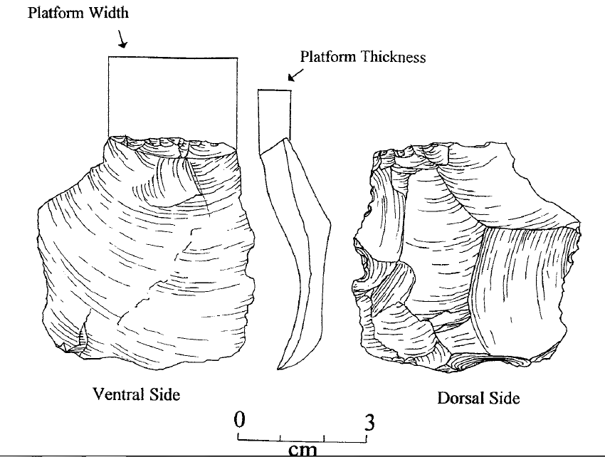
2D caliper measurements of flake platform area are also good overall discriminators of reduction trajectories, so you should take them

Slide 34
Common composite measurements
Elongation
Length/Thickness ratio
Width/Thickness ratio
Edge length/mass ratio

Slide 35
EL/M values are an estimate of the amount of ﬂake edge produced from a given amount of stone
EL = Length + maximum width + maximum dimension

Slide 36
Mackay, A. (2008). A method for estimating edge length from flake dimensions: use and implications for technological change in the southern African MSA. Journal of Archaeological Science, 35(3), 614–622.

Slide 37
Flaking efficiency during the Howiesons Poort of South Africa

Slide 38
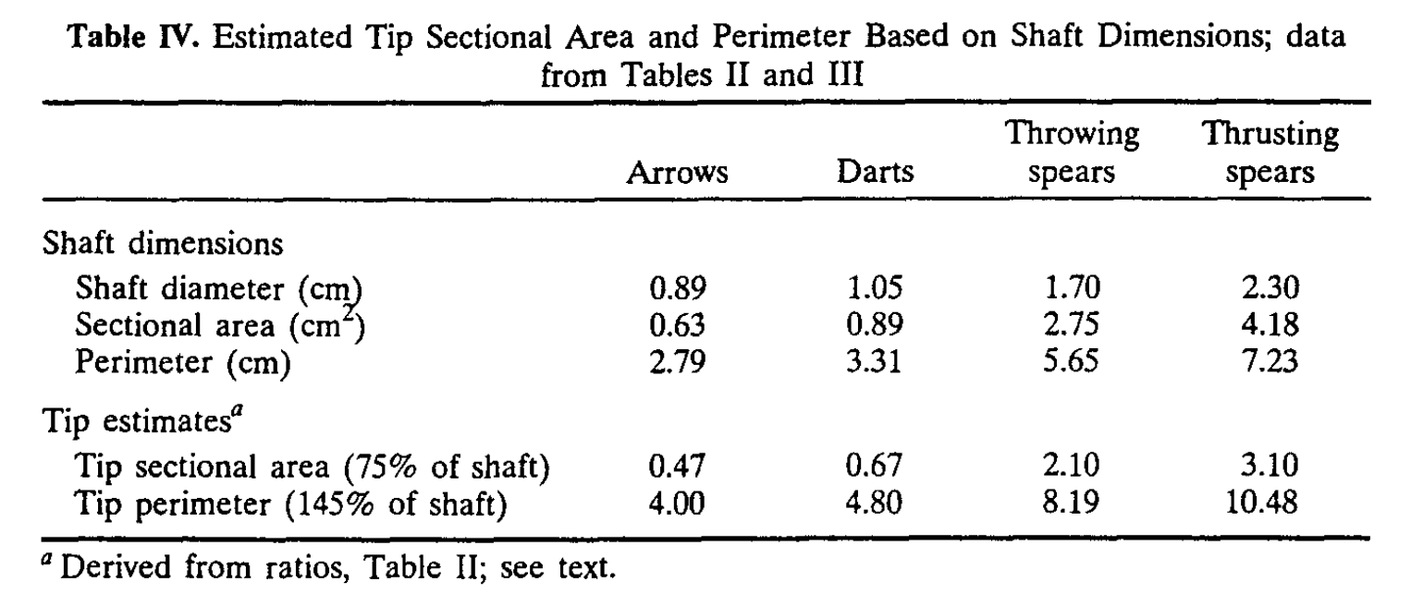
Tip Cross-Sectional Area (TCSA)
Notes:
a simple ballistics measure
Hughes, S. S. (1998). Getting to the point: Evolutionary change in prehistoric weaponry. Journal of Archaeological Method and Theory, 5(4), 345–408.doi:10.1007/bf02428421
url to share this paper: sci-hub.se/10.1007/BF02428421

Slide 39
Tip Cross-Sectional Area (TCSA)
Notes:
a simple ballistics measure

Slide 40
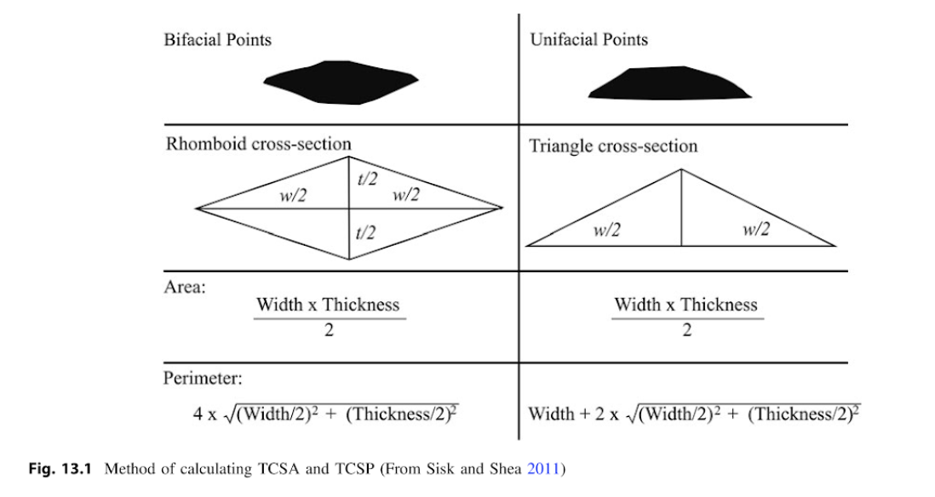
Tip Cross-Sectional Area (TCSA) & Perimeter (TCSP)

Slide 41
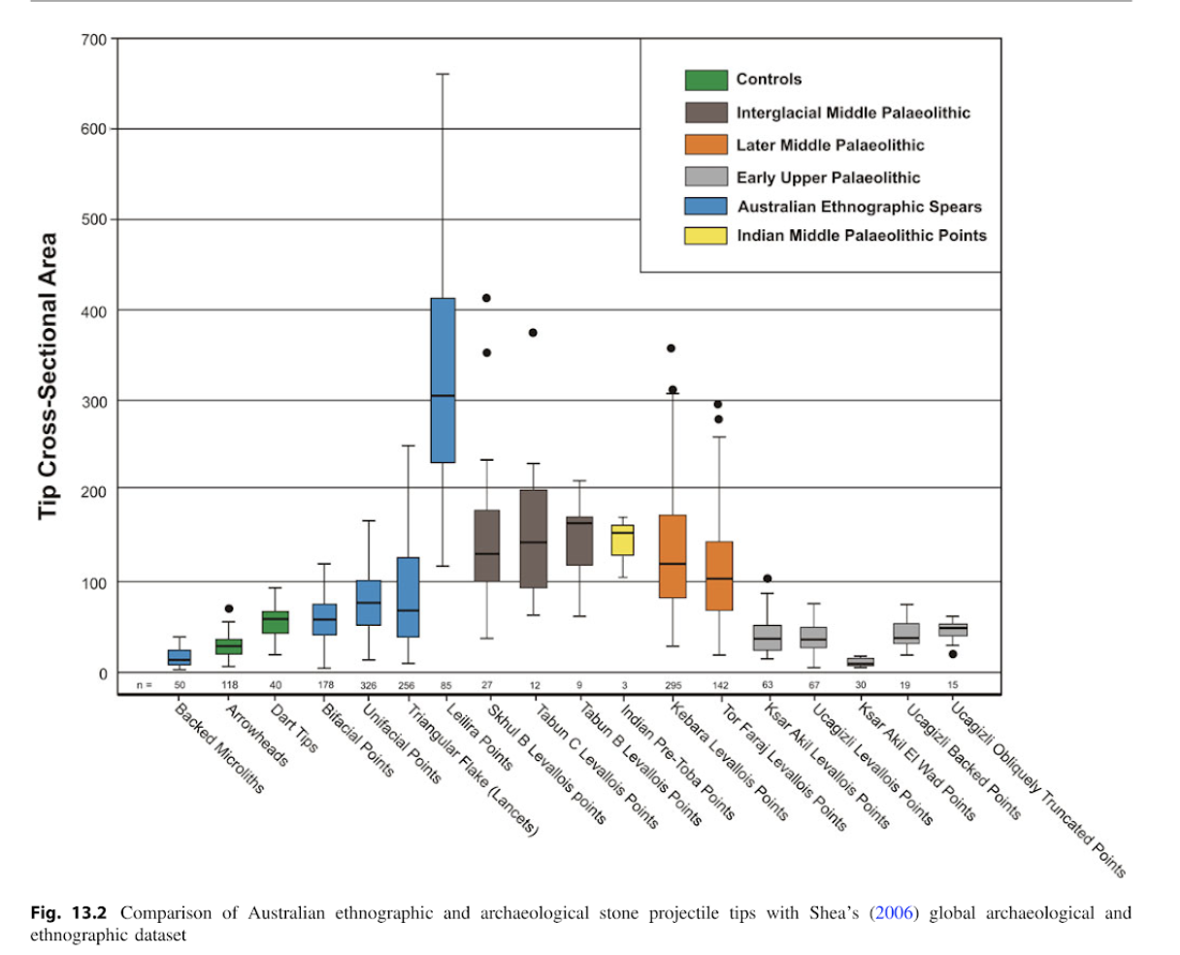

Slide 42
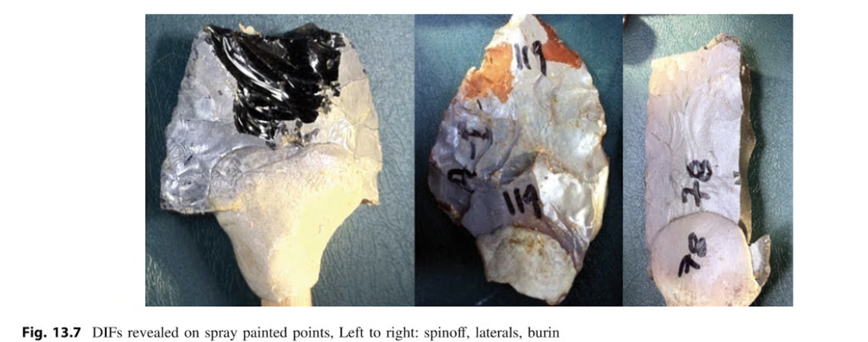
diagnostic impact fractures (DIFs)

Slide 43
Tanged points from the Jingeuneul site showing DIFs:
a, b crushing on both lateral edges,
c crescent scar likely due to hafting,
d burin-like fractures,
e flute-like fracture,
f snap fracture and spin-offs,
g transverse fracture with step termination, and
h transverse fracture with hinge termination

Slide 44
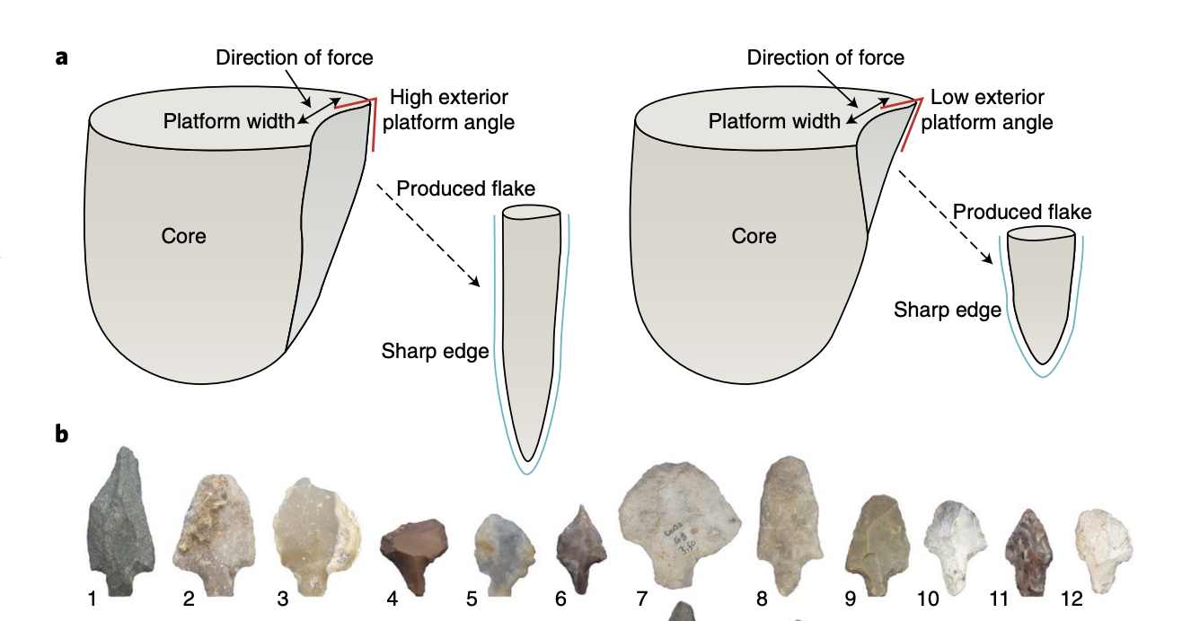
Angles are important but difficult to measure

Slide 45
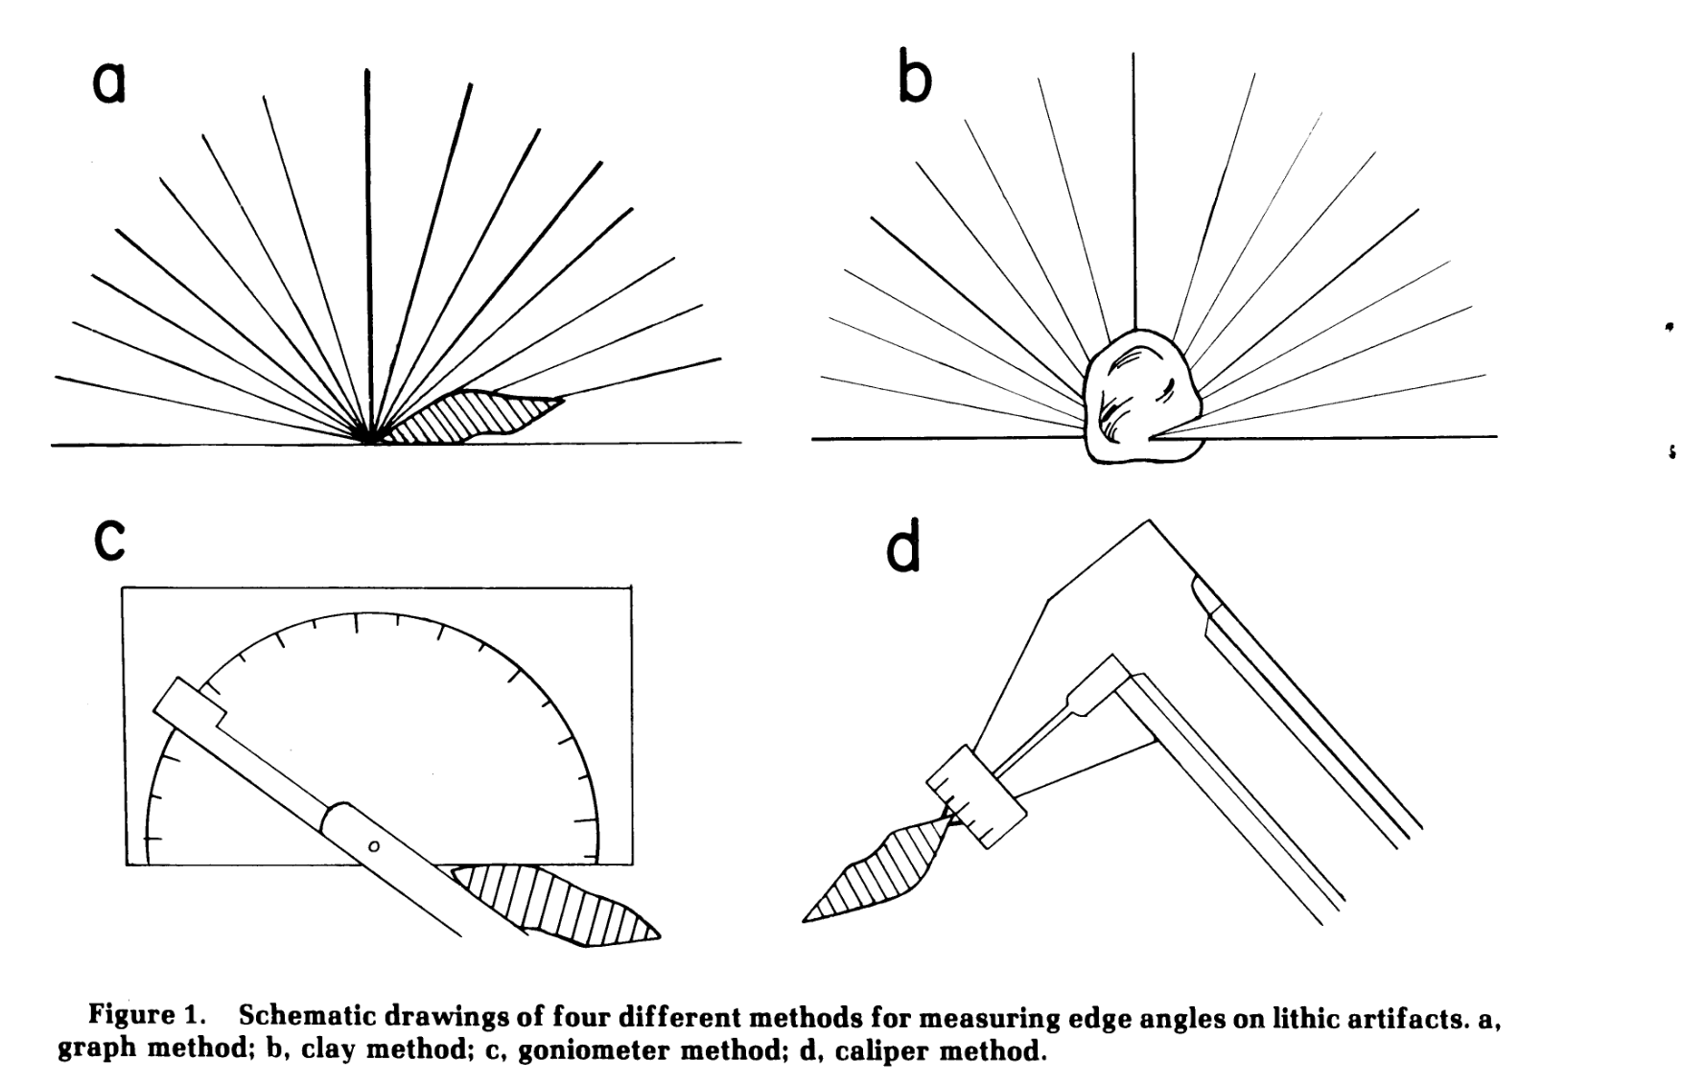

Slide 46
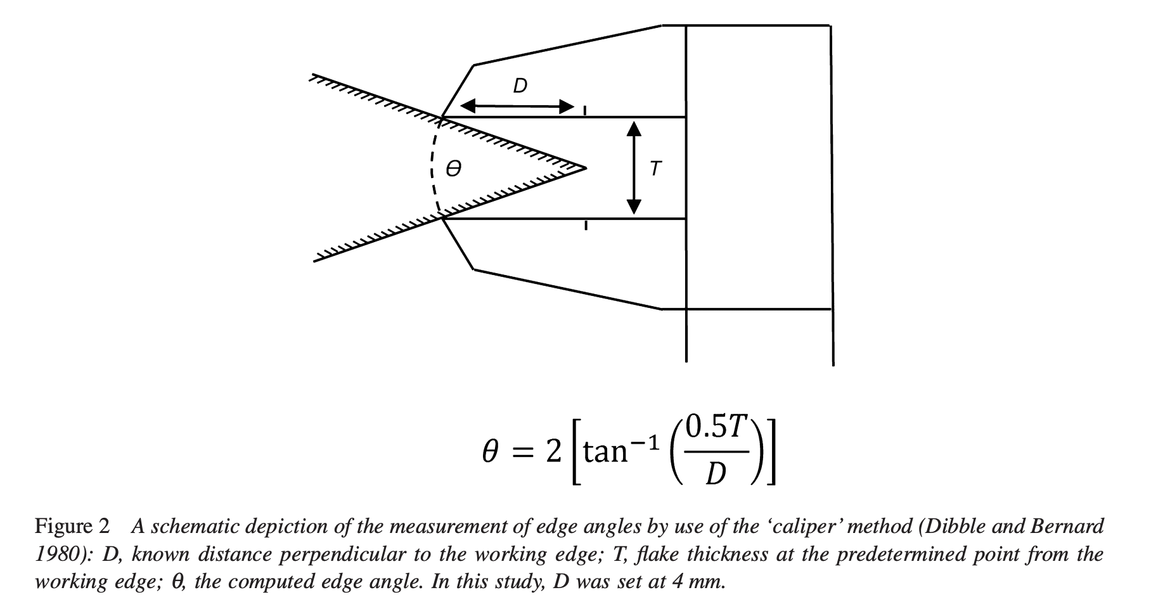

Slide 47
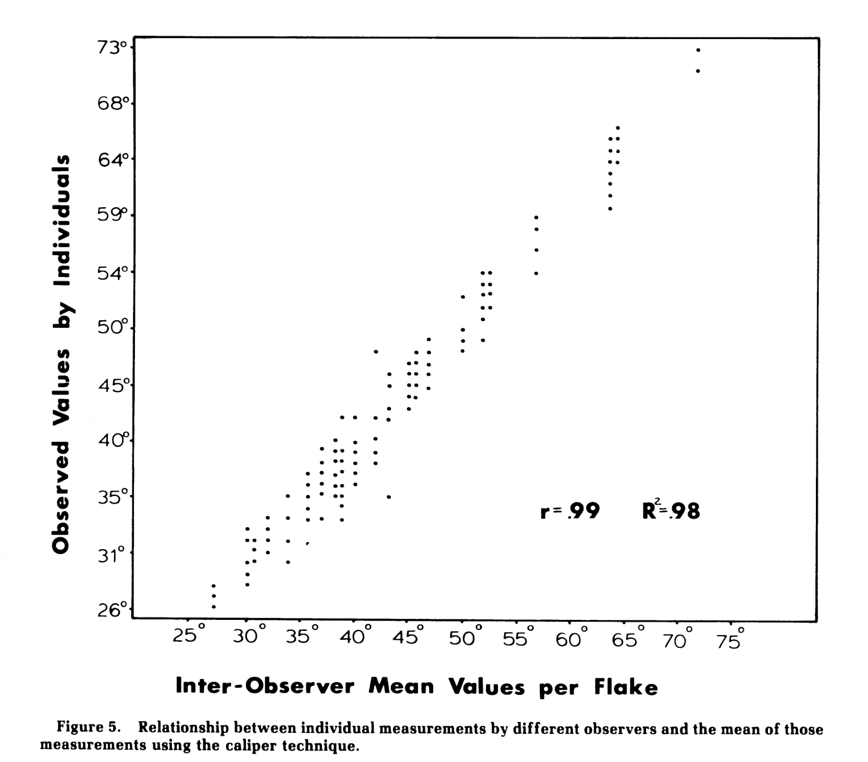

Slide 48
Visually distinctive artefact forms offer more opportunities for measurement

Slide 49
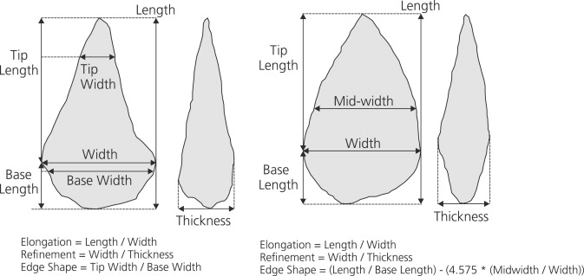
Many more linear dimensions possible because there are more landmarks

Slide 50
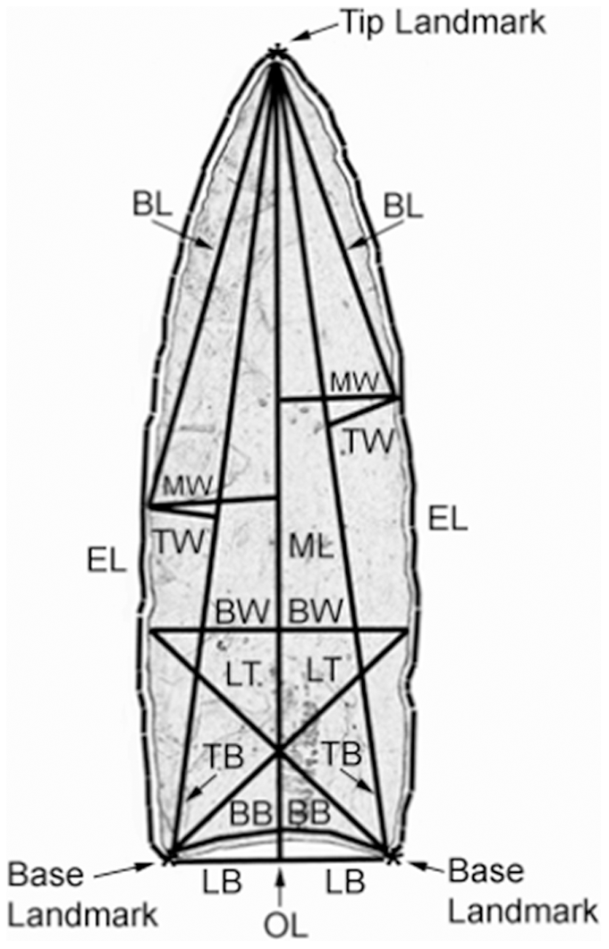
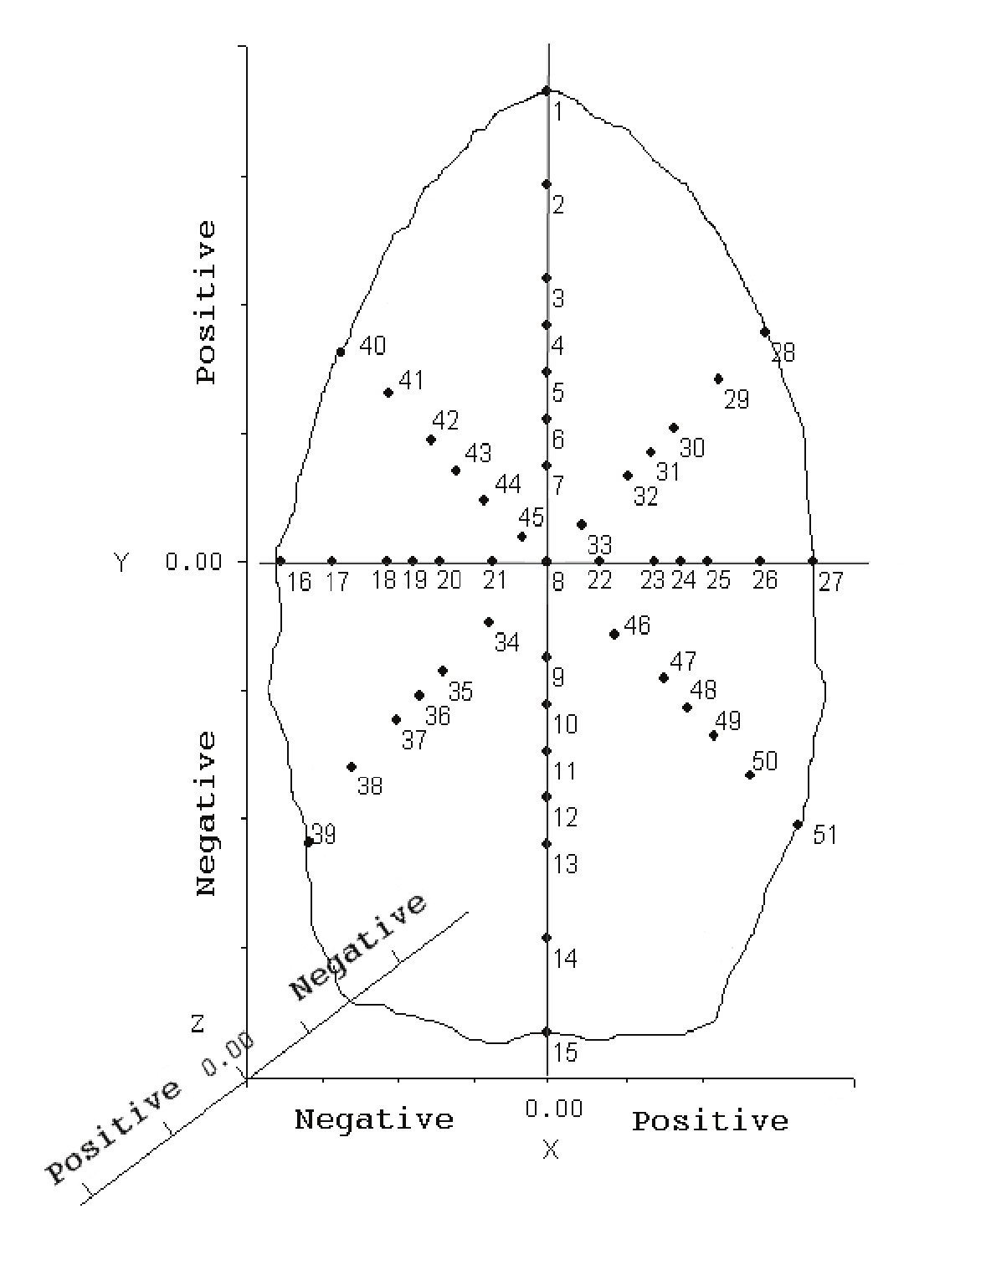
Landmarks and semi-landmarks

Slide 51
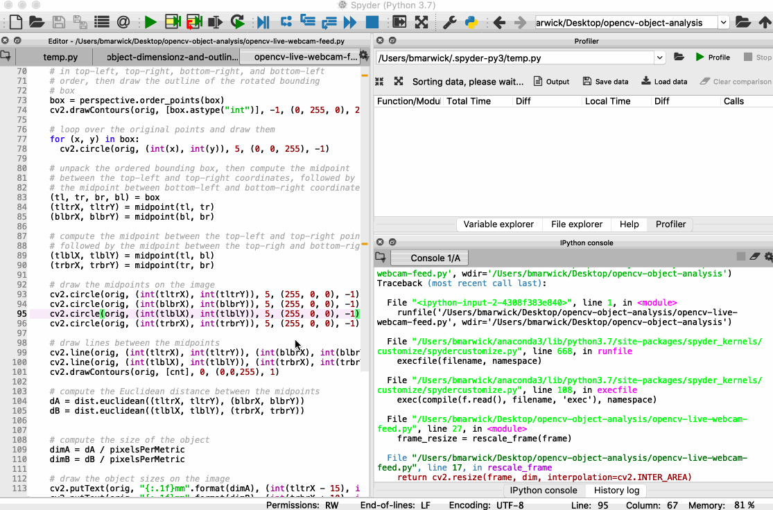
Methods for acquiring artefact outlines are ripe for disruption
https://gist.github.com/benmarwick/2b250d8ef3dbe36f817fbe2bf14aaa55

Slide 52
Analysis of artefact outlines by Elliptical Fourier Analysis

Slide 53
How to measure retouch?

Slide 54
Retouched flakes are flakes from which further flakes have been struck.
Unretouched flakes do not have further flakes removed from them, although they may have suffered other modification such as breakage.
Retouch scars are flake scars that were initiated at the margin of a flake to renew, reshape or resharpen the margin (modification of the junction between distal
and ventral faces).The initiation may have been removed by later retouching.

Slide 55
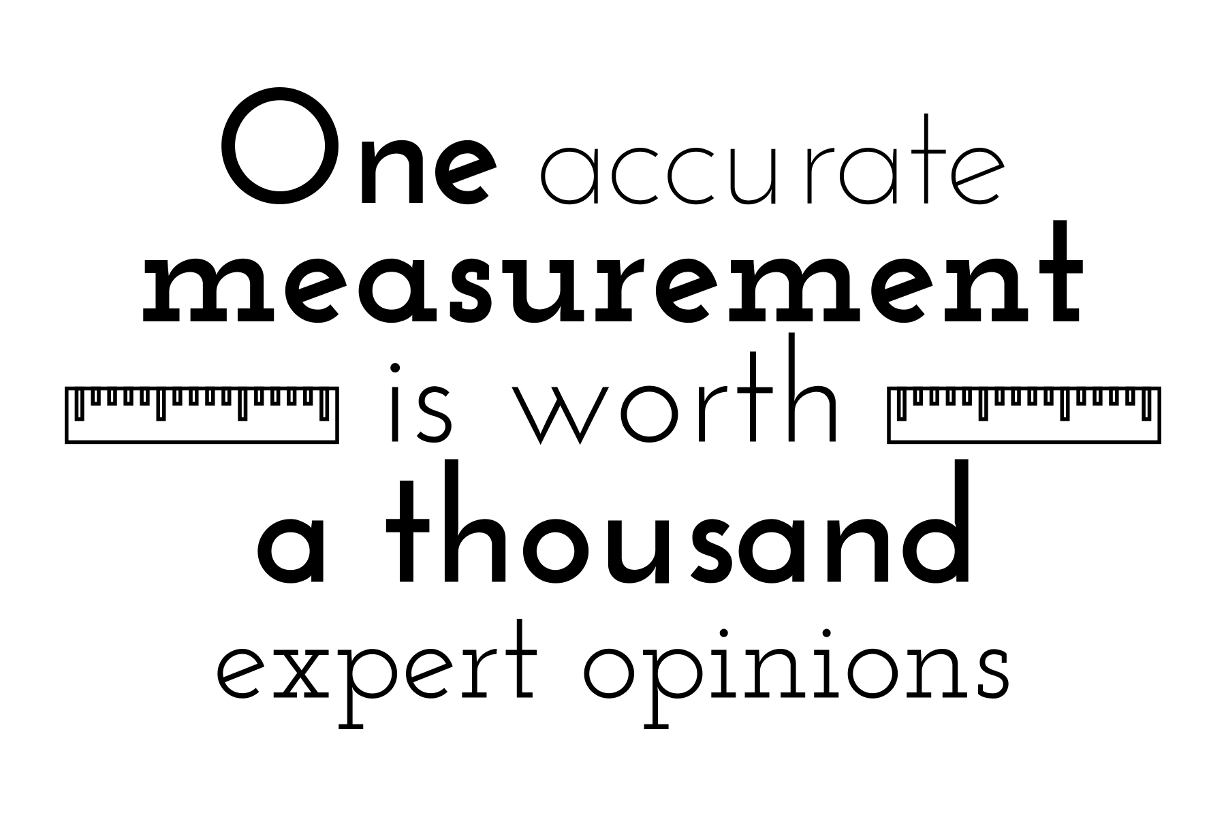

Slide 56
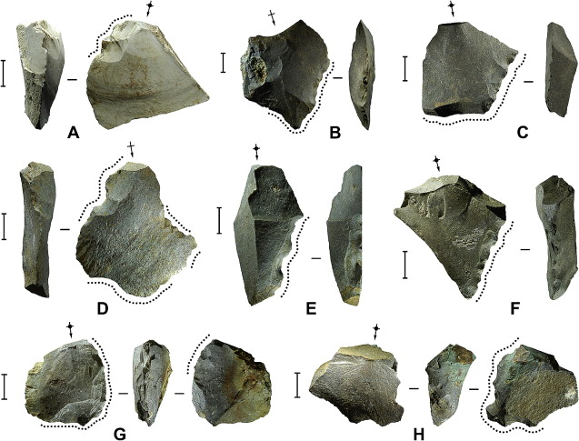

Slide 58
Kuhn’s GIUR, Clarkson’s II and perimeter are the most popular

Slide 59
Kuhn’s GIUR, Clarkson’s II and perimeter are the most popular

Slide 60
Kuhn’s GIUR, Clarkson’s II and perimeter are the most popular

Slide 61
Kuhn’s GIUR, Clarkson’s II and perimeter are the most popular
Retouch distalness index Retouch curvature index

Slide 62
Measuring the dorsal surface of a flake

Slide 63
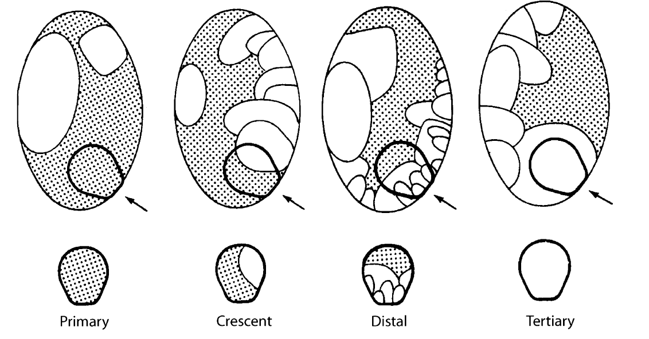
Dorsal cortex amount and location
Primary
Secondary
Tertiary

Slide 64
Dorsal Cortex
Difficult to measure very precisely
Ordinal scale of 0-3
Measure in intervals of 10%
Location of cortex
Dorsal Flake Scars
Not easy, difficult to replicate
Look for initiations & terminations on dorsal surface
Ordinal scale of 0-3
Count of scars
Orientation of scars
Number of ridges

Slide 65
How to quantify the size of an artefact assemblage?

Slide 66
MNF=C+T+L
C: the number of complete flakes
T: the largest category of transverse fragments (excluding
Medial)
L: the count of longitudinal fragments given by
L=CL+BL
where CL is the greater of left or right longitudinal fragments without transverse breakage and BL is the largest of the four relevant categories of transversely broken longitudinal fragments
Hiscock, P. (2002). Quantifying the Size of Artefact Assemblages. Journal of Archaeological Science, 29(3), 251–258.

