Slide 1
ARCHY 483 Analysis of Stone Artefacts
Spring 2019
Lecture 5 Interpreting inter-assemblage variation: mobility, landuse & provisioning

Slide 2
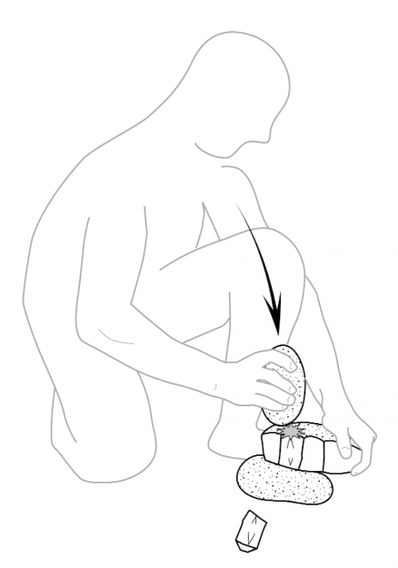
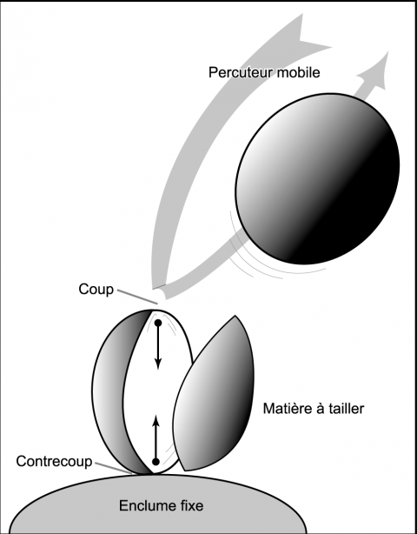
Q1: What is the name of this technique?

Slide 3
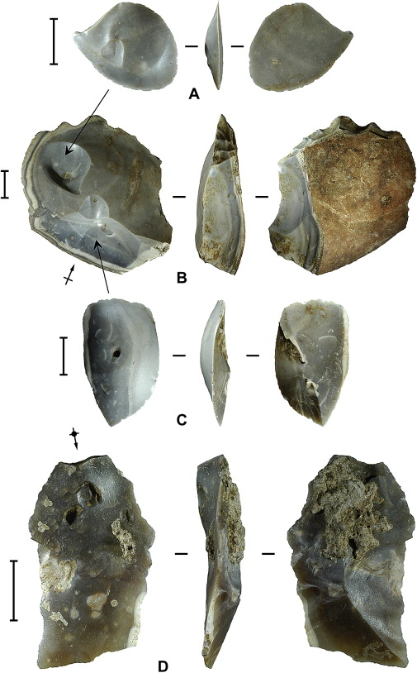
Q2: What is the name of the distinctive type of fracture on these pieces, and how is it caused?

Slide 4
Q3: What are two common types of core preparation? Sketch one of them

Slide 5
Q1: What's going well in this class?

Slide 6
Q1: What's going well in this class?
Q2: What about the class needs improvement?

Slide 7
Q1: What's going well in this class?
Q2: What about the class needs improvement?
Q3: What can you as students do to improve the class?

Slide 8
Q1: What's going well in this class?
Q2: What about the class needs improvement?
Q3: What can you do as a student to improve the class?
Q4: What can we as the instructors do to improve the class?

Slide 9
Replication assignment
Bicho, N. and Cascalheira, J. (2018) The use of lithic assemblages for the definition of short-term occupations in hunter-gatherer prehistory. In Picin, A. and Cascalheira, J. (eds.) Short-term occupations in Paleolithic Archaeology. Interdisciplinary Contributions to Archaeology. Springer. https://doi.org/10.17605/OSF.IO/3WGSA
Marwick, B., Clarkson, C., O'Connor, S., & Collins, S. (2016). Early modern human lithic technology from Jerimalai, East Timor. Journal of Human Evolution, 101, 45-64.
Marwick, B., 2013. Multiple Optima in Hoabinhian flaked stone artefact palaeoeconomics and palaeoecology at two archaeological sites in Northwest Thailand. Journal of Anthropological Archaeology 32, 553-564. http://dx.doi.org/10.1016/j.jaa.2013.08.004
Read the paper carefully to identify the key claims made by the authors
Identify a data visualization in the paper that the authors present in support of one of their key claims.
Write some original R code to reproduce the figure
Describe how your figure is similar or different from the original, and what the implications are for the author’s claims (true, false, overstated, understated, etc)

Slide 10
Approaches to Debitage Analysis

Slide 11
Typological approaches
Triple cortex
Mass analysis
Application load
Technology

Slide 12
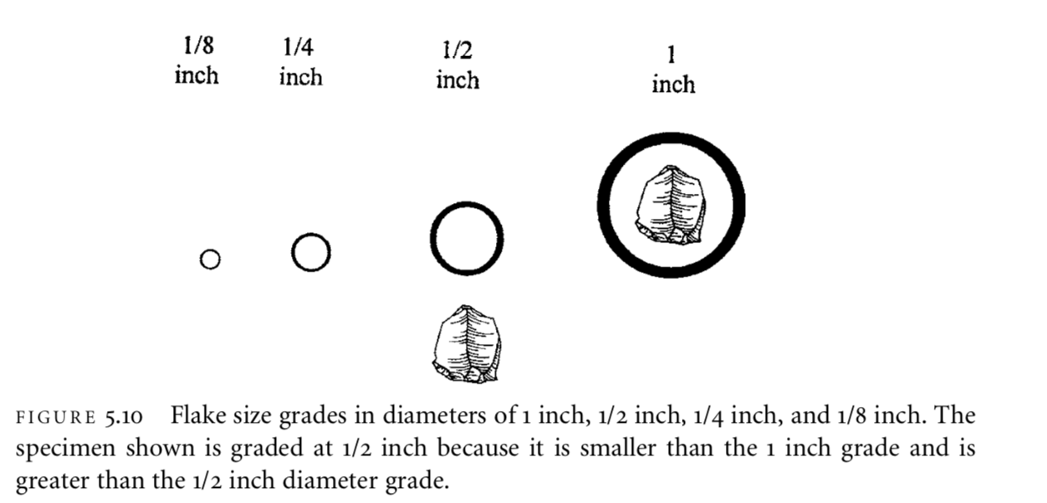
Notes:
Examples of biface thinning flakes. Note the complex striking platform and pronounced lips.

Slide 13
Notes:
Examples of biface thinning flakes. Note the complex striking platform and pronounced lips.

Slide 14
Notes:
F I G U R E 6.3 Example of bipolar flaking showing split objective piece and compression forces originating from opposite ends.

Slide 15
Notes:
Examples of flakes removed to retouch an endscraper. Note the curved distal ends.

Slide 16
Trend with decreasing relative amounts of bifacial thinning flakes suggests that bifacial technology decreases with increased amounts of relative sedentism
Sedentism == expedient artefact assemblages

Slide 17
Typological approaches
Free-standing

Slide 18
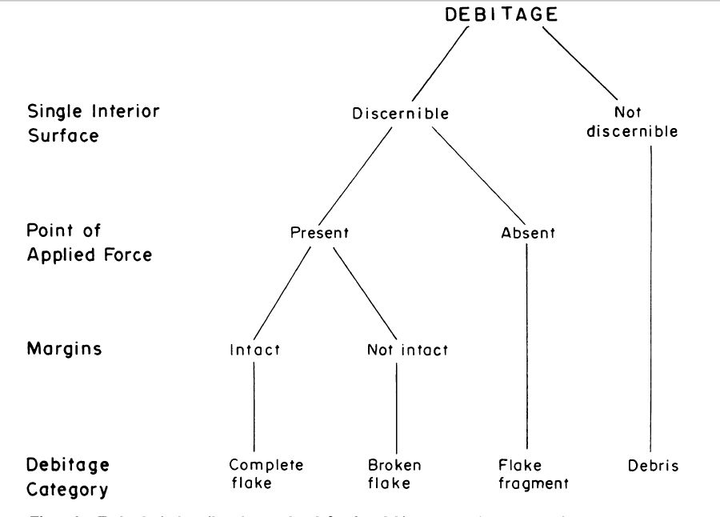
The Sullivan and Rozen (1985) typology

Slide 20
Group IA: unintensive core reduction
Group IB1: core reduction and tool manufacture
Group IB2: intensive core reduction
Group II: tool manufacture

Slide 21
Others have noted that proportions of flake types may vary for reasons relating to:
percussor type (i.e., percussor size, weight, density),
nodule size and shape,
platform type, and
flintknapper skill and
techniques

Slide 22
Controlled experiments of core reduction and tool production indicate that tool production produces relatively greater frequencies of complete flakes than does core reduction

Slide 23
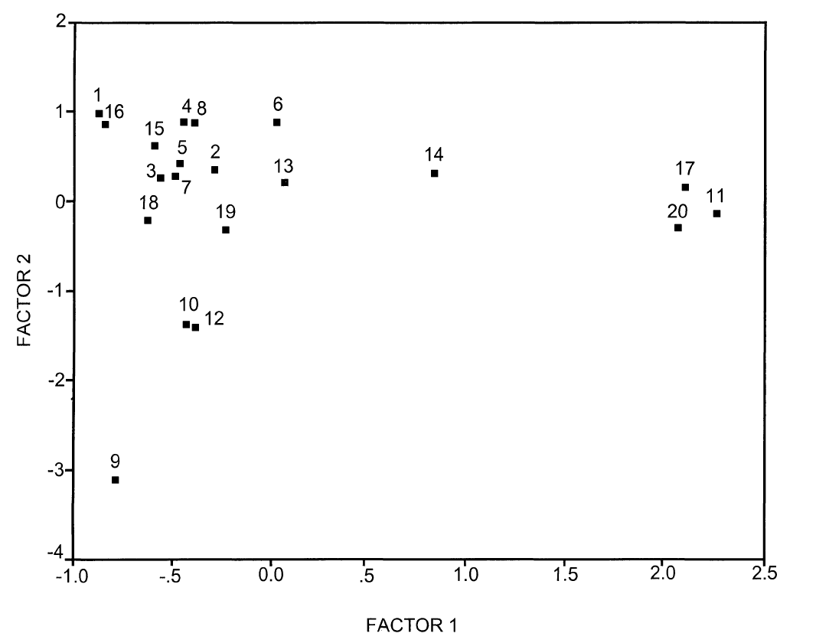
Prentiss’ big experimental replication study of the S&R typology
"tool" and "core" reduction assemblages
flake (#11),
biface (#14), unprepared core (#17)
prepared core (#20)
#9 hard hammer, flake edge
#10 soft hammer, flake edge and
#12 hard hammer, medium flake goal, biface reduction

Slide 24
Prentiss’ big experimental replication study of the S&R typology
Prentiss made many stone artefact assemblages using different techniques and end products:
Hard Hammer
Soft Hammer
Pressure
Prepared Core
Unprepared Core
Biface
Flake Tool
Then he counted up how much of each of these types were present in each assemblage:
CF = Complete Flake
PF = Proximal Fragment
MDF = Medial/distal Fragment
NF = Nonorientable Fragment
SF = Split Flake

Slide 25
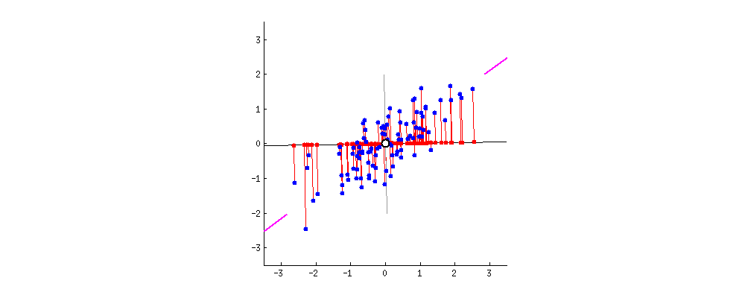
PCA is about reducing the dimensions of the data

Slide 26
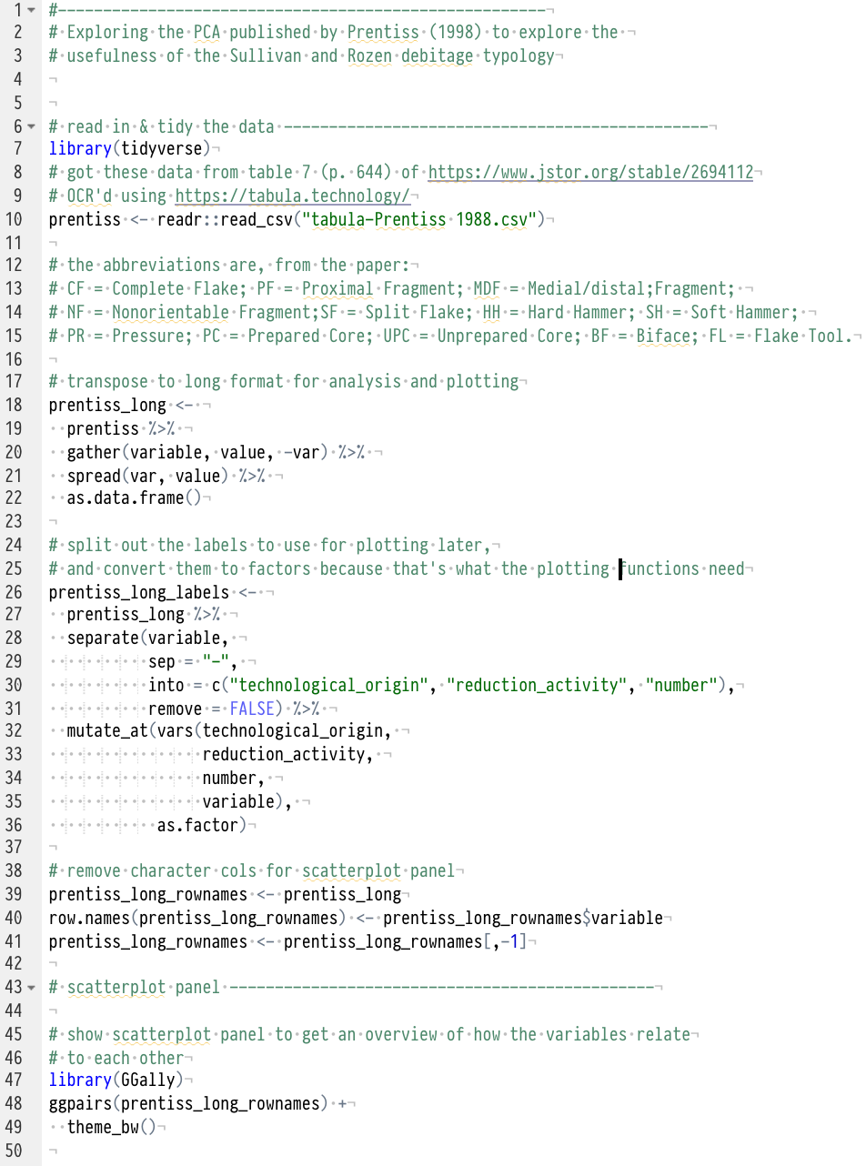
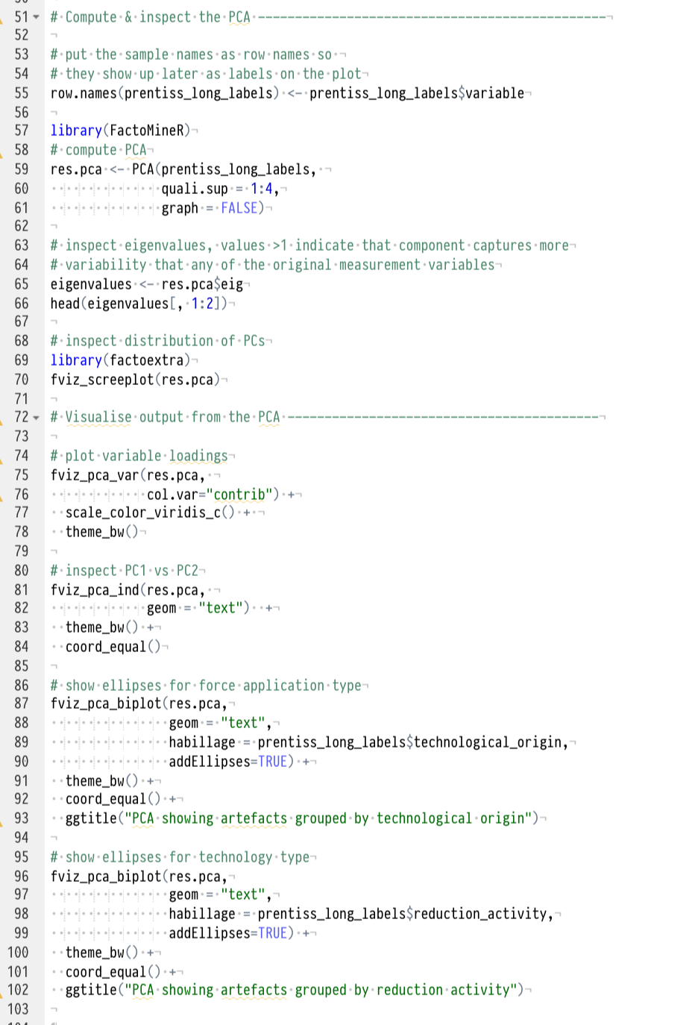
Code & data online at https://gist.github.com/benmarwick/dc8a8abd17207f907123e65160dbccf8

Slide 27
Data generated through the use of the SRT in measuring debitage assemblage variability will be consistent and relatively free of random error (assuming operator error is minimized as well).
Though reliable, the SRT does not appear to be a valid measuring instrument.

Slide 29
S&R’s typology now widely regarded as misleading.
BUT

Slide 30
Made a significant and positive impact on lithic analysis, particularly in the areas of terminological clarity and replicability of attributes and debitage typologies.

Slide 31
Approaches to assemblage interpretation

Slide 32
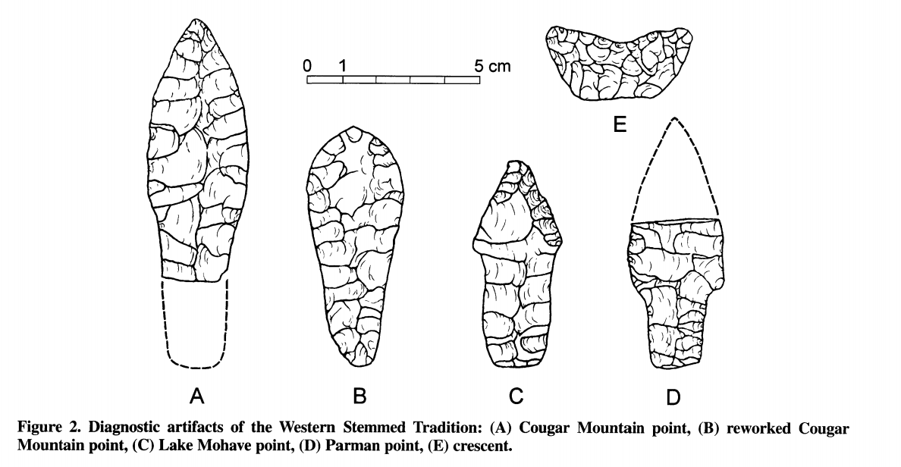
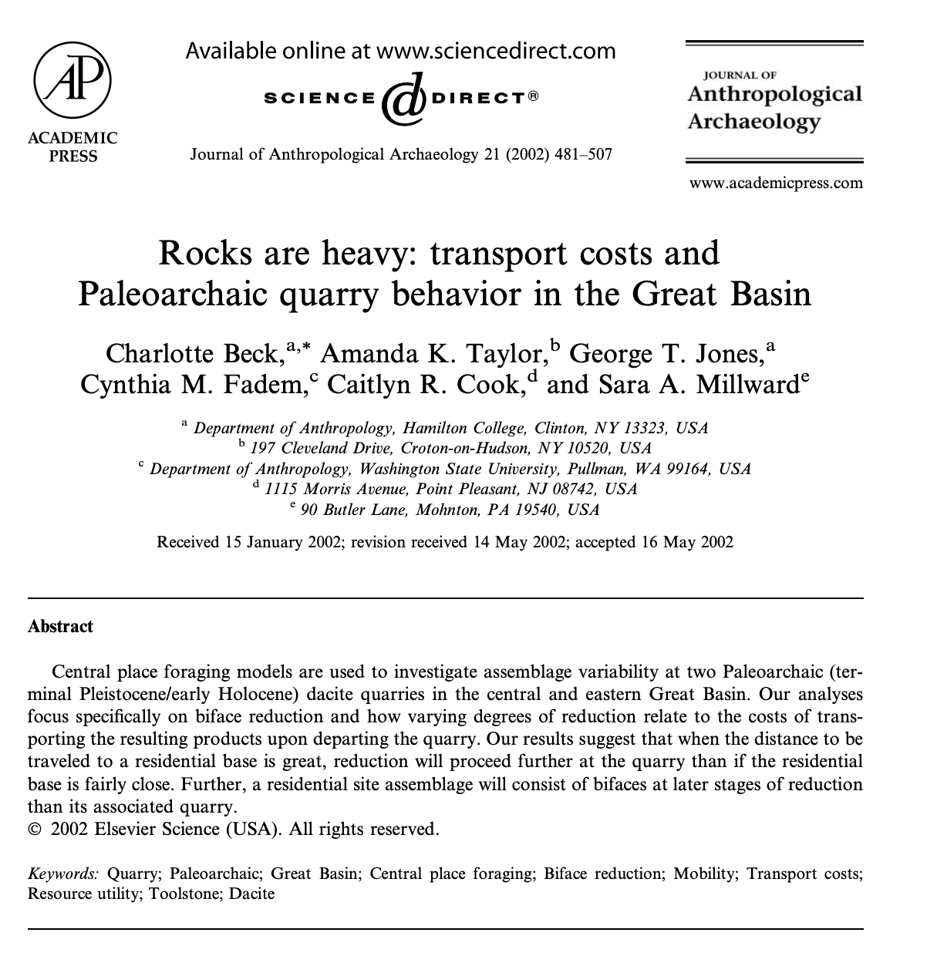
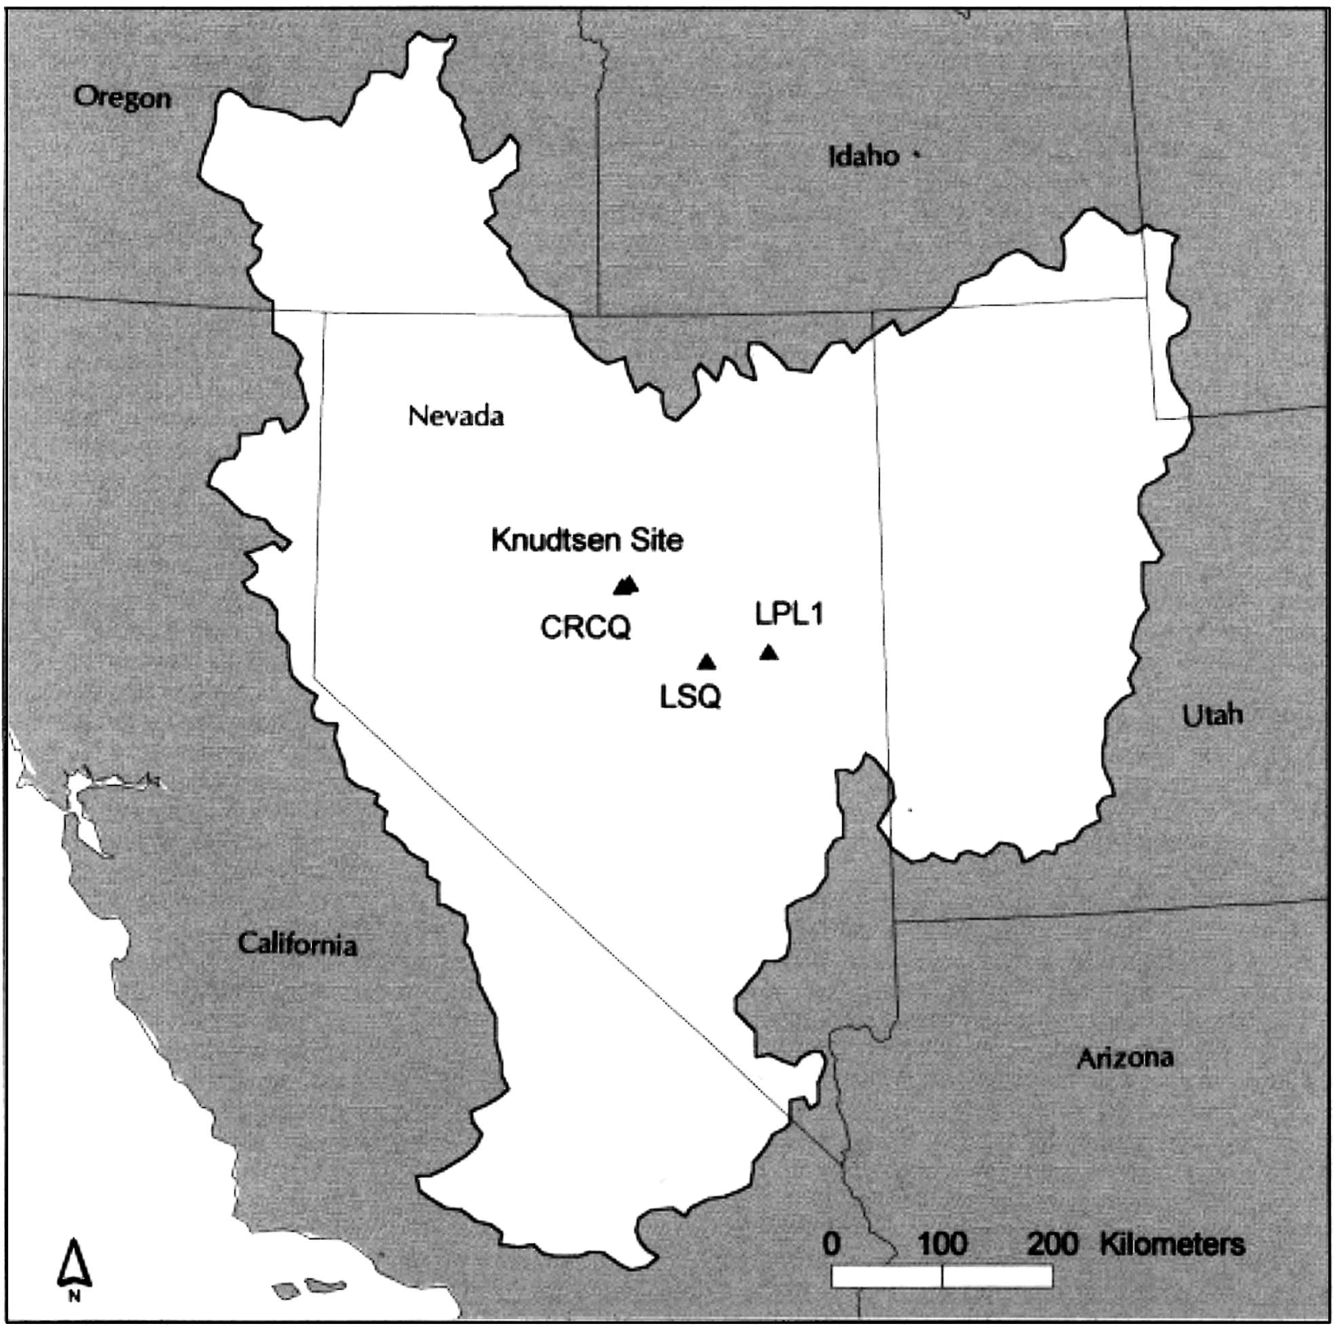

Slide 33
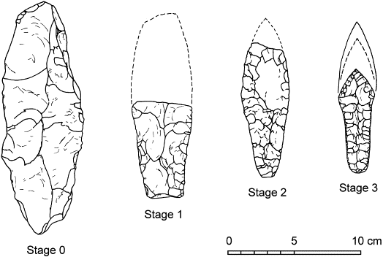

Slide 34
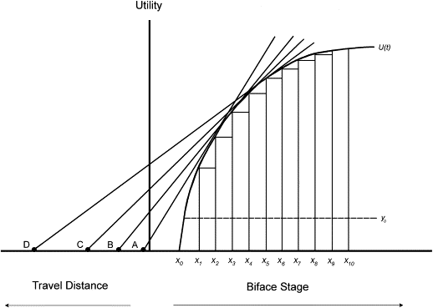

Slide 35
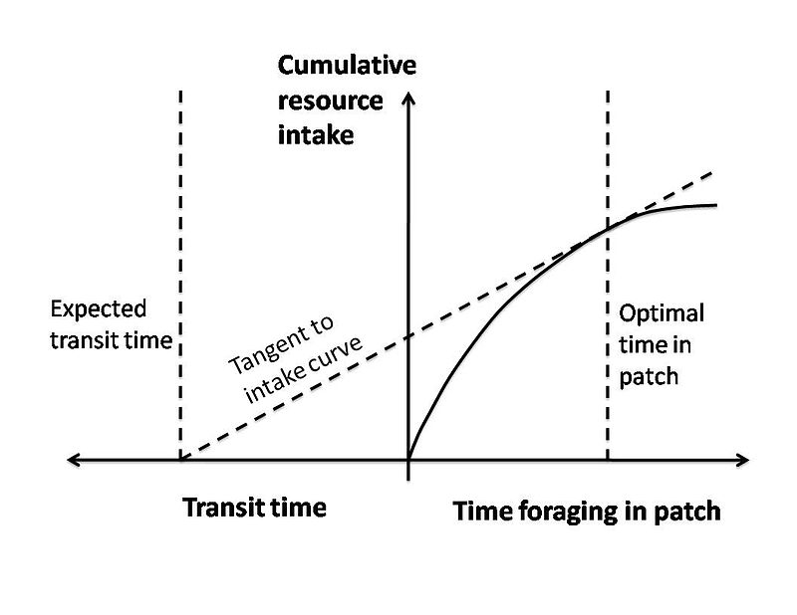
Patch Choice Model -> Marginal Value Theorem: when it is economically favorable to leave?

Slide 36
As travel time to the patch increases it is predicted that the forager will stay longer in the patch.

Slide 37
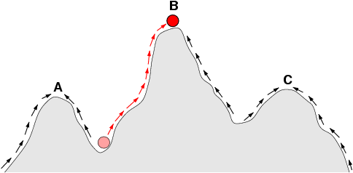
The fitness landscape does not have a single peak (solution)

Slide 38
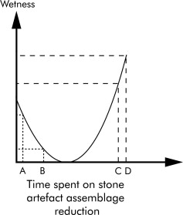
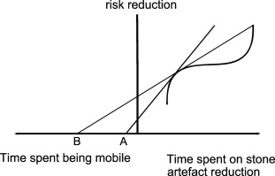
multiple optima to formalise the dynamism and complexity of the technological systems

Slide 39
Technological organisation

Slide 41
Risk

Slide 42
Risk
The probability that some problem will occur and
The cost of such an occurrence
Technology can be seen as a means of reducing such probabilities in the face of unacceptably high costs.

Slide 44
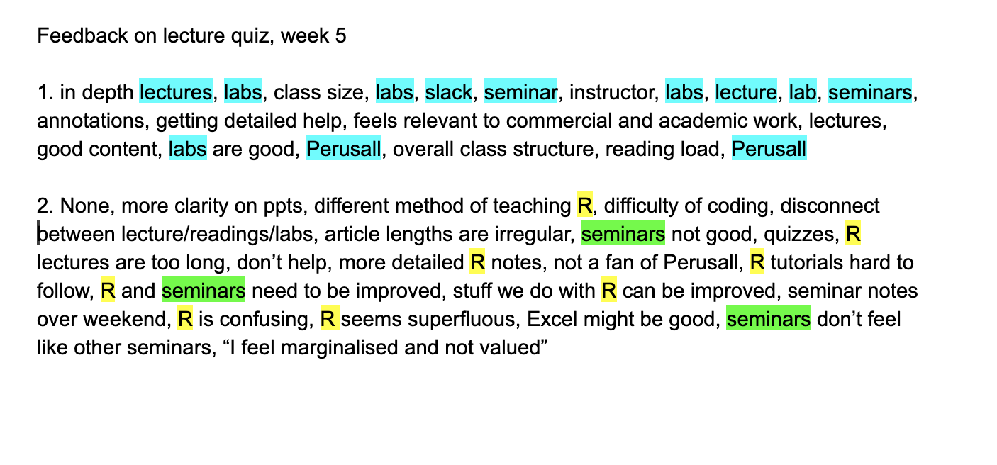

Slide 46
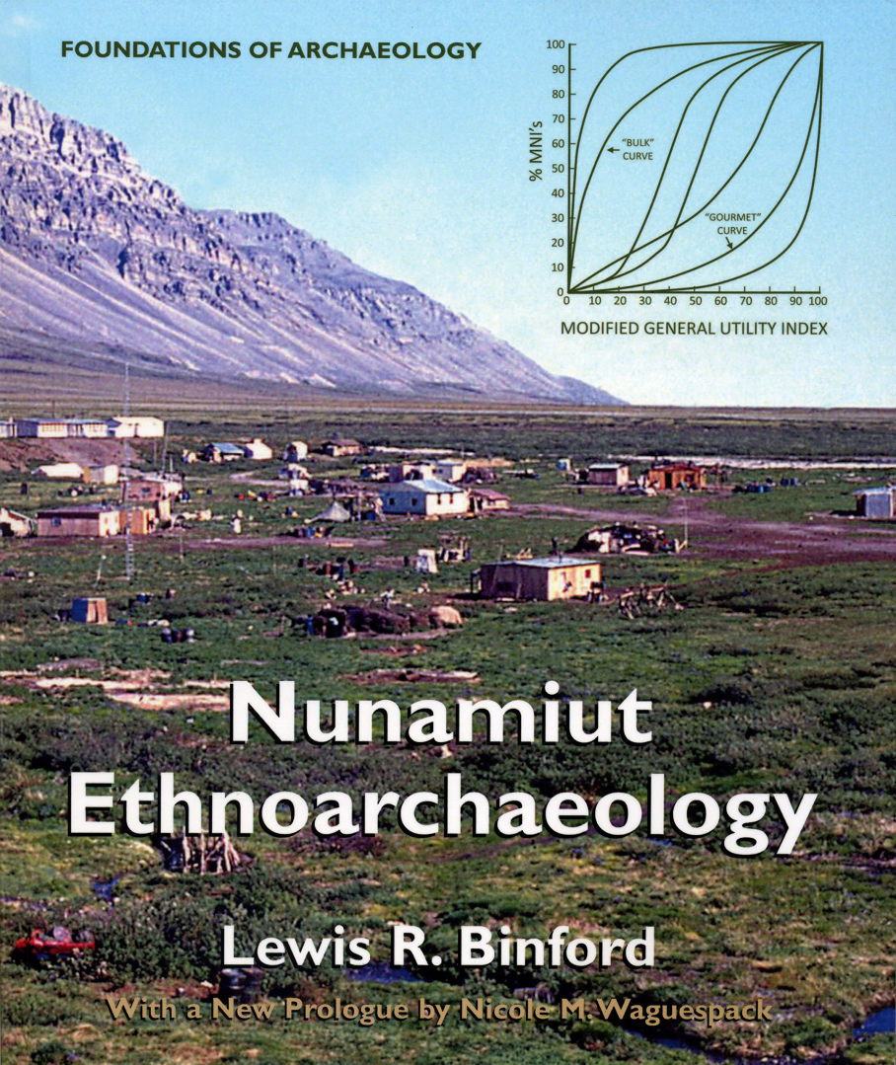
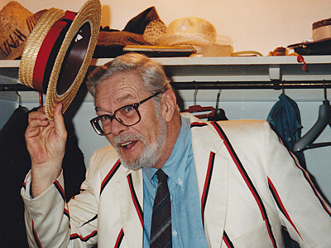
Mobility

Slide 47
Forager

Slide 48
Collector

Slide 50
Bifacial tools or cores are generally associated with frequent and/or lengthy residential or logistical movements
Expedient flake tools and bipolar reduction are associated with infrequent residential moves
The distribution of lithic raw material could alter these associations significantly

Slide 51
Limitations on understanding mobility
First, there are no simple relationships between mobility and tool manufacture. Many other variables intervene - tool function, raw material type, and distribution, hafting, and risk.
Second, the reconstruction of different tool manufacturing methods from debitage is fraught with interpretive difficulties.
Third, stone tools are not routinely used to a significant extent by any living foragers, making it difficult to test ideas relating stone tools to mobility

Slide 52
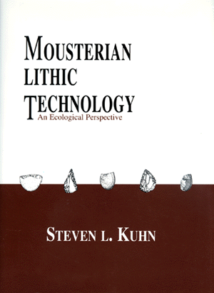
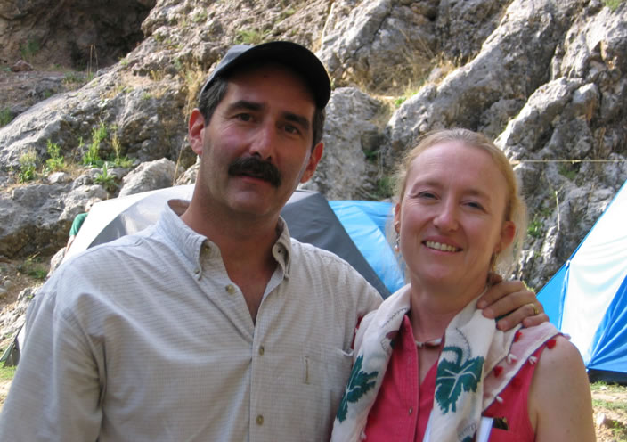

Slide 53
Kuhn’s Provisioning Model
provisioning of individuals
provisioning of places

Slide 55
Individual Provisioning
Little certainty over where or when extractive and maintenance tasks will take place
High logistical mobility in variable/patchy environments,
High residential mobility where foraging opportunities may not coincide well with opportunities to reprovision with raw materials, and where down-time cannot be scheduled with any certainty
Increasing resource depression leading to longer travel times to more distant patches, fewer and more time-limited encounters with high-ranked mobile prey, and increased climatic variability creating greater stochastic variation in resource availability.
Longer travel times should also give rise to greater pre-processing of resources to increase utility per unit load

Slide 56
Place Provisioning
Where the location and timing of activities to be performed in the future is predictable and mobility is low.
When high-ranked or stable resources are abundant and close by, variance in foraging returns is low, and resources are patchy
Where the type of equipment needed can be predicted
Where the range and quantity of extractive tasks may be greater
Low mobility and relatively short range logistical foraging
Not pre-processed to any significant degree.
Raw material stockpiling should therefore be a common feature of place provisioning

Slide 57
Summary
Debitage analysis
Technological Organisation / Toolkit Design
Risk
Mobility

Slide 58
Shott suggests that collectors produce assemblages with no correlation while foragers produce assemblages with a strong positive correlation; additionally, he suggests that there should be an inverse relationship between technological diversity and residential mobility
Torrence argues that technological diversity relates directly to the degree of risk involved in prey capture rather than mobility per se.

