Slide 1
About Yourself
Write
Preferred Name
Pronouns
Languages
Turn and Talk
What is your favorite thing about spring quarter?
What are you excited about this week?

Slide 2
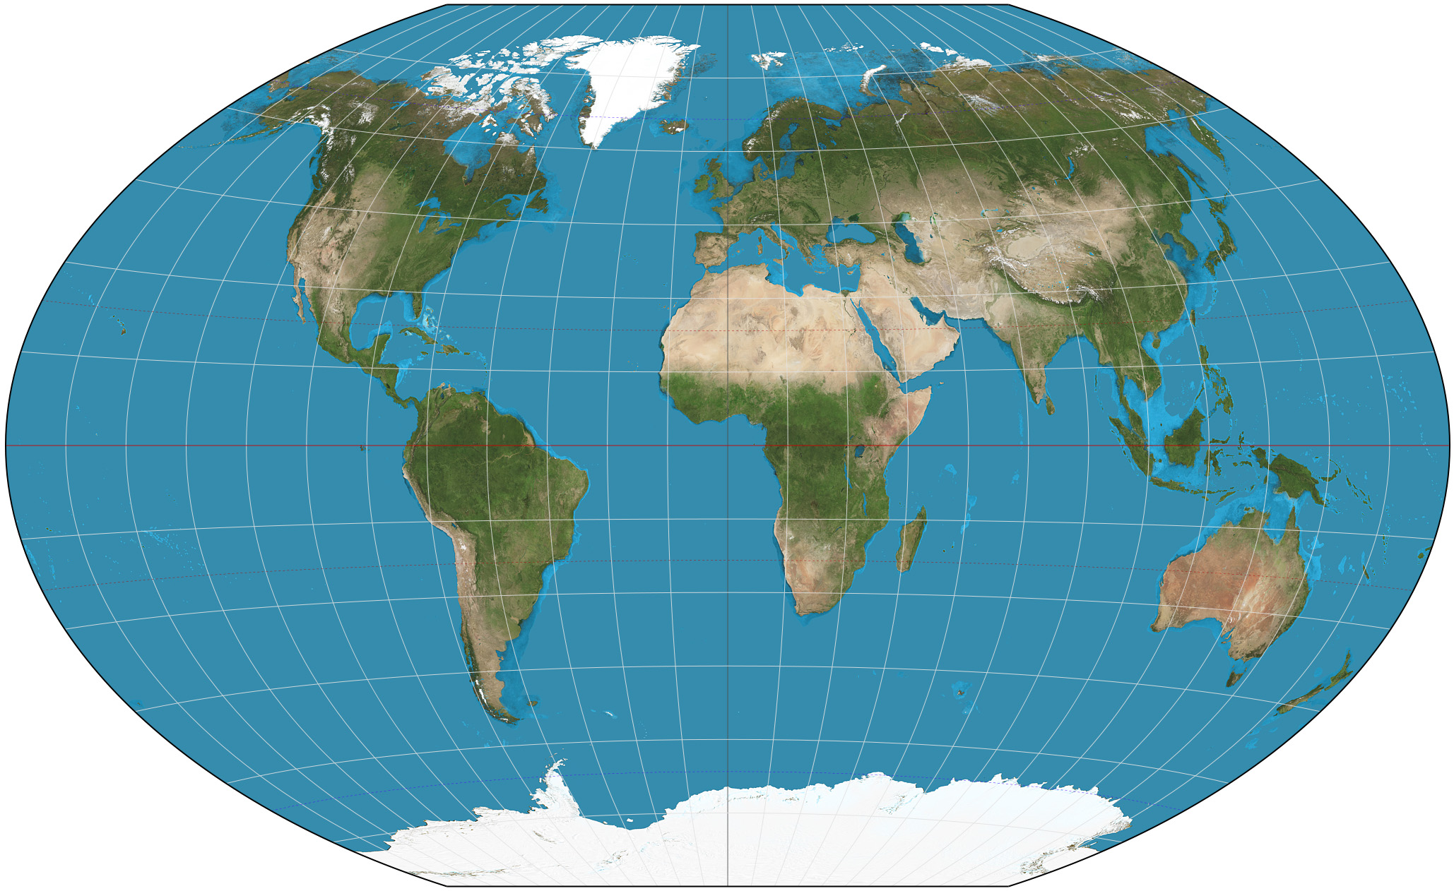
Geography Practice

Slide 3
Important terms (section AA)
Variability
Climatological mean – mean state of the climate somewhere for some variable (e.g., climatological mean temperature for WA state)
Frequency
Anomaly
Emissions
Forcing
Feedback
Coupling
Equilibrium – lowest energy state, homeostasis

Slide 4
Important terms (section AB)
Variability – natural range surrounding a certain mean state
Climatological mean - average of a single weather property
Frequency
Anomaly – an instance of unexpected outcome, deviates from the norm, significantly deviates from variability, out of the ordinary
Emissions
Forcing
Feedback – output of a system affects the input,
Coupling
Equilibrium - when the rate of change is zero, stable, homeostasis

Slide 5
Important terms (section AC)
Variability
Climatological mean – average climate
Frequency
Anomaly – something that doesn’t fit within the observed pattern, deviation from the average
Emissions
Forcing – long-term nearly continuous input of energy, something that drives the system (may drive the steady state system, may drive a change in the system)
Feedback – output that feeds into another input, output intensifies original input (positive)
Coupling
Equilibrium – place of stability (valley), minimum energy state, balanced inputs and outputs

Slide 6
Important terms (section AD)
Variability
Climatological mean – multidecadal average of weather
Frequency
Anomaly – an event that is statistically significantly different than what normally happens
Emissions
Forcing – long-term continuous push on an Earth system (or not),
Feedback – positive (destabilizing) and negative (stabilizing), output that influences the input of another
Coupling – components of the Earth system and how they interact
Equilibrium – lowest energy state, balance of various inputs and outputs in a system

Slide 7
A few more terms…
Spatial scales
Temporal scales
Units of ppm and ppb
Notes:
Spatial scales (Global / regional / local)
Temporal scales (Daily / seasonal / annual / interannual / decadal)
Units (ppm / ppb) = 1 ppm of CO2 is 1 molecule of CO2 per 1 million molecules of air

Slide 8
Optional refreshers (ask me for these)
Math review
Graph practice

Slide 9
Climate confusion: fact or fiction?
The climate is always changing.
97% of the world’s climate scientists agree that the world is warming due to manmade emissions of greenhouse gases.
Science tells us that we must act now to combat climate change by reducing our carbon footprints.
The concept of global warming was created by and for the Chinese in order to make U.S. manufacturing non-competitive.
The Intergovernmental Panel on Climate Change is incentivized to overstate the risks of climate change so they can keep their jobs.
Carbon dioxide is good for plants.
We can entirely undo any damage from putting extra CO 2 in the atmosphere by putting reflective particles in the stratosphere and reflecting more sunlight.
If every country did exactly what it pledged to in the Paris Agreement of 2015, but no more, we would avoid exceeding the 2°C (3.6°F) threshold that the UN has designated “dangerous.”
Notes:
True, but misleading. We also need to think about rate of change, cause of change, impact of change, reversibility of change. Note: Holocene climate was remarkably stable.
True. Consensus is not a democracy, consensus is based on science (observations, experiments, etc.).
Fiction. Science can tell us what would happen, but not what we morally ought to do about it.
Nope…
Nope, the IPCC works entirely with volunteer scientists. Monetary incentives actually work against this.
True, to some extent. Scientists are still trying to understand this, but good for plants doesn’t necessarily mean it will be a habitable world for humans.
False, there are radiative (light and heat driven) impacts from CO2, but also chemical impacts (including ocean acidification). Reflective particles also might dramatically change precipitation patterns even if temperature is controlled.
Fiction. Studies have shown that we actually need to do more to have a realistic shot of remaining below 2 degC. Meanwhile, many small island nations are pushing for a 1.5 degC target because of the dramatic increase in risks to their populations at 2 degC.

Slide 10
ATM S 211 Quiz Section | Optional Questionnaire
What is your preferred learning style? How do you learn best? (Example: visual, verbal, social, etc.)
This quiz section is intended to reinforce material covered in lectures. What helps you reinforce concepts learned in class and/or what do you think would be helpful in this quiz section? (Examples: re-watching lectures/looking over slides, going over old homework problems, trying new practice problems, doing live demos of concepts, etc.)
What can I do to support your learning in this class? What strategies have other instructors used that worked well for you in the past? (Example: individual vs. small or large group work)
Is there anything else you would like to share with me anonymously? Feel free to use the back side.

