Slide 1
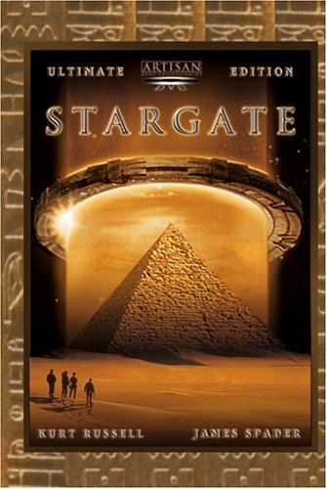
ARCHY 109 Archaeology in Film Winter 2020
Lecture 2

Slide 2
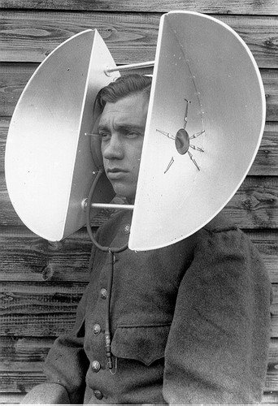
What are we going to do today?
1. Describe some of the archaeological themes in Stargate
2. Evaluate the veracity of the archaeological content and its likely function in the film

Slide 3
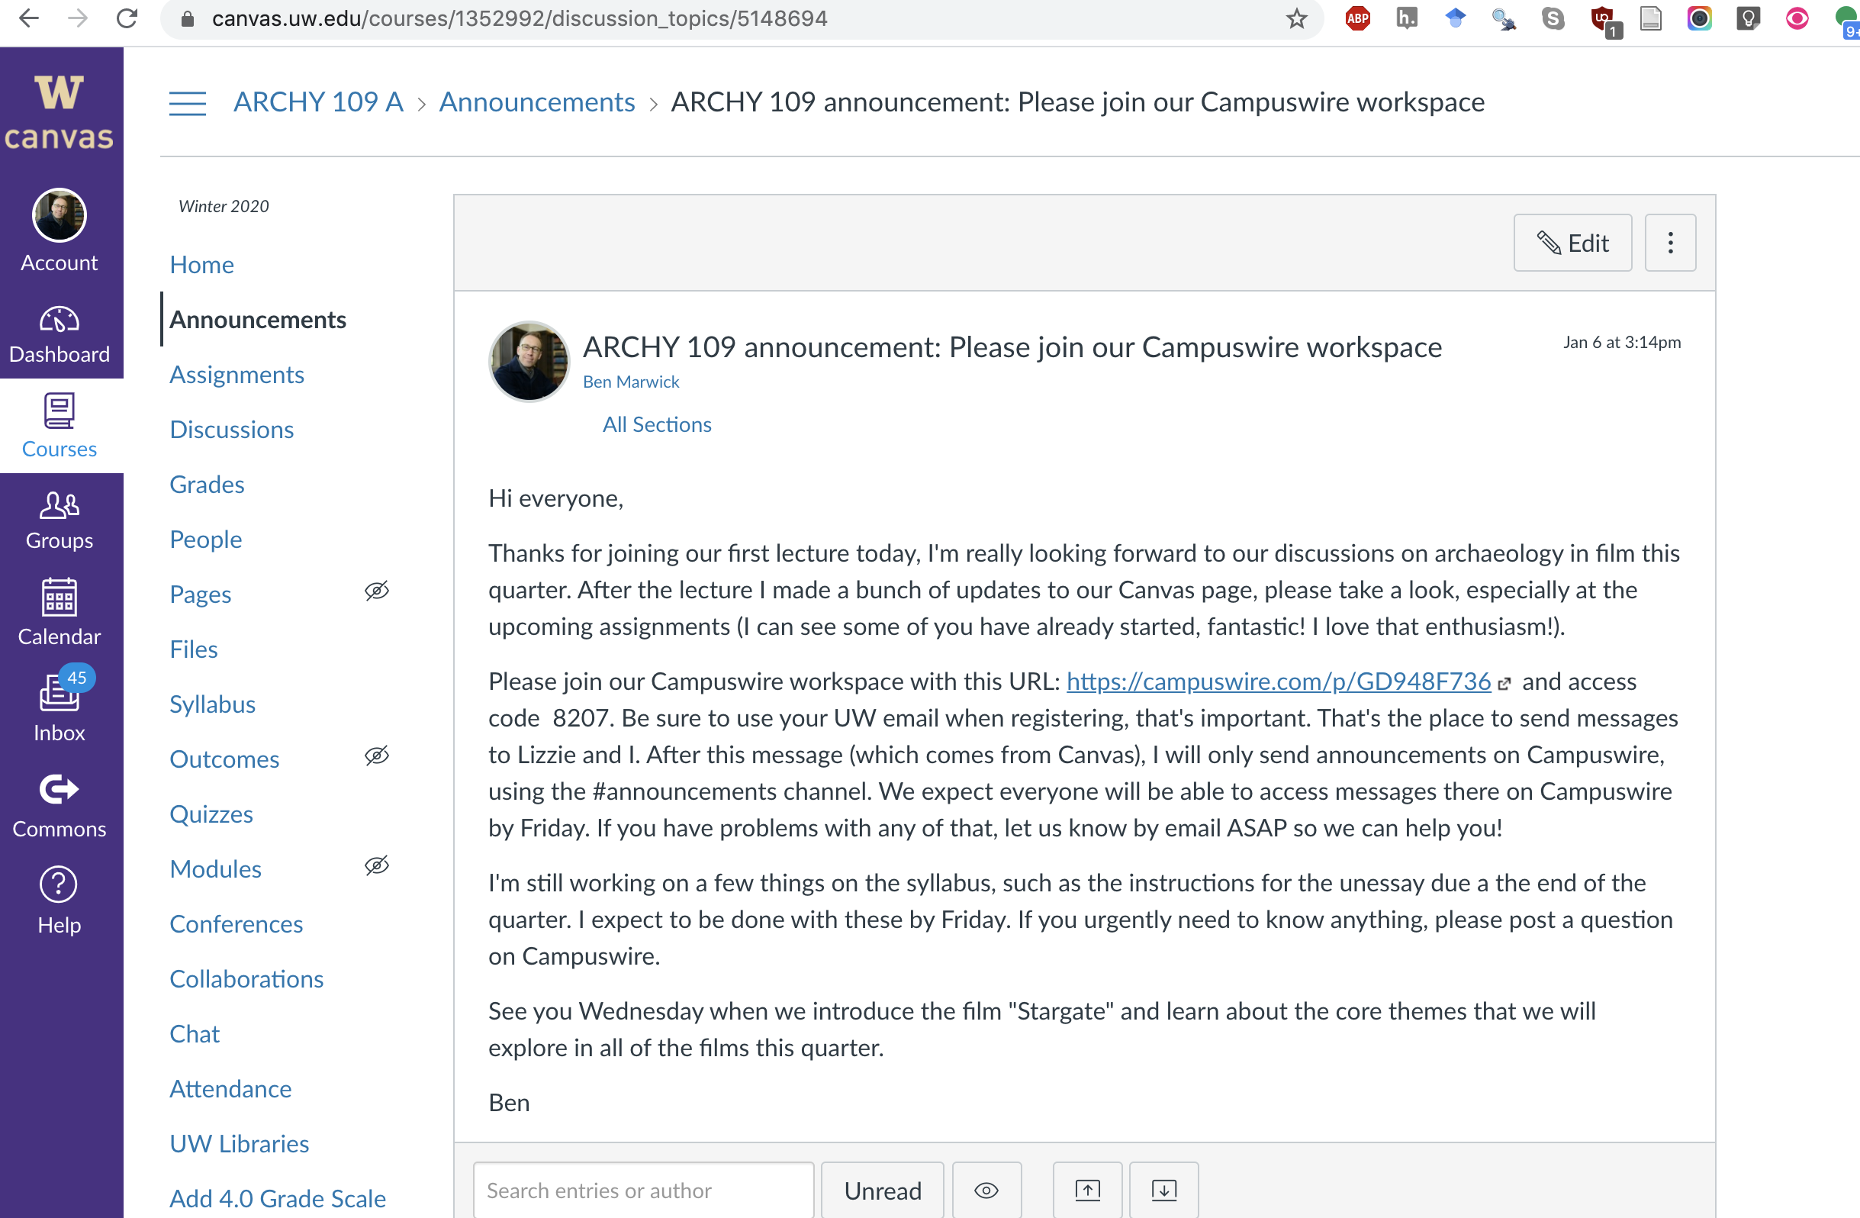
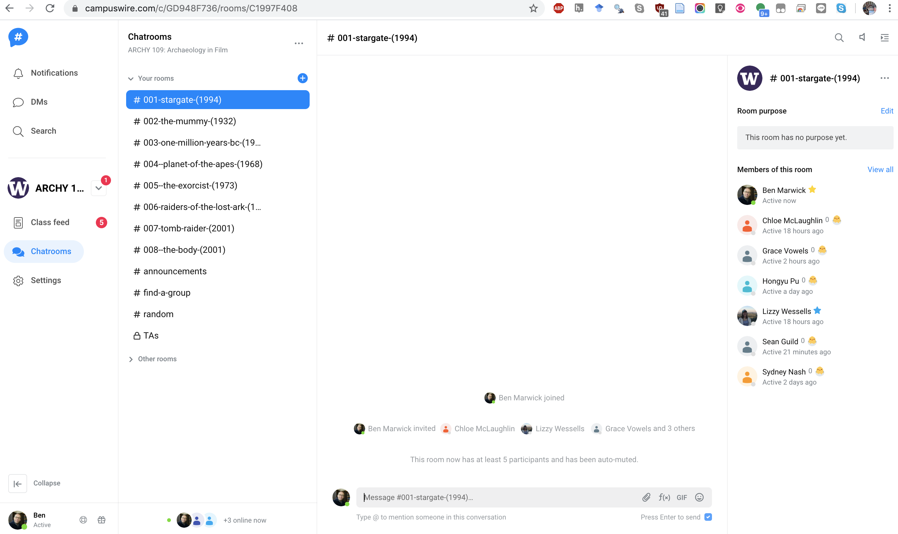
Things to know to help you succeed in the class
Check Canvas announcement for instructions on how to access Campuswire
You’re warmly welcome to use it professionally and respectfully during class to ask questions and share feedback and observations.
Survey on classroom behavior policy is now up, due Mon
Reading annotation assignment is now up, due Mon
I’ll discuss the instructions for the viewing notes assignment on Fri
Office hours begins today!

Slide 4
Stargate plot summary

Slide 6
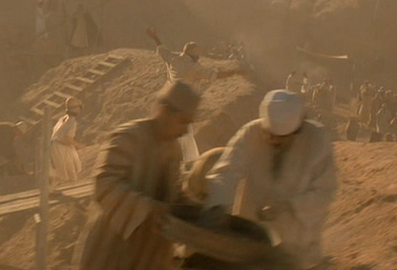
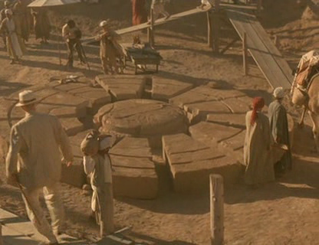
The opening titles of Stargate hint at an alien ancient Egyptian-ness...
The depiction of a 1928 excavation on the Giza plateau serves several purposes:
to embed the plot in a puzzle connected to archaeological discoveries, and to the Giza pyramids in particular.
to define an object discovered at Giza – an object we later discovered to be an ‘object of power’.
to frame archaeological knowledge as central to the mystery at hand.

Slide 7
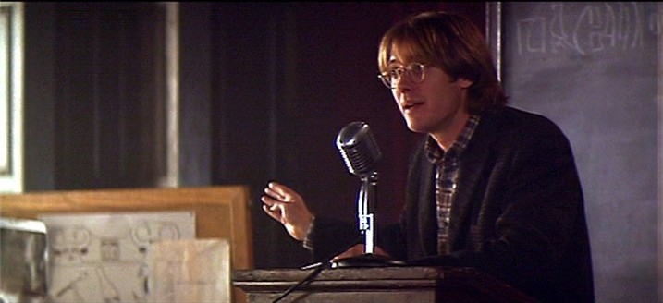
The film then transports us into the present, where we are introduced to a new generation of archaeologist in the guise of Daniel Jackson giving a lecture on “The Old Kingdom and the IVth Dynasty”.
His thesis is that the pharaohs of the 4th dynasty did not build the pyramids...

Slide 8
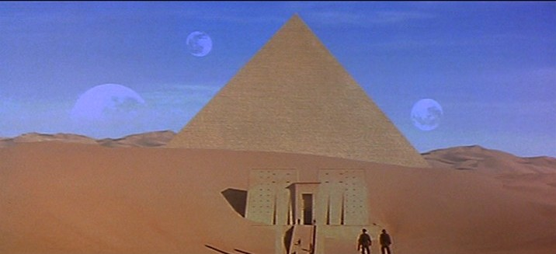
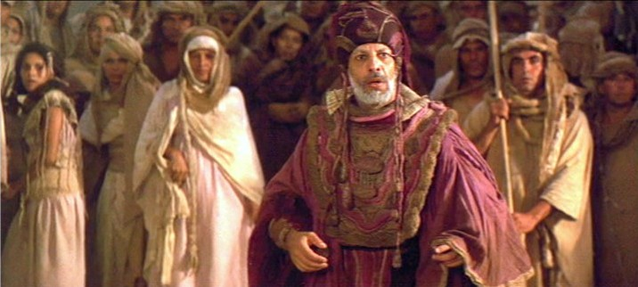
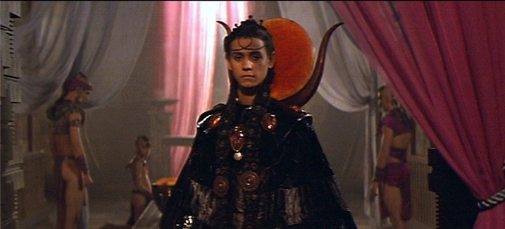
The past is revealed in the present:
Initially the archaeology of ancient Egypt is reproduced in the new world.
Then ancient Egyptians are discovered, linguistically and culturally unchanged as captives in a time capsule.
Ultimately the non-human element of the human past is revealed. The alien shaping human history still exists and still threatens humanity.

Slide 9
Themes for Stargate (and every film we watch in this class)

Slide 10
You need to make a note of these themes
You will need to use them in the assignments. You need to show awareness of these themes in your work to pass the class.

Slide 11
Theme 1: Possession of the bodies by entities from the past.
At least one character, the alien entity called Ra, is able to continue living by regenerating a human body that he has possessed.
Similar themes
Re-animation of the dead
Possession of the bodies by entities from the past
Danger of past continuing
Non-progress
Diff, scientific mechanisms
Notes:
He’s appearing with the classic symbol of Hathor, with the sun and the horns at the back there... this is a human who was captured 10,000 years ago and the alien has possessed it and is regenerating it. So we have regeration, prolonged life and possession… an alien takeover and the continued existence of the body from an ancient past.

Slide 12
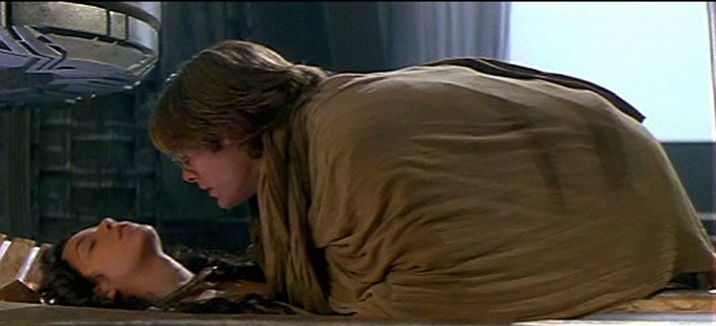
Theme 2: Re-animation of the dead.
On more than one occasion characters are killed, including the central character Daniel Jackson. Some of these people are reanimated in a container within Ra’s ship.

Slide 13
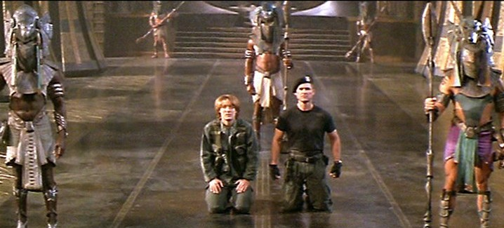
Theme 3: Danger of past continuing.
The premise of Stargate is that an alien tyranny once gripped earth and may yet return. This is an ancient threat that continues into the present.

Slide 14
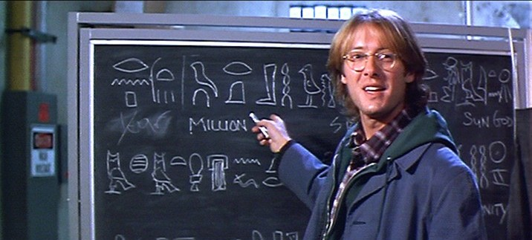
Theme 4: Danger is released through archaeology.
The story is one in which human history was shaped by an alien presence – an entity that enslaved humanity.
The archaeological discovery not only reveals this hidden history but threatens to repeat it by again allowing the alien access to earth.

Slide 15
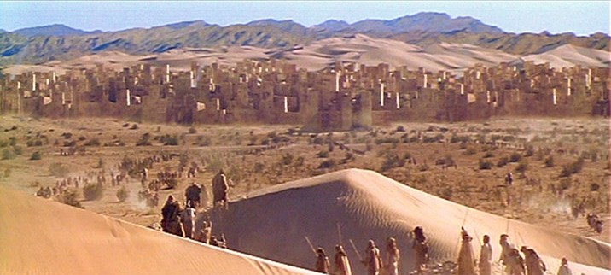
Theme 5: Non-progress
On the alien world that is discovered descendents of ancient Egyptian continue to live in the old ways – unchanged from pre-dynastic times, held in stasis by a ban on writing and innovation.
This resembles the plots of movies such as King Kong and Lost World – in which there is no intrinsic capacity for change... scary...

Slide 16
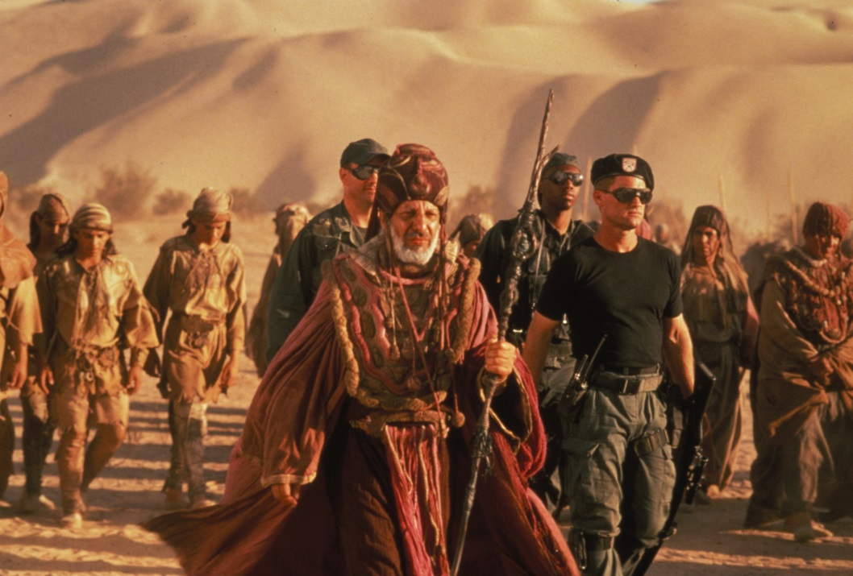
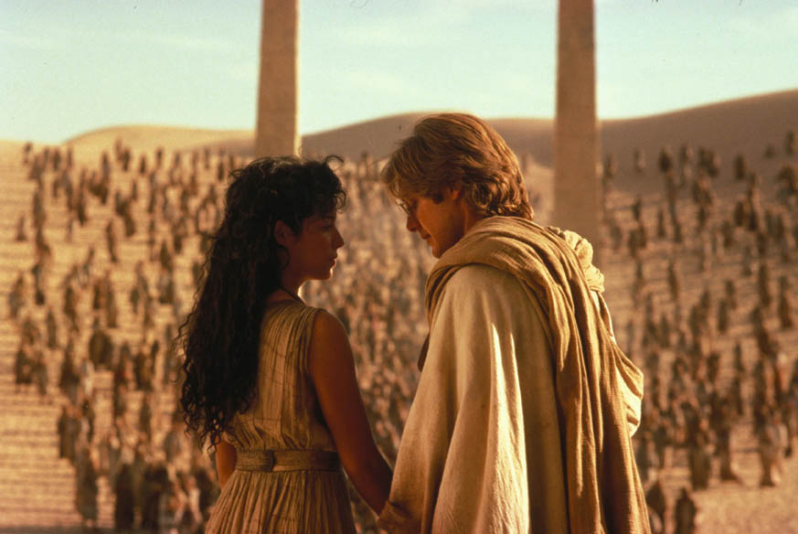
Theme 6: Culture difference
The film presents us with several degrees of cultural difference: within the modern earth inhabitants, between them and the inhabitants of the alien planet, and within the inhabitants of the alien planet.
We naturally take sides as we watch the film, this subtly shapes our view of what is normal and what is different, and what is good and what is wrong.

Slide 17
Inspiration for Stargate

Slide 18
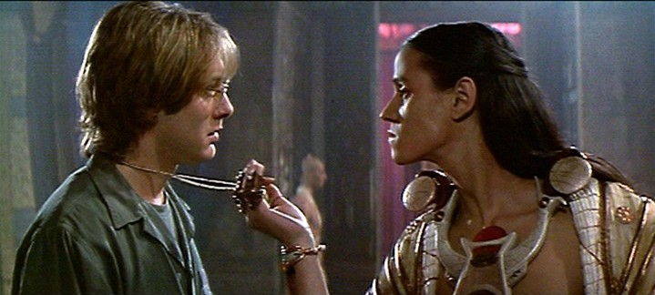
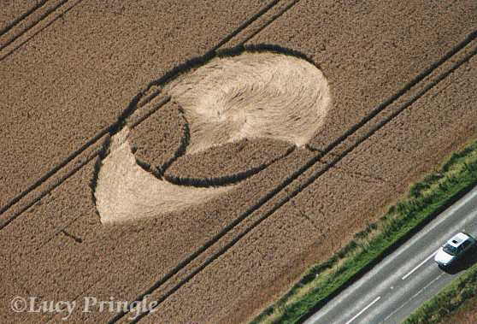
What elements of popular culture is this film drawing on to combine aliens, alien technology, and the ancient world?

Slide 19
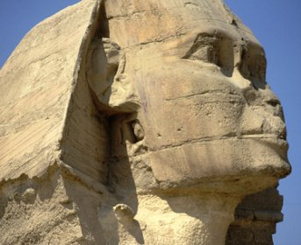
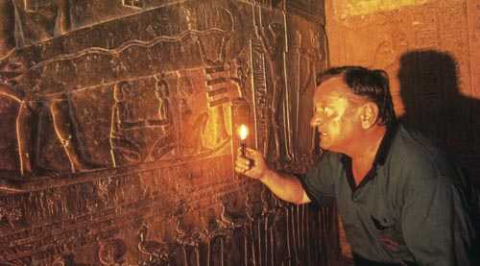
The plot of Stargate is derived from two related ideas:
Claims for much longer history for the pyramids than could be accommodated in conventional archaeological interpretations.
The idea that human history was shaped by the visitation of aliens.

Slide 20
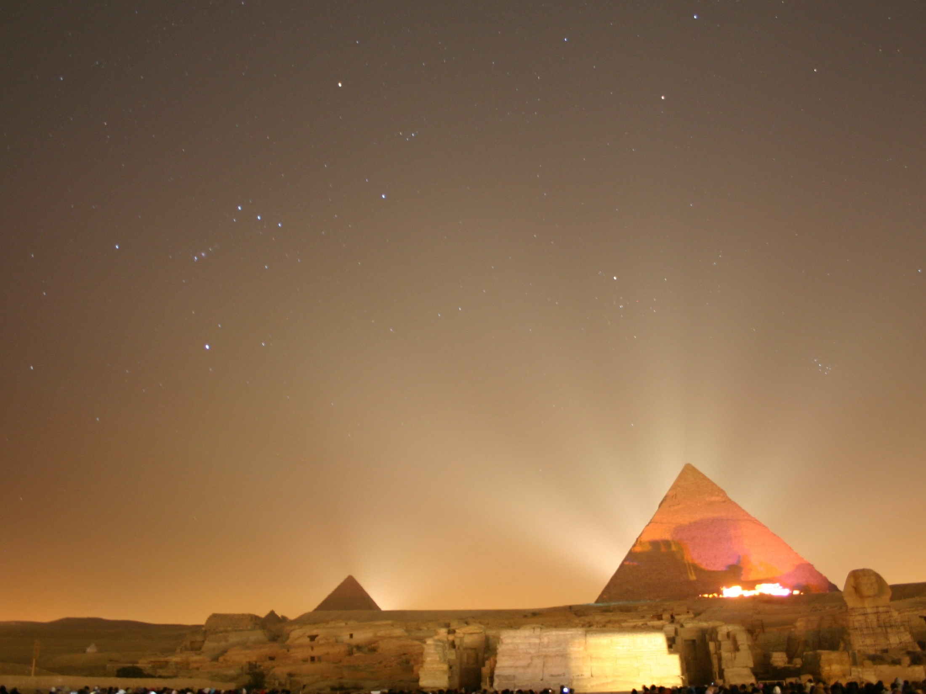
There have been some serious claims for a ‘higher civilization’ – either alien or more ancient – based on archaeological evidence such as...
1. The erosion of the Sphinx
2. Astronomical alignments of the pyramids
3. Architectural features inside the pyramids
Let’s look at some of these claims...

Slide 21
Archaeology and Stargate

Slide 22
Notes:
How old are the pyramids of Egypt?
https://www.polleverywhere.com/multiple_choice_polls/4pP4vs3SGeZjBCL

Slide 23
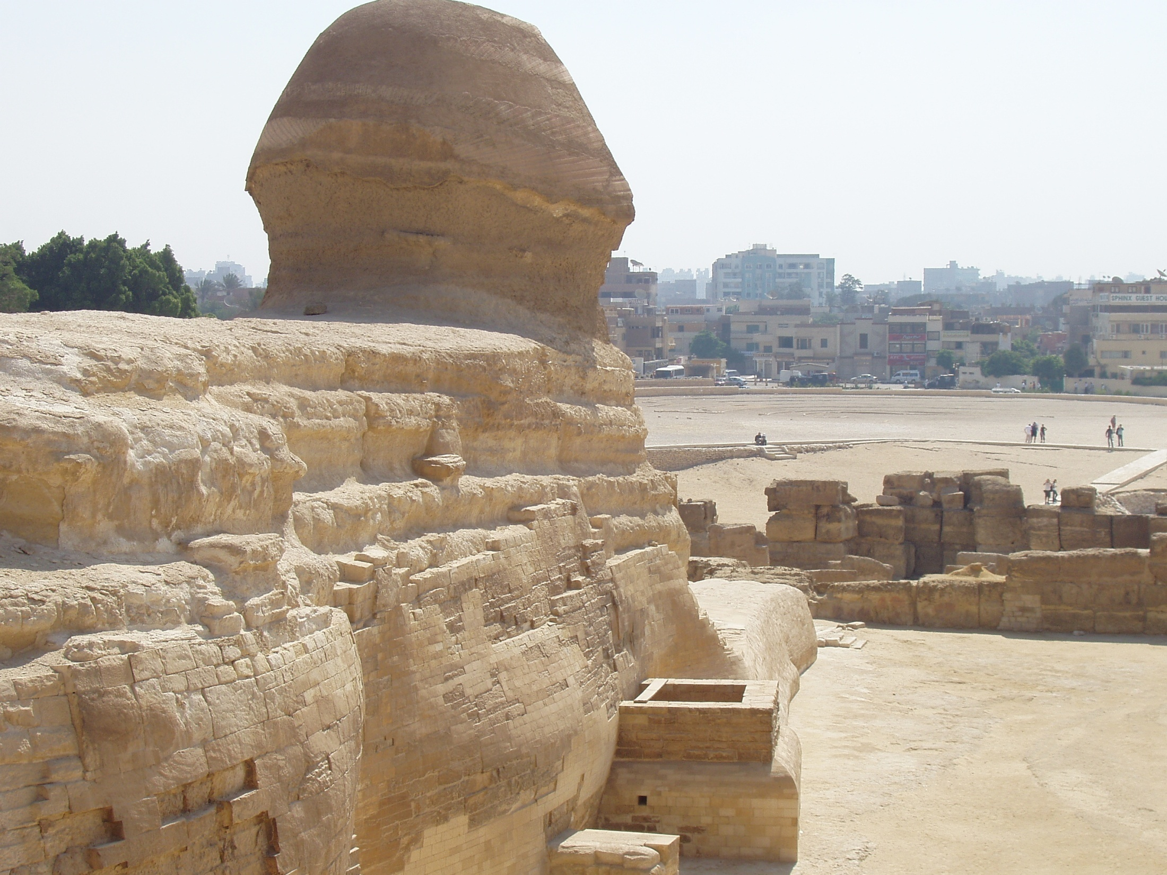

Slide 24
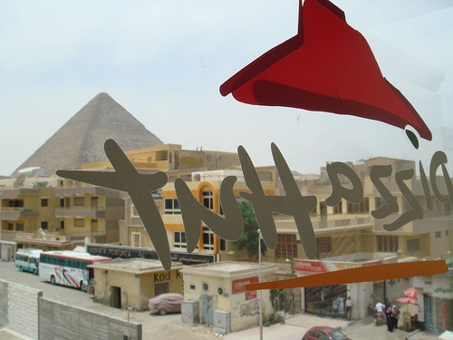

Slide 25
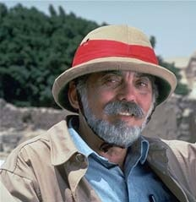
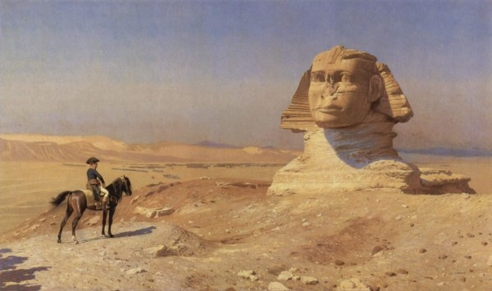
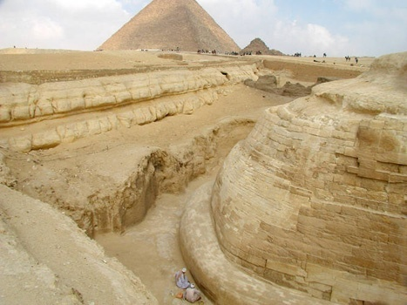
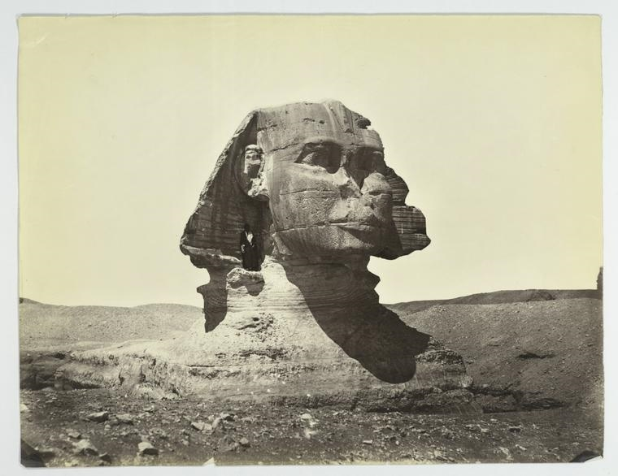
BU Geologist Robert Schoch interpreted erosion patterns on the Sphinx as a result of heavy rain from 7-9,000 BP
John Anthony West, author and tour guide, has written numerous books promoting this interpretation

Slide 26
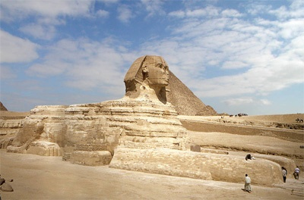

Slide 27
The Sphinx isn’t just one giant rock

Slide 28
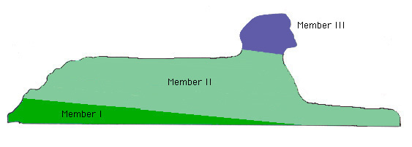
The Sphinx isn’t just one giant rock

Slide 29
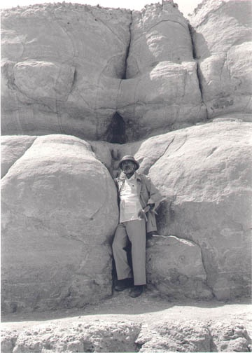
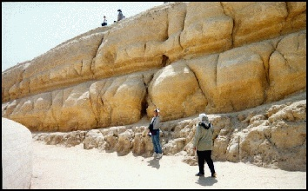
Geologists have found that the rapid weathering due to formation of salt crystals in the rock pores which causes exfoliation due to hydrostatic pressure from ground water and acid rain.
Chowdhury, A.N., A.R. Punuru, and K.L. Gauri, 1990. Weathering of Limestone Beds at the Great Sphinx; Environmental Geology and Water Science, Vol. 15, No. 3, pp. 217-225.
Gauri, K.L., A.N. Chowdhury, N.P. Kulshreshtha, and A. R. Punuru, 1990. Geologic Features and Durability of Limestones at the Sphinx; Environmental Geology and Water Science, Vol. 16, No. 1, pp. 57-62.
Punuru, A.R., A.N. Chowdhury, N.P. Kulshreshtha, and K.L. Gauri, 1990. Control of Porosity on Durability of Limestones at the Great Sphinx, Egypt; Environmental Geology and Water Science, Vol. 15, No. 3, pp. 225-232.
Guari, K. L., J.J. Sinai, and J.K. Bandyopadhyay, 1995. Geologic Weathering and its Implications on the Age of the Sphinx; Geoarchaeology, Vol 10, No. 2, pp. 119-133

Slide 30
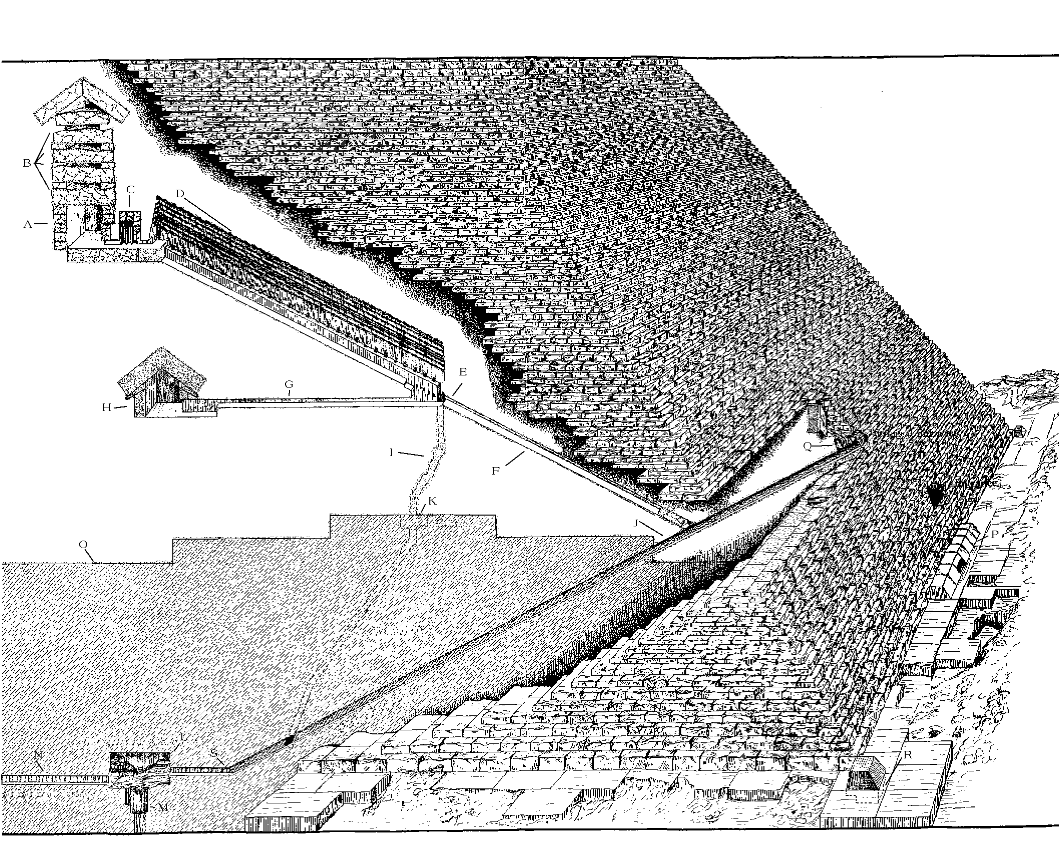
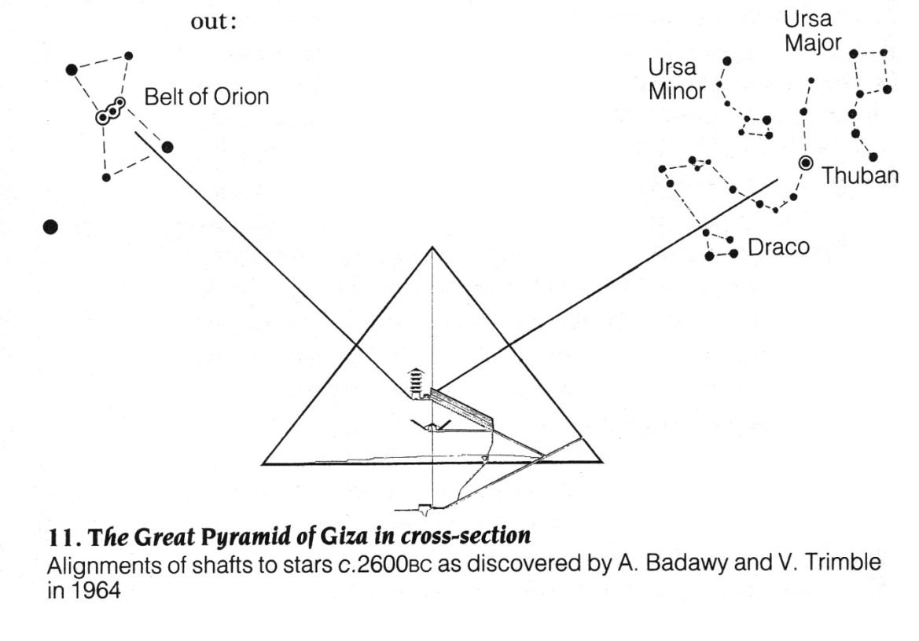
Astronomical alignments of the pyramids have been used to determine when they were built: 2600 BC or…

Slide 31
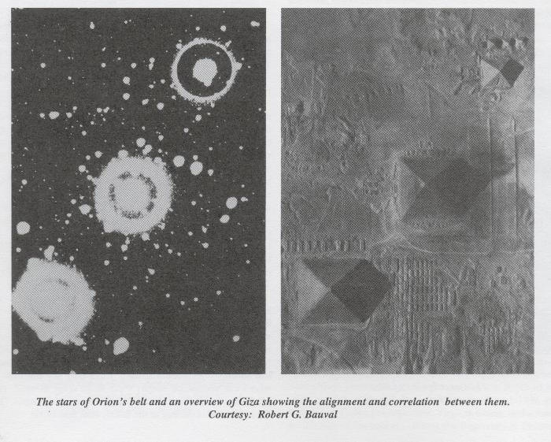
…10,000BC?

Slide 32
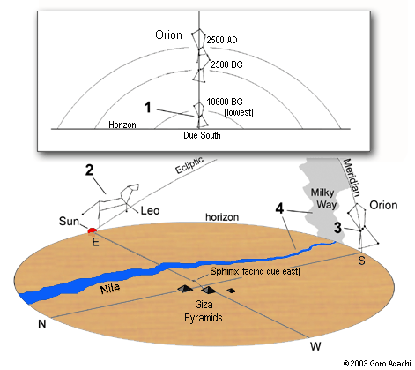
10,000BC?

Slide 33
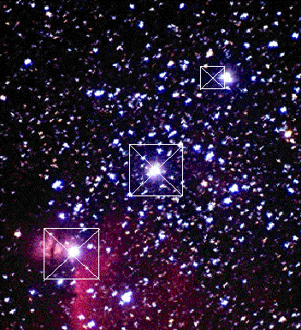
10,000BC? Really?
The picture of the pyramids is oriented with north at the bottom of the page. Orion's Belt, on the other hand, has north at the top.
To make the pyramids match the sky, you have to turn Egypt upside down.
Planetarium equipment has failed to reproduce this alignment: 47-50 degrees per the planetarium measurements, compared to the 38 degree angle formed by the pyramids
Fairall, A. (1999). "Precession and the layout of the Ancient Egyptian pyramids". Astronomy & Geophysics: The Journal of the Royal Astronomical Society 40 (4)

Slide 34
How old are the Sphinx and pyramids, really?

Slide 35
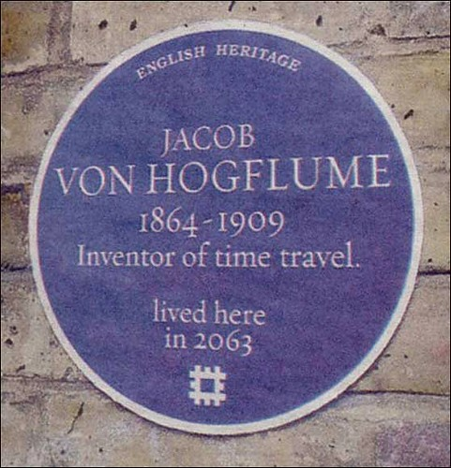

Slide 36
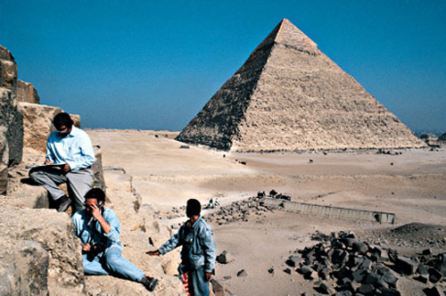
Radiocarbon dates have been obtained from specks of charcoal inside the mortar used to the build the pyramids
Bonani G, Haas H, Hawass Z, Lehner M, Nakhla S, Nolan J, Wenke R, Wölfli W. “Radiocarbon Dates of Old and Middle Kingdom Monuments in Egypt,” Radiocarbon 43, No. 3 (2001), 1297-1320(24)

Slide 37
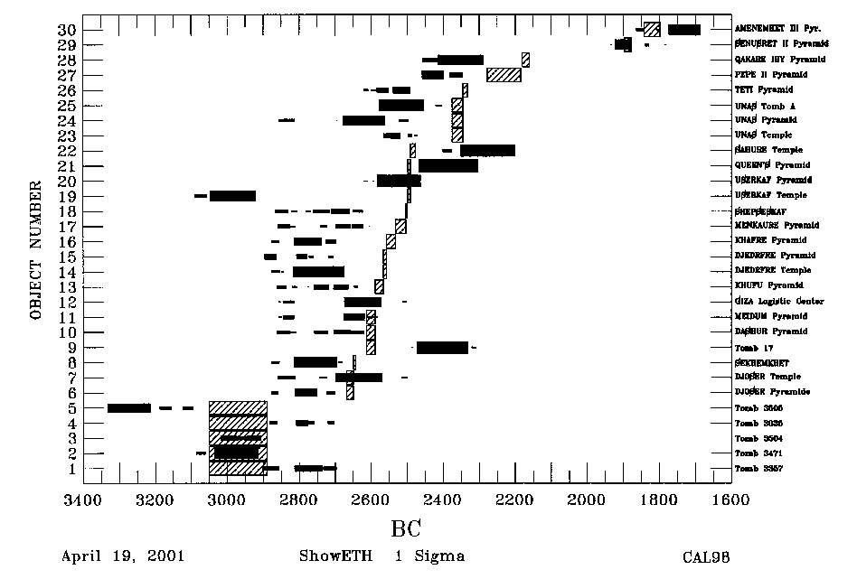

Slide 38
Notes:
How old are the pyramids of Egypt?
https://www.polleverywhere.com/multiple_choice_polls/y2hHbY36FN5aewi2SIETM

Slide 39
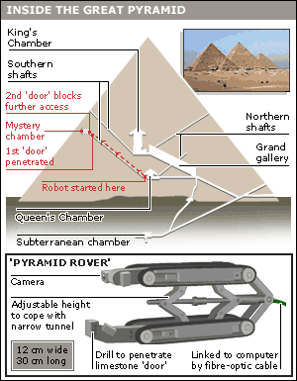
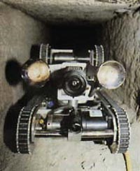
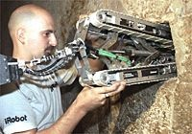
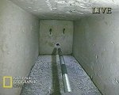
In 1993 permission was granted to test Cayce’s predictions about the unopened chamber.
A robot was used to explore some shafts...

Slide 40
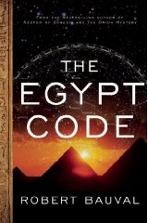
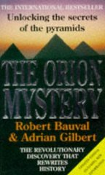
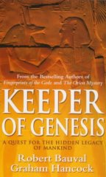
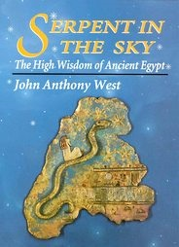
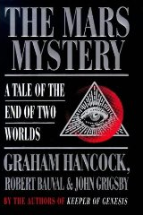
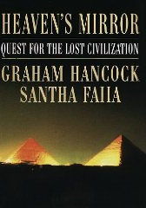
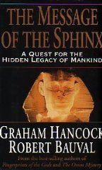
The real mystery is how wealthy are these guys from their numerous popular books, tv appearances and tours?

Slide 41
“They are not failed archaeologists, but successful mythographers of a post-science age.”
Jeb Card, SAA Archaeological Record, Nov 2019, p. 26-30

Slide 42
To summarise...
Five archaeological themes are in Stargate
The archaeological content is used to create drama through fear
There isn’t a lot of scientific support for the archaeology in the film
Notes:
Derisory comments on Budge… an old translator… a lot of use of Eygtian iconograohy… Jackson packing things he’d need… why would he need these books if he can just read them… but a few joke books in the pile, emphasizing the von danikine – john west connection.

Slide 43
To do…
Read the syllabus and assignment instructions
Fri: watch Stargate, get ready to make your first entry in your film journal
Visit us in office hours, right now, Mary Gates Commons.

