Slide 1
ARCHY 109 Winter 2020
Lecture 3
Stargate Screening Notes

Slide 2
What are we going to do today?
1. Feedback on your work so far
2. Instructions on viewing notes
3. Screening notes
4. Enjoy the film! 🍿🎉🎞

Slide 3
In class activities
Feedback
Reading annotations
Viewing notes

Slide 4
How to ace the viewing notes
Watch the film, then
Write your notes, then
Submit your notes

Slide 5
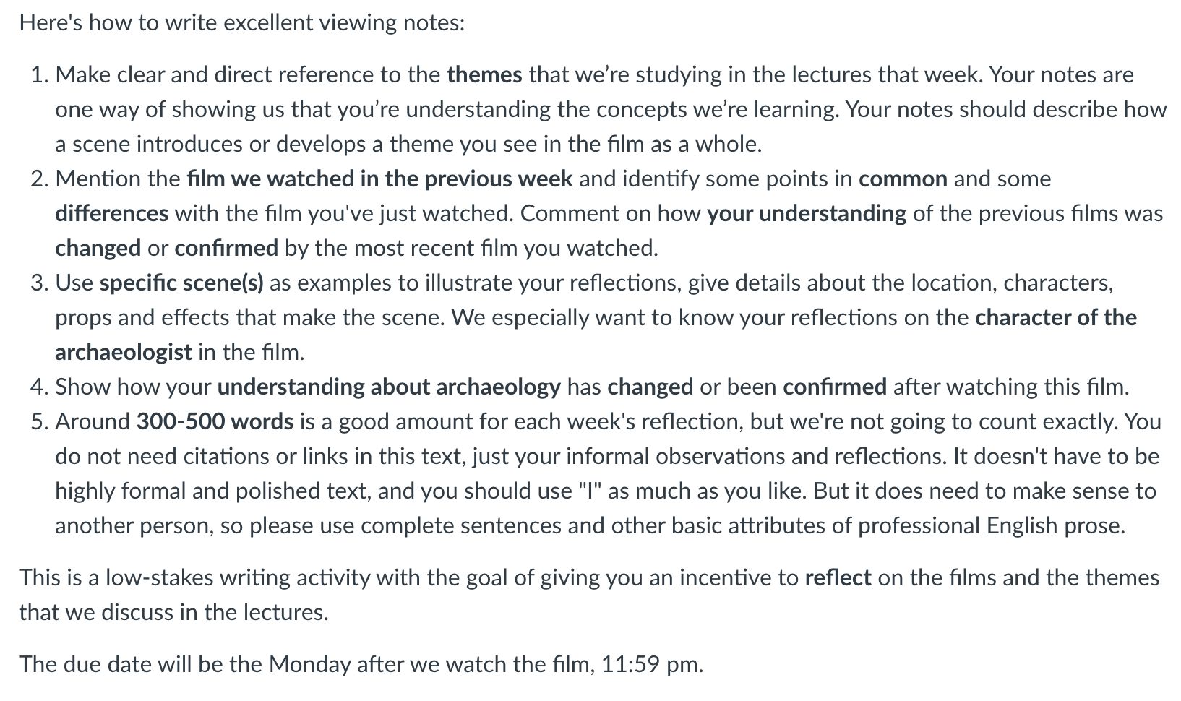
How to ace the viewing notes: show us your meta-cognition
Notes:
Metacognition is, put simply, thinking about one’s thinking. More precisely, it refers to the processes used to plan, monitor, and assess one’s understanding and performance. Metacognition includes a critical awareness of a) one’s thinking and learning and b) oneself as a thinker and learner. https://cft.vanderbilt.edu/guides-sub-pages/metacognition/

Slide 6
Notes:
What is archaeology? Submit three words
https://www.polleverywhere.com/free_text_polls/keqwZSzkXHhiRD37naFWY

Slide 7
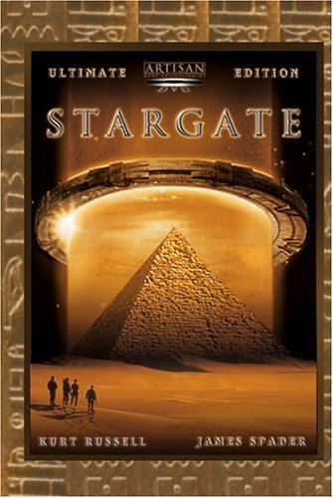
Facts and figures about the film
3.5 months to shoot, 2.5 months for CGI
Budget of $55 million.
US release on Dec 28, 1994, domestic gross of $71 million and worldwide $196 million.
Won five minor Sci-Fi/Fantasy awards
Generally poor reviews upon release... Variety: “badly remembered movie cliches” Sunday Times: “A load of outer space codswallop! ”

Slide 8
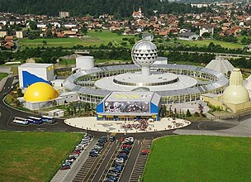
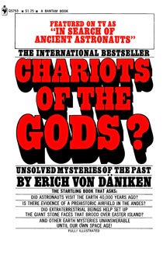
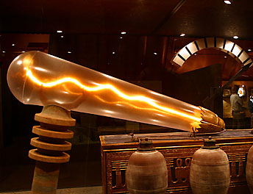
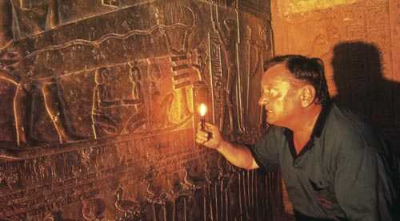
Roland Emmerich was clearly influenced by von Daniken. He watched von Daniken’s film Chariot of the Gods as a school boy.
The extended edition of the Stargate DVD Emmerich includes a featurette Is there a Stargate? which includes an interview with von Daniken.
“the past teemed with unknown gods who visited the primeval earth in spaceships”
Despite all the well-research plot elements (ie. Linguistics), Stargate is founded not on any validated academic archaeological findings but on popular, pseudo-scientific (and undoubtedly wrong) understandings of the Egyptian / human past.

Slide 9
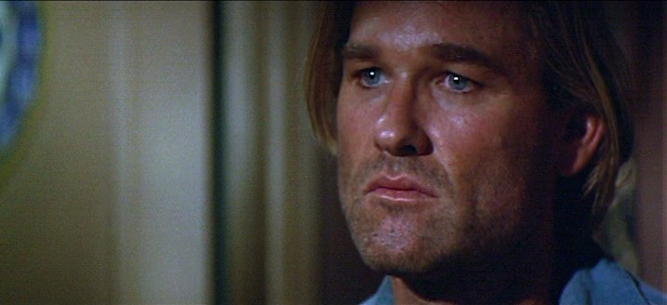
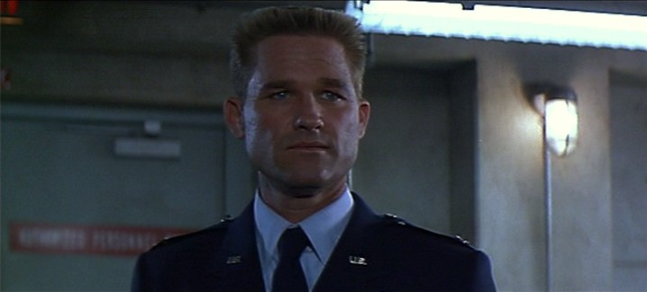
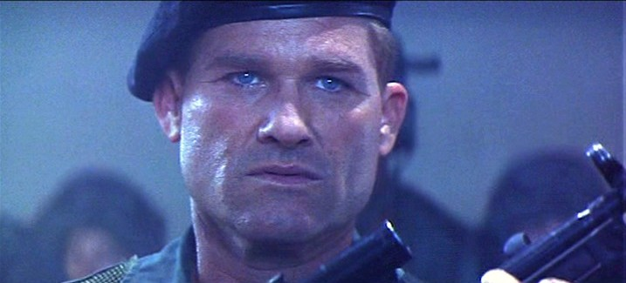
Transformations:
Colonel Jack O’Neil (Kurt Russell) begins as a failed suicidal army officer.
He is transformed into a military machine and patriot with a death wish.
Ultimately he learns to value the ancient people, to find a replacement son and to revitalise his life and career.

Slide 10
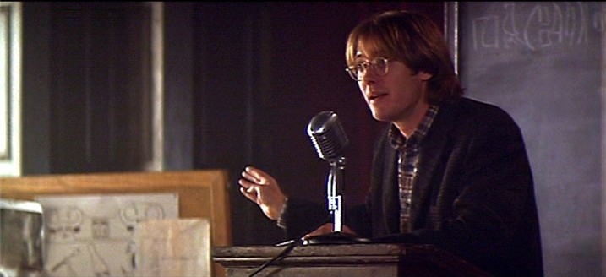
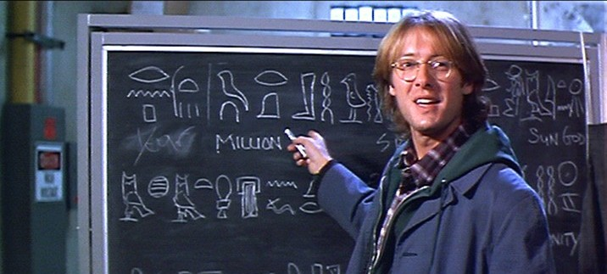
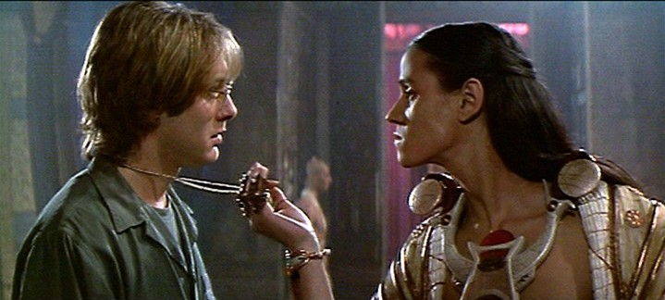
Transformations:
Dr Daniel Jackson (James Spader) begins as a marginalized archaeologist/linguist advocating radically unacceptable theories of the human past.
He is saved by his involvement in an archaeological riddle which he solves and by his integration into a new, non-academic community.
Ultimately he is transformed by his confrontation with the present/reality rather than his engagement with the past/theory to become an agent for action.

Slide 11
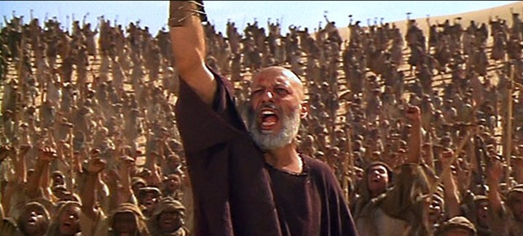
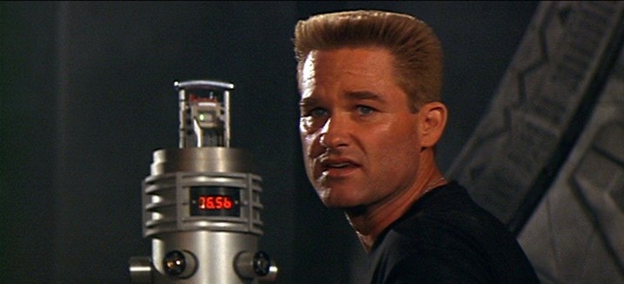
Of course there are the annoyingly contemporary themes of
an American military response to the unknown,
followed by an American attempt to ‘liberate’ and change an ancient society,
culminating in an American decision to use atomic weaponry to destroy the enemy.
Lets agree to not be too annoyed and to focus on some of the more archaeological aspects of the film.

Slide 12
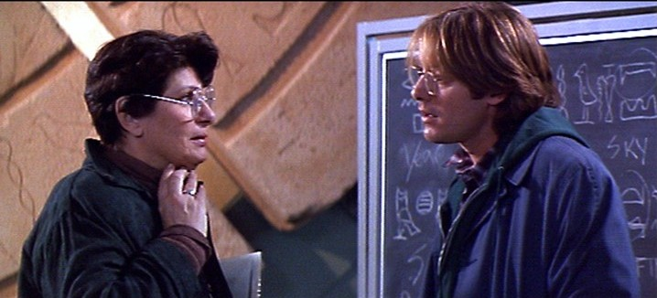
Things to watch for…
One joy of this film is the existence of lots of reasonably accurate archaeological statements and in-jokes:
Derisory comments on Budge’s guides to hieroglyphs.
Recycling of Egyptian symbolism (Eye of Horus becomes eye of Ra, lots of uses of Hathor’s horns etc).
On a table full of Jackson’s books, not only a copy of Christopher Frayling’s The Face of Tutankhamun (an inappropriately popular book dealing with a much late time period), but also pseudo-scientific book on Egypt.
The famous Kurt Russel line “Give my regards to King Tut asshole”. (Emmerich had a film of Tutanhkamun in production, but didn’t get made).

Slide 13
Coming up next…
Do your viewing notes and your reading annotations
Closing remarks on Stargate
Introduction to The Mummy (1932)
Don’t hesitate to contact us with any questions at all!

