Slide 1
ARCHY 109 Archaeology in Film Winter 2020 Lecture 14

Slide 2
What are we going to do today...
The real-world archaeology of The Exorcist
Enjoy watching the film 😱

Slide 3
Warning!
This is a horror film

Slide 5
Our ARCHY 109 class behavior contract: Do not use laptops in distracting ways (e.g. browse irrelevant web pages and social media during class)

Slide 6
Feedback and updates
Notes:
One thing that you liked, one thing that you didn’t, and what the film tells us about the viewing pulblic

Slide 7
Peer reviews will close tonight
Notes:
Think-pair-share
https://theconversation.com/should-scientists-engage-in-activism-72234
https://link.springer.com.sci-hub.se/referenceworkentry/10.1007/978-1-4419-0465-2_1076
https://journals.equinoxpub.com/JCA/article/view/29592/pdf

Slide 8
Peer reviews will close tonight
Log in to Poll Everywhere with your UW email
Notes:
Think-pair-share
https://theconversation.com/should-scientists-engage-in-activism-72234
https://link.springer.com.sci-hub.se/referenceworkentry/10.1007/978-1-4419-0465-2_1076
https://journals.equinoxpub.com/JCA/article/view/29592/pdf

Slide 9
Notes:
What was the pattern in fossils discoveries that made Piltdown look increasingly suspicious?
https://www.polleverywhere.com/multiple_choice_polls/FTTfuoOOt6wfR82

Slide 10
The archaeology of Pazuzu
Notes:
One thing that you liked, one thing that you didn’t, and what the film tells us about the viewing pulblic

Slide 11
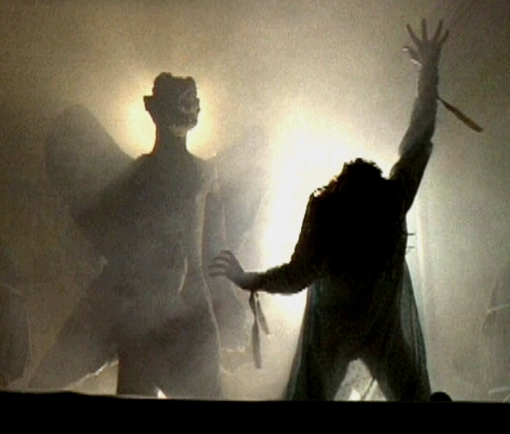
Log in to Poll Everywhere with your UW email

Slide 12
Notes:
What do you think Pazuzu is?
https://www.polleverywhere.com/multiple_choice_polls/OcWnxMdYBJzarv9

Slide 13
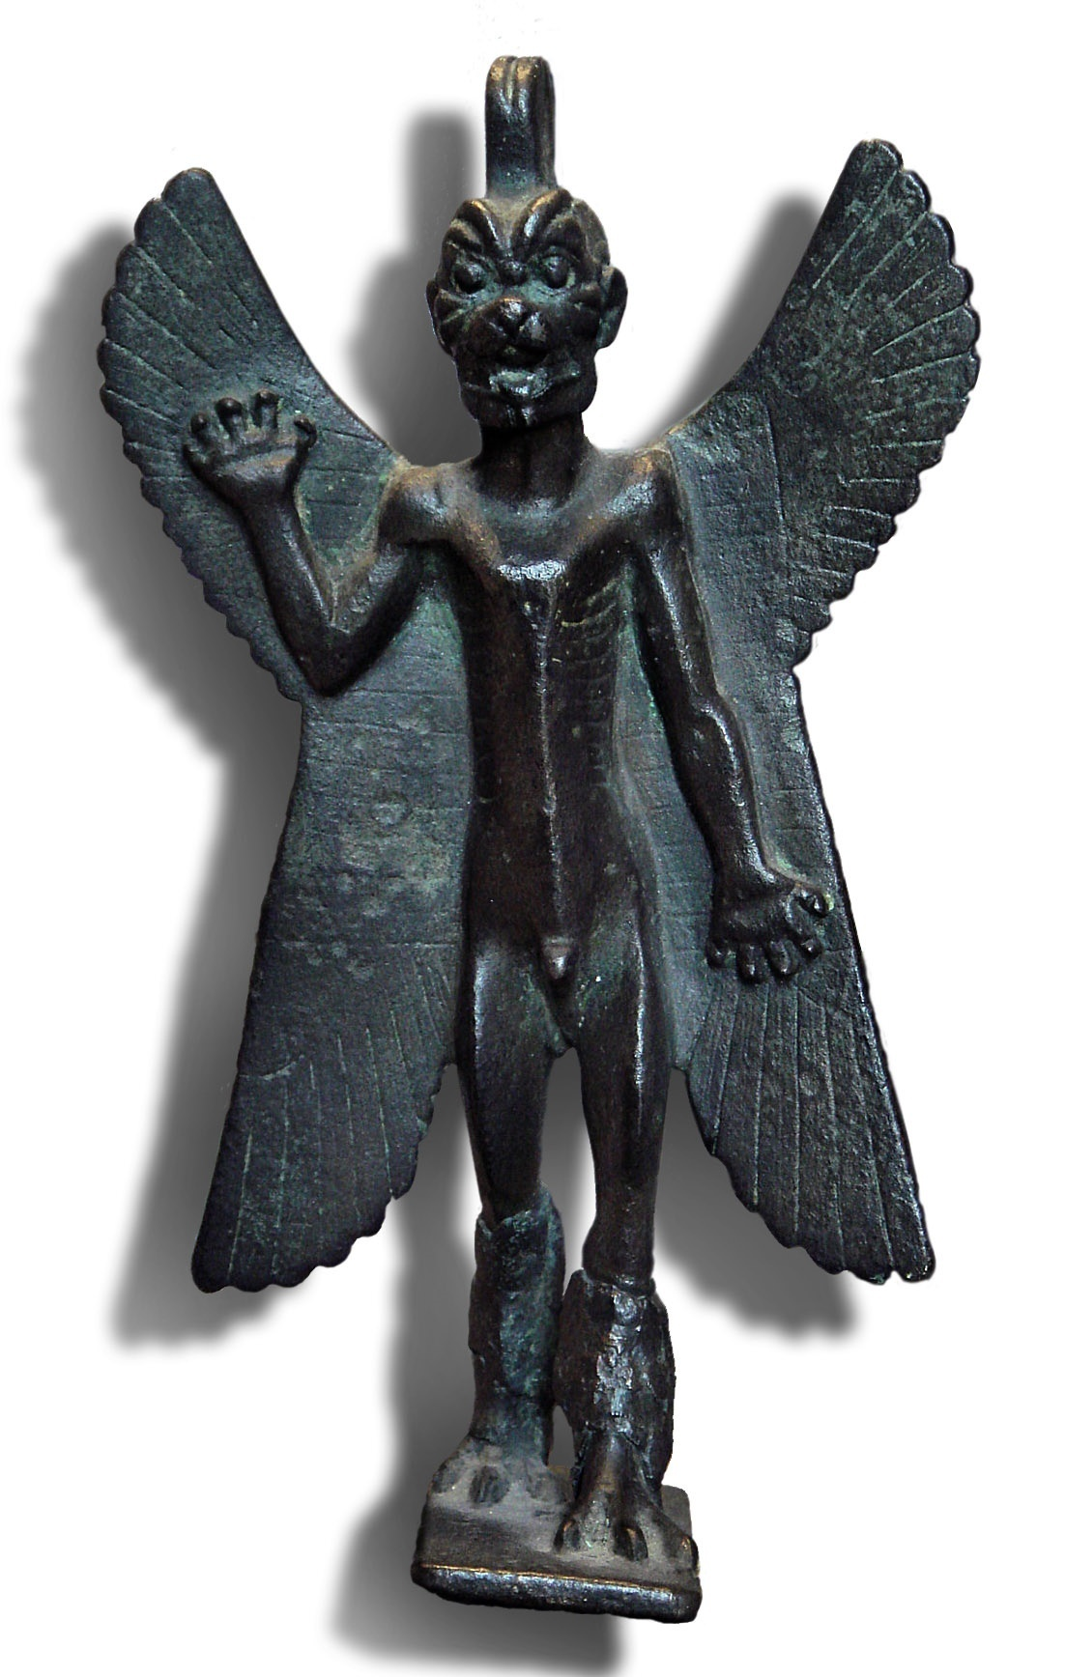
The image of Pazuzu as an inhuman figure is repeated throughout the film.
Pazuzu is a deity in ancient Assyrian cosmology, but his image is varied.
The image employed in the film is based on examples in the Louvre.
Amulets of Pazuzu generally depict it as being a composite creator: scaled limbs of a bird, head of a carnivore, wings of a grasshopper.

Slide 14
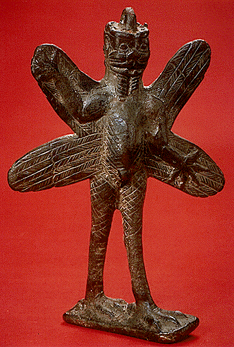
=?
This is the common interpretation of The Exorcist, suggested by the battle of the entity with the Catholic church, and in the dialog between the two priests about multiple demons. But…

Slide 15
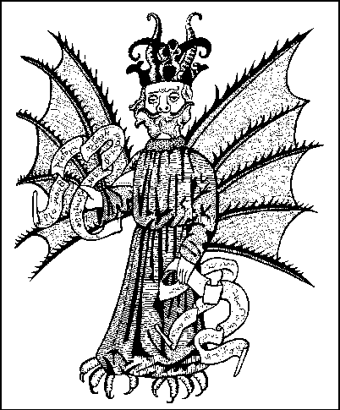
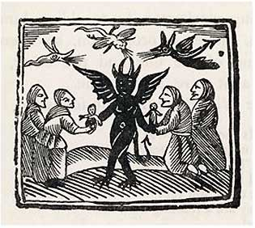
The image of Pazuzu conveys the impression of great antiquity and evokes notions of Biblical descriptions of evilness through its superficial resemblance to medieval satanic images.

Slide 16
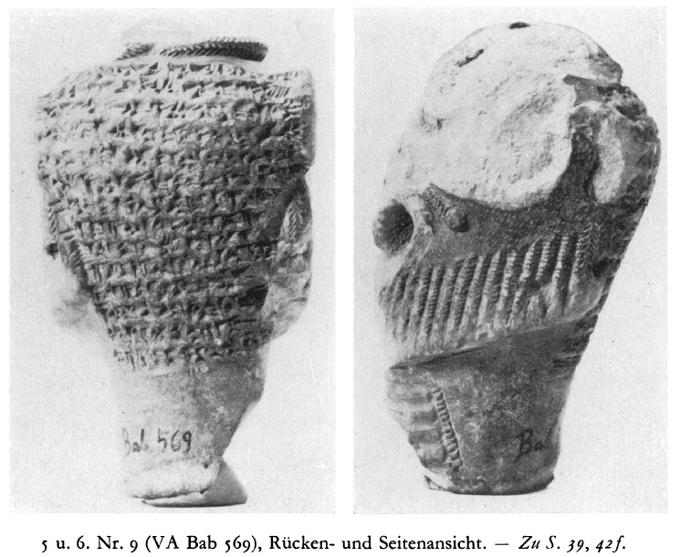

Slide 17
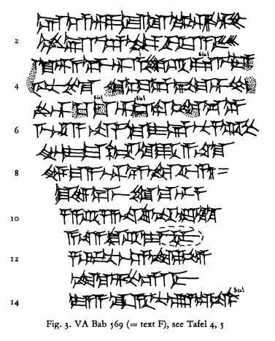
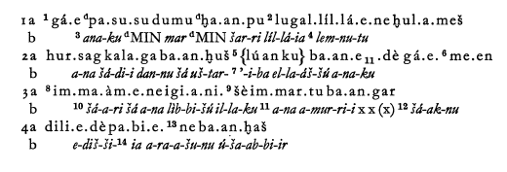

Slide 18
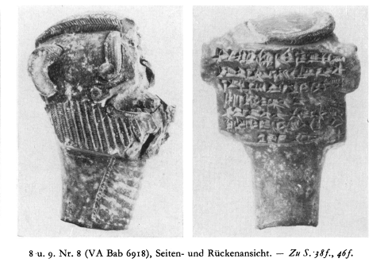

Slide 19
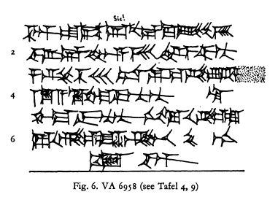

Slide 20
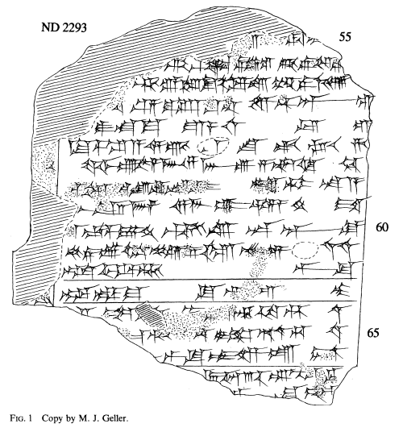
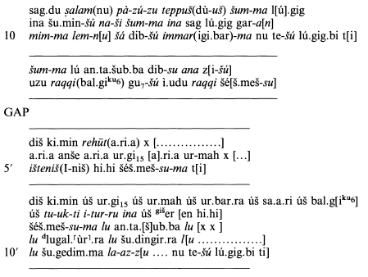

Slide 21
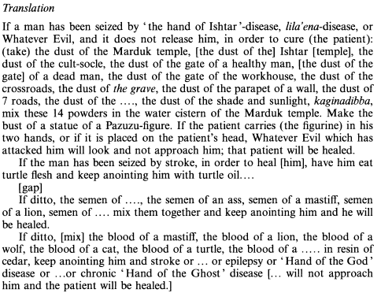

Slide 23
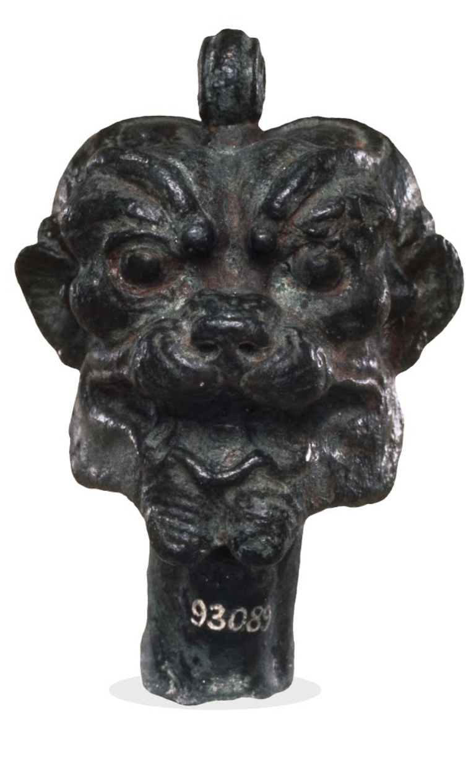
“Pazuzu, a demon from the hellish underworld, had the power of repelling other demons, and was thus invoked for beneficial ends, particularly to drive his wife Lamashtu back to the underworld. Lamashtu was a demoness who attacked men to infect them with various diseases.”
Patricia Kalensky, Louvre
“He is often regarded as an evil underworld demon, but he seems also to have played a beneficent role as a protector against disease-bearing winds (especially the west wind). He was closely associated with the demoness Lamashtu who stole babies from their mother's womb or when newly born. Pazuzu acted to counter her evil: he forced her back to the underworld. Amulets of Pazuzu like this were therefore placed in dwellings, attached to bedroom furniture. Smaller versions were hung around the necks of pregnant women.”
British Museum collection online
Notes:
https://web.archive.org/web/20100930162934/http://www.louvre.fr/llv/oeuvres/detail_notice.jsp?CONTENT%3C%3Ecnt_id=10134198673225951&CURRENT_LLV_NOTICE%3C%3Ecnt_id=10134198673225951&FOLDER%3C%3Efolder_id=9852723696500800&baseIndex=56&bmLocale=en

Slide 24
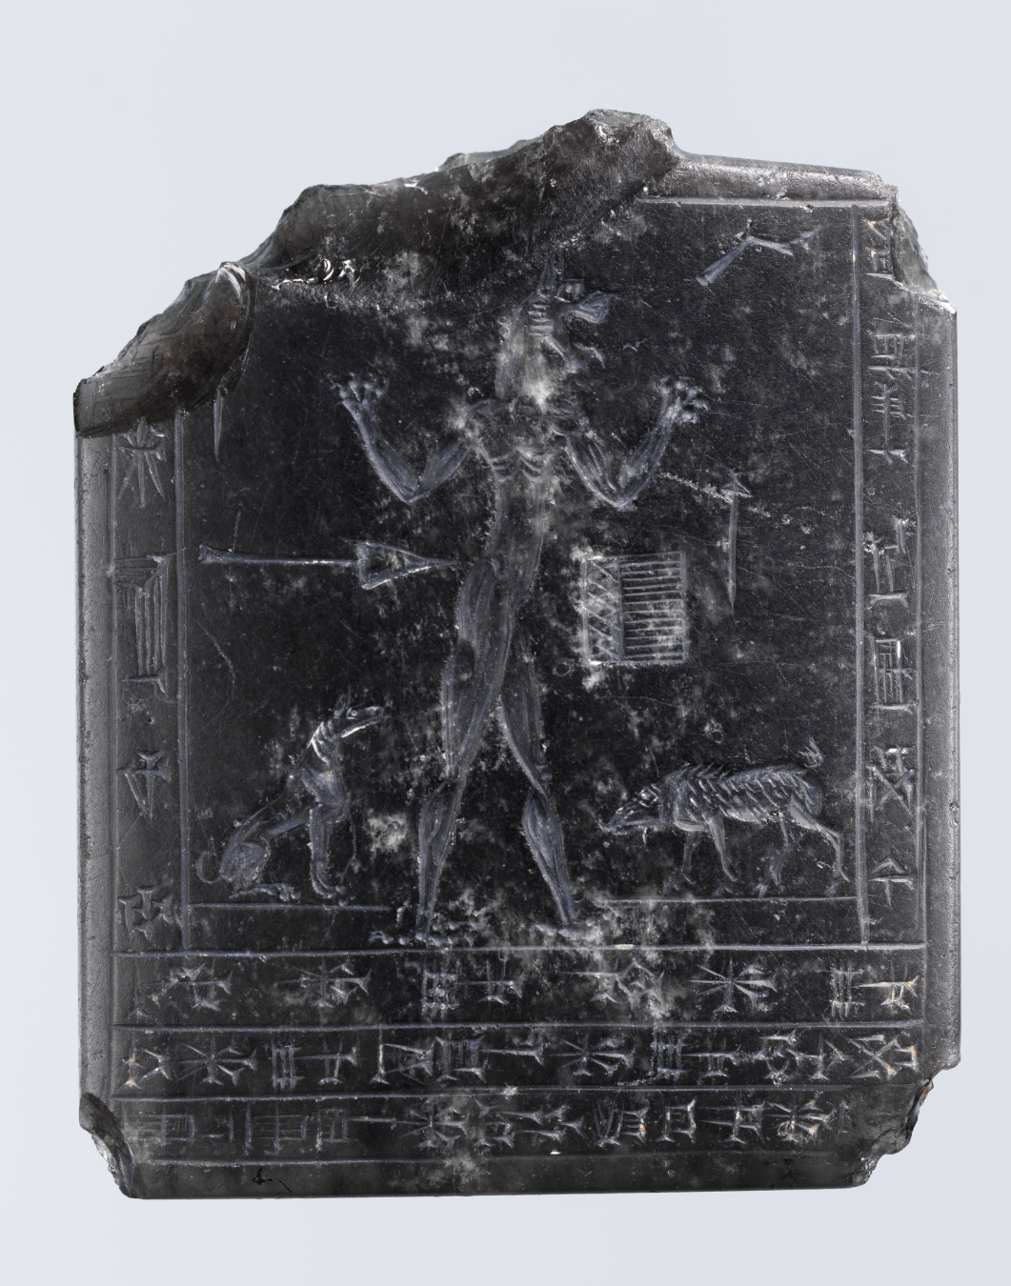
Pazuzu was a powerful defense against demonic attacks from Lamashtu.
In his original context, Pazuzu's identity was complicated, not just one side in a simple opposition between good and evil.
The archaeological record of Pazuzu adds complexity and ambiguity to the film. It makes the past seem confusing, in addition to a source of random, intimate danger.
Notes:
https://www.metmuseum.org/exhibitions/listings/2014/assyria-to-iberia/blog/posts/pazuzu

Slide 25
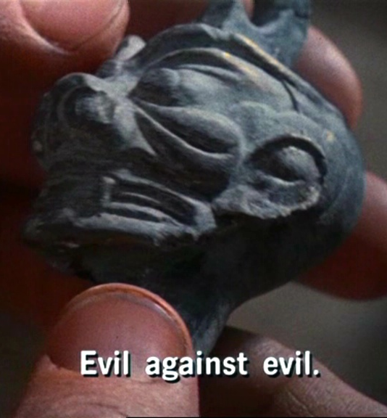
The archaeological record suggests that the conventional interpretation of The Exorcist is wrong
1. Pazuzu was an amulet/statue used to protect households: it was an Assyrian protector against pestilential winds.
2. Pazuzu wasn’t a nice entity, but it could be harnessed to protect people against even worse entities.

Slide 26
≠
Pazuzu is not Satan possessing the girl. Could it be an ancient guardian manifesting to assist the exorcism?

Slide 27
Facts and figures about the film
Budget of $12 million, Warner did not have high expectations, but it made $441.3 million, and became the top-grossing R-rated film of all time
Nominated for 10 Oscars, won 2 (screenplay, sound mixing). First horror film to be nominated for Best Picture
Banned in the UK. US audiences had strong reactions, fainting, "cinematic neurosis" triggered by viewing the film.
Contains semi-subliminal images (you can see them), pig squeals mixed into the sound effects, one of the medical procedures is real
The director used violent surprises to get his desired reaction from the cast

