Slide 1
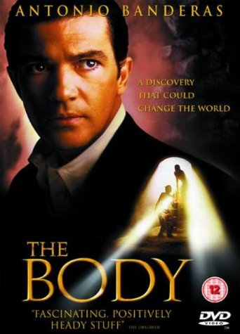
ARCHY 109 Archaeology in Film Winter 2020
Lecture 21

Slide 2
What are we going to do today?
1. Archaeology as a source of social and political disruption in The Body
2. The real world of archaeology and socio-political disruption: Ayodhya and stratigraphy
3. Introduction to Wall-E

Slide 3
The depiction of the multitude of political factions attempting to control or exploit the situation makes The Body especially interesting and realistic

Slide 4
Which groups have an interest in the archaeology in The Body?
Log in to Poll Everywhere with your UW email

Slide 5
Notes:
Which one of these is NOT directly involved in the story in The Body?
https://www.polleverywhere.com/multiple_choice_polls/eSvTfXvhUKEq1cO

Slide 6
The danger of archaeology to unleash social and political disruption

Slide 7
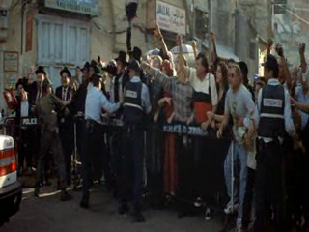
The archaeological excavation of human remains causes rioting, bombing and disruption of the dig.
The combination of (1) religious groups, (2) government and (3) an archaeologist results in tensions between religion, politics and archaeology (ie. science).

Slide 12
Notes:
https://www.indiatoday.in/india/video/ram-janam-bhumi-babri-masjid-demolition-ayodhya-ram-temple-421951-2013-08-24

Slide 13
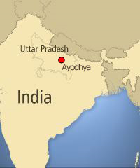
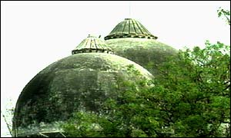
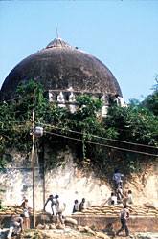
Ayodhya
In 1528 a mosque was built at Ayodhya, in the northern India state of Uttar Pradesh.
Ayodhya is mentioned (ambiguously) in several Hindu scriptures and during at least the last 150 years many Hindus have claimed it to be the birthplace of Lord Rama, the seventh incarnation of Lord Vishnu.

Slide 14
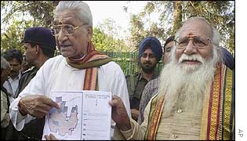
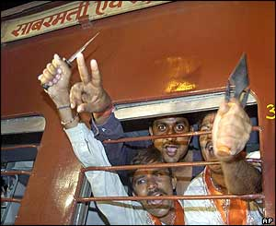
The Bharatiya Janata Party (BJP), the central party of the Indian government, was founded in 1951 and seeks the reassert Hinduism by developing a 'Hindu spirit' and a sense of the priority of Hinduism in Indian history.

Slide 15
Claims that an early Hindu temple had existed on the Ayodhya site became highly valued by the BJP.
In 1984 Hindus formed a committee to "liberate" the birth-place of Lord Rama and build a temple in his honour.
In 1991 BJP came to power in Uttar Pradesh, where Ayodhya is located, making it easy for them to pursue their interests in the holy site

Slide 16
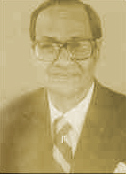
Before
B.B. Lal, retired Director General of the Indian Archaeological Survey, dug a trench at the side of the mosque in the 1970’s

Slide 17
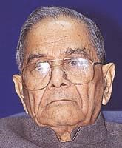
Before After
B.B. Lal, retired Director General of the Indian Archaeological Survey, dug a trench at the side of the mosque in the 1970’s
He found that occupation began in the 11th century, initially claimed no evidence for an early temple

Slide 19
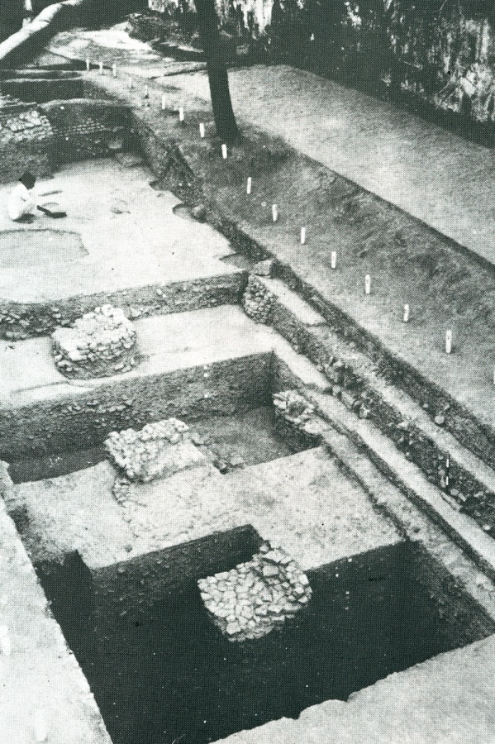
In 1992 a government forum published a booklet:
Ramajanma Bhumi Ayodha: New Archaeological Discoveries.
This booklet, with government support, announced that archaeological finds
‘…prove that there did exist at this very site a magnificent temple, from at least the 11th century, which was destroyed to build a mosque-like structure over the debris of the temple in the 16th century’.

Slide 21
This photograph from Lal’s original report was used to as evidence for the existence of pillars of the earlier Hindu temple.
The booklet spoke of many other artefacts and architectural features – such as black stone pillars and stone sculptures – none of which Lal reported.

Slide 22
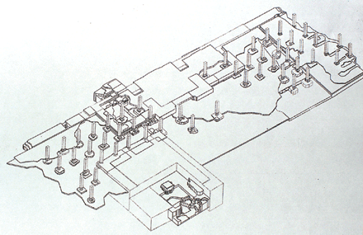
An artist’s impression of the temple

Slide 23
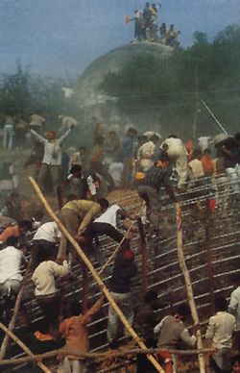
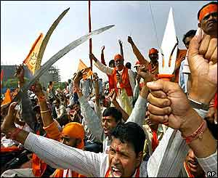
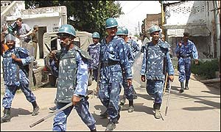
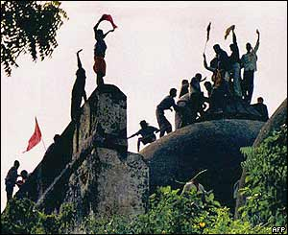
It came to be widely accepted that an important Hindu temple to Rama had once existed here and had been destroyed to build the mosque.
In 1992 supporters of the BJP attacked the mosque and tore it down.
2,000 people died in conflict between rioting between Hindus and Muslims.
36 mosques in the district were destroyed.

Slide 24
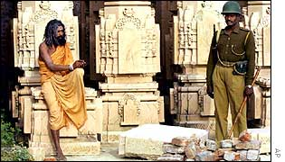
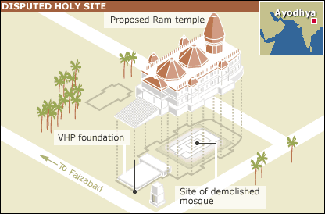
Tensions still exist, with plans to build a Hindu temple on the site being strongly opposed by Muslims.
On the anniversary of the demolition, in March 2002, approximately 1,000 people, mostly Muslims, died in riots in Gujarat following a train attack.
High Court judges determining the ownership of the site ordered archaeologists to begin a survey to find out whether a temple to Lord Rama existed on the site.

Slide 25
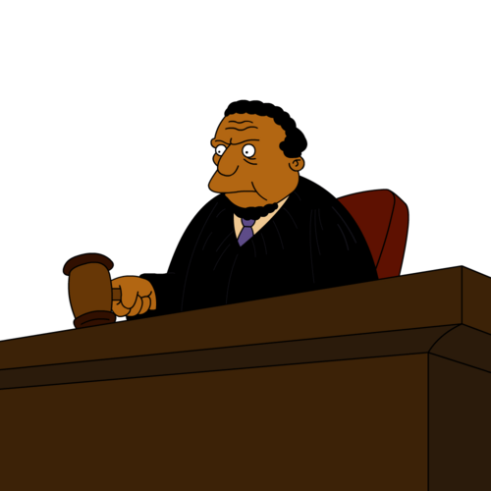
What were the results of the Court-ordered archaeology?
I order you to dig!

Slide 27
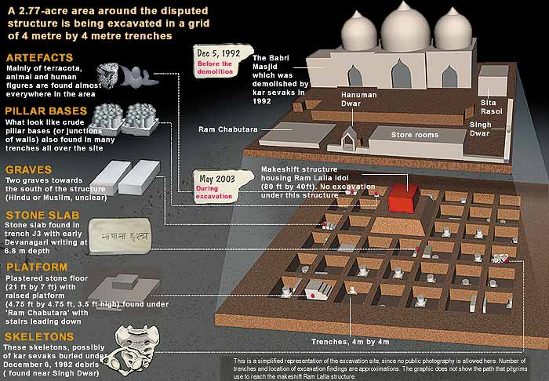

Slide 28
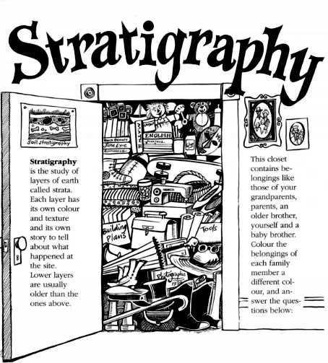
The study of layers

Slide 29
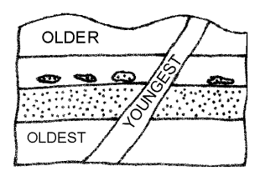

Slide 30
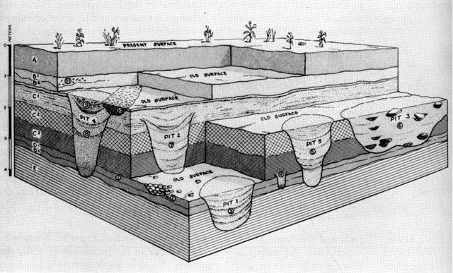
What is the correct order of the numbered pits?

Slide 31
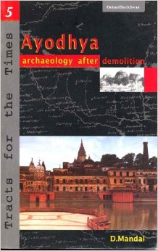
A critical analysis of the archaeology

Slide 32
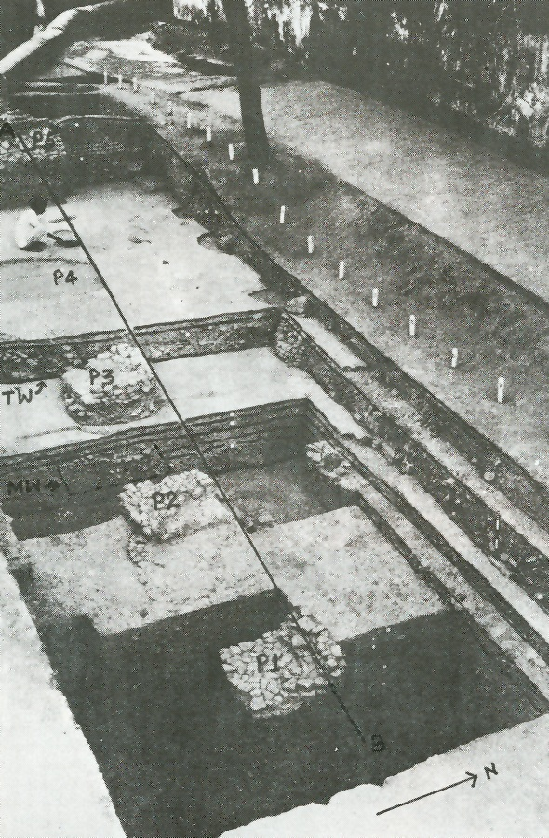
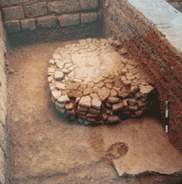
Mandal has shown that the structures in the photographs are not pillar bases for a temple.

Slide 33
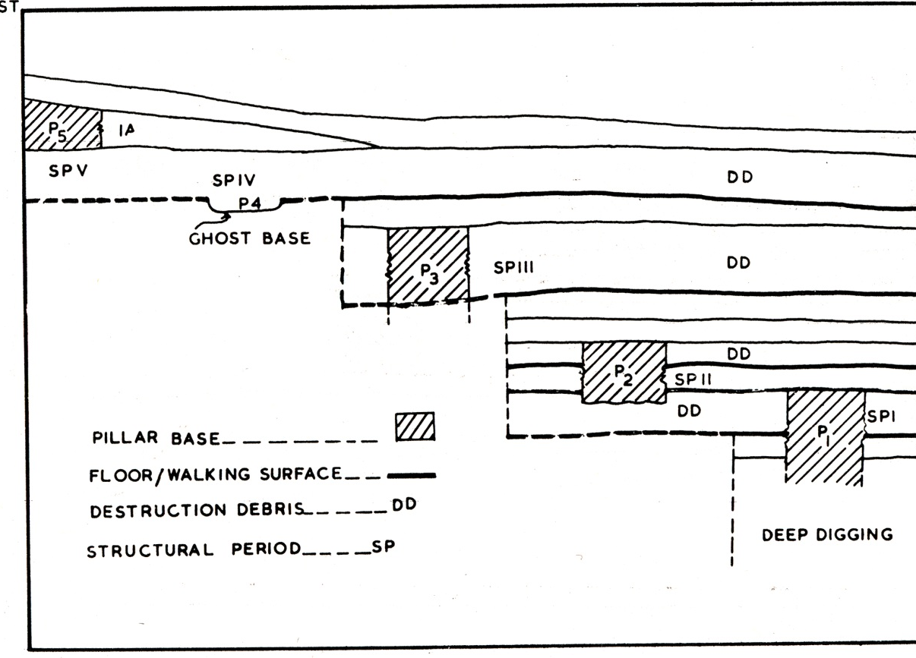
Log in to Poll Everywhere with your UW email

Slide 34
Notes:
What is true of the stratigraphy of this site?
https://www.polleverywhere.com/multiple_choice_polls/CBEyhjd2RZkkqRu

Slide 36
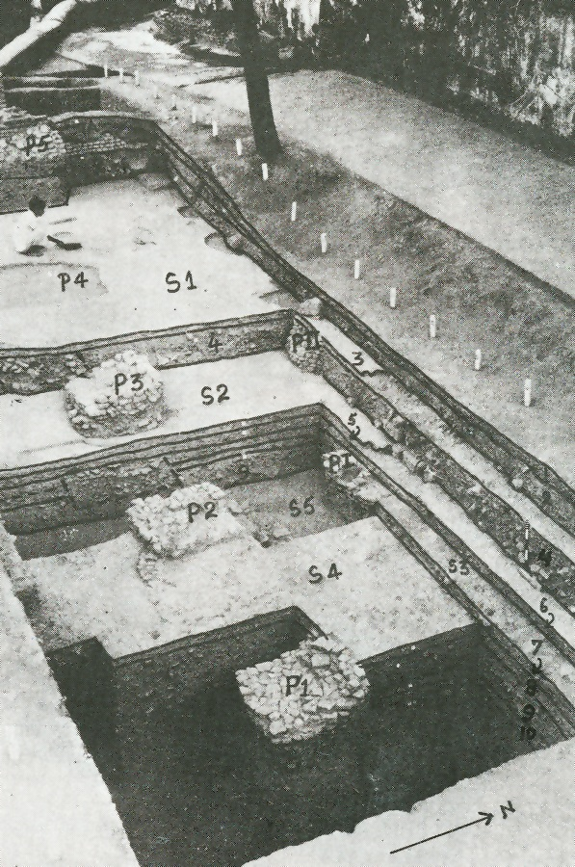
Re-examination of Lal’s research did not show a pre-Islamic temple.
It is stratigraphically impossible for the brick piles to be column foundations

Slide 37
No evidence for a pre-Islamic temple on the Ayodya site.
Good evidence for political manipulation of the archaeological record

Slide 38
Introduction to WALL-E

Slide 40
Plot summary of Wall-E
Set on Earth and in space 700 years in the future
Earth has been abandoned to waste, one last robot is left on Earth, dutifully performing his job: Wall-E
A probe, Eve, is sent from the human space colony to see if Earth is habitable again, she finds that it is
The two robots fall in love, Wall-E returns to the colony with Eve as she attempts to fulfill her objective.
The autopilot robot challenges Eve, the humans and Wall-E assist her to success and they all return to Earth to re-settle

Slide 41
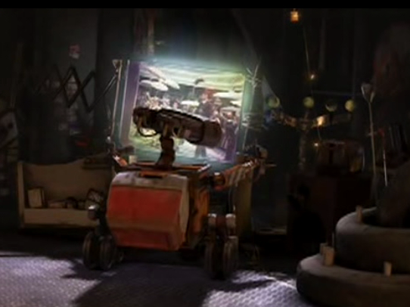
Memory and Identity
Wall-E is obsessed by memory.
Although Wall-E is a mechanical goat, he is regularly overwhelmed with nostalgia for an ancient civilization
He is fascinated by its relics and collects and classifies them methodically

Slide 42
To conclude...
The film uses archaeological evidence as a catalyst for substantial social, political and religious disruption
This is not too far-fetched, the example of Ayodhya in India shows a similar situation in the real world

