Slide 1
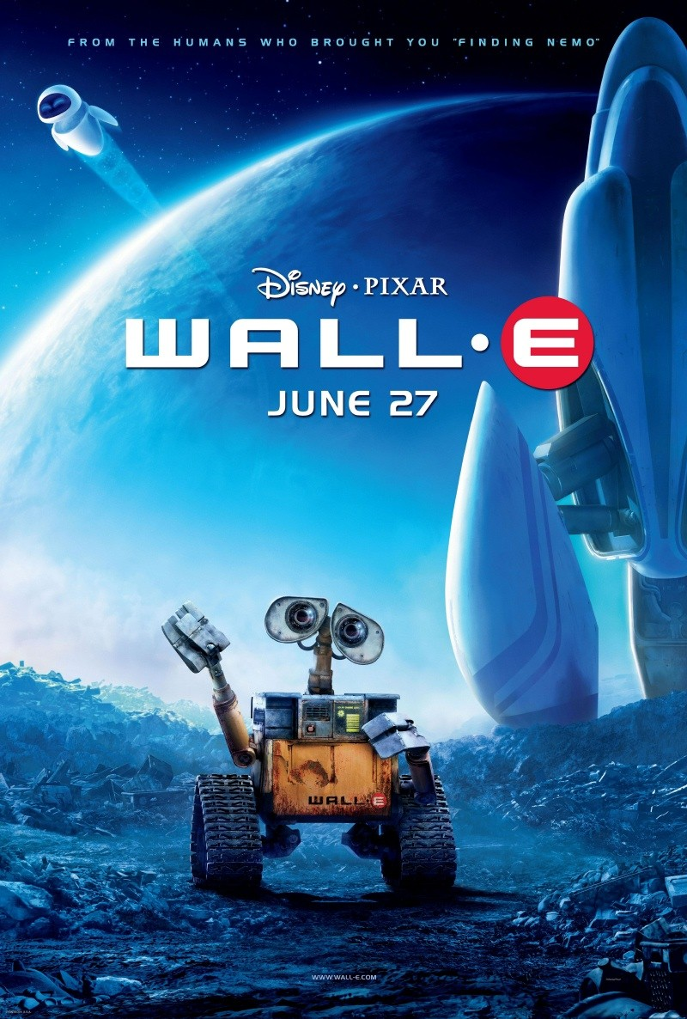
ARCHY 109 Archaeology in Film Winter 2020
Lecture 23

Slide 2
What are we going to do today?
1. Feedback & updates
2. Online course evaluation
3. Has human evolution stopped?
4. Final remarks

Slide 3
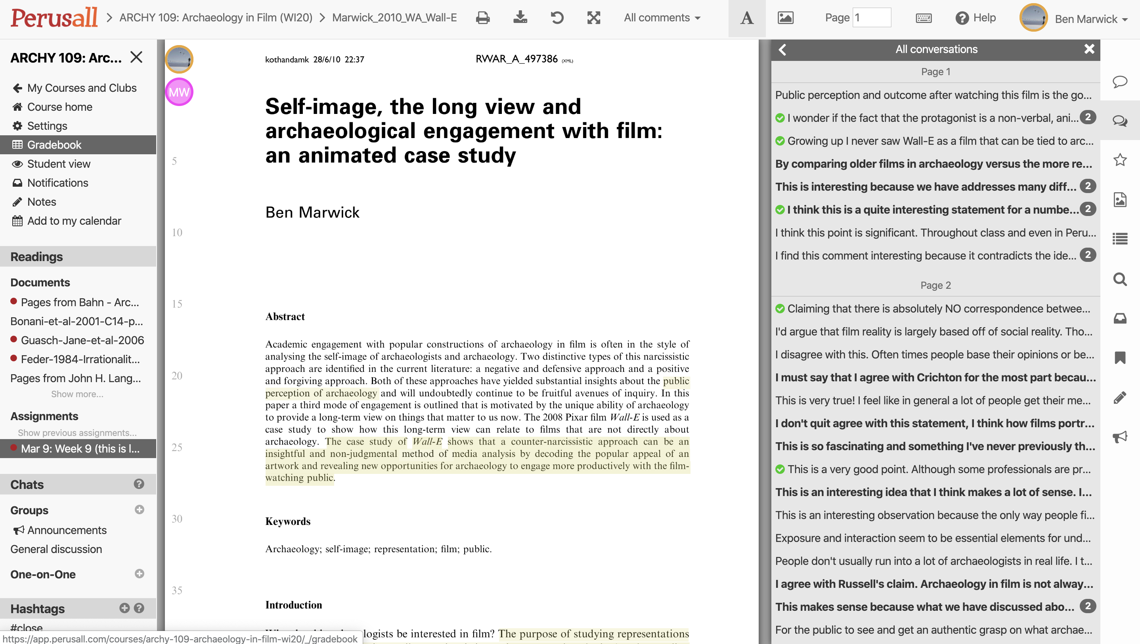
Outstanding work on the reading annotations, keep it up!

Slide 4
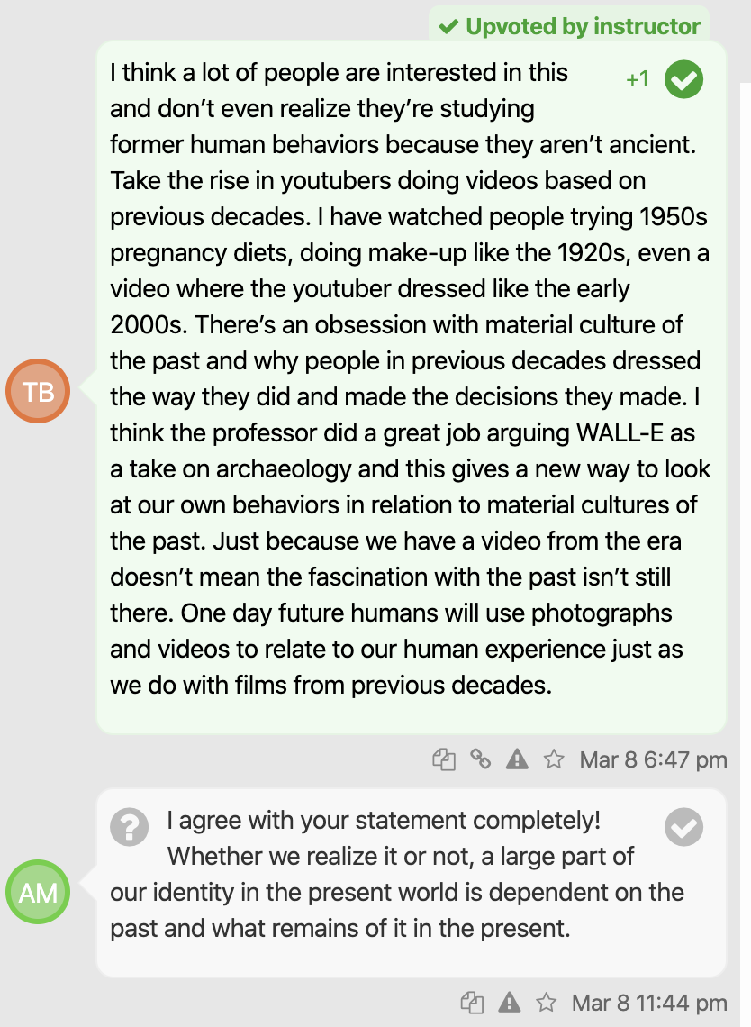
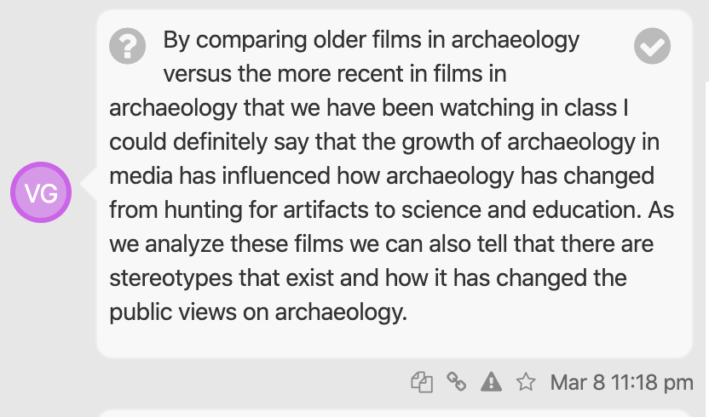
Outstanding work on the reading annotations, keep it up!

Slide 5
Outstanding work on the reading annotations, keep it up!

Slide 6
Course Evaluation
This course evaluation will take 5-10 minutes to complete. Your evaluation is voluntary - you may leave some or all of the questions unanswered. All answers are confidential. No identifying information will be shared with instructors or teaching assistants, and results will not be released until after instructors have submitted final grades to the registrar.
Your evaluation of your academic experience is extremely valuable. Faculty take your responses seriously and use your feedback to improve their teaching, and you can view results online to help you select courses during registration.
Thank you for your participation!!

Slide 7
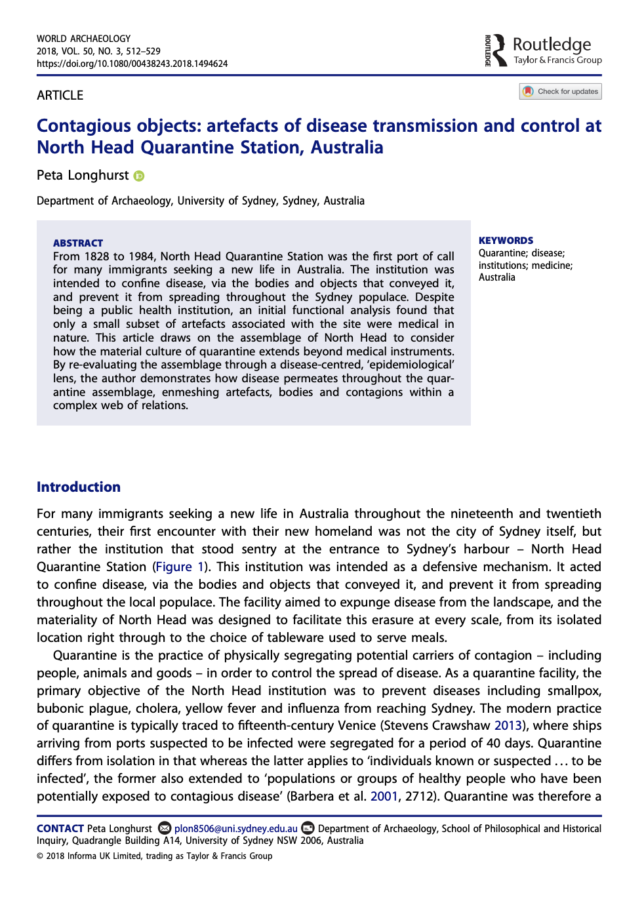
Join me next year
Fall: ARCHY 369: Archaeology of Medicine
Winter: ARCHY 208: Intro to Archaeological Data Science
Spring: ARCHY 483 & 488 Lithic Technology Lab & Seminar

Slide 8
For more details on classes in the Anthro dept…

Slide 9
Has human evolution stopped?

Slide 10
Memory and Identity
Non-progress

Slide 11
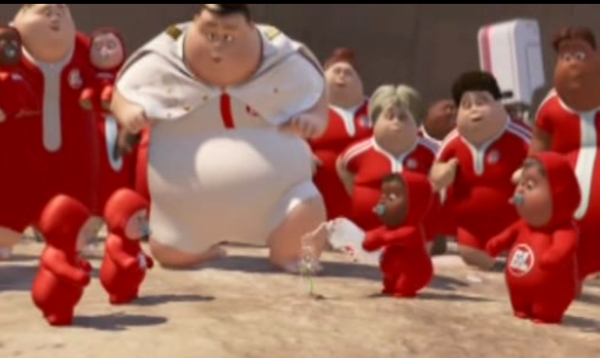
Non-progress and devolution
In Wall-E we see futuristic humans that appear to have devolved to resemble giant babies, with soft faces, rounded torsos and stubby, weak limbs
At the end of the film they re-invent agriculture as part of becoming human again
The paradox is that technological advancement results in stagnation of human culture.

Slide 12
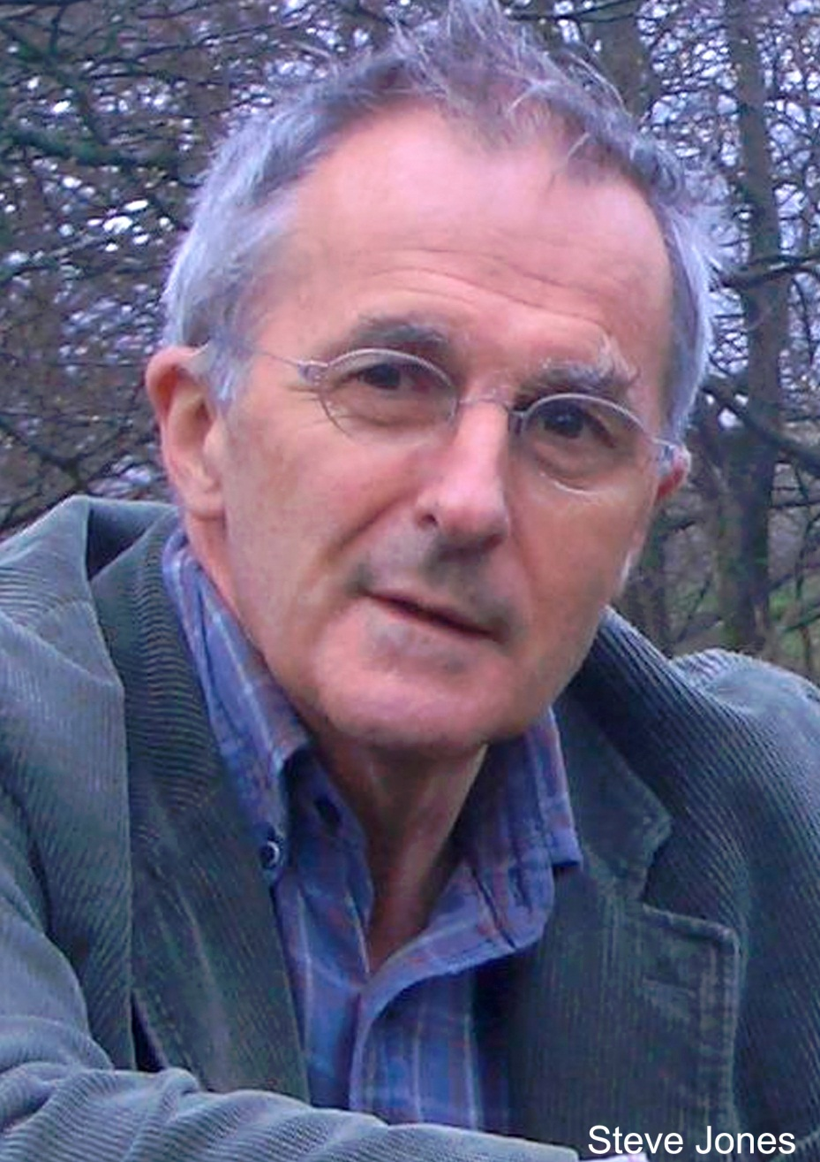
Steve Jones, Professor of Genetics at University College, London
Are we stuck with non-progress or degenerative situation?
Modern children's chances of reaching the age of 25 have reached 98 per cent

Slide 13
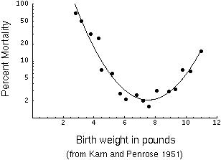
13,700 infants born in London from 1935 to 1946

Slide 14
13,700 infants born in London from 1935 to 1946

Slide 15
Notes:
Live birth weights for babies
https://www.polleverywhere.com/multiple_choice_polls/9I8G4iIDqvGXdGo

Slide 16
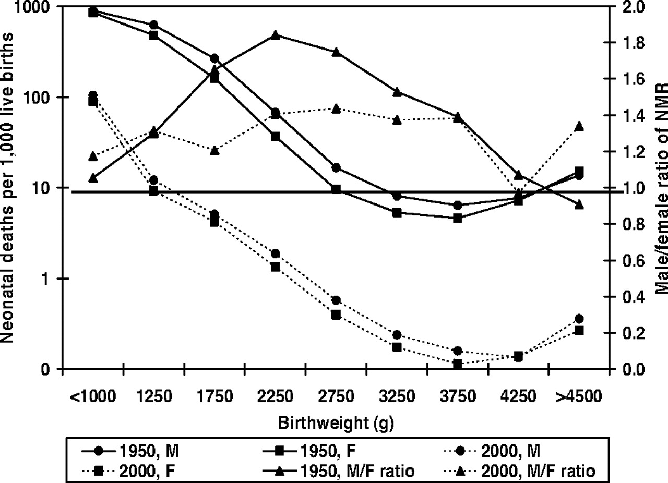

Slide 17
3 lbs
8 lbs

Slide 18
Notes:
Infant mortality from the 1930s to the 2000s
https://www.polleverywhere.com/multiple_choice_polls/PynZqwBnmAq48r6

Slide 19
Steve Jones, Professor of Genetics at University College, London
Are we stuck with non-progress or degenerative situation?
Modern children's chances of reaching the age of 25 have reached 98 per cent
Fewer older fathers

Slide 20
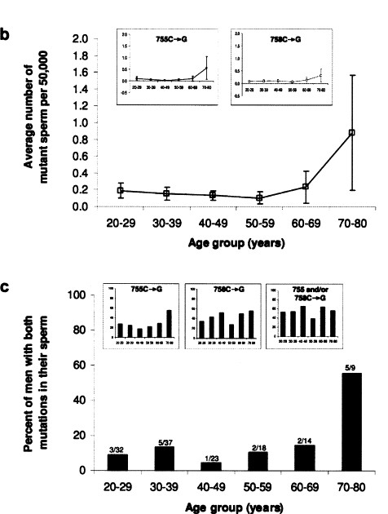

Slide 21
Notes:
Human male sperm…
https://www.polleverywhere.com/multiple_choice_polls/imrCsbHe6VJJYSY

Slide 22
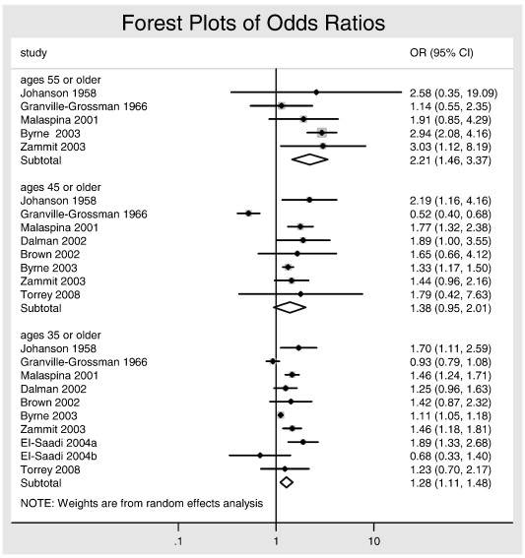
Autism
55yo
45yo
35yo
Effect size

Slide 23
Notes:
Autism and age of father
https://www.polleverywhere.com/multiple_choice_polls/Ql5NVtWYH0DcVfd

Slide 24
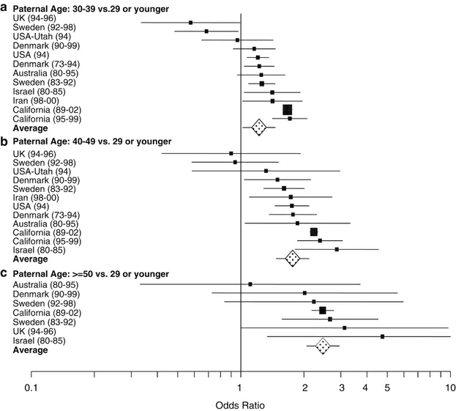
Schizophrenia
30-39yo
40-49yo
>50yo

Slide 25
Notes:
Schizophrenia and age of father
https://www.polleverywhere.com/multiple_choice_polls/GtoRDqE5qucbIsg

Slide 26
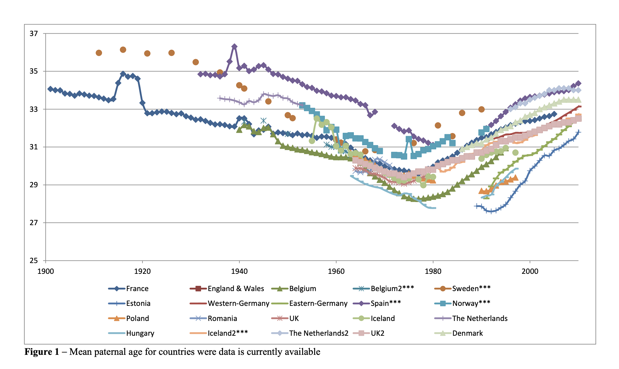
Fewer older fathers?
Notes:
https://cdn.uclouvain.be/public/Exports%20reddot/demo/documents/cq16_kai.pdf
The age of fathers in the USA is rising: an analysis of 168 867 480 births from 1972 to 2015
https://academic-oup-com.offcampus.lib.washington.edu/humrep/article/32/10/2110/4096427

Slide 27
Steve Jones, Professor of Genetics at University College, London
Are we stuck with non-progress or degenerative situation?
Modern children's chances of reaching the age of 25 have reached 98 per cent
Fewer older fathers
Human populations are now being constantly mixed because people are going to universities and colleges where they meet and marry people from other continents

Slide 28
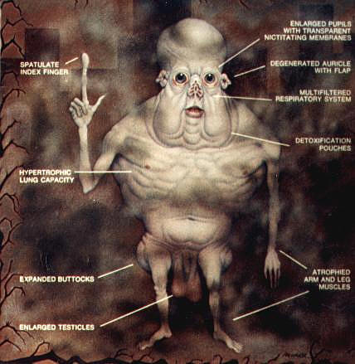
Are we stuck in a non-progress or degenerative situation?
The Ultimate Future of Human Evolution?
Modern children's chances of reaching the age of 25 have reached 98 per cent
Fewer older fathers
Human populations are now being constantly mixed because people are going to universities and colleges where they meet and marry people from other continents
Modern Western science protects people from the effects of evolution

Slide 29
Notes:
Has human evolution stopped or slowed?
https://www.polleverywhere.com/multiple_choice_polls/DeqQc0INwN3VsNU

Slide 30
Evolution includes natural selection, mutation, and random change
These processes have not stopped or disappeared, but they are leaving few visible traces on people in Western countries in the 21st century

Slide 31
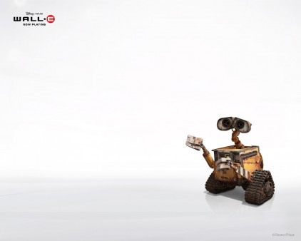
To conclude...
Archaeological themes in Wall-E include memory and non-progress
Evolution amongst humans may have slowed, but has not stopped

Slide 32
Final remarks

Slide 33
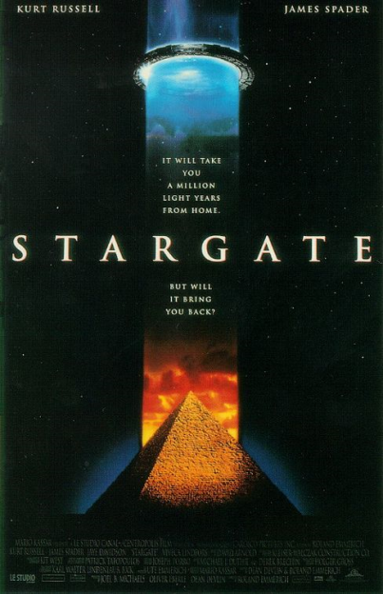
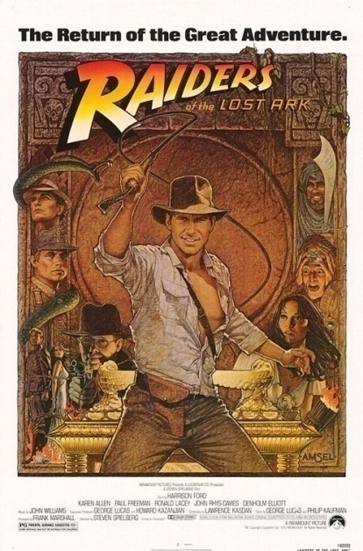
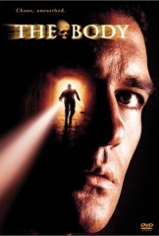
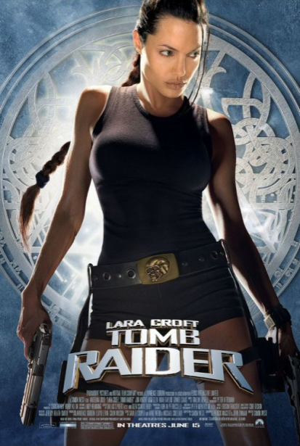
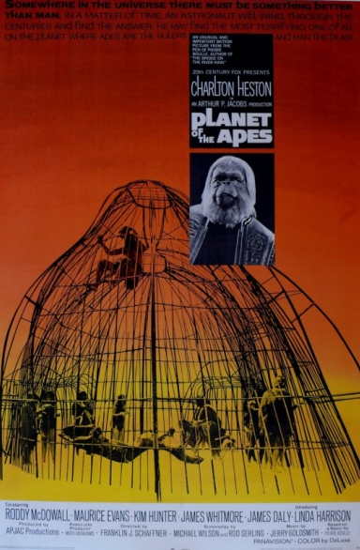
What do we know?

Slide 34
Moral lessons of archaeology in film

Slide 35
WALL-E
The technology and culture that we create shapes our future
Make technological and cultural choices that are good for humanity

Slide 36
The Body
Politics and religions manipulate archaeology to dangerous ends
Be critical of information used in political & religious contexts

Slide 37
Tomb Raider
Stigmatized knowledge can motivate harmful behaviour
Be mindful of what motivates your own behaviour; don’t act on false pretense

Slide 38
Indiana Jones
People fear the past because it can be disruptive to their idea of what is normal
Don’t fear the past. Accept that ‘normal’ is context-dependant

Slide 39
The Exorcist
Scientific fraud happens, but science still progresses
Be methodical about accepting, rejecting or suspending your judgment about important things in your life

Slide 40
Planet of the Apes
Science challenges popular views of our past
Choose science over supernatural beliefs when making important decisions in your life

Slide 41
One Million Years BC
Popular views of cultural difference are mostly wrong
Treat people equally, regardless of how different they are from you

Slide 42
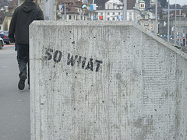

Slide 43
What you can now do:
1. Describe some of the diverse representations of archaeology and the human past in Hollywood films.
2. Analyse the functions of archaeological themes in Hollywood films. Identify how film‐makers use these themes in their films to communicate to the viewing public.
3. Interpret archaeological themes used in Hollywood films and their relationship to values and ideals held by the viewing public.

Slide 44
“the constant firing of our neurons in response to fictional stimuli strengthens and refines the neural pathways that lead to skillful navigation of life’s problems”
GOTTSCHALL, J. 2012. The Storytelling Animal: How Stories Make Us Human, New York, Houghton Mifflin Harcourt (HMH).

Slide 45
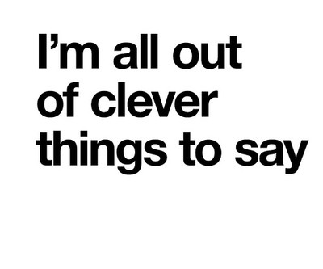

Slide 47
