Slide 1
PolS/LSJ 363 Law in Society M&W 10:00-11:30 Professor Michael McCann Gowen 47 mwmccann@uw.edu Office Hours: Tu 1-2, W 11:30-1 Teaching Assistants: Jennifer Driscoll Thomas Locke

Slide 2
We all need to help one another….
We hope that you are well and safe.
We realize that your situations are diverse and unequal.
The technical aspects of this course will be challenging, inconstant, unreliable, aggravating for many.
This is new for us, the instructors.
We will do our best to adapt and to be flexible, and we ask the same of you.
Communicate how we can help!

Slide 3
Course Materials & Requirements
Canvas website: https://canvas.uw.edu/courses/1370684
Readings – all texts on Canvas website syllabus
Lectures – Power Point format, numbered, daily
Zoom protocols – video/audio off; use chat button
Films (Central Park Five) streamed
Lecture and discussion format; quiz sections
Goal: deep & complex analysis, making the familiar seem strange; minimizing opinion trading
Mid-term and Final at-home, open book essays
Participation via weekly discussion papers

Slide 4
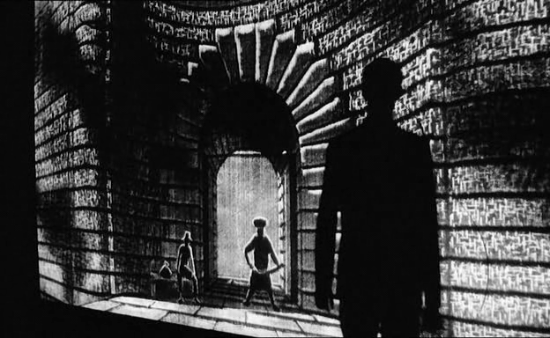
https://www.youtube.com/watch?v=pqPeI7-eVgc
Kafka, “Before the Law” (The Trial, 1925)
What is law?
Where/who is law?
How does law matter? What does law do?
For whom does law matter/work?
Before, With, & Against the law

Slide 5
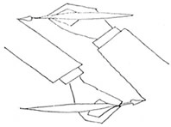
We are all subjects of (subjected to) law, but we are also agents who use law to advance our interests, if in unequal ways. Law and society are interrelated, or mutually constitutive; they shape each other.

