Slide 1
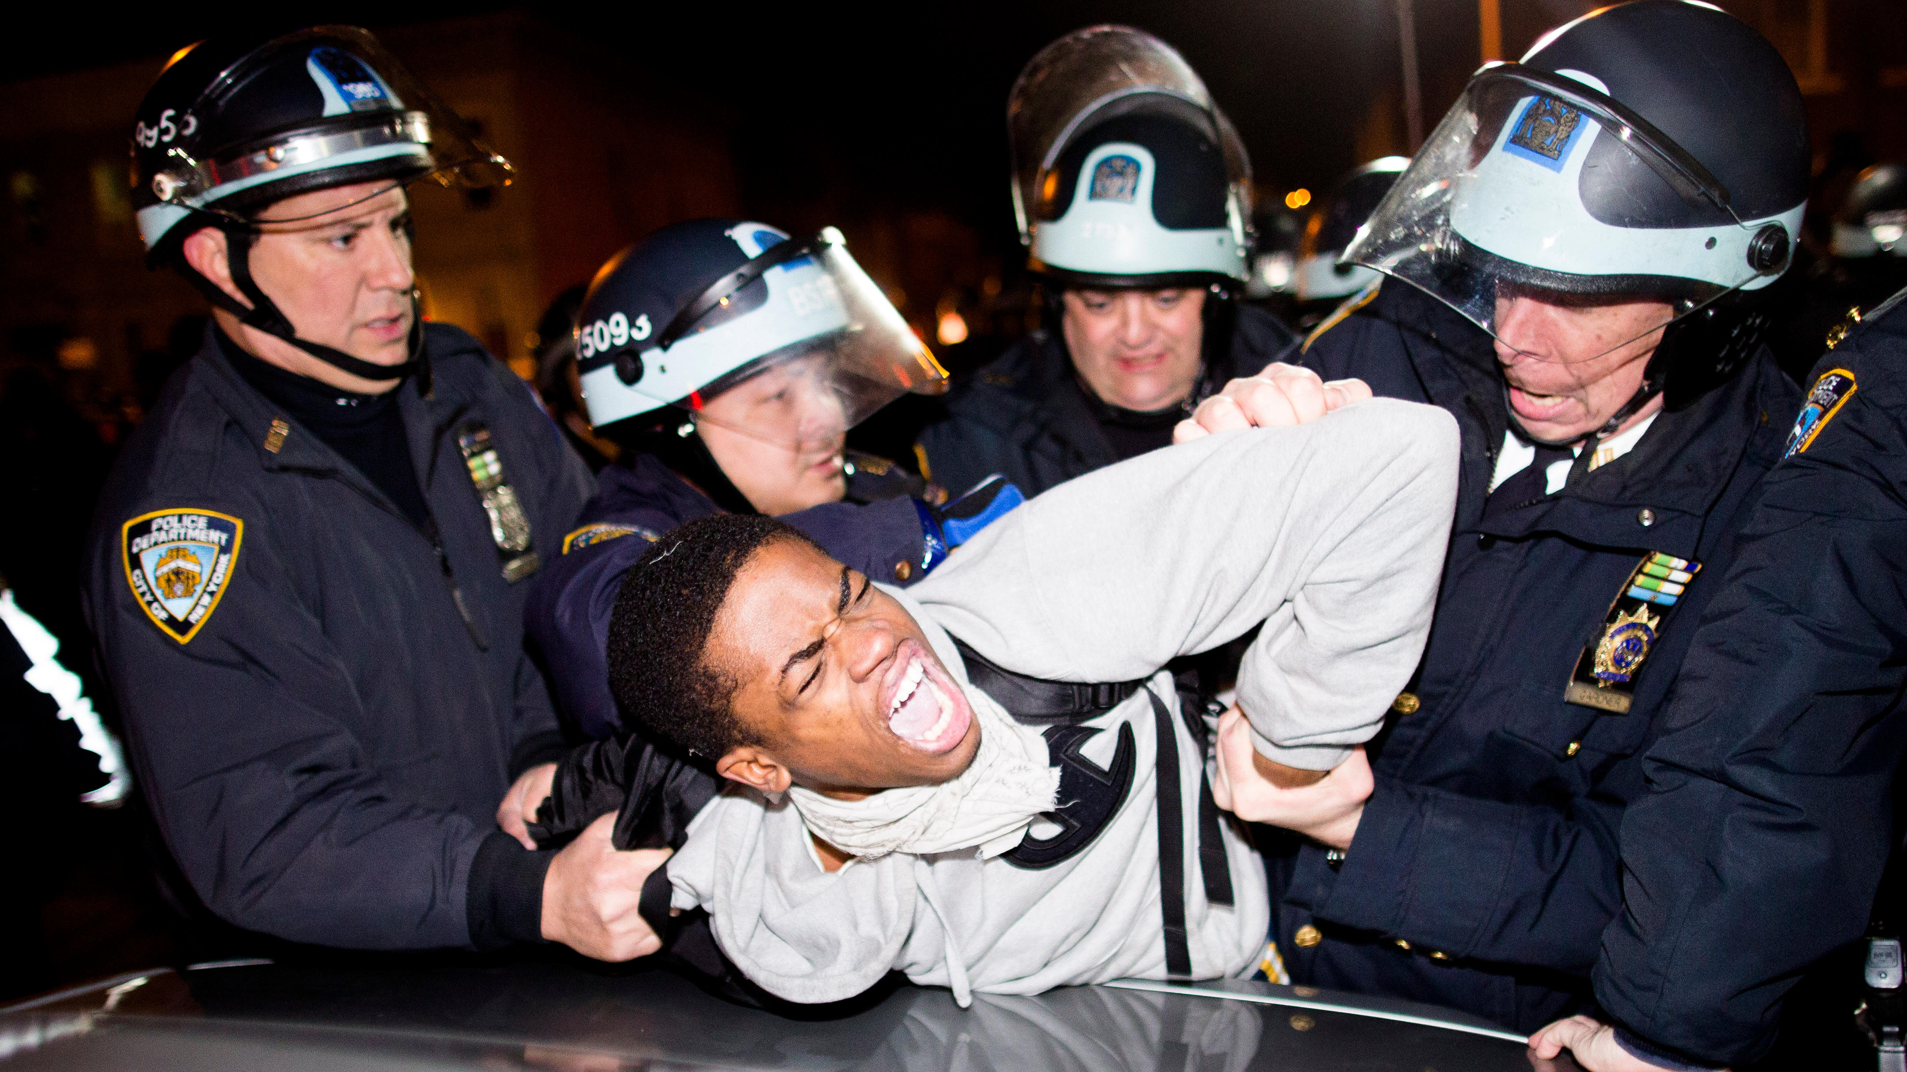
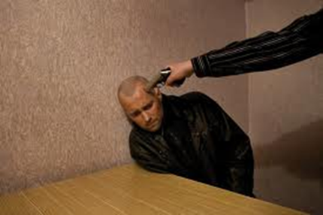
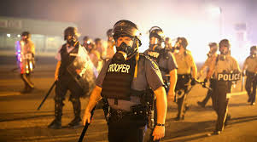
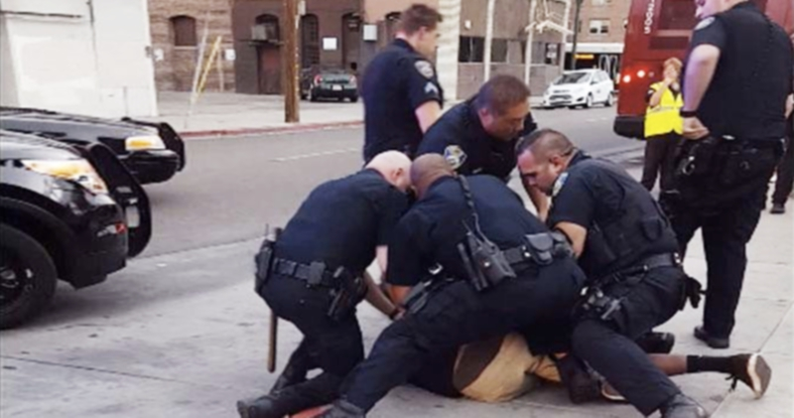
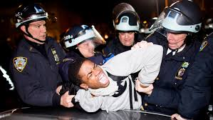
Law’s Violence: The Police
Cover: “Legal interpretation takes place on a field of pain and death…..”

Slide 2
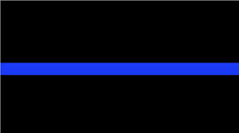
Law’s Violence: The Police
1.The Thin Blue Line –
The challenge for police……
Police must exercise some coercion/violence to enforce law
Police violence must be constrained. Least necessary to serve legitimate ends (economy of violence)?
Justifiable claim of defense of self/others? Context matters.
Due process exists to demand legitimate reasons?
Is law’s violence “better” than illegal violence in society?
If law’s words fail to limit violence → loss of trust, more violence, more failed words...less police power

Slide 3
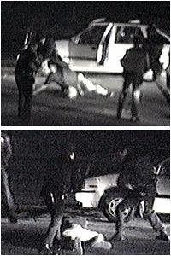
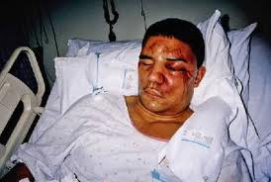
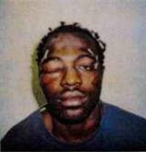
Law’s Violence: Police in the Street
2. Police Brutality
Rodney King
A. Above the law? (Excessive? Brutal?)
B. Context-specific factors…matter?
C) Paradox of Extortionate Transactions
(Muir)

Slide 4
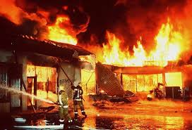
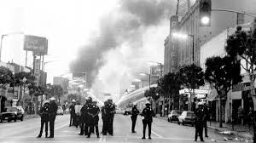
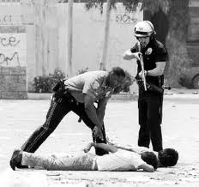
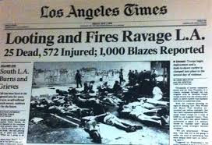
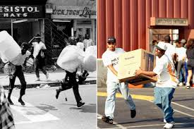
Law’s Violence: Police in the Street
D. Standards -- Defense of self/others?
Police effectiveness? Morality? Trust?

Slide 5
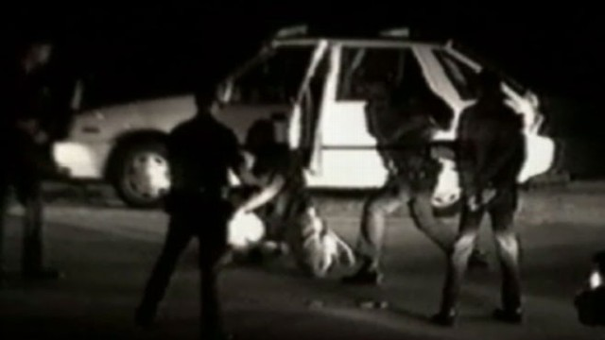
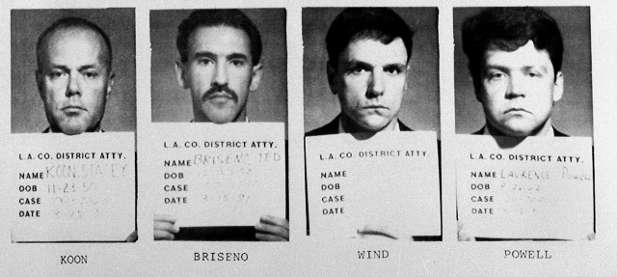
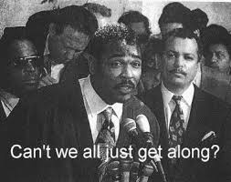
Law’s Violence: Police in the Street
F. Cycles of mistrust difficult
to break
Police abuse → lose trust,
legitimacy (power)

Slide 6
Law’s Violence: Police in the Street
3. Forms of routine police violence
A. Alabama car chase and beating
B. Albuquerque border incident
C. West Palm Beach video
D. Police yelling serious threats
E. Seattle jay walker
Excessive police force → lose power in community
Seattle Police – investigation, charges by DOJ, public

Slide 7
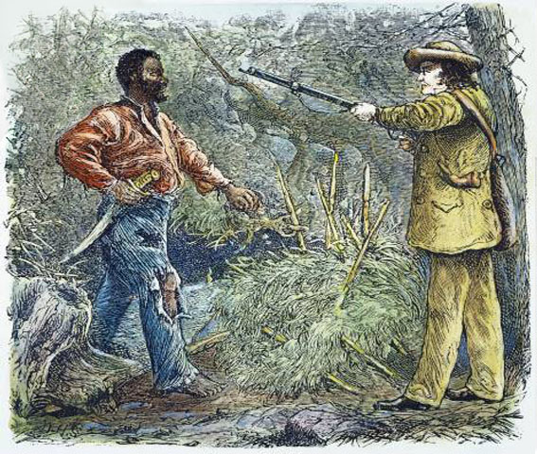
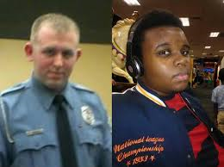
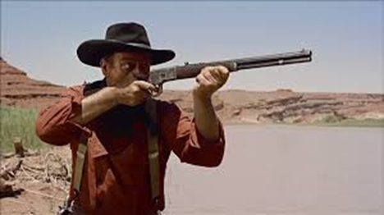
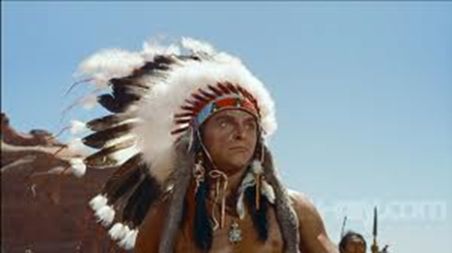
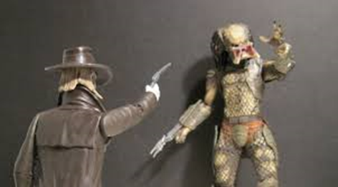
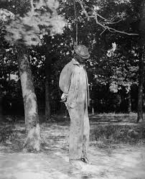
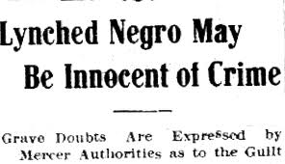
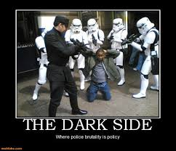
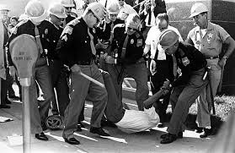
Law’s Violence: Racial Politics in the Street
4. History of racial vigilantism
Race is at center of concerns
about police violence today

Slide 8
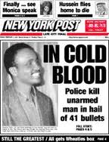
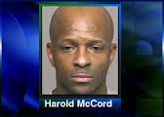
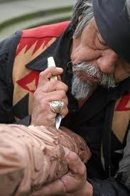
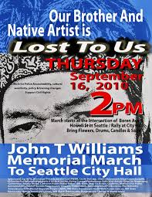
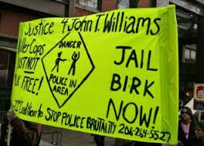
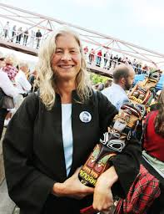
Law’s Violence: Police in the Street
5. How common (racial divide in opinion)?
Amadou Diallo (1999)
https://www.youtube.com/watch?v=aQMqWAiWPMs
Harold McCord (2004)
John T. Williams (2010)

Slide 9
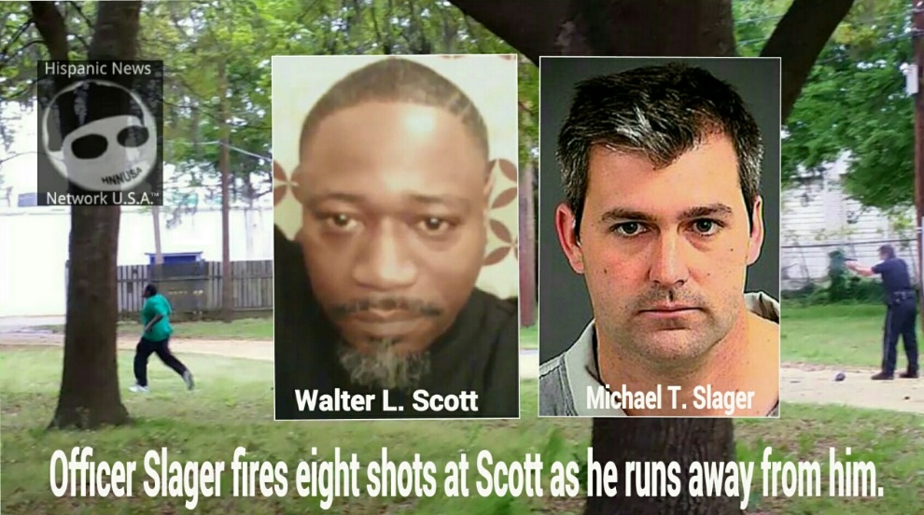
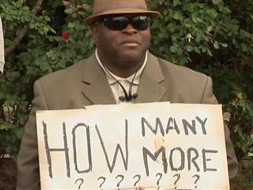
Law’s Violence: Police on Black Bodies
Recent Episodes:
Michael Brown (2014, Ferguson)
Ricardo Diaz-Zeferino
Eric Garner
Tamir Rice
Antonio Zambrano-Montes
Walter Scott, Freddie Gray, Sandra Bland,
Samuel Dubose, Laquan McDonald,
Alton Sterling, Philando Castile, Paul O’Neal
Signs and Symbols of Distrust

Slide 10
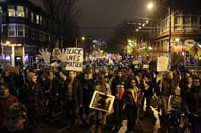
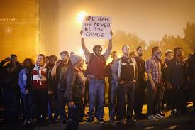
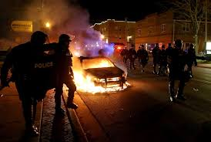
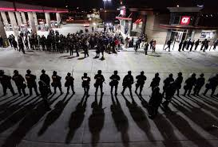
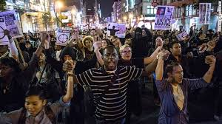
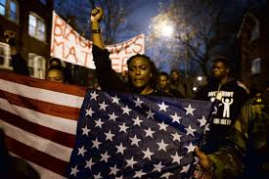
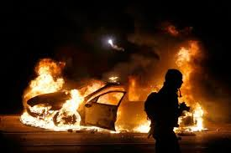
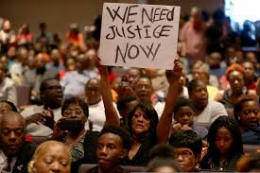
Law’s Violence: Police on Black Bodies
Signs and Symbols of Distrust

Slide 11
Law’s Violence: Police in the Street
GENERAL PRINCIPLES OF LEGAL POLICING
Law requires the exercise of violence,
but excessive violence makes law illegal and ineffective.
Violence can be justified (legitimated) by persuasive legal accounting of danger to self & others, but violence also undermines the capacity for words to have meaning. (Cover)
Policing requires trust of the community, produced by the subordination of force to words – justice rules violence.
HENCE…Good law enforcement requires judgment, justification, economy of violence -- as does the reasoning of a good judge. A demanding ideal to build power of trust.
Cops must be “streetcorner politicians” (Muir) Paradoxes….

Slide 12
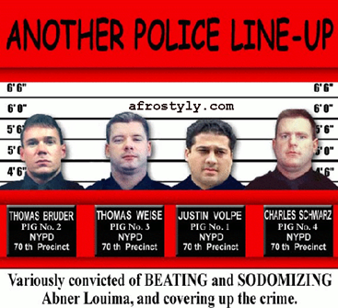
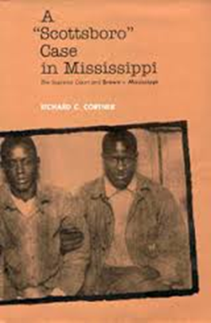
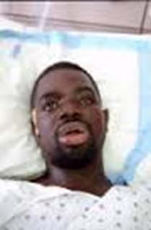
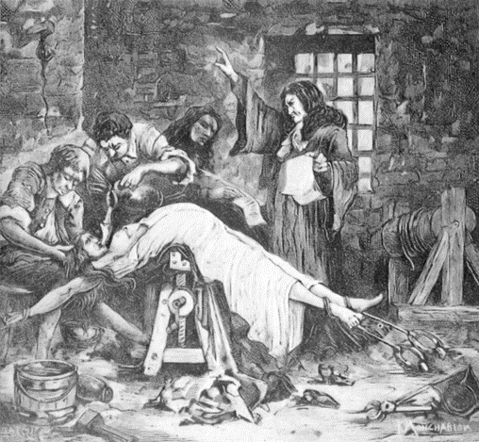
Law’s Violence: Police in the Station
6. Police Interrogation (in station)
A. Less visible > potential for abuse
Brown v. Mississippi (1936)
Central Park Five (1989)
Abner Louima (NY 1999)
B. Accusatorial logic of process

Slide 13
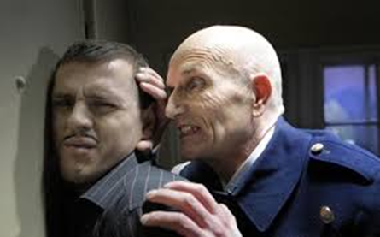
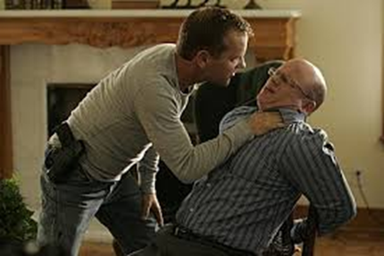
Law’s Violence: Police in the Station
C. Problem w/ confessions?
How voluntary? Whom to believe?
Physical vs. Psychological coercion
Central Park Five: manipulated teens

