Slide 1
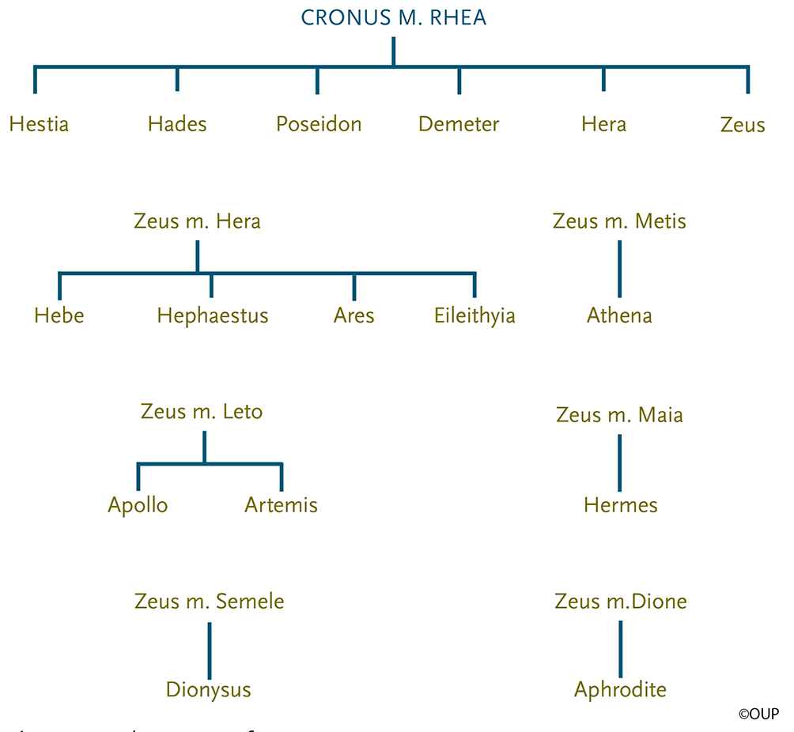
Figure 5.1
The 12 Olympians:
Zeus
Hera
Poseidon
Demeter
Hephaestus
Ares
Athena
Apollo
Artemis
Hermes
Dionysus
Aphrodite
The Lineage of Major Deities

Slide 2
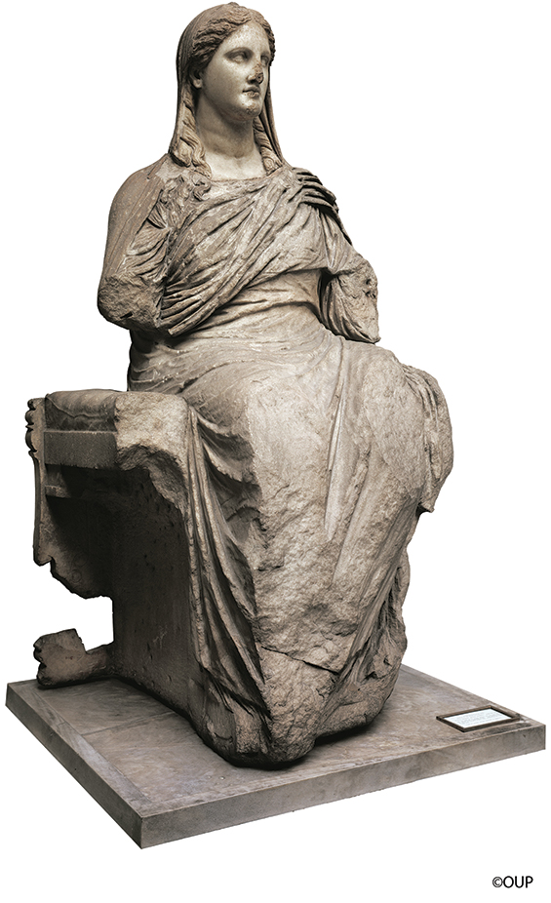
Important terms and characters in Chap. 14 (Demeter etc.)
Mother-goddess (or 'great mother), archetype
(see MLS pp. 9-10 and 62-64 for definitions and discussion; see also pp. 77-78)
Homeric Hymn to Demeter #2 (MLS pp. 334-45)
Demeter
Persephone (daughter of Zeus and Demeter)
Hades
Eleusis
Eleusinian Mysteries (MLS pp. 345-52)
note esp. Mylonas on p. 351
Celeus
Metaneira
Demophoön
Demeter
Marble, second half of the fourth century B.C.; height 58 in. (© The Trustees of the British Museum)

Slide 3
Mother-goddess (or 'great mother), archetype
(see MLS pp. 9-10 and 62-64 for definitions and discussion; see also pp. 77-78)
Homeric Hymn to Demeter #2 (MLS pp. 334-45)
Demeter
Persephone (daughter of Zeus and Demeter)
Hades
Eleusis
Eleusinian Mysteries (MLS pp. 345-52)
note esp. Mylonas on p. 351
Celeus
Metaneira
Demophoön
Attica, with Eleusis and Athens

Slide 4
Homeric Hymn to Demeter 2.105-122 = MLS p. 336, lines 82-95
τὴν δὲ ἴδον Κελεοῖο Ἐλευσινίδαο θύγατρες (105) ἐρχόμεναι μεθ’ ὕδωρ εὐήρυτον ὄφρα φέροιεν κάλπισι χαλκείῃσι φίλα πρὸς δώματα πατρός,
τέσσαρες ὥς τε θεαὶ κουρήϊον ἄνθος ἔχουσαι, Καλλιδίκη καὶ Κλεισιδίκη Δημώ τ’ ἐρόεσσα Καλλιθόη θ’, ἣ τῶν προγενεστάτη ἦεν ἁπασῶν· (110) οὐδ’ ἔγνων· χαλεποὶ δὲ θεοὶ θνητοῖσιν ὁρᾶσθαι. ἀγχοῦ δ’ ἱστάμεναι ἔπεα πτερόεντα προσηύδων· Τίς πόθεν ἐσσὶ γρηὺ παλαιγενέων ἀνθρώπων; τίπτε δὲ νόσφι πόληος ἀπέστιχες οὐδὲ δόμοισι πιλνᾷς; ἔνθα γυναῖκες ἀνὰ μέγαρα σκιόεντα (115) τηλίκαι ὡς σύ περ ὧδε καὶ ὁπλότεραι γεγάασιν, αἵ κέ σε φίλωνται ἠμὲν ἔπει ἠδὲ καὶ ἔργῳ. Ὣς ἔφαθ’, ἡ δ’ ἐπέεσσιν ἀμείβετο πότνα θεάων· τέκνα φίλ’ αἵ τινές ἐστε γυναικῶν θηλυτεράων χαίρετ’, ἐγὼ δ’ ὑμῖν μυθήσομαι· οὔ τοι ἀεικὲς (120) ὑμῖν εἰρομένῃσιν ἀληθέα μυθήσασθαι. † Δὼς ἐμοί γ’ ὄνομ’ ἐστί· τὸ γὰρ θέτο πότνια μήτηρ·
The daughters of Celeus, of the family of Eleusis,
saw her there as they came after the easily drawn water
so they might bring it in their bronze pitchers to the dear home of
their father.
There were four of them, just like goddesses in their youthful bloom,
Callidice and Cleisidice and lovely Demo and
Callithoë, who was the oldest of them all.
They did not know Demeter, for it is difficult for mortals
to recognize the gods;
and standing near they spoke winged words:
“Who are you, old woman, of those born long ago?
Where are you from? Why have you come away from the city and
not approached the houses there, in whose shadowy halls dwell
women just like you and younger,
who would welcome you in word as well as in deed?”
Thus they spoke. And she, the queenly goddess, answered
with these words:
“Dear children, whoever you are of women, I bid you greeting, and I
shall tell you who have asked.
My name is Doso, for my lady mother gave it to me….”

