Slide 1
Trojan Sagas and Trojan War
On the archaeology of Troy and the historicity of the Trojan War, see MLS pp. 46-55

Slide 2
Homer (see MLS p. 54)
oral poet who lived in 8th century BC (toward end of Dark Ages)
Composed:
Iliad: 24 Books, ca. 16,000 lines, tells story of the Trojan War (ends with destruction of Troy (=Ilios), dated to ca. 1184 BC)
Odyssey: 24 Books, ca. 12,000 lines, tells story of Odysseus (=Ulysses), a Greek warrior from the island of Ithaca and his journey home following the conclusion of the Trojan Awr
Bust of Homer

Slide 3
Figure 18.1
The House of Atreus

Slide 4
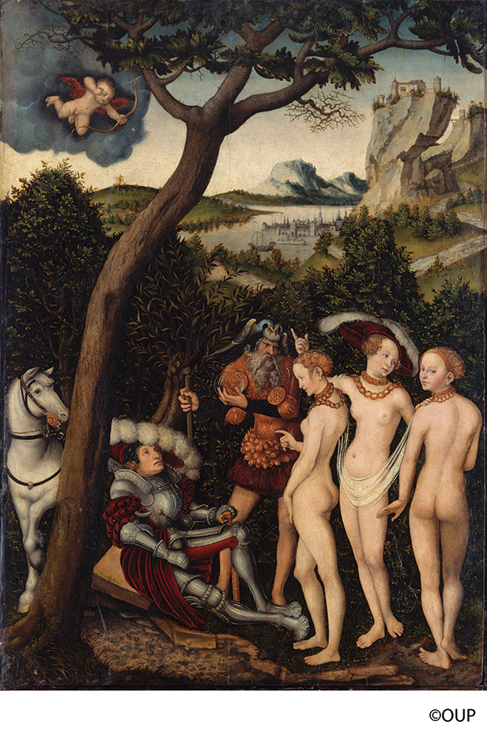
Stage 1 of Trojan War: Key events prior to the war
Helen, ‘the most beautiful woman in the world,’ chooses Menelaus for her husband (MLS pp. 468-9)
The Judgment of Paris (pp. 469-73)
At wedding feast of Peleus and Thetis Eris (Discord) throws apple: “For the most beautiful”
Hera, Athena, and Aphrodite claim it; Paris called on to judge
Paris chooses Aphrodite (and thus Helen)
Achilles, son of Peleus and sea nymph Thetis (MLS pp. 481-83; see also pp. 165-66; painting p. 121)
Gathering at Aulis and Agamemnon’s sacrifice of his daughter, Iphigenia (MLS p. 483-85)
Philoctetes (MLS p. 485)
Bitten by snake and abandoned on Lemnos, alone for 10 years
Prophecy of Heracles’ bow and arrows
The Judgement of Paris
Lucas Cranach the Elder (1472–1553)

Slide 5
Trojan Sagas and Trojan War
On the archaeology of Troy and the historicity of the Trojan War, see MLS pp. 46-55

Slide 6
Stage 2 of Trojan War: The war itself (MLS pp. 485-509)
Chryseis, daughter of Chryses, a priest of Apollo
Briseis
Trojans Greeks (Achaeans)
Priam Agamemnon
Hecuba Menelaus
Paris Diomedes
Cassandra Odysseus
Hector Ajax, son of Telamon
Nestor
Patroclus
Achilles (‘best of the Achaeans,’ ‘godlike’)

Slide 7
Figure 19.1
The Royal House of Troy

Slide 8
Stage 2 of Trojan War: The war itself (MLS pp. 485-509)
Chryseis, daughter of Chryses, a priest of Apollo
Briseis
Trojans Greeks (Achaeans)
Priam Agamemnon
Hecuba Menelaus
Paris Diomedes
Cassandra Odysseus
Hector Ajax, son of Telamon
Nestor
Patroclus
Achilles (‘best of the Achaeans,’ ‘godlike’)*
*NB: ways in which Achilles fulfills the motifs of the ‘hero’ (MLS p. 403); also note the ‘thematic code of heroic arete (excellence)’=‘warrior code’
‘Achilles and Ajax playing ‘dice’’
Attic amphora signed by Exekias, ca. 535 B.C.

Slide 9
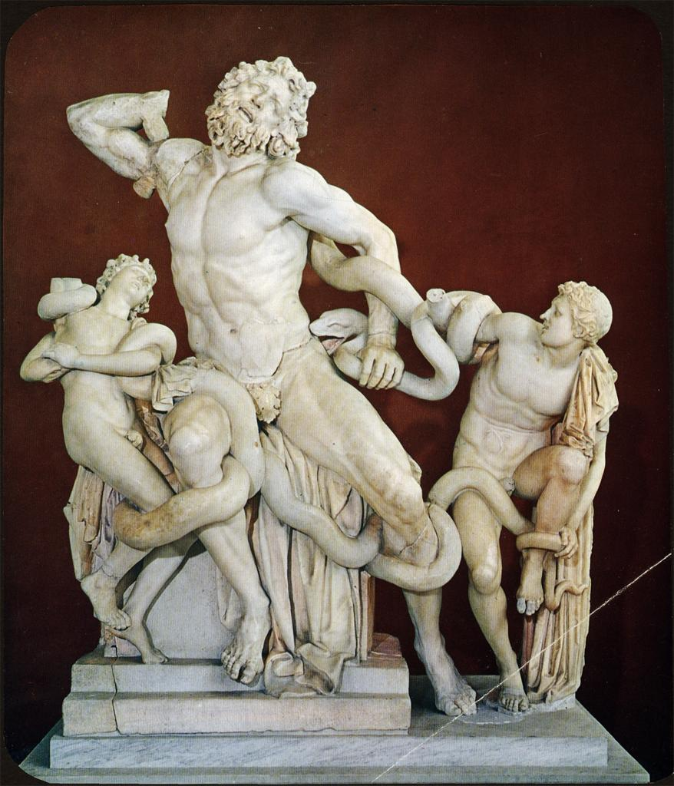
Laocoon (3rd cent. BC?
The Trojan Horse
Despèches, from drawing by Luca Penni (16th cent.)

