Slide 1
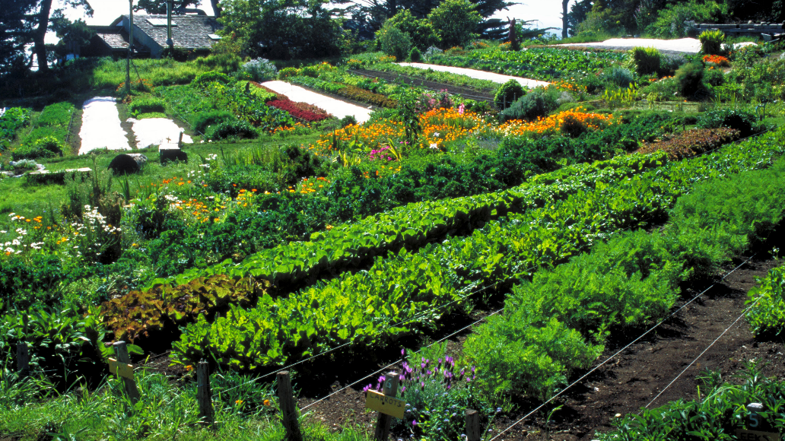
About 60 percent of farm land is still tended by traditional or indigenous farmers. They have fed family & local communities for thousands of years. 2015, there were an estimated 570 million such farmers; in contrast, there are about a million farmers using conventional & biotechnology systems.
Altieri on traditional agriculture
Notes:
Photo: Polyculture urban farm in Seattle area.
Source of notes: Miguel Altieri, Agroecology: The science of sustainable agriculture (1995).

Slide 2
Altieri: Five reasons to prefer smaller place-based agroecosystems
Small farms are the key to the world’s food security
Small farms are more productive and resource-conserving than large-scale monocultures
Small traditional and biodiverse farms represent models of sustainability
Small farms represent a sanctuary of GMO-free agrobiodiversity
Small farms cool the climate

Slide 3
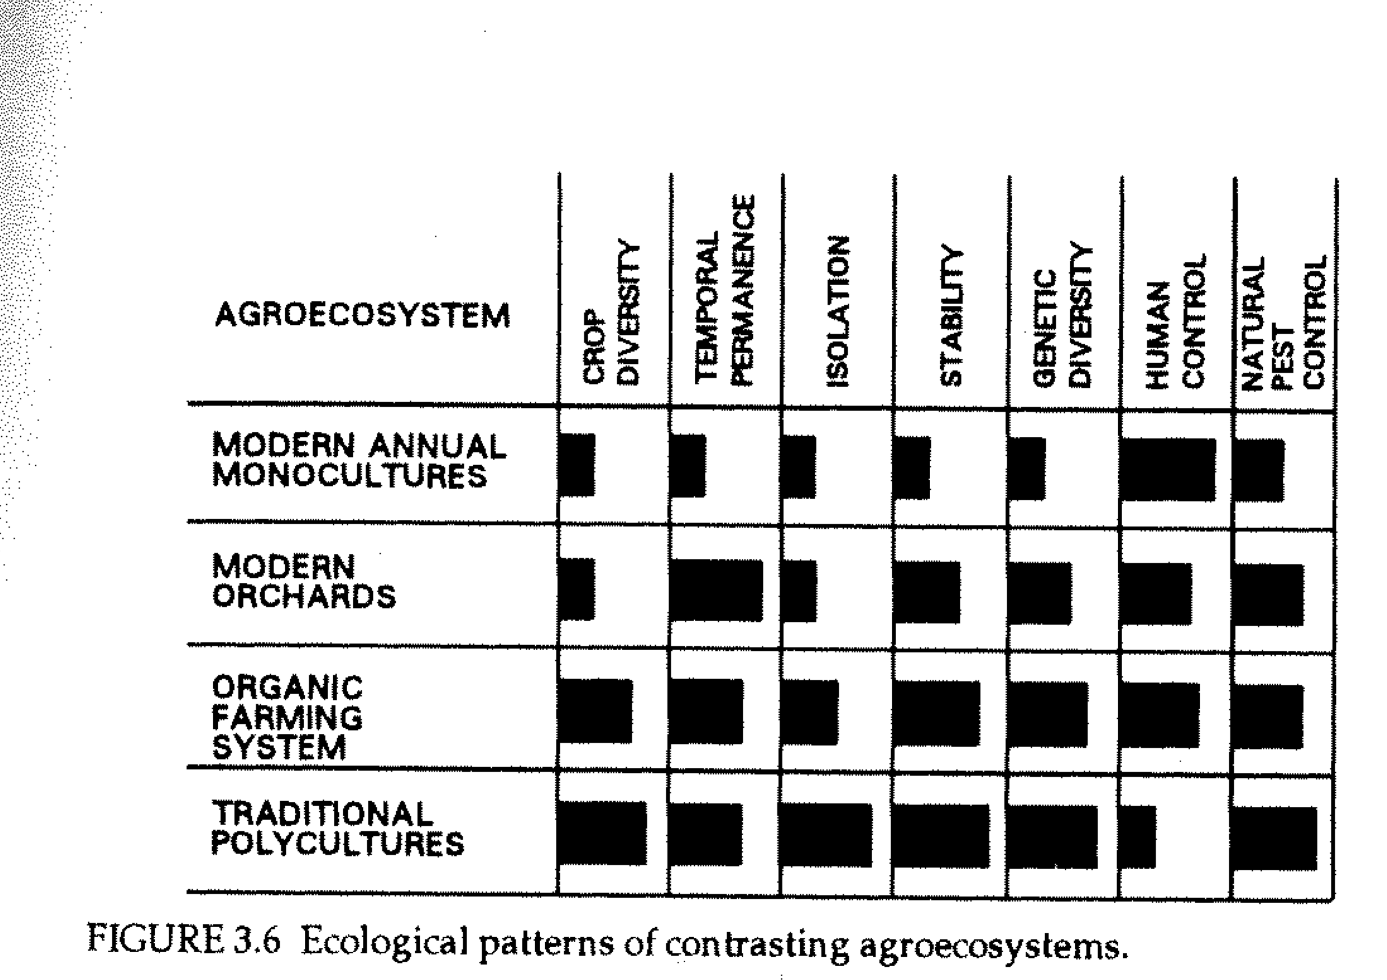
Agroecosystems
7 qualities for comparative research (Altieri 1998)

Slide 4
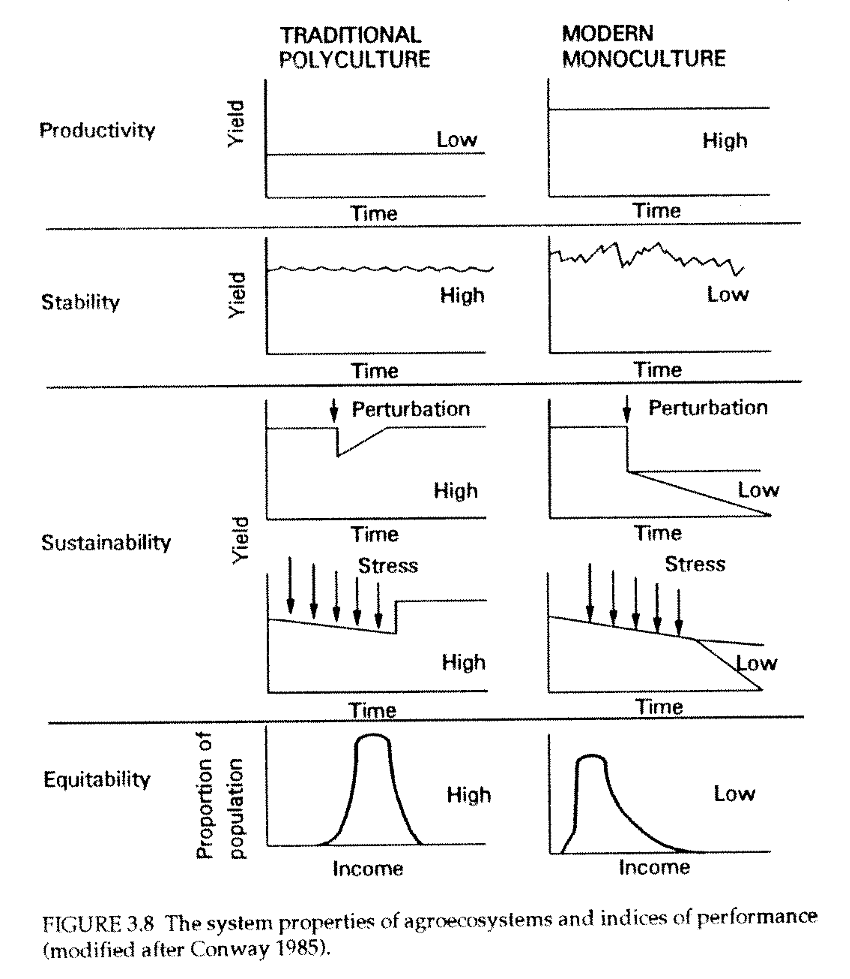
Comparative productivity of agroecosystems

Slide 5
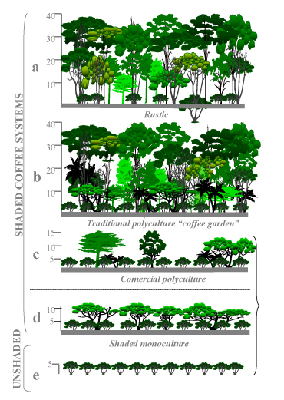
Agrobiomimicry
Is it necessary to clear the forest to plant the crop?
In traditional farming systems, most of the natural landscape ecology is kept and not razed for the monocrops.
Polycultures mimic the species and structural and temporal diversity of the local ecosystem.

Slide 6
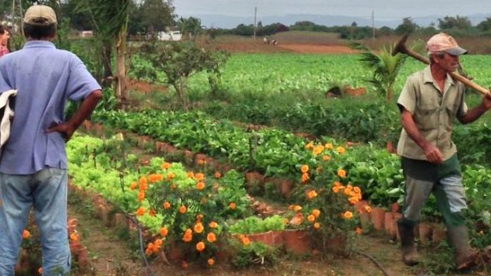
Characteristics of traditional agroecosystems
The long view. Most traditional farmers “have employed practices designed to optimize productivity in the long term rather than maximize it in the short term.” (108)
Local inputs. The inputs (fertilizer, natural controls, etc.) originate in the immediate region; work is performed by people or animals sustained by local food sources.
Innovation. Most traditional farmers are more innovative than recognized and constantly experiment with crop varieties, soil regeneration practices (biodynamics), and are willing to adopt new technology when it fits into local practices.
Notes:
Cuba. Permaculture garden. SOURCE: Food First. https://foodfirst.org/what-cuba-can-teach-us-about-food-and-climate-change/.

Slide 7
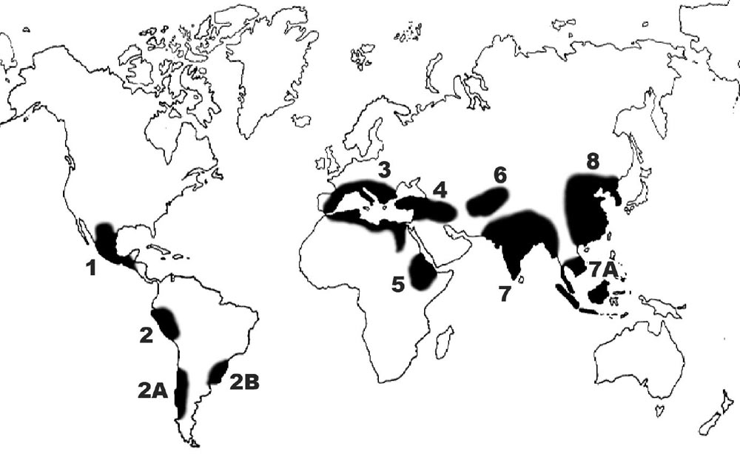
Centers of origin and diversification
The concept of ‘center of origin’ was first developed by the Russian scientist Nicolai Vavilov who identified several distinct biogeographical regions across the globe that are home to the wild ancestors of crops domesticated and diversified by indigenous farmers over millennia.

Slide 8
Sample List of Crops from the Principal Centers of Origin
Near East (Fertile Crescent): Wheat and barley, flax, lentils, chickpea, figs, dates, grapes, olives, lettuce, onions, cabbage, carrots, cucumbers, and melons; fruits and nuts.
Africa: Pearl millet, Guinea millet, African rice, sorghum, cowpea, Bambara groundnut, yam, oil palm, watermelon, okra.
China: Japanese millet, rice, buckwheat, and soybean.
South East Asia: Wet- and dryland rice, pigeon pea, mung bean, citrus fruits, coconut, taro, yams, banana, breadfruit, coconut, sugarcane.
Mesoamerica/North America: Maize, squash, common bean, lima bean, peppers, amaranth, sweet potato, sunflower; cacao, tomato.
South America (Andes region): lowlands: cassava; mid-altitudes and uplands (Peru, Chile, Ecuador): potato, peanut, cotton, maize.

Slide 9
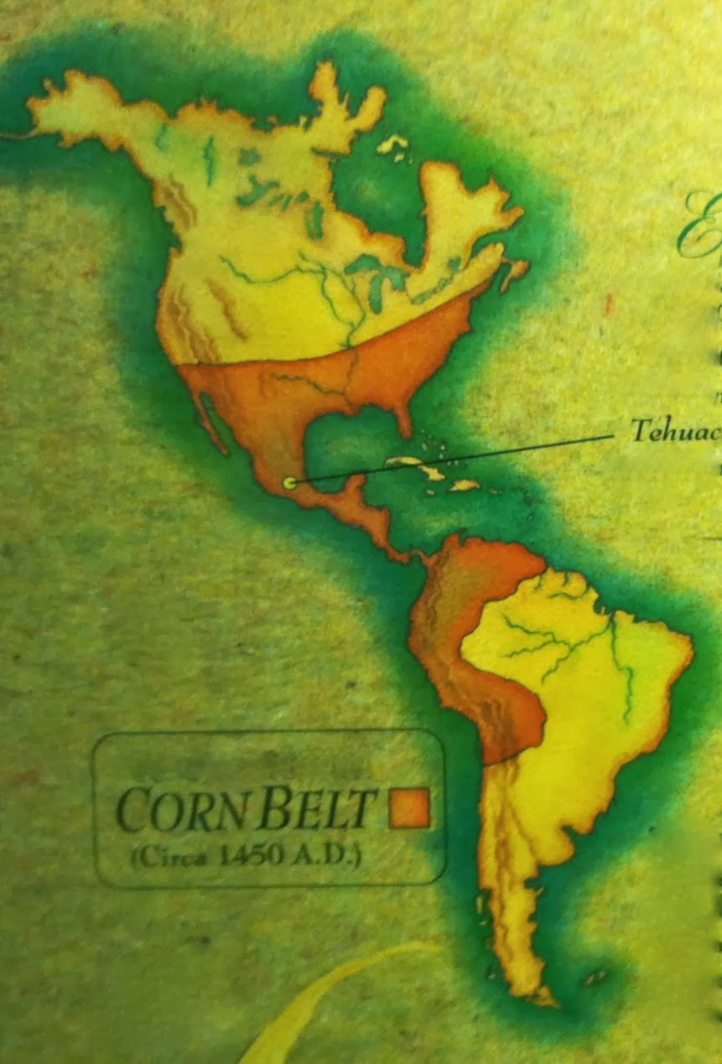
Mapping maize (Zea mays)
The “Corn Belt” or
”Corn Corridor”

Slide 10
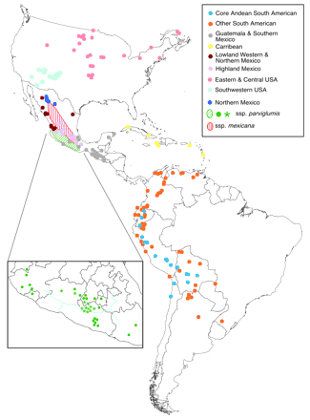
Refining the map
The current state of genomic mapping of the centers of origin and diversification
of teocintle and maize (Matsuoka et al 2002)

Slide 11
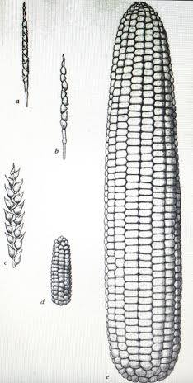
Center of origin crops are landraces
Nobel laureate, George Beadle uses this diagram in his “Ancestry of Corn” study (1980). It shows the wild ancestor teocintle labeled here as a and b. The tunicate florescence (intermediate form) as c. Ancestral native corn as d; and ‘modern’ corn as e, this latter presumably a Green Revolution hybrid as ideal type.
Landrace. A native crop developed in its center of origin and it is cultivated in areas with populations of wild ancestors and intermediate forms.

Slide 12
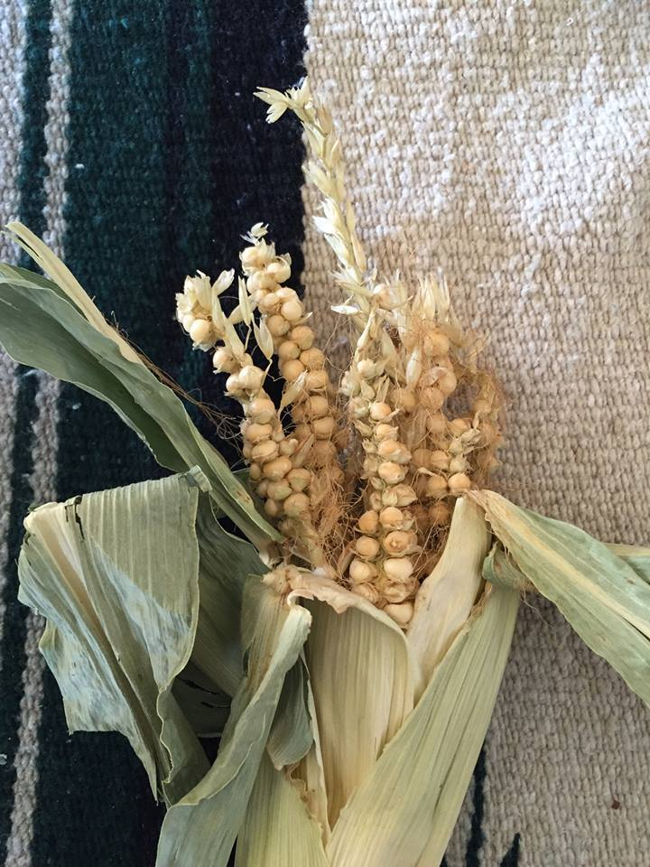
Landraces
Tunicate florescence from the 2010 harvest of maíz de concho from Corpus A. Gallegos (1998 accession). Grown at Almunyah Dos Acequias, San Pablo, CO. This occurs randomly for in-bred parent lines of landrace heirloom seed stock when native corn reverts back to wild ancestral forms. This does not happen in hybrid varieties or GMO ‘events’.
Significance: The close relationships between domesticated, intermediate and wild ancestors is important because these are veritable storehouses of thousands of years of genetic information about adaptation to place-based conditions and continued gene flow.

Slide 13
Ecological features of traditional agriculture
Spatial and temporal diversity and continuity. Last a long time; spatially diversity due to agrobiomimicry.
Water conservation. Majority of cases, rain-fed systems. Crops determined in part by water availability. Where irrigation is used, these systems tend to manage water allocation and use rights as a common property right (e.g., acequias, zanjas, subaks, etc.).
Optimal use of space and resources. Assemblages of plants with different growth habits, canopies, and root structures allow for better use of environmental inputs (nutrients, water, climate). Agroforestry is one example.
Recycling of nutrients. Closed-cycles of inputs to sustain and enrich soils. Polycultures. Intercropping (companion plants and soil biodynamics).
Control of succession and protection of crops. Natural controls are the key and these include species and structural diversity. Many of these controls include practices that enhance soil fertility; this involves companion planting, mulch, hugelkultur or rotten wood mounds, etc.

Slide 14
Advantages of traditional agriculture
Polyculture yields tend to be higher (relative to inputs) compared to single-crop systems. (Altieri, Agroecology, 112-15)
Efficient use of resources. Soil; water; labor; even sunlight as a resource is managed through use of shade-tolerant crops underneath existing canopies.
Nitrogen availability. Cereal/legume mixtures (e.g., bean fixes nitrogen for the maize). This includes the intercropping of annual and perennial crops.
Reduction of diseases and pests. Cost-free effective measures to control pathogens and pests centered on (1) species and structural diversity and includes (2) diversity of beneficial insects (and microorganisms) attracted to specific companion plants to control the pathogens and pest insects.

Slide 15
Advantages of traditional agriculture
Weed suppression. The canopy, diversity of cultivars and companion plants, and use of adaptive plants (like maize and beans) interrupt the flow of light quicker than unwanted plants. This works to suppress weeds.
Insurance against crop failures. Polycultures provide a hedge against catastrophic loss tendencies that affect monocrops. Loss of a crop means the other crops compensate for that loss.
Other advantages. Soil enrichment; avert loss of soil moisture; enhanced opportunities for marketing. Mixed crops allow for shared (cooperative) labor costs.

Slide 16
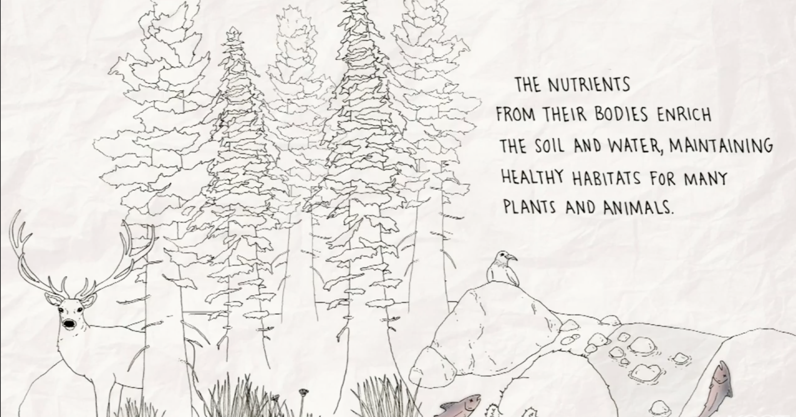
TEK in Traditional Agriculture
Altieri shows how TEK (traditional ecological knowledge) operates in the context of traditional agriculture. Three dimensions:
Physical environment. Soil, water, climate, etc.
Biological folk taxonomies for classification systems.
Experimental nature of TEK.

Slide 17
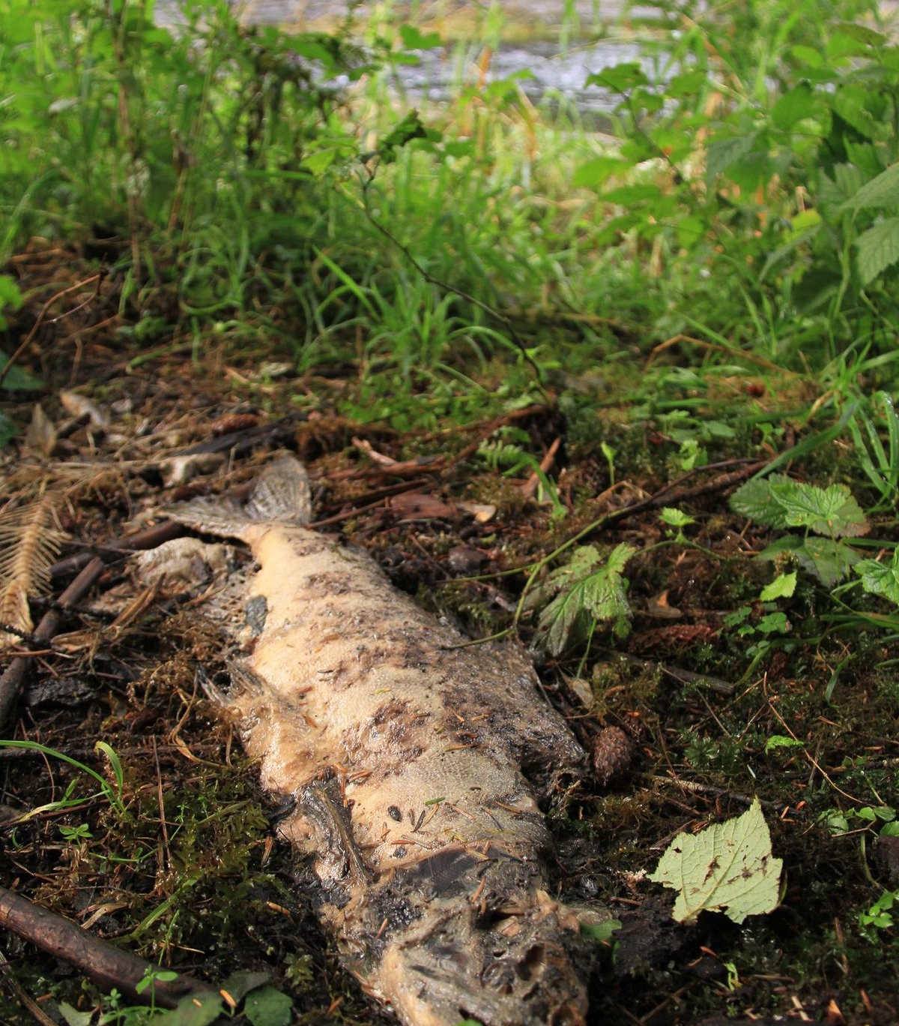
TEK in Traditional Agroecosystems
Salmon feed the land.
It is the nature of TEK to understand and respect these interconnections.

Slide 18
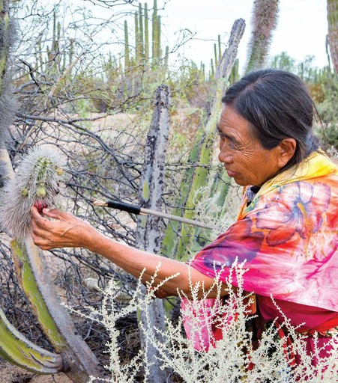
Physical environment
Today this includes climate change adaptations. Here, a Seri woman in Baja California examines a native cactus with a changing growth cycle to better understand how to sustain its habits and habitat. She is involved in a long-term experiment to observe and adapt to these changes.

Slide 19
TEK in traditional agriculture
Soil classification. Ethnoedaphology is the knowledge of ecological processes in soil. Ethnopedology is the knowledge of/and classification of soils as they are.
Biological folk taxonomies. Follows Berlin is laying out the methods involved in the classification of biological organisms including cultivars, companion plants and wild animals. This allows for discerning which organisms are beneficial or harmful yet many “pests” are considered food sources themselves.
Experimental nature of TEK. Based on acute yet long-term (multigenerational) observations and experimental learning; also experiential: “knowing how” rather than “learning that”.

Slide 20
Nahautl words that illustrate soil TEK
Atocpan tierra gruesa y fertil (Molina 1571)
Atoctlalli alluvial soil, moist, fertile land; translated as “suerte de tierra”
Cuenchihu to work the soil; to work the land (Molina 1571)
Elemiqui to cultivate the soil (Simeon 1996)
Ixmolonia to loosen the soil (Molina 1571)
Mo:le:hua to break up soil (Kartunnen 1992)
Tezoquitli parcel of land heavy in minerals, rocky soil (Tamasolco 1593)
Tlalli the earth, land, soil
Tlalmoyahua to loosen the soil (Molina 1571)
Tlamomolonia to work land, to aerate the soil (Karttunen 1992)
Teocuemitl sacred land under cultivation (Tezozomoc 2017)
Teotlalyollotli the sacred heart of the soil (Tezozomoc 2017)

Slide 21
Traditional agriculture and biocultural diversity
The in situ/in vivo versus ex situ debate. One of the most contentious debates today is over the conservation of crop genetic resources.
Which is best suited strategy? In situ (in place of origin) and in vivo (living adaptations) or ex situ (centralized out of place; like the ‘seed morgue’ known as Norway Svalbard Global Seed Vault.
Ex situ involves separation from ongoing living co-evolution of cultivars in relation to wild ancestors and intermediate forms. In situ/vivo is based on this very principle.
Ex situ is mostly useful to corporations or agencies with the capacity to make use of the genomic maps associated with each accession. It is not like the farmer can request seeds to actually plant in the ground. This is seen by many as a potential source of biopiracy by the ‘Gene Giants.’
In situ/vivo involves recognition of how this is about biocultural diversity. Conservation of crop genetic resources is ultimately grounded in protection of the 10,000 years of co-evolution of people and plants, a process that is still unfolding in centers of origin/diversification because of changes associated with climate chaos.

Slide 22
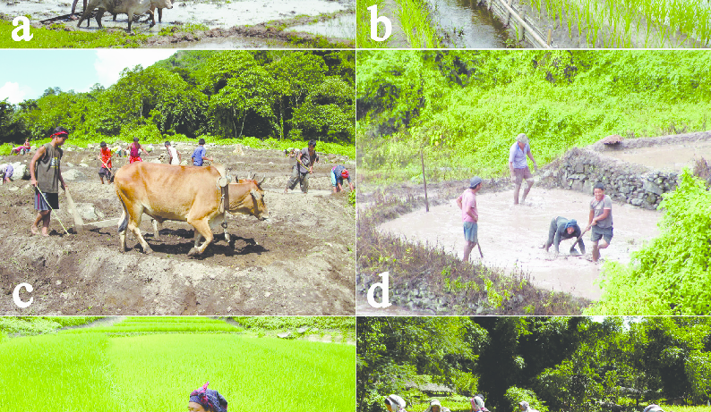
Examples of traditional agroecosystems
Altieri provides numerous examples of traditional agroecosystems including some we have already been studying. These include:
Paddy rice culture (SE Asia).
Javanese long duration rotation islands (Talun-kebun) and home kitchen gardens (Pekarangan)
Mexican polyculture milpa. Mexican corn-bean-squash plus garden in agroforestry long duration rotation island mosaics.
Shifting cultivation of various types.
Frijol tapado, a slash-mulch system (Central America).

Slide 23
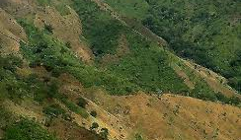
Frijol Tapado
Frijol tapado is a slash-mulch system from steep mid-elevation lands in Central America with high amounts of rain. These are “marginal” lands undesired by larger-scale producers.
Note: many of these small holder farmers were displaced from lower elevation lands, a point overlooked by Altieri who tends to ignore the historical and political ecological context.

Slide 24
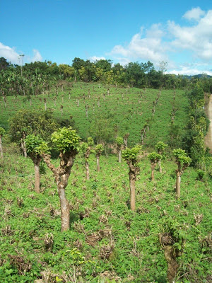
Frijol Tapado
Advantages of frijol tapado system:
Slash/mulch can add large amounts of organic matter to the soil; beans fix nitrogen; higher yields.
Reduces labor in weeding.
Crop residue and drought resistant varieties become healthy fodder for livestock during dry season.
Some jack bean leaves eliminate lead cutter ant colonies. Allelopathic effects.

Slide 25
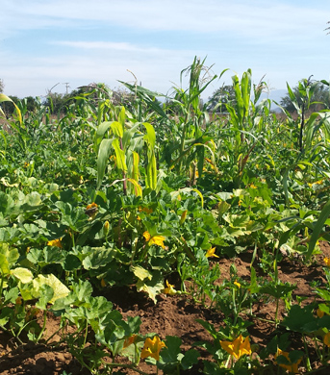
Critique
Beyond nitrogen? While is its widely recognized how legumes work as nitrogen fixers (e.g., bean for corn), there are 1000s of other companion plants that provide macro- and micro-nutrients to the soil in a form available for absorption into the plant biomass. This affects the nutrient density of the landrace crops.
Weed suppression. Many of local place-based cultures do not have the concept of “weed.” Every plant is viewed as having a purpose (medicinal, nutritional, soil enrichment) and diversity includes managing these to make sure no one species becomes dominant.
Labor costs. Role of cooperative labor and mutual aid traditions to explain how labor costs are reduced.

Slide 26
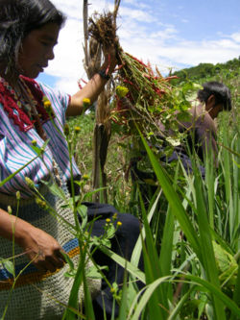
Folk biological classifications. Altieri follows Berlin is laying out the methods involved in the classification of biological organisms but this occludes the role of spirituality, origin stories, and myths related to land ethics, the indigenous principles that teach the next generations the obligations for the care of the land and other direct sources of right livelihood.
Critique

Slide 27
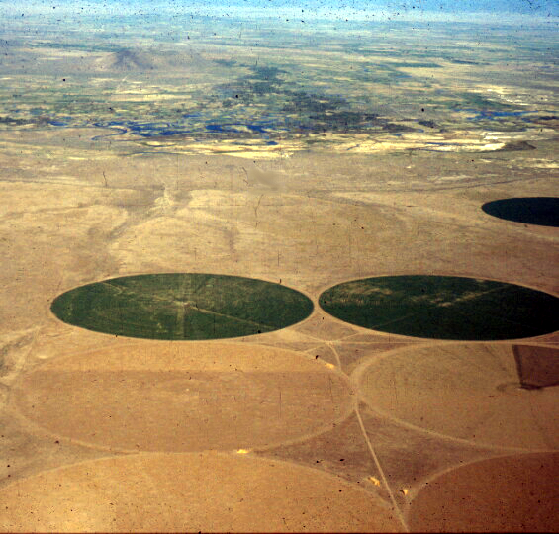
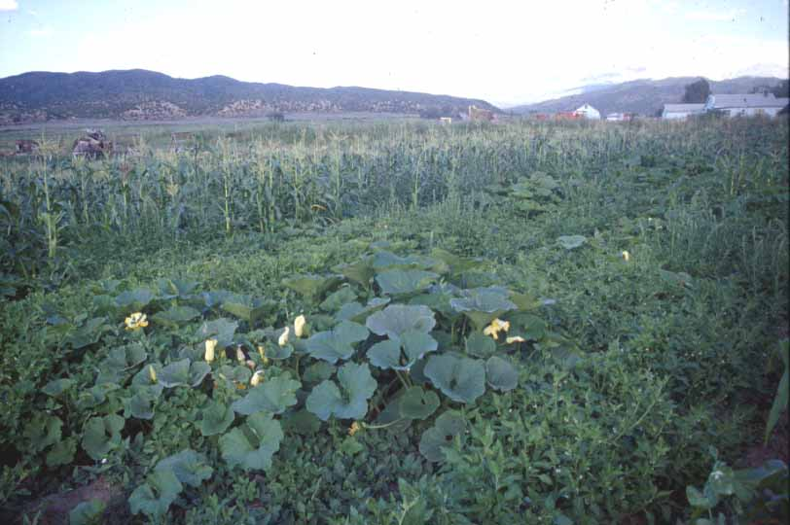
Polka-dot monoculture uniformity. Center—pivot sprinkler operations in the San Luis Valley, CO.
Acequia biocultural diversity. The huerto familiar, home kitchen garden at Corpus Gallegos Ranches, San Luis, CO. Photos by Devon G. Peña

