Slide 1
Traditional Polycultures and a ‘Just’ Sustainability
This diagram illustrates the “shifting mosaic” or long rotation island landscape ecology of the traditional polyculture forest garden, in this case Mayan milpa.

Slide 2
Polycultures typically include livestock

Slide 3
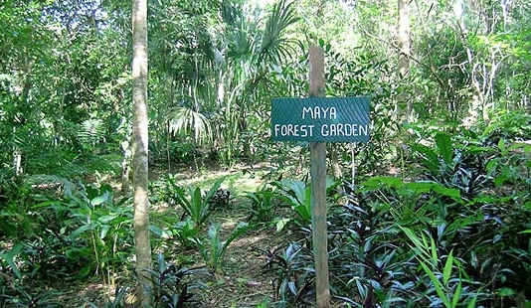
What is a milpa?
This is a traditional Yucateca version of the polyculture farming system which evolved over roughly 4,000 years. Farmers grow corn, beans, squash, and other food plants together in a kind of agricultural scrap quilt; they accept edible “weedy” greens in their fields; and use the surrounding forest for beekeeping and honey production. Many farmers grow a variety of fruit including pineapple, bananas, and guanabana while others grow shade coffee. (Jenkins, p. 4)

Slide 4
Ecological succession in long duration rotation island
Notes:
Source of diagram: Toledo et al. 2008. USO MÚLTIPLE Y BIODIVERSIDAD ENTRE LOS MAYAS YUCATECOS (MÉXICO).

Slide 5
Forest-corn garden-forest ‘succession’
Alfonso Tzul, Maya farmer and retired agricultural extension officer, describes how forest gardens work over the decades to restore the native ecology of place. A contemporary example.
STAGE 1: From the Forest to the Milpa. Patch of forest is cleared of trees and then burned to prepare for planting. First 2-3 years maize, beans, and squash cultivated in the full sun. Amidst this low canopy of maize is a dynamic ecology of herbs, tubers, and other companion plants.
STAGE 2: From Milpa to the Forest Garden. Milpa evolves into forest garden. Fruit trees (plantain, banana, papaya) planted; begin to produce within a year. Avocado, mango, citrus, allspice, guava, cherimoya, ramón, planted amidst the sacred triad of corn-bean-squash and bear fruit in 5 years.
Notes:
SOURCE: El Pilar Forest Garden Network at: http://www.mayaforestgardeners.org/forestgardening.php. Also: The following ritual is part of a larger thanksgiving ceremony called “U Hanlil Col” (The Feast of the Garden). “U Hanlil Col” is usually given when the first ears of corn in a milpa have gotten to a point where they can be eaten as “corn-on-the-cob”.

Slide 6
Forest-corn garden-forest ‘succession’
STAGE 3: From the Forest Garden to the Forest. Fruit trees mature; begin to produce; provide a new canopy blocking the sun and inhibiting undergrowth. Only shade tolerant alleles of corn, beans, and squash are viable if available. Amidst the fruit tree canopy, hardwoods, such as cedar and mahogany, are planted to mature over the next decades.
STAGE 4: Forest Regeneration. The forest garden is transformed into a hardwood forest. The hardwoods rise above the fruit trees to create a high canopy. The milpa has now regenerated to look much like it did before the forest gardener cleared and burned it two decades earlier. It is now a managed forest with little to no undergrowth. The forest gardener will let the hardwood trees grow and mature.

Slide 7
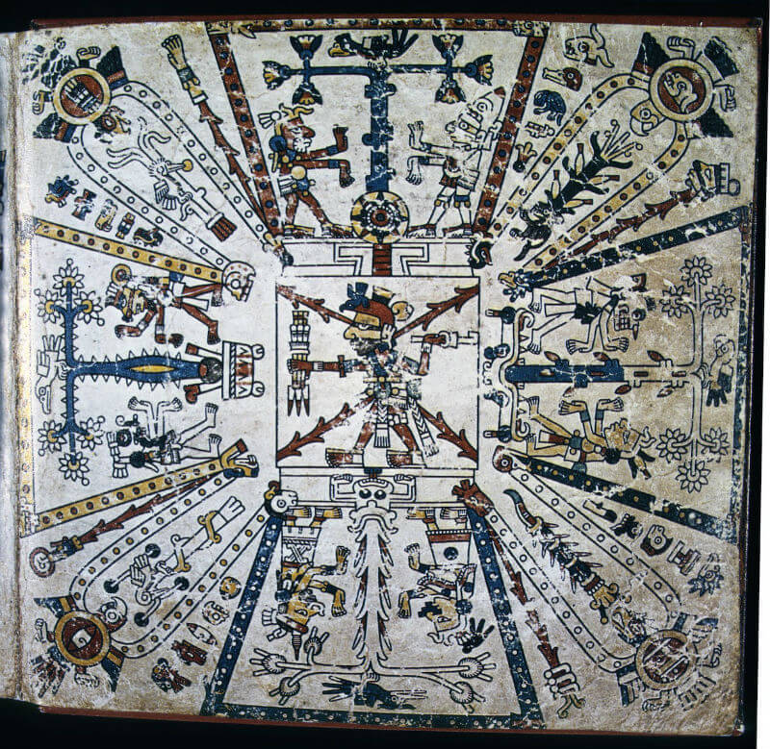
Where does respect for existing landscape ecologies come from?
Sacred trees have a deep history in Mayan thought, philosophy and ethics. They are prominently featured in Mayan glyphs, codices, and murals. The image here is from Page 1 of the Tonalámatl codex and shows the four cosmic trees of the Yucatec Mayan origin myth.

Slide 8
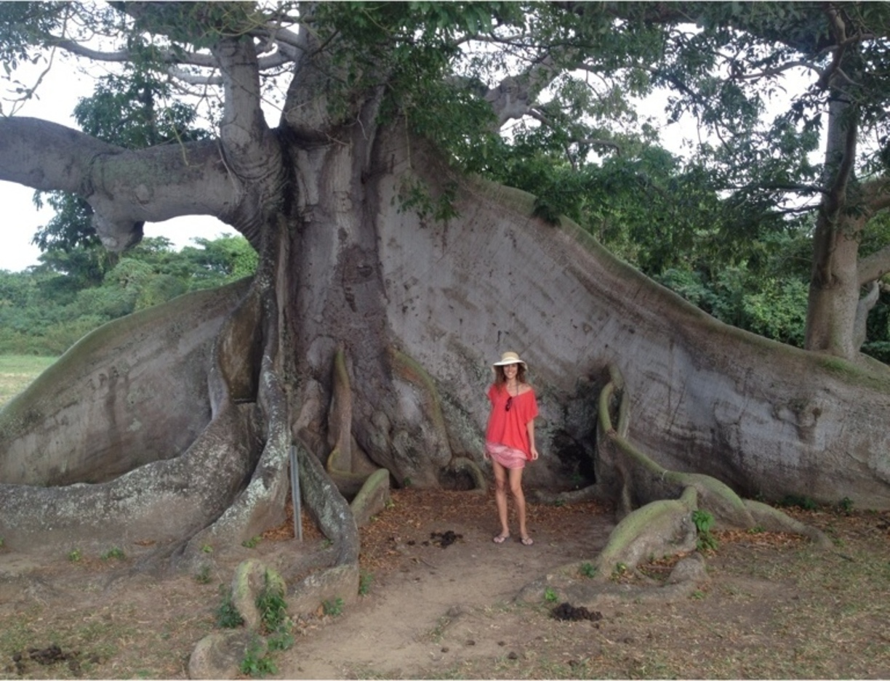
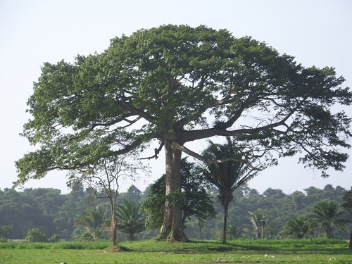
Among these cosmic trees is the Ceiba

Slide 9
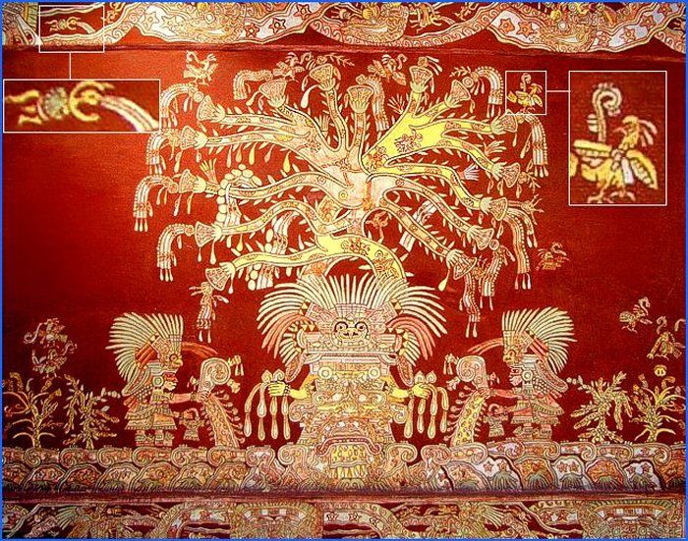
The Ceiba
(Ceiba pentandra)
Árbol de la Vida
Tree of Life
Jenkins does not explain why so many canopy and other trees are left uncut in milpas or replanted in the 4th cycle. There are pragmatic reasons but land ethics, grounded in the deep spiritual value and status of these trees, is also a major factor.

Slide 10
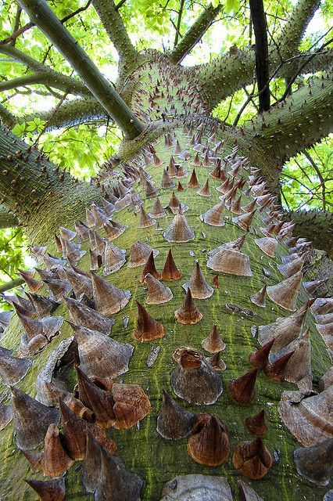
Another sacred tree:
The Pochote tree, a.k.a. Silk Floss Tree (Chorisia speciosa), is sacred to the Maya and among the Mixtec of Oaxaca where it is named Cipactl, which means “Tail of the Mother Earth Lizard.” When you are born Mixteca, the umbilical chord is hung from this tree so that the Lizard Mother can guide you. When you die, your shoes (huaraches) are hung from the tree so you can walk with the Lizard Mother in the afterlife.

Slide 11
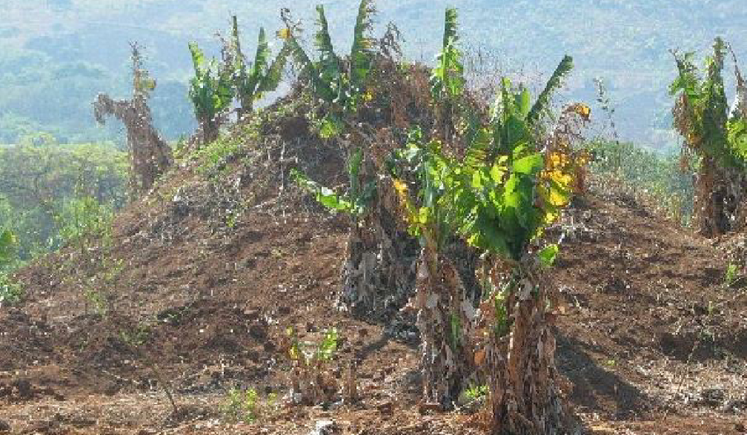
Back to Altieri and traditional polycultures
Traditional Management Practices. The range of practices is as diverse as the local ecology advices. For e.g., in Southern Sudan and Zaire, farmers know how sorghum and cowpea do well in termite mounds. In Oaxaca, farmers use Atta ant refuse as fertilizer for tomatoes, chili, and onion. (117)

Slide 12
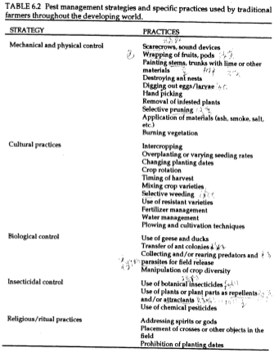
Traditional management practices

Slide 13
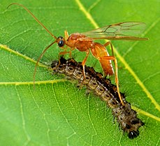
Natural controls for insects
Direct non-chemical control strategies. Includes cultural, mechanical, physical, and biological practices.
Built-in control mechanisms. Inherent to the biotic and structural diversity of the agroecosystem.
Notes:
Photo: Aleodis indiscretus wasp (a.k.a. Braconid wasp) parasitizing gypsy moth caterpillar.

Slide 14
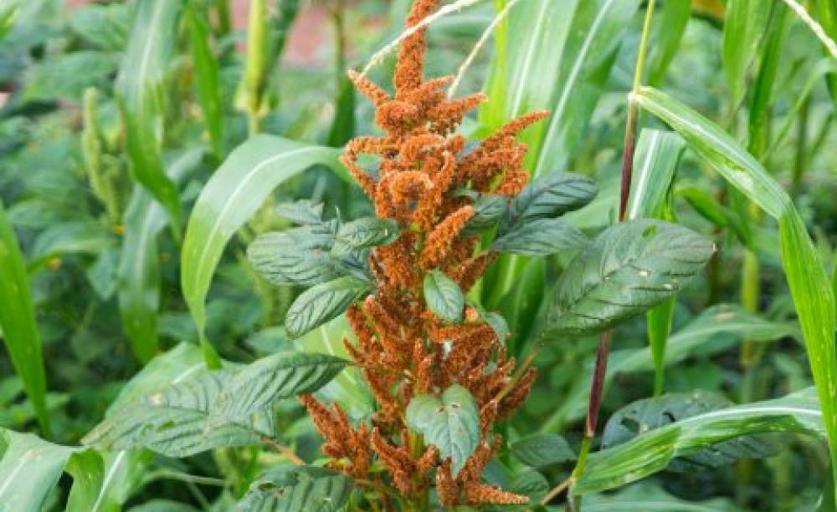
Natural controls for weeds
Selective weeding. Many weeds are valued as edible, medicinal or biodynamic wild companion plants and are controlled through repeated foraging practices.
Crop diversity. Polyculture practices produce complex allelopathic relations and discourage unwelcomed guests.
Notes:
Photo: Hairy orange Amaranth in a corn milpa. Oaxaca, Mexico.

Slide 15
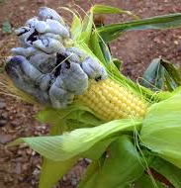
Huitlacoche
Even fungus finds a place in the milpa
a.k.a. Mexican Truffles. Corn Truffles. Corn Smut. Raven Scat. Ustilago maydis.
Loaded with soluble fiber, the amino acid lysine and the antioxidant anthocyanin.
Tastes like a cross between smoked mushrooms and corn. Some people call it “black butter” and smear it on tortillas or bread.

Slide 16
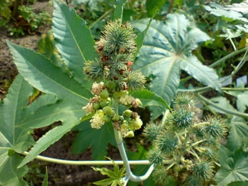
Biodynamic concoctions
Use of repellents and/or attractants. Farmers use natural materials found in the immediate environment (especially plants).
A remarkable number have pesticidal properties.
Use of plants or plant parts placed in the field or applied as herbal concoctions is widespread. (122)
Notes:
Castor bean tree (Ricinus communis). In Ecuador, farmers lay the castor leaves in the field to repel a species of nocturnal beetle.

Slide 17
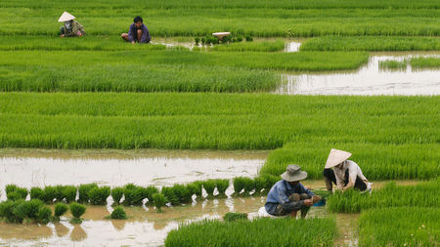
Examples: SE Asian paddy rice
There are many varieties of rice grown in each paddy; each adapted to different environmental conditions and resistant to different pathogens and pests.
Regular exchange of seeds among farmers reinforces this highly adaptive biodiversity.
Ducks and fish are allowed to forage for insects comprising a form of natural control.

Slide 18
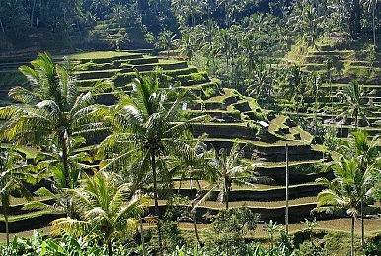
Examples: Javanese polyculture
Combine crops and/or animals with tree crops or forest plants.
Kebun + kebun-campuran + talun is their version of the shifting mosaic or rotation island model.
Livestock, esp. poultry and pigs, play a vital role in natural control by foraging in the forest patches.
Terracing is common on hillsides for erosion control.

Slide 19
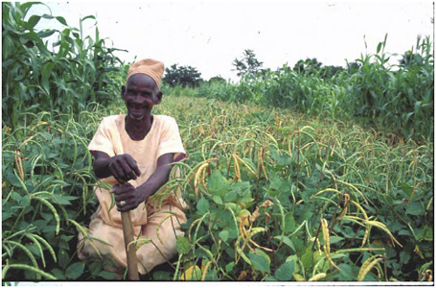
Examples: Nkomanjila System of Nyiha
Mbeya Region, Tanzania and northeastern Zambia.
Typical shifting mosaic system focused on wood and fruit bearing trees, chickpeas and other pulses, finger millet, perennial sorghum, and cucurbits (pumpkins and gourds).
The cycle ends with 5-7 year fallow enhanced by planted trees.
This cycle is now difficult to follow due to land loss and degradation.
Notes:
Nyiha farmer with chickpeas, corn, and medicinal plants.

Slide 20
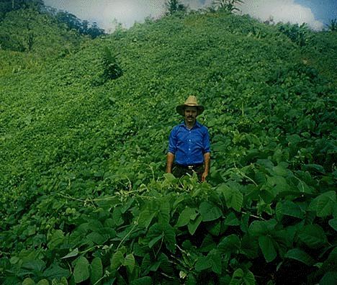
Examples: Frijol Tapado in C. America
Steep slopes on hill- and mountain-sides across C. America and SE Mexico; rain-fed.
One of the few systems transferred to Spanish colonizers.
Beans planted amidst early grasses on fallow plots; otherwise, grasses out-compete the beans.
Remnant grasses prevent soil erosion and sustain moisture in soil.
Vegetation cut from fallow used as green manure or mulch to fertilize beans.
Higher rate of return (with less labor involved) allows for sales to market for cash.
Notes:
Guatemalan Mayan farmer stands on a hillside frijol tapado field. Later, the bean crop residue becomes a super-charged fertilizer as standing mulch; it adds a huge quantity of organic matter to the soil. In fact, over time can deepen the soil horizon. Velvet ban, Jack bean, and scarlet runner bean are high in plasnt proteins and fiber.

Slide 21
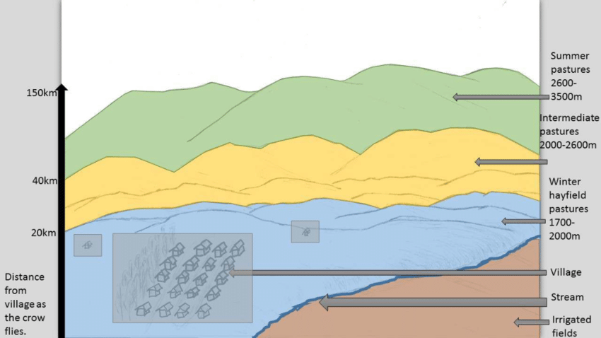
Examples: Agropastoral systems
Many of these systems use livestock. For e.g., rice paddy farmers use water buffalos for traction and as source of milk and meat consumed or sold at market.
They combine farming and pasturage of livestock. Transhumance plays a vital role in regenerative grazing.
Crops include row crops for domestic consumption or sales and field crops as forage for livestock.
Transhumance. The practice of moving livestock from one grazing ground to another in a seasonal cycle, typically to lowlands in winter and highlands in summer.
Notes:
The acequia-riparian long-lot system of Colorado and New Mexico is a good example of agro-pastoralism and will be studied later in the quarter.

Slide 22
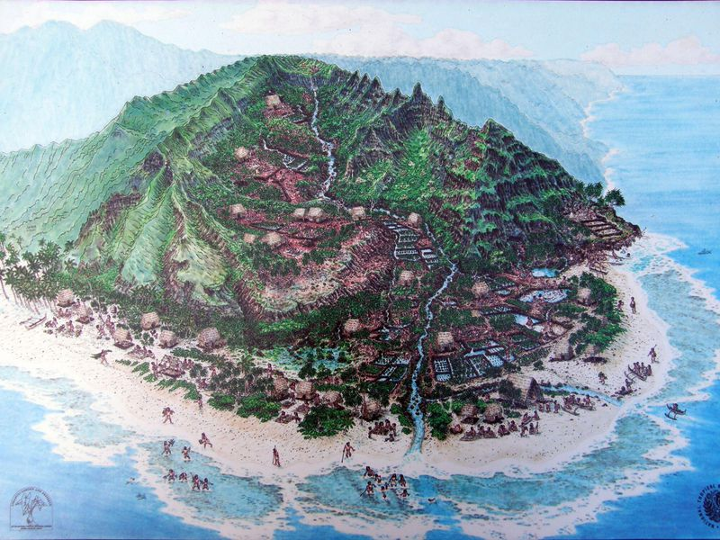
Examples: Andean & Hawaiian ‘Vertical’ Farming Systems
Given the mountainous Andean ecosystems in Bolivia, Chile, Ecuador, and Peru, farmers plot their agroecosystems across the elevations from sea-level to mountain valley and hillside terraces. Three sisters; potatoes; amaranth; quinoa.
This is also the pattern in Hawai’i’s Ahupua‘a landscape ecology which is focused on kalo (taro).
Moku-ahupua‘a system of land-use management was followed throughout the pre-invasion Hawaiian islands. Food sovereignty movements are seeking to restore these complex and resilient landscape ecologies.
Notes:
SOURCE: Illustration from Smithsonian Magazine. https://www.smithsonianmag.com/smithsonian-institution/finding-lessons-culture-and-conservation-end-road-kauai-180959183/. More than one hundred plant taxa have already gone extinct, and over 200 are considered to have 50 or fewer individuals remaining in the wild. Officially, 366 of the Hawaiian plant taxa are listed as Endangered or Threatened by Federal and State governments, and an additional 48 species are Proposed as Endangered.” While only comprising less than one percent of the United States land mass, Hawaiʻi contains 44 percent of the nation’s Endangered and Threatened plant species.”

Slide 23
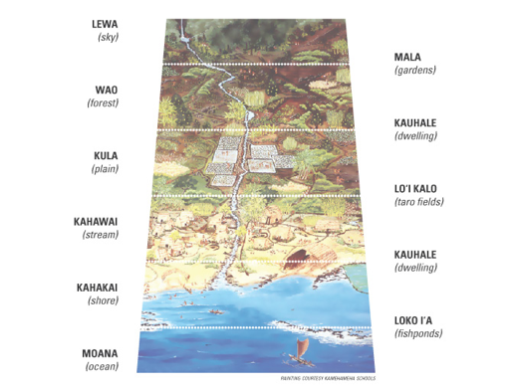
Moku-ahupua‘a system
Vertical (elevation gradient) farming is now all the rage among urban agriculture movement advocates. Few actually realize that this practice has been deployed both at the micro- (garden) and macro- (landscape ecology) scales by Indigenous farmers for hundreds, even thousands, of years.

Slide 24
Lessons Polyculture ecosystems are sustainable and equitable
Combine species and structural diversity in time and space through vertical and horizontal organization of crops.
Higher biodiversity (including microbes) recycling nutrients.
Use full-range of micro-environments; some are anthropogenic (e.g., apete, acequia riparian corridors)
Maintain recycling of local input materials and wastes.
Rely on biological and chemical interdependencies for natural controls.
Rely on local inputs; human, animal traction; gravity (for irrigation).
Rely and protect and diversify local landraces and their wild and intermediate relatives.
Level of income is low; noneconomic factors influence decision-making. Prosumption and autarky.

Slide 25
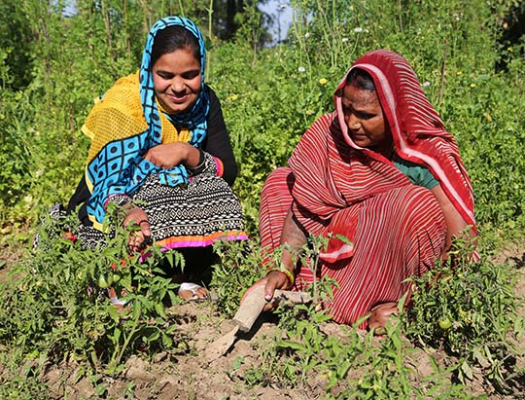
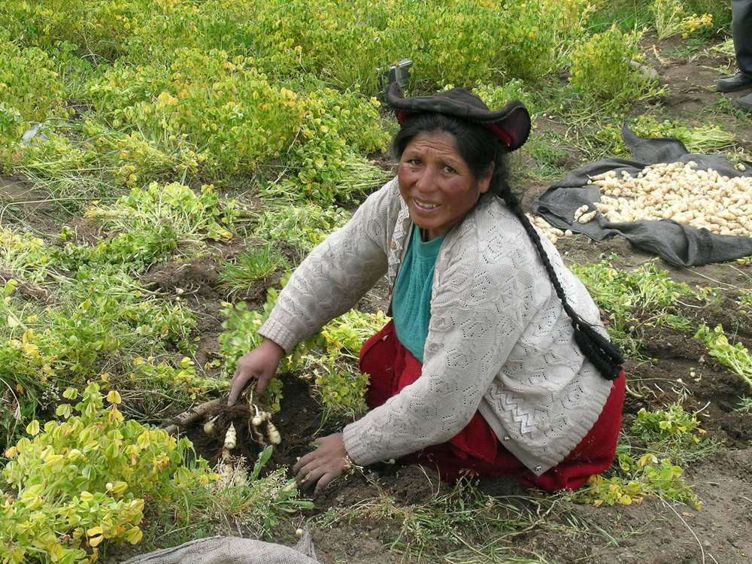
Lessons/critique
Gender. Role of women as farmers, seed keepers, plant breeders, market activities, etc.
Settler colonialism. Displacement and dispossession by corporate farmers, drug cartels, guerrilla forces, government infrastructure projects (dams, railroads, highways, ports, tourism centers, etc.)
Effects of climate chaos other environmental changes. Water scarcity; drought; shifts in animal and plant species. Disruption of resilience; stochasticity.

Slide 26

What is sustainability?
In 1987, the UN Brundtland Commission defined sustainable development as "meeting the needs of the present without compromising the ability of future generations to meet their own needs." (Report of the World Commission on Environment and Development.). This was formally adopted under the UNEP 1992 Earth Summit.

Slide 27
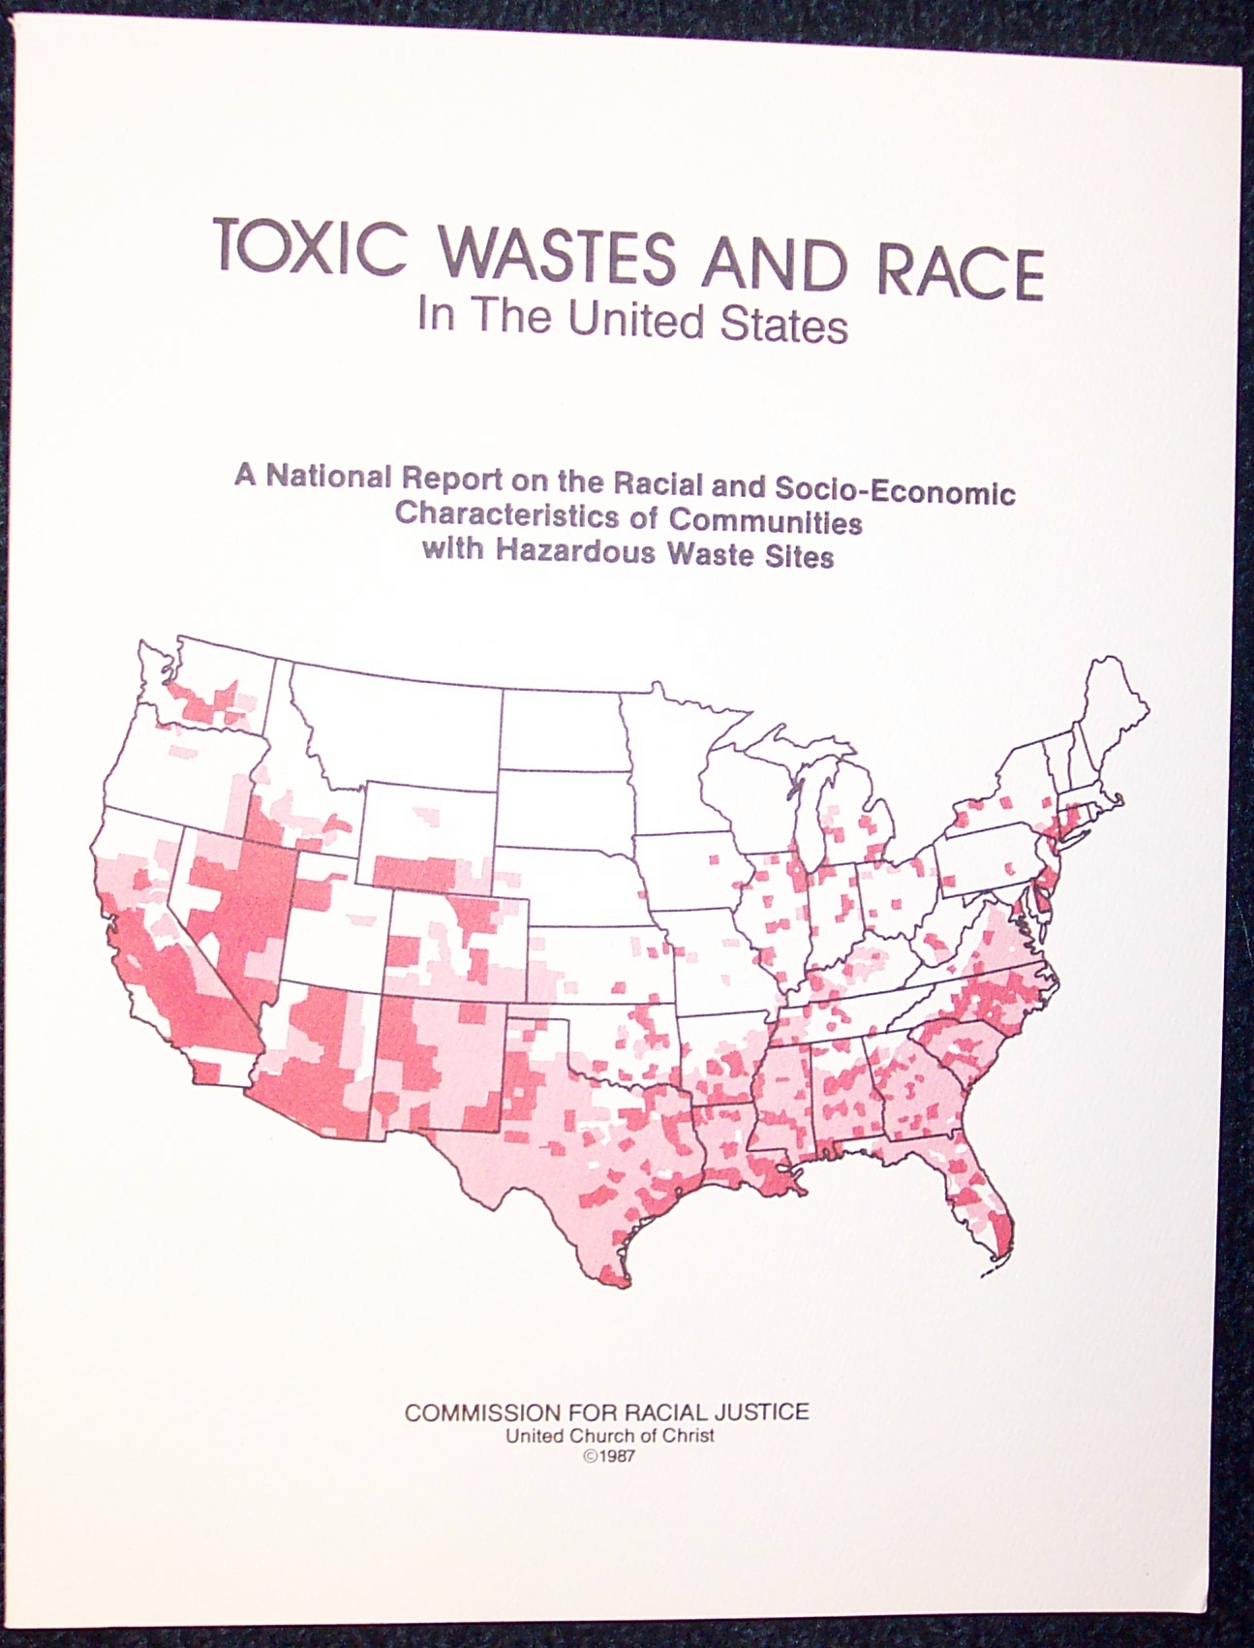
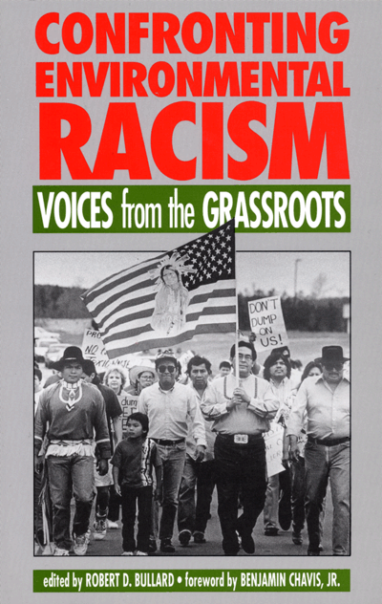
What is sustainability?
In 1991, the first Environmental Justice Summit in Washington D.C. challenged this definition and instead promoted the concept that sustainability is incomplete without accounting for environmental and social injustices and addressing systemic structural violence.
Just sustainability was promoted as alternative concept. Called for three forms of equity: intergroup, interspecies, and intergenerational.
Action principles:
we don’t have the complexion for protection (equity)
we don’t want an equal piece of the same rotten carcinogenic pie (ecological democracy or autonomy).

