Slide 1
Harold Conklin: First steps toward a decolonial ethnoecology
Satellite Image: Terraced landscape. Bannawol (Banaue), North Central Ifugao

Slide 2
Harold Conklin (1926-2016)
Retired at Yale. Professor Emeritus of the Human Environment and Professor Emeritus of Anthropology. Considered one of the world’s leading authorities on ethnoscience, the manner in which inhabitants of a particular area perceive and treat the environment.

Slide 4
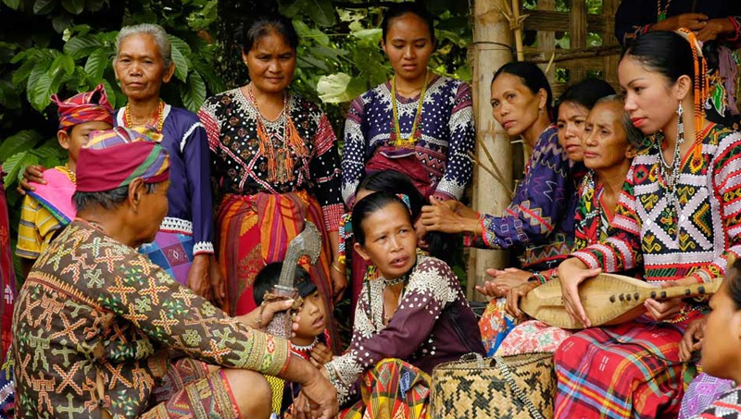
Mindoro Island Hanunóo people and territory
Notes:
MANGYAN is the generic name for the eight indigenous groups found in Mindoro island Mindoro (Mindoro is the seventh-largest island in the Philippines), each with its own tribal name, language, and customs.

Slide 5
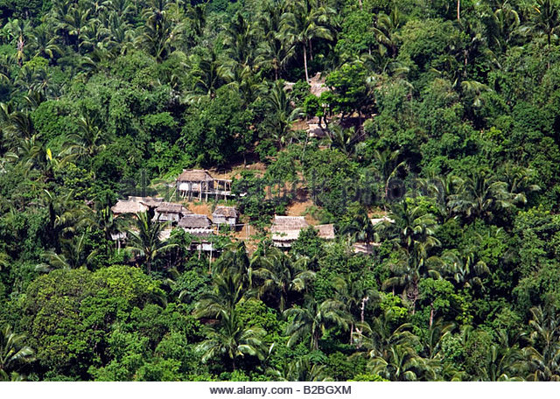
Background
Conklin’s work focused on the indigenous knowledge of ethnoscience in ecological context, particularly in the Mindoro district, Philippines.
“An Ethnoecological Approach to Shifting Agriculture” published in 1954 in Transactions of the New York Academy of Sciences.

Slide 6
The shifting mosaic
Goal is to present a better scientific understanding of so-called shifting agriculture.
Argues against prevalent misconceptions of indigenous agroecological practices within the Western academy.
Rejects the so-called ‘Green Revolution’ as a top-down corporate model.
Notes:
Hanunó'o, is one of the indigenous suyat scripts of the Philippines and is used by the Mangyan peoples of southern Mindoro to write the Hanunó'o language

Slide 7
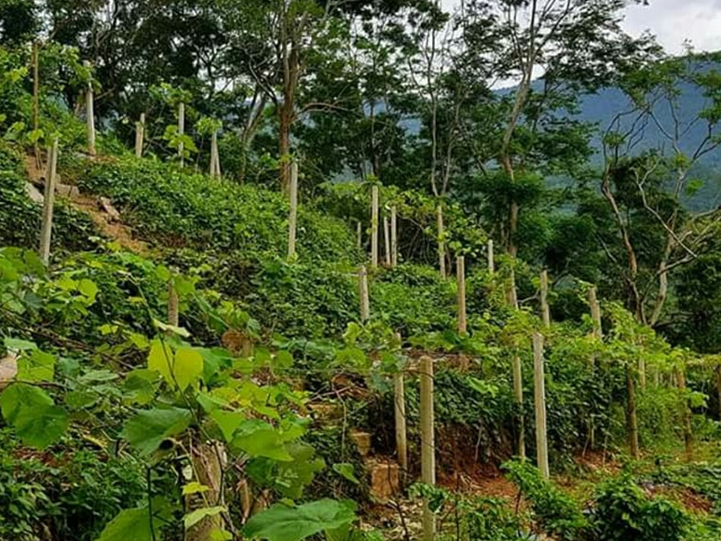
Shifting Agriculture
“For our purposes we may consider shifting cultivation, also known by such designations as field-forest rotation …or slash-and-burn agriculture, as always involving the impermanent agricultural use of plots produced by the cutting back and burning of vegetative cover.” (241)

Slide 8
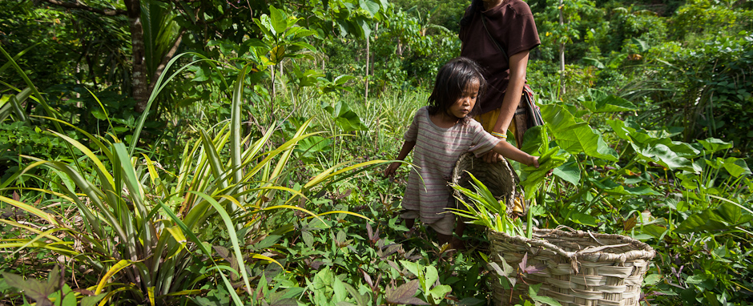
Culture-specific terms for rotation island agriculture
Philippines: kaingin (caiñgin)
Indonesia: ladang
Myanmar: taungya
India: djum
parts of Africa: chitemene
Central America: milpa

Slide 9
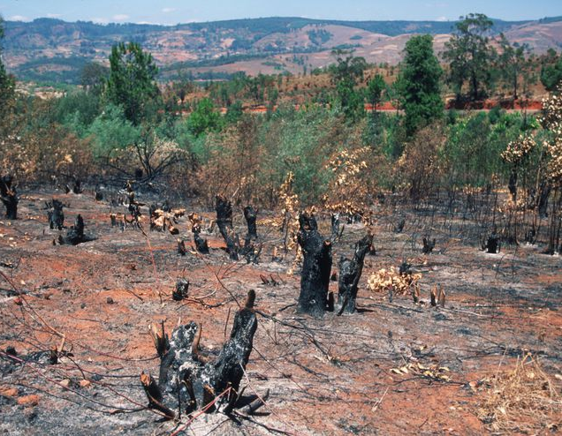
Popular (Mis)Conceptions of Shifting Agriculture
Haphazard; doesn't require labor input.
Swiddens usually cleared in areas of primary forest growth.
Fires escape plots and destroy nearby areas.
Swidden techniques are universally the same.

Slide 10
Popular Conceptions of Shifting Agriculture (cont.)
Stoloniferous grasses are undesired in swiddens.
Swiddens are monocultures; thus their productivity can be measured in the yield of a single crop.
Efficiency can be measured by the ratio of single crop yield per unit of cultivated area.
Swiddens are abandoned following the harvest.
There's no crop rotation, only plot rotations.
"Native ignorance" leads to losses in fertility and permanent loss of forest cover when reclearing is more frequent than approx. 25 years.

Slide 11
Hanunóo TEK among the most extensive in world

Slide 12
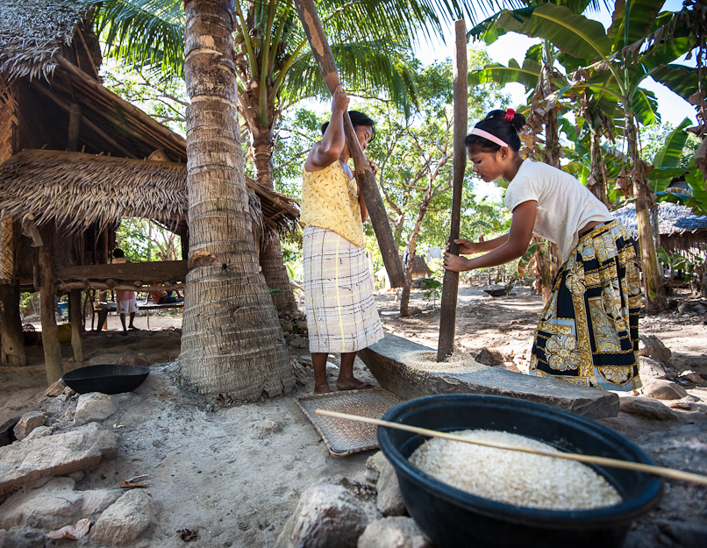
Rice
Conklin does not mention this but the Hanunóo have 92 different names for rice including: shelled/unshelled, pounded/unpounded, dry, wet, fluffy, sticky, full colored, etc.

Slide 13
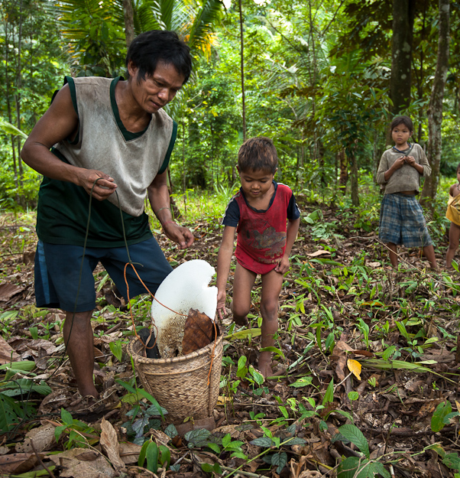
Methods
Conklin lived with the Yagaw Hanunóo of Mindoro Island in the Philippines from November 1952 to January 1955.
He conducted participant-observation and (ostensibly) ethnographic interviewing.

Slide 14
First Year of a Cycle
Jan.–Feb.
Activities resulting in a slashed clearing, a gamasun.
Feb.–Mar.
Activities resulting in a cut clearing, a buklid.
Mar.–May
Activities resulting in a burned clearing, a tutud.
May–Oct.
Activities necessary for/resulting in the maintenance of a planted swidden (tanman).
Oct.–Nov.
Activities resulting in a riceless field, a dayamihan.
Nov.–Dec.
Activities resulting in a cleaned swidden, a lumun baguhan.

Slide 15
Hanunóo woman planting tubers

Slide 16
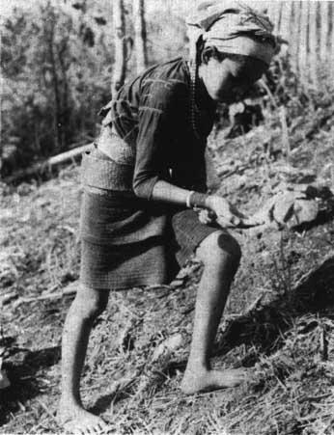
Sowing rice

Slide 17
Fencing around a cleared field ready for crops; note the intact canopy trees.

Slide 18
Weeding the forest garden
Rice, maize, bananas, yams and sweet potatoes are the main staples grown, but a total of more than 80 other crops are inter-planted in the forest clearings.

Slide 19
After the First Year
Activities resulting in a re-cleaned (used but still productive) swidden, a lumun da’an.
Perennial crops including fruit trees remain productive for an average of 2 to 5 years following the rice harvest.

Slide 20
Conclusions
“Swidden farming follows a locally determined, well-defined pattern and requires constant attention throughout most of the year.” (246)
Second growth forests are preferred. They protect primary forest.
Swiddens are contained by firebreaks.
Techniques are specific to location and local conditions (i.e. topography, climate).
Even the "weeds" are useful.

Slide 21
Conclusions
Swiddens are polycropped, meaning productivity can't be measured by the yield of a single crop.
Efficiency of swiddens should be measured by the ratio of total output (for all crops) to unit of labor (compare this to OFT of Hawkes et al.).
Plantings and harvest overlap.
Hanunóo shifting cultivation involves crop rotations. Cycle lengths can't be assessed by measuring the time between clearances or rice harvests.
Because "many variables are at work," it's difficult to prescribe an ideal minimum cycle length.

Slide 22
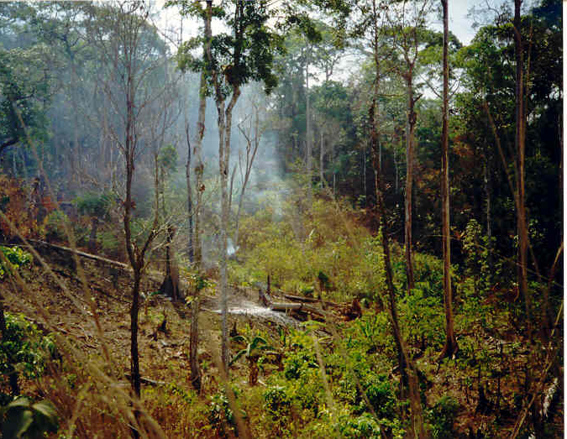
Some final thoughts
“A study of Hanunóo soil classification and associated ideas regarding suitability for various crops--other variables being equal--checked well with the results of a chemical analysis of soil samples.” (246)

Slide 23
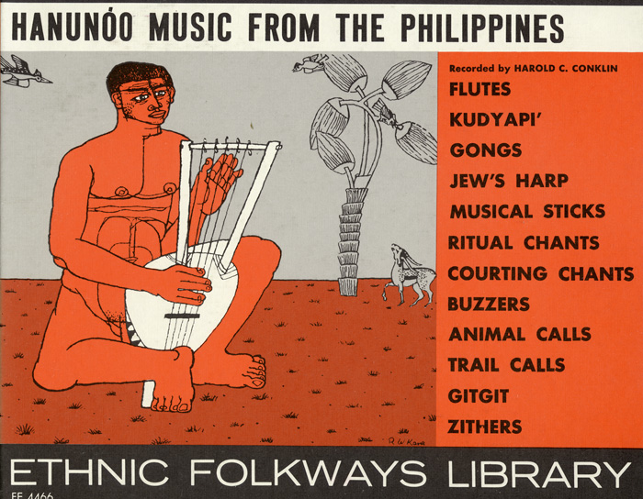
Critique
Hanunóo culture is not just about agroecological practices and ethnoecological knowledge:
Music, dance, artisan crafts, and political organization are equally important. Some music is necessary before the “felling” of a secondary forest so music lays a role in these practices.

Slide 24
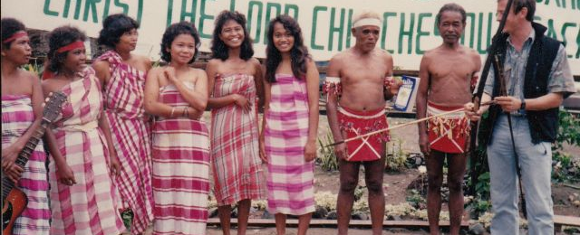
Critique
Conklin’s focus on ethnoecological knowledge leads him to overlook the conflicts between the Hanunóo and religious missionaries seeking to Christianize the people.

Slide 25
Critique
Poetry is important as a story-telling method for keeping track of historical events and values/worldviews important to the Hanunóo.

Slide 26
Some final thoughts
“Biotic factors are most subject to control and experimentation by the Hanunóo, and are of the greatest concern to them.” (246)
Ethnobotany Plants teaching people how to live lightly with the land and gently protecting and using them for food and medicine.

