Slide 1
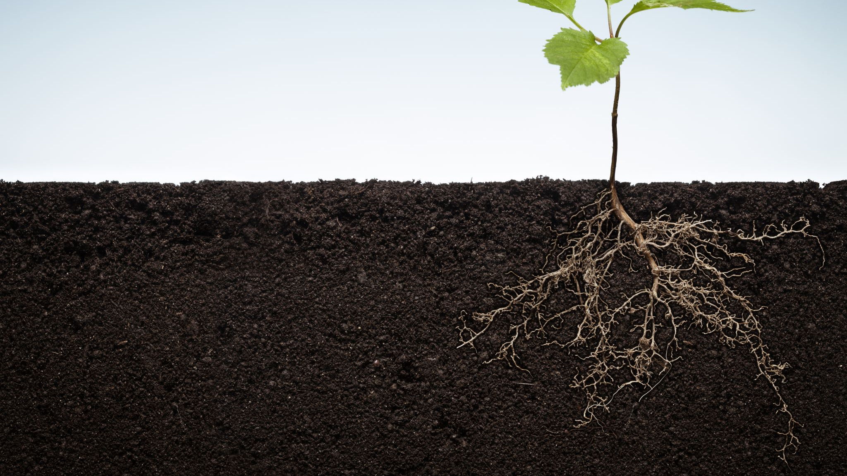
The environmental history of soil degradation
David R. Montgomery

Slide 2
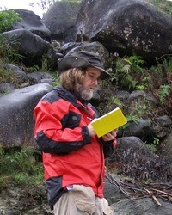
David R. Montgomery
Professor, Earth and Space Sciences, College of the Environment, U. Washington
MacArthur Genius (2008)
Studies the evolution of topography and the influence of geomorphological processes on ecological systems and human societies.
B.S. Geology, Stanford University (1984)
Ph.D. Geomorphology, UC Berkeley (1991).

Slide 3
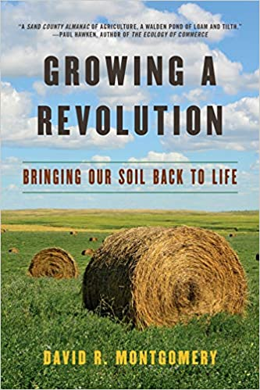
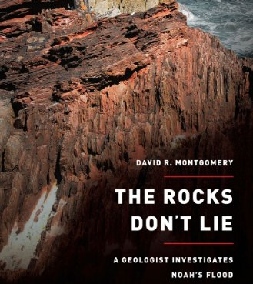
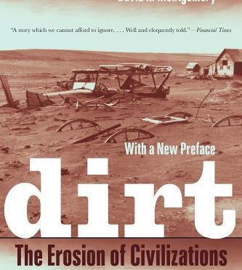
Books by David R. Montgomery

Slide 4
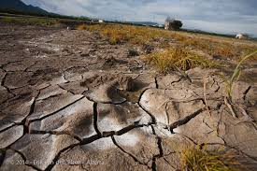
Principal arguments
Degradation of farmland is as great a threat to civilization as global conflict, exploding population, climate change, and dwindling supplies of fresh water.
One-third of farmland is degraded.
Some consequences already evident: e.g., land grabs for export-oriented production.
Soil fertility a key strategic resource.

Slide 5
Principal arguments
Quote:
“From the Roman Empire to the Maya and Polynesia’s Easter Island, one great civilization after another sank into poverty ands eventual demise after destroying their topsoil.” (18)

Slide 6
A political economic problem
Montgomery notes that the challenge of feeding the world is “an economic and distribution (and therefore political) problem [rather] than an agronomic one.” (19) We harvest enough food, but it is not getting to all who need it.
”A growing movement of farmers is starting to turn ancient patterns around, restoring life and health to their land.” (19)
“Soil is full of life, dirt in not.” (20)
Tillage and the plow are the principal factors underlying soil degradation.

Slide 7
Other main arguments
The poorer the soil, the more impoverished the people.” (21)
Restoring soil health can help us solve other problems like water., energy, climate, and environmental and public health problems. (21)
There are solutions: Zero or minimum tillage methods and precision fertilizer use are two methods already embraced by a growing number of “progressive” or “regenerative” farmers. (22-3)
Using organic matter to rebuild soil is possible and leads to quick results. (25)

Slide 8
A new revolution?
First agricultural revolution: Shift to cultivation (instead of hunting and foraging) and eventually the use of the plow and animal labor.
Second ag revolution: Adoption of ”soil husbandry” (crop rotations, intercropping, manure, etc.).
Third ag revolution: Mechanization and industrialization; dependence on fossil fuels; intensive use of chemical fertilizers.
Fourth ag revolution: Green Revolution and biotechnology; boosted yields; corporate control of seeds and agrochemical inputs. (27)

Slide 9
So, a key question for Montgomery
“What will the future hold as we burn through the supply of cheap oil and our population continues to rise alongside ongoing soil loss and climate change?” (28)
“This time we need to ask what agriculture would look like if we relied on building fertile soil instead of depending on chemical substitutes. What would this new, fifth agricultural revolution look like?” (29)

Slide 10
Final points
This movement is coming and growing from the bottom-up, led by individual farmers instead of governments, universities or environmental organizations and groups. (29)
“The most promising way forward lies in the marriage of agrotechnology and agroecology to rebuild soil fertility. Combining ancient insights and modern science…is the way to both sustain agriculture and use it to help slow climate change.” (30)

Slide 11
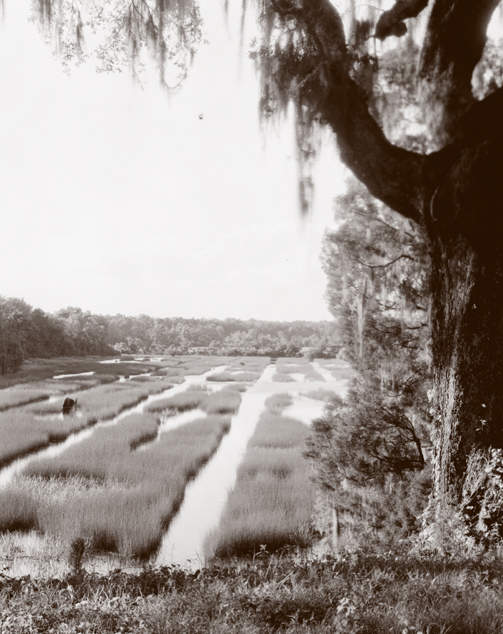
Decolonial Critique & Questions
Is it wise to open, without at least some critical reflection, on a source like T. Jefferson who was, after all, a slave owner and did very little farming himself? One could argue that the basis of “civilization” in the American colonies is soil and slaves.
Notes:
Photo note: During a tour of the South in 1938, Frances Benjamin Johnston, an architectural photographer, captured this image of a rice field at Mulberry Plantation near Monck’s Corner in Berkeley County, S.C. Photo: Library of Congress.

Slide 12
Slavery and soil degradation

Slide 13
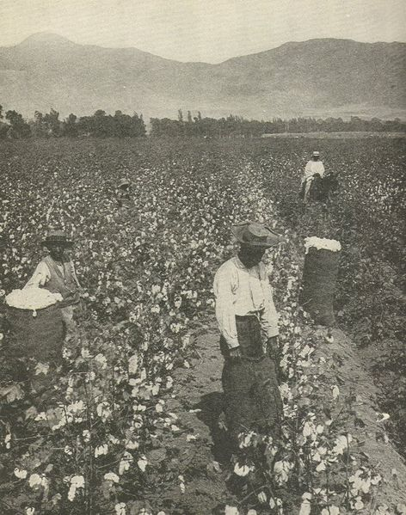
Cotton and tobacco monocultures
Montgomery fails to mention the role of cotton and tobacco monocultures in degrading soil quality, displacing wildlife habitat, and of course subjugating Black people to centuries of intolerable exploitation and inhumane abuse.
Invention and widespread use of pesticides was tied to two things: (1) what do do with military “economic poisons” and (2) the demand for control of the boll weevil by the former slave-owning plantations growers.

Slide 14
Other miscues and misrepresentations
The quote from p. 18 cited earlier is filled with errors and omissions:
Re: Roman Empire – Soil erosion (from overuse of land to feed the standing armies of empire) played a role, but deforestation (to build warship fleets, military hardware, etc.) was a more fundamental underlying cause of soil erosion.
Re: Rapa Nui (aka Easter Island) – New studies reject the simplistic and speculative arguments first posed by Jared Diamond that the Indigenous people clear cut the forest and eroded their soils leading to collapse.
Re: Maya - Studies since the 1990s (e.g., Fedick, The Maya Managed Mosaic) have shown a more complex picture and deforestation and soil erosion are not seen as principal or even minor factors in the de-urbanization of Mayan civilization.

Slide 15
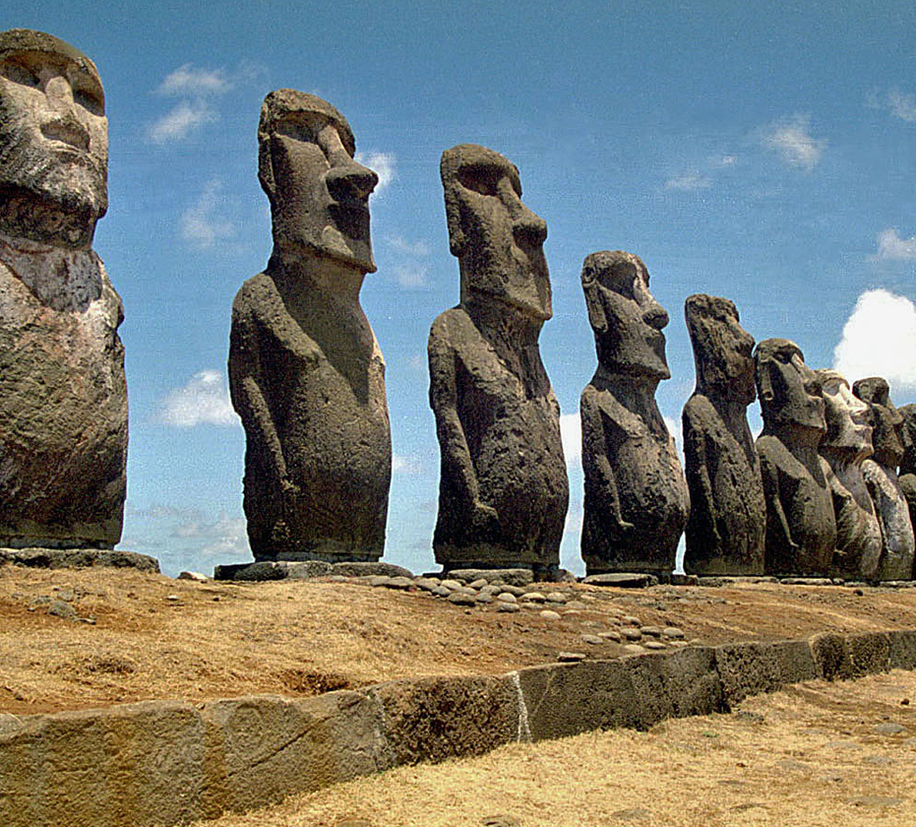
Rapa Nui
When I first went to Rapa Nui to conduct archaeological research, I expected to help confirm this story. Instead, I found evidence that just didn't fit the underlying timeline. As I looked more closely at data from earlier archaeological excavations and at some similar work on other Pacific islands, I realized that much of what was claimed about Rapa Nui's prehistory was speculation. I am now convinced that self-induced environmental collapse simply does not explain the fall of the Rapanui.
Terry L. Hunt (2006) Rethinking the Fall of Easter Island
American Scientist.
Notes:
Source: Terry L. Hunt 2006. Rethinking the Fall of Easter Island. American Scientist. 94:5: 412.URL: https://www.americanscientist.org/article/rethinking-the-fall-of-easter-island#:~:text=Around%201200%20A.D.%2C%20their%20growing,war%2C%20famine%20and%20cultural%20collapse.
Accessed June 3, 2020.
Note: A recent survey of the island found only 48 different kinds of native plants, including 14 introduced by the Rapanui.

Slide 16
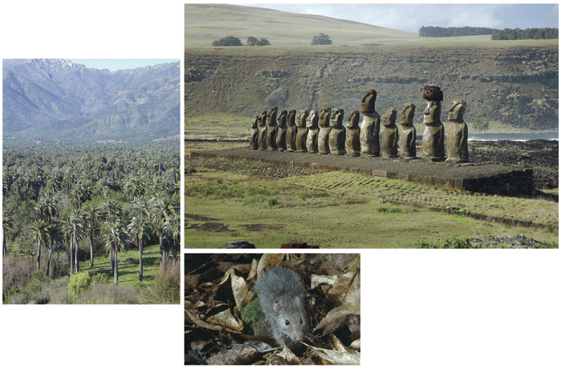
Rapa Nui
What then?
Rats; an introduced species. Ate the reproductive parts of the Jubaea palm. By 1250AD massive loss of palms.
After 1250AD, the decline of palm groves is shown to be associated with accelerated soil erosion.
Terry L. Hunt (2006) Rethinking the Fall of Easter Island.
Notes:
Source: Terry L. Hunt 2006. Rethinking the Fall of Easter Island. American Scientist. 94:5: 412.URL: https://www.americanscientist.org/article/rethinking-the-fall-of-easter-island#:~:text=Around%201200%20A.D.%2C%20their%20growing,war%2C%20famine%20and%20cultural%20collapse.
Accessed June 3, 2020.

Slide 17
The Maya Decline or De-Urbanization?
More recent studies, lFedick 1996 and Peña 2005, strongly indicate: (1) the Maya civilization DID NOT collapse but rather de-centralized back into earlier more rural forms of co-inhabitation of their ecosystems; (2) the flight from the city was a result of rebellion of farmers against the city-state elites and their constant warfare; (3) dendrochronology does suggest climate change impacts contributed to the flight from the cities – drought cycles made urban farming more difficult; and (4) areas around urban centers were degraded but the surrounding forests were intact and indeed intensely and sustainably managed in long duration rotation island milpas; farmers returned to their milpas in bajadas and rejolladas (collapsed, filled-in cenotes). Their famous floating gardens or xinampas were located in these landforms.

Slide 18
Colonial gaze?
“We cannot afford to repeat the mistakes of the past now that there’s no where left to go.” (18)
What’s wrong with this statement from a decolonial standpoint?

Slide 19
Inventing new myths?
While promoting zero-tillage or minimum tillage practices for soil conservation (a very good idea), Montgomery fails to mention that the overwhelming cases of farmers adopting these methods must rely on heavy use of agro-industrial chemicals like herbicides (a bad idea).
In the end, this blind-spot perpetuates a new myth, namely that zero-tillage is an environmentally friendly soil conservation practice. It can be but not when paired with herbicide and other agro-chem treatment protocols.

Slide 20
Other criticisms
Montgomery never explains what the ancient methods that will help save us are. This represents (perhaps inadvertent) erasure of Indigenous knowledge since most of the practices he associates with the “New” Ag Revolution have long been practiced by Indigenous farmers including intercropping, crop rotations, composting and mulching, polycultures, companion planting, etc.
If this is a political economic problem, then should we not have to critically examine the problematics of capitalism instead of blaming the vaguer concept of “industrialization” writ large?

Slide 21
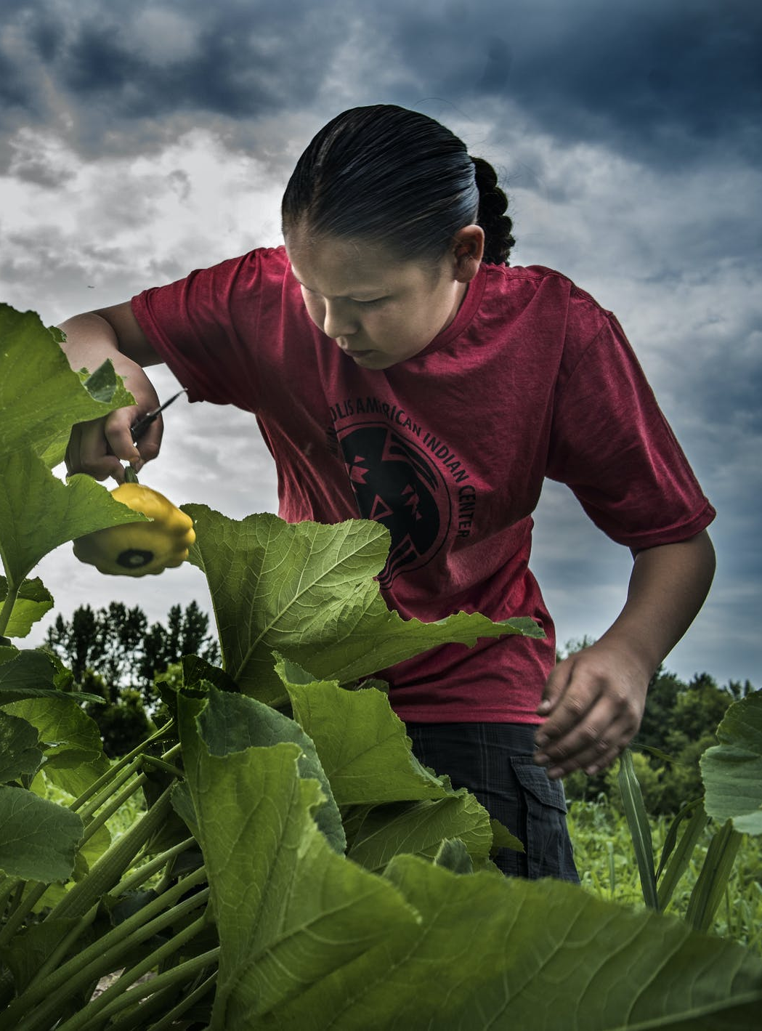
Final criticism
Montgomery’s idea that the Regenerative Agriculture movement is being led from the bottom-up by individual farmers overlooks the fact that for Indigenous farmers the movement involves networks, community-based organizations, and other institutions of collective action rather than persons acting alone.
Notes:
Photo note: Waate Aubid of East Lake, Minn., harvested pattypan squash at the Dream of Wild Health’s farm in Hugo. “You get to eat healthy, you don’t get chemicals in your vegetables,” he said. The farm teaches American Indian kids and families about healthy food and farming. Photo by RICHARD TSONG-TAATARII.

