Slide 1
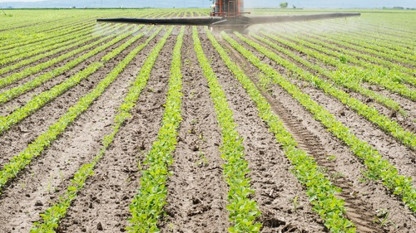
Montgomery
on the Myths of Modern Agriculture

Slide 2
The big three myths
Industrialized agrochemical agriculture feeds the world. Montgomery states, this model “feeds the developed world but not humanity.”
Industrialized agriculture is more efficient.
Intensive agrochemical use will be necessary to feed the world of tomorrow.

Slide 3
The GMO Sideshow
In addition, Montgomery rightly questions some of the myths associated with agricultural biotechnology as a panacea to meet the challenges of feeding the world while protecting the environment.
While Bt crops have reduced some pesticides, overall agrochemical use has increased by at least 7 percent (2012 study, unclear in the text what the date range is).
A principal benefit he says of GMOs is reduced soil erosion (due to zero or minimum tillage methods).

Slide 4
Critique
Re: Myth 1. Industrialized agrochemical agriculture does NOT even feed the so-called “developed” world (a racist term btw).
The principal crops in USA are corn, soybean, canola, and cotton and more than 90 percent of these are GMOs with heavy chemical treatment protocols at least for the herbicide resistant “events.”
These principal crops are not eaten directly by people (except for GMO sweet corn and as ingredients in corn masa for tortillas and related products). These crops are bound for processed foods like HFCS (high fructose corn syrup) and cotton of course is not a food (at least not for people).
The GMO crops may save soil, but at great cost to the biodiversity and health of the rhizosphere.

Slide 5
Critique
Re: Myth 2. Industrialized agriculture is more efficient.
This depends on how we measure efficiency. If we include all of the losses in terms of soil quality, habitat, ecosystem services, the integrity of the rhizosphere, and decreased nutrient density and increased chemical residues in crops.
Also, we need to measure total biomass and not just farm gate deliveries (commodities delivered to the market).

Slide 6
Critique
Re: Myth 3. Intensive agrochemical use will be necessary to feed the world of tomorrow.
Agreed. However, this overlooks several issues:
Land grabs?
Women and local food systems.
Food sovereignty movements.
BTW: GMOs are not a side show, they are the central dispute between agroecology and biotechnology.

