Slide 1
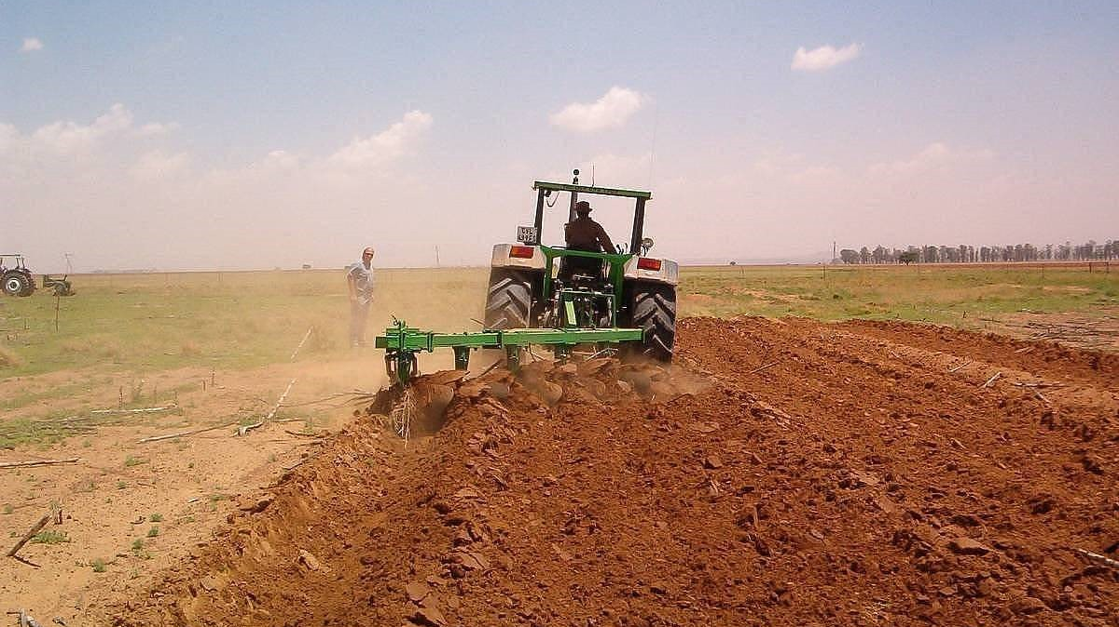
Montgomery
Rise of soil restorationist movements. Settler colonial regenerative agriculture.

Slide 2
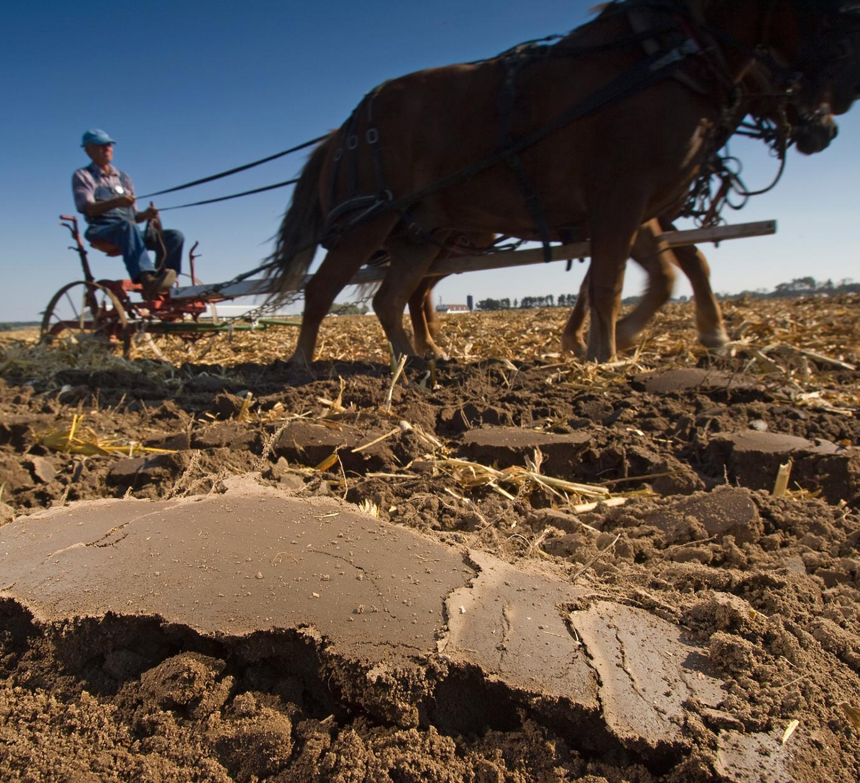
Critique of the plow
Much of the degradation soil across the world, and certainly in the USA, was a result of over-plowing the land which resulted in erosion, compaction (e.g., hardpan or clay lens), and even nitrification; this also affects rivers, streams, ponds, lakes, and even seas through runoff that leads to eutrophication.

Slide 3
Montgomery’s solution is basically, “Ditch the plow.”
A “New” Way
1. Minimum disturbance of the land.
2. Growing cover crops and retaining crop residue so that soil is always covered.
3. Use of diverse crop rotations.
“These principles can be applied anywhere, on organic or conventional farms, with or without genetically modified crops.” (68)

Slide 4
All these so-called “new” paradigm principles actually are very deeply rooted in Indigenous traditions and practices.

Slide 5
Conservation agriculture
“We need faming methods that are far less harmful to beneficial soil life. For soil health is built upon the backs of soil organisms, from the common earthworm to specialized bacteria, mycorrhizal fungi, and other microorganisms.
At its heart this is what conservation agriculture is all about – practices that promote and protect the tiny multitudes that we now know help crops grow and keep soil fertile.” (68)

Slide 6
How does conservation ag accomplish this?
No-till is at the heart of conservation agriculture. Benefits of no-till:
Non-harvestable plants left in place as crop residues serve as soil cover
These decompose in the field where they form a “carpet of organic matter” on the ground surface (mulch)
“Mulched plots have higher bacteria, fungi, earthworm, and nematode populations.”

Slide 7
The question of weed control under no-tillage systems
“Conventional tillage does provide weed control, but under conservation agriculture herbicides or cover crops accomplish the same thing and drastically reduce soil erosion.” (69-70)
Critique: Montgomery is too lax in his willingness to accept herbicide use as part of the no-tillage paradigm. Some of the benefits of no-tillage Montgomery cites are rendered obsolete because herbicides damage and even destroy the mycorrhizal bacterial colonies and other beneficial microorganisms that sustain soil structure, fertility, and drive the nutrient exchange and uptake paths.

Slide 8
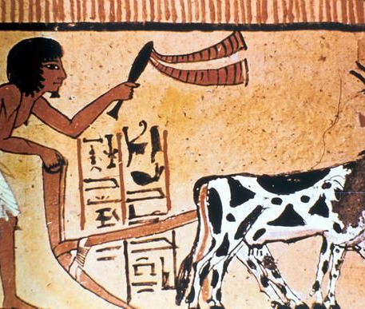
Reflections on history
Earliest farmers practiced no-till (e.g., digging sticks)
Evolution of the plow stated some 3 to 5K years BCE
Roman iron plow is precursor of modern plow
Big turning point: Modern mouldboard plow (1784); this plow is the first to turn the soil over.

Slide 9
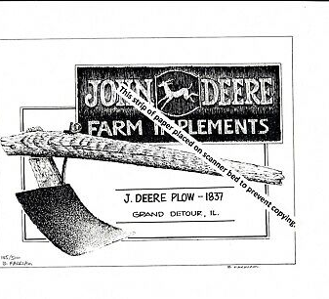
Reflections on history
1830s: John Deere introduced cast-iron play based on Thomas Jefferson’s design.
1920s: Hugh Hammond Bennett labels soil erosion a “national menace.” (72)
1935: FDR signs legislation creating the Soil Conservation Service (SCS)

Slide 10
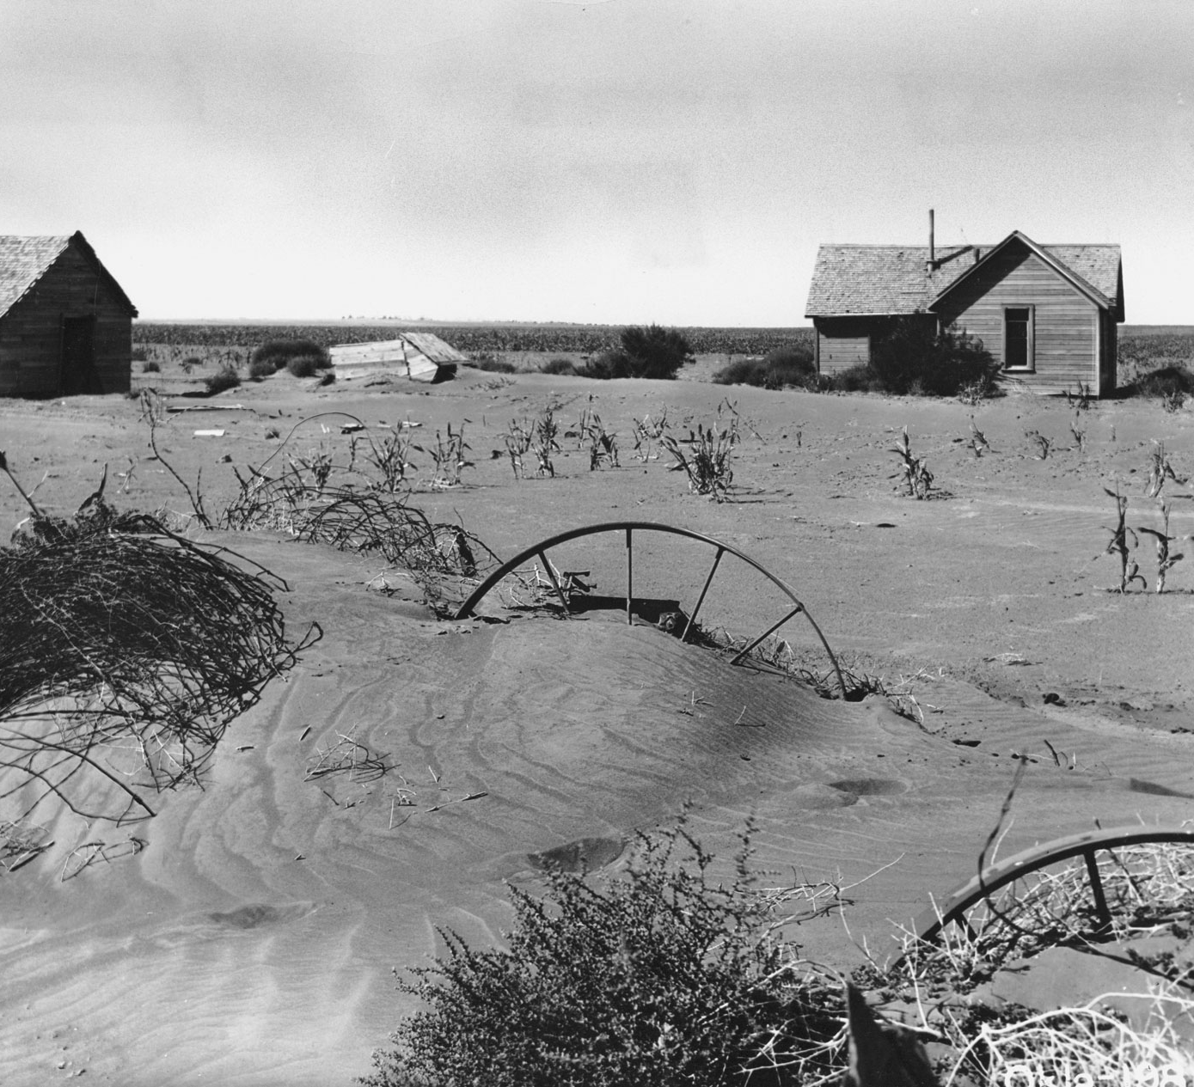
Reflections on history
Dust Bowl. “Though the drought may have triggered it, the Dust Bowl was a manmade disaster.” (72)
Montgomery argues that this was a result not just of drought but of the widespread incidence of over-plowing.

Slide 11
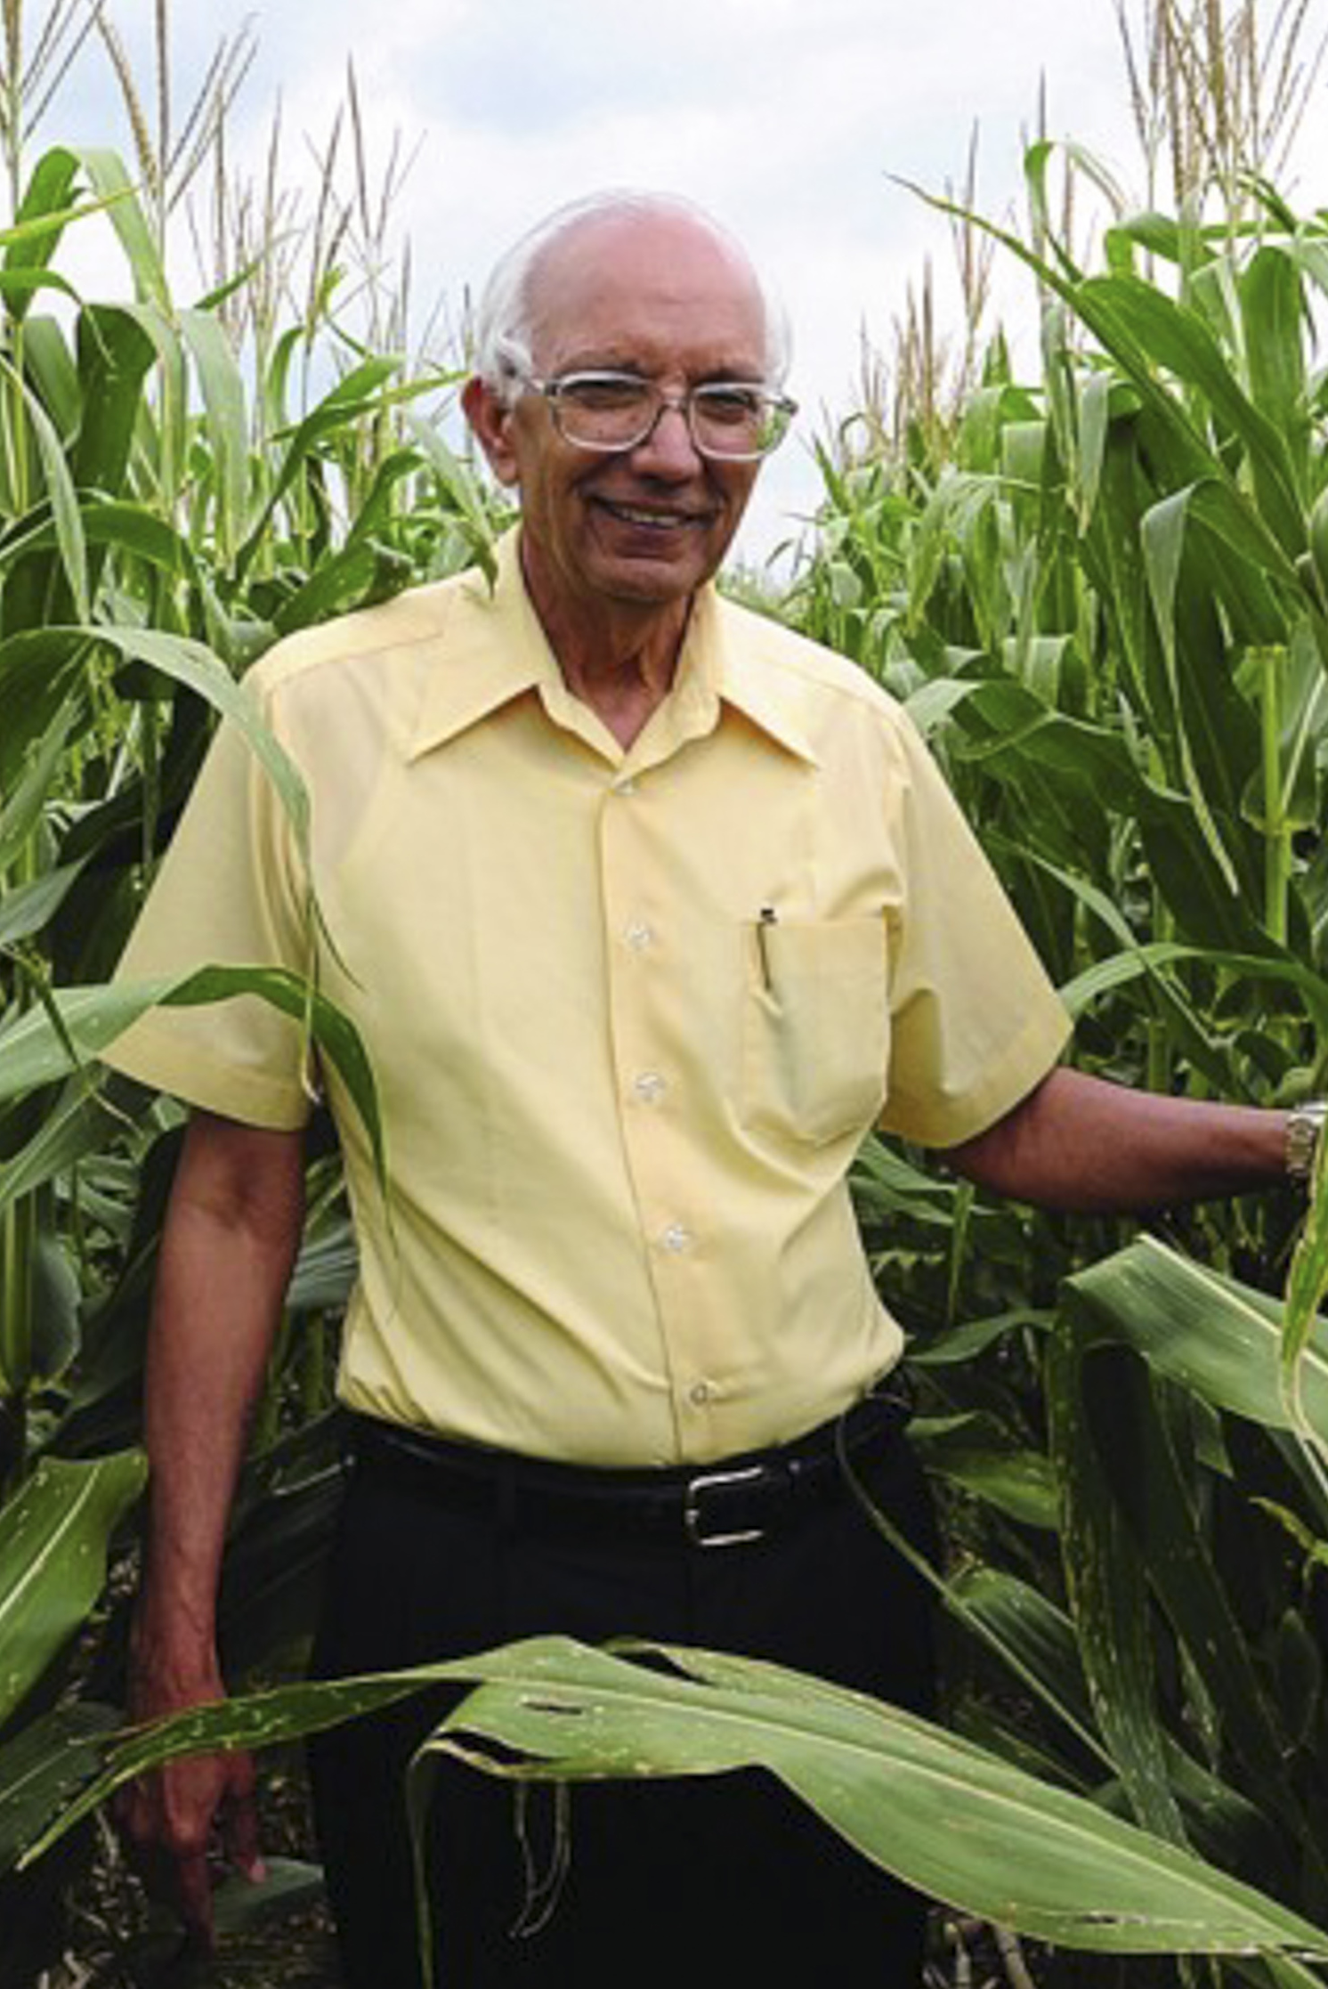
Reflections on history
1943, Edward Faulkner’s book, Plowman’s Folly published
Faulkner was the first to promote no-till in the USA and championed organic methods to build soil structure and fertility.
Rattan Lal. Punjab Agricultural U. (75ff). Story of a Pakastani refugee who becomes a major proponent of no-till and other regenerative agricultural practices. Many of his ideas came from traditional practices that indicate a long duration rotation island or shifting mosaic approach to agroforestry (like the Maya milpa). World Food Prize (2020).

Slide 12
Last words on ditching the plow
But an easy chemical weed control from Monsanto’s development of Roundup (glyphosate) and genetically modified glyphosate-tolerant crops in the 1990s accelerated the adoption of no-till. And this, in turn, helped open the door for conservation agriculture…(83)

Slide 13
Oat straw bale mulch in Prof.Peña’s huerto familiar
Notes:
Trans: Huerto Familiar = Home kitchen garden.

Slide 14
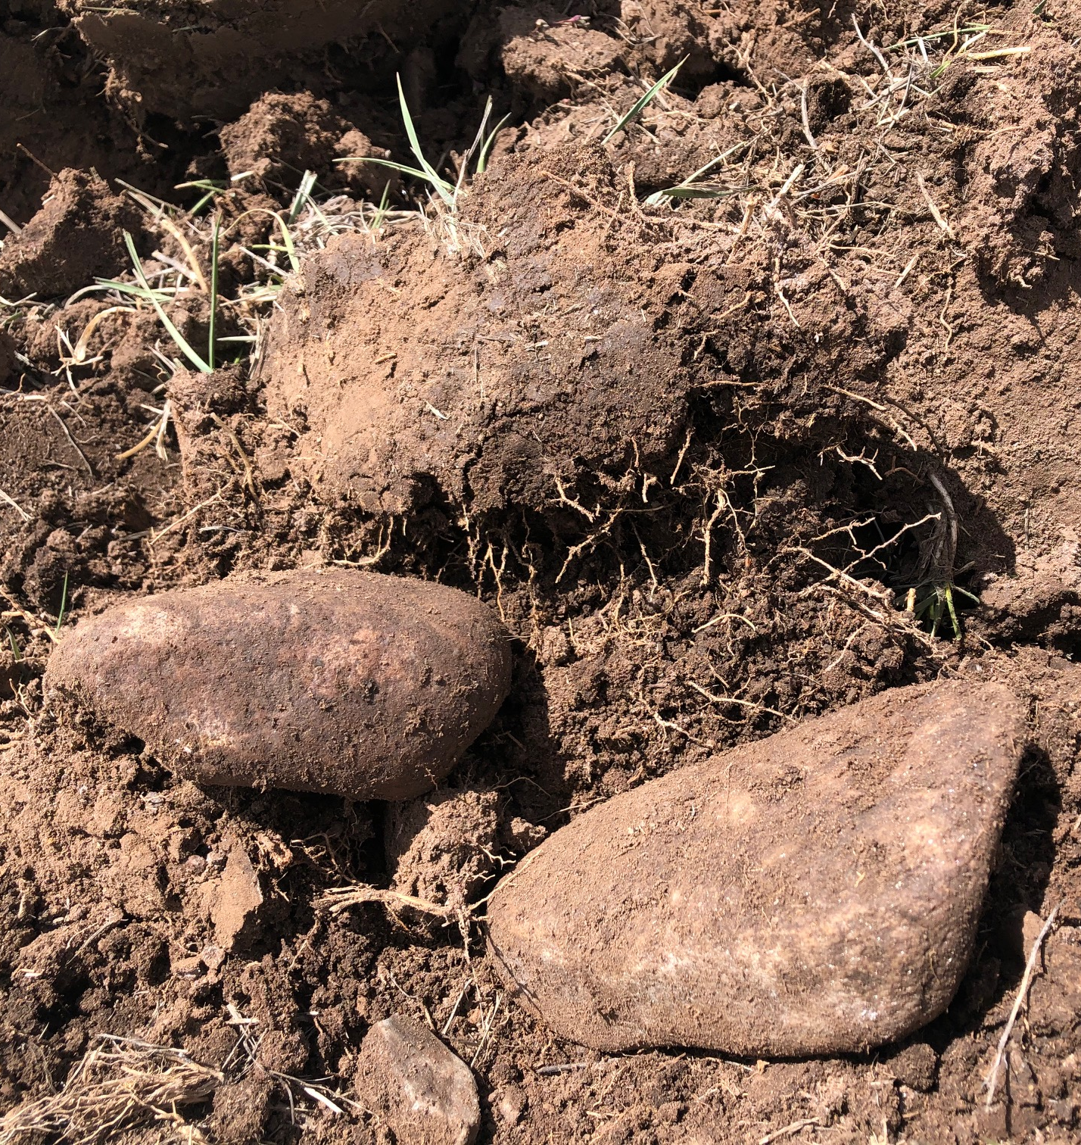
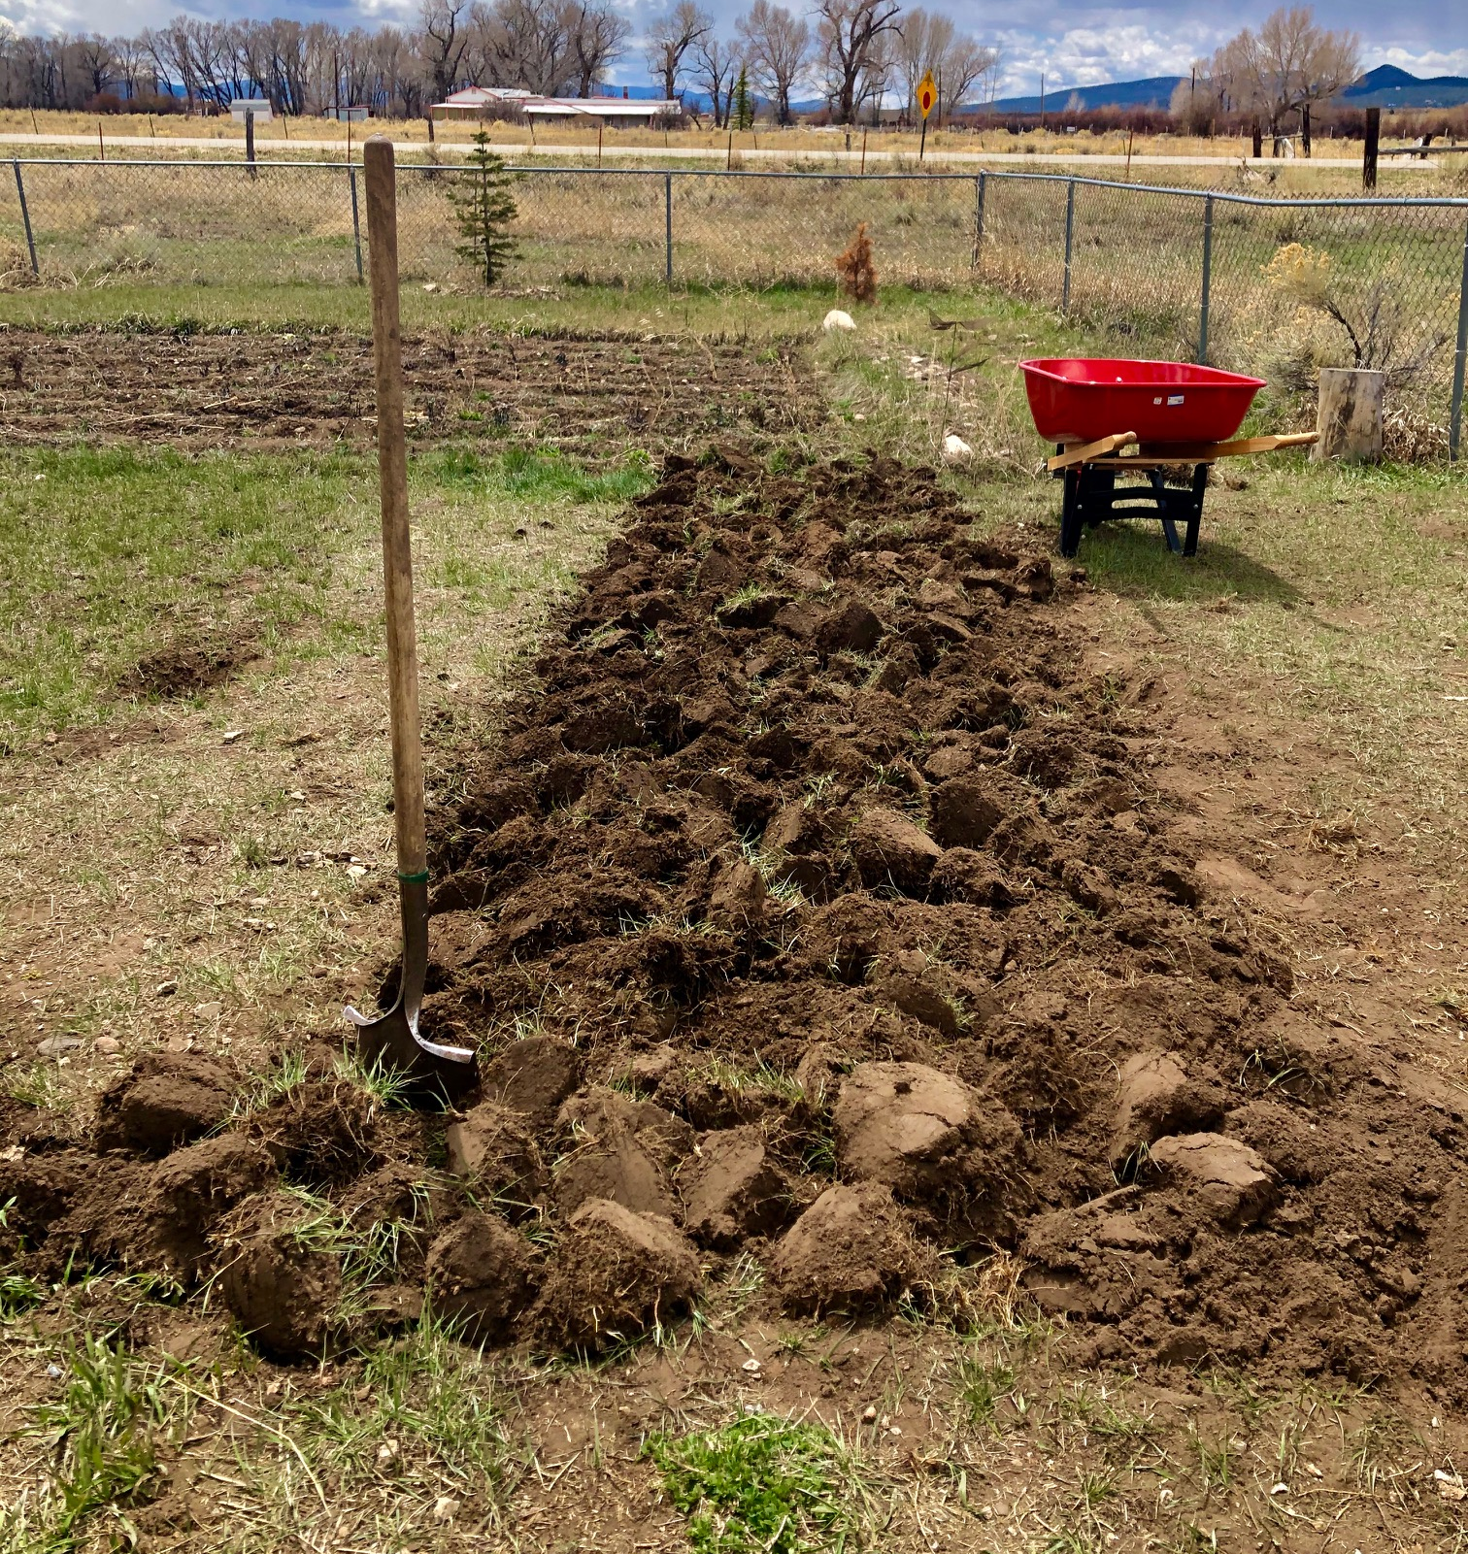
TURF CONVERSION

Slide 15
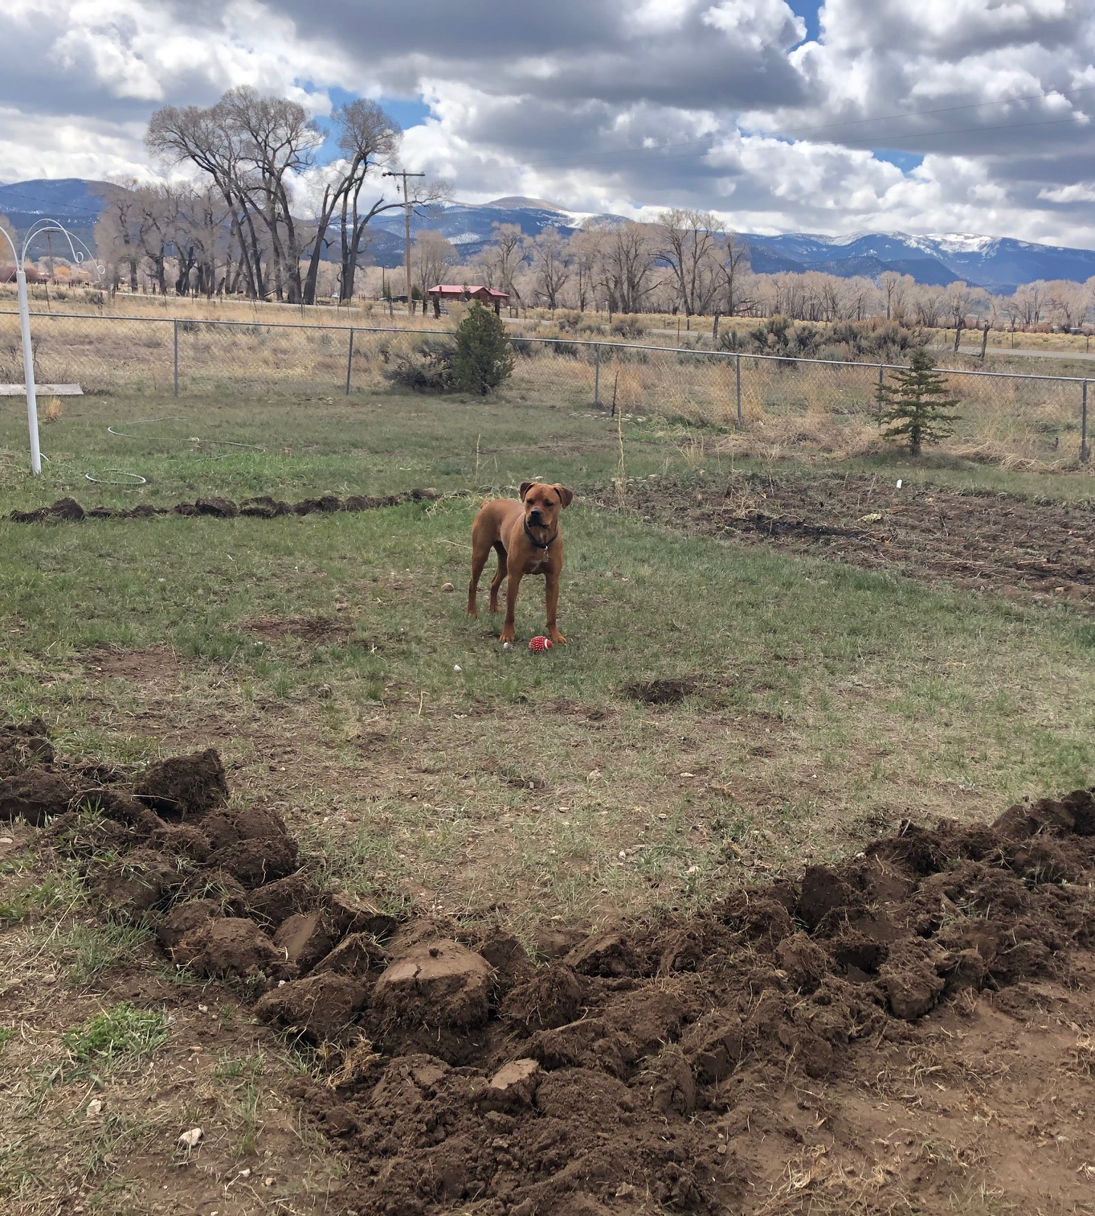
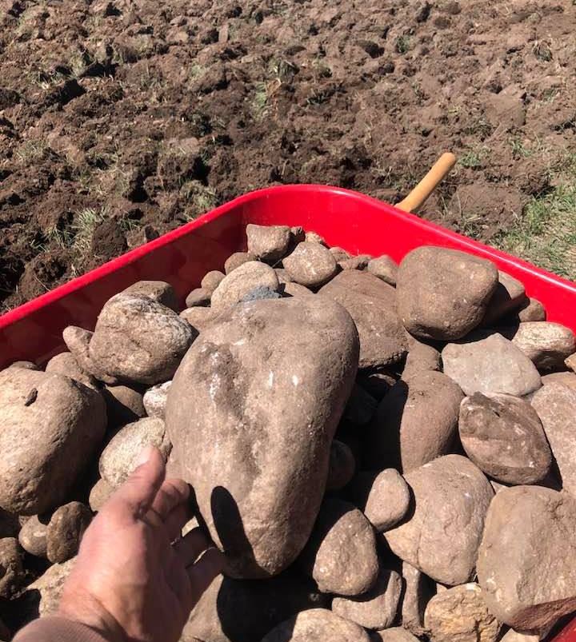
TURF CONVERSION

Slide 16
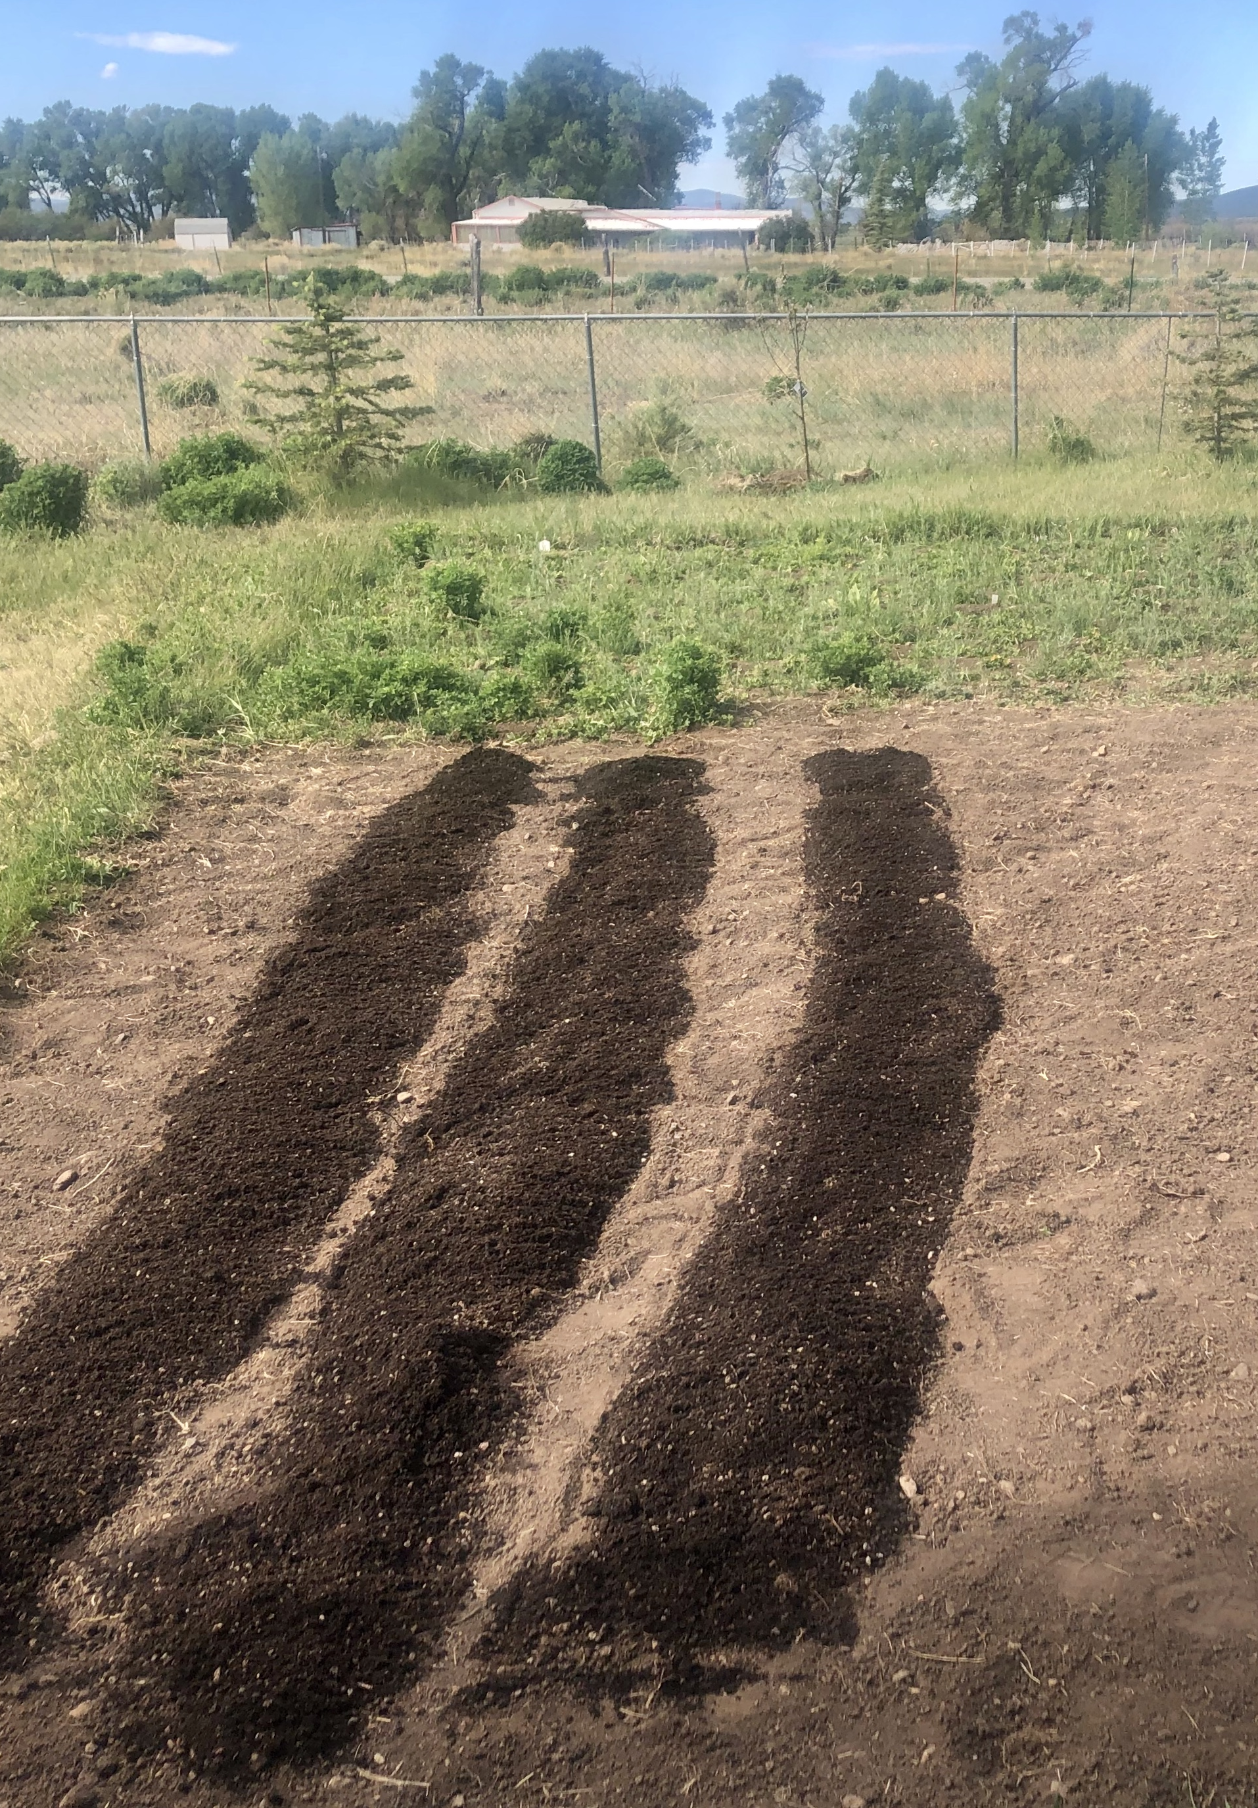
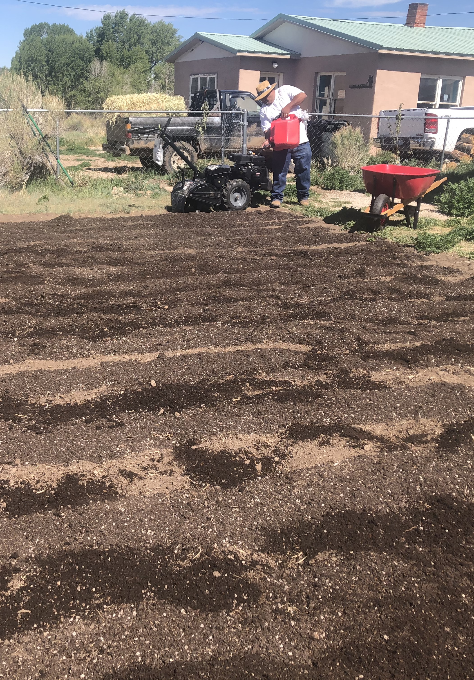
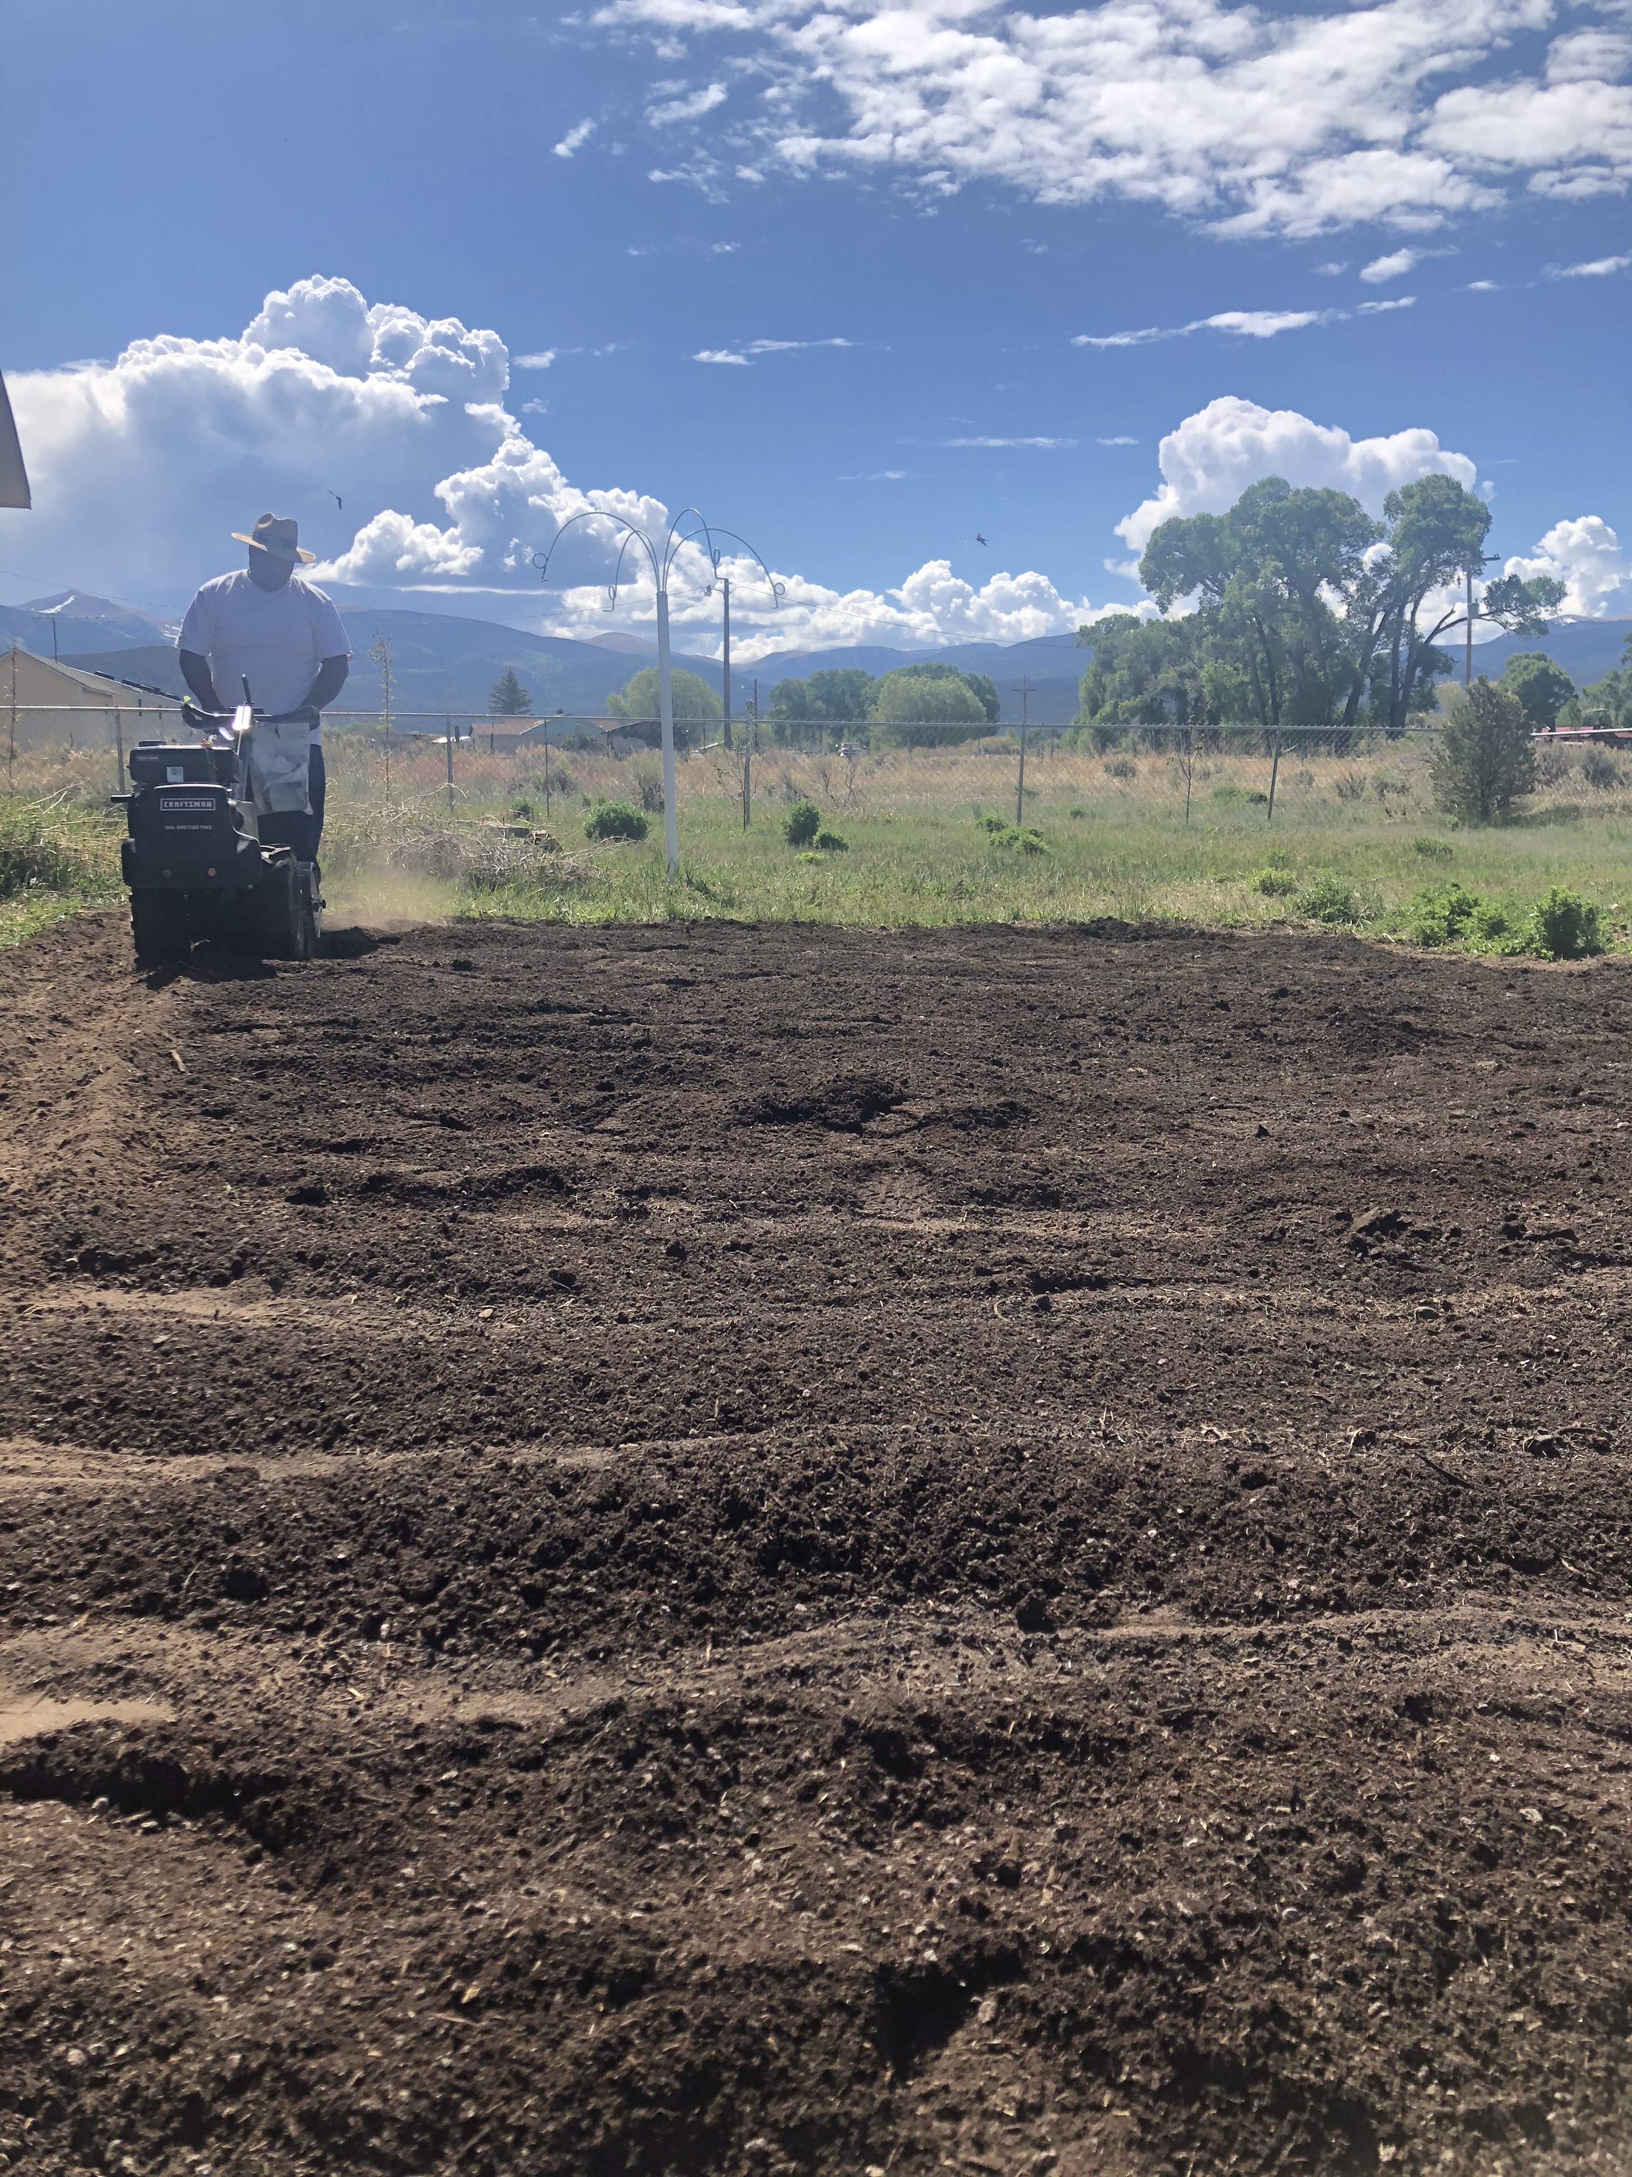
TURF CONVERSION

Slide 17
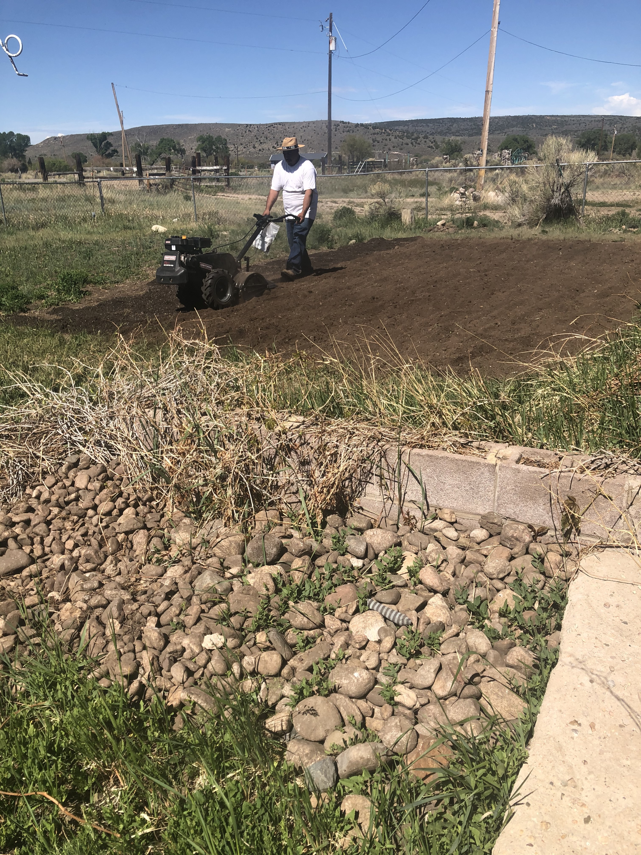
TURF CONVERSION
We removed about a half ton of rocks from the glacial alluvial deposits underneath the turf grass.
Important not to remove all the rocks because they help retain warmth in the soil and create ecological niches for microorganisms.

Slide 18
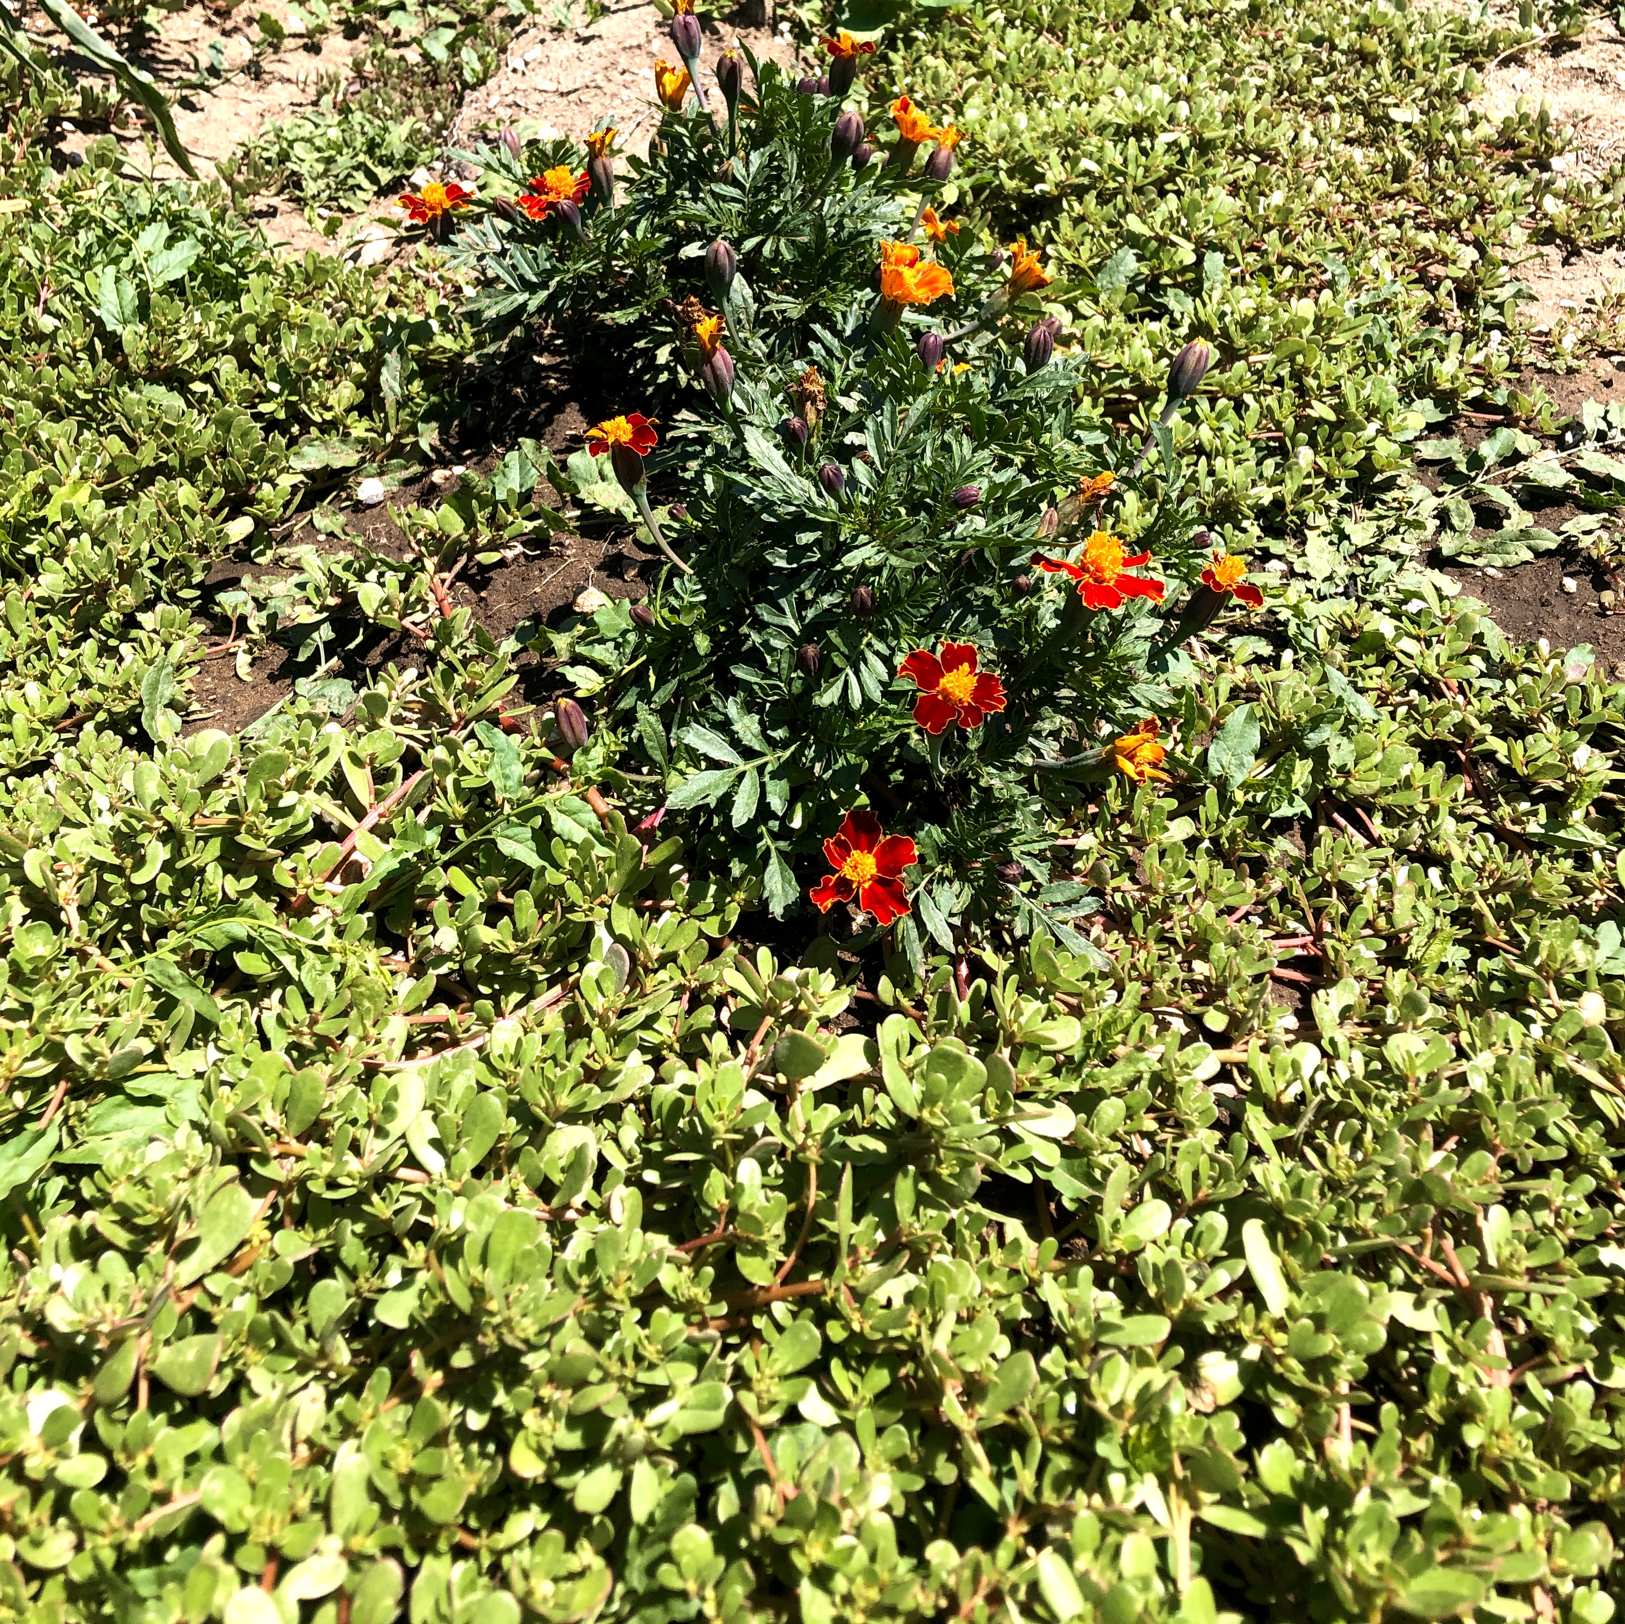
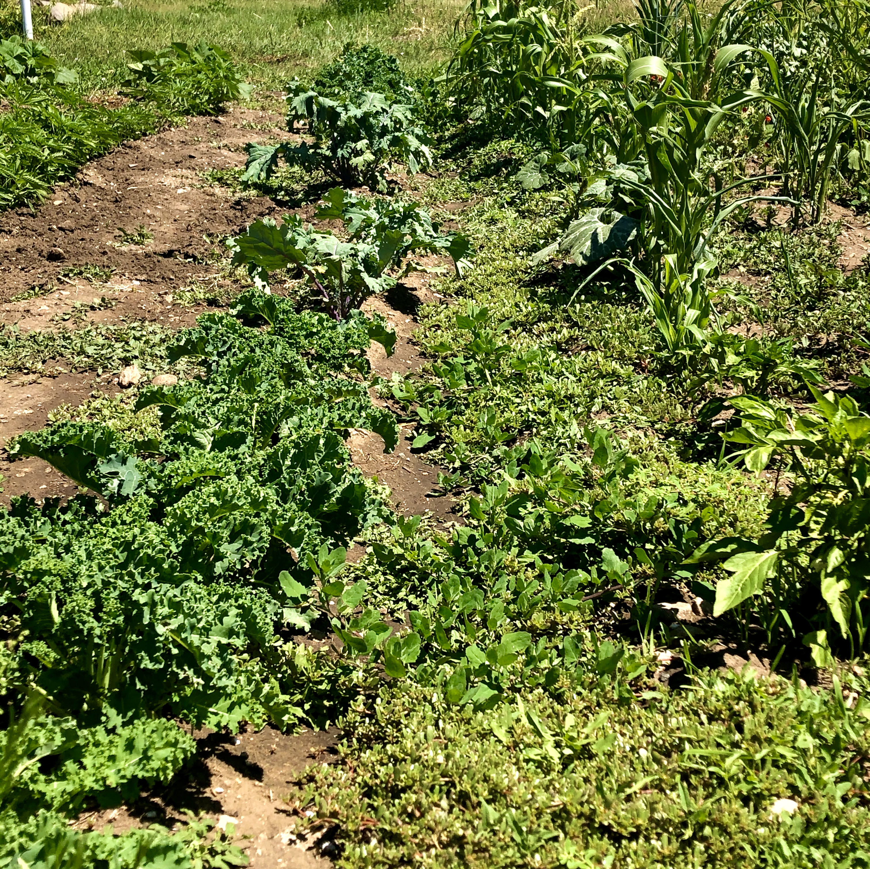
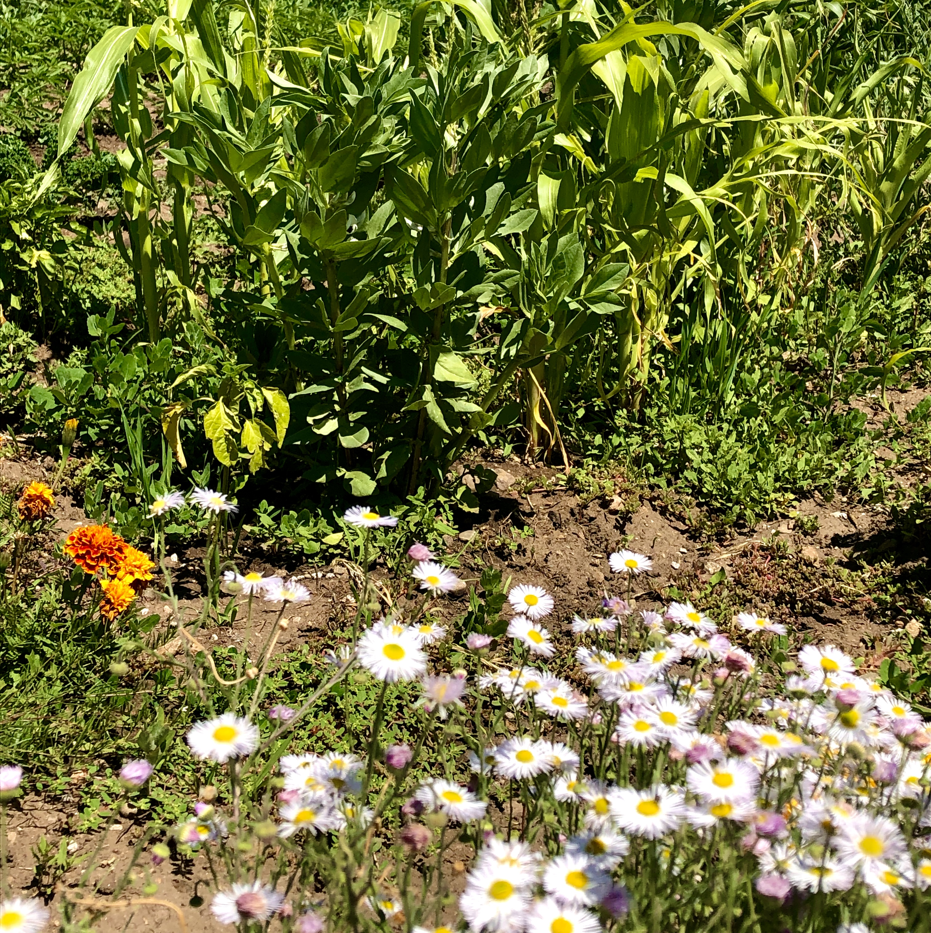
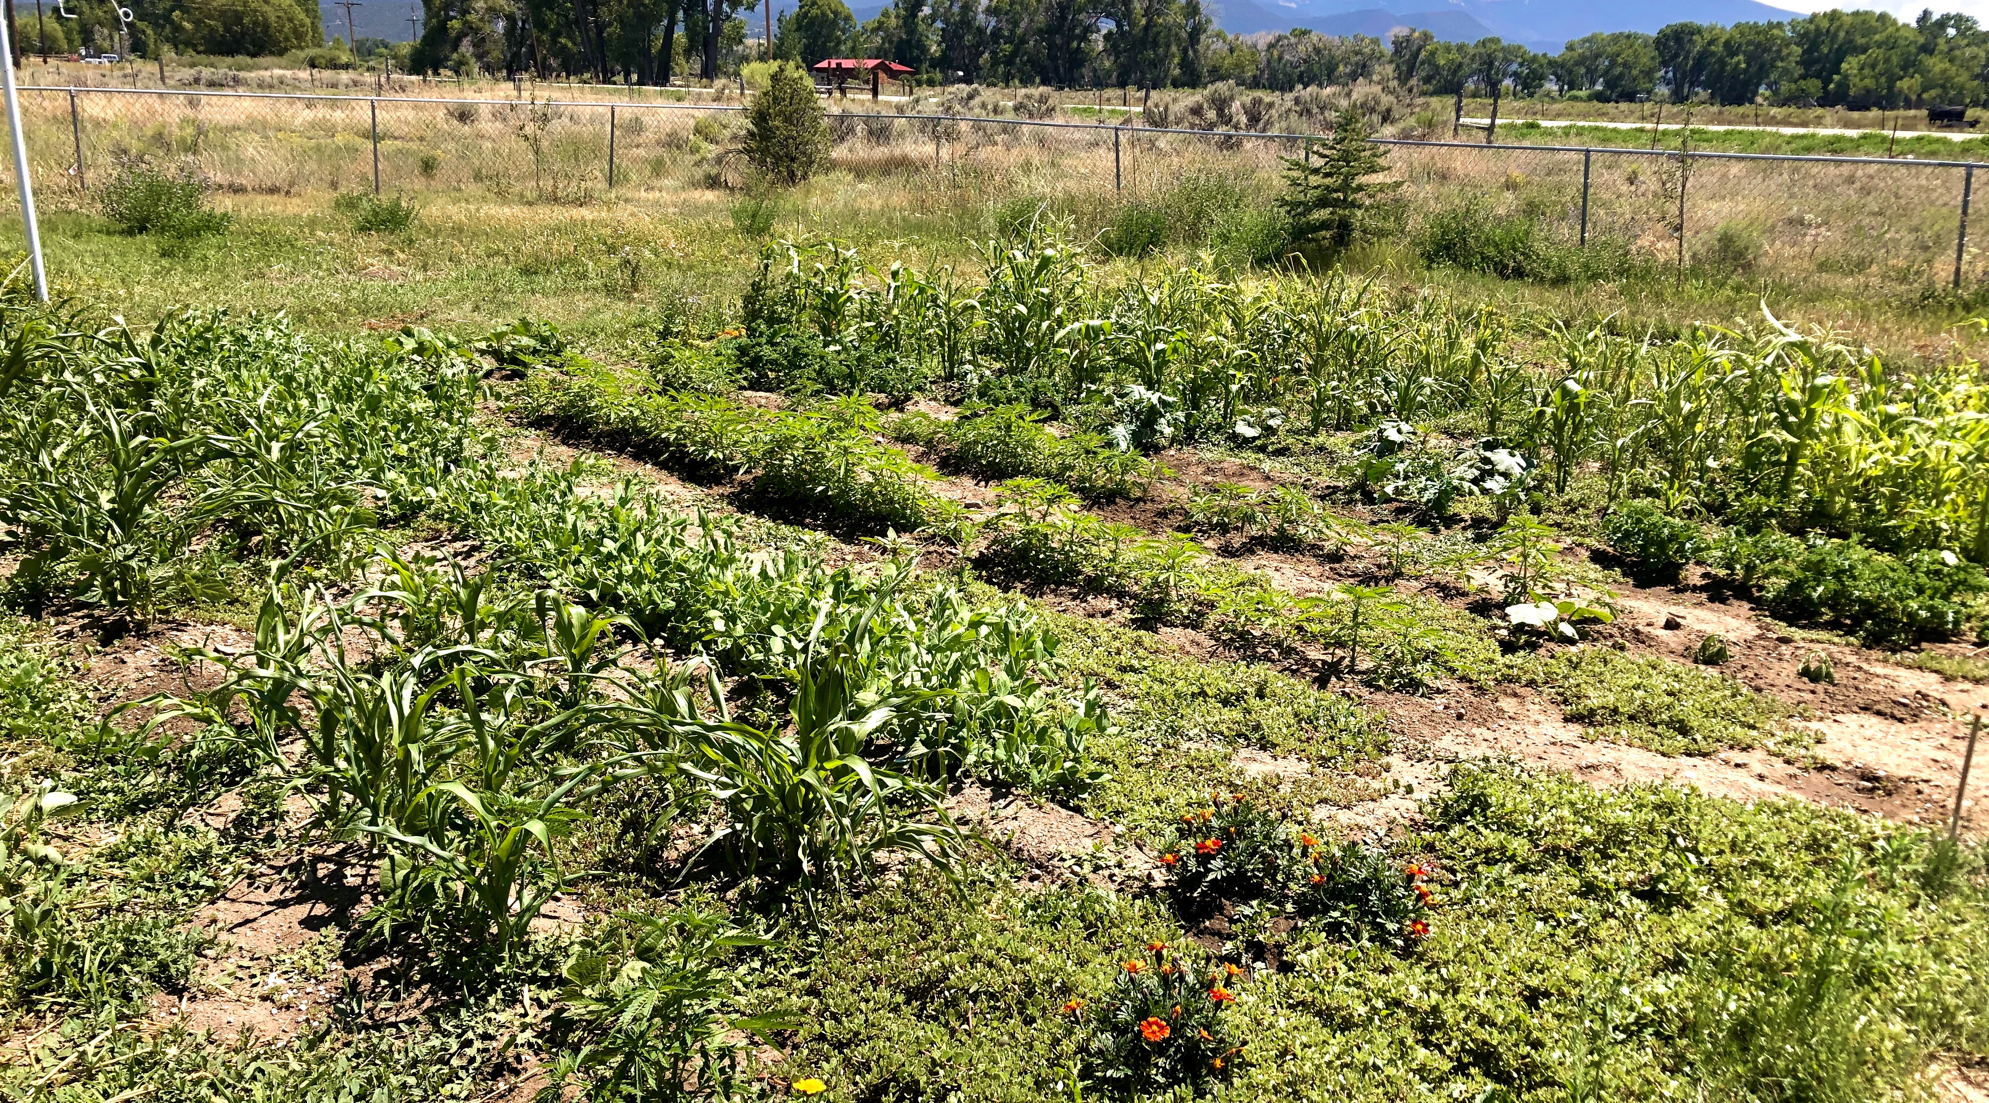
The new huerto familiar
The new home kitchen garden has very few weeds. The principal one is Purslane (Portulaca oleracea) which we call “verdolagas” and is considered a “super green.” It also suppresses other weeds, preserves soil temperature, and has soil biodynamic properties. Purslane is a perennial cover crop. We will follow no-till practices on most of this huerto. The calabacita section requires mounding.
Notes:
Purslane is medicine food; super rich in antioxidants and other beneficial micronutrients. It is also high in many nutrients.
A 100 gram (3.5 oz) portion contains:
Vitamin A (from beta-carotene): 26% of the DV.
Vitamin C: 35% of the DV.
Magnesium: 17% of the DV.
Manganese: 15% of the DV.
Potassium: 14% of the DV.
Iron: 11% of the DV.
Calcium: 7% of the RDI.

Slide 19
Is no-till the best or only option?
For home kitchen gardens, there are alternatives to absolute no-till and this includes various ancient Indigenous practices:
Companion planting
Intercropping
Short duration fallow rotations with cover crops
Crop and allele diversity
Inoculation of root zone with beneficial bacteria.
Addition of biodynamic tinctures and nutrient preparations.
Mulching/composting.
Use of organic composted soil.

