Slide 1
Glyphosate and cancer Samsel and Seneff
Notes:
SAN FRANCISCO (AP) — A jury’s $289 million award to a former school groundskeeper who said Monsanto’s Roundup left him dying of cancer will bolster thousands of pending cases and open the door for countless people who blame their suffering on the weed killer, the man’s lawyers said.
Go to: https://apnews.com/7c8381dd72b048e889d2c1b9af4658b8

Slide 2
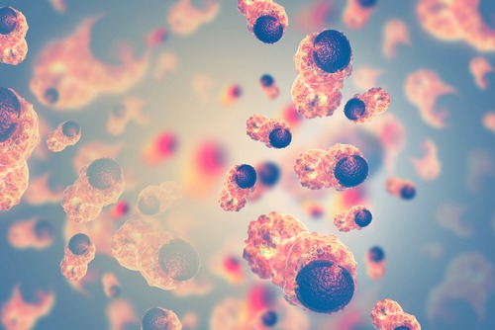
It should be noted that the use of glyphosate for pre-harvest staging for perennial weed control is now a major crop management strategy. The increase in glyphosate usage in the United States is extremely well correlated with the concurrent increase in the incidence and/including several cancers or death rate of multiple diseases. (121)

Slide 3
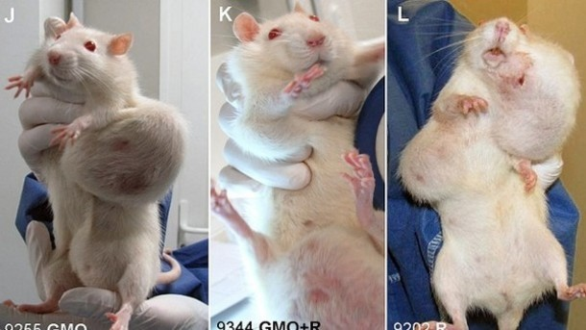
A study of rats fed GM maize and/or Roundup in their water over their entire lifespan revealed significantly increased risk of massive mammary tumours in the females, along with kidney and liver damage in the males. (122)
Notes:
The study was:
Séralini, G.E., Clair, E., Mesnage, R., Defarge, N., Malatesta, M., Hennequin, D. & Spiroux de Vendômois, J. Republished study: Long-term toxicity of a Roundup herbicide and a Roundup-tolerant genetically modified maize. Environ. Sci. Eur. 26 (2014) 14.

Slide 4
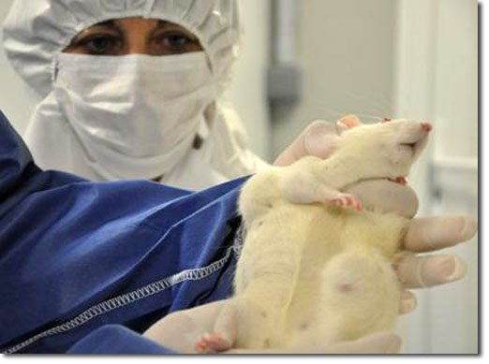
Most of the tumours were benign, but there were three metastases (in female animals) and two Wilm’s tumours found in the kidneys of males, which had to be euthanized early due to the excessive tumours, which grew to more than 25% of their body size. The exposed animals also had a shortened life span compared to the controls. (122)

Slide 5
Glyphosate has been demonstrated to have oestrogenic effects at minute dosages, in in vitro experiments on mammary tumour cells.
Glyphosate was able to induce proliferation in these
cells in concentrations of parts per trillion!

Slide 6
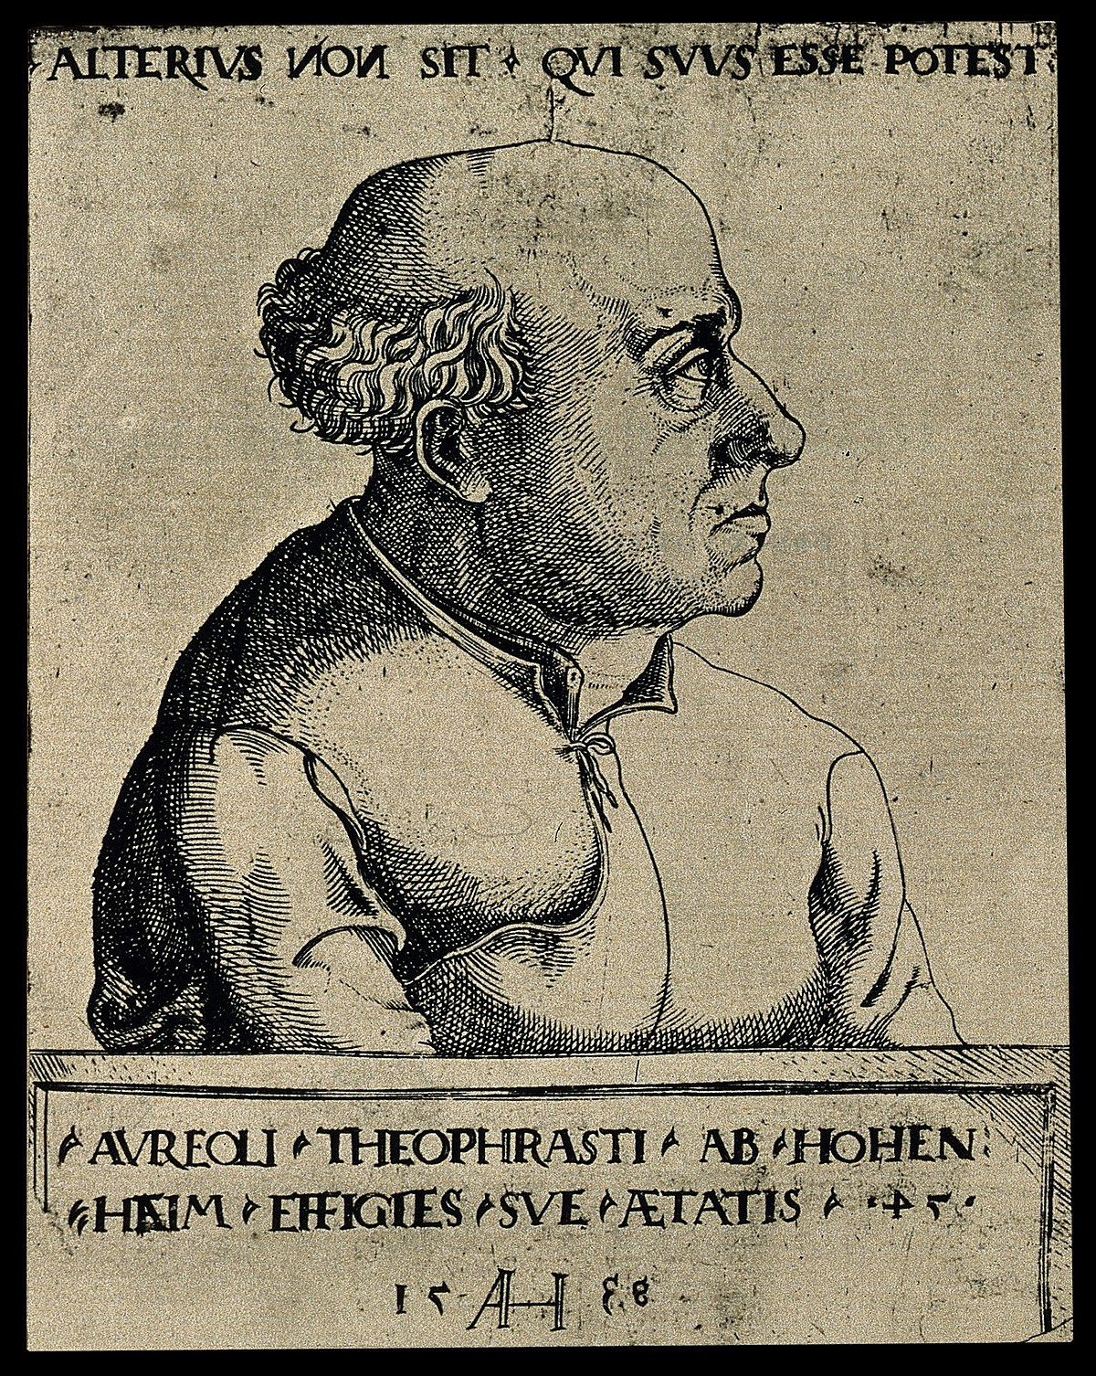
The Paracelsus doctrine shattered
Traditional concepts in toxicology are centered on Paracelsus’ dictum that “the dose makes the poison”, meaning that one should expect an increasing risk of toxicity as the level of exposure is increased. However, the generality of this concept has been challenged due to the realization that endocrine-disrupting chemicals (EDCs) often show a greater potential to cause cancer at very low doses than at higher doses; i.e., the relationship between dose and response is nonmonotonic, with higher doses producing a lower toxic effect than lower doses. (122)

Slide 7
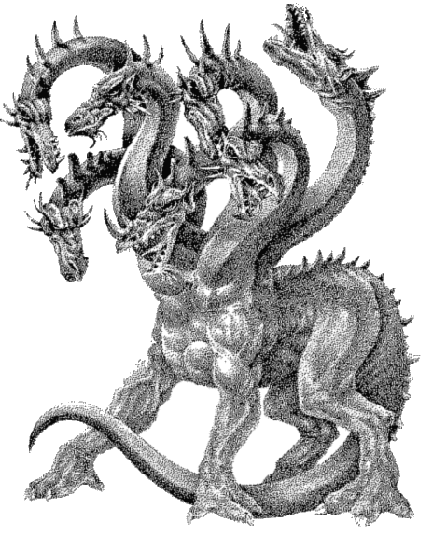
Hydra-headed toxicity
Glyphosate is toxic to many microbes as well as to most plants, and one likely effect of chronic low-dose oral exposure to glyphosate is a disruption of the balance among gut microbes towards an over-representation of pathogens. (122)

Slide 8
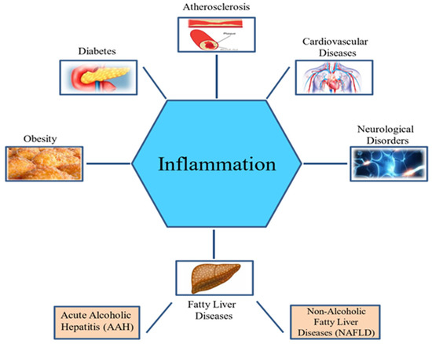
Inflammatory states and disease
This leads to a chronic inflammatory state in the gut, as well as an impaired gut barrier and many other sequelae. It has become increasingly apparent that chronic inflammation increases cancer risk and, in fact, many inflammatory conditions, such as Crohn’s disease, hepatitis, schistosomiasis, thyroiditis, prostatitis and inflammatory bowel disease are known cancer risk factors. (122)

Slide 9
MONSANTO’S EARLY STUDIES
Kidney Disease
Based on information contained in Monsanto’s glyphosate studies on rats and mice [13–18]. In [13], changes in the kidneys associated with chronic progressive neuropathy were noted mostly in males, but also in some female animals of both control and treated groups. There was also mineralization and mineralized debris found in the pelvic epithelium of the kidney, most often in females.
A 50% increase in changes to the kidney of the low-dose group and, in the high-dose group, a fourfold increase in incidence was found compared to the control. Associated with Interstitial renal fibrosis. (123)

Slide 10
MONSANTO’S EARLY STUDIES
Tumorigenicity
A 26-month long-term study in rats conducted by Bio/dynamics revealed multitudes of tumours in glands and organs.
Monsanto trade secret document revealed that there were statistically significant lymphocytic hyperplasias of the thymus as well as significant C-cell thyroid tumours.

Slide 11
MONSANTO’S EARLY STUDIES
Tumorigenicity
Based on information contained in Monsanto’s glyphosate studies on rats and mice [13–18]. In [13], changes in the kidneys associated with chronic progressive neuropathy were noted mostly in males, but also in some female animals of both control and treated groups. There was also mineralization and mineralized debris found in the pelvic epithelium of the kidney, most often in females.
A 50% increase in changes to the kidney of the low-dose group and, in the high-dose group, a fourfold increase in incidence was found compared to the control. Associated with Interstitial renal fibrosis.

Slide 12
MONSANTO’S EARLY STUDIES
Bioaccumulation
Ridley and Mirly [25] found bioaccumulation of … glyphosate in Sprague Dawley rat tissues. Residues were present in bone, marrow, blood and glands including the thyroid, testes and ovaries, as well as major organs, including the heart, liver, lungs, kidneys, spleen and stomach. (124)
The 1988 Monsanto study disclosed: “A significantly greater percentage of the dose remained in the organs and tissues and residual carcasses for the males than for the females. Overall recoveries for group 5 animals were 92.8% and 94.2% for males and females respectively.”

Slide 13
MONSANTO’S EARLY STUDIES
Glyphosate metabolites (it goes beyond AMPA)
Metabolites of glyphosate found during analysis include the nonbasic compounds aminomethylphosphonic acid (AMPA), methylaminomethylphosphonic acid (MAMPA), N-formylglyphosate, N-acetylglyphosate, N- nitrosoglyphosate and an unknown compound tagged as “Compound #11”.
Glyphosate readily reacts with oxides of nitrogen (e.g., NO2) to form the metabolite N-nitrosoglyphosate. This engenders concern because N-nitroso compounds are carcinogens. Nitrous acid occurring in sweat excreta of the skin could be problematic in the presence of glyphosate and may be responsible for the rise of some skin cancers.

Slide 14
Other indications of bad trouble
Extremely high levels of methylglyoxal are found in commercial carbonated beverages sweetened with high fructose corn syrup (HFCS), but not in those that are sweetened with artificial sweeteners [68]. Since HFCS is derived from glyphosate-resistant corn, it is conceivable that the methylglyoxal was produced in the plant in response to glyphosate exposure.
HFCS is implicated in both obesity and diabetes prevalence. Make it from GMO corn and it is likely also producing other toxic and immunological effects.

Slide 15
The GMO HFCS curse
A study comparing rats fed a high-fructose compared to a high-glucose diet revealed that those rats fed fructose experienced a significant increase in body weight, liver mass and fat mass compared to the glucose- fed rats [75]. This was accompanied by a reduction in physical activity, although the total number of calories consumed remained equivalent. We suspect that this phenomenon may be largely due to the presence of glyphosate and methylglyoxal contamination in the fructose (which was likely derived from the GMO Roundup- Ready HFCS). (132)

Slide 18
Glyphosate and the oxidation threat
As was shown by Monsanto’s own studies [26], glyphosate readily reacts with nitrogen oxides to form N- nitrosoglyphosate (NNG), which is of great concern due to its toxicity.
N-nitroso compounds can act carcinogenically in a large number of animal species; there is no rational reason why human beings should be an exception, all the less so since in vitro experiments have shown N-nitroso compounds are metabolized in the same way by human livers as by the livers of experimental animals. (134)

Slide 19
COLON AND LIVER CANCER
As shown in Table 1, the incidence of liver cancer in the USA has increased substantially in the past two decades, pari passu with the increase in glyphosate usage on corn and soy crops.
Nonalcoholic steatohepatitis (NASH) is a fatty liver disease that has been linked to excess dietary fructose [130]. We hypothesize that it is due primarily to the disruption in gut metabolism of fructose due to glyphosate blocking the shikimate pathway, as discussed previously.

Slide 20
COLON AND LIVER CANCER
Inflammation and metabolic disorders are intimately linked, and both are characteristic features of diabetes and obesity [136]. Diabetes and obesity are linked to dramatically higher risk of cancer, particularly of the liver and gastrointestinal tract [137]. This is directly linked to bile acid dysregulation and dysbiosis of the gut microbiome.
Gut dysbiosis, due in part to glyphosate’s antimicrobial effects, leads to gut inflammation and impairment of the gut barrier function. This means that pathogens will escape the gut and infiltrate the liver. (134-5)

Slide 21
Conclusions
…we have provided strong evidence that glyphosate is likely contributing to the increased prevalence of multiple types of cancer in humans. Monsanto’s own early studies revealed some trends in animal models that should not have been ignored. Forty years of glyphosate exposure have provided a living laboratory where humans are the guinea pigs and the outcomes are alarmingly apparent. (141)
We have shown that glyphosate transforms exposed cells into a tumour-provoking state by suppressing crucial enzymes in the electron transport chain, such as succinate dehydrogenase and fumarate hydratase. Glyphosate chelates manganese, reducing its bioavailability, and manganese is an important catalyst for Mn-SOD, which protects mitochondria from oxidative damage, which can cause mutations in DNA. (141)

Slide 22
Conclusions
Multiple studies, both in vitro and in vivo, have shown that glyphosate damages DNA, a direct step towards tumorigenicity. These studies have been conducted on sea urchins, fish, mice and various human cell types in vitro. Children in Malaysia living near rice paddies have evidence of DNA damage.
Epidemiological studies strongly support links between glyphosate and multiple cancers, with extremely well matched upward trends in multiple forms of cancer in step with the increased use of glyphosate on corn and soy crops. (141)
While these strong correlations cannot prove causality, the biological evidence is strong to support mechanisms that are likely in play, which can explain the observed correlations through plausible scientific arguments.

Slide 23
Conclusions
Manganese deficiency stresses the pancreas and impairs insulin synthesis, and this could explain the recent epidemic in pancreatic cancer. Increased oxalate, due in part to the proprietary formulations, stresses the kidney and contributes to risk of renal tumours. Glyphosate’s accumulation in bone marrow can be expected to disrupt the maturation process of lymphocytes from stem cell precursors. Glycine forms conjugates with organic benzene- derived carcinogenic agents, and glyphosate likely interferes with this process. Glyphosate’s interference with CYP enzyme function impairs detoxification of multiple other carcinogenic agents, increasing their carcinogenic potential. Overall, the evidence of the carcinogenicity of glyphosate is compelling and multifactorial. (141)

