Slide 1
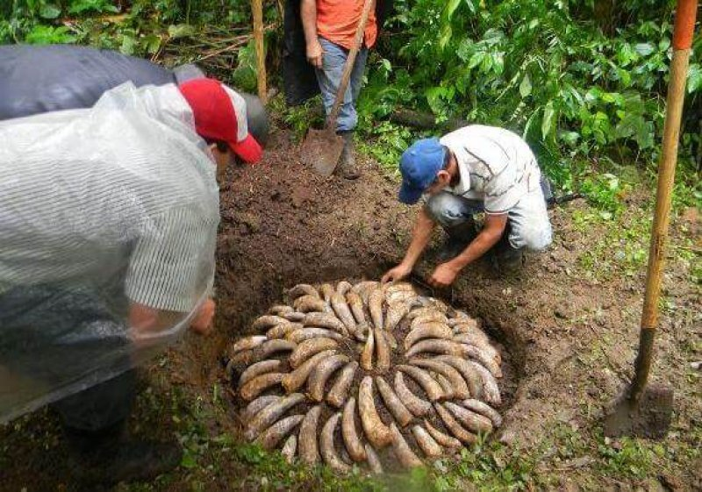
Biodynamics and compost
Reeve, et al.
Biodynamic (BD) agriculture was first presented as an alternative form of agriculture in 1924 by the Austrian philosopher Rudolf Steiner (Steiner, 1993). Since then it has gained considerable following, especially in Europe, Australia, New Zealand and India.
Notes:
Photo credit: Antonio Marxuach/Travel Word. BD farmers bury rams’ horns filled with fermented mixture derived from an assortment of herbs.

Slide 2
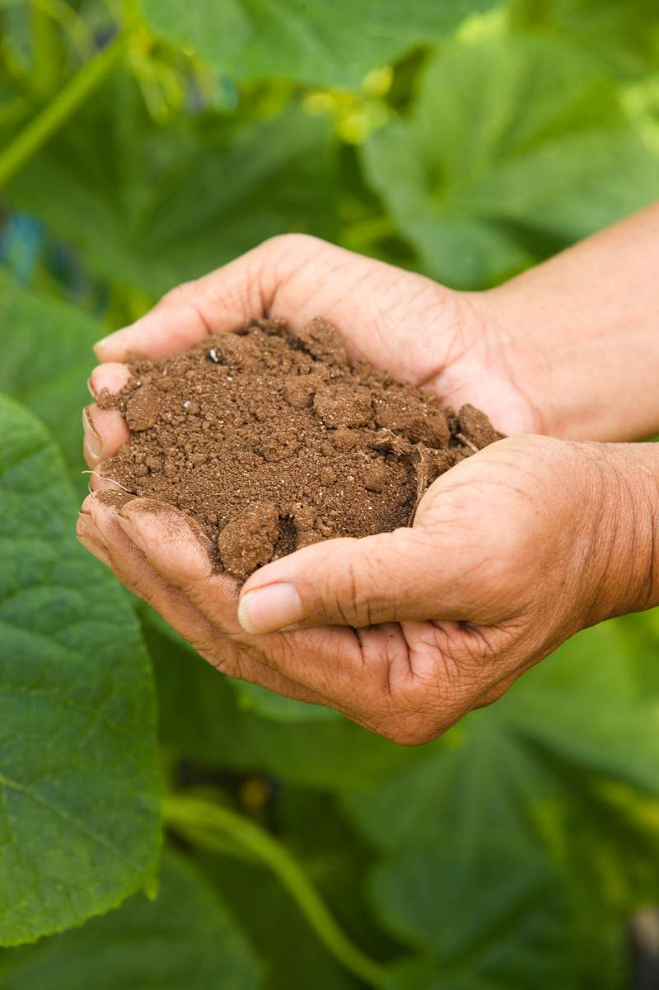
That which secures life from exhaustion lies in the unseen world, deep at the roots of things.
- Rudolf Steiner
Notes:
My wish here today is to advance a conversation between the Indigenous Agroecological Tradition (IAT) and the Western Biodynamics and Permaculture (WBP) movements. As one can see, given this quote from Rudolf Steiner, many thinkers, farmers, and advocates from European and American settler colonial societies share important ethical principles for an alternative science of soil and farming anticipated by the agroecologists of our First Nations/Peoples as we have seen in the epigrams from my grandmother and beloved elder mentor, Adelmo Kaber.

Slide 3
Rudolf Steiner’s Principles of Biodynamics
Agriculture course (1924)
  Treat soil as a living organism.
  Regenerate soil through manure, compost, and allelopathic companion planting and treatment.
  Always go with polycultures: include mix of perennial and annual crops with livestock.
  Be aware that a plant’s growth and nutritive qualities are affected by soil fertility and ‘cosmic’ forces like moon- and star-light. See Bünning and Moser (1969)

Slide 4
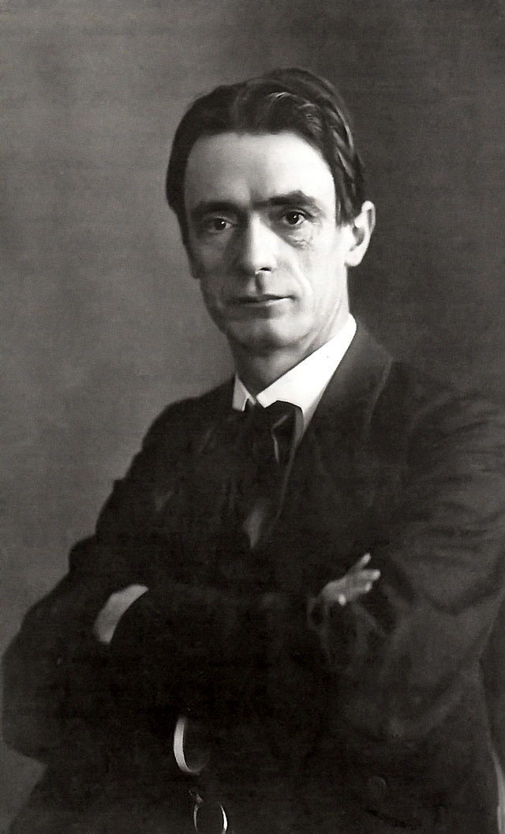
Steiner (1861-1929)
Lord Northbourne adopts Steiner’s concept of “farm as organism” in 1940s and coins the term “organic farming.” In 1950’s, influenced by the rise of biodynamic farming in Europe, the American Jerome. I. Rodale adopts the term “organic” in his book, The Organic Farmer.
Like biodynamic forbearer, Rodale’s primary emphasis was soil health; avoidance of synthetic chemicals; use of compost and cover crops; and holistic pest and weed management. He diverged from the fundamental view of the farm as organism.
- Light of Day Organics

Slide 5
Biodynamics timeline (modified)
Chronology of modern agroecological factors
affecting nutritive quality of crops
1750-1850 1920 1930 1940 1950 1960 1970 1980
R. Steiner Nazism
Enclosure (1861-1925) Dust Bowl Pesticides Monocultures
⬅Colonialism SCS Fertilizers (NPK) Herbicides
Bureau of Reclamation Farming Agroecology
systems
vitamins discovered
INDUSTRIAL GREEN
REVOLUTION REVOLUTION

Slide 6
Biodynamics timeline (extended)
Chronology of modern agroecological factors
affecting nutritive quality of crops
1950 1960 1970 1980* 1990 2000 2010-
Pesticides rDNA (1974)* Bt corn(1996)
Herbicides Roundup (1996)
First transgene
introgression (1998)
Monocultures Agroecology Chakrabarty Patent gene IAASTD editing
GREEN GENE (BIOTECH) AGROECOLOGY
REVOLUTION REVOLUTION PARADIGM SHIFT?
(ROOTED IN IK)
* Stanford U. Cohen-Boyer patent (1974; 1980)

Slide 7
Steiner anticipated impacts of the Green Revolution
      The well established result was the anticipated increase in yields, but with an unanticipated decrease in nutritive value of the agricultural produce. Equally unforeseen was the gradual deterioration of soil quality, i.e. the destruction and increasing disappearance of ‘living soil’. Food began losing its nutrition, we became diseased, and the natural healthy thinking of the past was lost.
      Bio-Dynamics (Fall 1968)

Slide 8
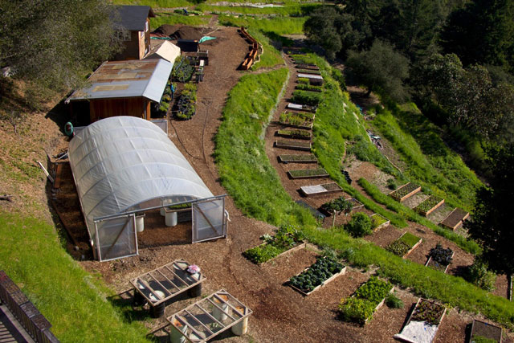
Soil health is human health
Steiner’s declared aim was to work with the soil as the true foundation of human health. This meant restoring to the soil the organic matter it needs to hold its fertility, and restoring to the soil a balanced system of functions by treating it not merely as an aggregation of chemicals, whether mineral or organic, but as a truly living system.

Slide 9
Modern science and biodynamics
Modern studies in edaphology (the study of soil and organism ecology) and pedology (the study of soil quality in its natural environment) are anticipated and influenced by many of the concepts and methods used by Steiner. Studies of soil microbiota and the effects of agroindustrial chemicals on soil ecosystems are an example of this legacy.
…But so too, it turns out, is the recovery of the soil knowledge of 13th C. Colhua Mexica and other Indigenous farmers.

Slide 10
Discourse politics
Like Rachel Carson, Steiner was attacked by the chemical industry and accused of peddling “pseudoscience”. Biodynamics is a hoax.
Despite these attacks, there is a considerable body of scientific evidence supporting key tenets of the theory and praxis of biodynamics.
Colonialist parallel: Likewise, indigenous knowledge systems for regenerative soil practices have until recently been erased or discounted as unscientific superstitions.

Slide 11
Plant | Ethnomedical Value | Biodynamic properties
Chamomile Manzanilla (Matricaria recutita). This is an Introduced and ‘naturalized’ plant. | Tea has calming effect; sulfur content has antifungal properties; hay fever relief; anti-inflammatory; muscle spasms; menstrual disorders; insomnia; ulcers; wounds; gastrointestinal disorders; prevents rheumatic pain; reduces swelling of hemorrhoids. | Roots loosen compacted earth so other plants can find nutrients & water. Preparation of flower ‘tea’ helps unblock plant sap & prevents stress from excess heat/cold; adds sulfur & calcium to compost mixes; high in potassium. Stabilizes nitrogen within compost & increases soil life to stimulate plant growth.
Datura Tolohua (Datura innoxia) | Analgesic; narcotic effects used in setting broken bones; in making incisions as well as relieving painful bruises and other injuries. Anti-angiogenesis properties. | Insecticidal potential of leaf hexane extract. Phytoextraction of heavy metals from soil (e.g., excess cadmium, chromium). Grows in alkaline soils. Should not be grown alongside potato plants as it can be a center of viral infections.
Notes:
Ethnomedical and Biodynamic Properties of Companion Plants in Traditional ‘Three Sisters’ Milpas. Codex de la Cruz-Badiano. 257 plants in the catalog with 180+ illustrations.

Slide 12
Plant | Ethnomedical Value | Biodynamic properties
Lambs quarters Quelite (Chenopodium album) | Astringent; upset stomach relief; prevents scurvy. Tea used to treat diarrhea. | Useful as ‘trap crop’ for leaf miners. Hosts beet leaf hopper. Restores nutrients to the soil (phosphorous may not be bioavailable to plants for many years through green manure).
Laurel; Mexican Bay Leaf Eca-patli (L. glaucescens) | Bruised together in frigid water with other herbs & stones, then soaked in a neck wrap for sore throats or relief of head & neck pains. | Creates a supportive microclimate for shade-tolerant pulses and vegetables.
Notes:
Ethnomedical and Biodynamic Properties of Companion Plants in Traditional ‘Three Sisters’ Milpas

Slide 13
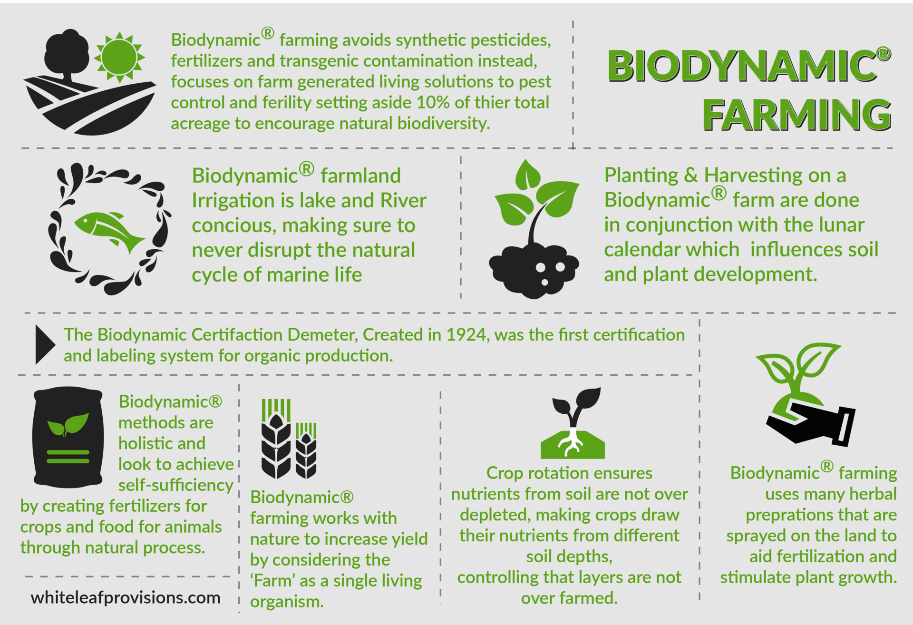
Core principles
Biodynamics shares much in common with organic methods of farming, including soil building, crop rotations, and composting. A key aspect of the BD method is the use of special preparations that are applied to the soil, crops and composts. The compost preparations consist of six fermented herbal substances. (5658)

Slide 14

Sample of plants used in BD soil amendments
Yarrow blossoms (Achilliea millefoilium L.)
Chamomile blossoms (Matricata recutita L.)
Stinging nettle shoots (Urtica dioica L.)
Oak bark (Quercus robur L.)
Dandelion flowers (Taraxacum officinale L.)
alerian flower extract (Valeriana officinalis L.) Table 1 (5659)

Slide 15
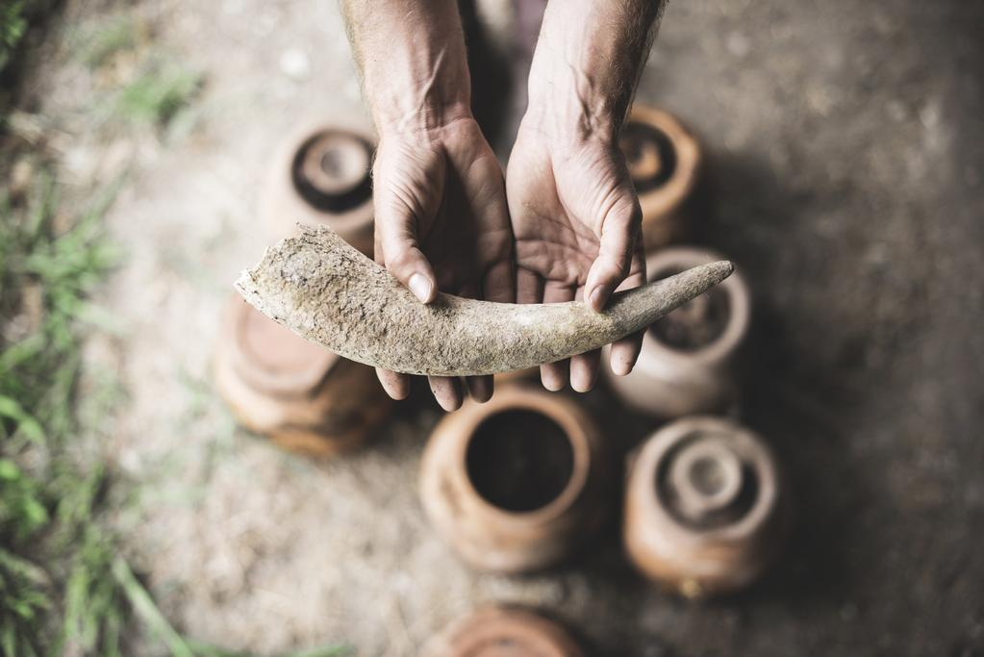
Purpose of the study
…firstly, to test the effect of BD compost preparations on the quality of compost produced on a commercial California vineyard. Secondly, water extracts of finished BD-treated and non-treated pomace composts with and without added fertilizer were tested for effects on wheat seedling growth. (5659)

Slide 16
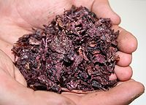
The case of BD wine
McNab Ranch, Hopland, CA
Wine production creates considerable volumes of organic waste called grape pomace, which includes grape seeds, skins, and stems. Composting has become the obvious solution for pomace disposal for many wineries. The resulting compost is often used on site in the vineyards to increase soil organic matter, soil nutrients, water holding capacity and porosity. (5659)

Slide 17
Findings
Oxidation-reduction reactions are essential to growth and survival of organisms, as the oxidation of organic molecules produces energy.
Note: Dehydrogenases are a subclass of the class of enzymes called “oxidoreductases.” Oxidoreductases, in general, catalyze oxidation and reduction reactions.

Slide 18
Findings
There were no differences in mineral elements by treatment at the start or end of composting (Table 2). Potassium was significantly higher in 2005 and Na and Mg were higher in 2002 at the end of composting suggesting some accumulation of salts.

Slide 19
Findings
Compost pH can also be influenced by the initial pH of the feedstocks. Grape pomace is usually a highly acidic material, with a pH as low as 3.5. (5662)
The BD-treated compost had greater dehydrogenase activity in both years suggesting that BD compost had greater microbial activity.
Composting in both treatments resulted in a 99.8% reduction in fecal coliforms over the 200 d process, confirming the efficiency at which these organisms are reduced during composting.
Composting in both treatments resulted in a 99.8% reduction in fecal coliforms over the 200 day process, confirming the efficiency at which these organisms are reduced during composting. (5665)

Slide 20
Caveats
Compost pH can also be influenced by the initial pH of the feedstocks. Grape pomace is usually a highly acidic material, with a pH as low as 3.5. (5662)
The BD-treated compost had greater dehydrogenase activity in both years suggesting that BD compost had greater microbial activity. (5665)
In 2005, compost analysis showed a lack of NO􏰁3 formation. These findings were likely due to excessive pH in the compost.
High pH could have been caused by fresher manure with a higher concentration of urea. Composting conditions were also somewhat wet in both years which could have contributed to the problem.

Slide 21
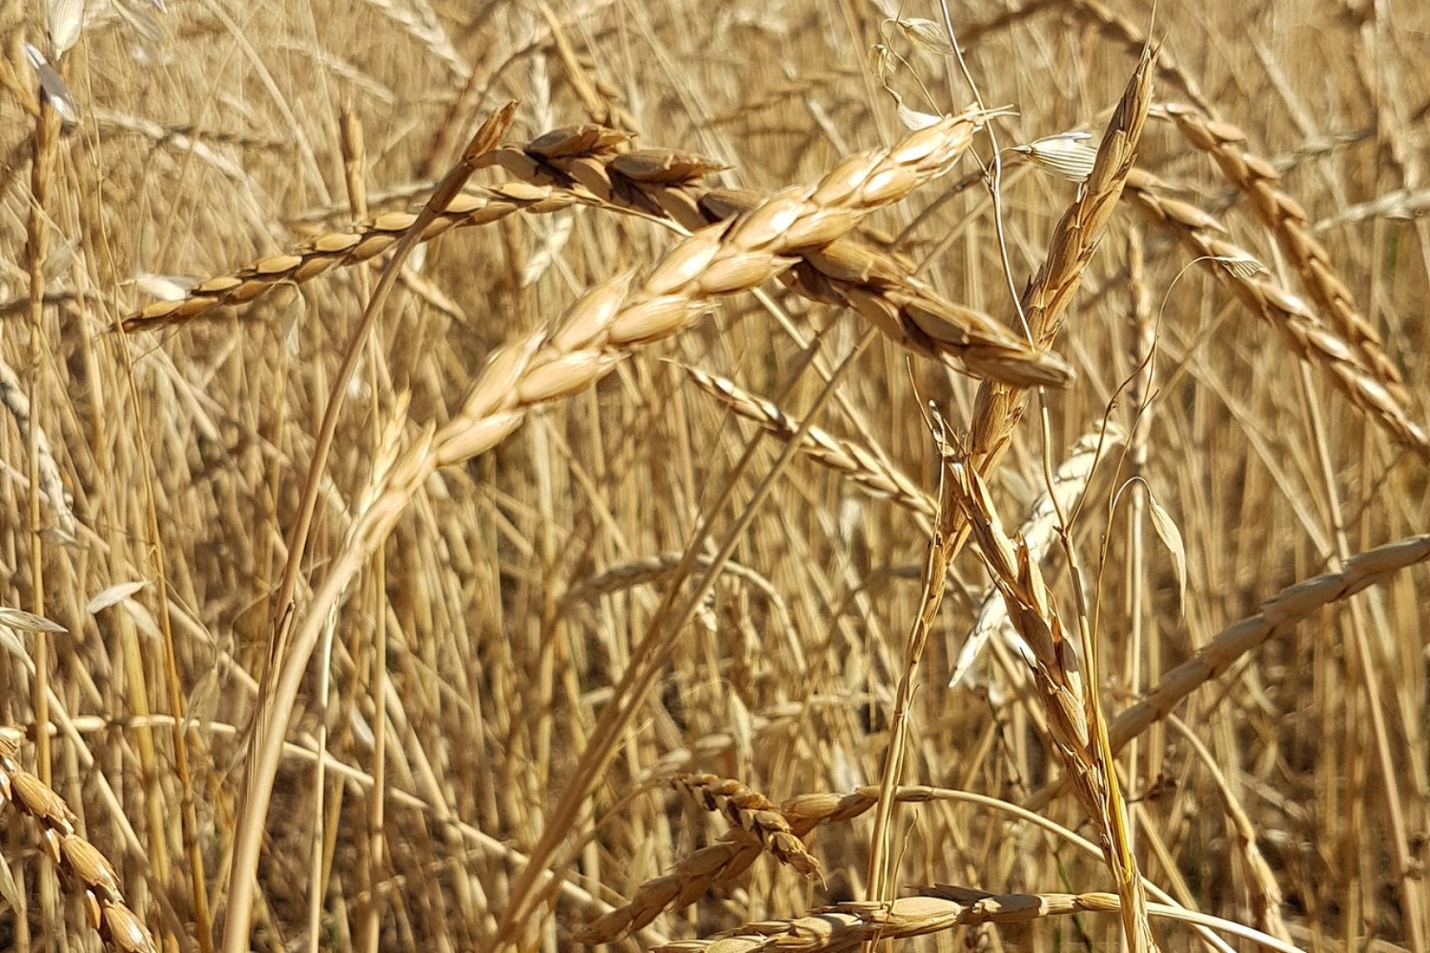
The wheat seedling results
Compost extracts from this study were also tested for their effects on growth of wheat seedlings. Wheat growth in all treatments including water controls was greater in 2003 than in 2005, indicating different growth conditions between the two years. (5662)

Slide 22
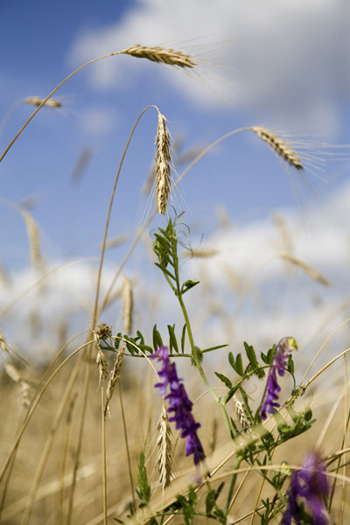
The wheat seedling results
Wheat seedlings that received 1% extract of either BD or control composts in 2005 grew similar root and shoot biomass as fertilized seedlings, despite the 1% compost extracts containing only 30% as much nitrogen as the fertilizer treatment. (5662)
All 1% compost extracts with or without fertilizer resulted in greater shoot height, and root biomass in both years than water only controls. This effect was not seen as consistently in the shoot biomass data; of the unfertilized treatments only 1% BD compost produced greater shoot biomass than water in 2002.

Slide 23
The wheat seedling results
In 2005 the 1% compost extract alone resulted in similar growth to the highest level of fertilizer and the addition of fertilizer to the compost extract had no further effect on growth. In both years there was a distinct compost effect on shoot and root biomass.
Shoot biomass was highest in all treatments receiving 1% compost extract. In 2005 root biomass equaled the highest fertilizer rate in all 1% compost treatments. There were no differences between 0.1% compost extract and water with the exception that 0.1% BD compost extract grew taller plants than water in 2002.

Slide 24
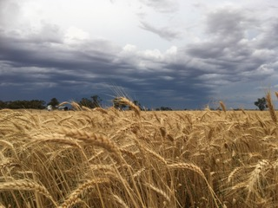
Other studies
Controlled studies on the nutritive effects of compost teas are rare. A few:
Hargreaves et al. (2008) showed compost tea (10% extraction) to be as effective as compost applied to the soil in growth of raspberry canes.
Keeling et al. (2003) showed growth promoting effects on wheat and oilseed rape beyond expected nutritive response when combining mature compost extracts with fertilizer at a 17% dilution. They did not see any response at greater dilutions than this.
Evidence is mounting that growth promotion by compost extracts may be due to effects other than nutrient additions. Sikora and Enkiri (1999) found greater N use when fertilizer was supplied together with compost at lower N contents than fertilizer alone, suggesting constituents other than N were responsible.

Slide 25
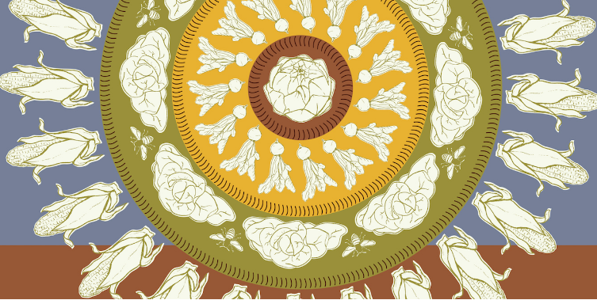
Implications
Our data indicate compost teas or extracts can be as effective as fertilizer applications at an extraction rate of 1% in promoting growth of young wheat seedlings in the greenhouse, despite the 1% compost extracts containing only 30% as much nitrogen as the fertilizer treatment. The potential for compost tea/extracts for supplementing or replacing other fertilizer seems promising and warrants further testing both in greenhouse situations and in the field. (5664)

Slide 26
Implications
A more plausible potential mode of action for the preparations may be through hormonal effects. Studies have found plant growth stimulatory substances in the BD preparations. (5665)
Another possible mode of action could be through bacterial regulation effects. Bacteria detect and react to extremely low levels of signal molecules in their environment, as shown in work on quorum sensing.
Many higher plants have been shown to produce signal-mimicking compounds, thereby affecting bacterial density relationships.

Slide 27
Critique
Focus on wine and wheat is quite Eurocentric and none of the research mentioned is useful or focused on the polyculture crops and companion plants in Indigenous agroecology.
An analysis of the effects of BD soil treatments (like fermented herbal teas) on the rhizosphere ecology is missing here. They do mention quorum sensing and bacterial regulation effects. Early and intermediate shoot and root biomass is their principal metric.
Biomass at early stages of the lifecycle of wheat is not the best indicator of overall plant growth dynamics. They overlook PGPRs. Biomass is also a poor indicator for plant health (as ability to suppress pathogens) or harvest yield and yet “biomass” is a central metric in this study.

Slide 28
Critique
They disclosed a conflict of interest. The research was partly funded by Fetzer Vineyards.
An explanation of the importance of dehydrogenase production and activity and its role in anti-oxidation processes would have been useful since this is also related to QS and regulation by PGPR (plant growth promoting rhizobacteria).

