Slide 1
Soil Biological Community in Alternative (Organic and Biodynamic) Agricultural Systems?
Megan Ryan
Review of studies
Compares the soil biological community on farms where plant nutrition is managed in a 'conventional' manner (addition of synthetic easily-soluble fertilizers) with farms which adopt 'alternative' fertilizer strategies (organic or biodynamic).
Such alternative strategies include additions of natural minerals, composts or manures, and growth of green manure crops or inclusion of legumes in the rotation.
Four groups of soil organisms are examined (soil micro-organisms, soil fauna, soil-borne plant pathogens and soil micro-organism/ plant symbioses which enhance plant nutrient uptake).
Case study of biodynamic and conventional dairy farms in southern Australia. (131)

Slide 2
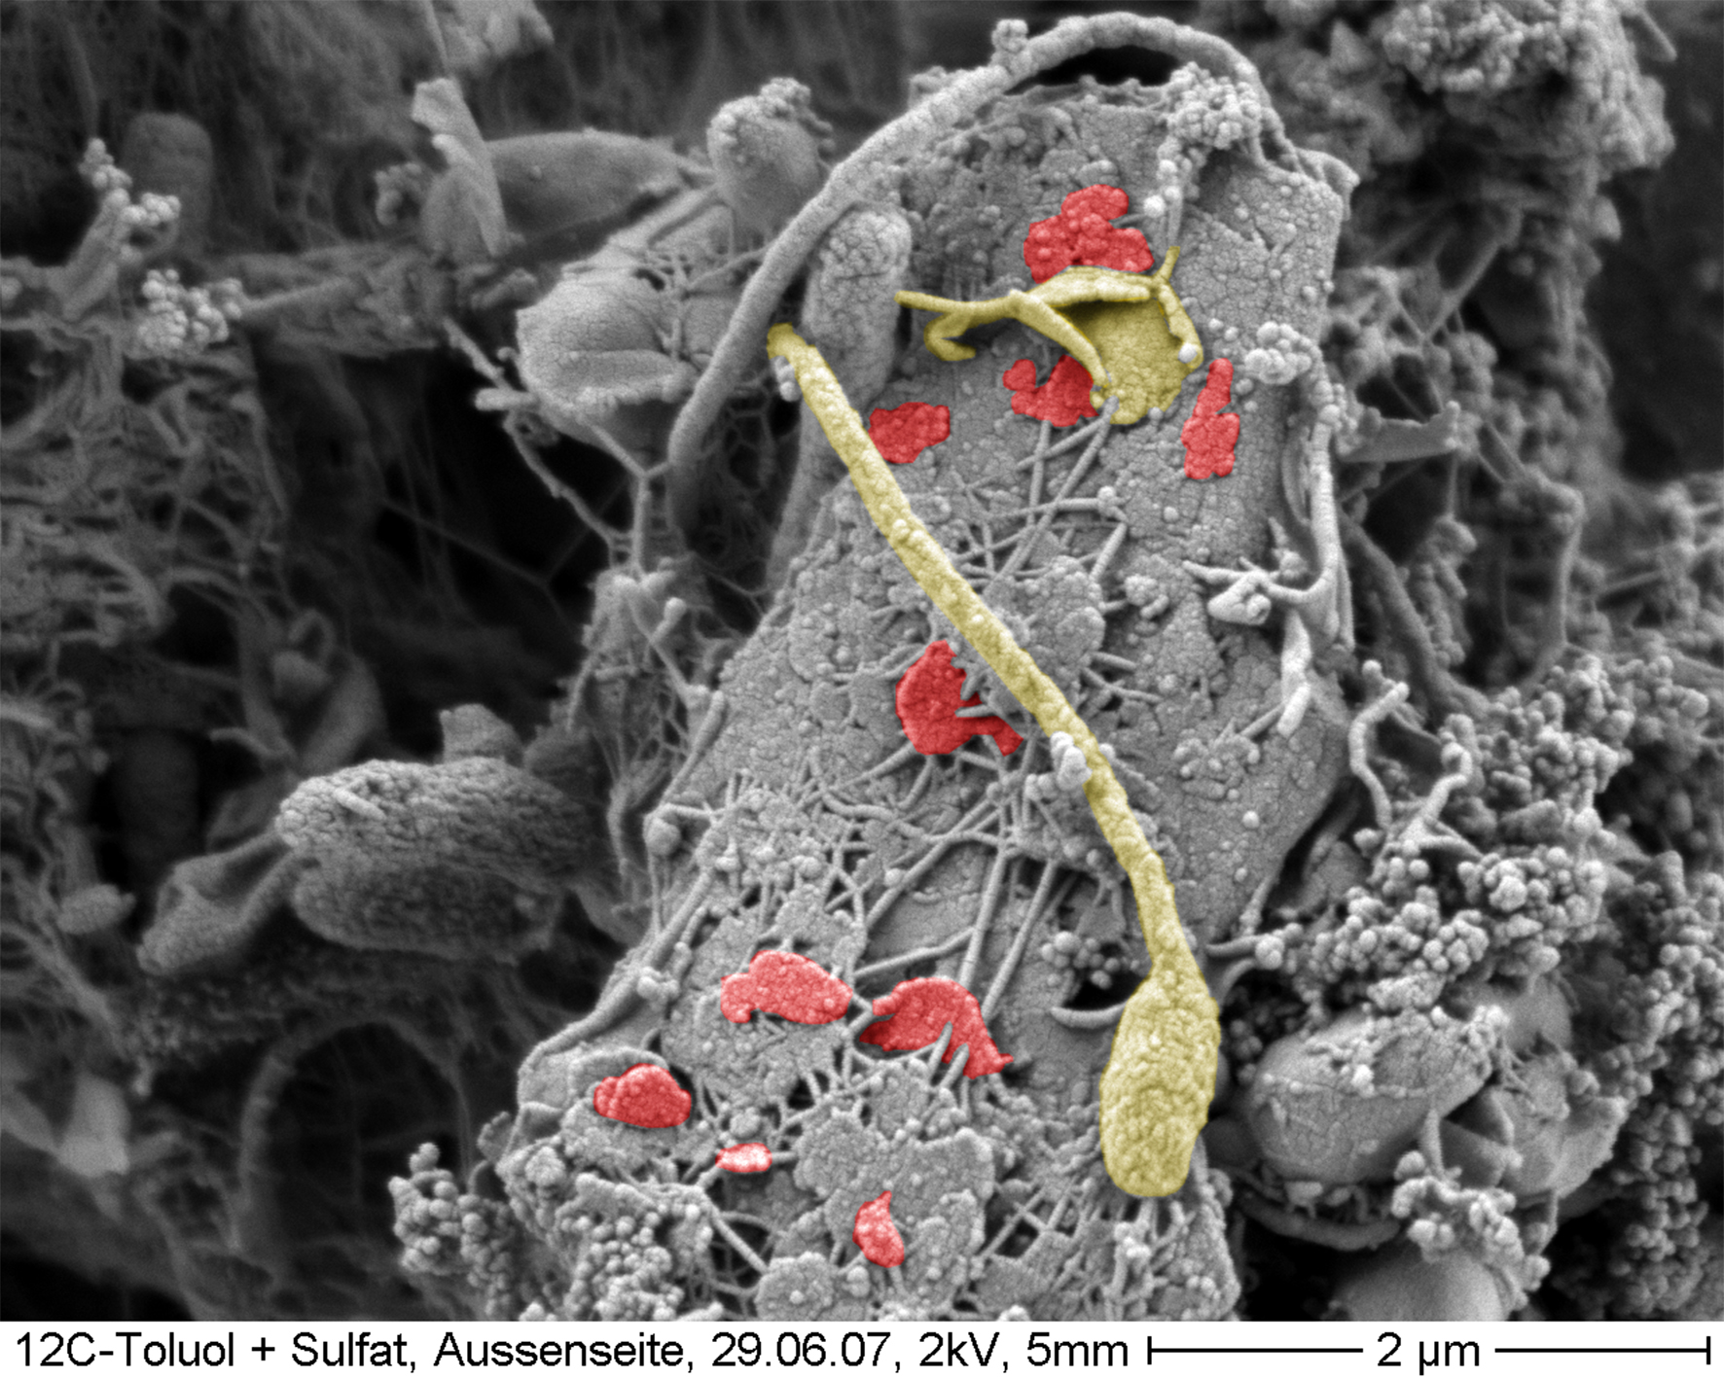
Principal findings
Non-transient increases in the soil community may take many years to appear as relatively stable soil organic carbon tends to increase slowly.
Conventional practices, such as addition of soluble fertilizers and pesticides, may affect some groups of soil organisms, but their overall effect on the soil community will generally be small.
Notes:
Note on electronphotograph: The electron micrograph shows bacteria (Hyphomicrobium sp.; Yellow) growing up partly on solid surfaces, floors and sediment grains. During growth whatsoever cells die and deformed or fragmenting cell envelopes remain. Small-scale fragments of these shells (red) then set the microparticulate matrix in soils and sediments. Credit: Photo: Burkhard Schmidt-Brücken, Institute of Material Science/Dresden University of Technology Colored by: Christian Schurig, Helmholtz Centre for Environmental Research

Slide 3
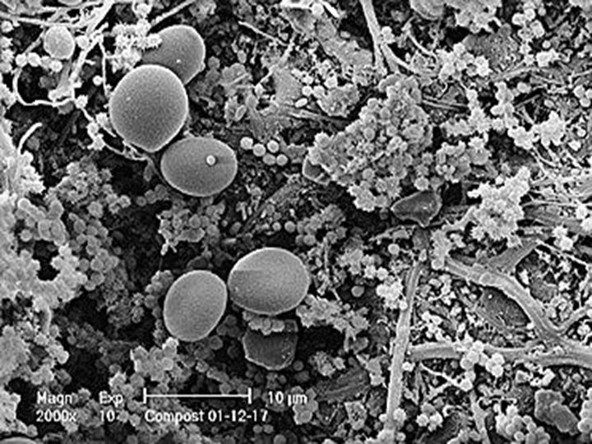
Principal findings
Concluded that the total soil microbial biomass and the biomass of many specific groups of soil organisms will reflect the level of soil organic matter which is largely determined by the volume of recent organic matter inputs.
When alternative farms include regular inputs of organic matter in their rotation, they will tend to have a larger soil community than conventional neighbors whilst these inputs are decomposed.
Compost under electron microscope

Slide 4
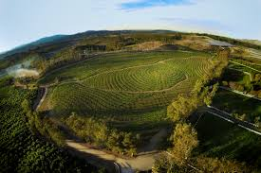
A big caveat?
However. if alternative farming systems do not include large inputs of organic matter, if their production is strongly limited by low levels of nutrients such as phosphorus, or if they are of a low intensity nature. the soil community may not differ from a conventional neighbor.
Notes:
Photo notes: Aerial shot of Apricot Lane Farms, Moorpark, CA (Ventura County).
Source: https://www.apricotlanefarms.com/

Slide 5
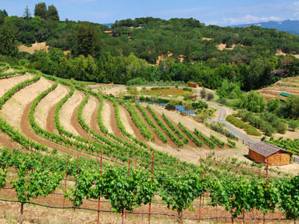
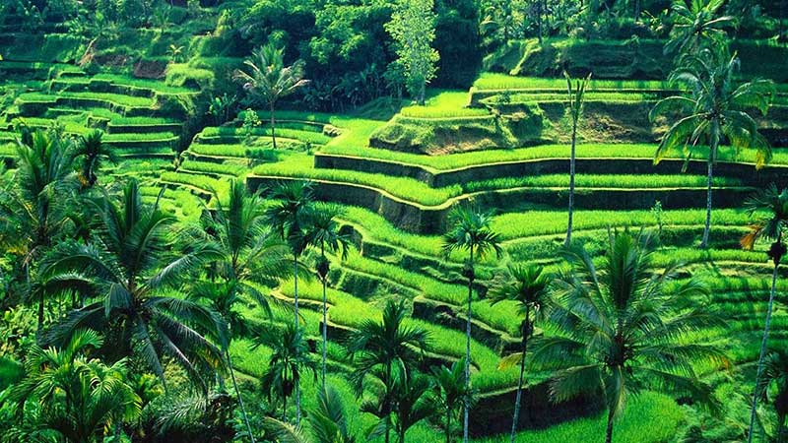
A critical conclusion
…and a decolonial note
This is often the case in Australia and may occur with increasing frequency in other regions if alternative farms have negative nutrient balances. Hence, an enhanced soil community relative to conventional neighbors should not be considered as a definitive feature of alternative agricultural systems.
Notes:
Decolonial note: The top right image is from a modern permaculture farm in BENZIGER FAMILY WINERY in Glen Ellen. The bottom right image is a classic Balinese rice terrace agroecosystem that has been in use for more than a thousand years.

Slide 6
The most statistically significant difference is in the density of vesicular-arbuscular mycorrhizal (VAM) fungi at p<O.OOI (or less than 1:1000 chance of being wrong).
Notes:
Technical note: Vesicular-arbuscular mycorrhiza (VAM) is formed by the symbiotic association between certain phycomycetous fungi and angiosperm roots. The fungus colonizes the root cortex forming a mycelial network and characteristic vesicles (bladder-like structures) and arbuscules (branched finger-like hyphae).

Slide 7
Critique
1. The study is a bit dated and substantial new studies have appeared (more a criticism of the instructor). Some of this recent research supports Ryan’s postulation that the effects of hormones may be more significant than the nutrient sources, diversity, and density.
2. Many of the BD soil teas, tinctures, and other amendments are derived from European and other non-native plants that are not always present in Indigenous agroecosystems. We need to experiment with composted and fermented mixtures involving native companion plants.
3. Ryan admits to needing to consider the effects of BD amendments on what are essentially the signaling and ISR dynamics associated with these methods. Likewise, this lacks references and analysis of the dirt-to-gut connection.
Notes:
Re: 1. I am still reviewing and digesting the more recent studies published during 2000-20.
Re: 2. For e.g., a very typical BD mix will include chamomile which is introduced and yarrow which is native. I would like to experiment with a blend of yarrow, marigold, and Mexican mint (all of which are companions in Indigenous Mexican milpas and have proven medicinal, nutritional, and soil biodynamic properties).
Re 3. I have failed to locate research on BD effects on soil rhizosphere and human gut microbiomes but the entire field is young. Clearly, the methods, sources and sites need to be de-colonized. I suspect BD hormonal qualities may have an even more significant effect if we utilize polyculture-companion plant fields as our sites but we would have to consider the environmental history of the sites to discern how the land (and Indigenous farmers) have been subjected to historical trauma and structural violence since this can produce pre-existing conditions in need of attention and healing.

Slide 8
Critique
They disclosed a conflict of interest. The research was partly funded by Fetzer Vineyards.
An explanation of the importance of dehydrogenase production and activity and its role in anti-oxidation processes would have been useful since this is also related to QS and regulation by PGPR (plant growth promoting rhizobacteria).

