Slide 1
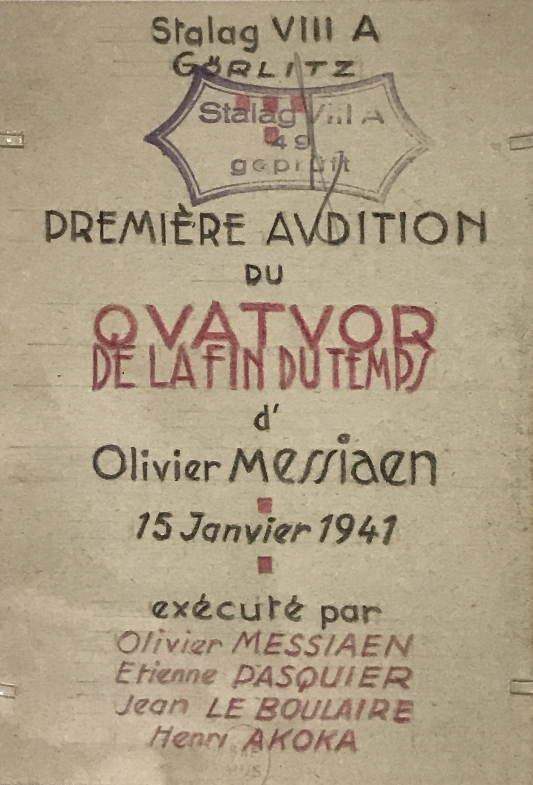
Olivier Messiaen
Quartet
for the end of time

Slide 2
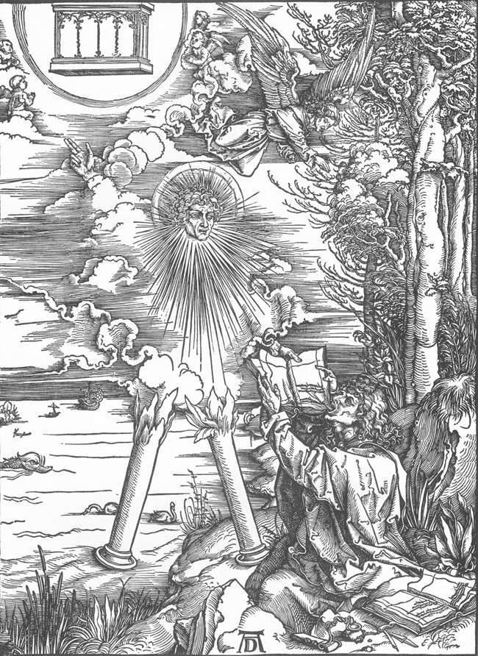
Notes:
(Rev 10:1–2, 5–7, King James Version):
And I saw another mighty angel come down from heaven, clothed with a cloud: and a rainbow was upon his head, and his face was as it were the sun, and his feet as pillars of fire ... and he set his right foot upon the sea, and his left foot on the earth .... And the angel…lifted up his hand to heaven, and swore by him that liveth for ever and ever ... that there should be time no longer

Slide 3
Liturgie du cristal:
Between three and four in the morning, the awakening of birds:
a solo blackbird or nightingale improvises, surrounded by a
shimmer of sound, by a halo of trills lost very high in the trees.
Transpose this onto a religious plane and you have the
harmonious silence of heaven.
— Messiaen, Quatuor pour la fin du temps,
program note

Slide 4
Liturgie du cristal:
Between three and four in the morning, the awakening of birds:
a solo blackbird or nightingale improvises, surrounded by a
shimmer of sound, by a halo of trills lost very high in the trees.
Transpose this onto a religious plane and you have the
harmonious silence of heaven.
— Messiaen, Quatuor pour la fin du temps,
program note

Slide 5
Liturgie du cristal:
Between three and four in the morning, the awakening of birds:
a solo blackbird or nightingale improvises, surrounded by a
shimmer of sound, by a halo of trills lost very high in the trees.
Transpose this onto a religious plane and you have the
harmonious silence of heaven.
— Messiaen, Quatuor pour la fin du temps,
program note

Slide 6
deci-tala (adapted from Hindustani music)
non-retrogradable rhythms
modes of limited transposition

Slide 7
Cello Rhythm:

Slide 8
Cello Rhythm:

Slide 9
Piano Rhythm:

Slide 10
Piano Rhythm:

Slide 12
Suppose that there were a single beat in all the universe. One beat; with
eternity before and eternity after it. […] That is the birth of time. Imagine
then, almost immediately, a second beat. Since any beat is prolonged in
the silence that follows it, the second beat will be longer than the first. […]
That is the birth of rhythm
— Messiaen, Conference de Bruxelles

Slide 13
“Was’ and ‘will be’ are created species of time
which we in our carelessness mistakenly apply
to eternal being. For we say that it was, is and
will be; but in truth ‘is’ applies to it, while ‘was’
and ‘will be’ are properly said of becoming in
time.”
— Plato, Timaeus

