Slide 1
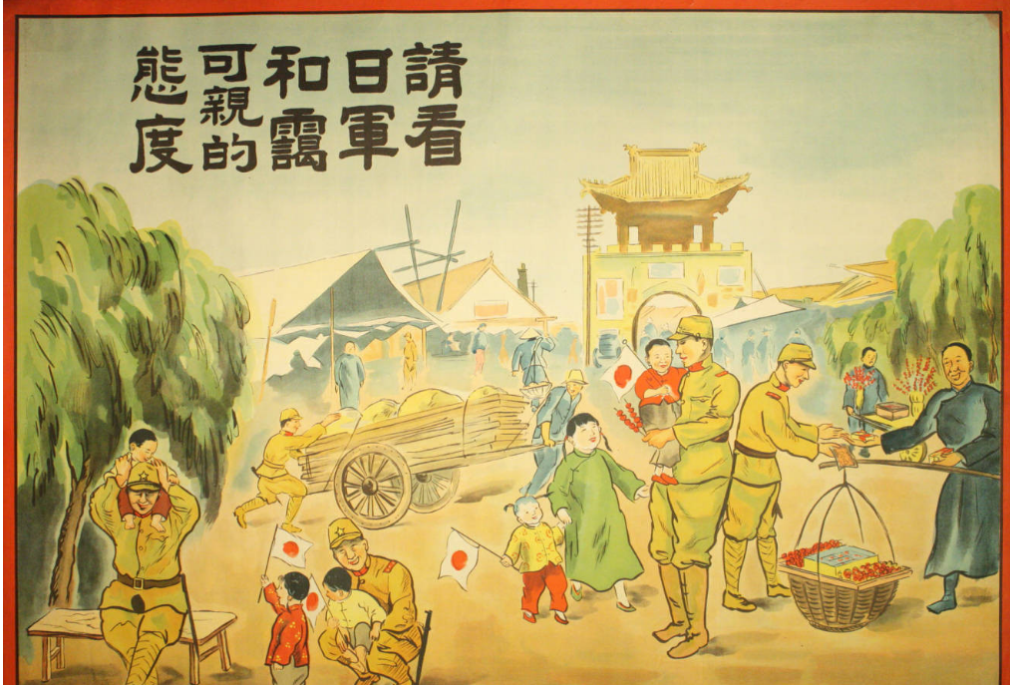
Japan’s Empire plus thinking about the final digital project for this class
Japanese propaganda poster produced for occupation of China during the Second Sino-Japanese War (‘37-’45). It reads: “Please see how kind and affable the Japanese Army is.” This messaging generally fell flat in China. Chapman University Special Collections.

Slide 2
Terms from lecture Meiji Restoration (begins 1868) The Meiji Emperor The samurai (warrior class, highest caste) The Shogunate (regime before Meiji Restoration, decentralized power, control by samurai class) Greater East Asian Co-Prosperity Sphere The unequal treaties The Russo-Japanese War (1904-5) The Washington Naval Treaty (or 5-5-3 treaty) Ba
Outline of the class
Lecture, Japan’s Empire
Part I: Long run-up to Pearl Harbor: 19th C Japan, the Meiji Restoration and Japan’s empire building
Part II: The Second Sino-Japanese War and the Pacific War (Japan vs. United States), to Okinawa
2. Discuss of readings
3. Talk about the final project – what are you going to do for the final project??

Slide 3
One of Perry’s “black ships,” contemporary Japanese illustration (via Almay). The threat posed by Perry’s arrival in Tokyo Bay precipitated Japan’s signing of the unequal treaties with the US and European powers, the Ansei Five-Power Treaties

Slide 4
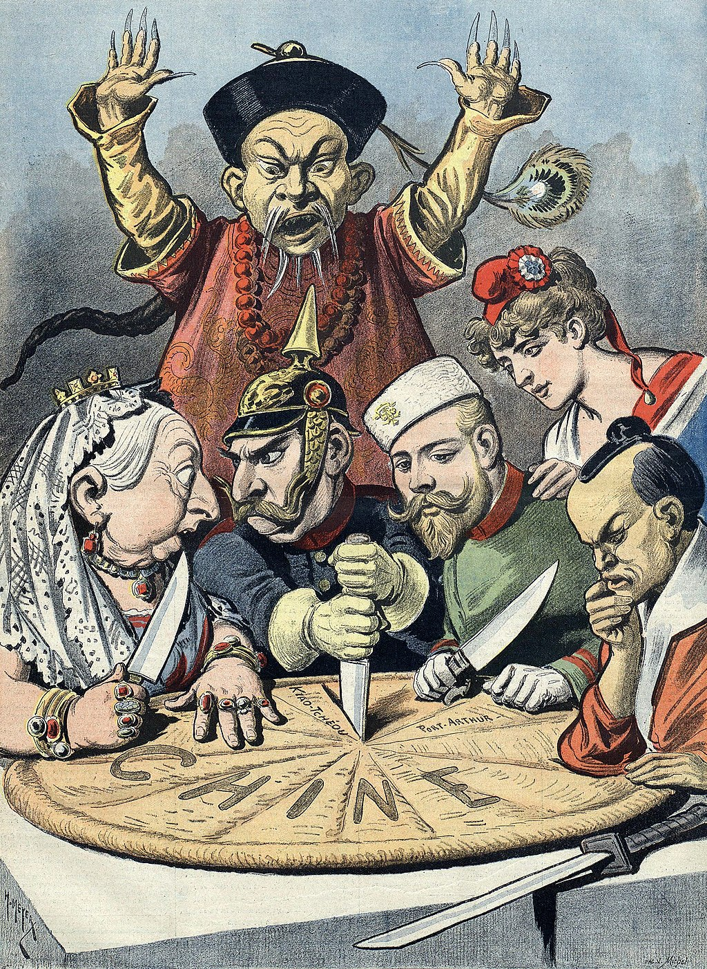
What Japan sought to avoid: China’s fate
Racist French cartoon of the dismemberment of China, 1898, Bibliothèque nationale de France.
The person with their hands up is a stereotyped Qing official depicted in an offensive way. The pie is marked “China.” At the table are Queen Victoria (UK), Kaiser Wilhelm II (Germany), Tsar Nicholas II (Russia), the French Marianne (symbol of France – France and Russia had an alliance at the time), and the Emperor Meiji (Japan).

Slide 5
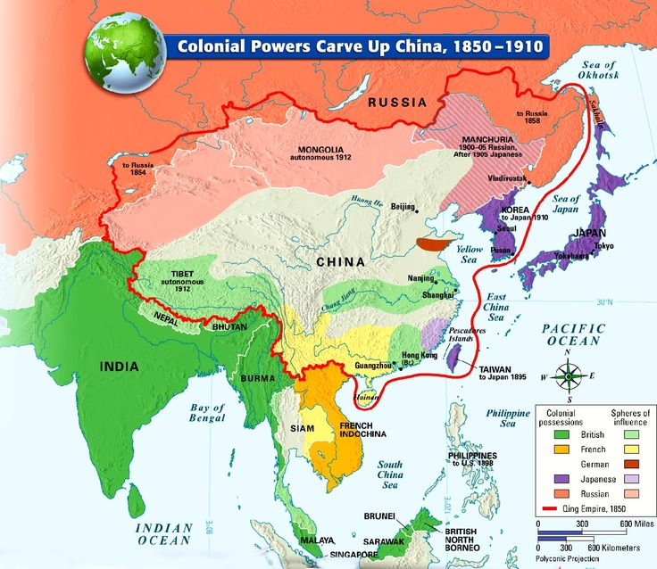

Slide 6
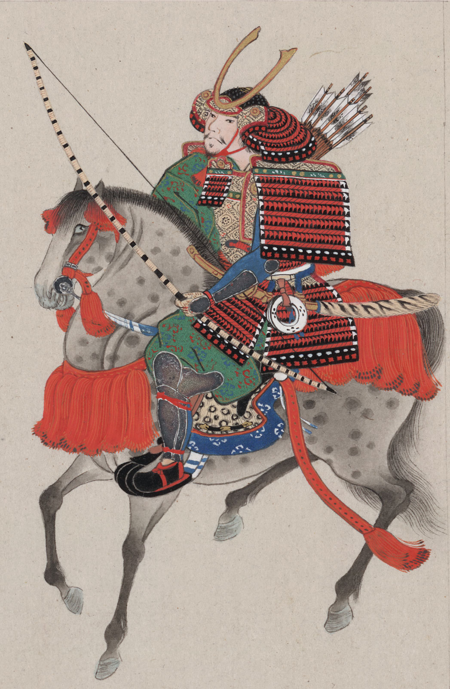
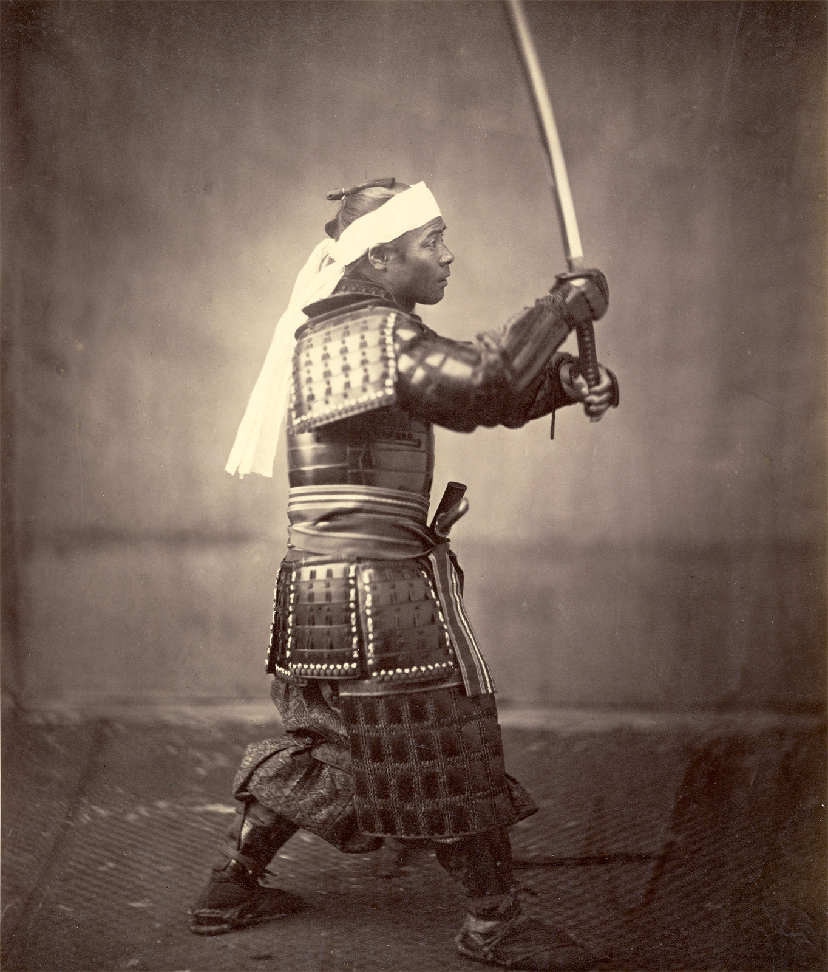
Left: J. Paul Getty Museum, open content, samurai with sword c. 1860
Right: Samurai on horseback, drawing, late 19th C, Library of Congress
(both images via Britannica)

Slide 7
There’s apparently quite a bit of Lord Nelson’s hair still around, even today.

Slide 8
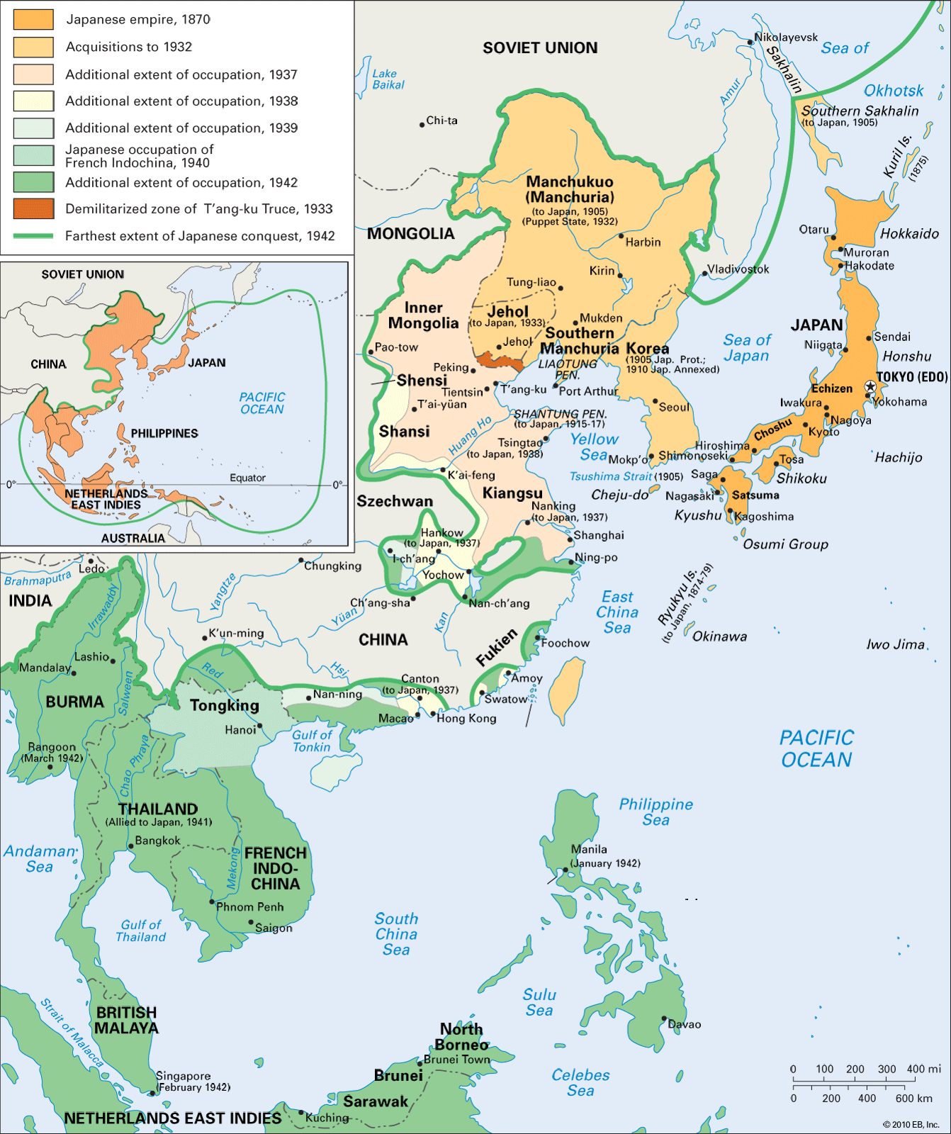
Japan’s empire, 1870-1942 (source: Encyclopedia Britannica)

Slide 9
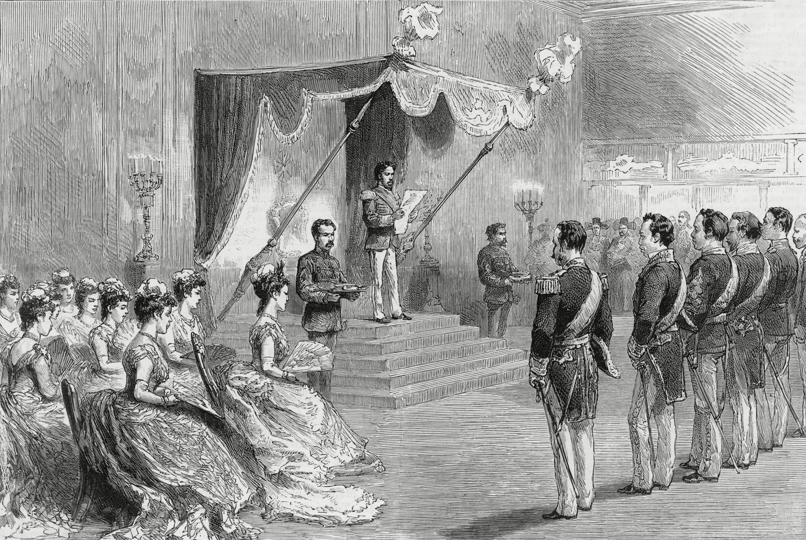
Domestically peaceful industrialization, centralization, militarization, but little real democracy under the Meiji emperor (reigned 1867 to his death in 1912) Left: Postcard of Tokyo, streetcar in Kyobashi Ginza. (Almay, 1920) Right: The Meiji emperor prolclaiming the Meiji Constitution, 1889.

Slide 10
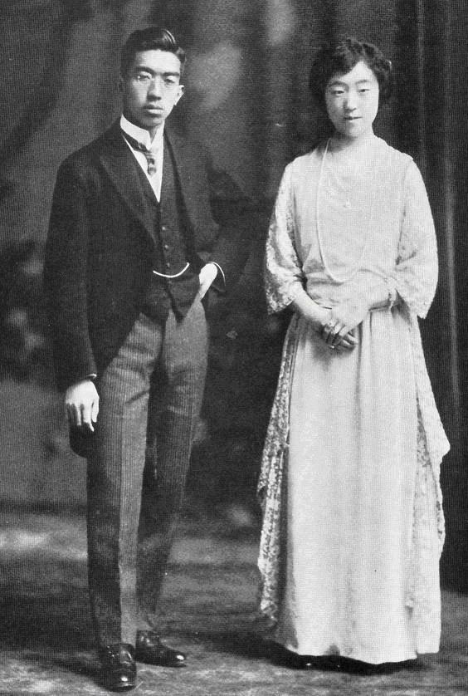
Emperor Hirohito and Empress Kojun, 1924

Slide 11
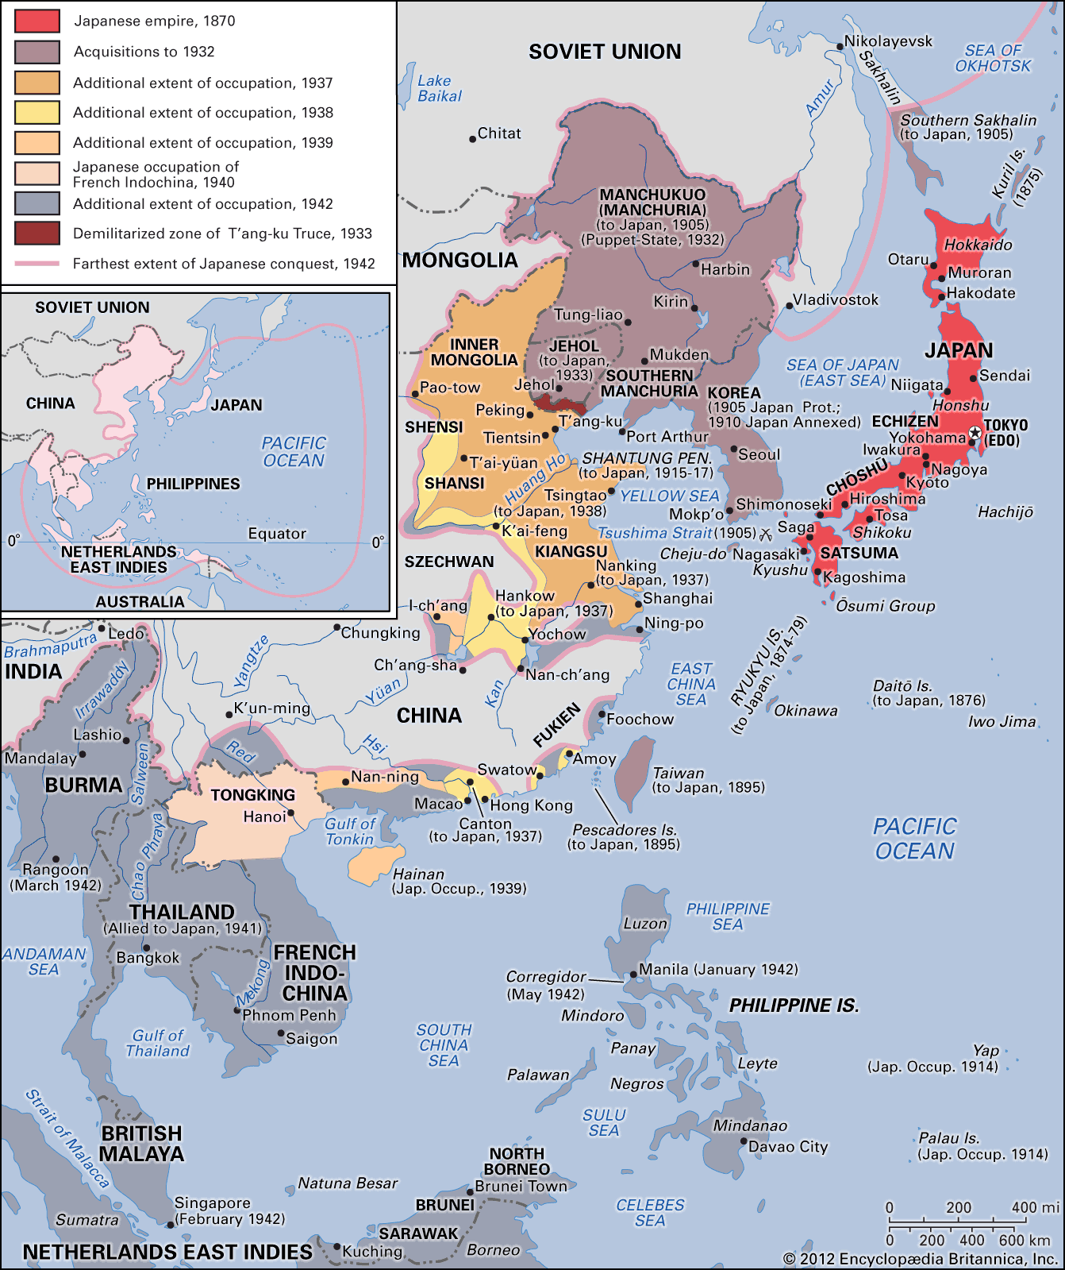
Phases of Japanese conquest, shows Manchukuo.
Note Manchukuo, a puppet state from ‘32, also note all the other colonies in the region – India (British), French Indo-China (Vietnam), the Philippines, also (portions shown here, at bottom) what is today Indonesia, then a Dutch colony.
(source: Britannica)

Slide 12
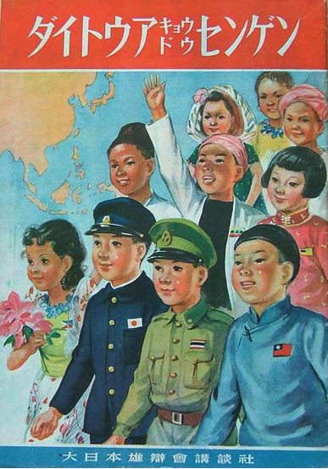
Japanese booklet on the Greater East Asian Co-Prosperity Sphere (Image from James Orr’s essay/exhibit)
The Greater East Asian Co-Prosperity Sphere
An anti-imperial empire?
A good digital exhibit done through a peer-reviewed journal on the Greater East Asian Co-Prosperity Sphere is linked here.

Slide 13
Japanese propaganda poster, produced for Japanese occupation regime in China. In English it reads: “Look at the communist atrocity! The just Japanese Army liberates people from atrocity and eradicates the evil and selfish Communist Army and the ruthless Communist Party.” Chapman University special collections

Slide 14
The war in China, 1937-45, this map shows stalemate in 1941

Slide 15
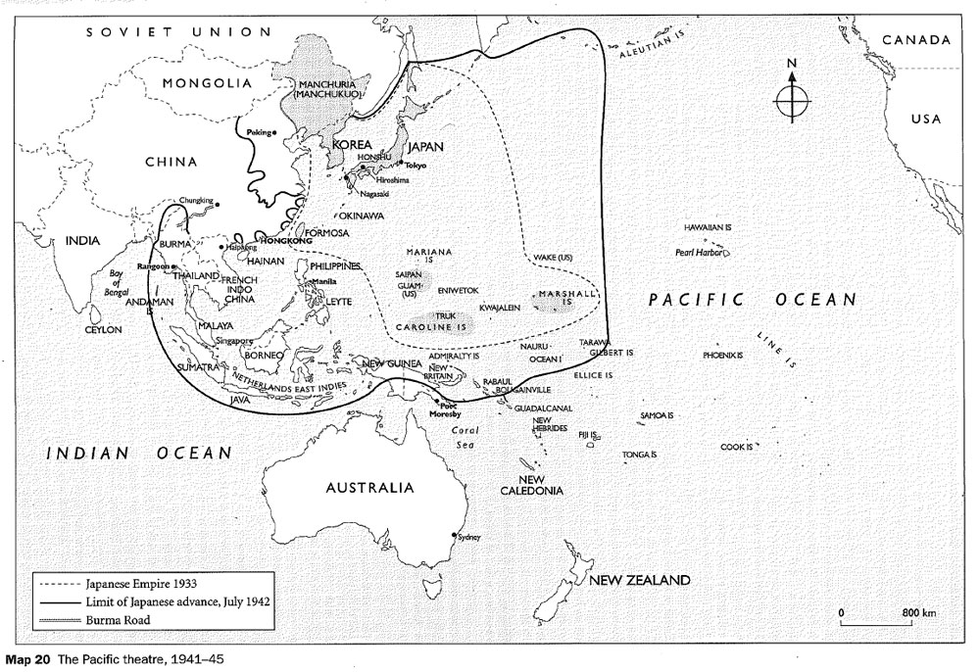
Japan’s high water mark = black line, this is in July of 1942
(Britannica)

Slide 16
Midway Atoll, red pin. Hawaii circled in red.

Slide 17
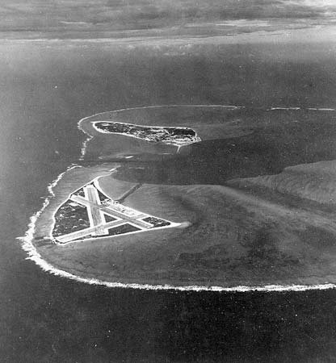
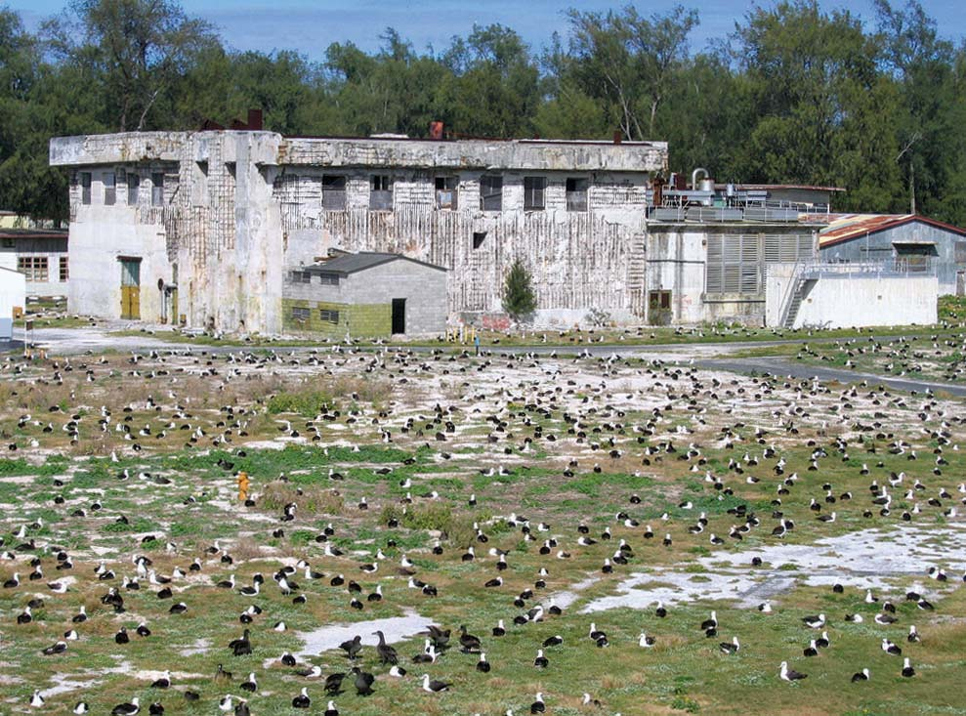
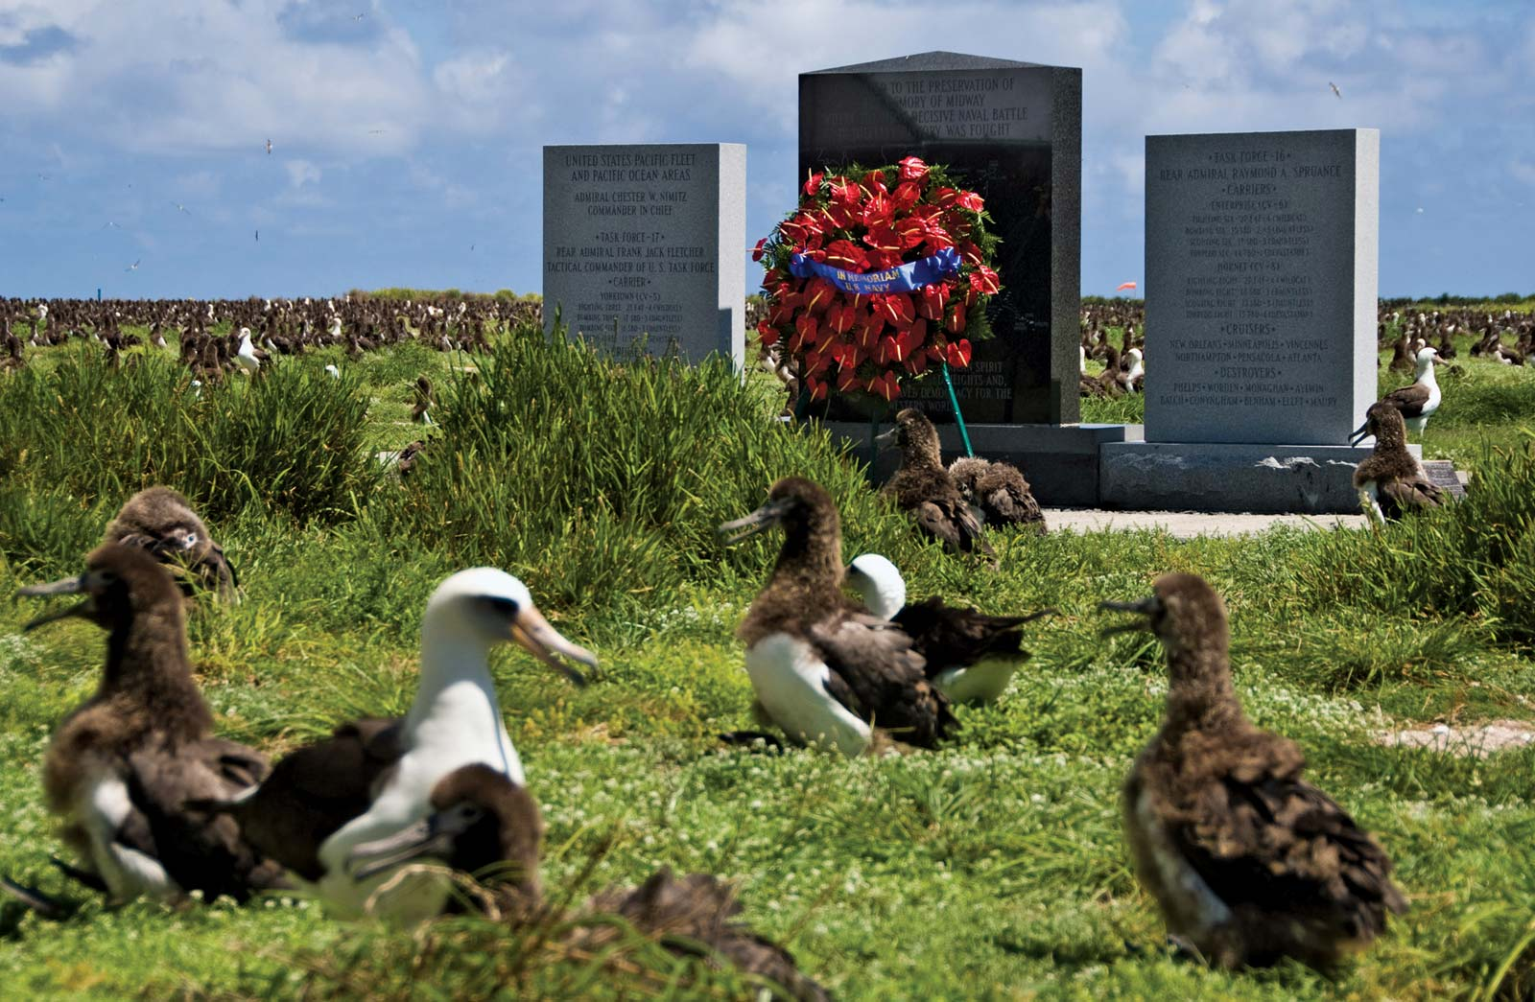
Together with Coral Sea (Many ‘42) the Battle of Midway (June ‘42) is an important turning point in the Pacific War.
Above left: Midway Atoll, US Navy photo, November 1941. Eastern Island, site of airfield, in foreground. (Both images from Britannica)
Above right: Abandoned US Navy building, Midway Atoll, recently. The islands, key sites for some migrating birds, are now a National Wildlife Refuge.
Laysan albatrosses in front of the Battle of Midway National Memorial, Midway Atoll, recently.

Slide 18
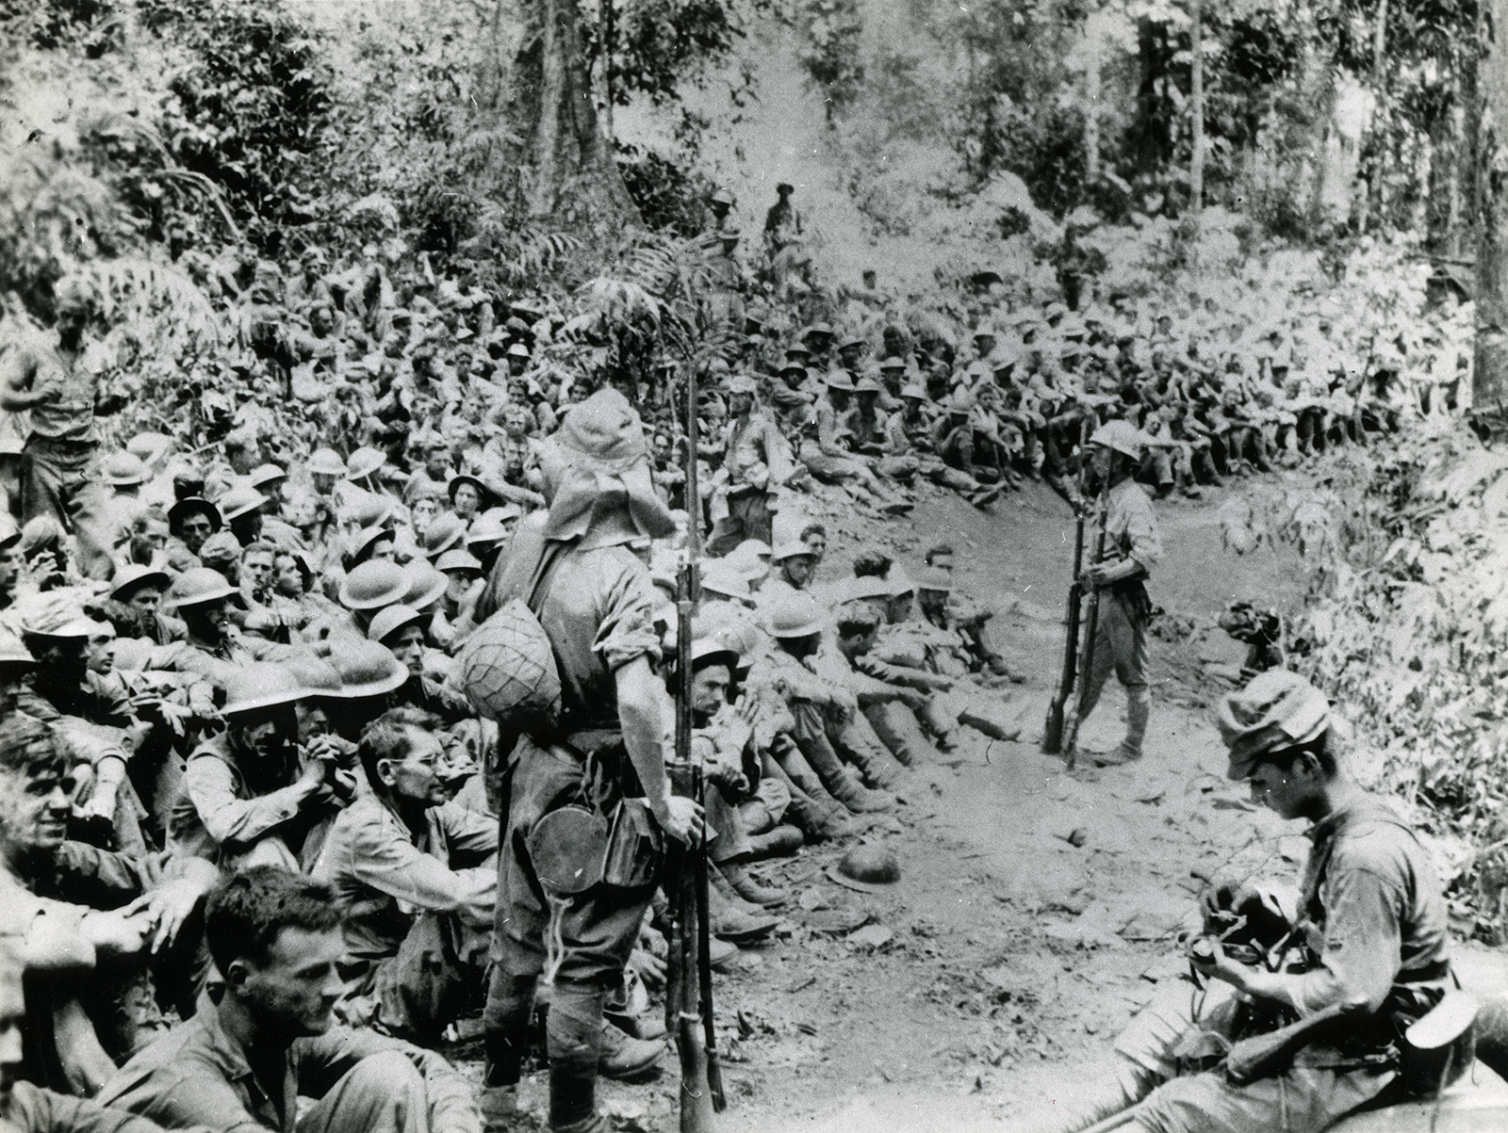
American POWs under Japanese guard, prior to beginning Bataan Death March. (US Marine Corps via Britannica.)
Bataan death march, April 1942
Murdered during the forced march:
2,500 Filipinos and 500 Americans
Murdered later at the POW camp:
26,000 Filipinos and 1,500 Americans

Slide 19
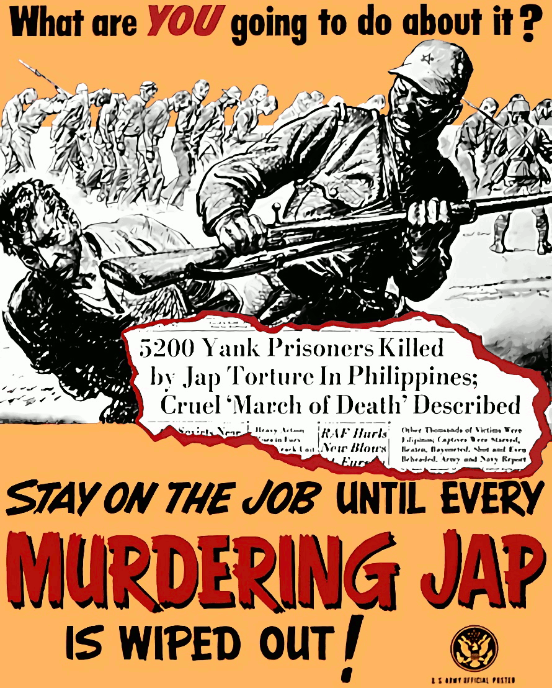
National Archives (identifier 515483)

Slide 20
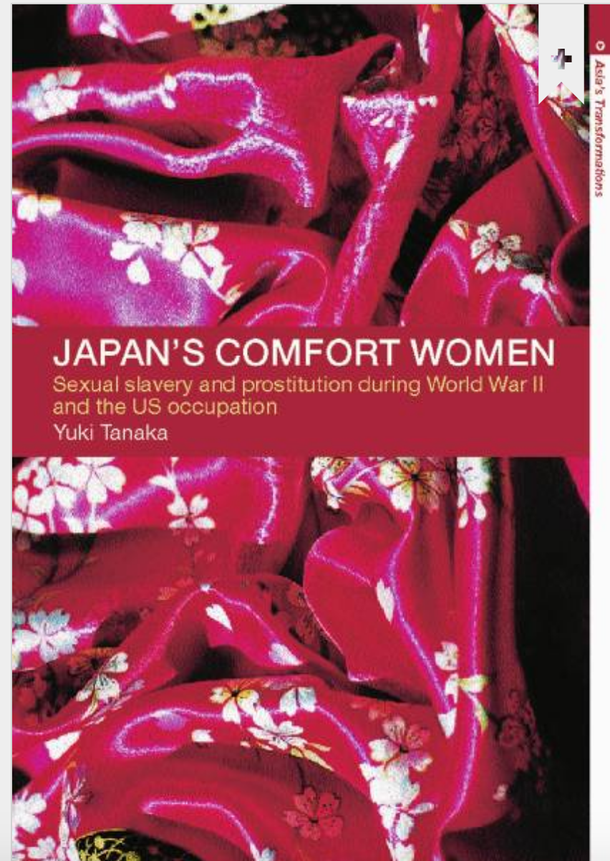
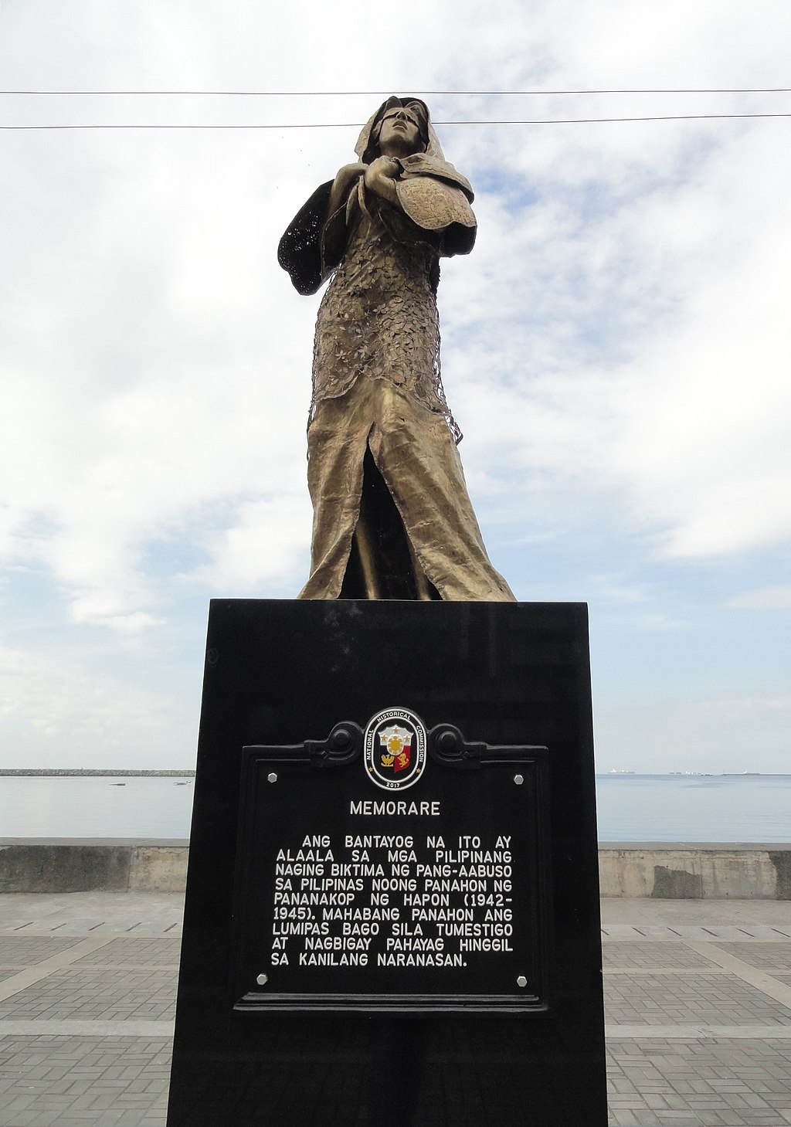
Left: From Taylor & Francis (2001)
Right: Memorial to “Comfort Women” in Manila. The sign reads: “This monument is a memory of all the Filipino women who became victims of abuse during the Japanese occupation (1942-1945). It took them a long time before they testified and gave their statements regarding their experience.”

Slide 21
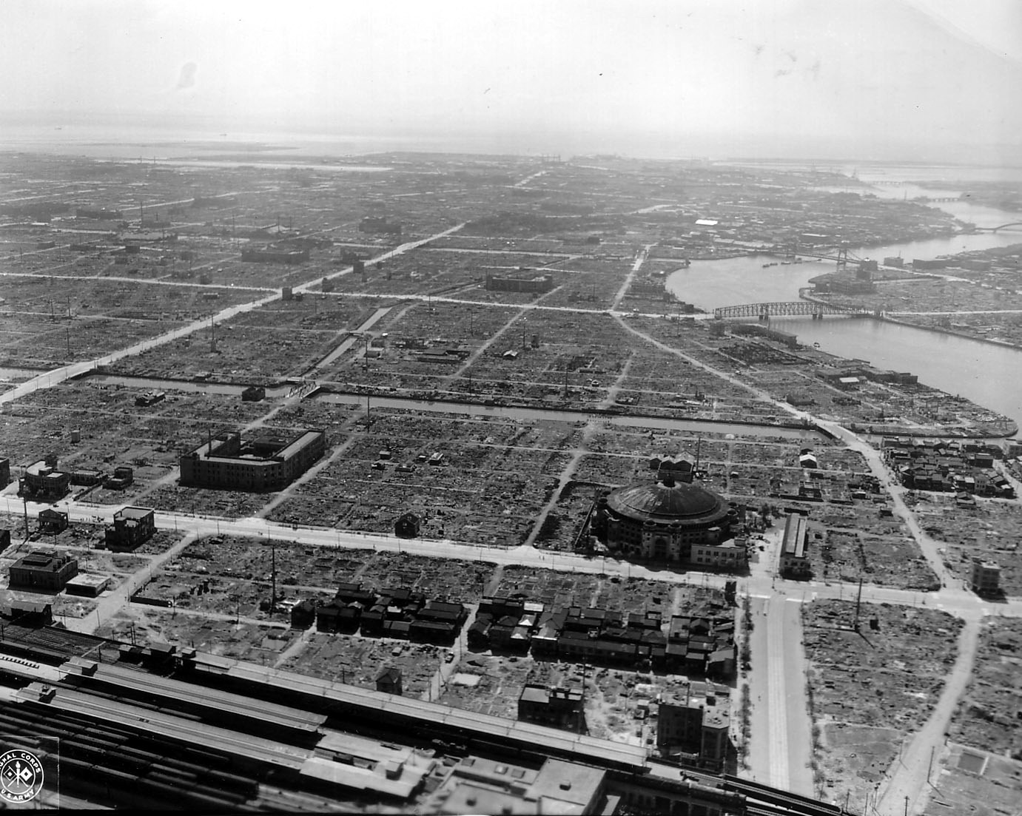
Tokyo, probably in 1945 after the Japanese surrender, US Army Signal Corps photo

Slide 22
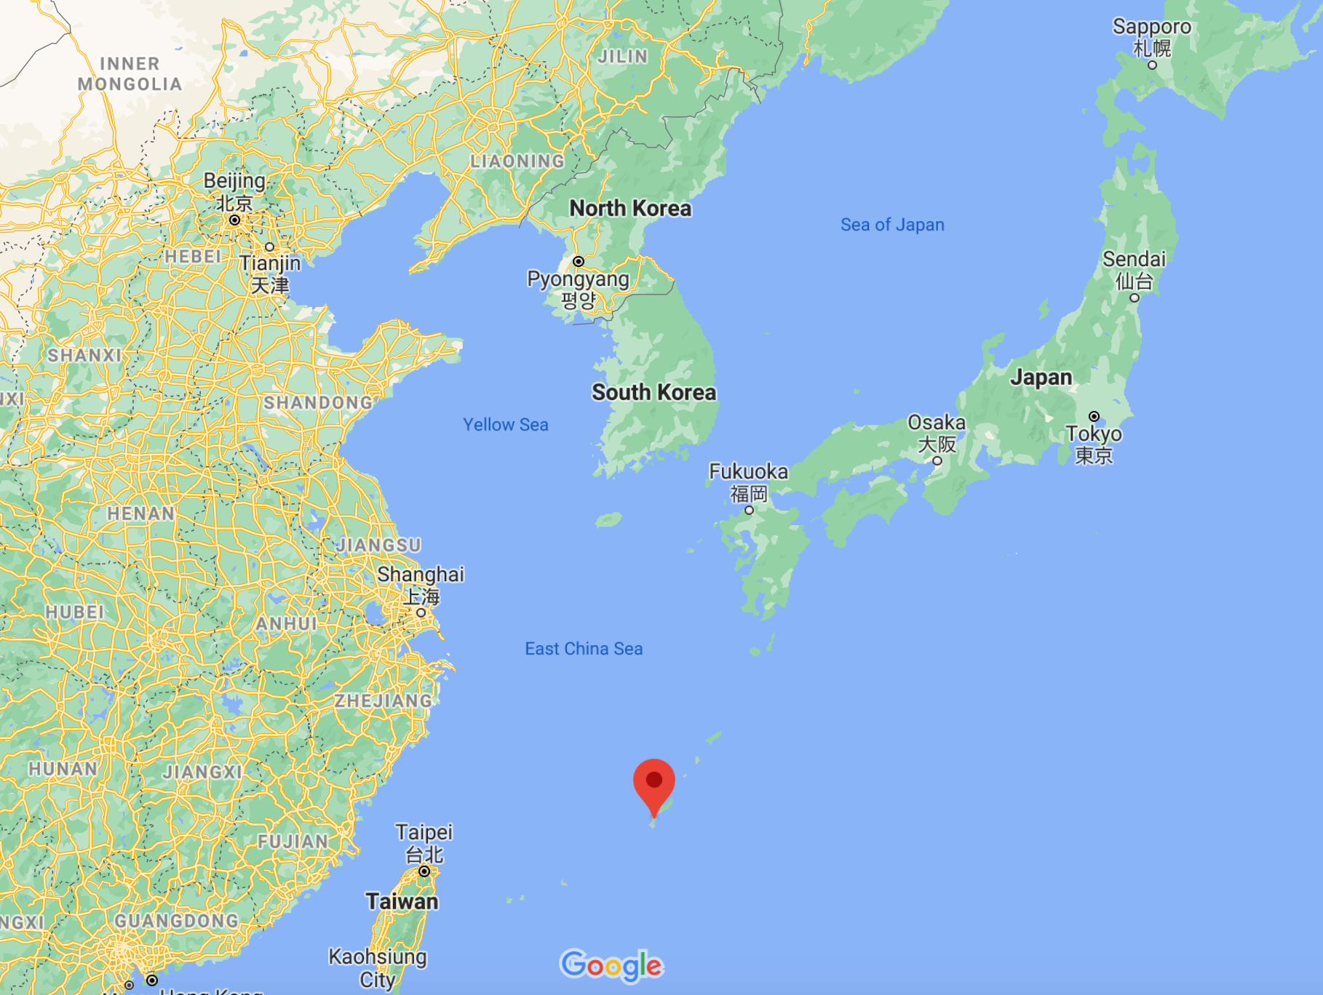
Okinawa is the red pin

Slide 23
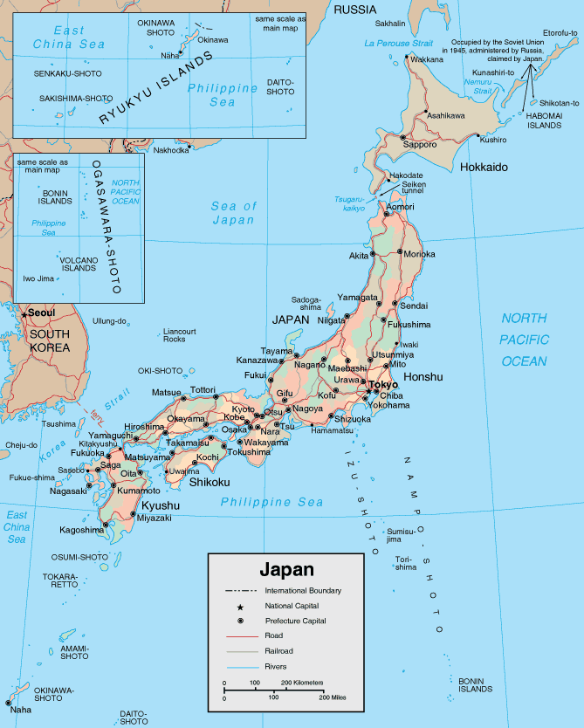

Slide 24
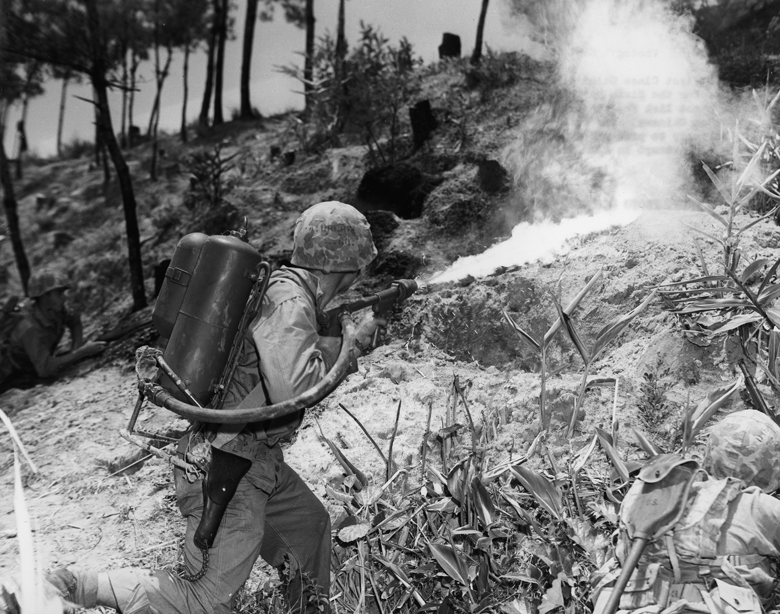
Battle of Okinawa (March – July, 1945): US Marine uses a flamethrower against a Japanese position.
Estimated losses, Okinawa:
12,000 dead US military
100,000 dead Japanese military
100,000 dead Japanese civilians
(Photo: US Marine Corps via Britannica)

Slide 25
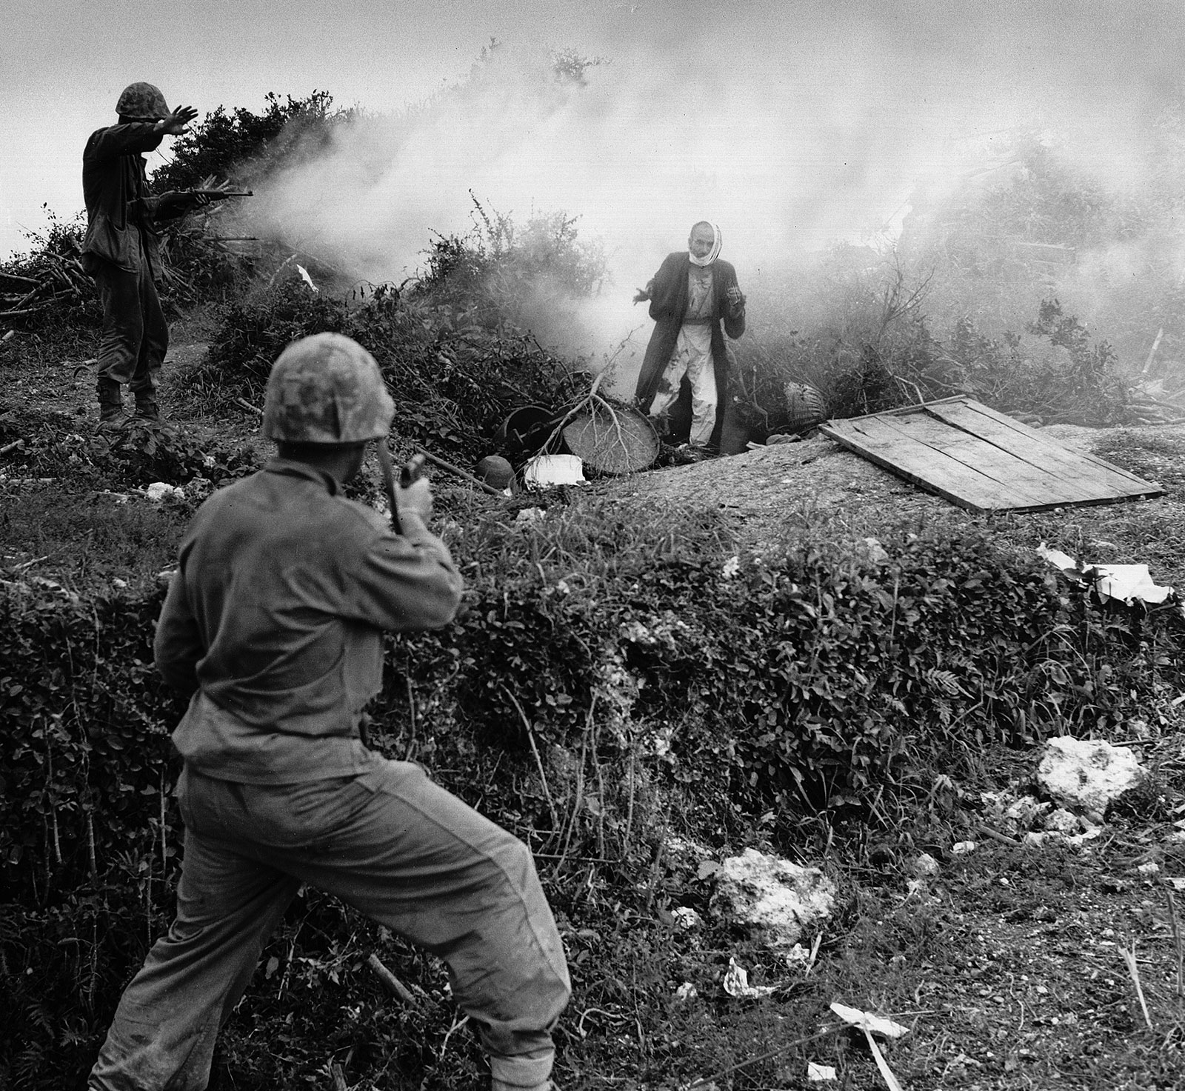
Battle of Okinawa, a Japanese soldier surrenders to US Marines, after apparently being flushed from a cave by a smoke grenade (US Defense Dept., via Britannica)

Slide 26
Civilians and US Marines at the Battle of Saipan (Mariana Islands) June-July 1944 "A member of a Marine patrol on Saipan found this family of Japs hiding in a hillside cave. The mother, four children and a dog, took shelter from the fierce fighting in that area." (Photographer’s original caption.) Marine Corps/DOD (US National Archives 532380/Local identifier: 127-GR-113-83266)

Slide 27
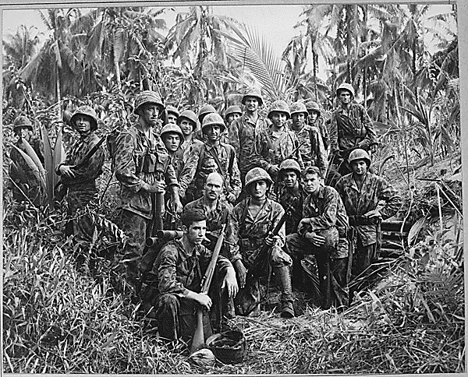
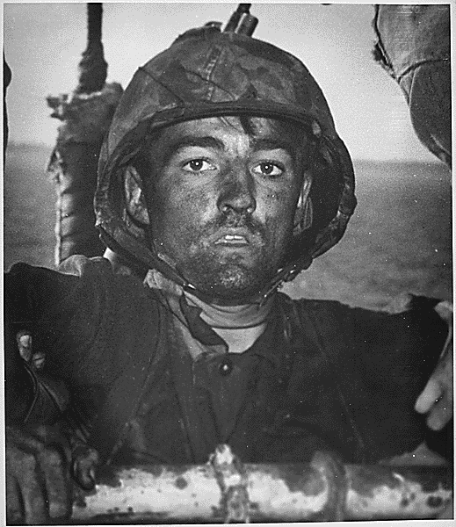
Left: “These men have earned the bloody reputation of being skillful jungle fighters. They are U.S. Marine Raiders gathered in front of a Japanese dugout on Cape Totkina on Bougainville, Solomon Islands, which they helped to take.” (Photographer’s original caption.) National Archives (520643/Local identifier: 80-G-205686)
Right: “Back to a Coast Guard assault transport comes this Marine after two days and nights of Hell on the beach of Eniwetok in the Marshall Islands. His face is grimey with coral dust but the light of battle stays in his eyes.” (Photographer’s original caption) National Archives (513202/ local identifier: 26-G-3394)

Slide 28
Thinking about your final project …

Slide 29
Iwo Jima is the red pin

