Slide 1
Lightning tour of Greece and Rome

Slide 2
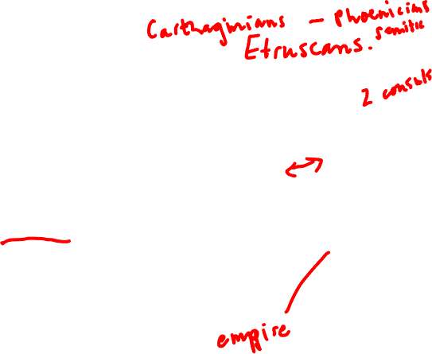
Comparative timeline of Greek and Roman interaction
Greece
Rome
8th c. Greek colonization in S. Italy and Sicily
510/9 Expulsion of tyrants Peisistratids from Athens
Classical period (480–323 BCE) ends with conquests of Alexander the Great of Macedonia in Greece, Asia Minor, Egypt, Syria, Persia, Central Asia
Hellenistic Period, rule of these areas continued by descendants of Alexander the Great and his generals.
753 BCE Foundation of Rome
509 BCE Expulsion of last king of Rome (Tarquinius Superbus), beginning of Roman Republic
Late 3rd c. BCE wars against Carthage
2nd c. BCE Wars against Hellenistic kings (descendants of Alexander the Great and his generals)
2nd-1st c. BCE Greece and Asia Minor become Roman provinces
Early 1st c. CE Roman republic ends, beginning of rule by emperor

Slide 3
Greeks and Romans
500 - 323 BCE: Classical Period, rise of Alexander of Macedon (Alexander the Great)
323 BCE – 30 CE: Hellenistic Period. Greece dominated by kingdoms in Macedonia, Asia Minor, and Egypt run by descendants of generals of Alexander the Great, which are eventually conquered by Romans
30 CE – 476 CE: Greek world dominated by Roman Empire with center in Roman
324 CE – 1453 CE: Roman Empire shifts center to Byzantium, ruled by Greek-speaking emperors

Slide 4
Greece never one political unit, always made up of independent city-states
Rome is one city-state that became an empire

Slide 5
Timeline of historical periods in Greek world
Late Bronze Age: 1700-1200 BCE
Dark Age: 1200-800 BCE
Archaic Period: 800-500 BCE
Classical Period: 500-323 BCE
Hellenistic Period: 323-30 BCE
Roman Period: 30 BCE-476 CE
Byzantine Period: 324-1453 CE

Slide 6
Late Bronze Age: 1700-1200 BCE
Minoan fresco from Knossos, 1700-1500 BCE
Minoan and Mycenaean cultures on Crete and mainland Greece, palace economies
Strong trade and cultural connections with Egypt and Near Eastern cultures, writing systems (Linear A and B) developed
“Trojan War” traditionally dated by later Greeks to end of this period

Slide 7
Dark Age: 1200-800 BC
Centaur figure in proto-geometric style from Lefkandi, c. 900 BCE
Complete collapse of Mycenaean culture and palace economy
Loss of trade connections and economic decline
Gradual recovery and restoration of some skills and trade links

Slide 8
Archaic Period: 800-500 BCE
Kouros from Attica, c. 600 BCE
Expansion of trading network to western and eastern Mediterranean, Asia Minor, Levant, Black Sea
Foundation of Greek colonies
Rise of polis system
Alphabetic writing adopted from Semitic culture
Panhellenic instutions (Olympic games, Delphic oracle)
Rise of tyrants

Slide 9
Classical Period: 500-323 BCE
Statue of ephebe (?), found on Athenian acropolis, c. 480 BCE
Coalition of Greek cities repel two Persian invasions
Rise of democracy in Athens, emergence of “Athenian brand”
Athens and Sparta emerge as dominant powers in region
Later Greeks consider this the highpoint of Greek culture
Rise of Alexander the Great of Macedon, campaign against Persia
Greek control of Egypt and Persian empire

Slide 10
Hellenistic Period: 323-30 BCE
1st. C. BCE mosaic found in Pompeii after 4th c. BCE Greek painting of Alexander in battle against the Persians
Death of Alexander, rule of his generals and their descendants as monarchs in Asia Minor and Egypt
Decline of Greek polis and freedom?

Slide 11
Roman Period: 30 BCE-476 CE
Roman general with Greek athlete’s body, 1st c. BCE, Tivoli
Romans become masters of Western and Eastern Mediterranean, including mainland Greece, empire
Fraught relationship between Roman civic and military power and Greek culture
Eventual decline of importance of Rome as capital of empire, transfer of imperial power to site of Byzantium

Slide 12
Byzantine Period: 324-1453 CE
Emperor Justinian I, mosaic from Ravenna, 6th c. CE
Center of Roman empire moves from Rome to Byzantium, renamed Constantinople
Emperors and court Greek-speaking, though Latin retained as official language in some contexts
Greeks begin to describe themselves as Romaioi (“Romans”), ancient term Hellenes associated with pagan past
Christianity becomes state religion
Gradual separation from western (Latin-speaking half of Roman empire), religious schism, conflict
Eventual collapse and fall of Constantinople to Turkic Ottomans.

Slide 13
Timeline of historical periods of Roman empire
Early Rome, regal period: 753–510/509 BCE
Republic: 510/509–27 BCE
Empire: 27 BCE–476 CE (West) –1453 CE (East)

Slide 14
Early Rome – regal period: 753 BCE—510/509 BCE
Myth of foundation by brothers Romulus and Remus, raised by she-wolf
Rule by kings
Kings credited by later Roman historians as introducing fundamental civic, military, and religious institutions of Rome
Kingship comes to an end with expulsion of King Tarquinius Superbus by other Roman aristocratic families

Slide 15
Republic: 510/509–27 BCE
Rome now ruled by two consuls with term of one year, magistrates, and senate
Rome acquires further territory in Italy from Latin and other Italic tribes
Through series of wars with Carthage and then Greek rulers Rome acquires Mediterranean empire
Fierce competition between Roman generals and senate results in breakdown of institutions of Republic and series of civil wars.
Victor in final civil war is the adopted son of Julius Caesar, known to us as Octavian

Slide 16
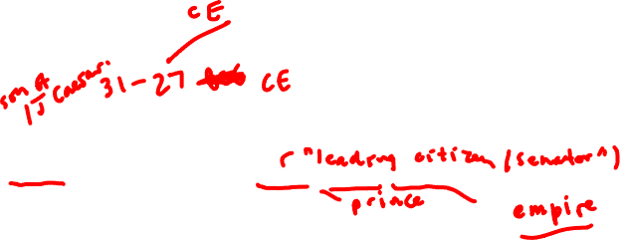
Empire: 27 BCE–476 CE (West) –1453 CE (East)
Octavian is given special powers by Senate, claims to “restore Republic”, is voted the additional name Augustus
Augustus becomes first emperor (princeps, imperator) of Rome.
Series of dynasties of Roman emperors
Roman empire expands
212 CE: all inhabitants of Roman Empire given Roman citizenship
303 CE: persecution of Christians under Emperor Diocletian
313 CE: Edict of Milan. Emperor Constantine provides restitution to Christians formerly persecuted
341 CE: banning of pagan sacrifice
380 CE: Emperor Theodosius proclaims Christianity the religion of the Empire
Split of Empire into western and eastern halves ruled separately, eastern capital at Byzantium/Constantinople, rulers are Greek speakers
476 CE fall of Rome to Germanic king
eastern half continues until 15th c. and fall of Constantinople to Ottoman Turks.

Slide 17
Hesiod, Theogony 1011-1016. (8th-7th c. BCE?): fitting the Romans and Italians into Greek mythological genealogy
And Circe the daughter of Helios [“Sun”], Hyperion's son, loved steadfast Odysseus and gave birth to Agrios and Latinos who was faultless and strong: also she brought forth Telegonos by the will of golden Aphrodite. And they ruled over the famous Tyrrhenians [=Etruscans, an ancient Italian people], very far off in a recess of the holy islands.

Slide 18
Athenian black-figure neck amphora from 525-500 BCE showing the Trojan warrior Aeneas leaving Troy and carrying his father, Anchises. His mother, Aphrodite, stands behind, his son precedes him.

Slide 19
Voyage of Aeneas, mythical founder of Roman people, from Troy to Italy

Slide 20
Prophecy of Anchises to his son, Aeneas, mythical founder of the Roman people, in the Underworld (Virgil [Roman poet 1 c. BCE – 1 c. CE], Aeneid [Roman national epic] book 6)
For other peoples will, I do not doubt,
Still cast their bronze to breathe with softer features,
Or draw out of the marble living lines,
Plead causes better, trace the ways of heaven
With wands and tell the rising constellations;
But yours will be the rulership of nations,
Remember, Roman, these will be your arts:
To teach the ways of peace to those you conquer,
To spare defeated peoples, to war down the arrogant.

