Slide 1
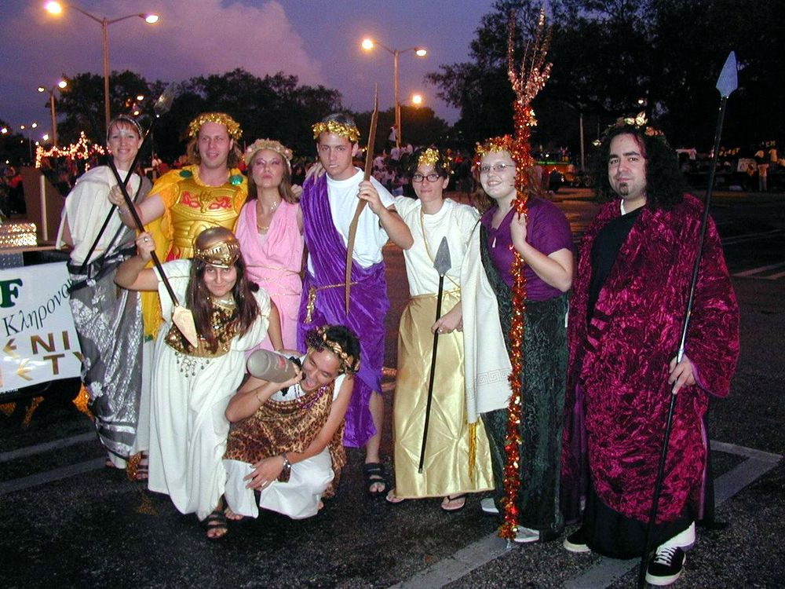

Slide 2
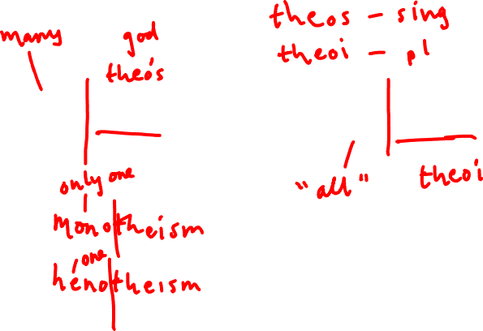
Polytheism and Pantheon
(Greek)

Slide 3
What do gods look like?
Human-like (anthropomorphic) or not?
How do you tell one god from another?

Slide 4
Anthropomorphism (imagining gods [or other non-humans] as human in appearance)
Xenophanes of Colophon, early philosopher, 6th c. BCE
Fr. 14: But mortals deem that the gods are begotten as they [mortals] are, and have clothes like theirs, and voice and form. (R. P. 100)
Fr. 15: Yes, and if oxen and horses or lions had hands, and could paint with their hands, and produce works of art as men do, horses would paint the forms of the gods like horses, and oxen like oxen, and make their bodies in the image of their several kinds. (R. P. ib.)
Fr. 16: The Ethiopians make their gods black and snub-nosed; the Thracians [people living in region that is now Bulgaria/Rumania] say theirs have blue eyes and red hair. (R. P. 100 b.)

Slide 5
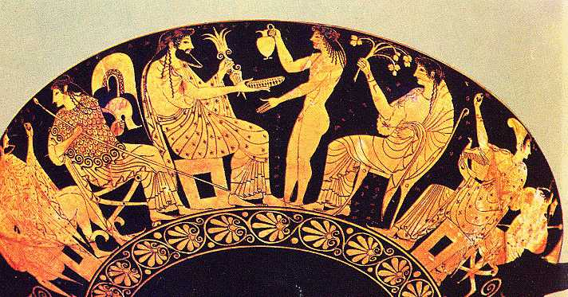
Olympian gods on Athenian red-figure drinking cup, 5th c. BCE

Slide 6
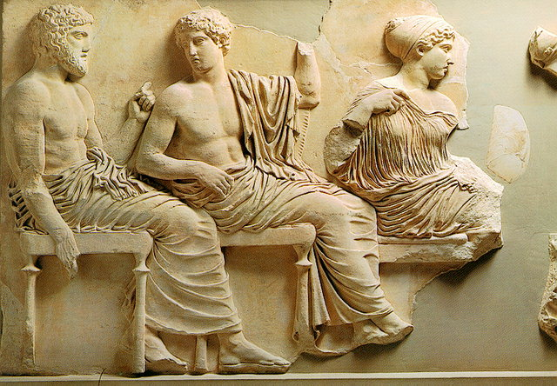
The Olympian gods. East frieze of the Parthenon, Athens. 5th c. BCE.

Slide 7
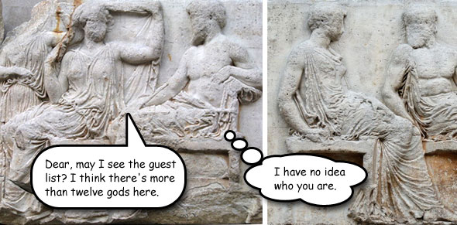
http://www.squidoo.com/greek-mythology-puzzles
Photo of Hera and Zeus by Yair Haklai; Athena and Hephaistos by Marie-Lan Nguyen.

Slide 8
-theisms
polytheism (Gr. polus – “many”, theos – “god”)
henotheism (Gr. heis, henos - “one”, theos - “god”)
monotheism (Gr. monos - “only, sole”, theos – “god”)
What does it say that none of these terms is an actual, original, Greek term?
Which of these systems is compatible with others?

Slide 9
Polytheism: listing of gods or system?Burkert on polytheism, Greek Religion 216
“To give an account of Greek religion means listing numerous gods one after another; the task of the history of religion seems to dissolve into the history of individual gods.”
“But there is a danger this will lead to a fundamental misunderstanding, as if polytheistic religion were the sum of many individual religions…”
“… the whole is more than the sum of the parts”

Slide 10
Idea of pantheon: pan- (‘all’) + theoi (‘gods’)
What is a pantheon?
What are some organizing principles?

Slide 11
Some possible organizing principles behind pantheons
the family
12 gods (canonical set – substitutions possible though: e.g. Dionysus and Hestia)
Olympians
husband and wife
male and female
married and unmarried
brother and sister
old and young
insider and outsider
Olympian and chthonic
function, field of expertise

Slide 12
Concept of the pantheon
Pantheon: Gr. pan – “all”, theos – “god” (but it is a modern term even though from Greek roots)
Herodotus (5th c. BCE Greek historian), Histories 2.117, on differentiation between the gods

Slide 13
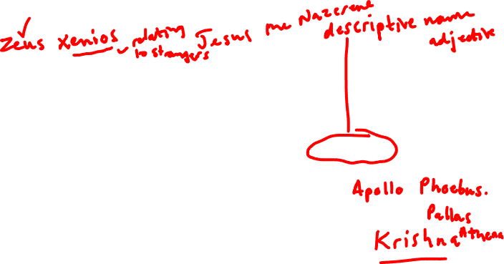
Herodotus (5th c. BCE Greek historian), Histories 2.117, on the system of the gods
“Where each the gods sprang from, whether or not they had all existed from eternity, what forms they bore—these are questions of which the Greeks knew nothing until the other day, so to speak. For Homer and Hesiod were the first to compose Theogonies [account of the origin/birth of the gods], and give the gods their epithets, to allot them their several offices [timai, lit. “honours”] and occupations [tekhnai, lit. “skills, crafts”], and describe their forms.”
How does Herodotus envisage the history of Greek concept of the gods?
cf. 19th and early 20th c. ideas about evolution of religion
Is this model true?

Slide 14
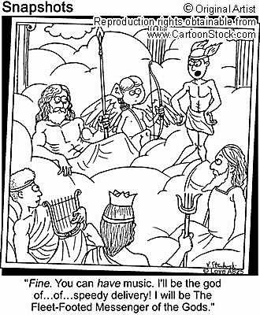

Apportionment of function and honor

Slide 15
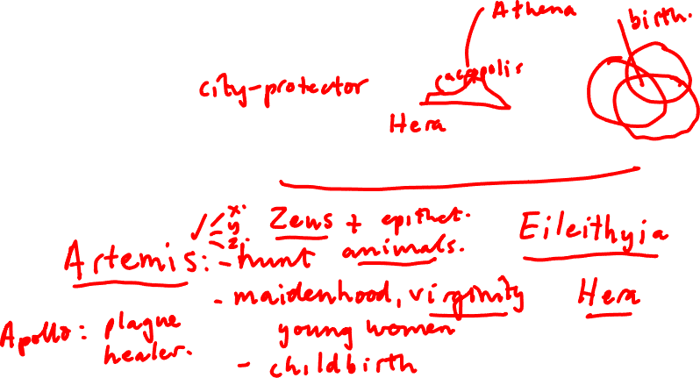
Assigning and apportioning portfolios
How is this done?
One function to one god? Can a god have more than one function?
Do these functions change?

Slide 16
Signaling function by adding epithet (title/adjective) to name
e.g. Zeus xenios (“one who protects stranger-host relationship”)
very common in cult [i.e. how people worship the gods] but not as much in myth [i.e. stories people tell about the gods]: why?
see Herodotus 1.44 story and Xenophon story

Slide 17

Xenophon (Athenian, late 5th - early 4th c. BCE), who has been sacrificing and praying to Zeus Basileus (Zeus the king) and getting no results. Anabasis 7.8
Then (Eukleides the seer) said (to Xenophon): "Zeus Meilikhios [“the mild one”] is an obstacle to you, I am sure," adding in another tone of voice, ”Have you tried sacrificing to that god, in the way I used to sacrifice and offer whole burnt offerings for you at home?” Xenophon replied that since he had been abroad, he had not sacrificed to that god. Accordingly Eukleides counselled him to sacrifice in the old customary way: he was sure that his fortune would improve. The next day Xenophon went on to Ophrynium and sacrificed, offering a holocaust [sacrifice where animal is slaughtered and burned entirely on hearth-type altar] of swine, after the custom of his family, and the signs which he obtained were favourable.

Slide 18
Herodotus, Histories 1.44. King Croesus of Lydia calls on Zeus using three different epithets
Croesus, distraught at the death of his son, cried out the more vehemently because the slayer was one whom he himself had cleansed of a bloody deed, and in his great and terrible grief at this mischance he called on Zeus by three names — Zeus katharsios [the Purifier], Zeus epistios [of the Hearth], Zeus hetaireios [of Comrades]: the first, because he wanted the god to know what evil his guest had wrought him; the second, because he had received the guest into his house and thus unwittingly entertained the slayer of his son; and the third, because he had found his worst foe in the man whom he sent as a protector.

Slide 19
Consequences of system of honours and profiles. Speech of Aphrodite from Euripides, Hippolytus
(5th c. BCE Athenian tragedian) adapted trans. Theodoridis
I am Aphrodite. A goddess! Also called Cypris. A great goddess among mortals, as well as throughout the heavens. Of those mortals who look upon the light of the sun and who live between the very edges of the East, the Black Sea and the farthest ends of the West, the great Pillars of Atlas, of all those who respect my power, I respect them, also.
But those of them who treat me with disrespect, them I crush and destroy!
It’s part of being a god. We, gods, all of us, enjoy being revered by the mortals.
So I say and so I shall prove very shortly!
You see, Hippolytus, that child of the Amazon Hippolyta, by the seed of Theseus, who was raised by that pure man, Pittheus, is the only one -the only one in the whole of Troezen, who hates me. He says that I am the worst of all the gods! Hippolytus, says this! He is the only mortal, the only man, who says this!
The boy will neither marry anyone nor go anywhere near the bed of love!
Instead, he reveres that Artemis, Zeus’ daughter, Apollo’s sister!
Nods towards the statue of Artemis
He thinks she’s by far the greater of all the goddesses and so, the two of them, he and his little virgin deity there, take their great hunting dogs and go roaming about the plush forest together all day, sending all the wild beasts away! A mortal has no business being in such a close relationship with an immortal! Far too inappropriate a behaviour for a mortal, I say!
But the fact is, the relationship itself doesn’t bother me, really. I’m not the jealous type. Why should I be bothered about those two?
But the disrespect he shows for me –a goddess! For that I will punish him severely! Today!

Slide 20
Multiple pantheons
Homeric and Hesiodic: panhellenic, familiar to most or all Greeks
Orphic: differs from Homeric and Hesiodic – we will see this when we discuss mystery cult
Local: each city or town has its own collection of gods it sees as significant

Slide 21
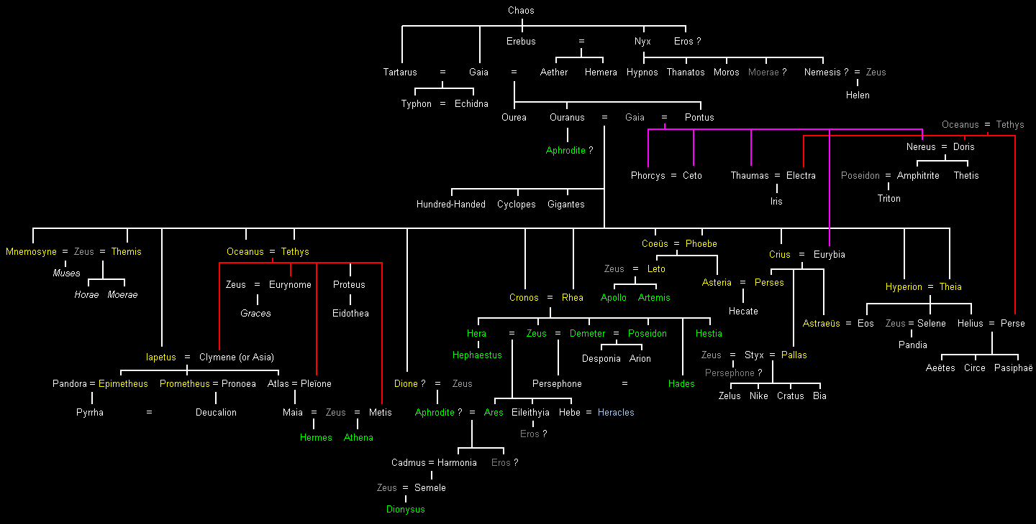
Genealogy of the gods according to Hesiod (7th c. BCE?)

Slide 22
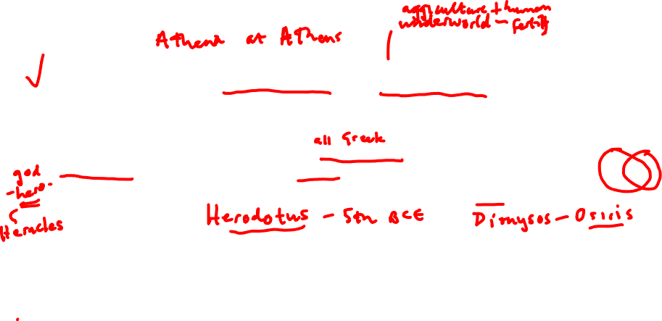
Examples of local variety in pantheons
Local version of god may have different function from panhellenic version: e.g. Hera at Argos as protector of city, Persephone in Locri (S. Italy) as protector of children (see Price, pp. 24-24).
use of epithet attached to name of god to indicate function
Connection of local deity to more panhellenic figure: e.g. Poseidon-Erechtheus at Athens, Athena-Aphaia on Aigina
Connection of deity to deity from another culture, e.g Zeus-Ammun Re (Egyptian god)
Multiple aspects of a god: e.g. Artemis as goddess of the wild and hunting, goddess presiding over childbirth, goddess presiding over young people transitioning from one age group to another.

Slide 23
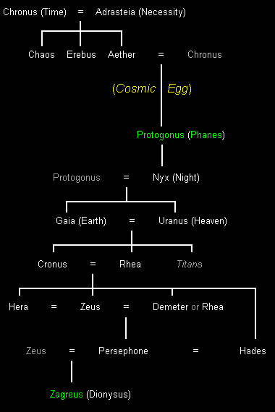

Genealogy of the gods according to the Orphic tradition

Slide 24
Xenophon (Athenian, late 5th - early 4th c. BCE), who has been worshiping Zeus Basileus (Zeus the king). Anabasis 7.8
Then (Eukleides the seer) said (to Xenophon): "Zeus Meilikhios is an obstacle to you, I am sure," adding in another tone of voice, "have you tried sacrificing to that god, in the way I used to sacrifice and offer whole burnt offerings for you at home?” Xenophon replied that since he had been abroad, he had not sacrificed to that god. Accordingly Eukleides counselled him to sacrifice in the old customary way: he was sure that his fortune would improve. The next day Xenophon went on to Ophrynium and sacrificed, offering a holocaust [sacrifice where animal is slaughtered and burned entirely on hearth-type altar] of swine, after the custom of his family, and the signs which he obtained were favourable.

Slide 25
Talking about the gods
Myth focuses on individual gods and their activities
Everyday discourse seems to focus on gods as collective: “the gods”, “the god” (sing. for pl.), “the divine”, “fate”, “Zeus” (as representative of gods as a whole)
Cult requires direction of prayer and sacrifice to specific deities with specific epithets (e.g. story of Xenophon and Eukleides and which Zeus to pray to)

Slide 26

The Olympians
Association with Mount Olympus (cf. Near Eastern tradition of group of gods associated with sacred mountain)
Contrast with previous generations of gods (Titans, offspring of Gaia and Uranus)
Contrast with underworld deities (chthonians, chthonioi)
Canonical number of twelve, influence of art and poetry, “boundary line” of 8th c. (Burkert 176)
Family group

Slide 27
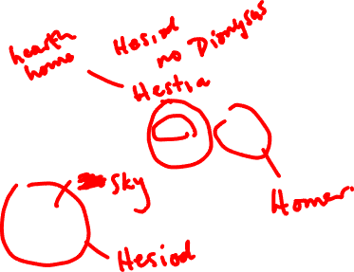
The Twelve Olympians note substitution of Dionysus for Hestia in some versions, and alternate paternity of Aphrodite

