Slide 1
English 213 W
Where does the “writing link” fit in?

Slide 2
Take a few minutes to respond to each question. Then we’ll break into small groups to
share them, before discussing them together in the large group:
1 . What do you feel are your strengths as a writer?
2. What concerns you about your own writing?
3. What are the skills you would most like to learn or improve upon in English 213:W?
4. Describe your relationship to your writing by comparing it to something it reminds you of.
For example, My relationship to my writing reminds me of a distant cousin four-times
removed. I only see her at occasional required family gatherings.
Or, My relationship to my writing reminds me of a comfortable pair of shoes that by now
have almost become my feet.

Slide 3
Why write?
I write to discover what I’m thinking.
I write to discover what I’m feeling.
Robert Hass
National Poet Laureate 1995 - 1997

Slide 4
LANGUGE & THINKING: PORTFOLIOS Bard College
The habit of probative thinking: Writing to explore, test, discover what you feel or think. You might save fragments or freewrites, inventive language play or reflections you value because they begin to make meaning for you, to extend your thinking in ways you don’t yet fully understand.
The habit of analytic thinking: Writing to respond to reading, to think about and build upon the writings of other authors whom you read in the workshop. Writing in which you analyze and understand why others think as they do, and then develop and explain your own viewpoint in a conversation others began.
The habits of narrative and poetic thinking: Writing to tell stories or to compose poems, both of which enable people to think and to express themselves in ways that non-fictional, analytic prose cannot do.
The habit of reflective thinking: Writing to investigate self-consciously how one writes and thinks. Each week’s portfolio, whatever else it includes, should contain some such “metacognitive” writing about how you came to choose the writing you included in your portfolio? What pleases or concerns you in it? If you had more time, what would you do? What kinds of response would you find most useful?
Hybrid habits of mind: Writing that does not feel like fully one thing or another but which seems either to combine several habits of mind in a way that feels new and fruitful or to complicate several habits of mind in a way that feels frustrating and confusing.

Slide 5
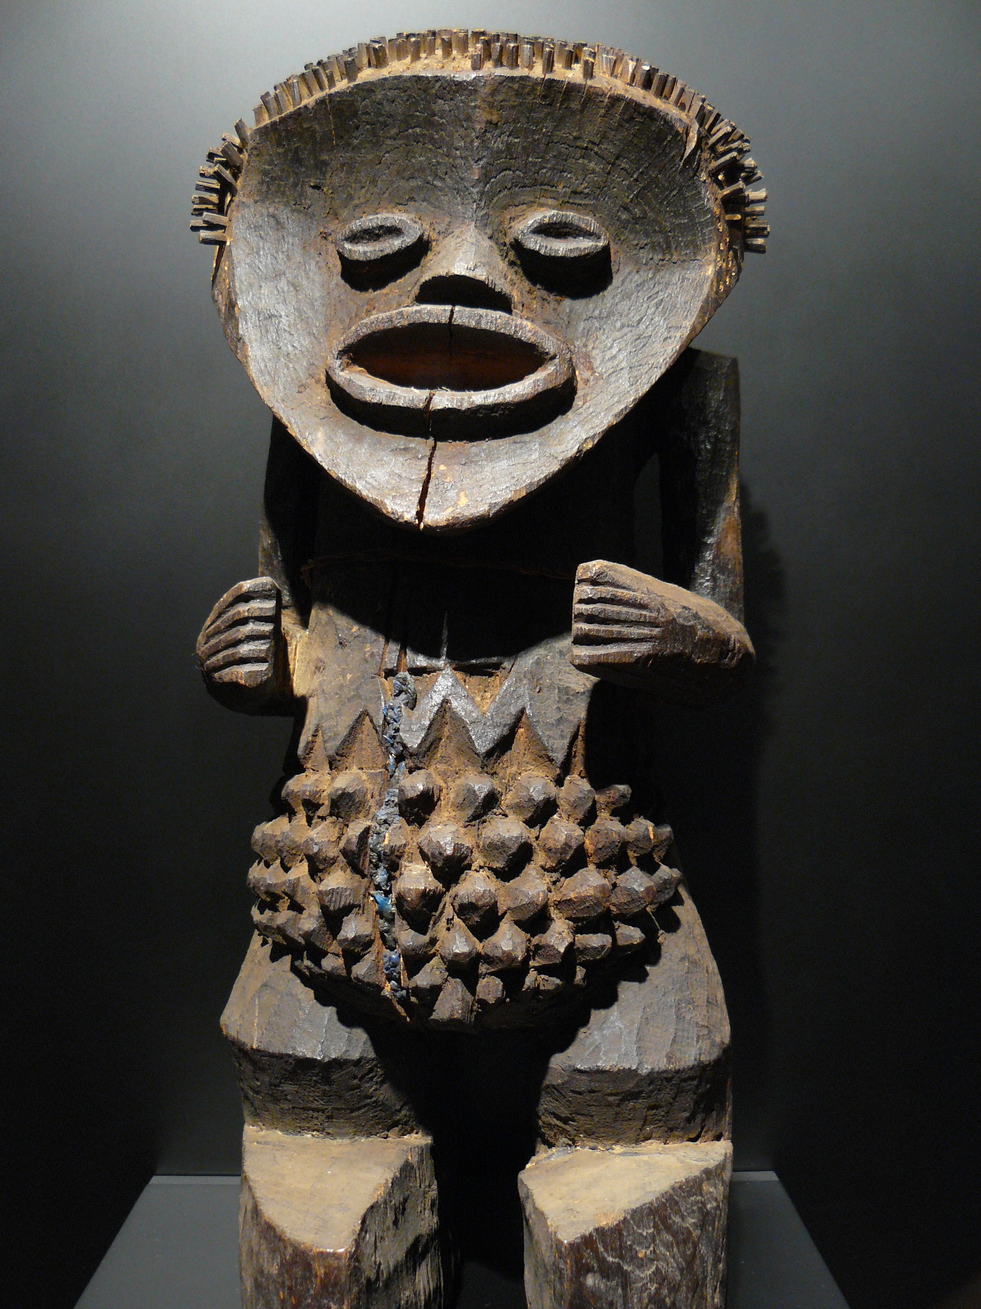

Slide 6
“When we read critically, we are reading for meaning—and that is not the same thing as reading for ‘message.’ Meanings are not things, and finding them is not like going on an Easter egg hunt. Meanings are relationships: they are unstable, shifting, dynamic.”
Ann Berthoff in The Making of Meaning

Slide 7
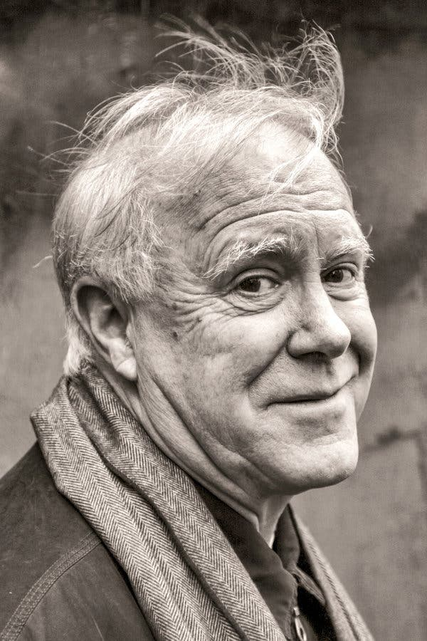
Only you have lived your life.
Robert Hass

