Slide 1
Cluster ~ Vignette
Try to retrieve the submerged sensations of that ample past.
Rilke Letters to a Young Poet

Slide 2
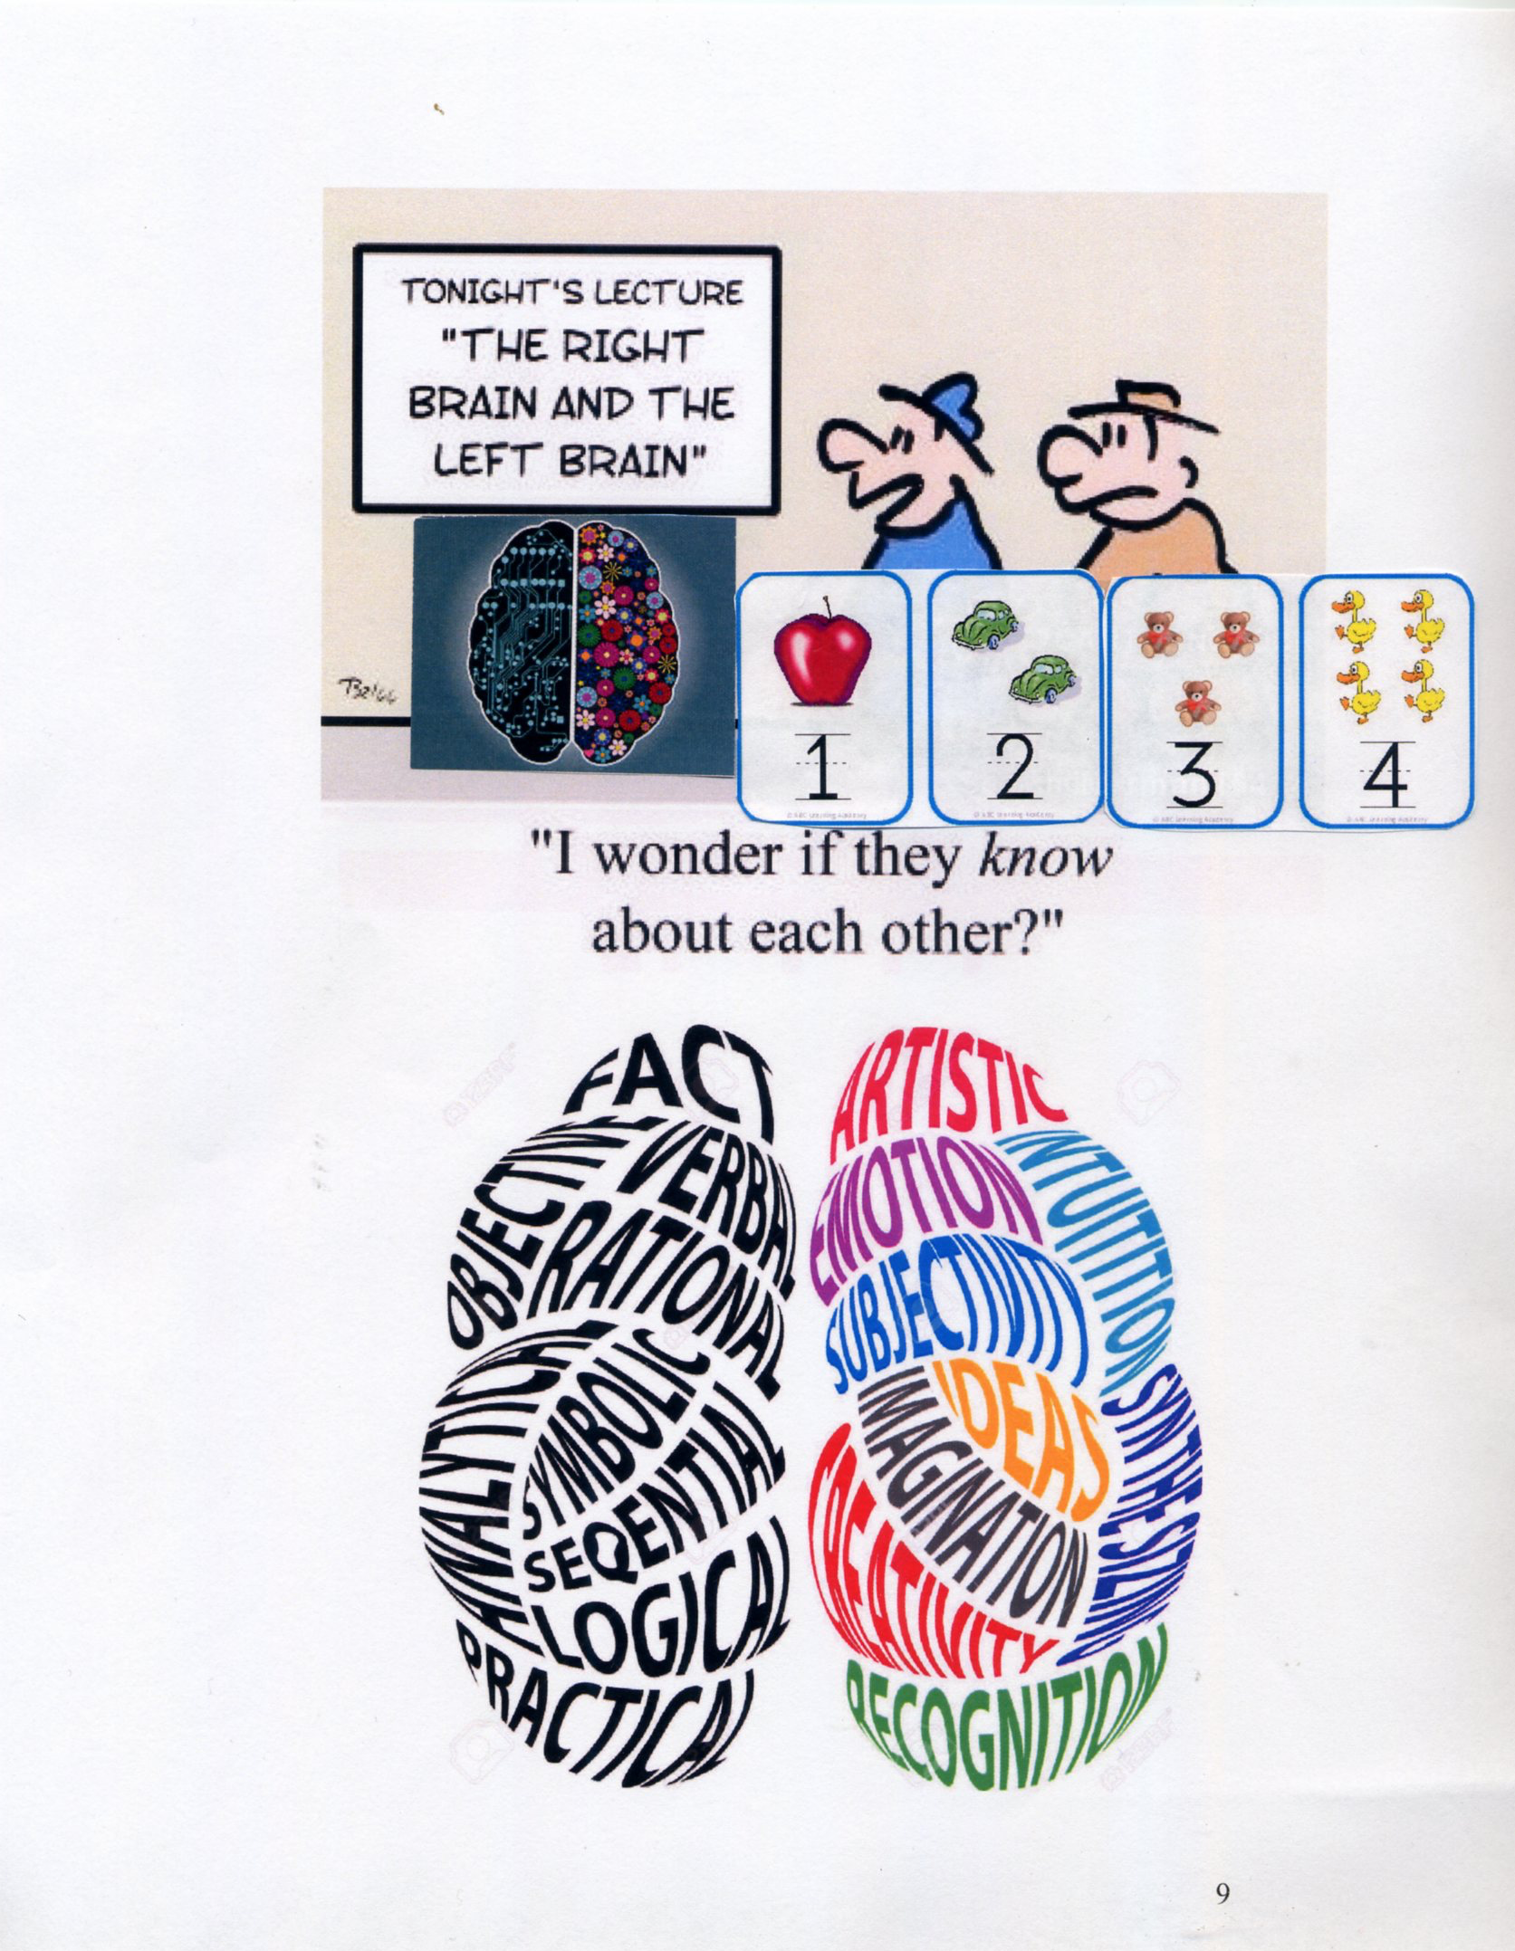

Slide 4
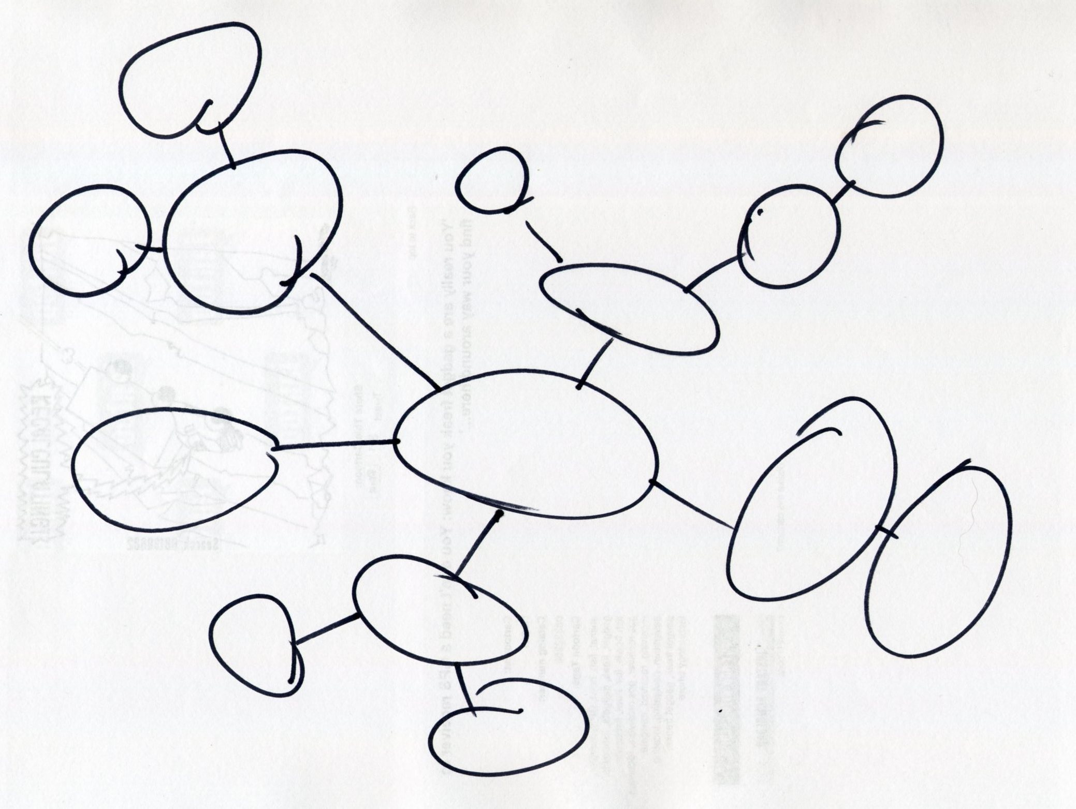

Slide 6
Rain Straight Down
For a long time we thought this boy
loved only things that fell
straight down. He didn’t seem to care
about anything else.
We were afraid he could only HEAR
things that fell straight down!
We watched him stand outside
in rain. Later it was said
he put a tiny pond of rainwater
in his wife’s ear
while she slept, and leaned over
to listen to it.

Slide 7
I remember he was happiest talking
about all the kinds of rain.
The kind that comes off herons’ wings
when they fly up from the lake. I know
he wanted some of the heron rain
for his wife’s ear too!
He walked out in spring to watch
the young girls rub wild onion under
their eyes
until the tears came out.
He knew a name for that rain too.
Sad onion rain.
That rain fell straight down
too, off their faces
and he saw it.

Slide 10
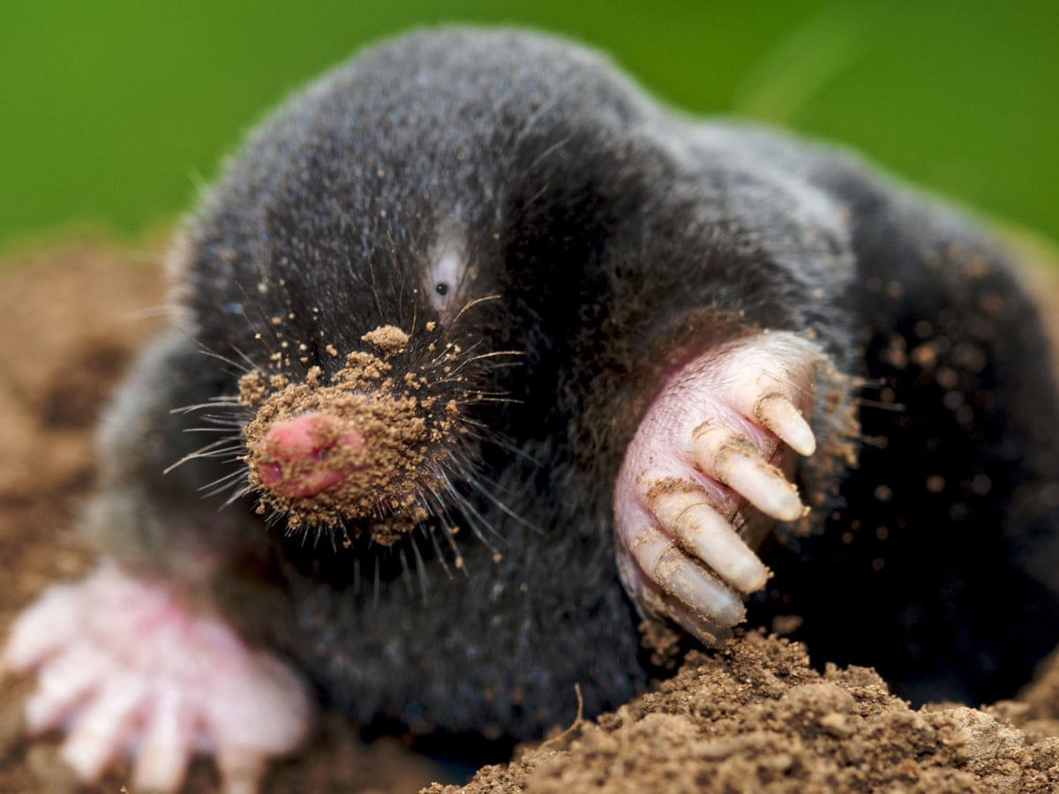
1200 × 900

