Slide 1
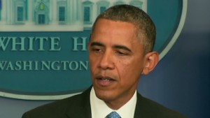
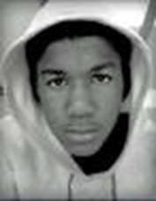
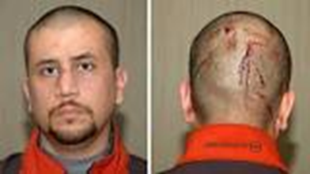
Lecture # 2 March 31, 2021
Paradox of Law #1: Law as words and as violence
Paradox of Law #2: Law is in state and in society
Ex: Obama on Trayvon Martin
1. Law is official processes/actors in state above & apart from society (judges/juries/lawyers/etc -- top down view)
2. Law is embedded within society – conveys values, signals expectations, constructs identities (bottom up)
Mass & social media produce legal knowledge –
criminals/victims; good/bad people; in/out-siders
Civil Rights Activism (BLM) – contests law of state & in society
Notes:
Trayvon Martin, George Zimmerman, 2012

Slide 2
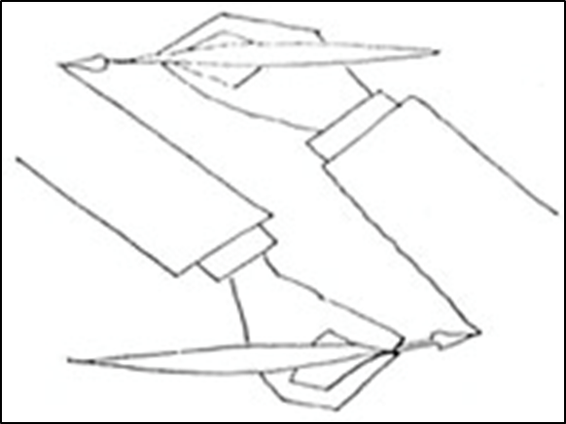
Law and/in society
Law and society are interrelated, or mutually constitutive;
they shape each other.
We are subjects of official rule and agents who enact law in
social and political practice, sometimes departing from or challenging official rules/rulers

Slide 3
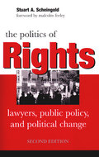
1. Scheingold: integrates two paradoxes
Law is real, but also a figment of
our imagination. How can this be?
a) Concrete, material, coercive institutional practices vs. abstract, symbolic, rhetorical…principles
What we say, and what we do….
b) Law = institutionalized practices & ideology
(Or…institutions = ideas in action?)
Law makes social life “accessible” (confers meaning, coherence)
c) But ideology often masks, distorts reality of
institutional practices
d) Law must be studied as both institutional
and ideological power
Notes:
Analogy of music to musician. Knowledge, skills, practices. Indeterminate – variations on themes. Difference is: music is not backed up by violence. Law is words/conventions and violent enforcement.

Slide 4
2. Law as “ideology”
a) Law provides symbolic framework for understanding political order and for ordering our political understanding
“Rule of law” is that overall framework of rules, principles, ideas, ideals, institutions, practices...
b) ) Legal principles and language constitute the community of rights-bearing members
c) As ideas are enacted in practice, they become a “real,” powerful, constitutive force (even if myth)
Thrones may be out of fashion and pageantry too, but political authority still requires a frame in which to define itself and advance its claims, and so does opposition to it. Clifford Geertz

Slide 5
3. What is the core substance of legal ideology is constitutional core (for Scheingold)?
a) Organization of government institutions– constitutional separation of powers, federalism, checks/balances, etc.
Courts enforce “impartial law” to contain political interests and arbitrary rules
(government of laws, not of men; “law is king”)
b) Legal rights→ social values– property, due process, civil liberties, equal treatment, etc.
Rights structure entitlements, obligations, relationships of power…for those who “belong…as equal citizens in capitalist society.”

Slide 6
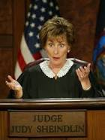
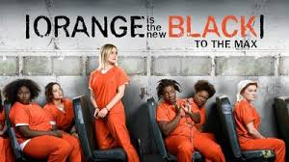
4. How is legal ideology (re)produced?
a) By state (government) & legal profession
b) Within society, by routine interaction (“laws R us”)
The language of law thus becomes, in some measure, a vulgar tongue…so that the whole people contract the habit and tastes of the judicial magistrate. Alexis de Tocqueville (1830)
c) Cultural institutions – education, work, family, mass entertainment
Notes:
Enzo the dog

Slide 7
5. Legal knowledge enables us to interact within communities, but also to contest the terms of community & practice –
Who belongs? Who has rights?
Which rights, policies, privileges….?
How do we want to organize ourselves to maximize security, freedom, prosperity?
Law is basis of community connection and contestation (unity & division)
Notes:
Unlike rules in a game. The contest is not just within the rules but over the rules, rights relationships.

Slide 8
6. How to explain fact of social exclusion and hierarchy?
a) Law creates and enforces rights to private property ownership → unequal wealth and power (classes)
b. Law tolerates and enforces racial divide in society Constitution protected slavery, Jim Crow segregation
c. Legal ideology obscures or rationalizes social inequality
“Myth of Rights” legitimates inequalities as “natural’
Delusion, hypocrisy, manipulation? Same effect…
Race & gender neutrality→ perpetuates inequalities
Politics of Rights = mobilizing law to close gap between promise of equal rights and reality of social inequality
Use “myth of rights” as resource to change reality
What if elites do not share/voice liberal rights?

Slide 9
7. Historicizing Scheingold
His “rule of law” is post WWII liberal constitutionalism
Formal, abstract legal principles of equal rights
Historically embedded in US along with hierarchical traditions of illiberal law
Illiberal/repressive law – less egalitarian; constructs racial/gender/ethnic, etc. differences & hierarchy; law as order and deference to authority
Ex. Slavery, Jim Crow, Asian exclusion, immigration law, female household labor
Inequalities in society are created and upheld by specific legal traditions
Kafka: law is equal for all vs “only for you”
US history: a hybrid mosaic of liberal & illiberal law
Today: race/gender neutrality and proceduralism masks the continuity of legally enforced inequality
Notes:
Unlike rules in a game. The contest is not just within the rules but over the rules, rights relationships.

Slide 10
“The Rule of Law” → multiple coexisting legal orders in US
Liberalism Illiberal/Authoritarian
Politics of rights – not on terrain of unitary legal order, but people subjected to illiberal law(s) embrace liberal rights ideals to challenge hierarchy
Notes:
Unlike rules in a game. The contest is not just within the rules but over the rules, rights relationships.

Slide 11
Reinterpreting Pres. Trump vs Rule of Law (Mednicoff)
The Nation
Trump’s All-Out Attack on the Rule of Law
The Washington Post
Trump's latest attack on the rule of law
The New York Times
How Trump Corrupts the Rule of Law
The Atlantic
What Pleases Trump Has the Force of Law
Obama/Scheingold vs Trump
Liberal Legality Illiberal/Authoritarian Legality
Notes:
Unlike rules in a game. The contest is not just within the rules but over the rules, rights relationships.

