Slide 1
Perennial Questions
What is really real?

Slide 2
Perennial Questions
What is really real?
Top-down

Slide 3
Perennial Questions
What is really real?
Top-down
Bottom-up

Slide 4
Perennial Questions
What is really real?
Top-down
Bottom-up
19th-century inversions:
Darwin, Marx, Freud

Slide 5
Perennial Questions
What is really real?
Top-down
Bottom-up
19th-century inversions:
Darwin, Marx, Freud
Schopenhauer:
The world has two aspects — Will and Representation
The World as Will and Representation (1818, 2nd ed. 1844, 3rd ed. 1859)

Slide 6
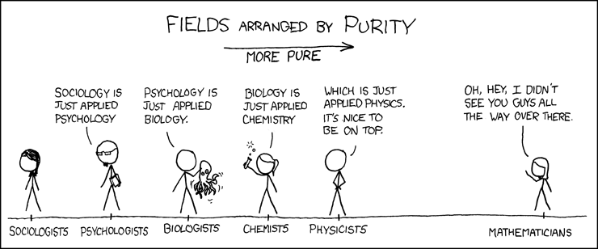
Will: striving, conflict, tumult, agitation
blind inclination — from energistic forces and physical matter to self-consciousness

Slide 7
Will: striving, conflict, tumult, agitation
blind inclination — from energistic forces and physical matter to self-consciousness

Slide 8
Will: striving, conflict, tumult, agitation
blind inclination — from energistic forces and physical matter to self-consciousness
In Darwinian terms:
consciousness / reason is at best just a chance adaptation, useful for survival

Slide 9
Will: striving, conflict, tumult, agitation
blind inclination — from energistic forces and physical matter to self-consciousness
In Darwinian terms:
consciousness / reason is at best just a chance adaptation, useful for survival
Schopenhauer: it’s worse —
reason is what uncovers our inexorable misery, meaninglessness

Slide 10
Will: striving, conflict, tumult, agitation
blind inclination — from energistic forces and physical matter to self-consciousness
In Darwinian terms:
consciousness / reason is at best just a chance adaptation, useful for survival
Schopenhauer: it’s worse —
reason is what uncovers our inexorable misery, meaninglessness
Notes:
Silenus: That the best thing for a man is not to be born, and if already born, to die as soon as possible.
Dionysus’ lackey
Orpheus is the only one who can put a stop to ixion’s wheel sisiphus’s boulder, etc.

Slide 11
Representation (reason, rationality, perception):
The ‘daylight’ of consciousness
Illusion of a well-ordered surface
Principle of sufficient reason (causality)
Principle of Individuation (objective knowledge)

Slide 12
Representation (reason, rationality, perception):
The ‘daylight’ of consciousness
Illusion of a well-ordered surface
Principle of sufficient reason (causality)
Principle of Individuation (objective knowledge)
The will objectifies itself in physical objects:

Slide 13
Representation (reason, rationality, perception):
The ‘daylight’ of consciousness
Illusion of a well-ordered surface
Principle of sufficient reason (causality)
Principle of Individuation (objective knowledge)
The will objectifies itself in physical objects:
Digestive organs are objectified hunger
Genitals are objectified sexual desire
Notes:
(teeth to guts to anus)

Slide 14
Schopenhauer’s
metaphysics of music:
If everything we experience is a representation,
then what is music representative of?

Slide 15
Schopenhauer’s
metaphysics of music:
If everything we experience is a representation,
then what is music representative of?
The Will (energy, desire) as it is in itself

Slide 16
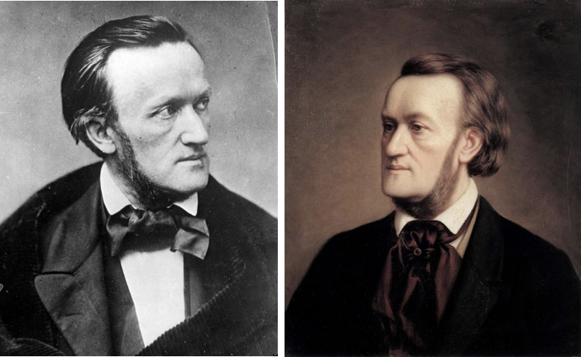
Richard Wagner
Tristan und Isolde (1859, 1st performance: 1865)
"henceforth no end to the yearning, longing, rapture, and misery of love: world, power, fame, honor, chivalry, loyalty, and friendship, scattered like an insubstantial dream; one thing alone left living: longing, longing unquenchable, desire forever renewing itself, craving and languishing; one sole redemption: death, surcease of being, the sleep that knows no waking”

Slide 17
Sigmund Freud on Dreams and Desire
The Interpretation of Dreams (1899)
The Dream-Work (1905)
Dreaming is a form of involuntary thinking
If it’s involuntary it is distinct from consciousness / conscious choice
(prefrontal cortex becomes inactive)
The mind operates through freely associative structures
(orbitofrontal cortex is active)
Dreams reveal the structure of this thinking as a sort of Gestalt
Notes:
There is something within you, beyond the “you” that thinks
why should we think there is an unconsciousness at all?
1 parapraxis, Freudian slip (mean your mother) actually means something (embarassing)
2 gaps in memory (can remember a word)
3 force of habit

Slide 18
Sigmund Freud on Dreams and Desire
Instinct: an impulse originating in body and transferred to mind
3 aspects of consciousness:
Unconscious (hidden, unknown knowns)
Preconscious (accessible, but subject to lapses)
Conscious (mode of rational thought / choice)
Notes:
Georg Groddeck: “The statement I live is only conditionally correct. "man is lived by the it" - feature-placing

Slide 19
Sigmund Freud on Dreams and Desire
Instinct: an impulse originating in body and transferred to mind
3 aspects of consciousness:
Id / Es / “it” (desire, drives)
Ego / Ich / “I” (reality checking)
Superego / Über-ich / “collective consciousness” (laws, rules, prohibitions)
Notes:
Id / es / “it” (locus of desire, drives, I want)
Ego / ich / “I” (reality checking, what is possible / beneficial relative to external reality)
Superego / Über-ich / collective consciousness (laws, rules prohibitions)

Slide 20
Defense mechanisms
How does the conscious mind deal with unacceptable drives/desires?
Repression
Sublimation
Neuroses
Dreams
Notes:
Sublimation (from solid to gas) e.g., from aggression to surgery

Slide 21
Dream Work
The mind imposes meaning / structure on random stimuli
through free association
cp. Montage technique | we fill it in sponataneously
Notes:
even if random, the mind imposes structure on it through free association

Slide 22
Notes:
The mind imposes meaning | structure | through association
Montage technique | we fill it in sponataneously

Slide 23
Repression
the dream disguise
an evolutionary adaption for self-preservation
why interpretation is necessary
Condensation
creates meaningful unity between causally unrelated things
(people/places can change qualities but still somehow remain the same)
Displacement
potentially harmful thoughts are rendered innocuous / trivial
Notes:
Repression self-censorship in the preconscious
The tension of sexual reproduction
Id (propagation of the species)
Ego (self-preservation)
Pleasure / Danger
Scottie: castration is transferred into desire to control / create M anew

