Slide 1
A Crash Course in Ethics and Aesthetics

Slide 2
A Crash Course in Ethics and Aesthetics
What is involved with experiencing something aesthetically, as opposed to
other ways of experiencing the world?

Slide 3
A Crash Course in Ethics and Aesthetics
What is involved with experiencing something aesthetically, as opposed to
other ways of experiencing the world?
2) What role might art and aesthetic experience play in society more generally?

Slide 4
A Crash Course in Ethics and Aesthetics
What is involved with experiencing something aesthetically, as opposed to
other ways of experiencing the world?
2) What role might art and aesthetic experience play in society more generally?
E.g., is art relevant to questions about ethics, and if so, how?

Slide 5
A Crash Course in Ethics and Aesthetics
What is involved with experiencing something aesthetically, as opposed to
other ways of experiencing the world?
2) What role might art and aesthetic experience play in society more generally?
E.g., is art relevant to questions about ethics, and if so, how?
3) Do different art forms suggest different answers to these questions?

Slide 6
A Crash Course in Ethics and Aesthetics
What is involved with experiencing something aesthetically, as opposed to
other ways of experiencing the world?
2) What role might art and aesthetic experience play in society more generally?
E.g., is art relevant to questions about ethics, and if so, how?
3) Do different art forms suggest different answers to these questions?
E.g., do classical music and film suggest different responses?

Slide 7
A Crash Course in Ethics and Aesthetics
Autonomy / Organicism
Q: Doesn’t art need to be socially relevant?

Slide 9
A Crash Course in Ethics and Aesthetics
Autonomy / Organicism
Q: Is music’s main value practical?
spatial / mathematical reasoning
social value -> community building
enhances job prospect?

Slide 10
A Crash Course in Ethics and Aesthetics
Autonomy / Organicism
Q: Is music’s main value practical?
spatial / mathematical reasoning
social value -> community building
enhances job prospect?
— OR — is it valuable, for its own sake?

Slide 11
A Crash Course in Ethics and Aesthetics
Autonomy / Organicism
The autonomous artwork
auto = self
nomous -> nomos (νομός) = law
autonomous thing (e.g., person, etc.) something that "gives law to itself”

Slide 12
A Crash Course in Ethics and Aesthetics
Autonomy / Organicism
Immanuel Kant, The Critique of Judgment (1790)

Slide 13
Ethics
Autonomy: Choice vs. Determinism
Can an action be im/moral if it is unchosen?
ex: boulder killing a person vs. murder
what about insanity?
Human autonomy is bound up with rationality

Slide 14
All humans are mortal.

Slide 15
All humans are mortal.
Socrates is a human.

Slide 16
All humans are mortal.
Socrates is a human.
Therefore ?

Slide 17
All humans are mortal.
Socrates is a human.
Therefore Socrates is mortal.

Slide 18
Ethics
Rationality is self-consistent, coherent, self-determining (autonomous)
Autonomy is a special sort of freedom
Negative Freedom: an absence of restrictions on us
Positive Freedom: our higher nature
(ex. the rich junkie)
What do consistency, coherence, and self-determination have to do with art?

Slide 19
Ethics
Autonomy is something everyone shares in
“So act that you treat humanity, whether in your own person or in the person of any other, always at the same time as an end, never merely as a means.”
(Immanuel Kant, Groundwork for the Metaphysics of Morals, p. 429)
Hence: exploitation is very bad.

Slide 20
Ethics
Autonomy is something everyone shares in
“So act that you treat humanity, whether in your own person or in the person of any other, always at the same time as an end, never merely as a means.”
(Immanuel Kant, Groundwork for the Metaphysics of Morals, p. 429)
Hence: exploitation is very bad.
What does freedom/autonomy —
self-determination/self-consistency — have to do with art?

Slide 21
Aesthetics
Choice / Determinism
Aesthetic experience is the mode of experiencing the world
in which we are most free
(Self-)Interest
Purpose (German: Zweck)

Slide 22
Aesthetics
Interest
To experience something aesthetically is to experience it
disinterestedly i.e., without self-interest
The Nude in art
Still life
Tree
intrinsic vs. instrumental value

Slide 23
Aesthetics
Purpose
To experience something aesthetically
is to experience it as without purpose,
but with a sense of purposiveness.
Q: “what are you gonna DO with that music degree?”
Q: “what is music good for, what is its utility?"
A: Strictly speaking, nothing, except its own beauty.
Intrinsic vs. Instrumental value

Slide 24
Aesthetics + Ethics: connections
Treat the world / people as autonomous ends in themselves
Intrinsically valuable
Categorization of the world (formal logic Lite)

Slide 25
Aesthetics + Ethics: connections
Determinate Judgment:
Applying general concepts to the individual things we experience.
Fido (individual) is a dog (general concept)
Reflective Judgment:
individual “makes sense” / is recognizable, but lacks a general concept

Slide 26
Aesthetics + Ethics: connections
Determinate Judgment

Slide 27
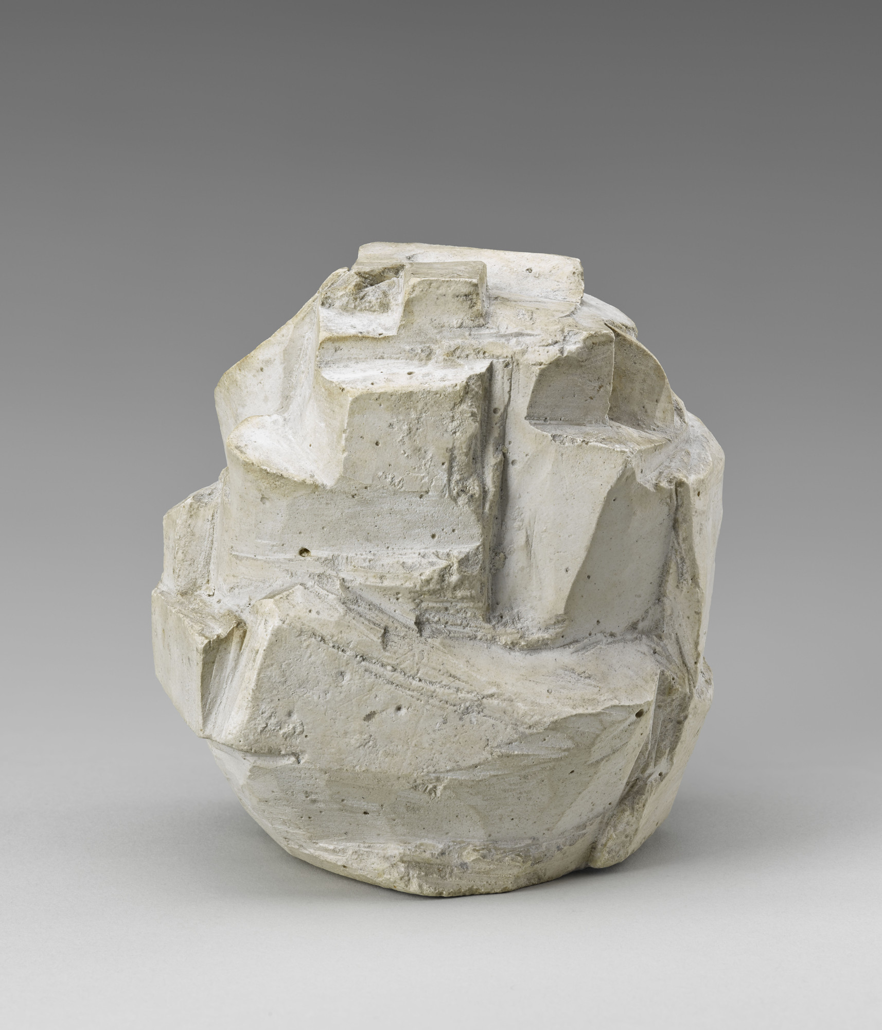
Aesthetics + Ethics: connections
Reflective Judgment

Slide 28
Aesthetics + Ethics: connections
Judgment and Identity
Determinate Judgment: My identity is defined by the groups I belong to
(nationality, economic class, profession, ethnicity, race, etc.)
Reflective Judgment: I am more than these general concepts.

Slide 29
Organicism
Organic life exhibits self-determination
Internal causes
Unity of part (organs) & whole (life)
More than the sum of its parts
Reciprocal Dependency
Reproduction: individual -> species
Ecology
groups of organisms interacting

Slide 31
“Two things fill the mind with ever-increasing wonder and awe, the more often and the more intensely the mind of thought is drawn to them: the starry heavens above me and the moral law within me.”
(Immanuel Kant, Critique of Practical Reason, conclusion)

Slide 32
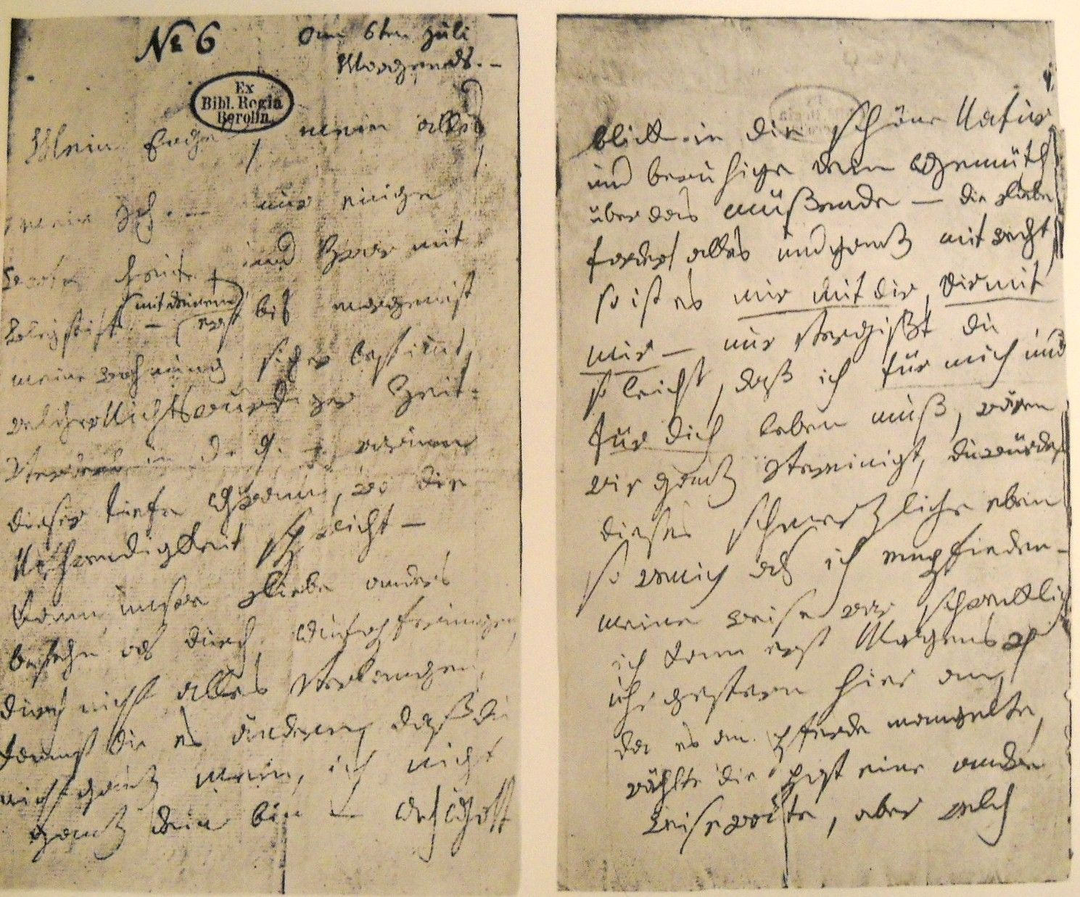
Beethoven: notebook, 1820
“the starry heavens above me and the moral law within me — KANT!!!”

Slide 33
Does art have to solve the problems in the world, or can it teach us to be ethical in another way?

Slide 34
Does art have to solve the problems in the world, or can it teach us to be ethical in another way?
Aesthetic experience teaches us
“how to love something, even nature, without interest.”
(Immanuel Kant, Critique of Practical Reason,
general remark following §29, 267)

Slide 35
Potential problems

Slide 36
Potential problems
Puts form above content
Escapism

Slide 37
Potential problems
Puts form above content
Escapism
Not universal at all
makes bourgeois culture appear universal

