Slide 1
World wars I & II: DIGITAL
HSTCMP 202

Slide 2
Hello and welcome
Laurie Marhoefer, Prof.
David Ou-yang, Teaching Assistnt

Slide 3
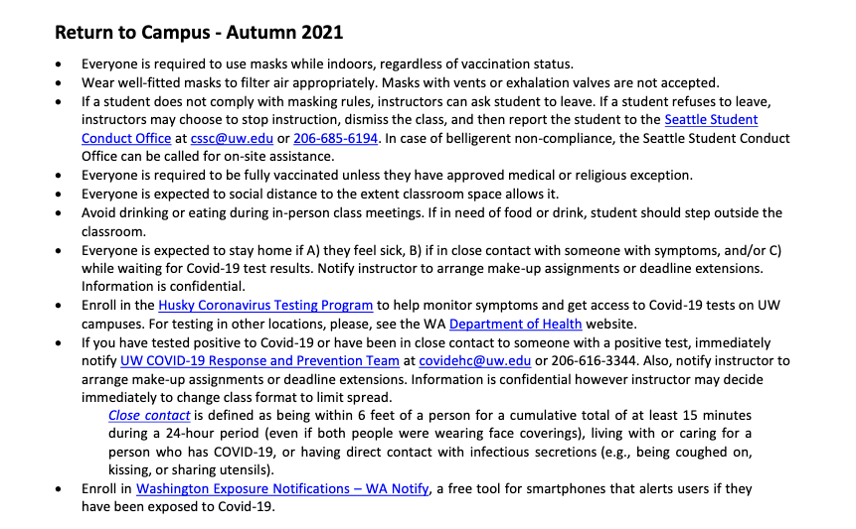
COVID POLICIES

Slide 4
What is military history?

Slide 5
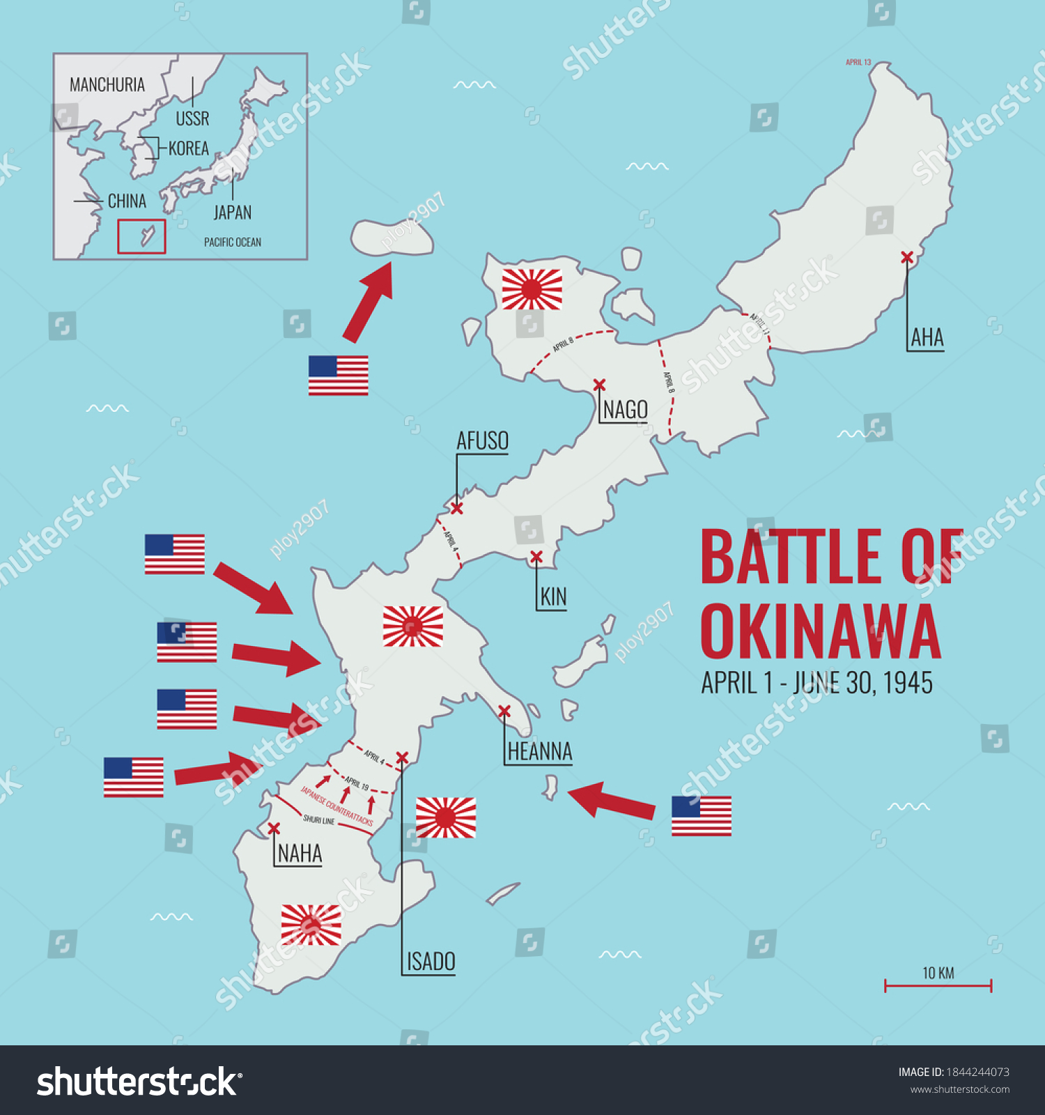

Slide 6
“If you can’t change [war] you must at least record it, so that it cannot be ignored or forgotten. It is some place on the record and it seemed to me personally that it was my job to get things on the record in the hopes that at some point or other, somebody couldn’t lie about it.”
-Martha Gellhorn
Photo JFK Presidential Library

Slide 8
Paul Nash, “We Are Making a New World” (1918)

Slide 9
Verdun Battlefields in 2005

Slide 10
Women working in the welding Department of the Lincoln Motor Co., in Detroit, Michigan, ca. 1918. (Library of Congress)

Slide 11
This shows the death rate by 100,000 people, hence controls for population which skyrocketed in this period. The four colored lines represent different sources of data, except the red and green which are the same source, green is military only, red is the total. You get the picture, in any event. The World Wars were major mass death events. If you’re interested you can download a CSV file of all of this data at Our World in Data.

Slide 12
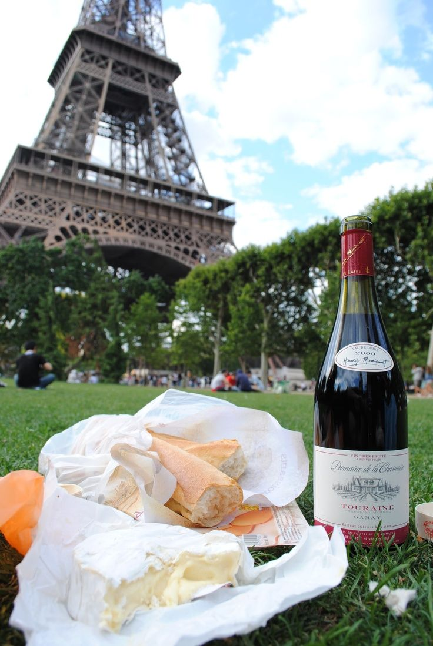
736 × 1099
How we think of Europe:

Slide 13
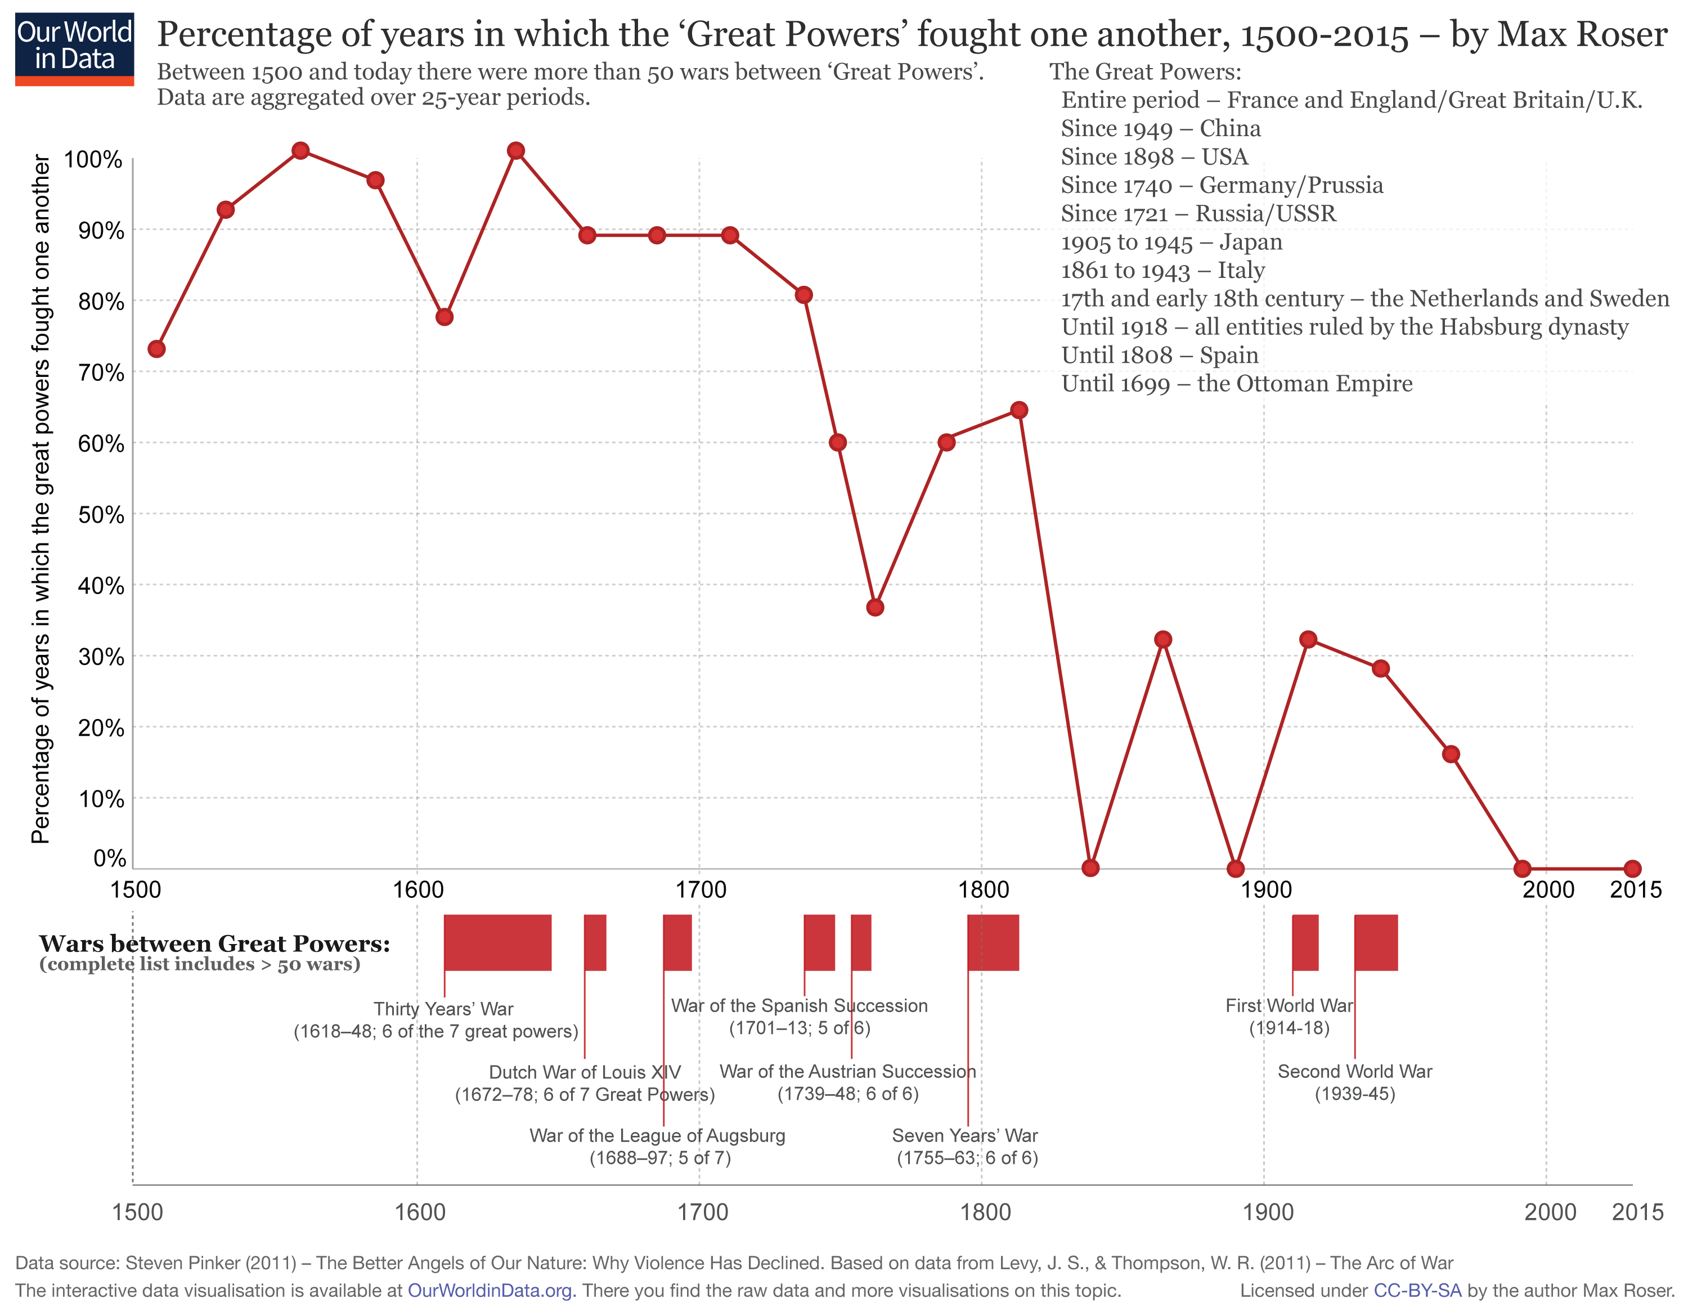
How we probably should think of Europe:

Slide 14
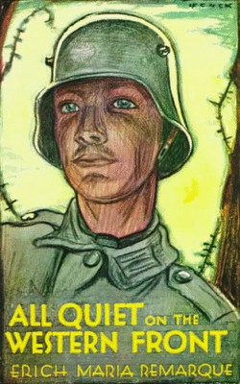
Buy these

