Slide 1
1914 / Digital workshop 1
HSTCMP 202, DIGITAL WORLD WARS
Thursday Oct 8

Slide 2
Outline & Key Terms
“Exquisite” war to “pure murder”
The war of movement in Europe and Africa
3 reactions to the beginning of the war
Digital History Workshop 1
”The War of Movement”
Schlieffen Plan & invasion of Belgium
Data science
technochauvinism (Broussard)

Slide 3
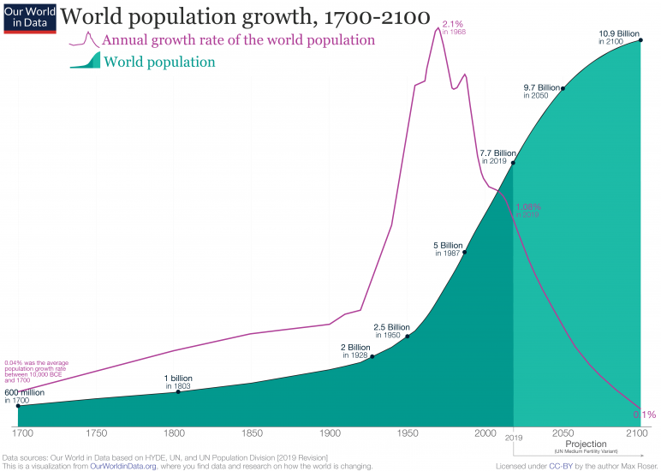
World population almost doubled between 1800 and 1914, from 1 billion to 2 billion people

Slide 4
August, 1914 – the largest mobilization in history size of armies in previous wars
Napoleonic Wars (France versus everyone, circa 1799-1815)
Napoleon’s Army (circa 1800) = 600,000
At the Battle of Waterloo (1815, final French defeat), the French forces suffered 25,000 casualties (”casualties” = dead plus wounded & missing)
American Civil War (1861-5)
Total enlisted, both armies:
United States about 2 million
Confederacy about 1 million

Slide 5
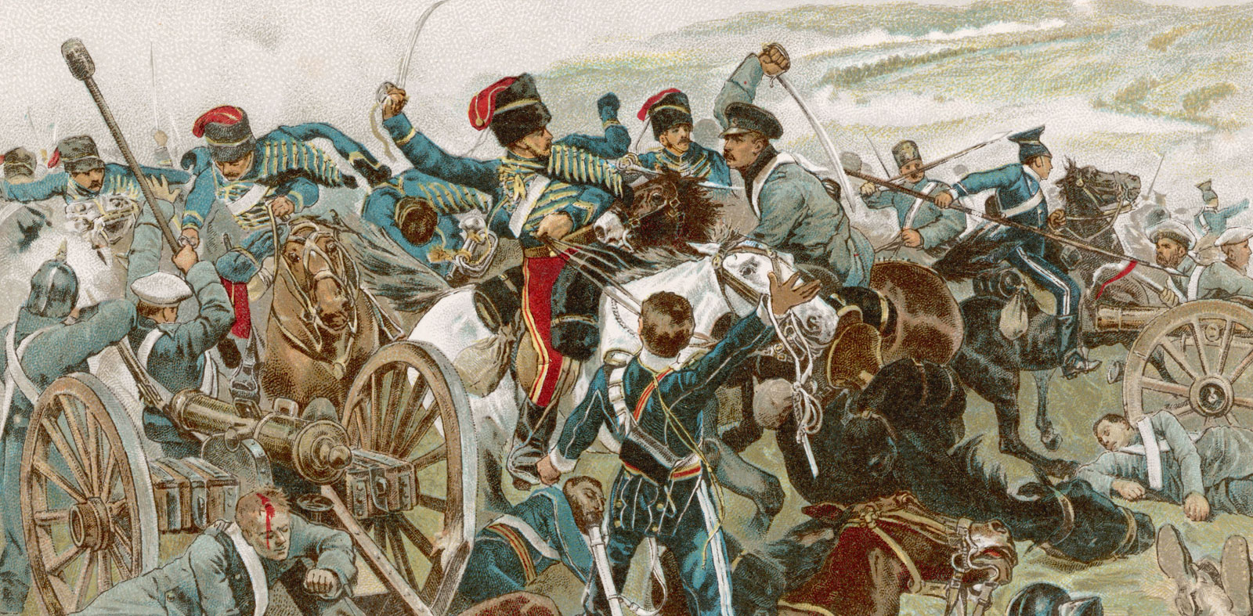
August, 1914 – the largest mobilization in history size of armies in previous wars
Crimean War (1853-1856)
Russian versus Ottoman Empire and its allies (including Great Britain); Russian Empire trying to take over territory from the Ottoman Empire
About 500,000 casualties on both sides total, over three years of war
Charge of the Light Brigade at the Battle of Balaklava, 1854 (Image source: Britannica)

Slide 6
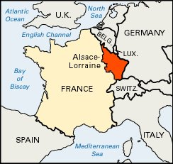
August, 1914 – the largest mobilization in history size of armies in previous wars
Franco Prussian War (1870-1871)
Prussia and other German-speaking states versus France; as a result, Prussia and smaller German states unite to form Germany
Prussia and allies mobilized 380,000 troops to the front within two weeks of the declaration of war
Alsace-Lorraine is orange – a point of contention between France and Germany

Slide 7
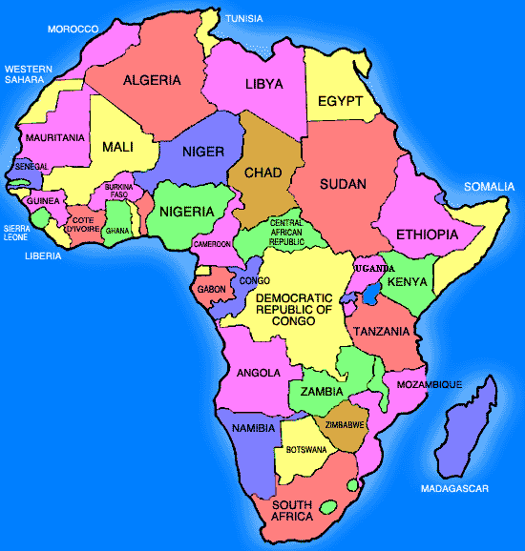
August, 1914 – the largest mobilization in history size of armies in previous wars … is the South African War (Boer War) a better predictor of what’s to come in 1914?
South African War (also called the Boer War) 1899-1902
The British, who have a colony in South Africa, versus the Boers (aka Afrikaners), white descendants of Dutch colonizers who have their own colonies in South Africa. Black South Africans, a large majority of the population, are caught in the middle; some picked a side and fought for it (many picked the British thinking they’d be better colonial overlords).
You can find South African on a map!

Slide 8
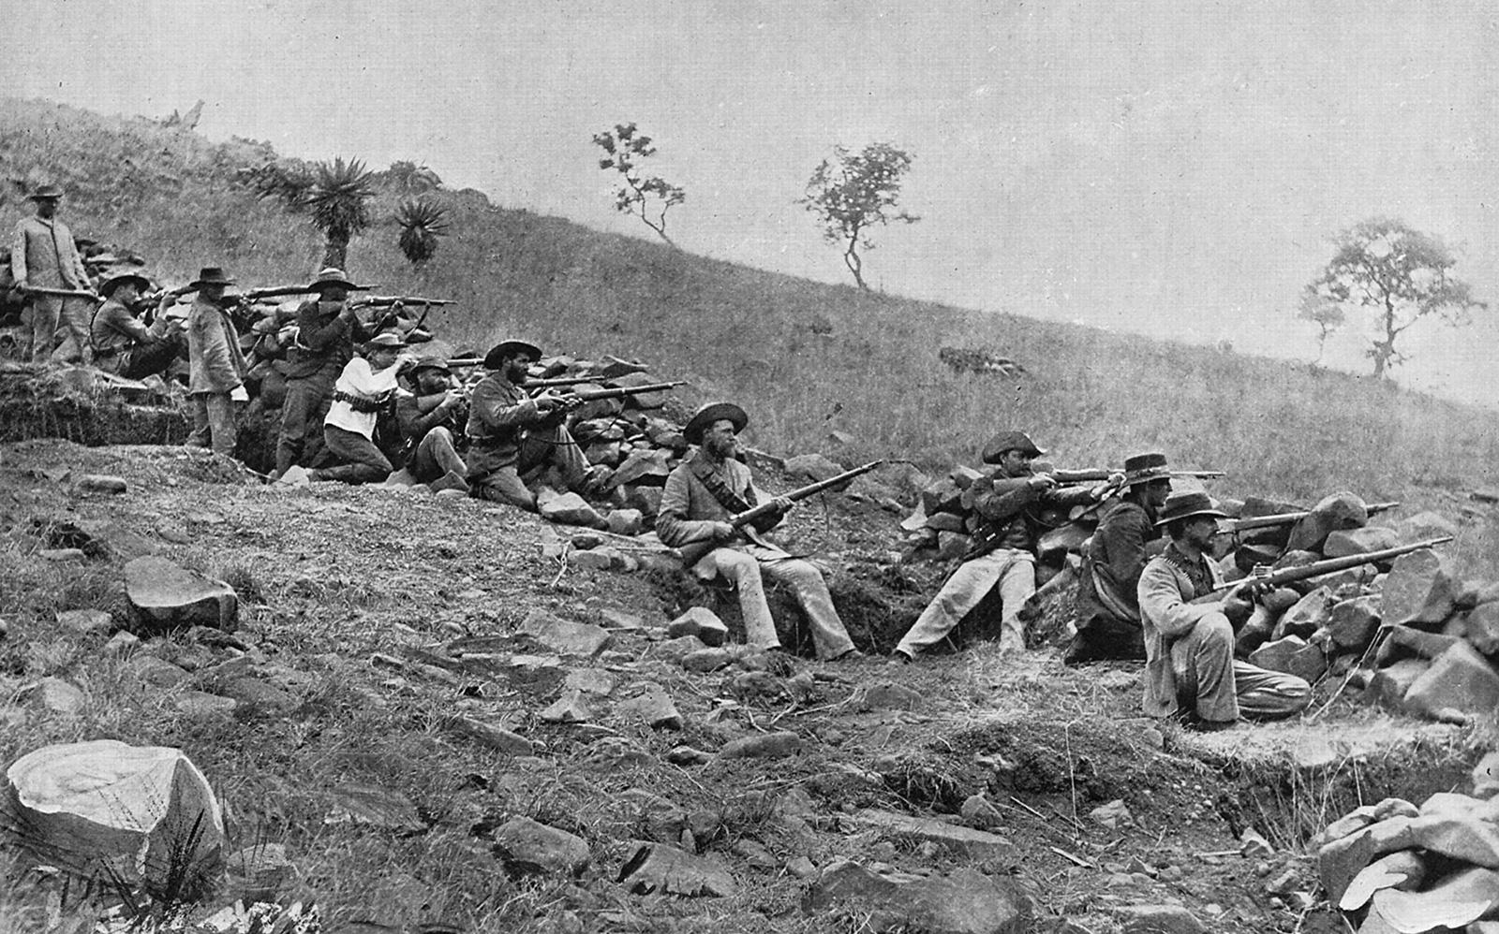
South African War (1899-1902)
Britain’s largest war between the Napoleonic Wars and the First World War
At their height, the two armies are about 500,000 troops (Great Britain) versus 80,000 (Boer forces)
Boer troops (source: Britannica)

Slide 9
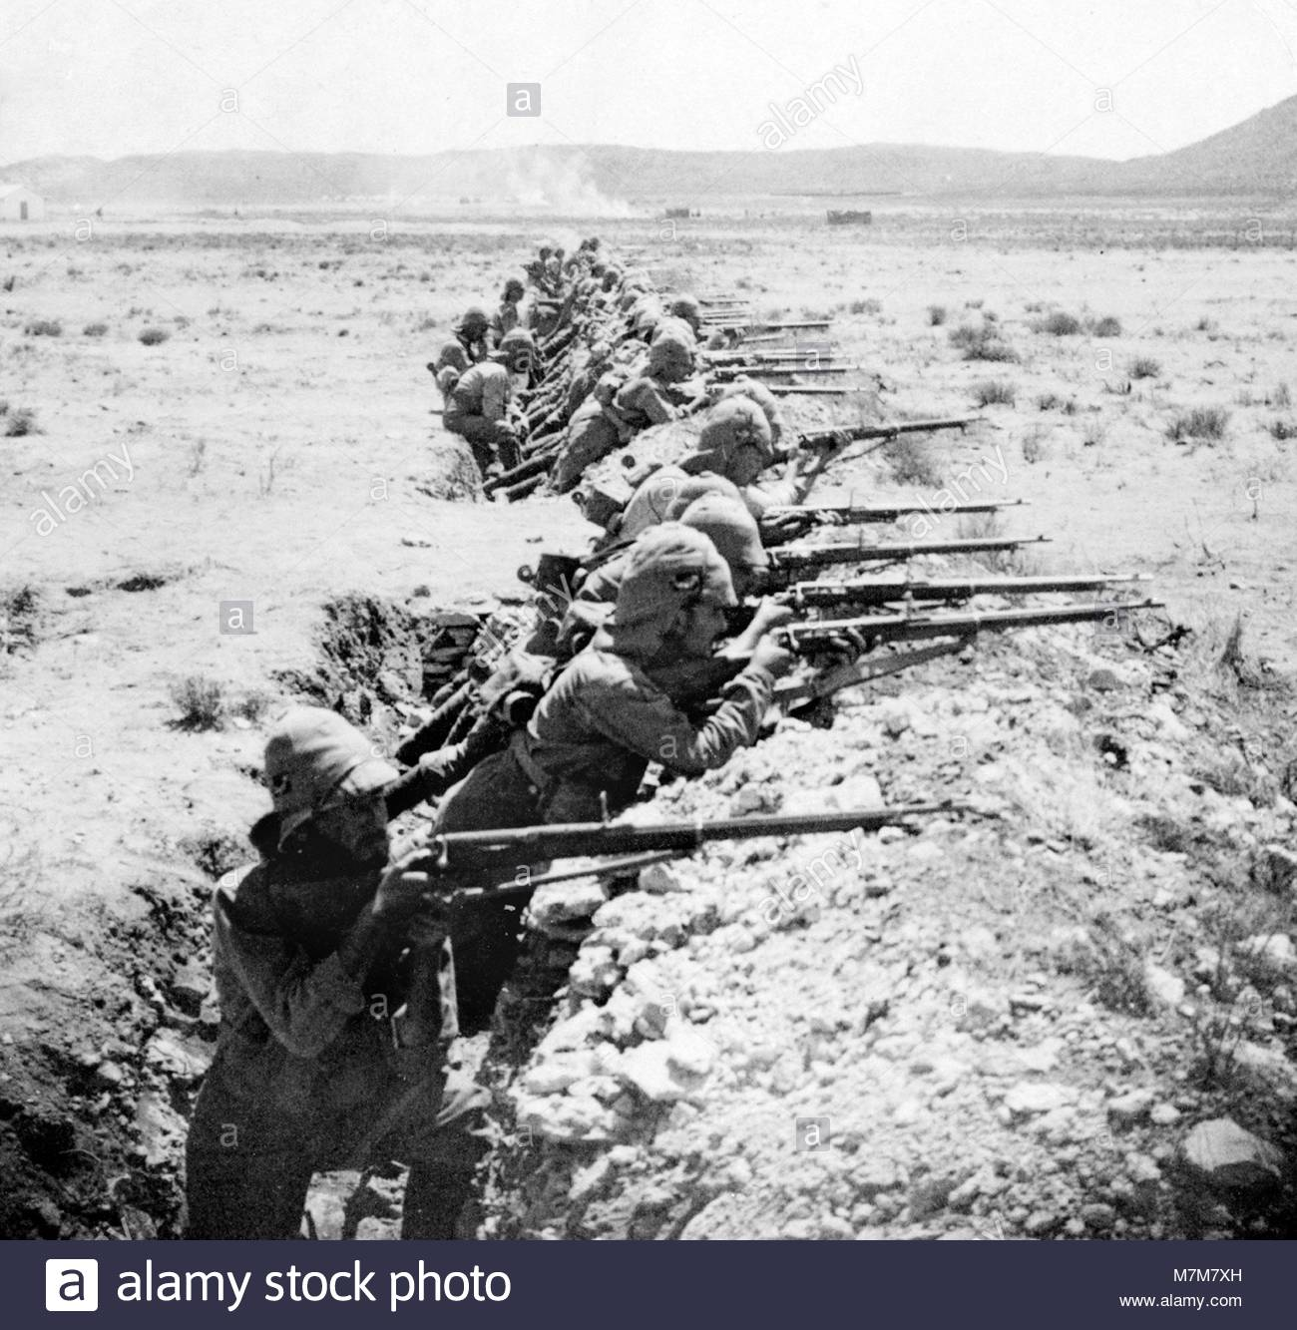
South African War (1899-1902)
Death toll
20,000 British troops
14,000 Boer troops
26,000 Boer civilians (most women and children) dead in concentration camps (of disease and starvation)
20,000 Black South Africans (civilians) dead in concentration camps

Slide 10
WWI CASUALTIES
From Grayzel (2013), statistics published by the Times of London in 1919

Slide 11
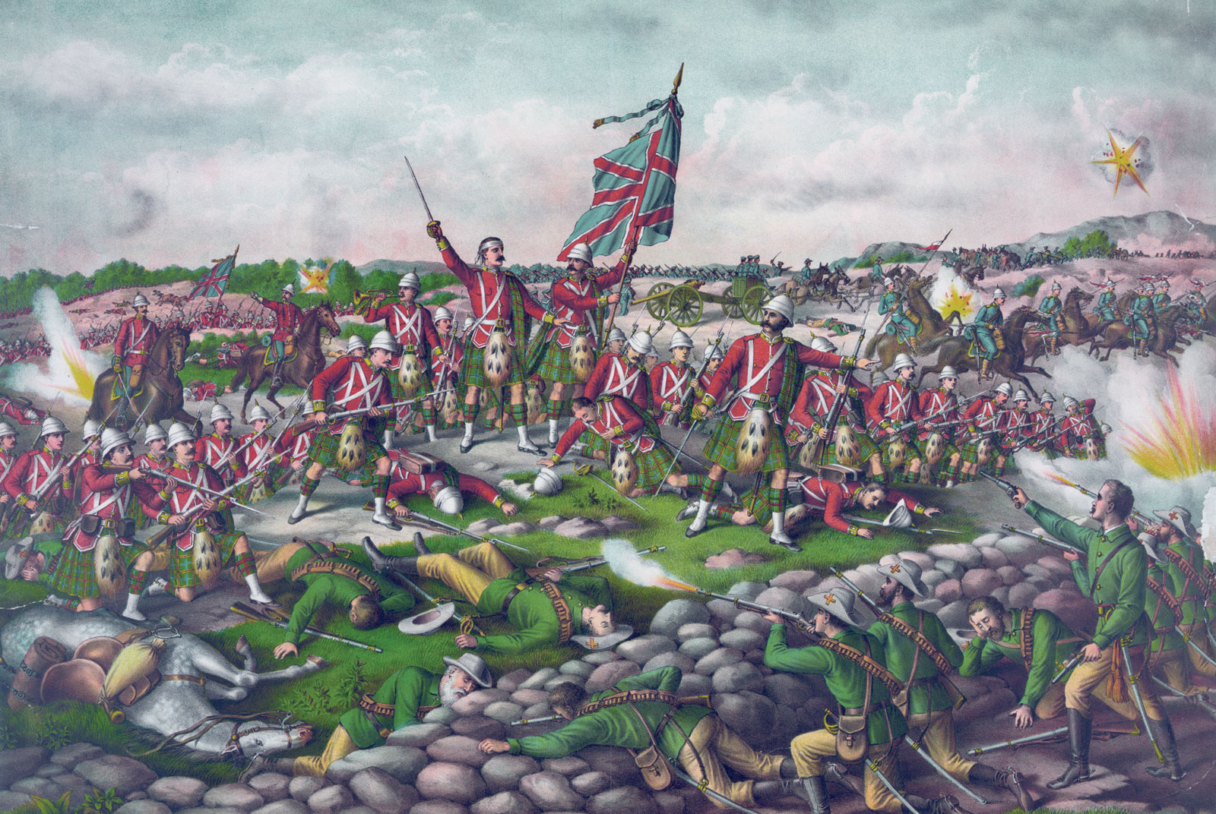
What’s a “battle”?
South African War

Slide 12
Allied/Entente Powers
Central Powers
France (& empire)
Britain (& empire)
Belgium
Serbia
Russia (until 1917)
USA (starting 1917)
Italy (starting 1915)
Japan
And many others
Germany (& empire)
Austro-Hungarian Empire
Ottoman Empire (starting fall 1914)
Bulgaria
And many others

Slide 13
A System of Entangling Alliances?
German Empire and the Austro-Hungarian Empire
France and the Russian Empire (based on French fear of German military)
Russian Empire and Serbia (based on shared Slavic identity)
Serbia informally allied with ethnic Serbs living under the Austro-Hungarian Empire in the former Bosnia-Herzegovina
British Empire and France are committed to protect Belgian neutrality

Slide 14
Archduke Franz Ferdinand and Sophie, Duchess of Hohenberg
28 July 1914, Sarajevo

Slide 15
From Berlin State Library, via Europeana 1914-1918

Slide 16
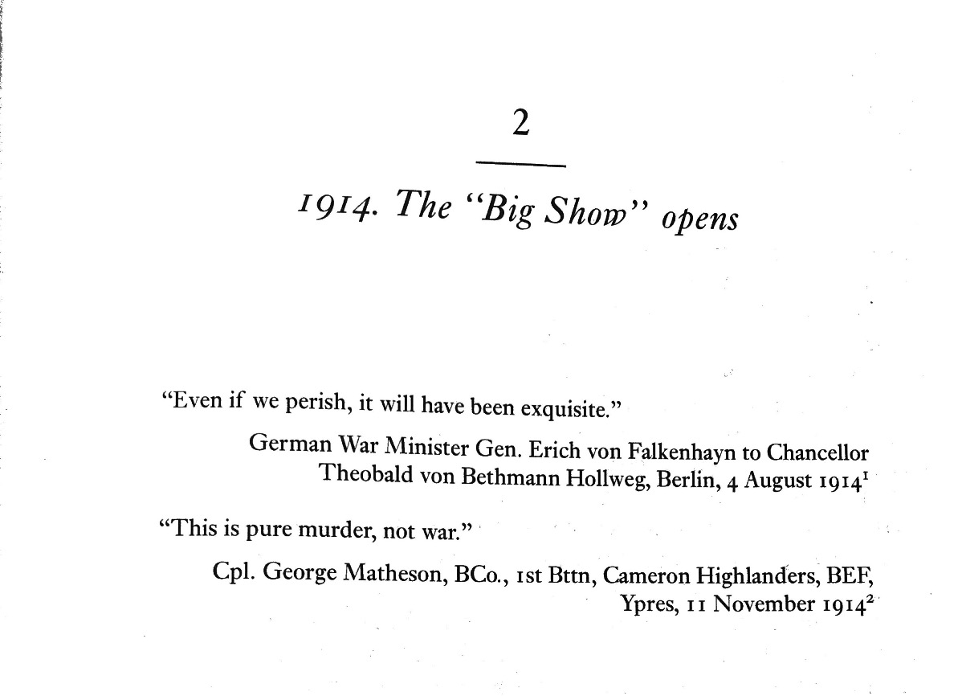
Q: How do we get from Falkenhayn’s take to Matheson’s?
What does Morrow have to say?

Slide 17
“German and Austrian, student and soldier, merchant and worker, all feel as one in this deadly serious hour.”
Vossiche Zeitung (liberal Berlin paper)
Crowds in Berlin on 1 August 1914 (Photo IWM)

Slide 18
Great Britain

Slide 19
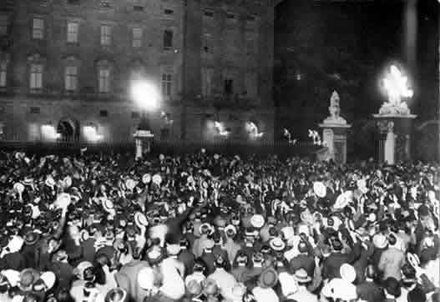
August 4, 1914. Crowd outside Buckingham Palace, London, as Britain declares war on Germany

Slide 20
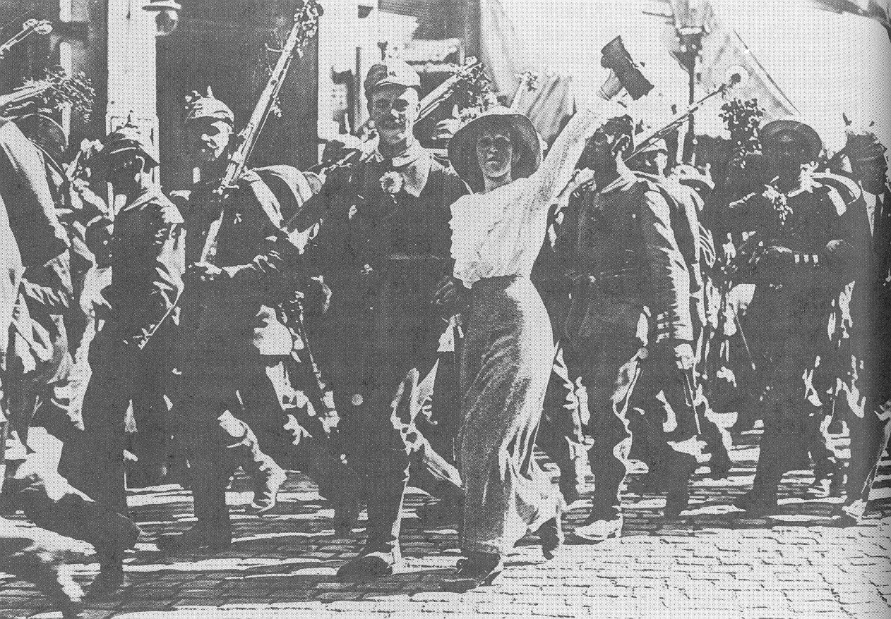
Berlin, August 1914

Slide 21
A friend is a comrade
Friendship is comradeship, fellowship
A horse is a steed, or charger
The enemy is the foe, or the host
Danger is peril
To attack is to assail
To be earnestly brave is to be gallant
To be cheerfully brave is to be plucky
Bravery considered after the fact is valor
The dead on the battlefield are the fallen
Obedient soldiers are the brave
To die is to perish
To show cowardice is to swerve
To enlist is to join the colors
Not to complain is to be manly
A soldier is a warrior
One’s death is one’s fate
The blood of young men is “the red/Sweet wine of youth” –R. Brooke
[from Paul Fussell, The Great War and Modern Memory, 22 – British young adult literature prior to WWI]

Slide 22
The War of Movement
“On August 6, 1914, 11,000 trains began the transport of 3,120,000 German troops across the Rhine. One reason for the failure of the Schlieffen Plan [to invade France through Belgium] was its initial success, as the troops overran their own timetable and supplies failed to keep pace. And although the French initially suffered some rapid defeats, they also fielded an army with unprecedented speed. For the first engagements in August about 2,000,000 Frenchmen were deployed in 4,278 trains, and only nineteen ran late.
Although once in the trenches the men frequently perceived the war as a protracted and monotonous struggle, the actual fighting was far faster than anything in history, revolutionized by the widespread use of magazine loading rifles, rapid fire artillery guns, and – that symbol of speedy killing – machine guns, which caused about 80 percent of all casualties. On July 1 [1916], the first day of the battle of the Somme, the British took about 60,000 casualties, of whom 21,000 were killed. [The historian] John Keegan has speculated that most of them were killed in the first hour of the attack, perhaps even in the first few minutes. The war set some gruesome speed records.”
Stephen Kern, The Culture of Time & Space (p. 299)

Slide 23
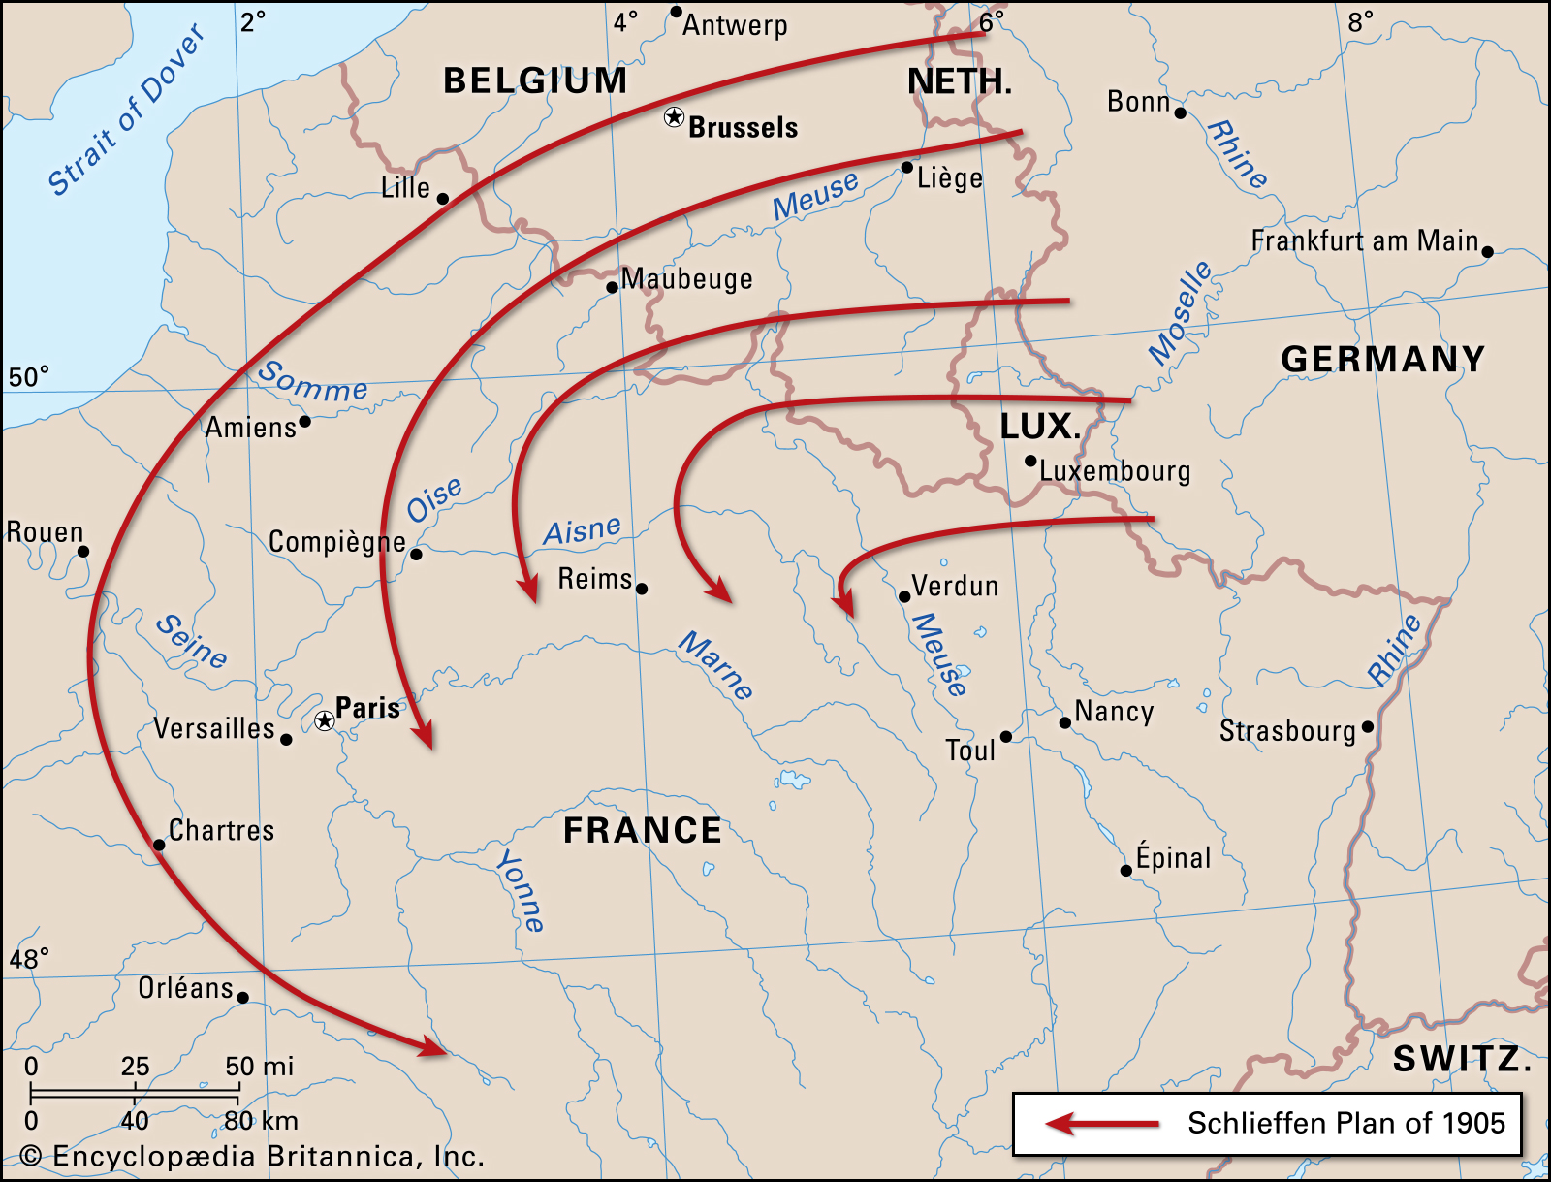
Germany’s war plan for a two-front war (The Schlieffen Plan, adopted in 1905)
A massive flanking of French forces (expected to be on the French-German border) by invading neutral Belgium, leading to a “decisive battle” in which French forces would be utterly annihilated.
It didn’t work and it’s the reason Germany invaded Belgium, a neutral country.

Slide 24
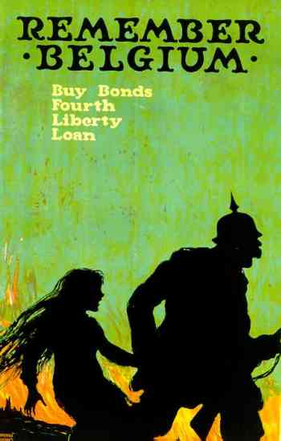

Slide 25
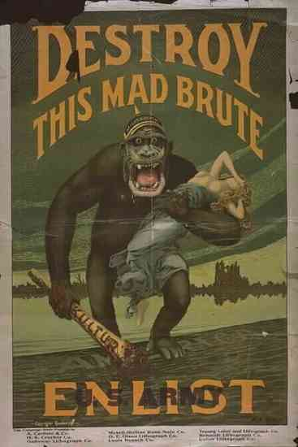
United States

Slide 26
By the end of the fall (1914), the War of Movement in Europe gives way to a War of Attrition
The Front doesn’t really change for the next four years

Slide 27
Breakout rooms 1-4
Lt. Col. Charles Walter Barton (an officer in the British King’s African Rifles in east Africa)
Breakout rooms 5-10
Captain Julian Grenfell (officer in the British army who joined the military in 1910)
Breakout rooms 10 and over
Private Franz Blumenfeld
(from Freiburg, enlisted at the start of WWI)
Who is the soldier that wrote your account? (class, nationality, previous military experience, guess at age/occupation/personality?)
When was this source written, and does that have an effect on how you read it?
What is the source – a letter, a diary, a report? Who was this soldier writing to?
Where is the soldier? How does this context change how you think about what he says?
How does he describe the war? What are his feelings about it? How is he doing? Which passages stand out to you as particularly representative of his experience?

Slide 28
The First Workshop

Slide 29
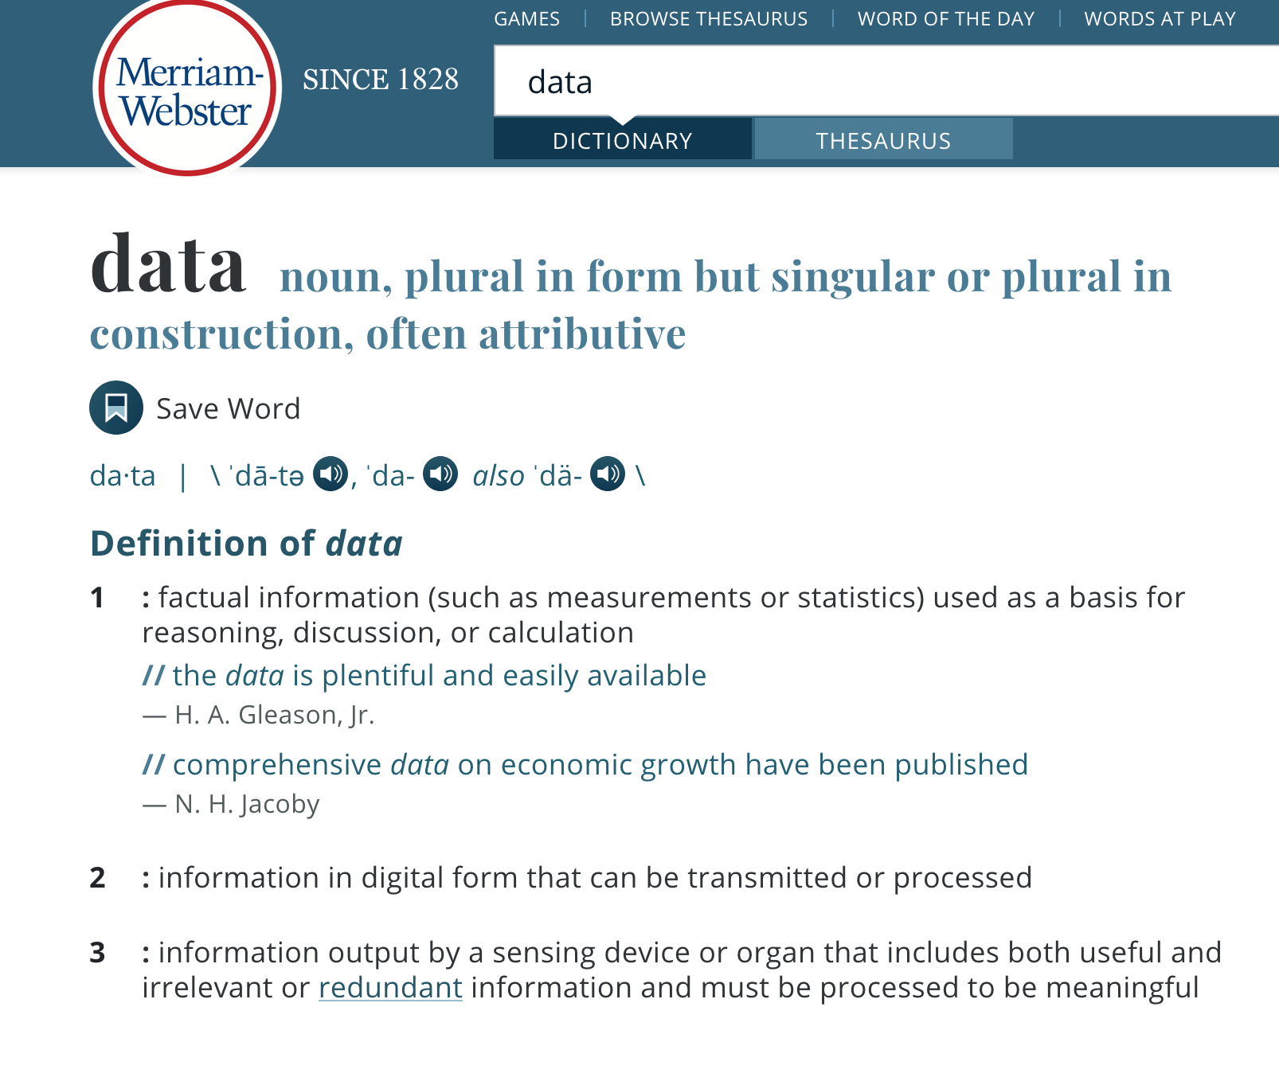
Q: What is “data”?
Broussard, page 18: “information points or units of information ... Ultimately, data always comes down to people counting things.”
Rosenzweig, “Why Digitize the Past?”: “Whereas analog data is a varying and continuous stream, digital data is only a sampling of the original data that is then encoded into the 1s and 0s that a computer understands.”

Slide 30
Q: What is data science?
Data science is an interdisciplinary field that uses computers to examine large sets of information.
“With vast amounts of data now available, companies in almost every industry are focused on exploiting data for competitive advantage. The volume and variety of data have far outstripped the capacity of manual analysis … at the same time, computers have become far more powerful … [very basically] data science is a set of … principles that support and guide the … extraction of information and knowledge from data. Possibly the most closely related concept to data science is data mining – the actual extraction of knowledge from data via technologies that incorporate these principles.”
(Foster Provost and Tom Fawcett, “Data Science and its Relationship to Big Data and Data-Driven Decision Making,” Big Data Vol. 1, No. 1, linked here.

