Slide 1
soldiers
HSTCMP 202, DIGITAL WORLD WARS

Slide 2
Key Terms/ideas
Who fought the First World War?
The Western Front
The “World’s War”
British
German
and French Soldiers and Laborers
“The Western Front”
“World’s War” – Weltkrieg

Slide 3
Military Organization(ish) in WWI:
Army
Corps (2 or 3 Divisions)
Division (European Armies ~15,000 men, US Army twice that size)
Are self-sufficient - Have their own engineers, medical corps, supply lines etc etc
Can be specialized, for example the British Army had the Tank Corps, Royal Army Medical Corps, Machine Gun Corps, etc
Corps
Division
Brigades – can be Infantry, Cavalry or Armored
Brigade
Brigade
Battalions (regimental sub-units of about 500- 1,000 men, commanded by a Lieutenant-Colonel)
In the British Army, Regiments have 2 or 3 Battalions, but they are broken up and serve in different Brigades and Divisions
Battalion

Slide 4
Battalion
(Commanded by Lt-Colonels)
Battery (for artillery units)
Squadron (for cavalry units)
Company (for infantry units)
Platoon (for Infantry)
Also called a Troop (for artillery or cavalry)
(About 25-30 men, commanded by a Lieutenant or Second Lieutenant )
(About 7-12 men, Commanded by a Corporal or Sergeant)
Section
Section
(All of these units are commanded by a Captain or Major, are about 100-150 men)

Slide 5
Commissioned v. Non-Commissioned
Field Marshalls and Generals
Brigadiers
Colonels
Majors
Captains
Lieutenants
And any variations on those ranks
Warrant Officers
Sergeant-Majors
Sergeants
Corporals
Privates, Gunners, Troopers, Seaman, Sailors, Airmen, Askaris

Slide 6
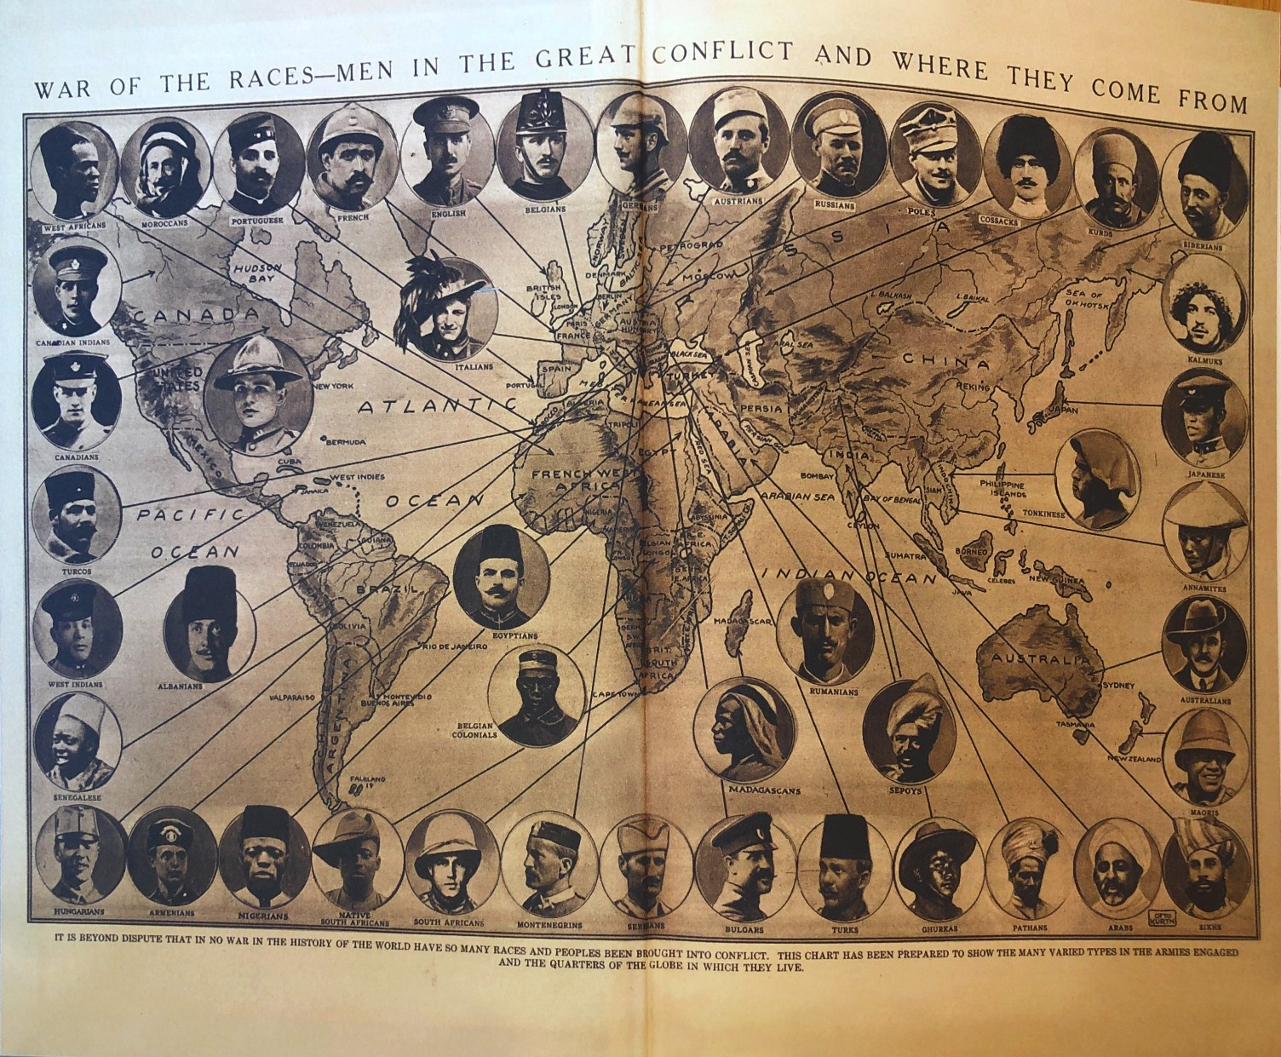

Slide 7
The Western Front

Slide 8
The Western Front, 1914
US Military Academy Dept. of History

Slide 11
Photo by a French official photographer, 1917
IWM Collection

Slide 12
Troops of the Border Regiment resting in a front line trench in Thiepval Wood, August 1916.
Ministry of Information Official Collection, IWM

Slide 13
Canadian official war photographer, IWM Collection

Slide 14
Colonel Philip R. Robertson, commanding officer of the 1st Battalion, Cameronians (Scottish Rifles) returning from a tour of his unit's positions in waterlogged trenches at Bois Grenier in January 1915.
IWM Collection

Slide 15
Checking for trench foot
IWM

Slide 16
Behind the reserve trenches
IWM Collections

Slide 17
The Western Front: The literary war & the ‘world’s war’?
Remarque and Olusoga

Slide 18
Olusoga argues:
“The Great War of 1914-1918 was the first true world war in that it was the first in which peoples and nations from across the globe fought and laboured alongside one another, rarely in equality other than equality of suffering.” (p. 15)
“The historical war has been overwhelmed by…the ‘literary war,’ a popular memory of the conflict formed from the collected fragments of prose and war poetry, which, over the course of the twentieth century coalesced into a dominant but narrow image of the conflict.” (p. 39)
“One facet long obscured by the victory of literature over history, and by the narrowness in terms of both class and race among the authors of that literature, is the global nature of the conflict.” (p. 40)

Slide 19
Moving towards the world’s history of the western front (and other fronts)…

Slide 20
Indian Expeditionary Force:
IWM photos 4997 (right) and 70214 (left)

Slide 21
Celebration of Chinese New Year's Day at the Chinese Labour Corps camp at Noyelles, 11 February 1918. IWM Q 9848
Riveters of the 51st Chinese Labour Company at work at the Central Workshops, Tank Corps. Teneur, spring 1918. IWM Q 9862

Slide 22
South African Native Labour Contingent (SANLC)
(IWM 4875)

Slide 23
South African Native Labour Contingent (SANLC)

Slide 24
Tirailleurs Sénégalais
The French Approach….
From Sengal-Online

Slide 25
Charles Mangin and La force noire (1910)
“The organizing of black troops has for its immediate goal maintaining our current effectiveness, which has been compromised by the decline of the French birthrate; it allows us to add to our regiments of Algerian tirailleurs [riflemen], which will cooperate with the same goal, and achieve the complete utilization of our Arab and Berber resources…
Very useful yesterday, necessary today, and indispensable tomorrow, black troops will not only give us numbers; they are composed of natural soldiers, accustomed to all deprivations and all dangers…;they have precisely the qualities that the long struggles of modern war require: simplicity, endurance, tenacity, the instinct for combat, the absence of nervousness, and the incomparable strength to face shock. Their arrival on the field of battle will produce a considerable moral effect against an adversary.
These precious advantages of number and quality are some important factors…but if the fighting is drawn out, our African forces will constitute for us an almost indefinite reserve out of our adversary’s reach and who will allow us to continue to fight until we have obtained a first success, and, once this success is obtained, to pursue the fight up to the final triumph
Charles Mangin, La force noire (Paris: Hachette, 1910) translated by Susan Grayzel. Mangin was a major proponent of using colonial troops in the French armed forces.

Slide 26
Lunn & Jingoes discussion
Your job: teach each other about the sources so that everyone understands both.
Some ideas for questions to talk about for both sources:
What is this source? Is it a primary source? A secondary source? (For Lunn, focus on the middle section of the chapter “Soldier’s Memories of Combat” pages 127-137 – all the quotations in this section are from Lunn’s interviews with Senegalese veterans)
Who are we learning about? What are the differences in the war experiences of the Tirailleurs Sénégalais and the members of the South African Native Labour Contingent?
What is the same about their war experiences, despite their different designations?
Why did they join the war?
How did they perceive the various European powers? How did they perceive Europe?
How did the war change them?
Bonus question: how do the attitudes of Germany, Britain, and France towards African troops compare to their attitudes towards African American troops – as evidenced in the other two documents you read for today?

