Slide 1
Technology in WWI /
Digital workshop 2
HSTCMP 202, DIGITAL WORLD WARS

Slide 2
Outline & Key Terms
Technology in the First World War
  Submarines
  Tanks & trucks
  Gas
  Airplanes & bombing
Workshop 2!
  Broussard on AI & Machine Learning
  Data Science what is it?
Data science
Machine Learning
Data Cleaning and Dirty Data
Chlorine gas
Mustard gas
Unrestricted submarine warfare
The Turtle

Slide 3
Art. 22.
The right of belligerents to adopt means of injuring the enemy is not unlimited.
Art. 23.
In addition to the prohibitions provided by special Conventions, it is especially forbidden -
To employ poison or poisoned weapons;
…. To employ arms, projectiles, or material calculated to cause unnecessary suffering
Art. 25.
The attack or bombardment, by whatever means, of towns, villages, dwellings, or buildings which are undefended is prohibited.

Slide 4
Machine Guns in WWI –
Cristopher RW Nevinson, La Mitrailleuse (1915)

Slide 5
Shelling in WWI

Slide 8
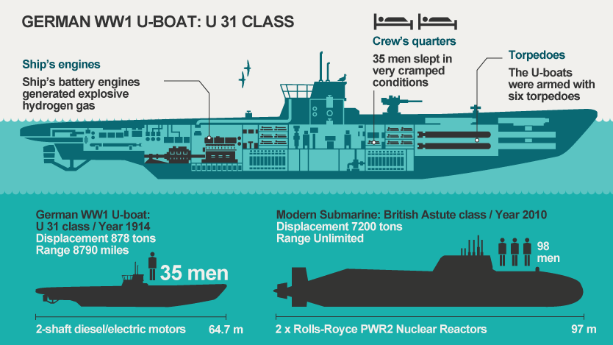
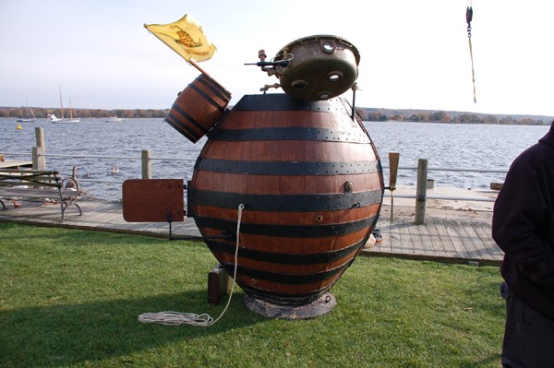
Right: Reproduction of the Turtle (American Revolutionary War)
Left: Diagram of the interior of a German sub (U-Boat) in the First World War
The submarine

Slide 9
Tanks & trucks
Paul Nash, Wire (1918)
Muirhead Bone, Tanks (1918)

Slide 10
Gas Weapons…
John Singer Sargent, Gassed (1918)
Imperial War Museum

Slide 11
American troops wearing gasmasks, France 1918
Effects of mustard gas on a horse, British Royal Army Veterinary Corps. IWM

Slide 12
Wilfred Owen (1893-1918)
Poet. British. Owen enlisted in 1915 and was commissioned into the Manchester Regiment in 1916. He was invalided home as wounded in 1917 (shell shock), but returned to the Western Front and won a Military Cross before he was killed in November 1918. His powerful poems, such as 'Dulce et Decorum Est', are the War's most eloquent expression of disillusionment. – Taylor Soja
Photo by John Guston, 1916
Photo and Bio NPG London

Slide 13
Wilfred Owen, Dulce et Decorum Est (Published 1920, written 1917)
Bent double, like old beggars under sacks,
Knock-kneed, coughing like hags, we cursed through sludge,
Till on the haunting flares we turned our backs,
And towards our distant rest began to trudge.
Men marched asleep. Many had lost their boots,
But limped on, blood-shod. All went lame, all blind;
Drunk with fatigue; deaf even to the hoots
Of gas-shells dropping softly behind.
Gas! GAS! Quick, boys!—An ecstasy of fumbling
Fitting the clumsy helmets just in time,
But someone still was yelling out and stumbling
And flound'ring like a man in fire or lime.—
Dim through the misty panes and thick green light,
As under a green sea, I saw him drowning.
In all my dreams before my helpless sight
He plunges at me, guttering, choking, drowning.
If in some smothering dreams, you too could pace
Behind the wagon that we flung him in,
And watch the white eyes writhing in his face,
His hanging face, like a devil's sick of sin,
If you could hear, at every jolt, the blood
Come gargling from the froth-corrupted lungs,
Bitter as the cud
Of vile, incurable sores on innocent tongues,–
My friend, you would not tell with such high zest
To children ardent for some desperate glory,
The old Lie: Dulce et decorum est
Pro patria mori.

Slide 14
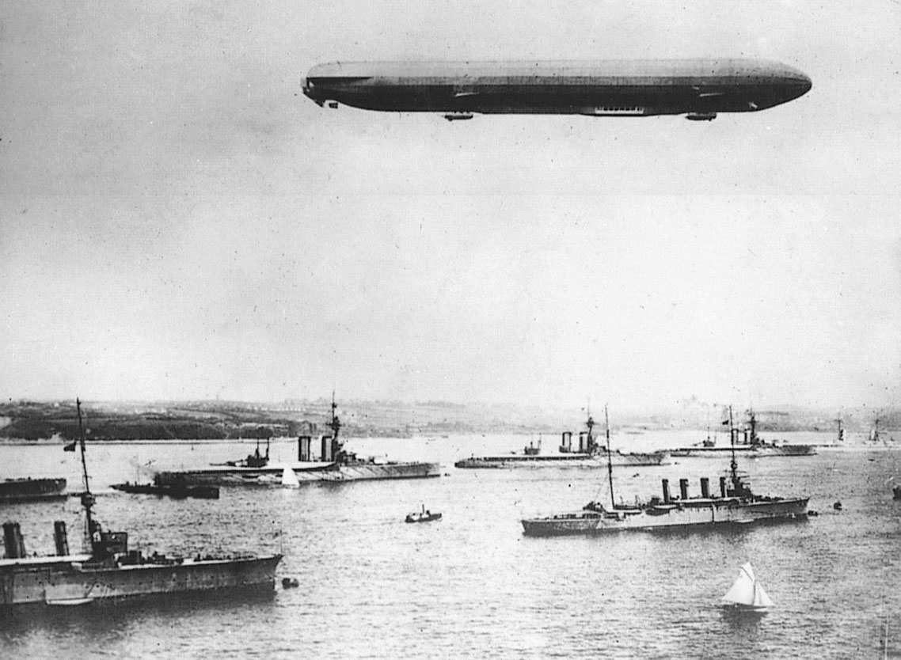
Airplanes & airships – dueling, surveillance and bombing
A German Zeppelin, WWI, with German ships (Britannica)

Slide 15
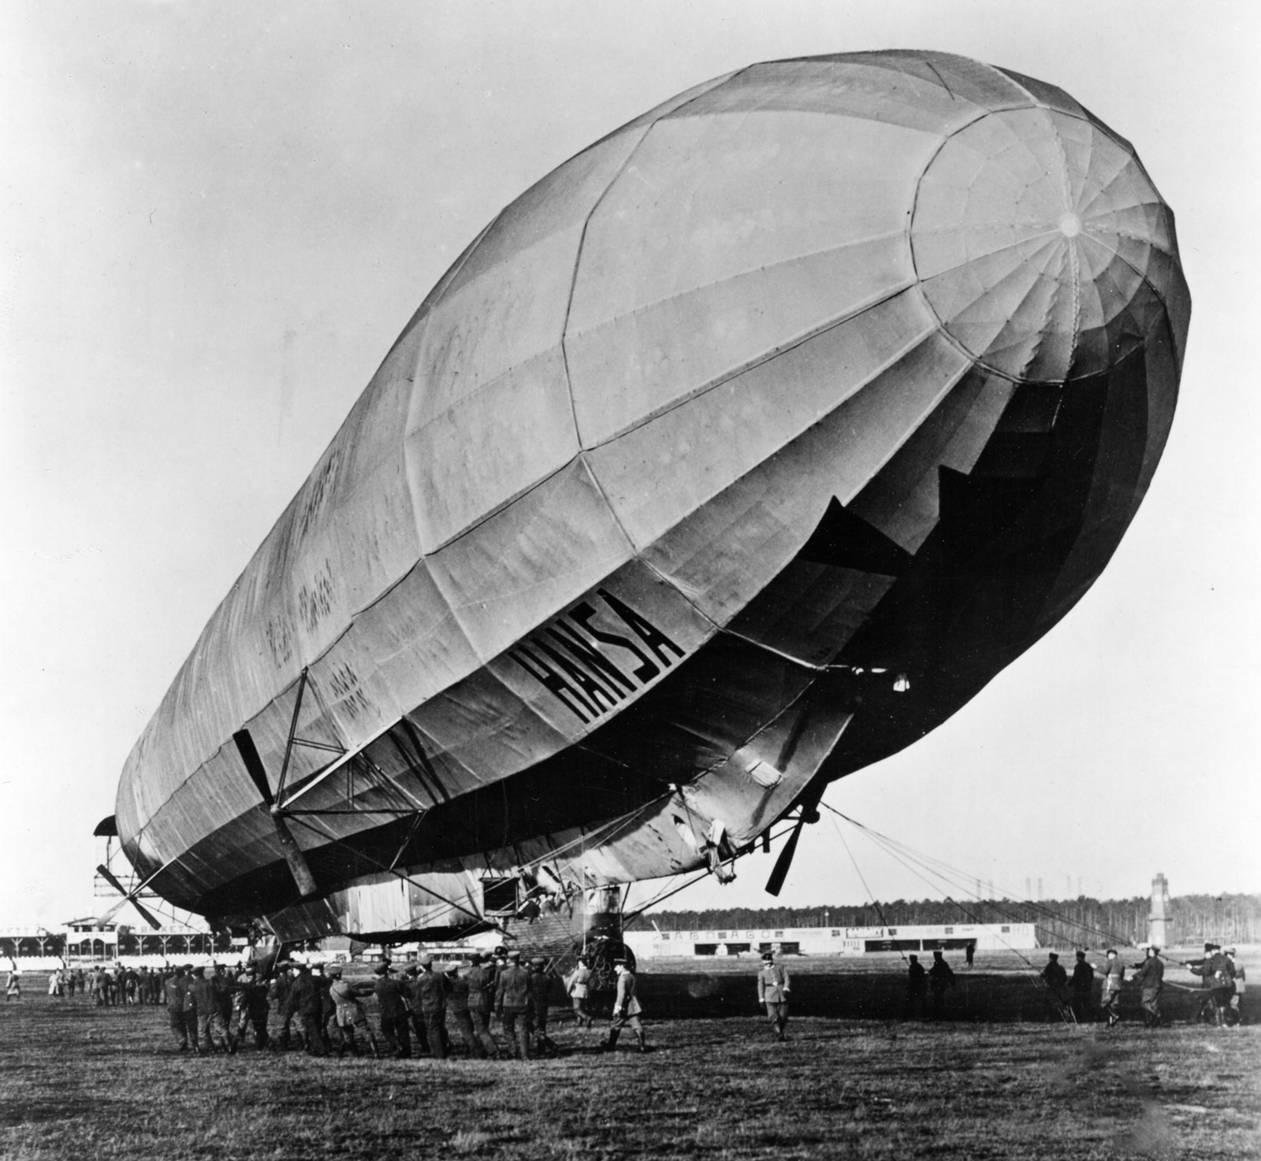
A German Zeppelin, WWI, in Berlin (Britannica)

Slide 16
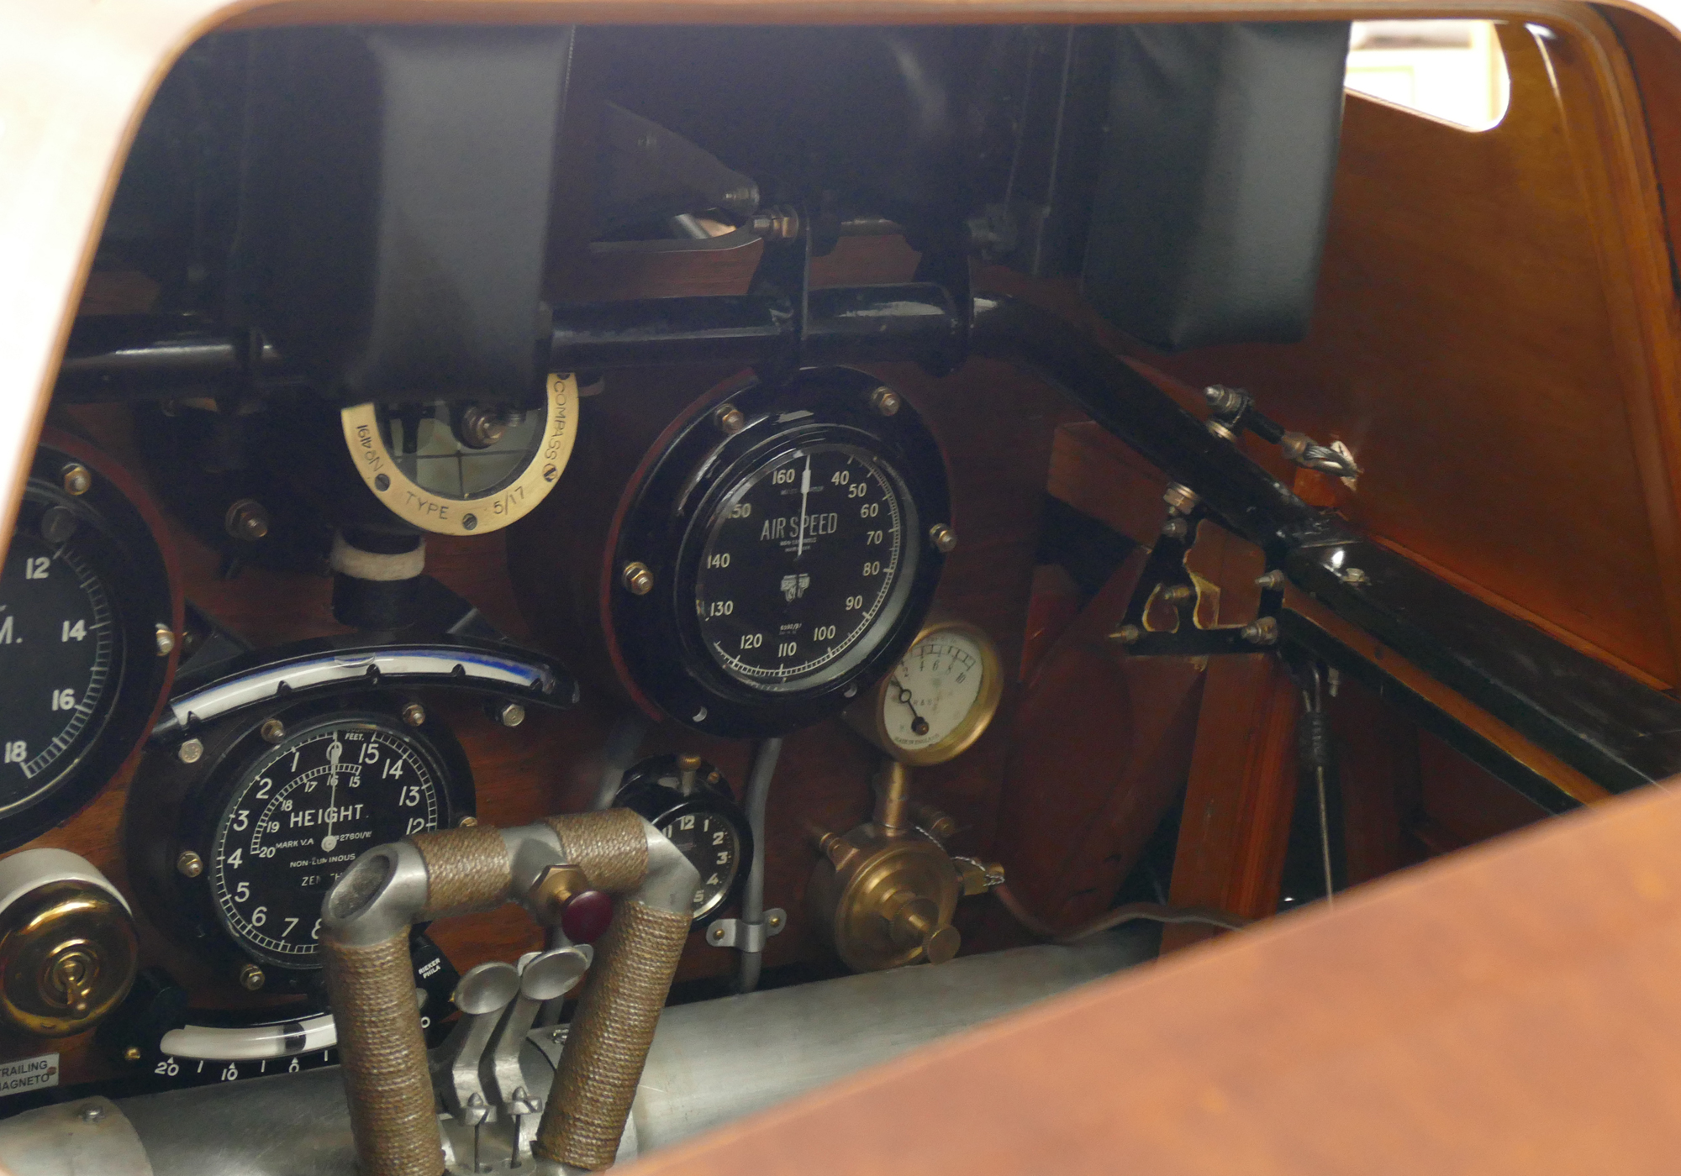
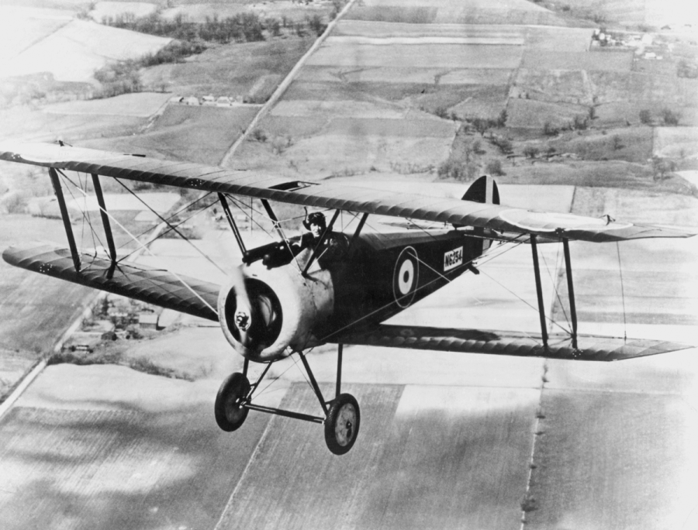
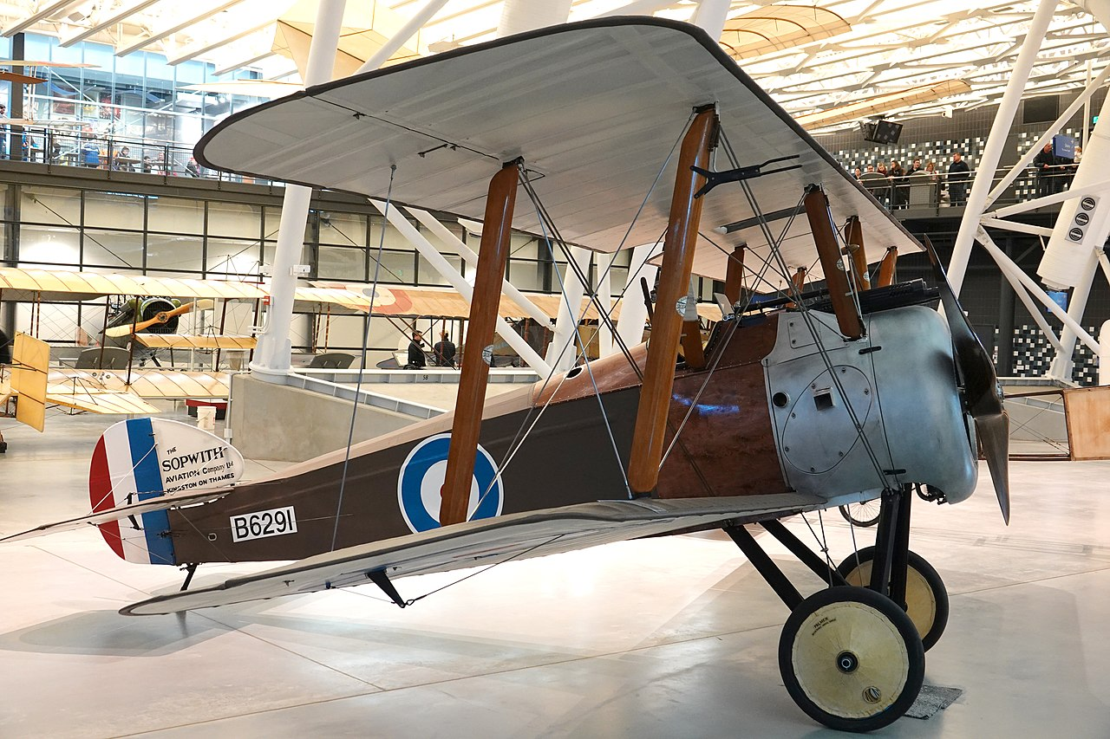
British plane the Sopwith Camel F-1 fighter (rather than bomber) – reputed to be one of the better planes of the First World War

Slide 17
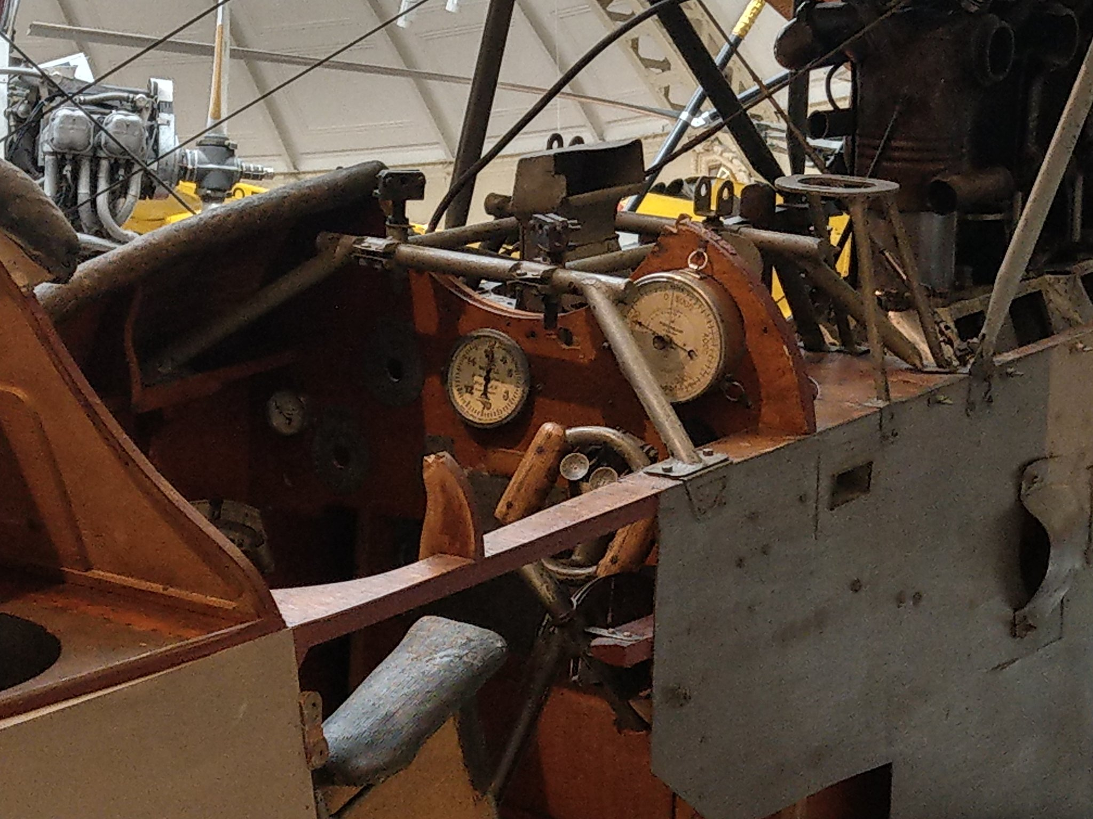
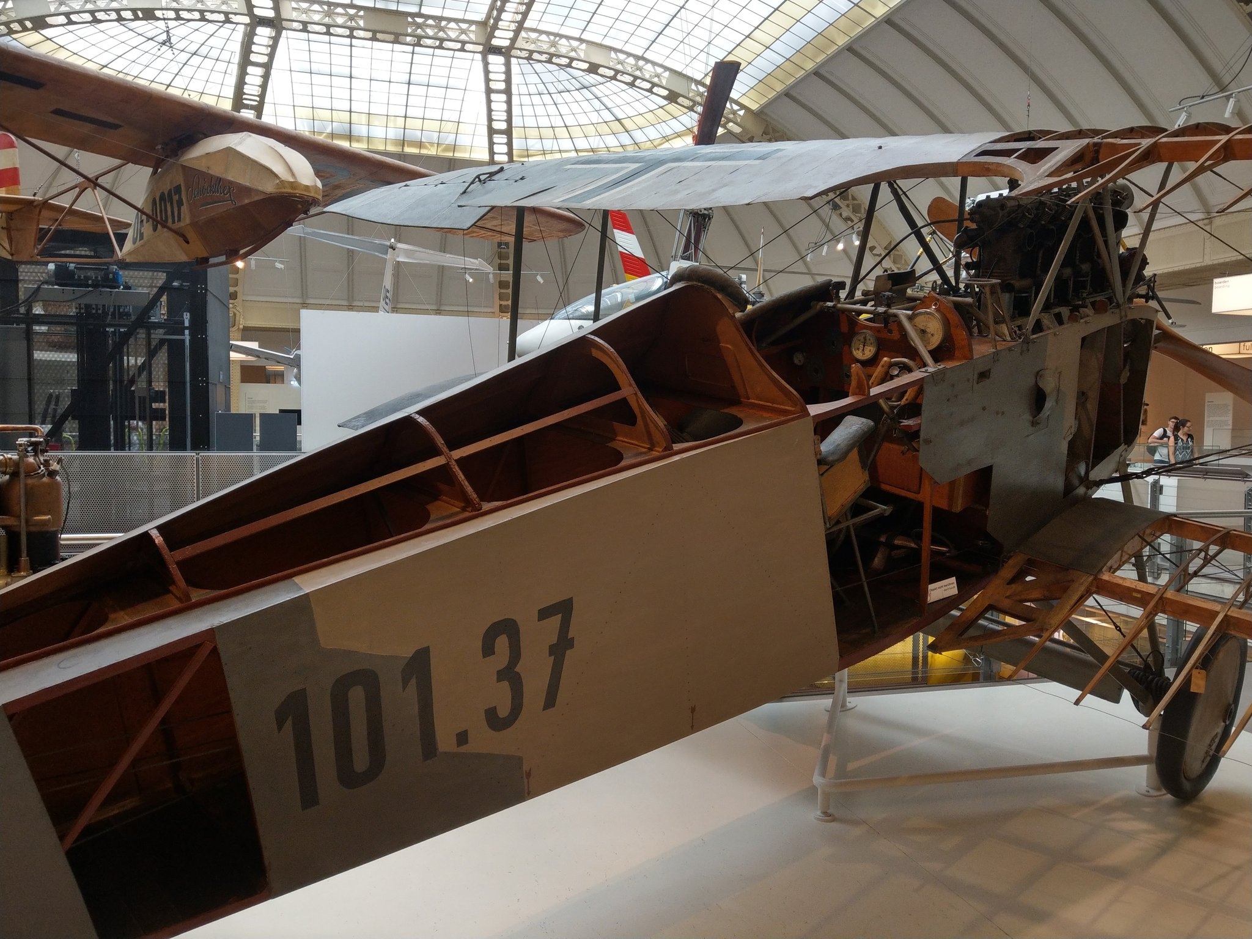
An Austro-Hungarian plane, now in a Vienna museum, partly disassembled. Low tech aviation!

Slide 18
Civilians as targets of war?
French kids in Alsace, in the French-German border, 1918

Slide 20
15,700 bombs fell on German territory, killing 740 people, injuring 1900 more, most of them civilians
The air raids of the First World War in Britain killed 1,239 civilians (of whom 366 were women, 252 children) and injured 2,886 (1,016 women, 542 children), with material damage totaling £3,087, 098

Slide 21
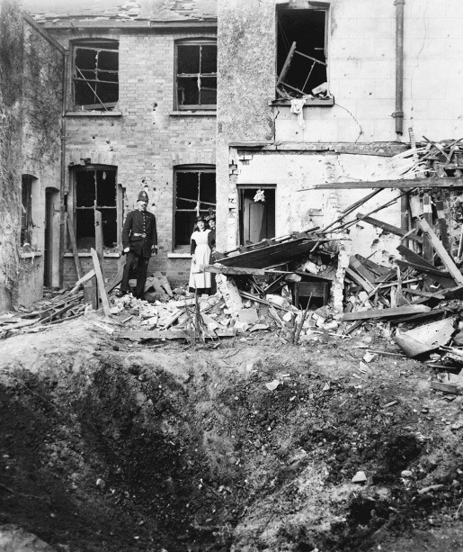
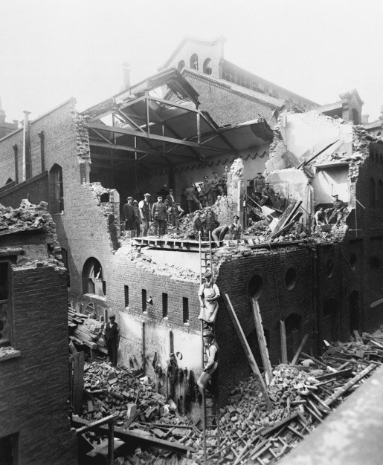
Both photos from Grayzel, At Home and Under Fire.
Figure 2.2. Damage caused by a zeppelin raid on Croydon on the night of 13–14 October 1915.
Both photos from Grayzel, At Home and Under Fire.Figure 3.1. Soldiers and civilians clear rubble from a building hit during an air- plane raid on London, 7 July 1917.

Slide 22
CRW Nevinson (British painter) A Taube (1916). ”Taube” means ”dove” in German. The Taube was also a German WWI plane used to bomb. The painting is of a French school boy. (Source: IWM)

Slide 23
Analyzing and visualizing historical data
Workshop 2

Slide 24
Henri Barbusse, Le Feu (Under Fire: The Story of a Squad). Published 1916.
Ernst Jünger, In Stahlgewittern (Storm of Steel). Published 1920.
Robert Graves, Good-Bye to All That. Published 1929.

Slide 25
What is artificial intelligence, according to Broussard?
General AI
Vs.
Narrow AI
“a mathematical method for prediction”, it gives “the most likely answer to any question that can be answered with a number” (p. 32)

Slide 26
What is machine learning?
“When a machine ‘learns,’ It doesn’t mean that the machine has a brain made out of metal. It means that the machine has become more accurate at performing a single, specific task according to a specific metric that a person has defined.
This kind of learning does not imply intelligence.”
(p. 92)

Slide 27
Key elements of making machine learning happen:
Training data
Test data
Algorithms

Slide 28
Key elements of making machine learning happen:
Training data
Test data
  BUT FIRST, DATA CLEANING HAS TO HAPPEN
Algorithms

Slide 29
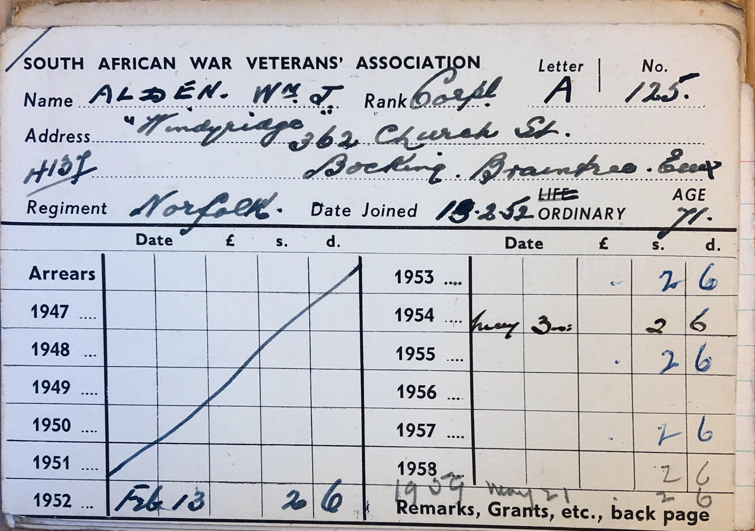
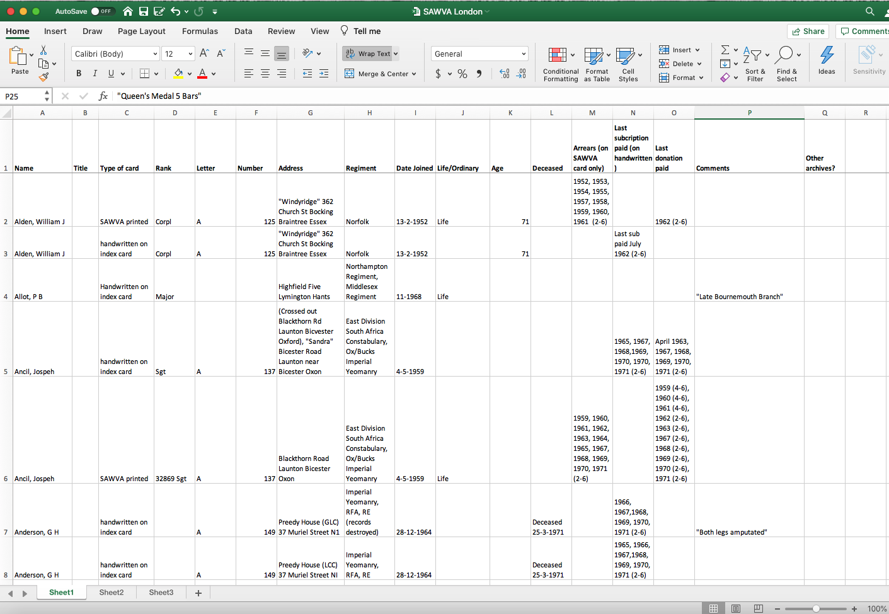
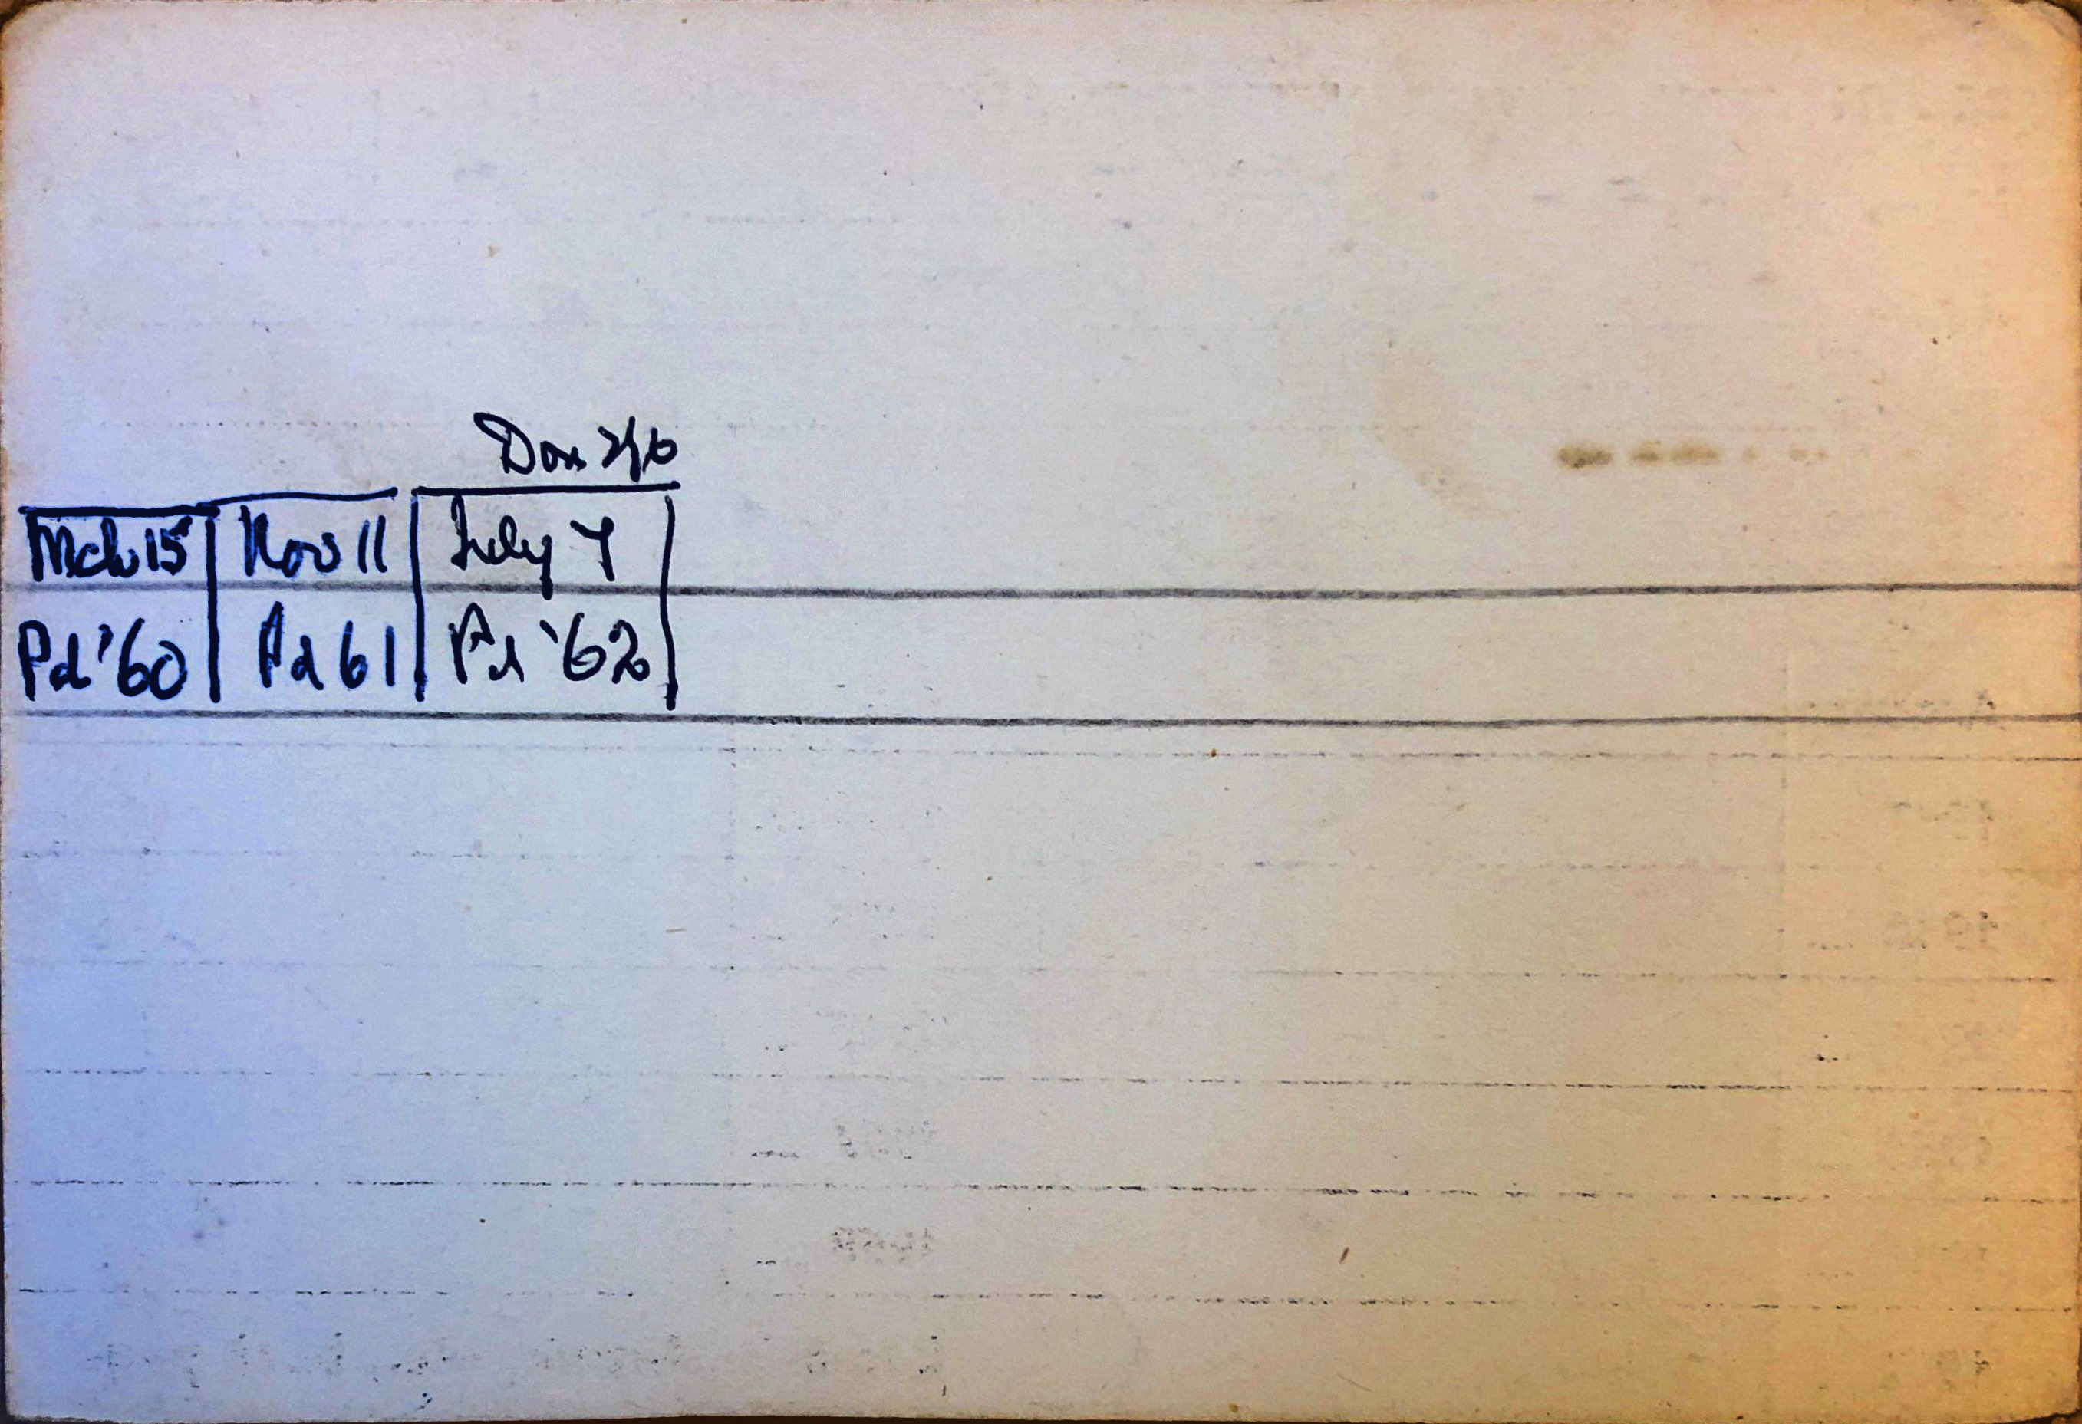
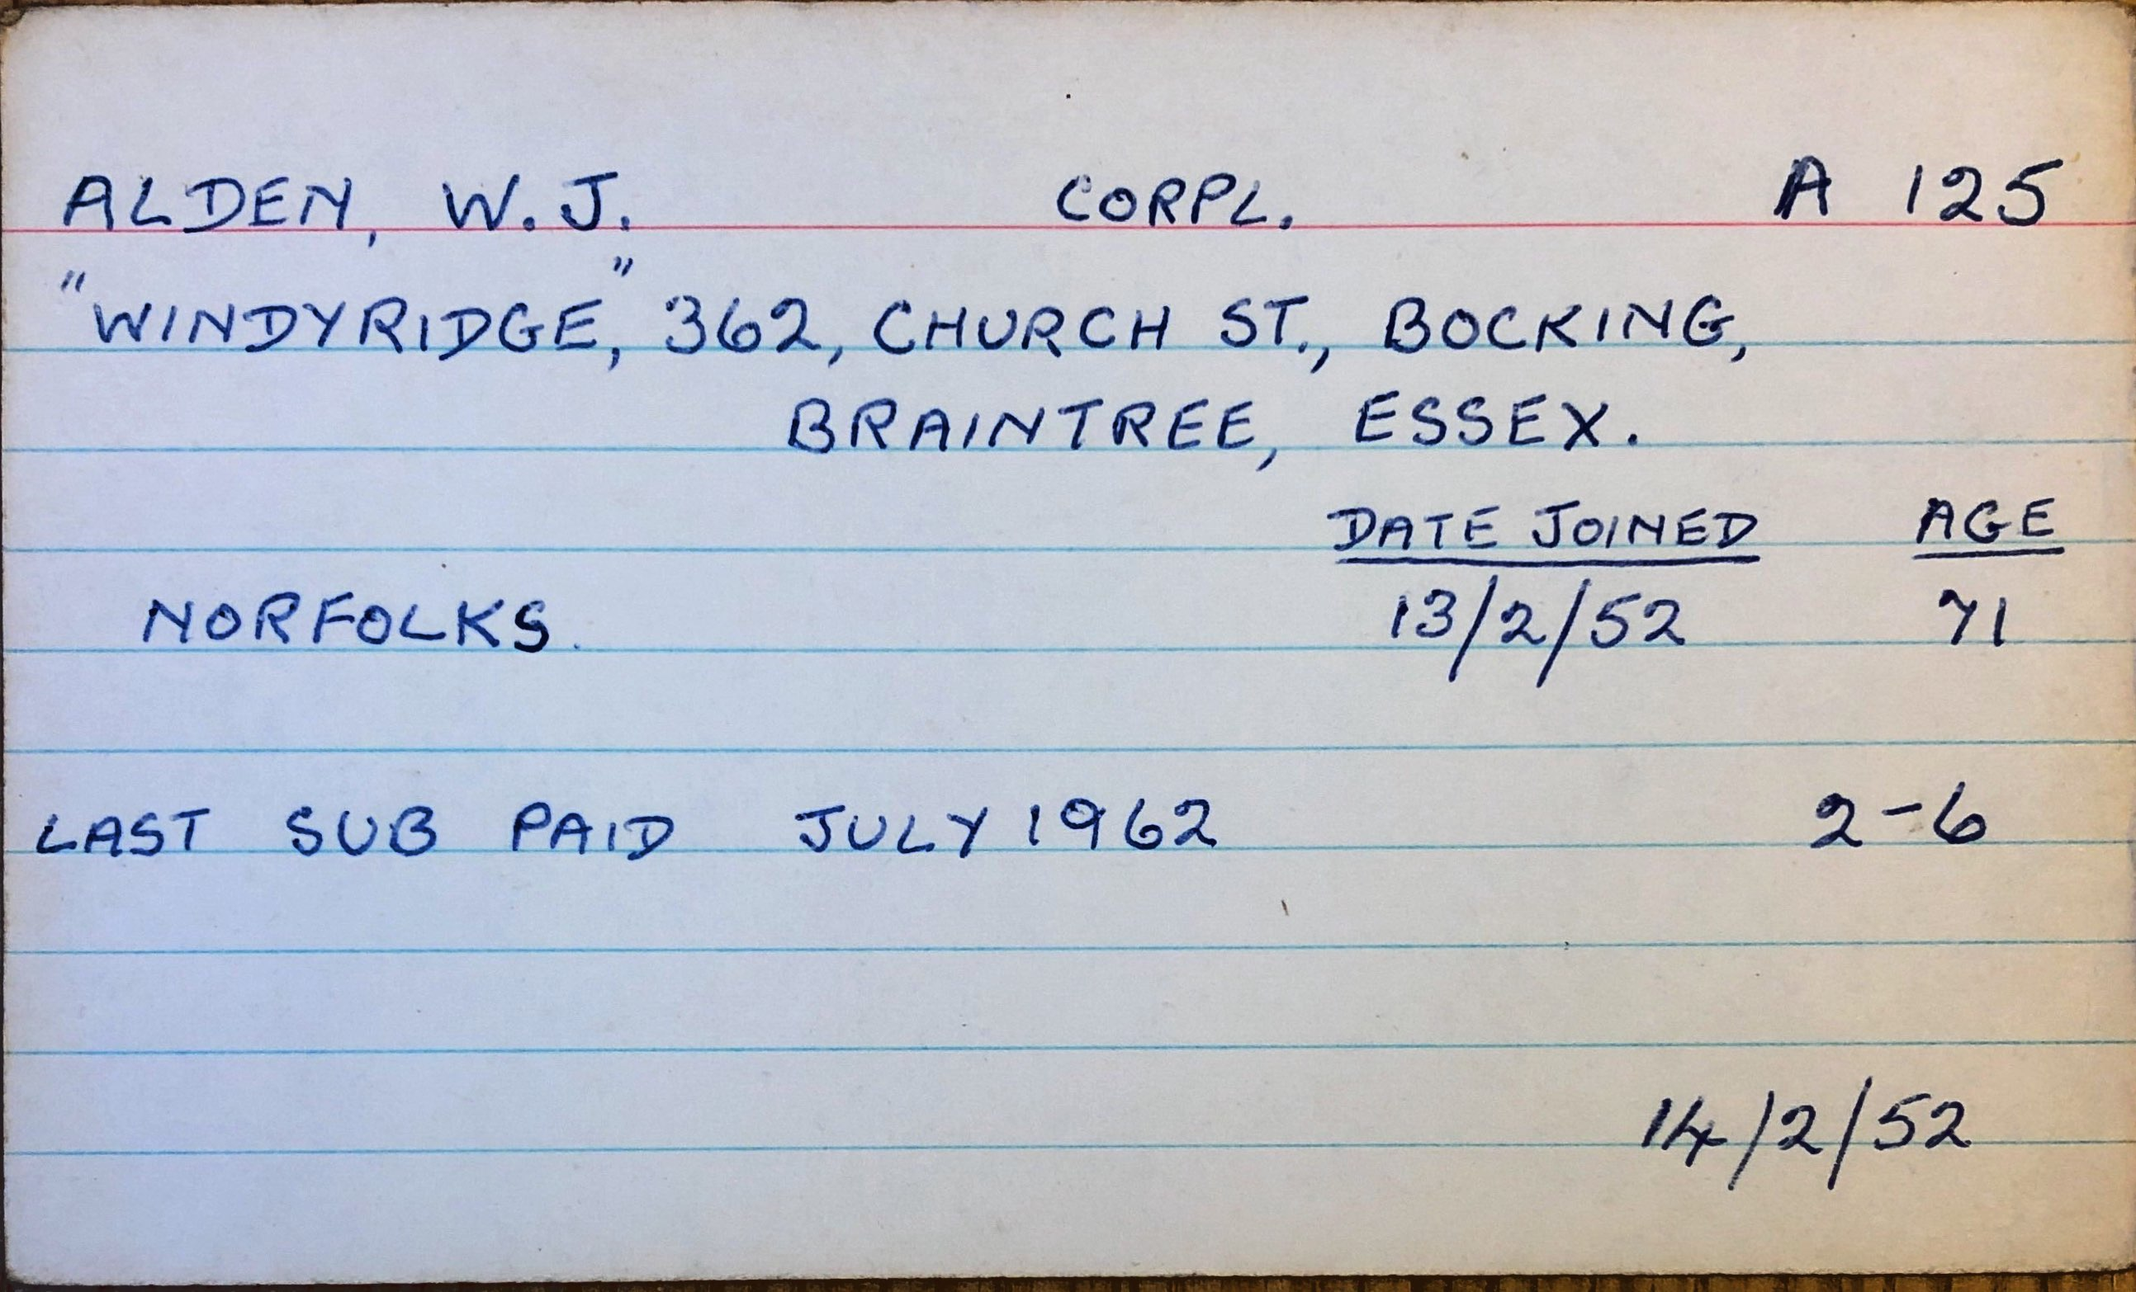
Prof. Soja’s project – digitizing the records of the South African War Veteran’s Association (SAWVA) in London.
Data organization and cleaning takes forever, involves lots of choices.

Slide 30
Key elements of making machine learning happen:
Training data
Test data
  BUT FIRST, DATA CLEANING HAS TO HAPPEN
Algorithms
AND: “Here’s an open secret of the big data world: all data is dirty. All of it. Data is made by people going around and counting things or made by sensors that are made by people. In every seemingly orderly column of numbers, there is noise. There is mess. There is incompleteness. This is life. The problem is, dirty data doesn’t compute. Therefore, in machine learning sometimes we have to make things up to make functions run smoothly.
Are you horrified yet?” (p. 103)

Slide 31
The Titanic example….
In Breakout Rooms, make a list of:
The specific ways that Broussard cleaned her data
The ways in which the Titanic data was still “dirty” – despite this cleaning.
What “human factors” remain? What choices did she make that you might make differently?
FYI, Smithsonian Magazine and Mythbusters say “It’s Definitive: Rose and Jack Could Both Have Survived in Titanic.”
https://www.smithsonianmag.com/smart-news/its-definitive-rose-and-jack-could-both-have-survived-in-titanic-66108527/

Slide 32
Language from police body camera footage shows racial disparities in officer respect
https://pubmed.ncbi.nlm.nih.gov/28584085/
Abstract
Using footage from body-worn cameras, we analyze the respectfulness of police officer language toward white and black community members during routine traffic stops. We develop computational linguistic methods that extract levels of respect automatically from transcripts, informed by a thin-slicing study of participant ratings of officer utterances. We find that officers speak with consistently less respect toward black versus white community members, even after controlling for the race of the officer, the severity of the infraction, the location of the stop, and the outcome of the stop. Such disparities in common, everyday interactions between police and the communities they serve have important implications for procedural justice and the building of police-community trust.

Slide 33
Question: Was Go Set a Watchman written by Harper Lee (author of To Kill a Mockingbird)?
Or, was it written by or in collaboration with her friend Truman Capote (author of In Cold Blood) or her editor (author of Cats and Other People)
Data: already readable by a computer! Score!
Algorithm/Tools: Linguistic analysis (stylometry). We will use Voyant.

Slide 35
Workshop Part 2 data science and history

Slide 36
Q: What is data science?
Data science is an interdisciplinary field that uses computers to examine large sets of information.
“With vast amounts of data now available, companies in almost every industry are focused on exploiting data for competitive advantage. The volume and variety of data have far outstripped the capacity of manual analysis … at the same time, computers have become far more powerful … [very basically] data science is a set of … principles that support and guide the … extraction of information and knowledge from data. Possibly the most closely related concept to data science is data mining – the actual extraction of knowledge from data via technologies that incorporate these principles.”
(Foster Provost and Tom Fawcett, “Data Science and its Relationship to Big Data and Data-Driven Decision Making,” Big Data Vol. 1, No. 1, linked here.

Slide 37
The Titanic example….
Take 5-10 minutes to either re-read this part of Broussard, or to explain it to all group members.
Then:
In groups, make a list of:
The specific ways that Broussard cleaned her data
The ways in which the Titanic data was still “dirty” – despite this cleaning. What “human factors” remain? What choices did she make that you might make differently?
Imagine a data set about World War I. Then think of a statistic you’d like to generate with it, similar to what Broussard did with the Titanic data.
FYI, Smithsonian Magazine and Mythbusters say “It’s Definitive: Rose and Jack Could Both Have Survived in Titanic.”
https://www.smithsonianmag.com/smart-news/its-definitive-rose-and-jack-could-both-have-survived-in-titanic-66108527/

