Slide 1
Interwar
HSTCMP 202, DIGITAL WORLD WARS
Tuesday November 2

Slide 2
The Interwar (1918-1939)
WWI in Africa – the beginning and end
Cultures of the WWI Dead
The invention of fascism
Fascism
The Menin Gate
Paul von Lettow-Vorbeck
The last shot fired in the First World War

Slide 3
The First World War in Africa – colonial warfare in the colonies

Slide 4
Indian Army troops arrive in Marseilles, 1914
Photo: National Army Museum (London)

Slide 5
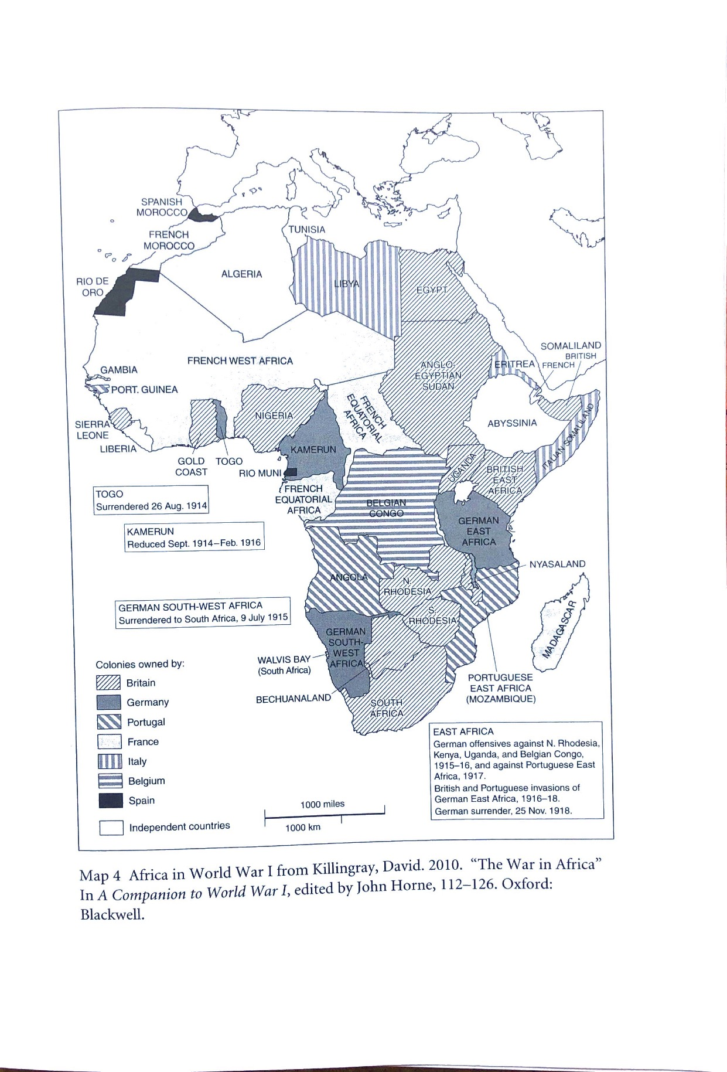
The War of Movement in Africa:
British/French invasion & capture of German Togo, starting 12 Aug 1914

Slide 6
Alhaji Grunshi, Gold Coast Regiment. First soldier under British command to fire a shot in WWI. Photographed 1918.
Wireless Station, Kamina. In German Togo

Slide 7
The War of Movement in Africa:
British/French invasion & capture of German Togo, starting 12 Aug 1914
British/French invasion of German Cameroon, captured Duala on 27 Sept 1914, but war extends into 1916
South African invasion of German South West Africa (delayed by Afrikaner Rebellion) begins Jan. 1915 and is captured that year
East African Theatre of War is messiest, lasts all 4 years but begins in 1914 with naval bombings and fighting on German East African Coast.
The War in East Africa will not end until 2 weeks after the end of the war in Europe

Slide 8
The East African Front
German East Africa = present-day Burundi, Rwanda, part of Tanzania, part of Mozambique
British East Africa = Kenya

Slide 9
Cultures of the Dead

Slide 10
Belligerent Power | Estimated Total War Dead
Russian Empire | 1,997,500
France | 1, 327, 000
French colonies | Between 71,000 and 78,000
Britain | 761,000
Australia, Canada, India, Newfoundland, New Zealand, South Africa, and other British colonies combined | 198,000
Italy | 600,000
United States | 87,900
Japan | 300
Romania | 250,700
Serbia | 278,000
Belgium | 38,000
Total Allied forces | 5,647,600
Belligerent Power | Estimated Total War Dead
German Empire | 2,037,000
Austro-Hungarian Empire | 1,513,500
Ottoman Empire | 772,000
Bulgaria | 87,500
Total Central Powers | 4,410,000
Estimates from Antoine Prost, “War Losses” (2014) 1914-1918 Online

Slide 11
“I wonder whether you or any of your readers could give me any certain information as to what is or is going to be the official name for the present war. Those of us who have to record matters are in a difficulty with regard to it. The general opinion rather seems to point to the use of the term ‘European War,’ but this, of course, ignores a very important part of the fighting in which this country is concerned in China, South Africa, Asiatic Turkey, and elsewhere.”
H.G. Wells
Times (London), Jan. 15 1915
“Surely no better name could be found for the present contest than the ‘Great War.’”
Times (London), Jan. 16 1915

Slide 13
Memorializing the war dead…
Tomb of the Unknown Soldier at Arlington National Cemetery, VA in 1922. The main structure would be replaced in 1931.
Photo Wikimedia Commons

Slide 14
Unveiling of the permanent Cenotaph in Whitehall, central London, Armistice Day 1920

Slide 15
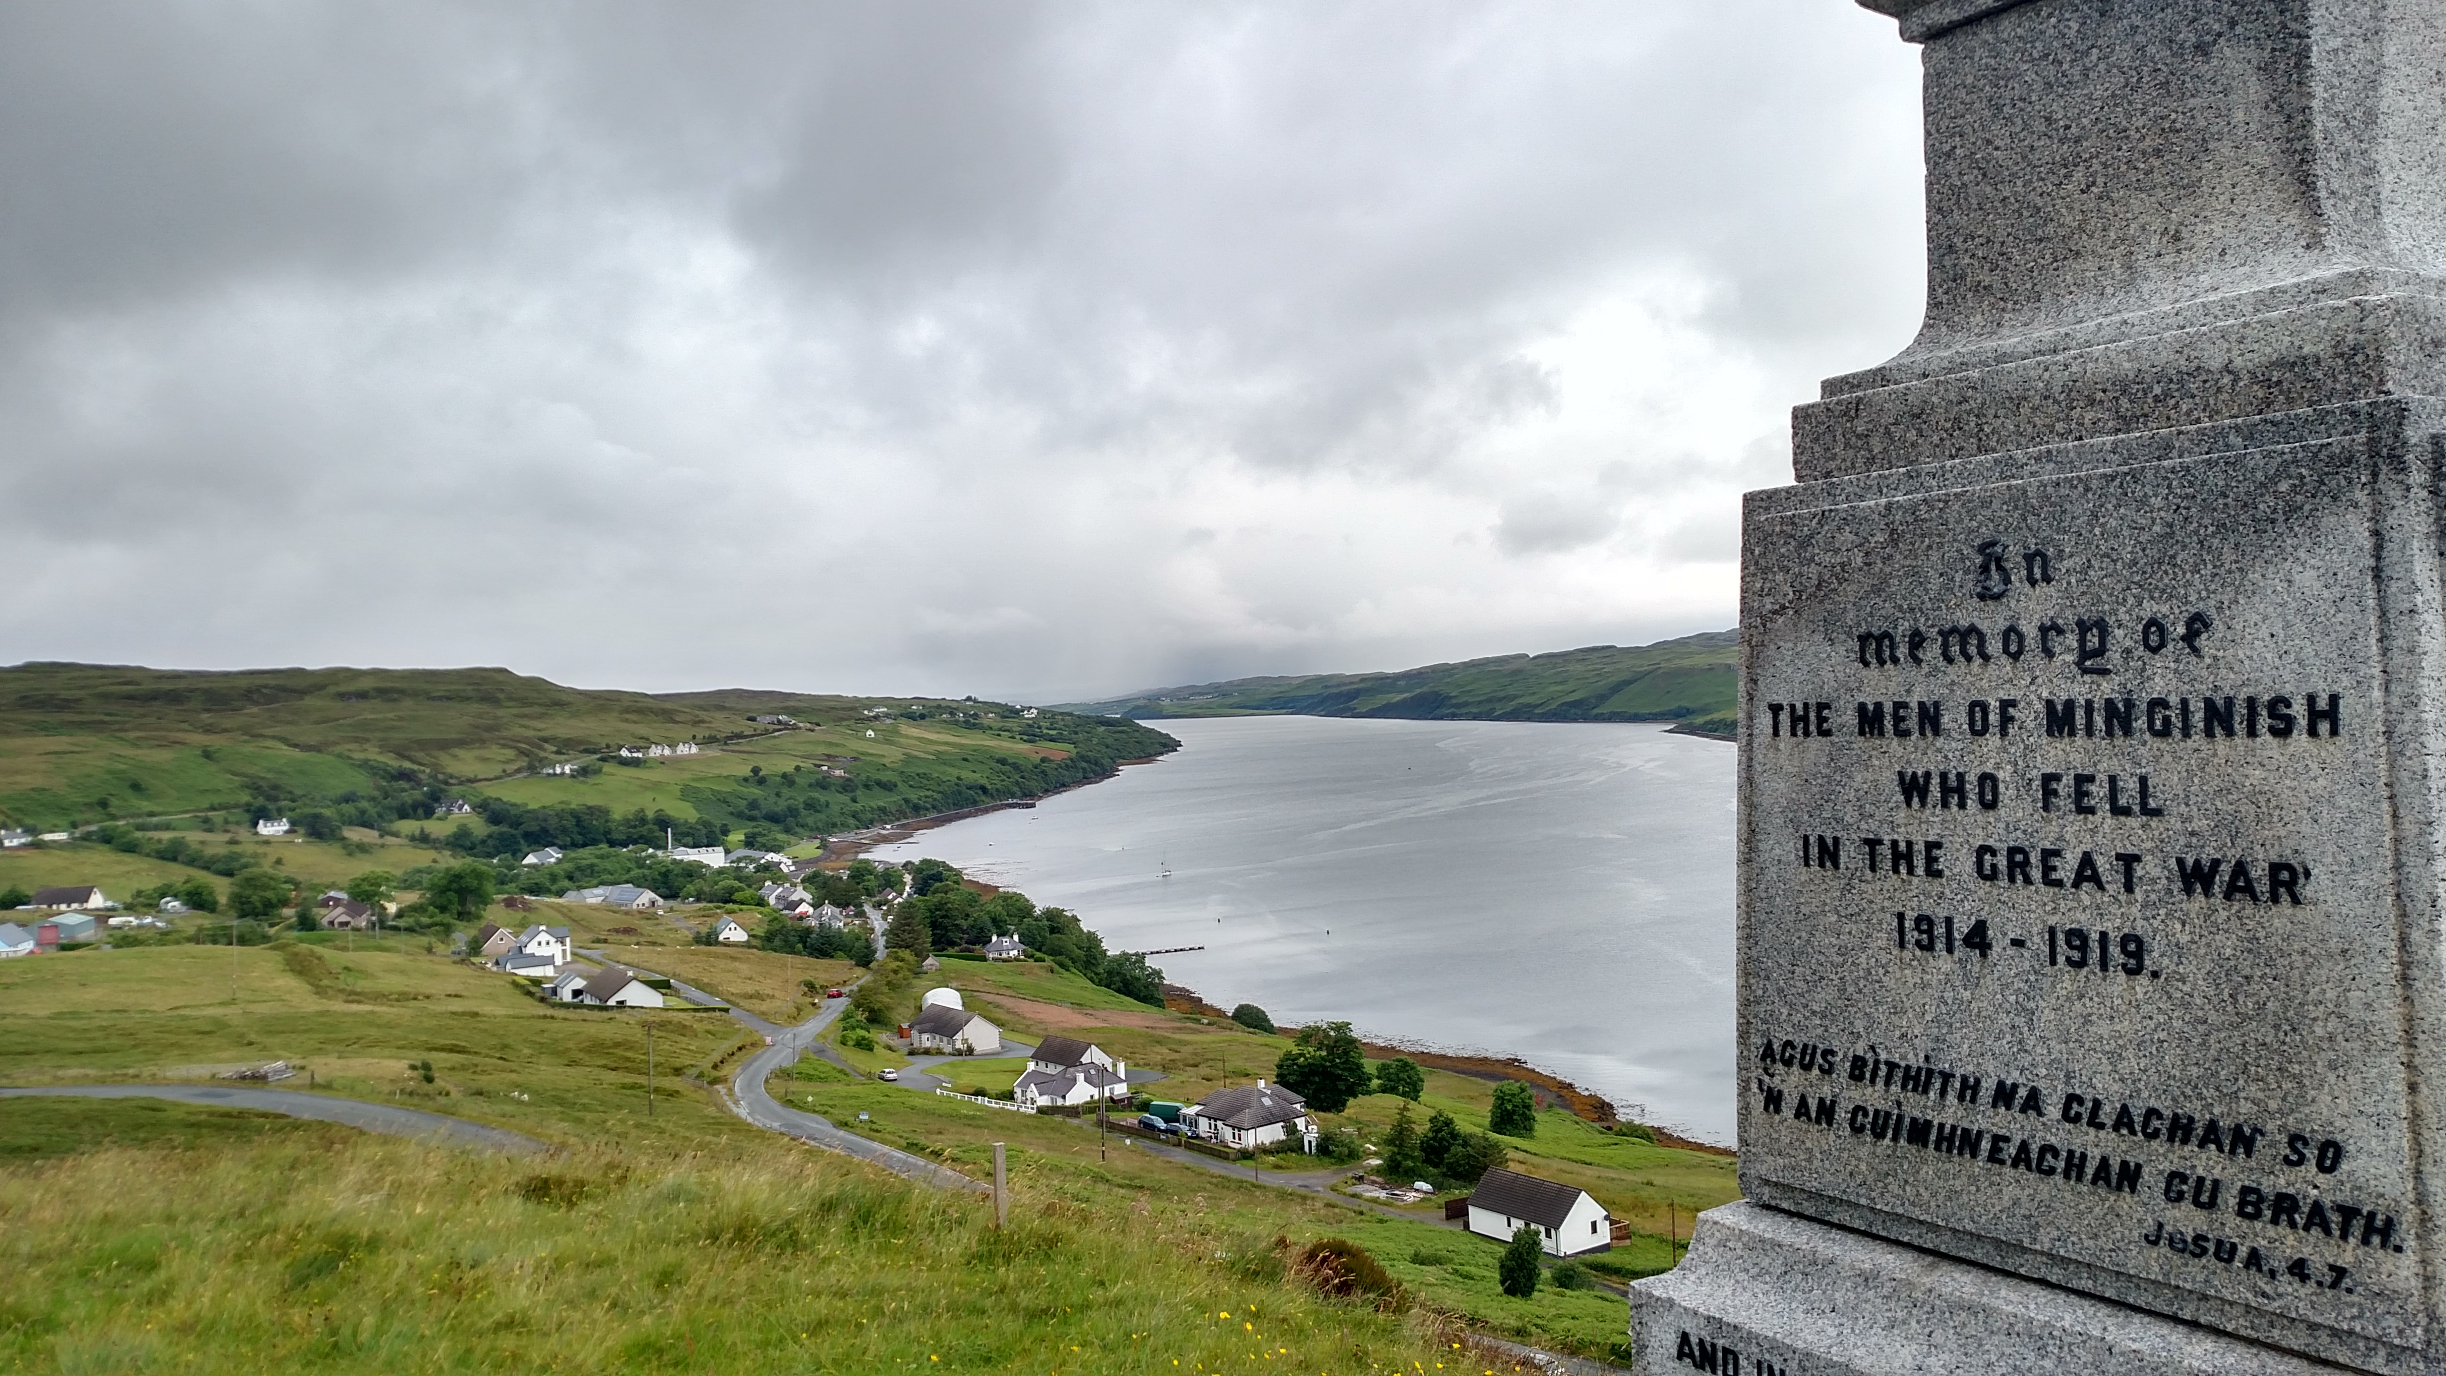
Notes:
Minginish Isle of Skye

Slide 16
Oak Park, IL
Dedicated Nov. 11 1925

Slide 17
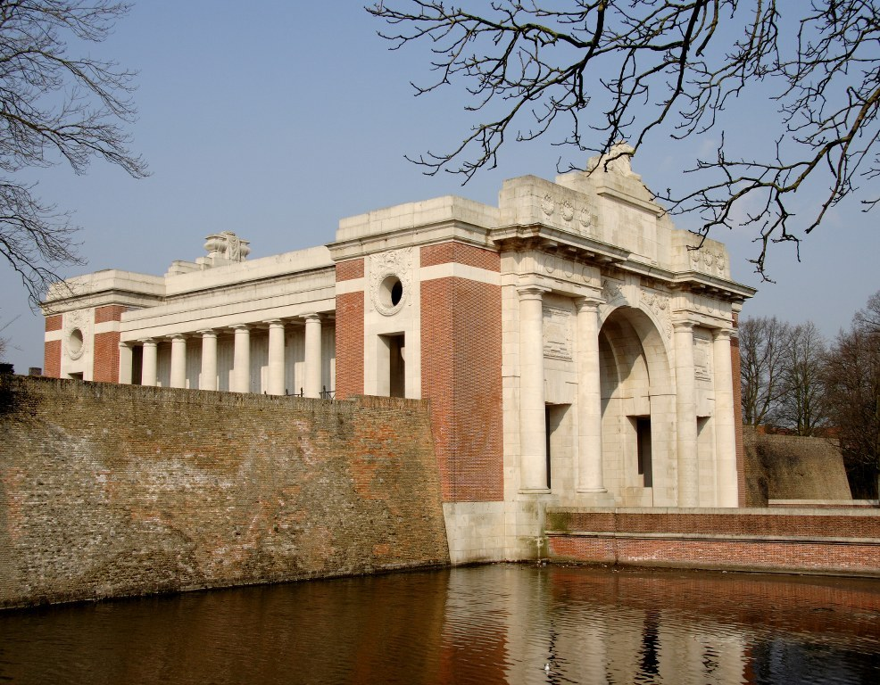
Menin Gate Memorial to the Missing, Ypres, Belgium. To British and Commonwealth (British colonial possessions/former colonies or colonies emerging as independent nations such as Canada) soldiers killed in the Ypres Salient in WWI whose graves were not located.
Dedicated in 1927
Last Post is played at 8 pm every night
Inscription inside the archway: To the greater glory of God. – Here are recorded names of officers and men who fell in Ypres Salient, but to whom the fortune of war denied the known and honoured burial given to their comrades in death.

Slide 18
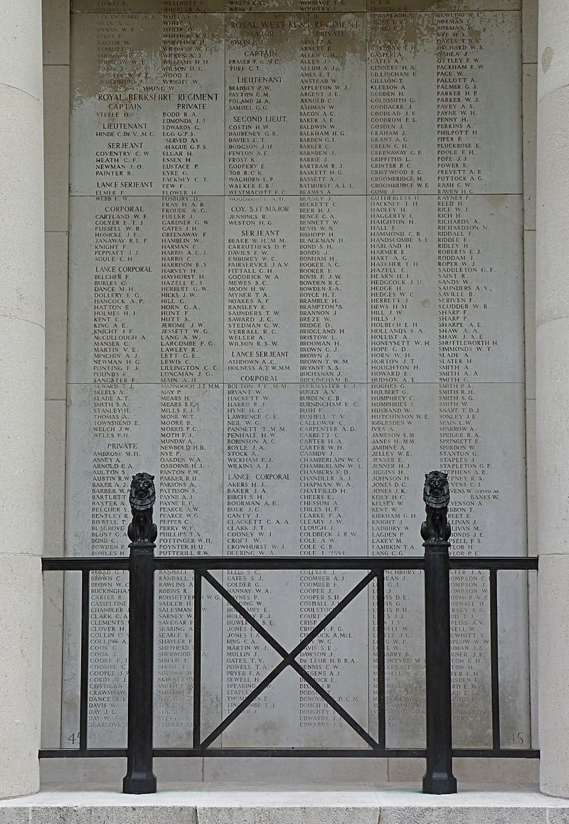
“On Passing the New Menin Gate,” Sigfried Sassoon, 1927 Who will remember, passing through this Gate, the unheroic dead who fed the guns? Who shall absolve the foulness of their fate,- Those doomed, conscripted, unvictorious ones? Crudely renewed, the Salient holds its own. Paid are its dim defenders by this pomp; Paid, with a pile of peace-complacent stone, The armies who endured that sullen swamp. Here was the world's worst wound. And here with pride 'Their name liveth for ever', the Gateway claims. Was ever an immolation so belied as these intolerably nameless names? Well might the Dead who struggled in the slime Rise and deride this sepulchre of crime.
One of the panels of the names of the missing inside the Menin Gate. There are about 54,000 names.

Slide 19
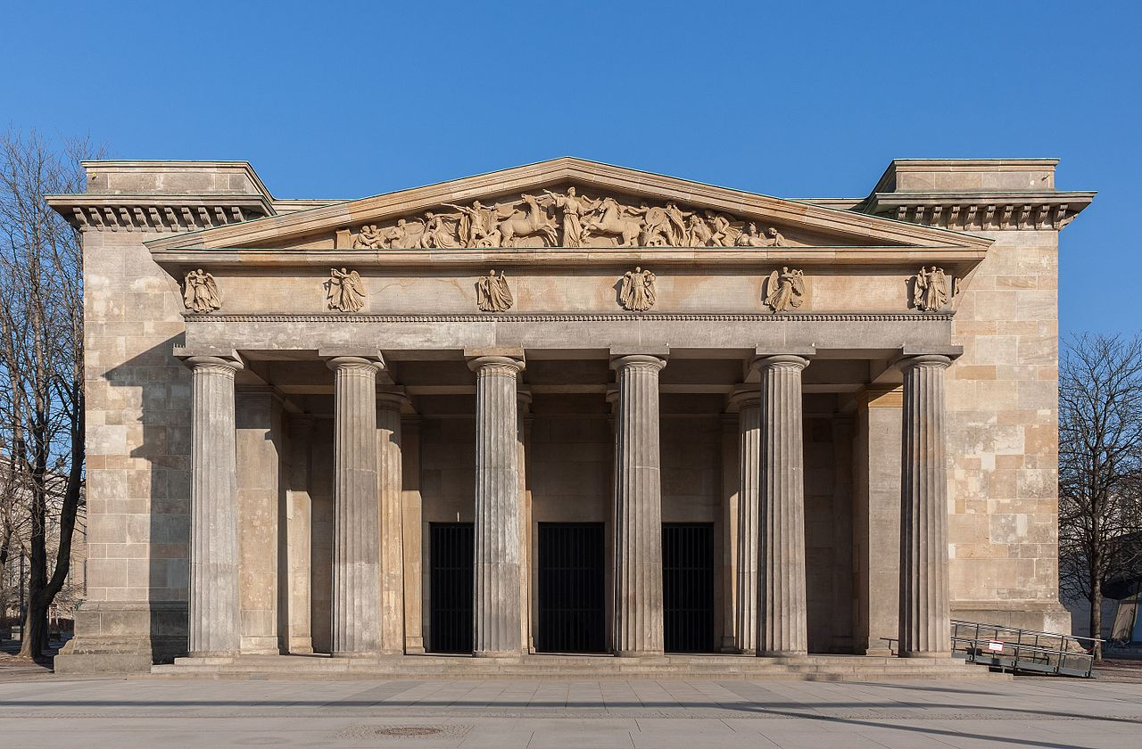
Major German memorial to the First World War dead: the Neue Wache, central Berlin

Slide 20
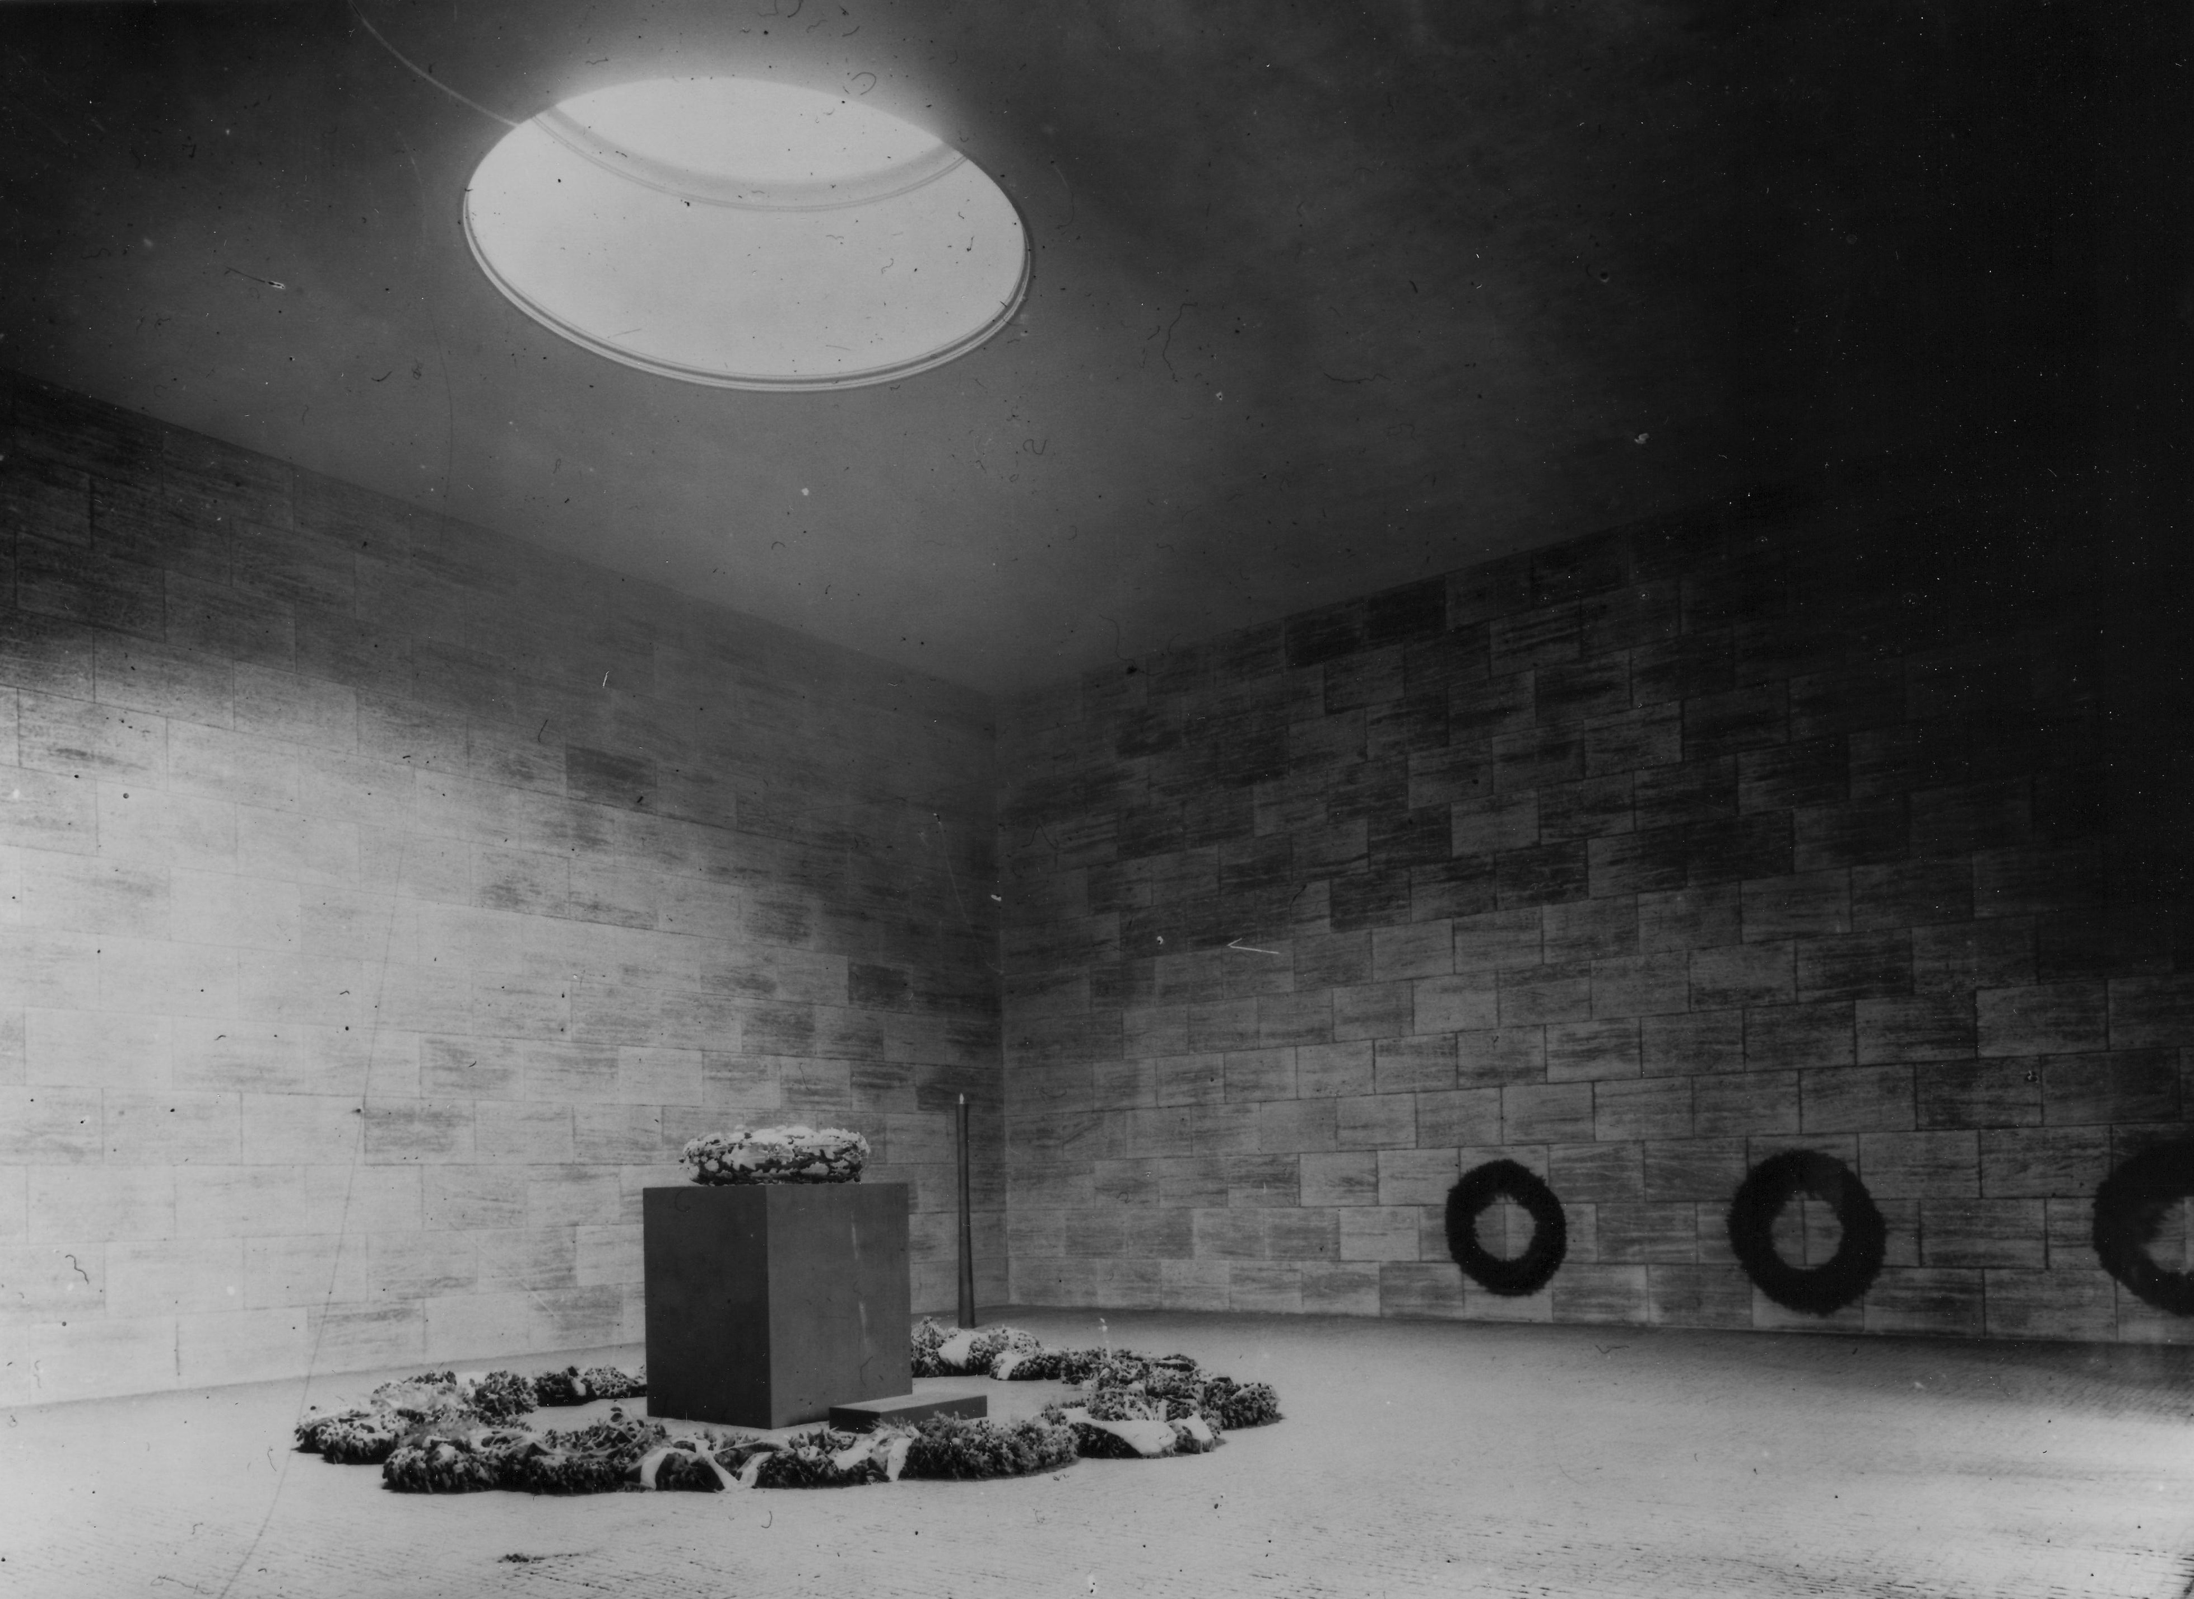
Inside the Neue Wache (New Guard House), 1931, before the Nazis took power. It was designated as a memorial to soldiers killed in the First World War. The interior, designed by Heinrich Tessenow, was meant to be minimalist. (Source Landesarchiv Berlin via this exhibit)

Slide 21
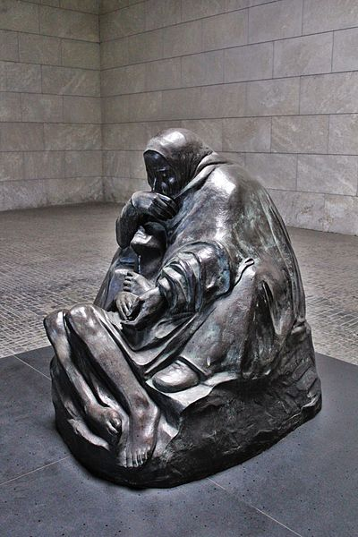
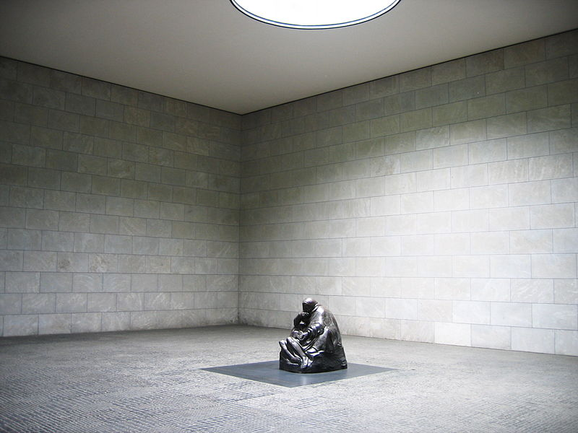
Kaethe Kollwitz, Mother with her Dead Son, 1937
In 1993, it was installed in what was initially one of Germany’s major WWI memorials at the New Guard House (Neue Wache). Today it is a memorial to all victims of war and dictatorship.

Slide 22
Kollwitz, The Grieving Parents, memorial at her son Peter’s grave in a German military cemetery in Belgium

Slide 23
Kaethe Kollwitz, The Mothers, woodcut, 1922

Slide 24
FASCISM

Slide 25
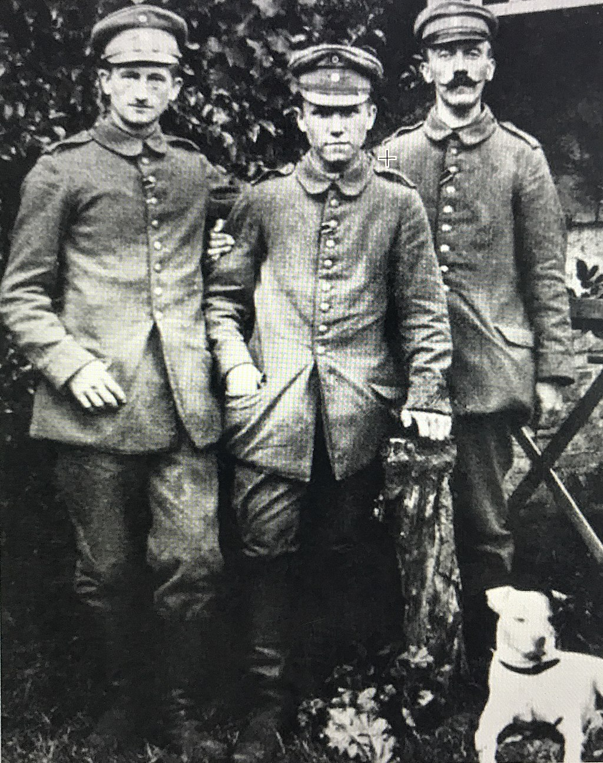
The invention of fascism, circa 1919 – fascism is a political philosophy that is a creation of the post-World-War-I world

Slide 26
Benito Mussolini (1883-1945)
Fascist party (Italy) founded 1921
German Workers Party (later the Nazi Party) founded 1919

Slide 27
Fasci di Combattimento (Combat Squads),
Est. 1919 in Milan
Rule by “trenchocracy”

Slide 28
Propaganda installation on the facade of Benito Mussolini's headquarters in the Palazzo Braschi, Rome, 1934, ahead of Italian National Elections.

Slide 29
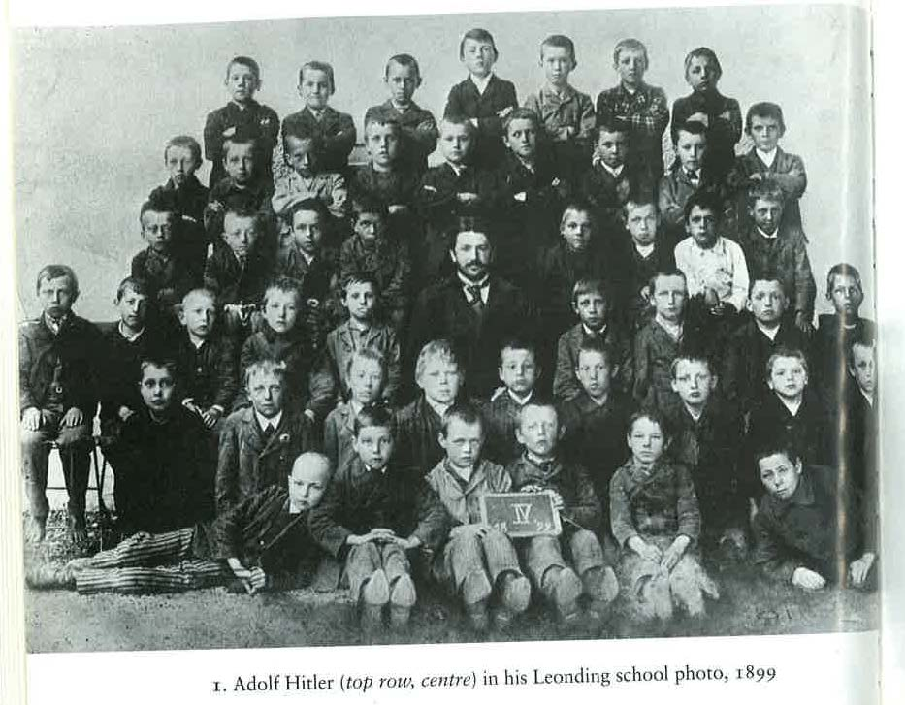
Hitler (top row, center) in his grammar school photo, 1899 (Kershaw, Hubris)

Slide 30
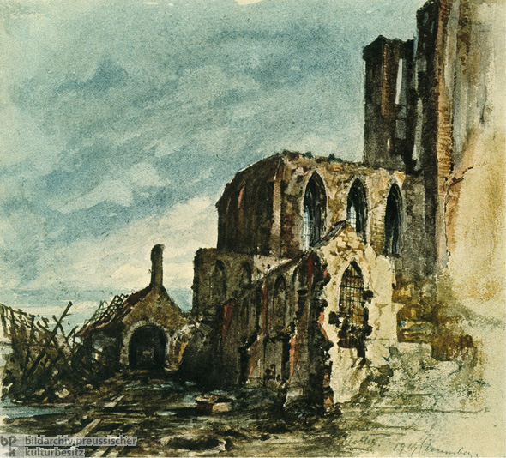
Adolf Hitler, watercolor, 1919 (ghi)

Slide 31
Populism
A type of politics that above all fights on behalf of “ordinary people” or “common people” (as it defines them) and opposes the power of elites, aristocrats, etc. Holds that ordinary people have good ideas and ought to have power over the state.
Can be right, center, or left.

Slide 32
Early Nazi Party platform, in a nutshell:
Democracy is division and strife, we need a united nation under a Leader! (Like it was in the trenches!) But the right (the old-style conservatives—aristocrats, the Kaiser) are too elitist and don’t do enough for the little guy. But the left isn’t patriotic and is wimpy on foreign policy, and lost the war for us. Also, the Jews are a big problem. Capitalism is flawed (the little guy is hurting) but the problem with capitalism is the Jews.

Slide 33
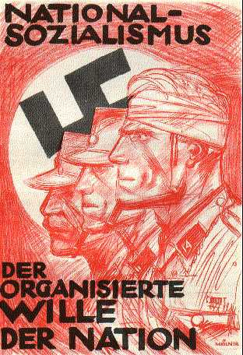
Nazi Party poster, circa 1920s
“National Socialism: The Organized Will of the Nation”
Calvin College Archive

Slide 34
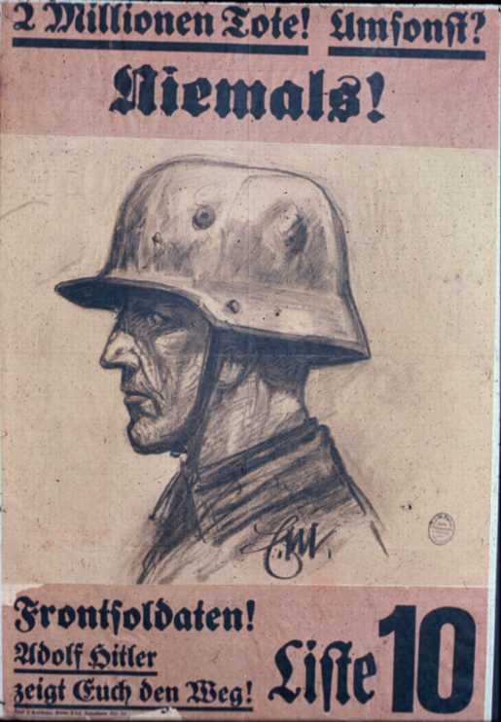
Nazi Party campaign poster, 1929
“Two million dead. Did they die in vain? Never! Front soldiers! Adolf Hitler is showing you the way!”
Source: Calvin College Archive

Slide 35
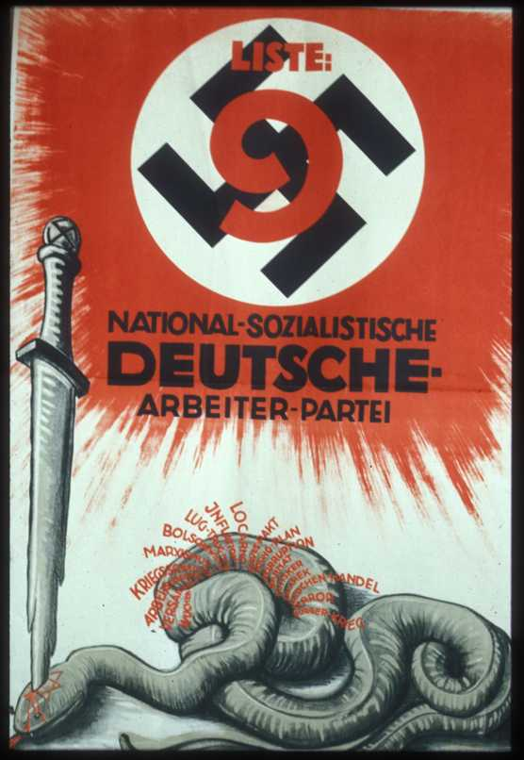
Nazi Party poster, 1930
“List 9, National Socialist German Worker’s Party”
The red words coming from the snake are: usury, Versailles, unemployment, war guilt lie, Marxism, Bolshevism, lies and betrayal, inflation, Locarno, Dawes Pact, Young Plan, corruption, Barmat, Kutistker, Sklarek [the last three names are Jews involved in major financial scandals], prostitution, terror, civil war.
* In the Locarno Treaty, Germany accepted its borders set by the Versailles Treaty. The Dawes and Young Plans were revisions to the Versailles Treaty; the Young Plan was actually pretty good for Germany

Slide 36
Growth of the Nazi party 1924-1933
1923—aprox. 5,000 party members
May 1924—6.5% of national vote
December 1924—3% of national vote
1928—2.6% of national vote
1928-1929 membership almost doubles (to 178,000)
September 1930— of 18.3% national vote
July 1932— of 37.3 national vote
November 1932—33.1 of national vote
(Sources: Childers, The Nazi Voter)
Nazi Party founded as the German Worker’s Party in 1919; changed its name to the National Socialist German Worker’s Party (“Nazi”) in 1920.

