Slide 1
Interwar day #2 plus Workshop 3: digital public history
HSTCMP 202, DIGITAL WORLD WARS

Slide 2
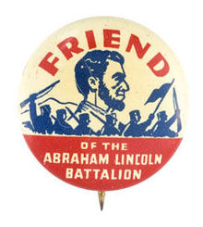
A. The League of Nations B. The Spanish Civil War BREAK C. Workshop 3: make a podcast!
An End to War? The League of Nations
Key terms & ideas
League of Nations
Peer review
Public history
Haile Selassie
Francisco Franco
Italian invasion of Ethiopia (1935-1936)
Spanish Civil War (1936-1939)

Slide 3
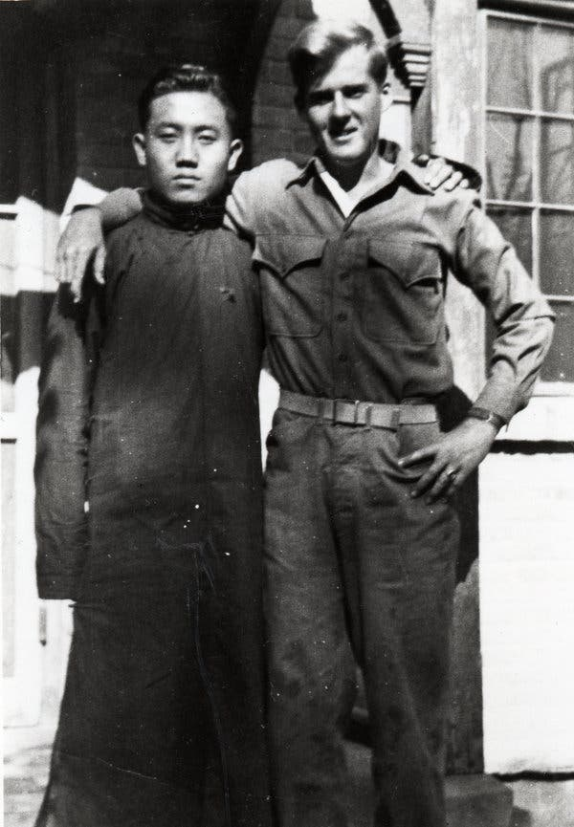
EB Sledge, right, with Hao Ching Foo, in Beijing, 1945. Hao worked for Sledege’s platoon.
(NY Times)

Slide 4
The League of Nations – To Prevent War

Slide 5
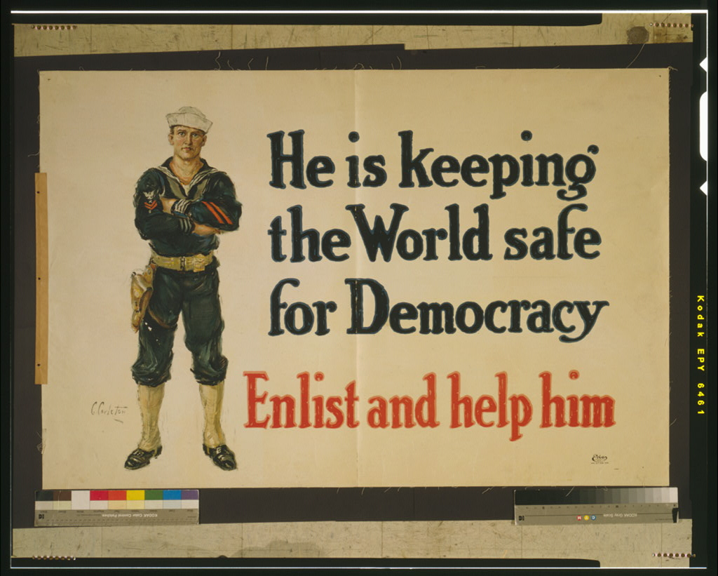
US Navy recruitment poster, published between 1916 and 1918 (Library of Congress)

Slide 6
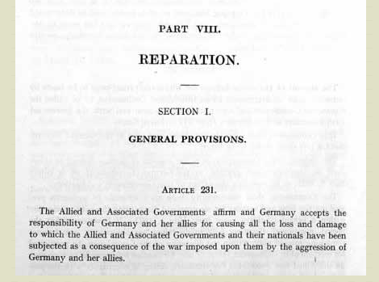
(National Archives, UK)

Slide 7
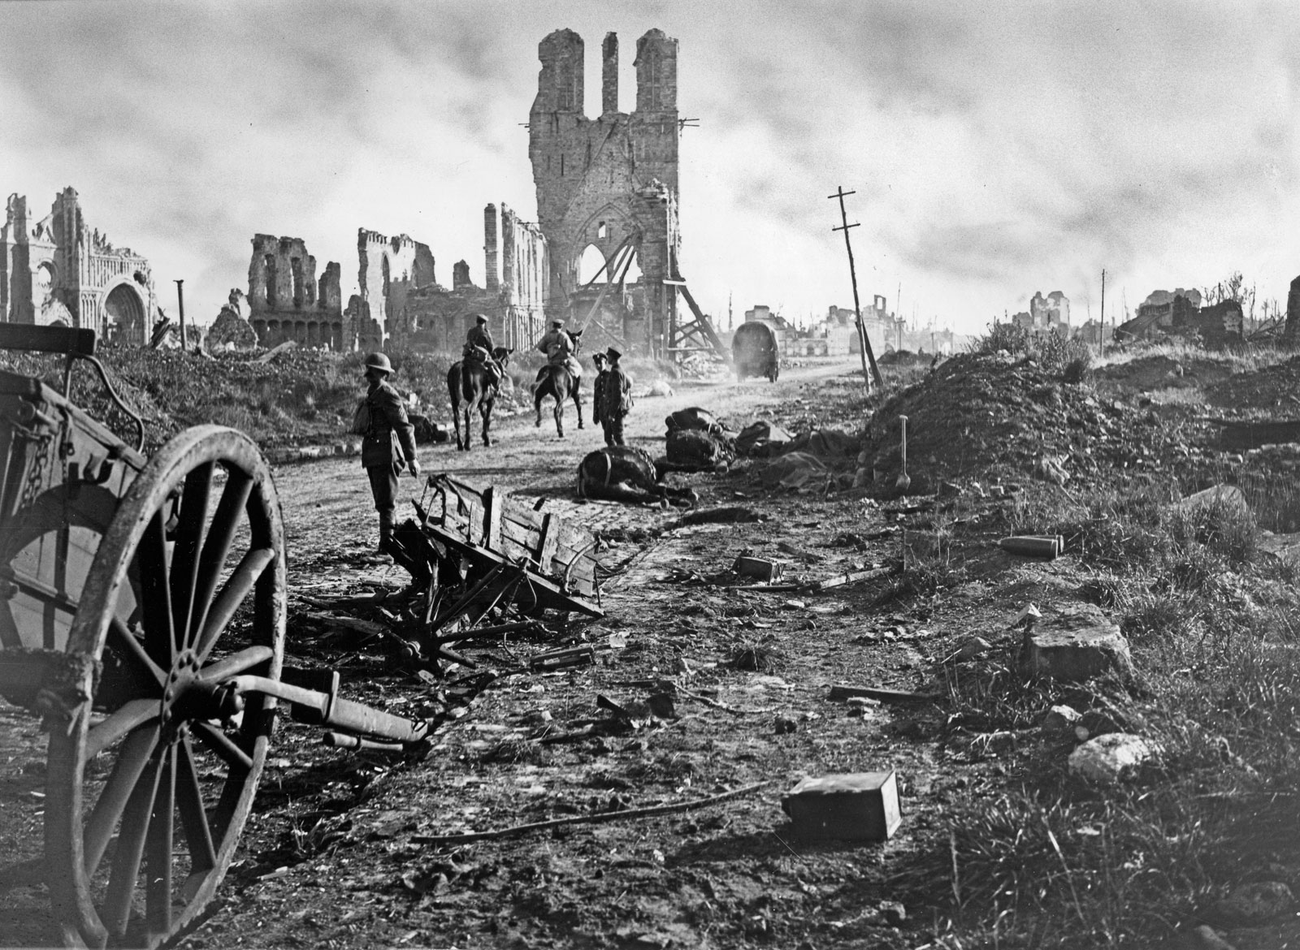
“It will be necessary for our enemies to pay for every step ahead with streams of blood. Large areas that so far has been unaffected by war will be wrecked completely. If the enemy wants to push us out of the occupied parts of northern France, and if they want to force a retreat from Belgium, they will have to count on an extended period of bloody battles and the completely useless destruction of their own territory.”
German officer Colonel Schwertfeger writing in a German newspaper, November 1918. Cited in Isabel Hull, Absolute Destruction: Military Culture and the Practices of War in Imperial Germany (Ithaca, NY: Cornell University Press, 2005), 261.
British troops passing through the ruins of the Belgium town Ypres, September 29, 1918 (Britannica)

Slide 8
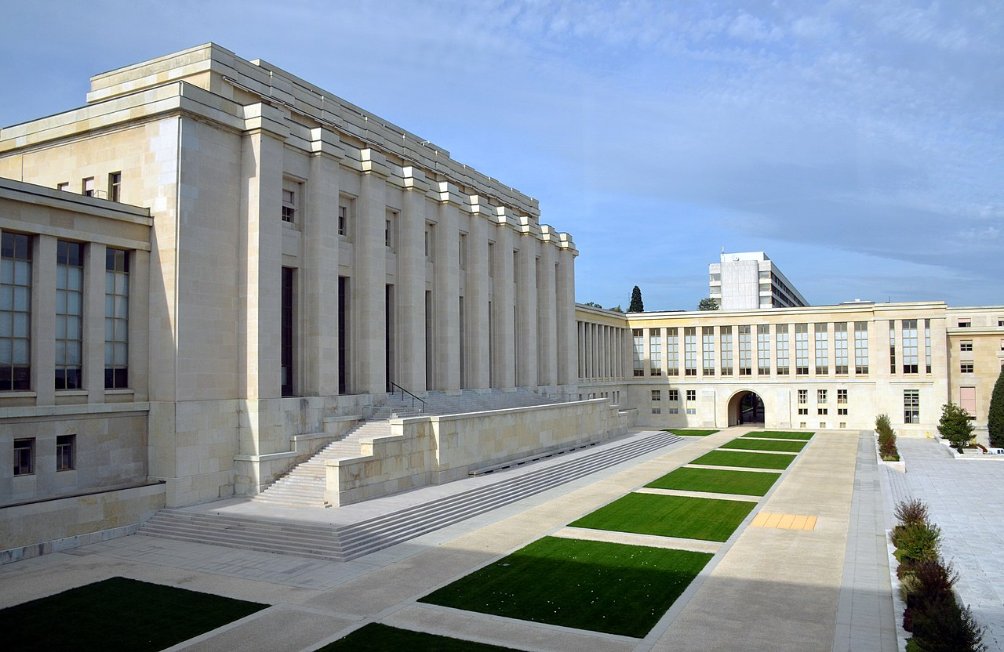
League of Nations Headquarters: The Palace of Nations in Geneva, Switzerland. (The United Nations HQ in contrast is in New York City.)
The League of Nations: focus on four roles
Prevent war!
International cooperation – on health for example
Promote international law, including humanitarian law
The mandate system – colonialism light?

Slide 9
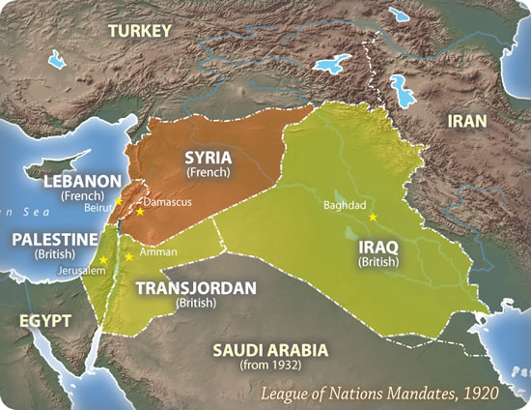

Slide 10
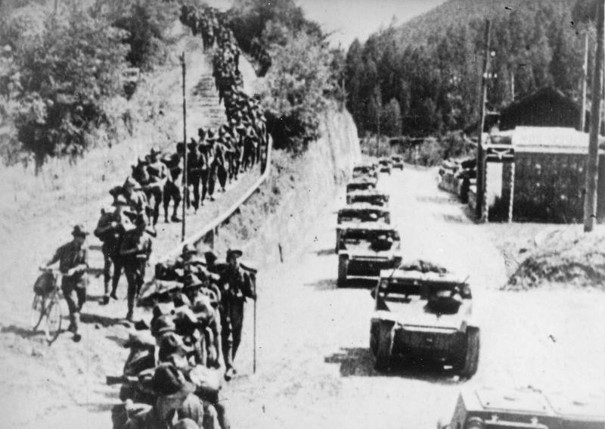
Italian L3/35 “tankettes” and infantry marching into Ethiopia, circa 1935
(Imperial War Museum)

Slide 11
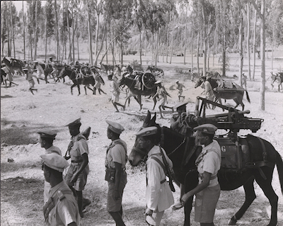
Female soldier, Ethiopian Army, 1935 (blackpast.org)
Ethiopian soldiers with captured Italian machine guns (blackpast.org)

Slide 12
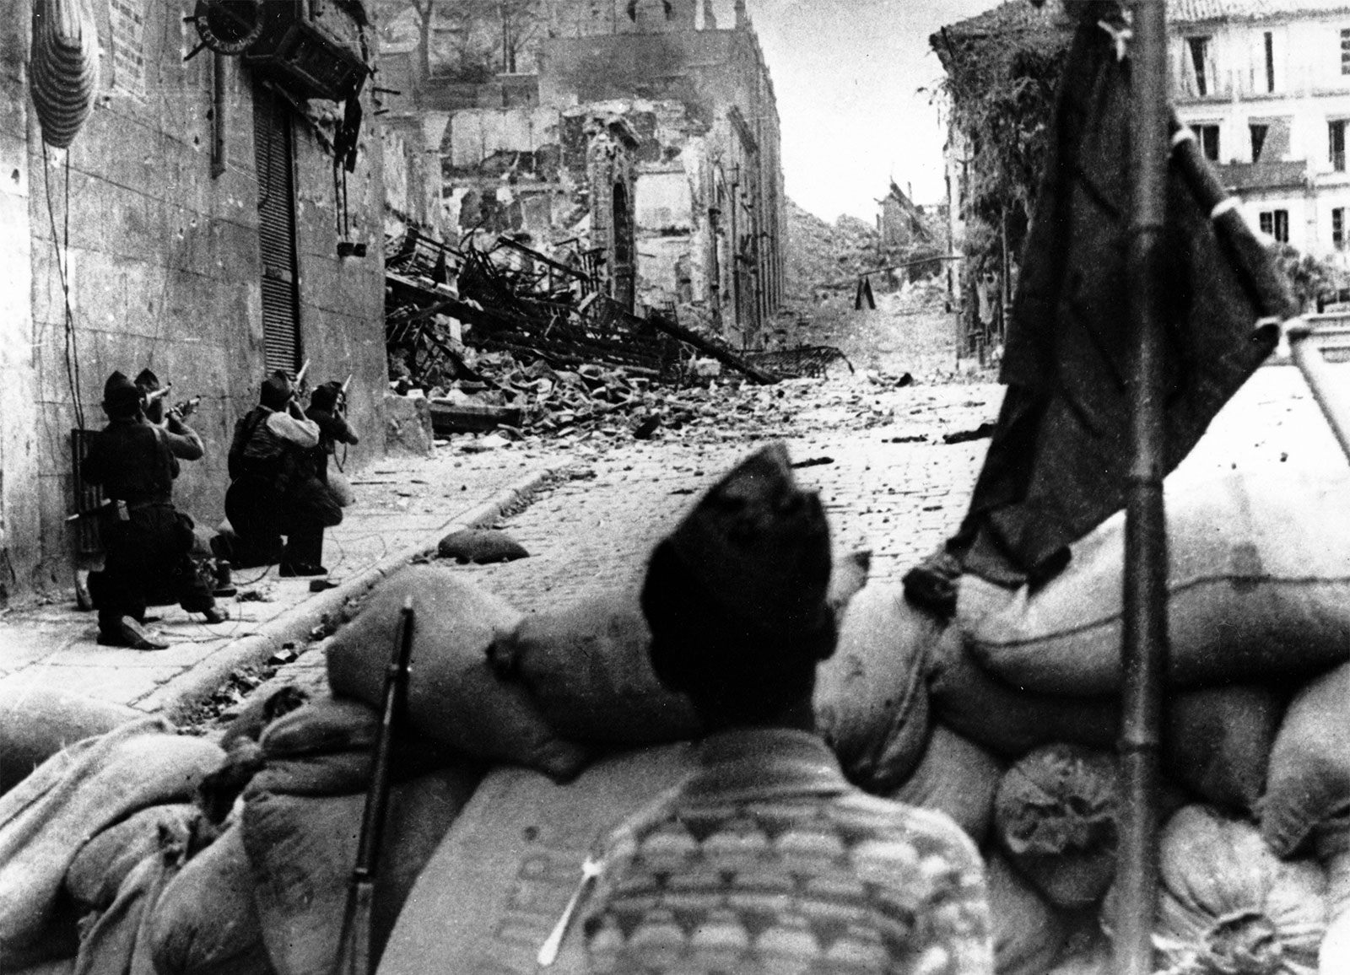
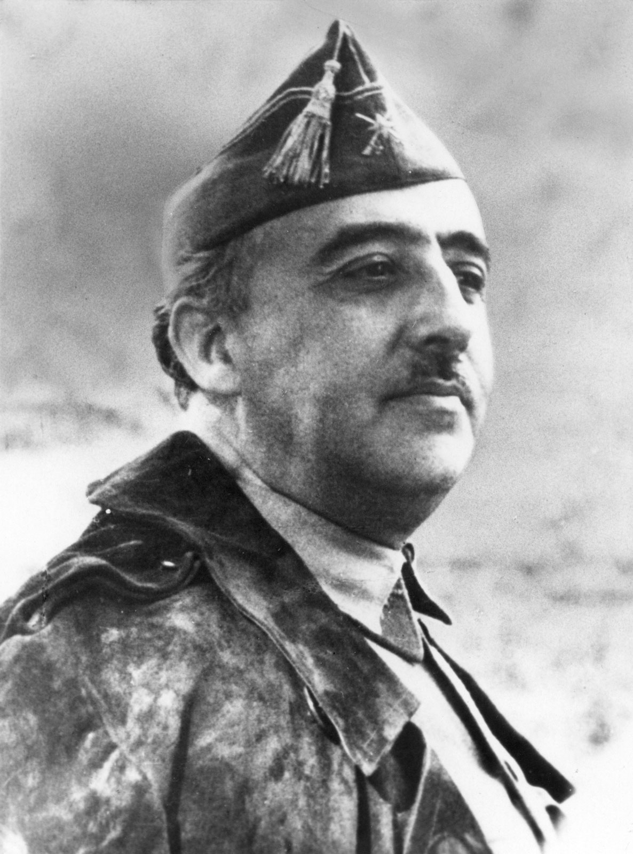
Right: Francisco Franco. Left: Nationalist troops fighting in Irun, Spain, Spanish Civil War (Britannica)

Slide 13
Left | Right
Republic/Loyalists/Popular Front | Rebels/Nationalists
Liberal Democrats/Republicans Socialists Communists, (PSUC) – pro-Stalin communists, receiving financial backing from the Soviet Union and Communist International. Will sponsor the International Brigades (more on this later) Marxists, (POUM) – a non-Soviet communist party, Trotskyists and NOT Stalin, but embrace the Bolshevik Revolution/communist politics broadly Anarchists, (CNT) – believe in no government and instead hyperlocal control, think of the state as only a way to protect property and property owners, use assassination tactics in Barcelona esp | Catholic Church Military Monarchists/Carlists – want to reinstate Alfonso and the influence of the Catholic Church Spanish Confederation of the Autonomous Right (CEDA) – rightwing coalition/party Fascist Falange – founded in 1933, inspired by the fascist parties of Europe

Slide 14
What are we fighting for?
To the people of Spain, for the future of their country
To some participants, a fight between fascism and communism
To most participants, fighting against fascism (but not really for communism) and for democracy.

Slide 15
The International Brigades, est. 18 September 1936 by the Communist International – volunteers from around the world who fought for the Republicans
35,000 total (but never more than 20,000 at any one time)
10,000 died in combat, from 50 different countries
9000 Frenchmen volunteered
2000 Germans
1000 Austrians
2000 Brits
2500 North Americans
150 Portuguese
Plus more from Poland, Italy, Germany, USSR, Bulgaria, most other European countries, also China, the Philippines
Numbers from Casanova, (2013)

Slide 16
The Lincoln Battalion
American
volunteers for the Republican side, Spanish Civil War
Oliver Law (left) and other members of the Lincoln Brigade in Spain (Lincoln Archives)

Slide 17
Thane Summers, UW undergrad in philosophy
Travelled to Spain in Spring 1937
Fought in MacKenzie-Papineau Battalion of the Lincoln Brigade

Slide 18
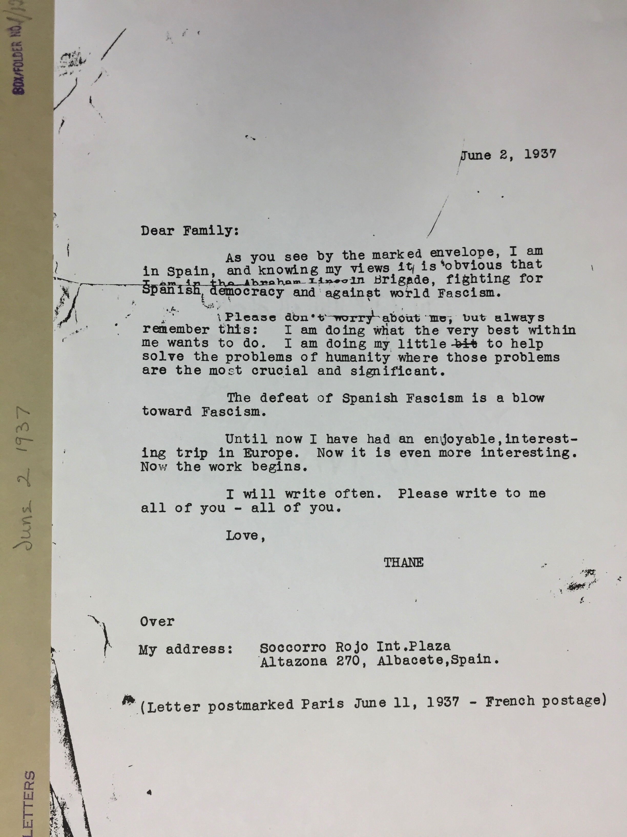

Slide 19
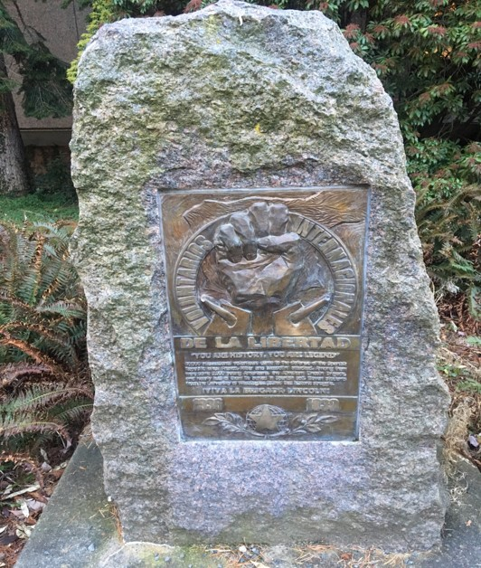
Memorial to the Spanish Civil War, outside the HUB:
“The 11 UW students that the memorial honors are: Charles Harvey Boyer, Charles P. Clyde, John Hollis Jenkins, Edgar A. Lehmann, Jack Lucid, David Nieder, James Norie, Franklin Plumb, Robert Pettijohn, Robert L. Reed, and Thane Summers. Three out of the eleven volunteers either went MIA or KIA during the war. These students were James Norie, Robert Pettijohn, and Thane Summers.”

Slide 20
Guernica
Bombed 26 April 1937

Slide 21
Guernica in ruins.
Wikimedia Commons

Slide 22
Pablo Picasso, Guernica (1937), at Museo Reina Sofia Madrid
Pablo Picasso, Guernica (1937)

Slide 23
What is public history?

Slide 24
Marhoefer, Laurie. "Lesbianism, Transvestitism, and the Nazi State: A Microhistory of a Gestapo Investigation, 1939–1943." The American Historical Review 121, no. 4 (2016): 1167-195.

Slide 25
Lynn M. Thomas, Beneath the Surface: A Transnational History of Skin Lighteners (Durham: Duke University Press, 2020)

Slide 26
Annette Gordon-Reed, The Hemingses of Monticello: An American Family (New York: W.W. Norton & Company, 2008)

Slide 27
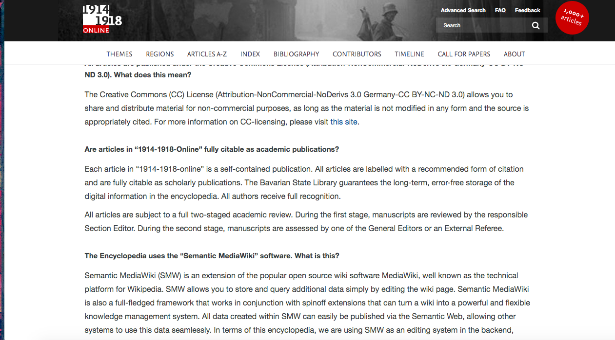
Good public history v.
bad public history

Slide 28
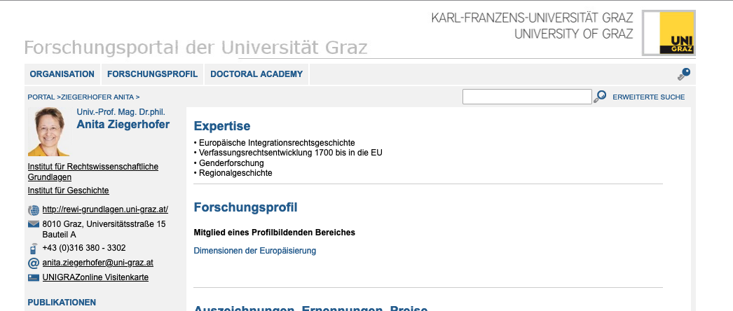
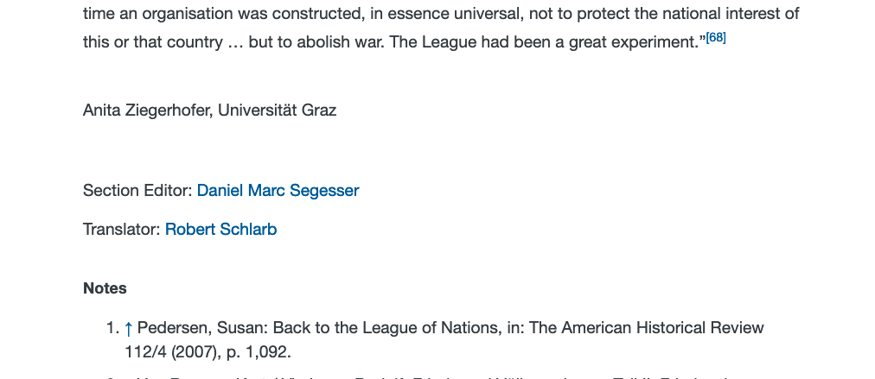
Ask yourself: who wrote this? Was it peer-reviewed?
Author, section editor and translator of the article in the International Encyclopedia of WWI on the League of Nations:

Slide 29
Is Wikipedia good public history?

Slide 30
From “One Woman’s Mission to Rewrite Nazi History on Wikipedia”

Slide 31
There’s a citation of my book on Wikipedia (Magnus Hirschfeld entry) that says the opposite of what my book says … I argue that surprisingly, von Papen didn’t crack down on “immorality,” though he made some vague gestures in that direction.

Slide 32
UW History Graduate Students Recommend History Podcasts:
American History Tellers (US history)
Arguing History (historiography)
Beyond Huaxia (Chinese history)
History of Japan (Japanese history, from alumnus Isaac Meyer)
History Workshop Podcast (general)
The Making of a Historian (general)
New Books in History (general)
Nostalgia Trap (history and politics)
Ottoman History Podcast (Ottoman Empire and modern Middle East)
Radiolab Presents: More Perfect (US legal history)
Retronauts (video game history)
Sawbones: A Marital Tour of Misguided Medicine (medical history)
Slow Burn (political history)
SRB Podcast (Russian history)
This Land (American Indian legal history)
Tides of History (early modern European history)
Who Makes Cents? A History of Capitalism Podcast (history of capitalism)
You Must Remember This (Hollywood and cinema history)

Slide 33
Primary source or secondary source?
Primary Sources | Borderline? | Secondary Sources
Primary source – written/made by the people we are studying, in the time period we’re studying (after the fact OK too if it’s a memoir or oral history or similar). Example: Sledge’s memoir, Picasso’s Guernica, the Treaty of Versailles, the letter from “S.” to the Scientific Humanitarian Committee, All Quiet on the Western Front (though it’s a novel, keep that in mind)
Secondary source – written by historians (or journalists) after the fact, based on primary sources. Example: Morrow’s book, Proctor’s book.

Slide 34
Questions
What makes a good podcast? Chat a little about Angela King’s stories and the RadioLab episode you listened to.
How did the podcasts hook you at the beginning (if they did)?
How did they get you invested in listening to the story they told (if they did)?

