Slide 1
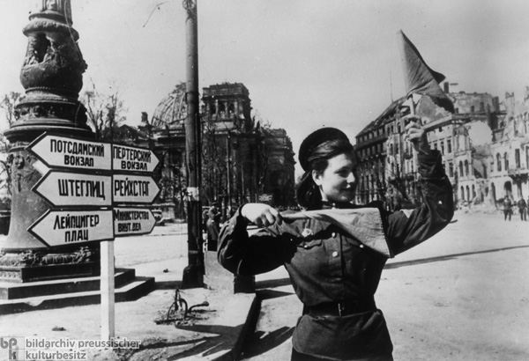
Night Witches, Rubble Frauen, and Hamsters: Women and the Second World War
A Red Army soldier directing traffic in Berlin after the German surrender (1945). The ruins of the Reichstag, the parliament building, are behind her to the left. (GHI)

Slide 2
What is a peer-reviewed (academic) secondary source?

Slide 3
The iconic US poster of “Rosie the Riveter”

Slide 4
Workers who built the B-29 wing assemblies pose with a finished B-29 super fortress, Boeing factory, Renton (Museum of Flight/Boeing)

Slide 5
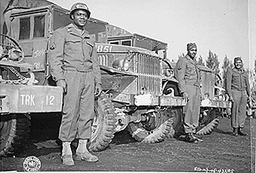
African Americans (including some women, such as the 6888th) served in the US military in segregated units; men often kept out of combat positions.
666th Quartermaster Truck Company, 82nd Airborne, European Theater (National Archives)

Slide 6
Workers clowning around, Boeing Factory. (Museum of Flight/Boeing)

Slide 7
Mary Ann Johnson pounding rivets on a B-17 Flying Fortress at Boeing (Plant 2) (Museum of Flight/Boeing)

Slide 8
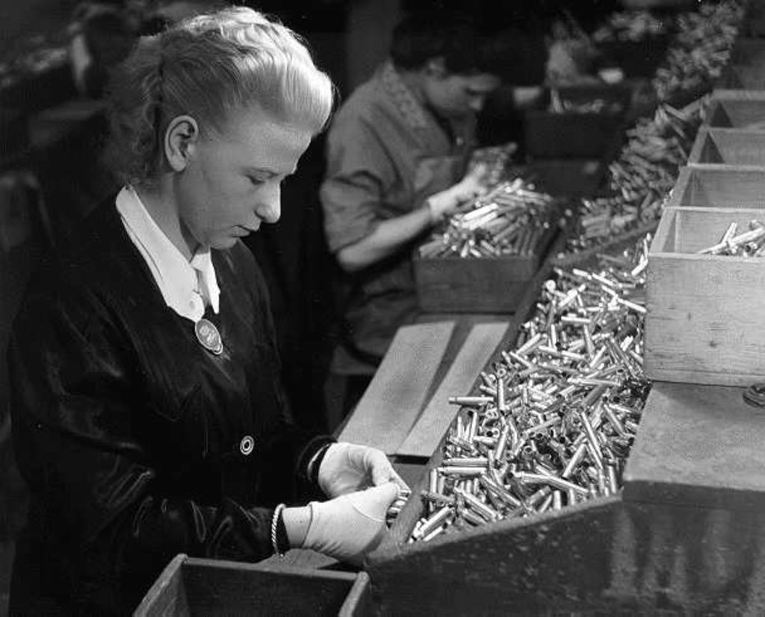
A German student doing ‘substitute’ work in a munitions factory, 1941
(source: LEMO)

Slide 9
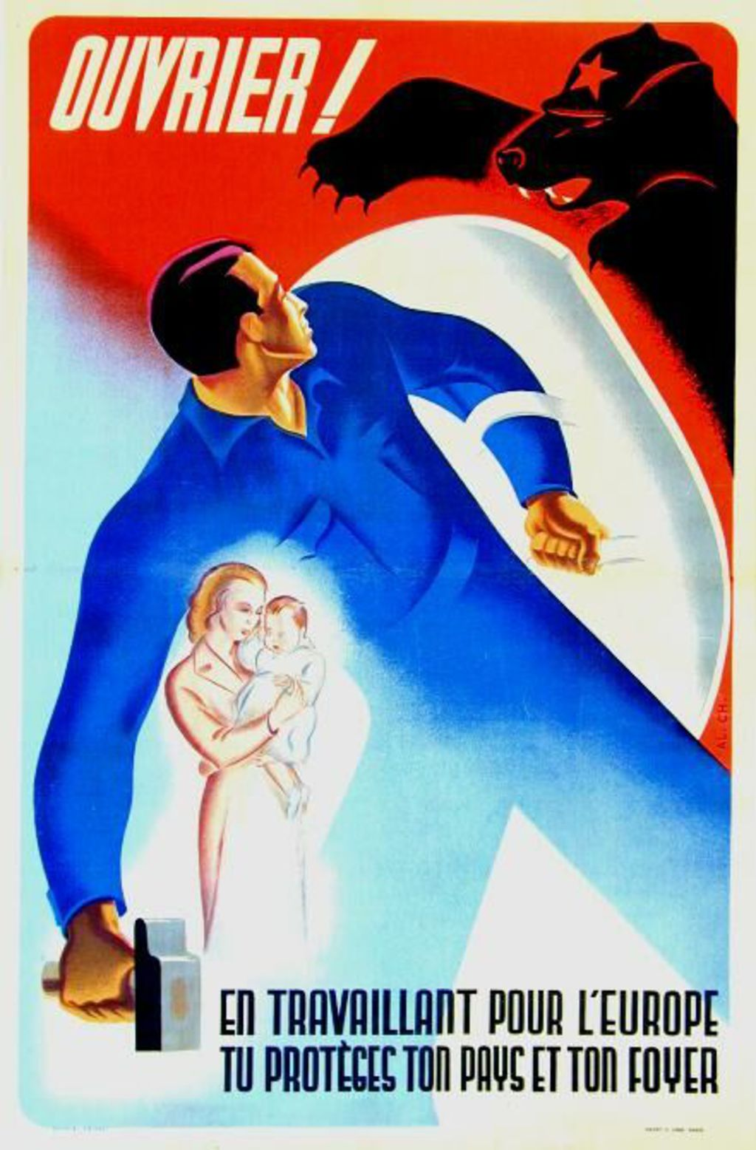
Women as symbols
“Worker! By working for Europe, you are protecting your country and your home.”
Poster produced by German occupation authorities in northern France, aimed at French workers.
Reading this image/do you know your mid-20th C European iconography?: Bear in a red fog, with a red star hat = … who?
(Source: LEMO)

Slide 10
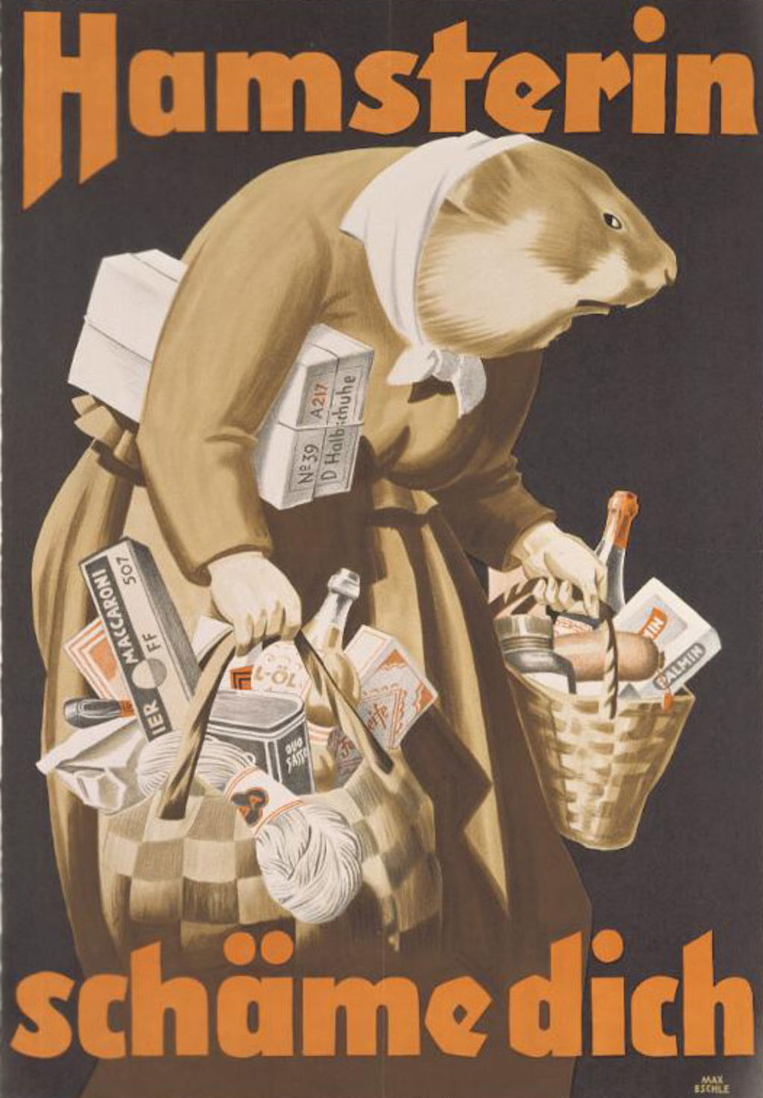
Women as symbols
“Hamster, shame on you.”
German, around 1942. “Hamsterkaeufe” is a German word, “hamster shopping,” meaning hoarding.

Slide 11
https://www.iwm.org.uk/collections/item/object/1060021825
Choose Cheese
(Imperial War Museum, Great Britain, 1940)

Slide 12
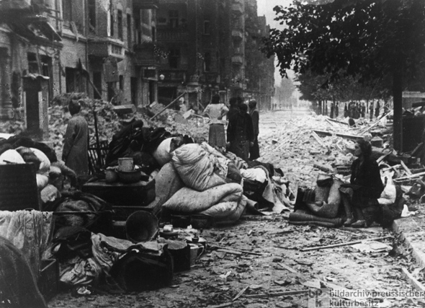
Berlin, 1 May 1945
(GHI)

Slide 13
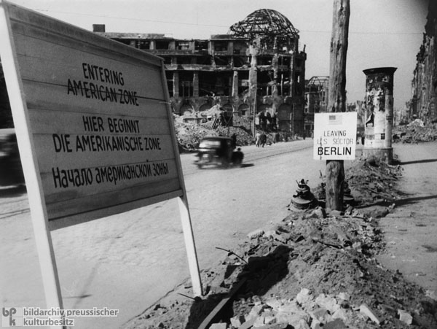
Berlin, 1945, border between Kreuzberg (in the American Zone) and Mitte (part of the Soviet Zone).
This is near Potdamer Platz. The domed building was the Haus Vaterland restaurant/entertainment palace.
(GHI)

Slide 14
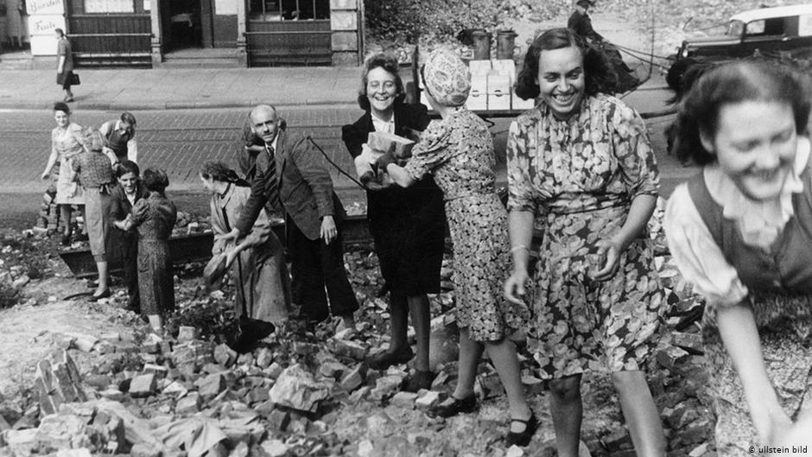
Source: DW

Slide 15
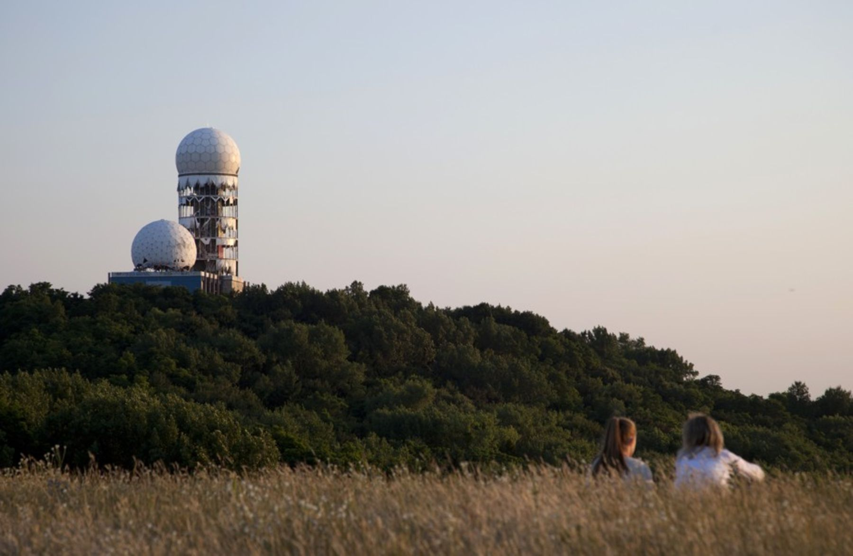
The Teufelsberg: mountain of rubble

Slide 16
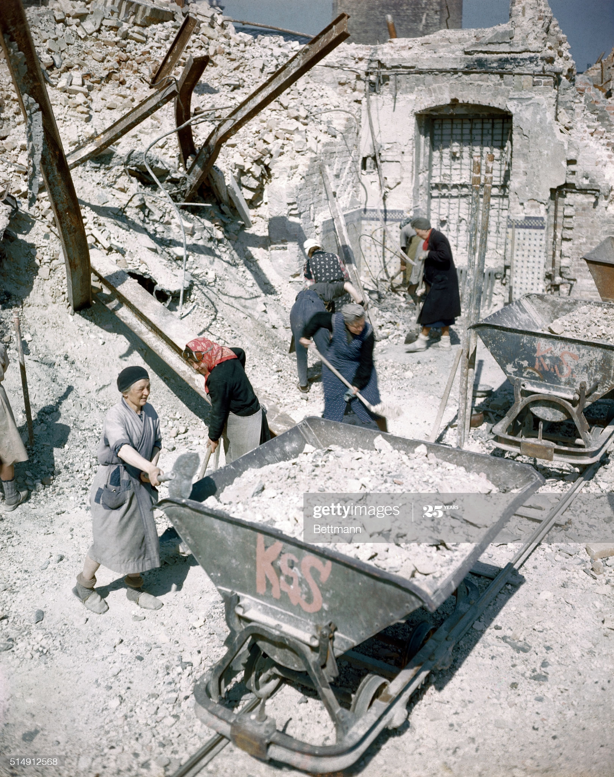
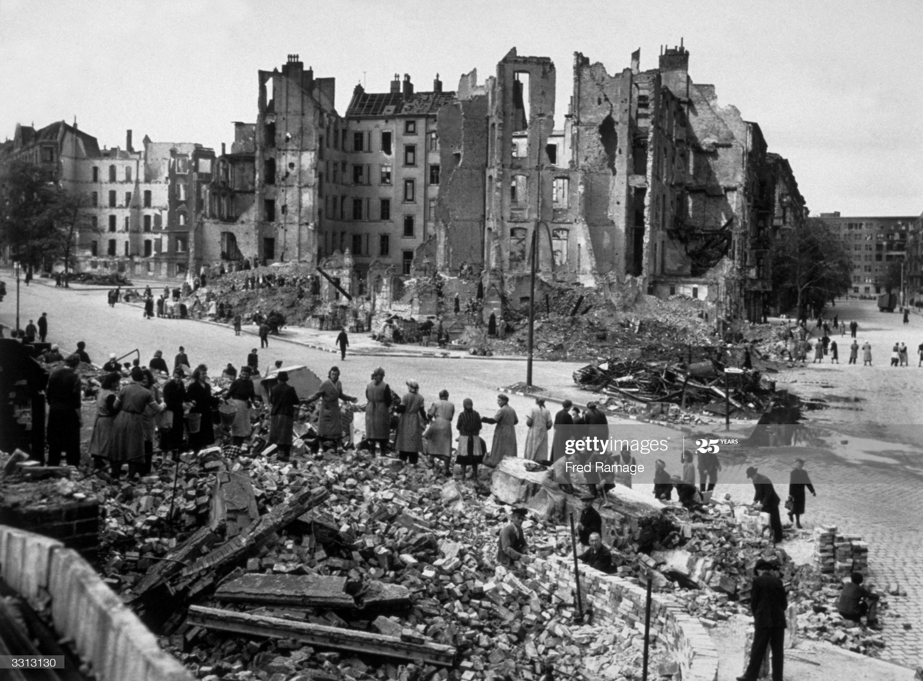
Left: Getty Images. They laid some narrow gauge track to dump sites so it would be easier to transport the rubble. Berlin.
Right: Getty, July of 1945, Berlin.

Slide 17
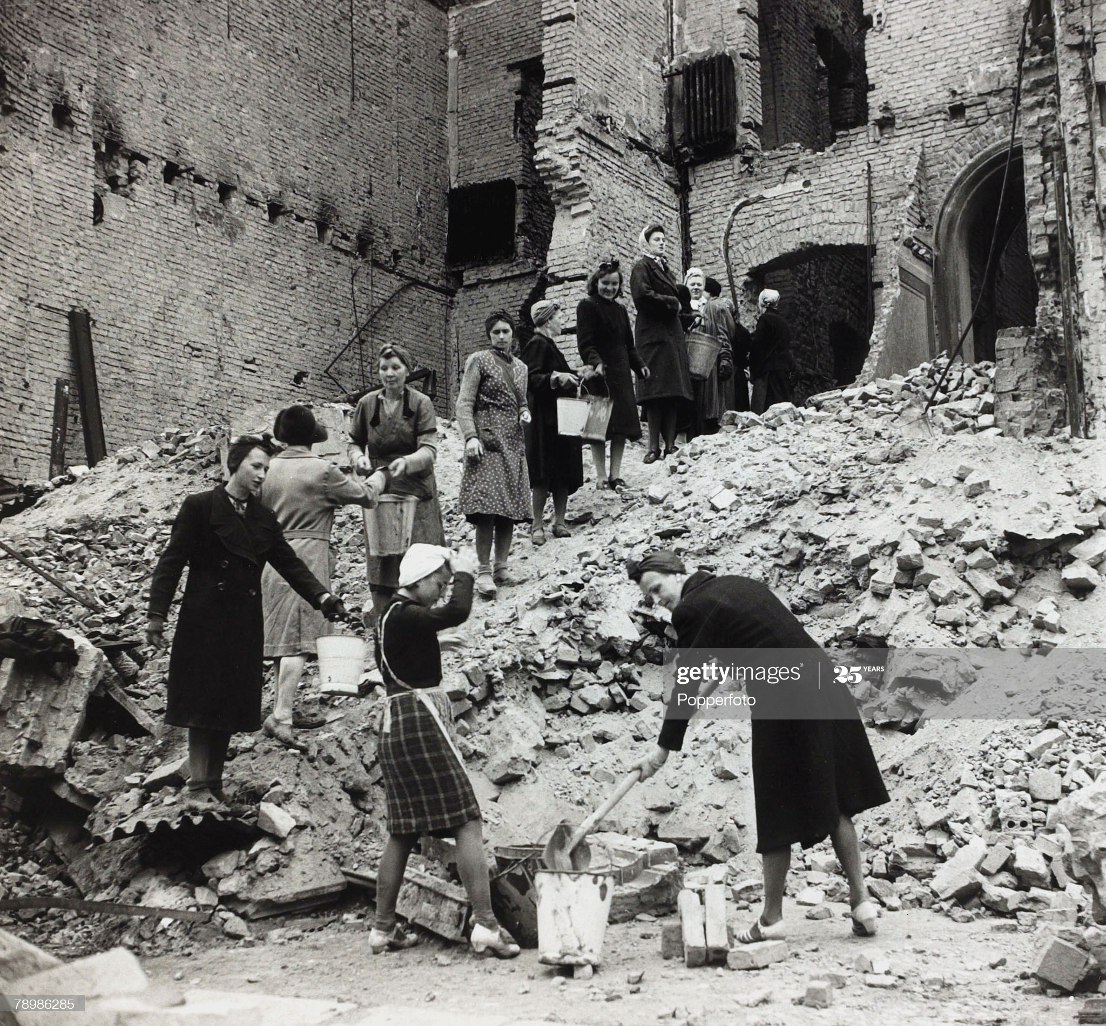
Getty: Berlin, 1945

Slide 18
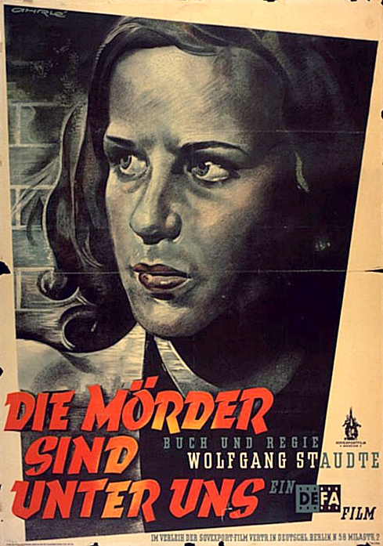
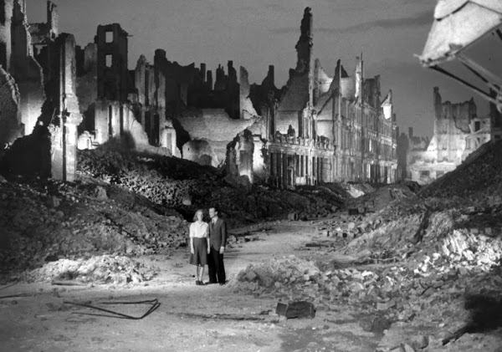
The Murderers Are Among Us (1946)

Slide 19
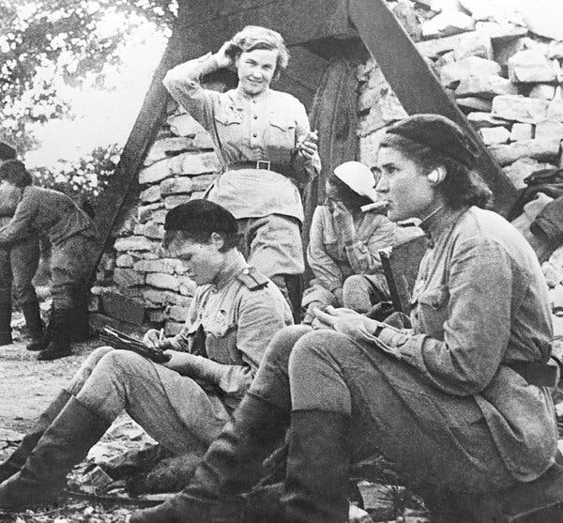
The Night Witches
Nadezhda Vasilyevna Popova (standing) and other Soviet pilots. Popova volunteered for the 588th Night Bomber Regiment.
(Source: New York Times)

Slide 20
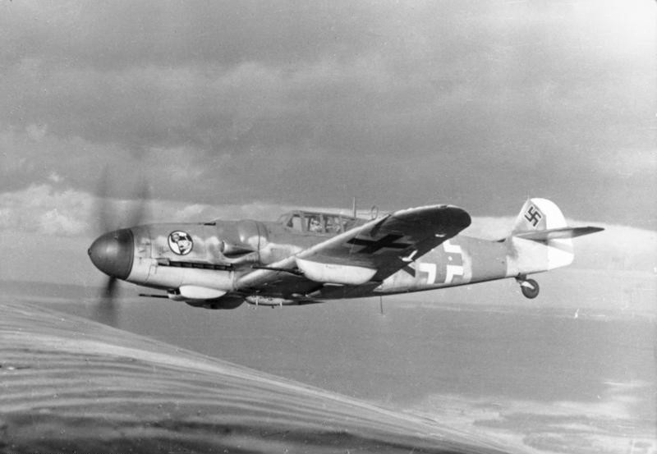
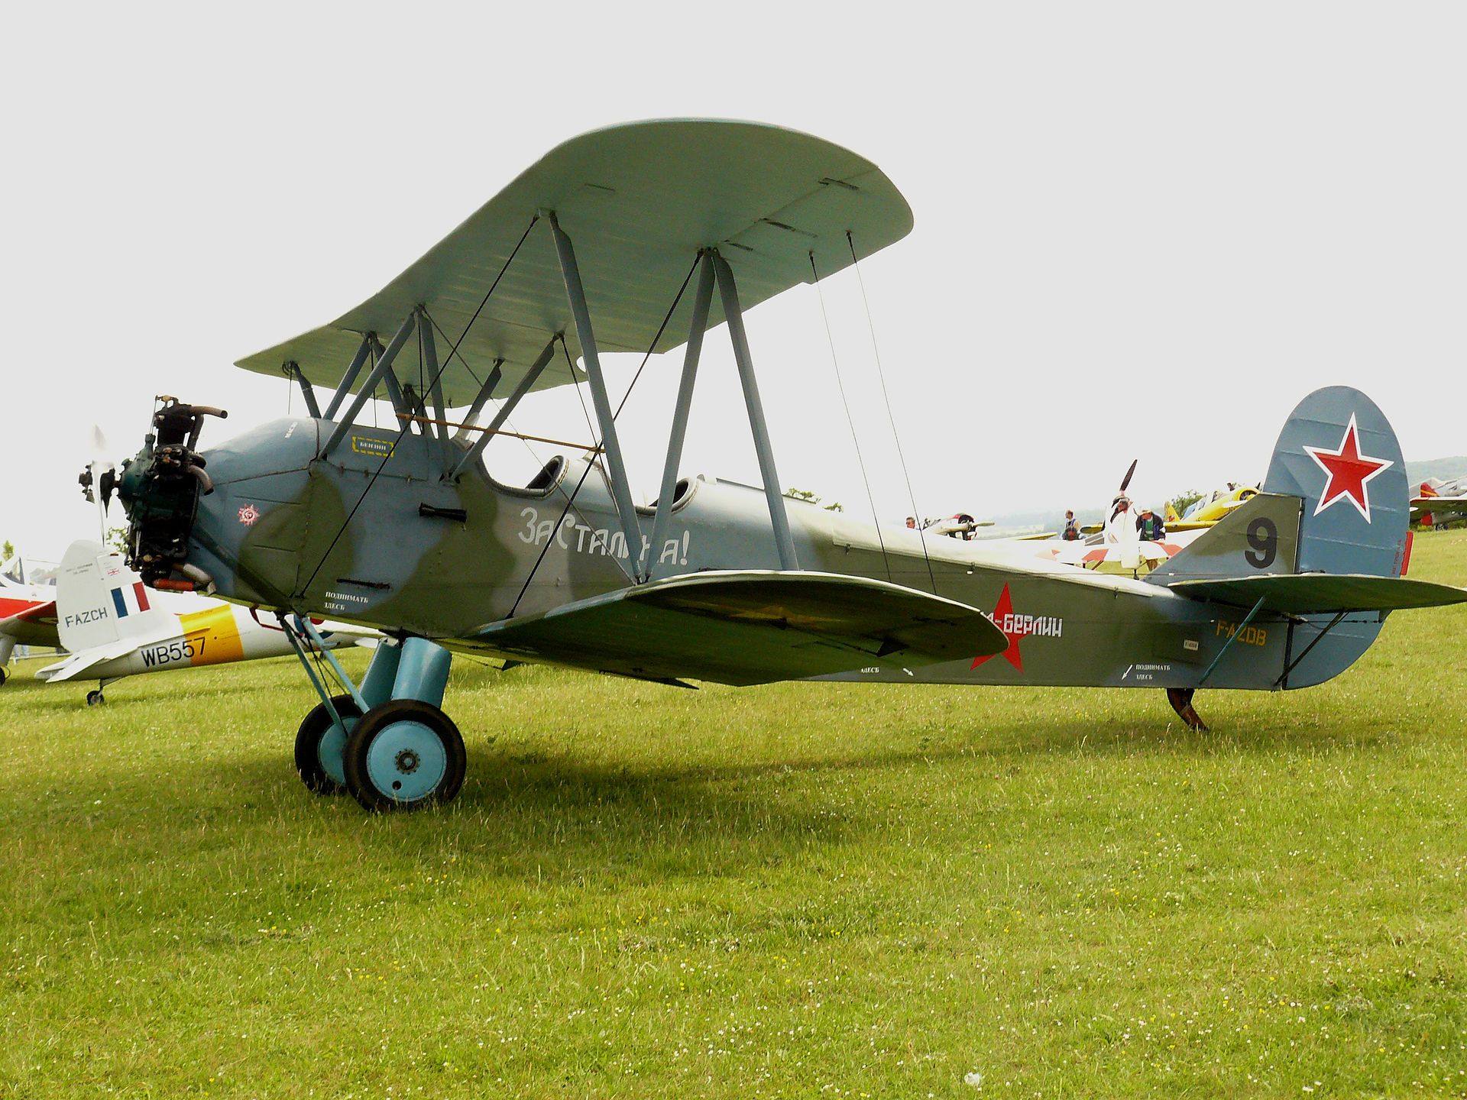
Right: the Polikarpov U-2 biplane, wood and canvas
Left: the Messerschmitt Me 109, all metal, enclosed cockpit, retractable landing gear, etc. (Bundesarchiv photo, 1943)

Slide 21
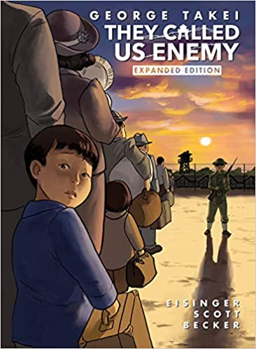
What surprised you (if anyting did) in Takei’s memoir? (pronounced: “T-kay”, rhymes with “hey”)
How does the incarceration of Japanese Americans in the US fit into the broader history of camps? (continuity – discontinuity?)

