Slide 1
Camps, Part II (The Holocaust) HSTCMP202 Fall 2021

Slide 2
Mass killing of Soviet POWS by Germans and their allies, 1941-5 Deportation Ghettos Einsatzgruppen – “special squads” – Nazi mobile death squads that carry out mass shooting (they are part of the SS) Babi Yar (in today’s Ukraine; then in the occupied Soviet Union) Killing centers T-4 program Auschwitz-Birkenau POW (prisoner of war) – not a civilian, but entitled to basic protection? The concentration camps system/forced labor as an giant network of camps inter-related with ghettos, mass shooting, and the five killing centers Stutthof (a concentration camp near Danzig, today in Poland)
The Holocaust
Discussion of Takei
Holocaust mini lecture – stages of genocide
Interlocking networks of different kinds of “camps”
Interlocking phases of killing, with varying victim groups
3. Discussion of Hinda Kibort’s oral history
4. Discussion of America and the Holocaust

Slide 3
What surprised you (if anyting did) in Takei’s memoir? (pronounced: “T-kay”, rhymes with “hey”)
How does the incarceration of Japanese Americans in the US fit into the broader history of camps? (continuity – discontinuity?)

Slide 4
Murder was illegal in this period in all of the countries involved, including in Germany.

Slide 5
Networks of “camps” part I, the “concentration camps”

Slide 7
Prisoners at Dachau, a concentration camp built in 1933 near Munich, circa 1933. (GHI)

Slide 8
Forced labor under guard at Oranienburg concentration camp, April 1933 (GHI)

Slide 9
Interlocking networks of “camps,” part II, the killing centers that were part of the T-4 program (targeted “Aryan” German citizens with disabilities)
Concurrent:
Victims groups, 1
Disabled German citizens (we estimate between 100,000 and 200,000 people), 1939-45

Slide 11
Interlocking system of “camps,” part III – 1941 and after,
Killing centers plus ghettos plus mass shootings (not in camps) – a widening, even more violent genocide

Slide 12
“Jewish residential area – entry forbidden.” Entrance to the Lodz ghetto. This is a German postcard. (ushmm)

Slide 13
USHMM: People being deported to their deaths from the Lodz Ghetto during the final liquidation of that ghetto, in summer 1944. The guards are regular German army soldiers

Slide 15
A portion of the camp network during the war.

Slide 16
Just Dachau subcamps, ‘38-’45

Slide 17
Victim groups, 2
Soviet POWs, 1941 and 1942 especially
2-3 million people, mass shootings (many in concentration camps), murdered by starvation, exposure, disease in camps (POW camps for the most part)

Slide 18
“The war against Russia will be such that it cannot be conducted in a knightly fashion; the struggle is one of ideologies and racial differences and will have to be conducted with unprecedented, unmerciful and unrelenting harshness … German soldiers guilty of breaking international law … will be excused. Russia has not participated in the Hague Convention and therefore has no rights under it.”
(Hitler, 30 March 1941, speech to his generals. Quoted in John Keegan, The Second World War (New York: Penguin, 1989), 186.

Slide 19
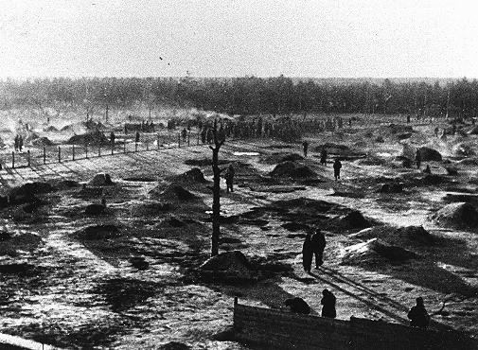
Camp for Soviet POWs, south of Hamburg, at Wietzendorf, Germany, 1941-2. Images shows holes the Red Army soldiers dug for shelter. (USHMM)

Slide 20
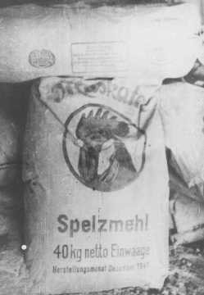
“Rations” for Soviet POWs – this is “substitute” flour, wood flour (finely powered wood/sawdust) that the Germans at a camp in occupied Poland used to make “bread” that was the ration for POWs, officially the Soviet POWS got less than five ounces a day of this. 1942 or ‘43 (USHMM)

Slide 21
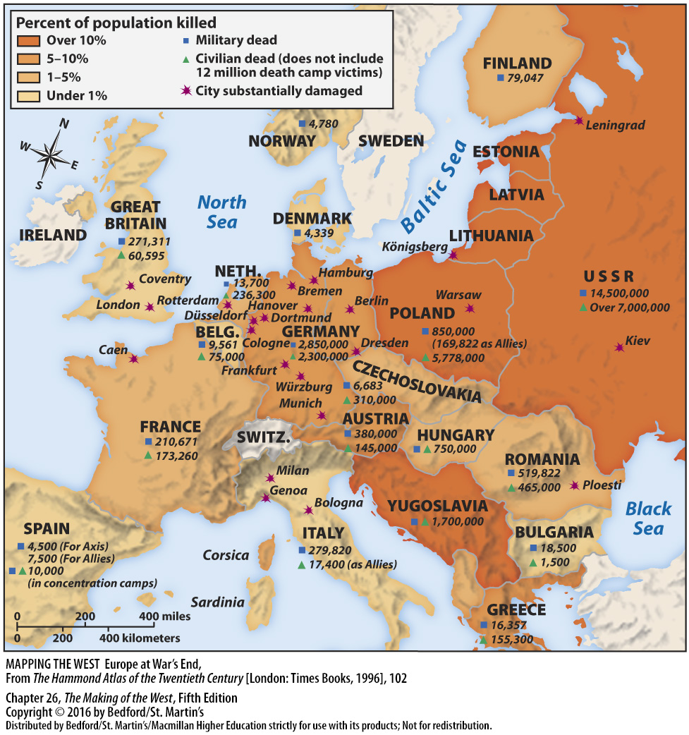

Slide 22
Victim groups, 3
European Jews, total of about 6 million people

Slide 23
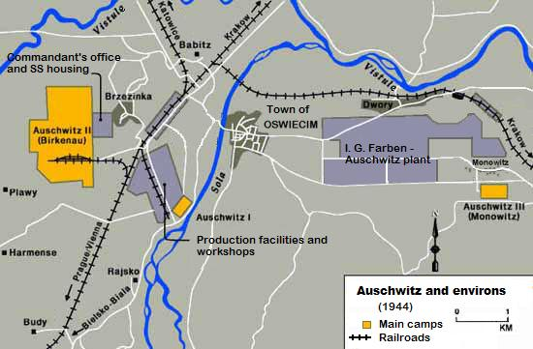
Map of the Auschwitz camp in 1944 (ushmm)
Note Auschwitz II/Birkenau, the killing/labor facility (left), the IG Farben plant (right), and Auschwitz I, the original labor/concentration camp (middle).

Slide 24
Recent remote-controlled small aircraft footage of the site:
http://www.huffingtonpost.com/2015/01/29/auschwitz-drone_n_6574130.html

Slide 25
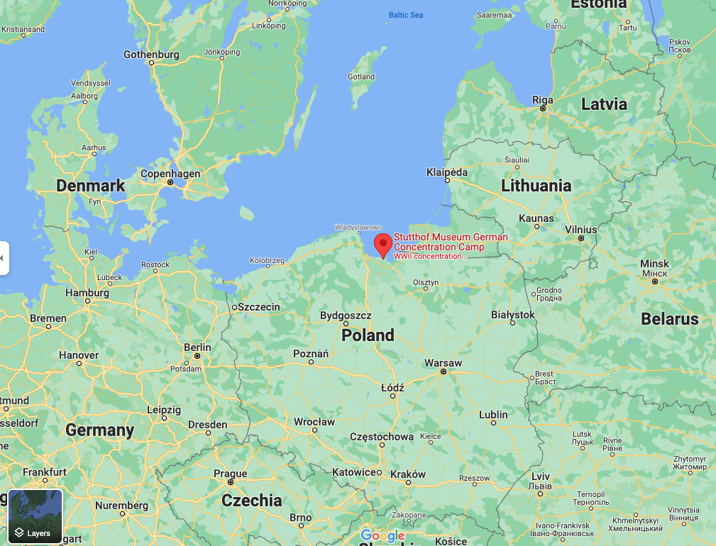
Hinda Kibort’s oral history
Watch her give a much longer talk about the Holocaust in 1982, at the USHMM website:
https://collections.ushmm.org/search/catalog/irn512455

Slide 26
Hinda Kibort’s oral history
Susan Glenn’s lecture
What surprised you (if anything)?
What do you think is important in these sources (one a primary source, the other a secondary source) in terms of the themes in our class?

