Slide 1
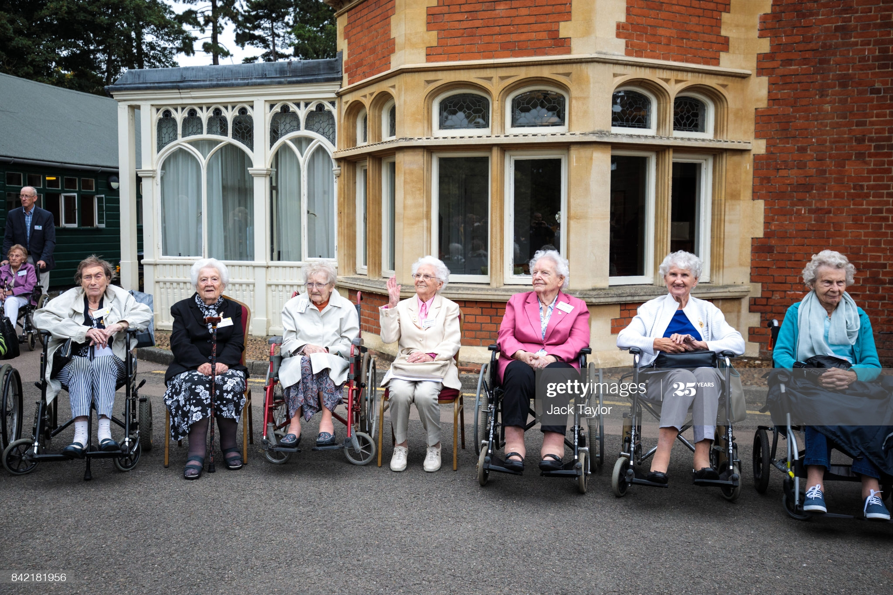
The Tech of World War II: The Computer, the B-29 long-range bomber, and the atomic bomb HSTCMP 202
2017 Bletchley Park reunion. The photographer’s caption reads in part: “World War II veterans who worked at Bletchley Park and its outstations gather for a group picture in front of Bletchley Park Mansion ... (Photo by Jack Taylor/Getty Images)”

Slide 2
Did technology change the course of the war? Or did the war change the course of technology?
The computer & code breaking – code breaking happened mostly without it.
Strategic bombing, the B-29 bomber, and the atomic bomb
Signals intelligence
Bletchley Park (UK)
Enigma machine
Richard Sorge
Alan Turing
Colossus

Slide 3
Human intelligence (spies) versus signals intelligence ( which“is concerned with the interception, decryption and interpretation of the enemy’s secure messages, however transmitted, and the protection of one’s own from interception.” (Keegan, The Second World War, 497))

Slide 4
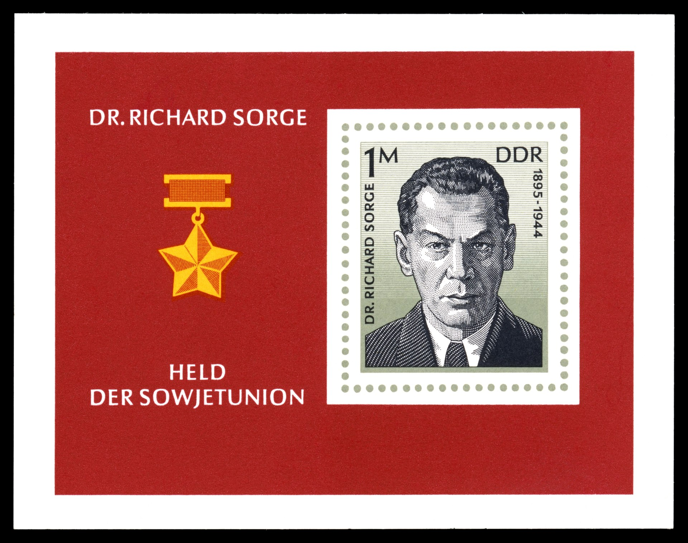
East German postage stamp, 1976, commemorating Sorge, Hero of the Soviet Union (East Germany was a communist country, it existed from 1945 to 1989)

Slide 5
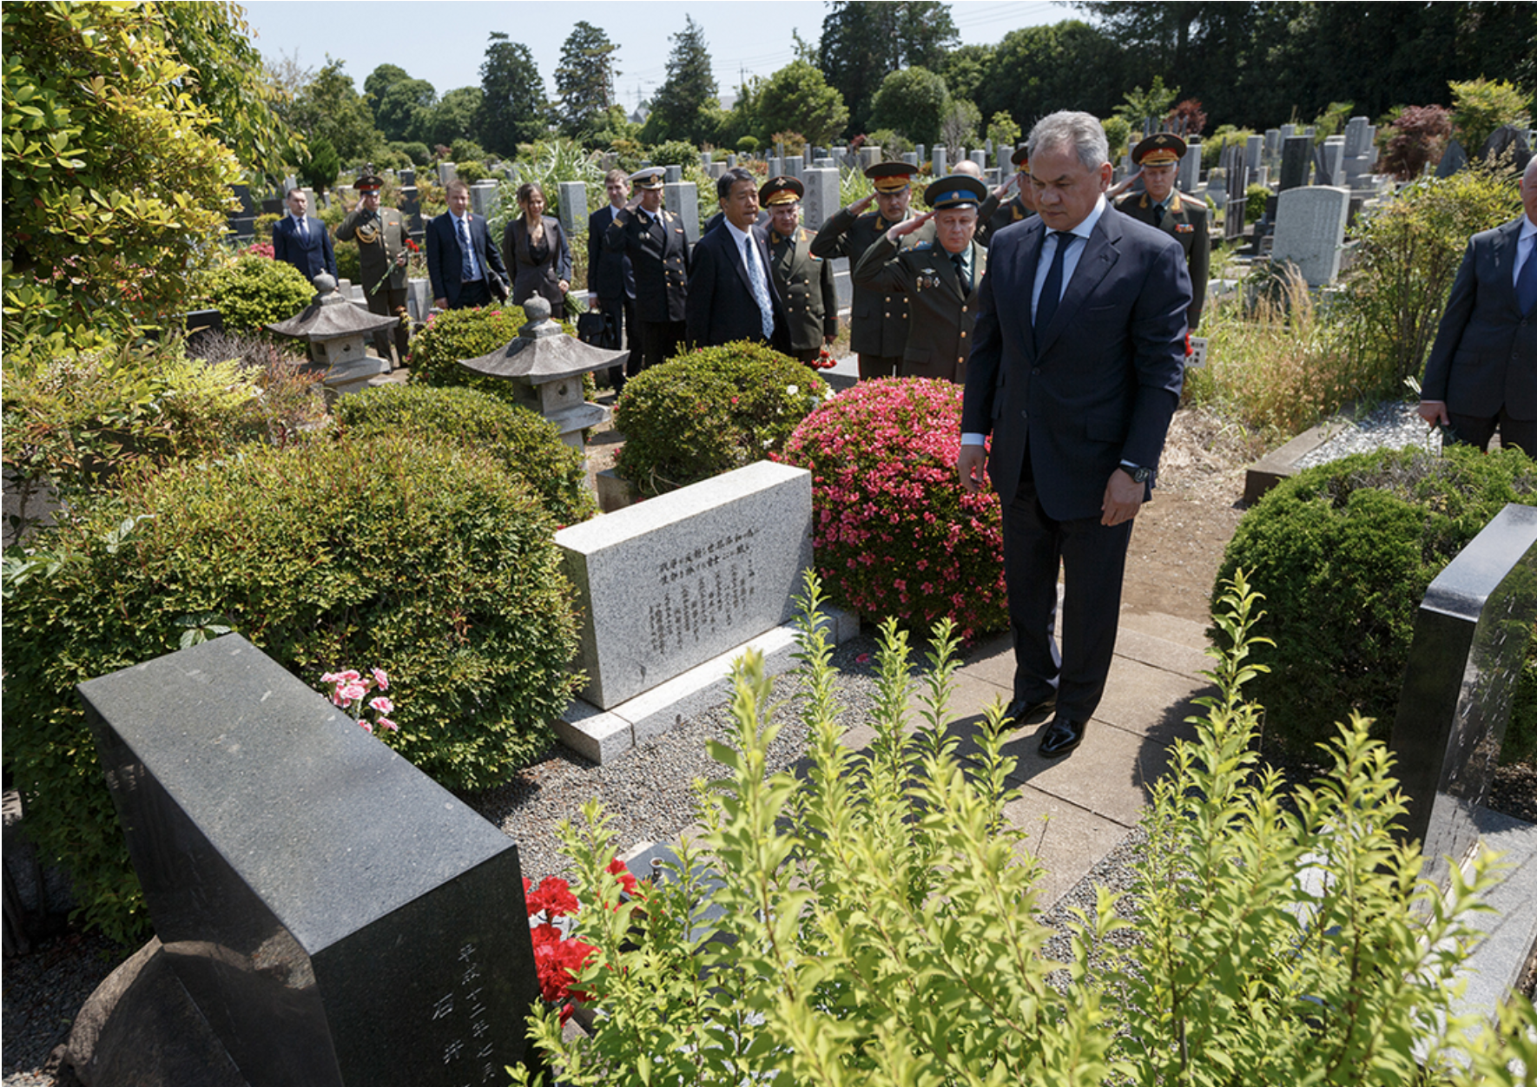
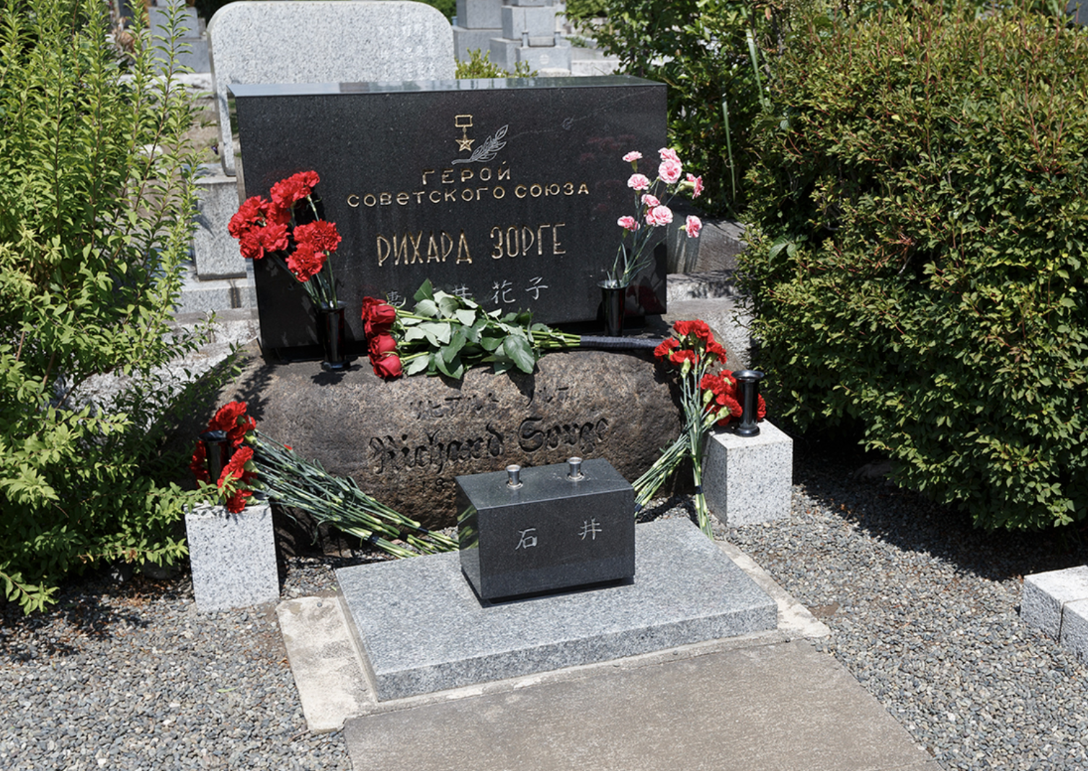
Russian Federation Minister of Defense Sergei Shoigu laying flowers at the grave of Richard Sorge in Tokyo, 2019.
(Source: Russian Federation Ministery of Defense English-language news website.)

Slide 6
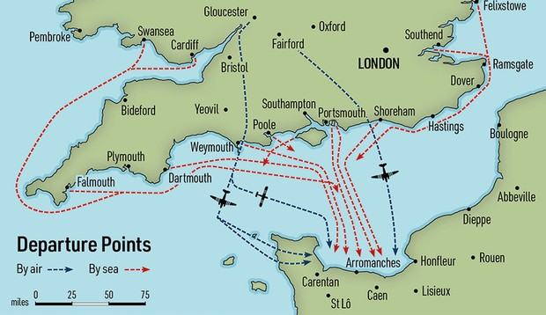
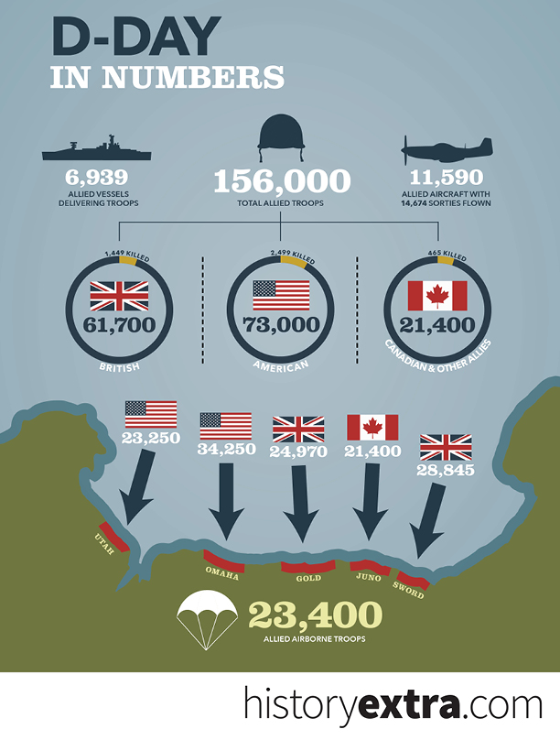
The 1944 Normandy Invasion (Allied invasion of France) (courtesy historyextra.com)

Slide 7
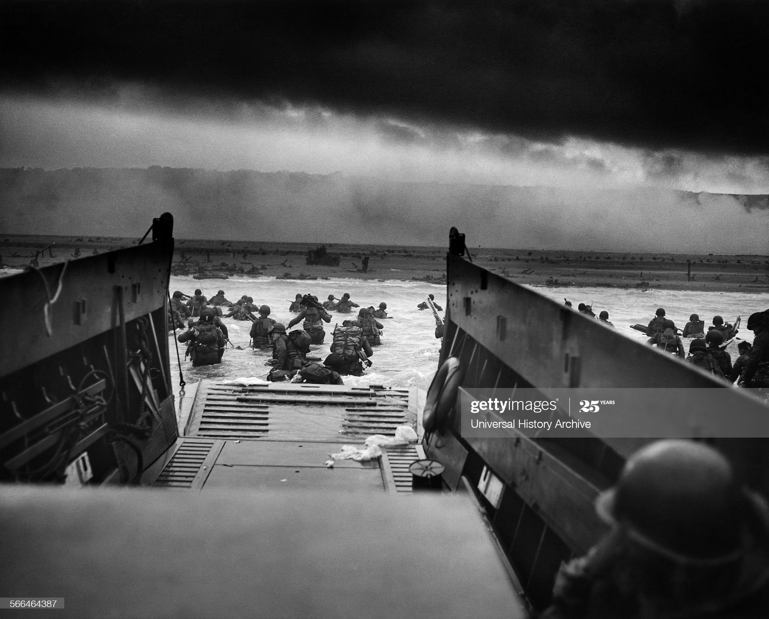
Americans landing at Omaha Beach, D-Day, June 6, 1944. (Getty)

Slide 8
A computer is an electronic machine that does arithmetic or logic –it applies either math or logic rules to sets of inputs – and does that thanks to electricity, and also thanks to a ‘program,’ a set of instructions that a human gives it ahead of time.

Slide 9
Codes – you swap in arbitrary symbols—typically, letters or numbers—for the components of the original message.
Ciphers – you use algorithms to transform a message into an apparently random string of characters.
An algorithm is a process or set of rules. You take a message, you apply a set or rules or process, your message is transformed into a new string of characters.
** in this lecture, I’ll probably often say “code” when I really mean “cipher”

Slide 10
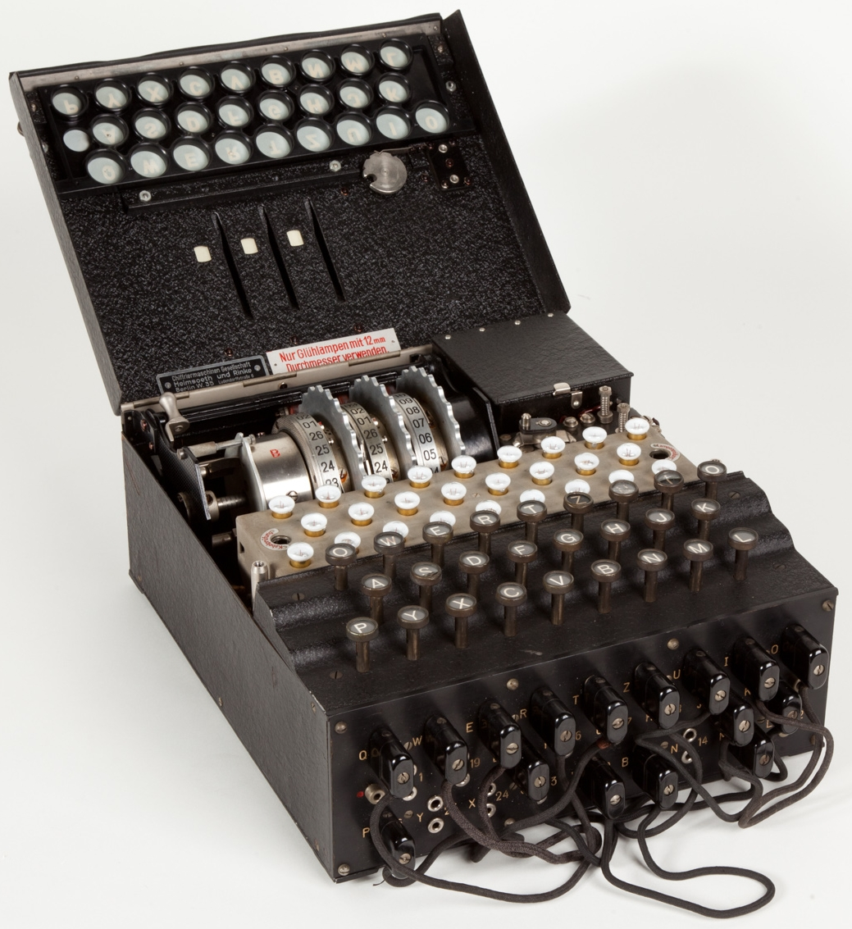
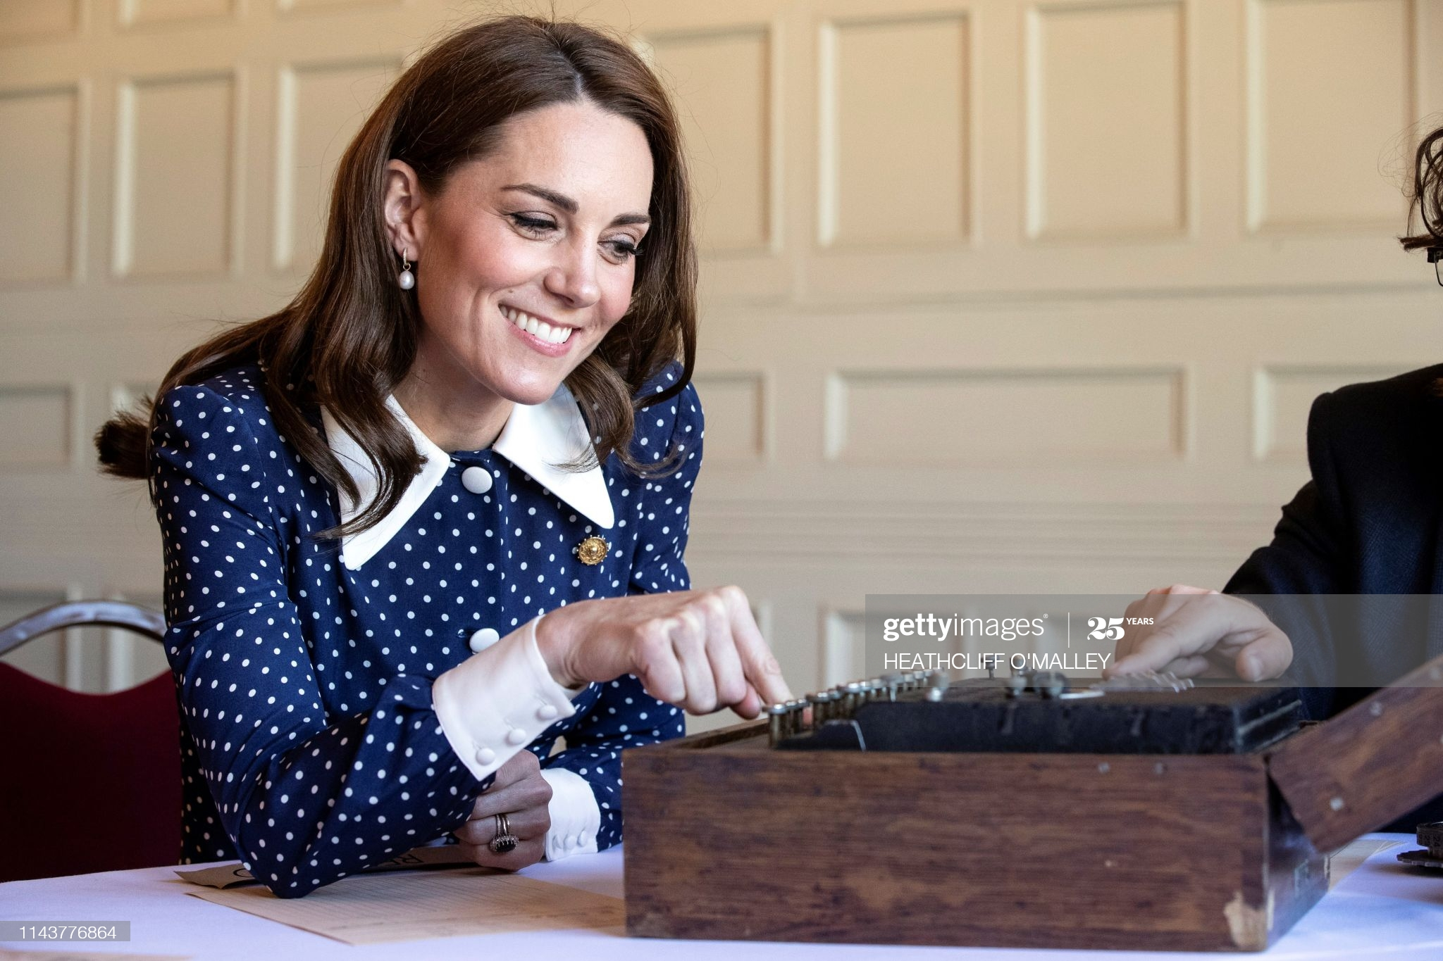
(Left) Catherine Duchess of Cambridge with an Enigma cipher machine at the museum at Bletchley Park, northwest of London, 14 May 2019 (Heathcliff O’Malley/AFP via Getty Images)
(Right) an Enigma machine, Museo scienza e tecnologia Milano, Italy (via Wikimedia)

Slide 11
Courtesy enigmamuseum.com

Slide 12
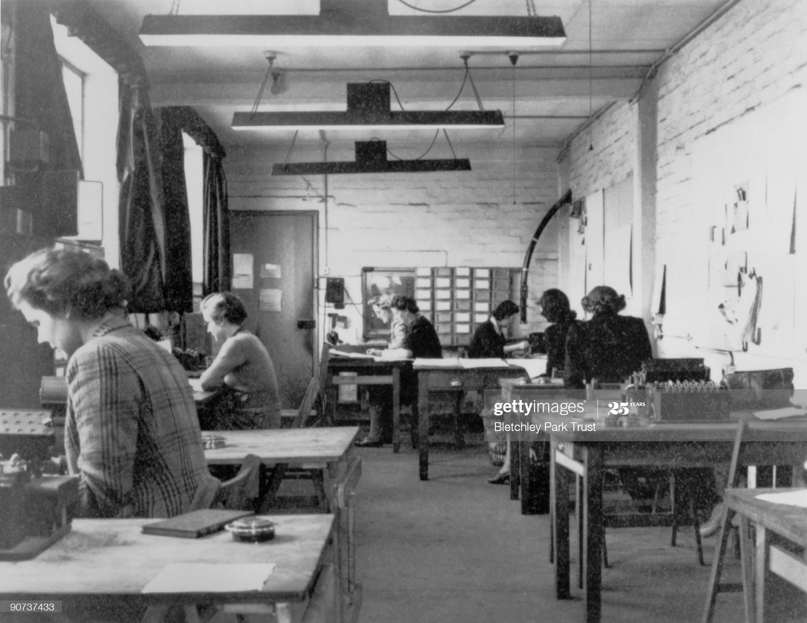
Cryptographers at work, Hut 6, Bletchley Park, October 1943. (Getty)

Slide 13
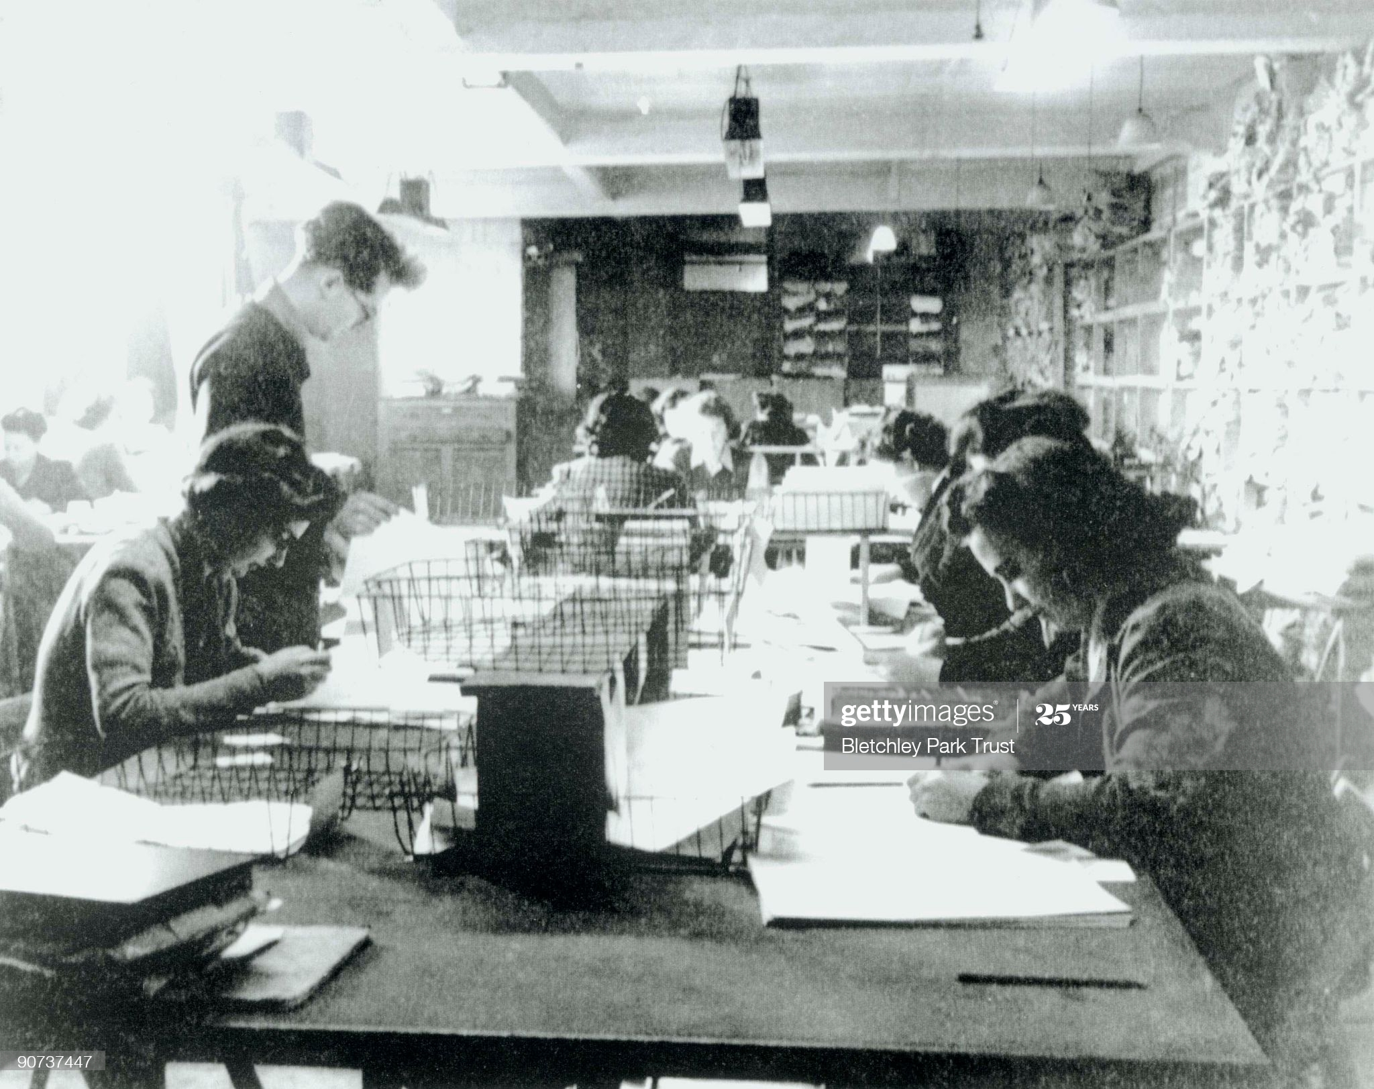
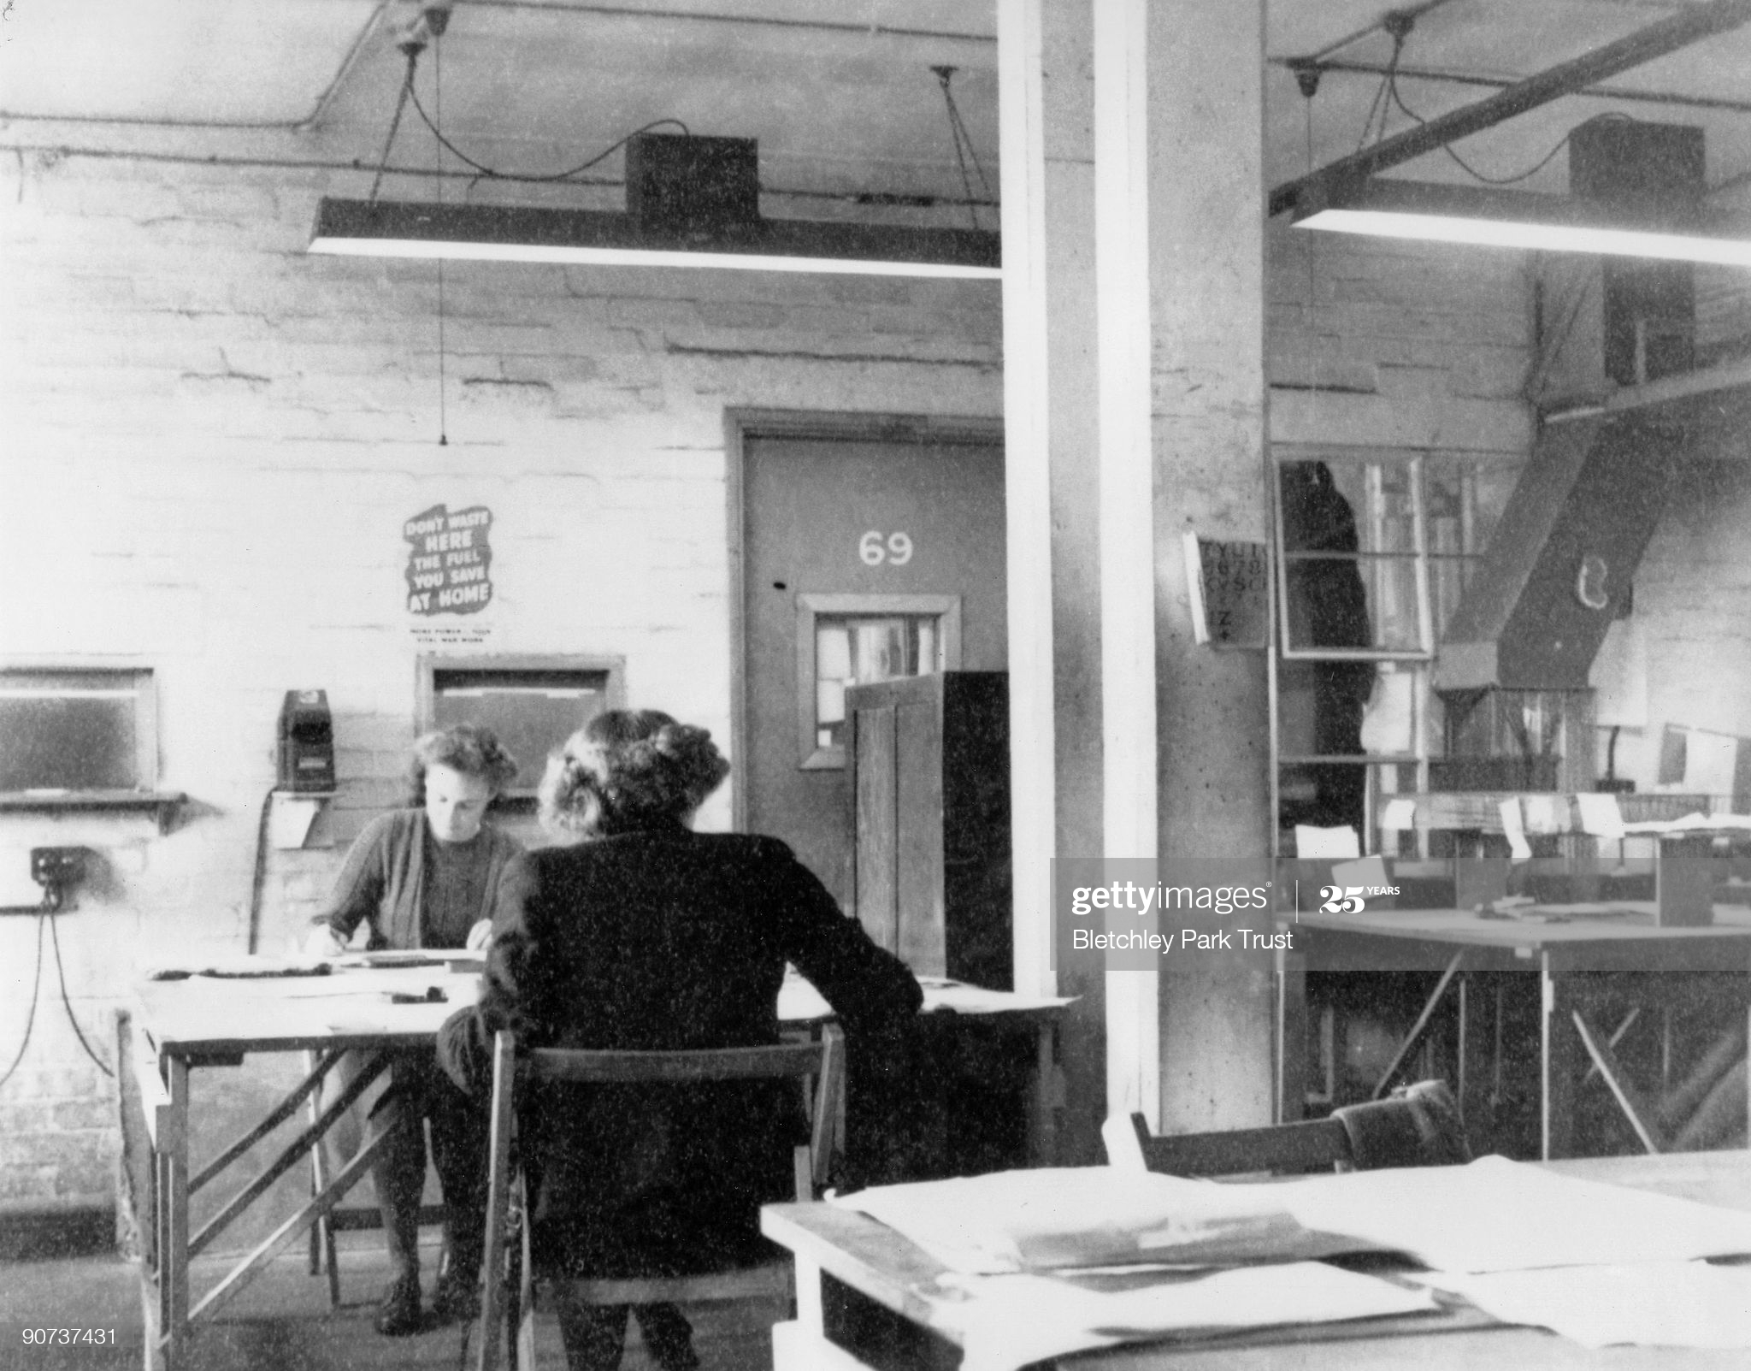
Hut 6 registration room, Bletchley Park, October, 1943. (Getty)
Hut 3 priority team, Bletchley Park, at work. October, 1943. (Getty)

Slide 14
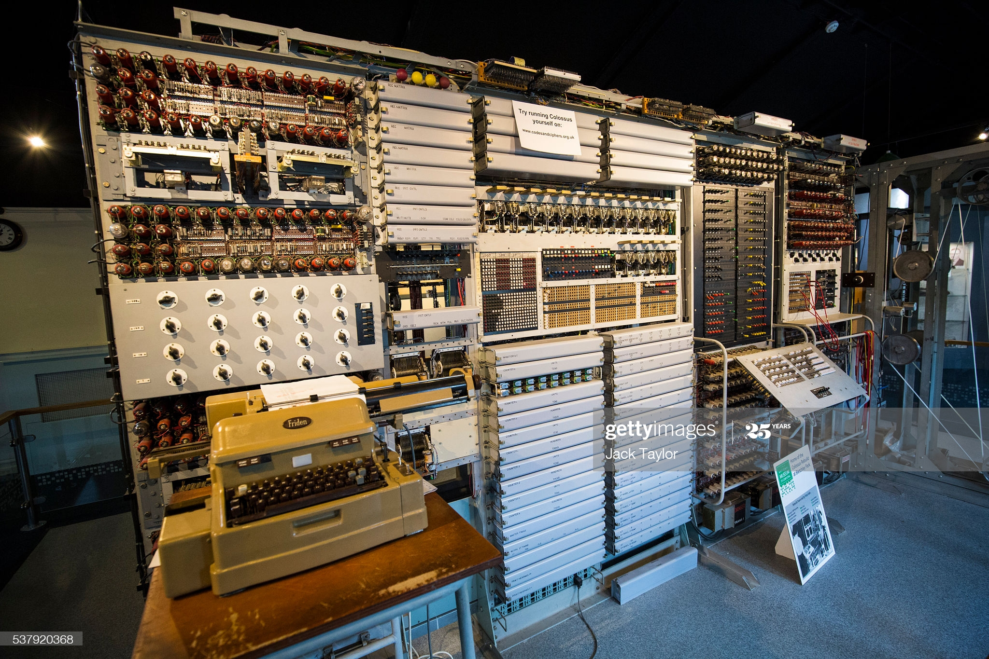
The rebuilt Colossus computer, first programmable electronic computer (Jack Taylor/Getty)

Slide 15
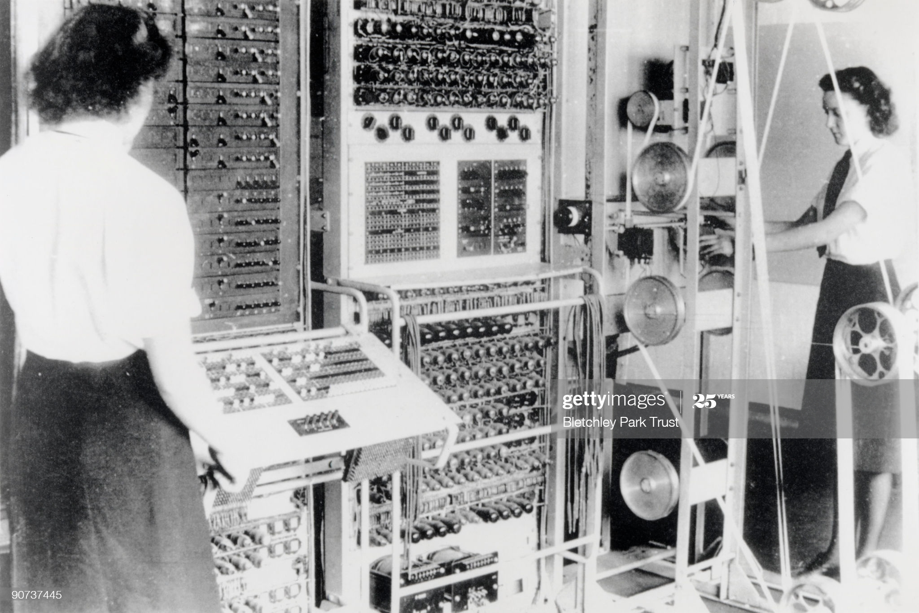
WRNS (Women’s Royal Naval Service) a women’s auxiliary (technically civilians) operating Colossus, 1943, at Bletchley Park.

Slide 16
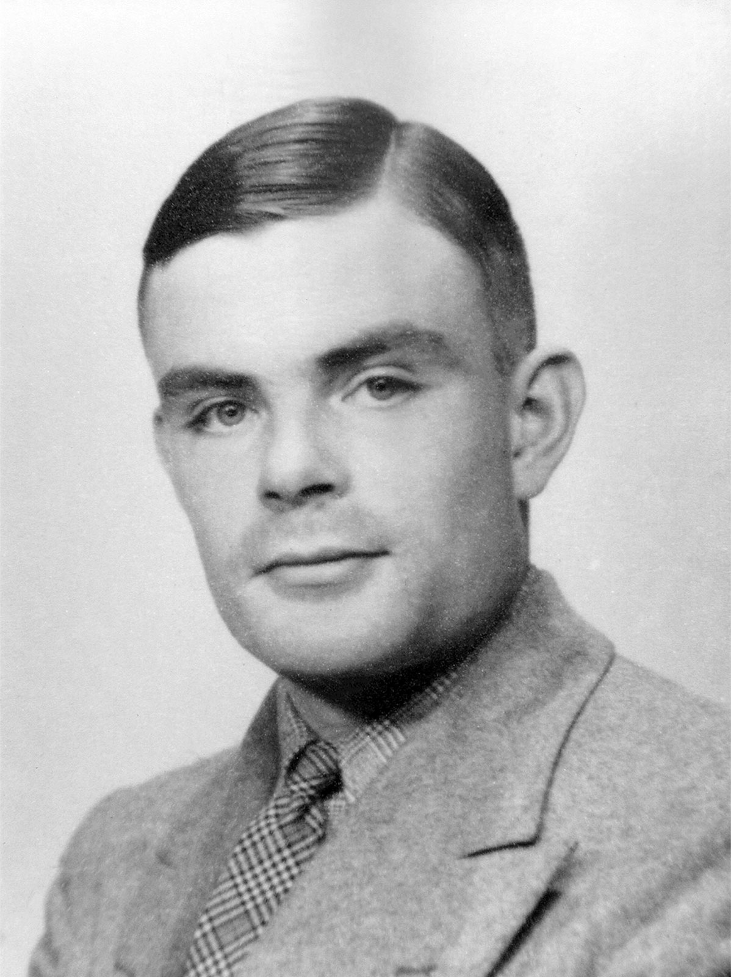
Alan Turing (Britannica)

Slide 17
Strategic bombing (distinguished form tactical bombing, which is air power in support of troops or naval operations) is air power on its own, not in conjunction with troops or naval operations, deployed against cities and industries with the dual purpose of damaging the enemy’s economy and civilian morale. Concept arises in WWI and is elaborated after WWI, before WWII. (Garon, “On the Transnational…,” 240)

Slide 18
1921, Giulio Douhet, Italian, former air corps officer, The Command of the Air, writes: WWI created a new kind of war, a total one – “the entire population and all the resources of a nation are sucked into the maw of war.” Air power makes the battlefield everywhere, and “all of their citizens will become combatants, since all of them will be exposed to the aerial offensives of the enemy.” (quoted in Garon, “On the Transnational,” 240)

Slide 19
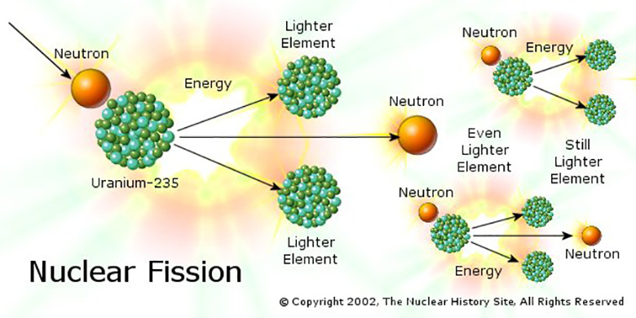
Nuclear fission and a chain reaction – fission is splitting the atom, by means of bombarding it with other particles – this is done by putting a lot of naturally unstable atoms next to one another – they emit particles that split neighboring atoms. What you get is a lot of particle emitting – splitting of atoms – this is called a chain reaction. It gives off energy in the form of light and heat. If the chain reaction is kept small-scale – that is, if you don’t let the atoms really get shaking in there and splitting like crazy – you can have a nuclear reactor for energy. Like, make electricity! But if you let the reaction get going you can have a nuclear bomb.
Source of image.

Slide 20
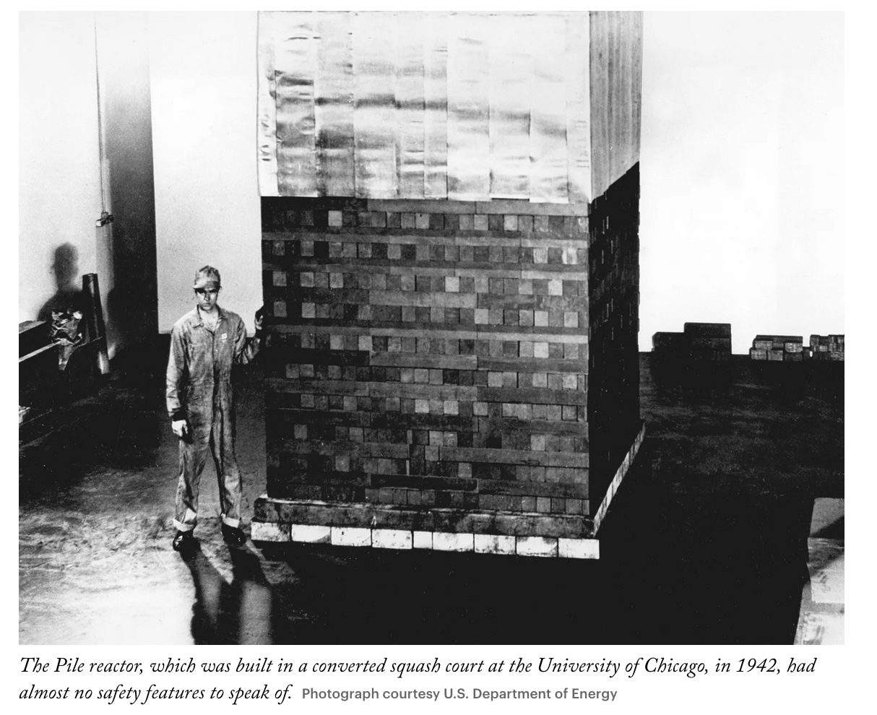
The first people-made chain reactions were pretty darn low-tech, by our standards. In a nutshell: enrich uranium to get an unstable isotope, squish it together surrounded by graphite – chain reaction.
The first “pile” (later, reactor) was built and successfully activated 1942, the University of Chicago pile, pictured here, via The New Yorker.

Slide 21
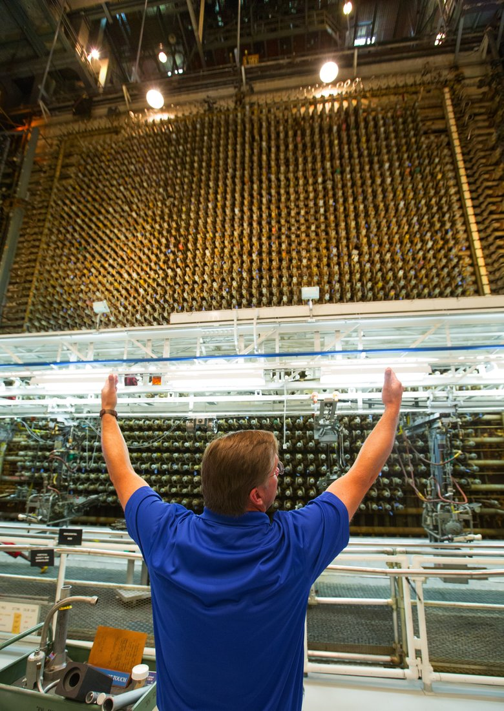
The Manhattan Project, an enormous government program that cost 2 billion dollars and employed 125,000 people at several giant facilities scattered across the U.S., included an elaborate plant at Hanford, WA for making plutonium
The Hanford site, which after ‘45 was used for Cold War nuclear weapons production quickly became the home of lots of dangerous toxic material and is to this day.
Hanford B reactor, pictured in 2015, Seattle Times : ‘Hanford B Reactor Facility manager Kevin Haggerty explains in October the reactor’s front face containing 2004 processing tubes that were loaded with uranium fuel. ”

Slide 22
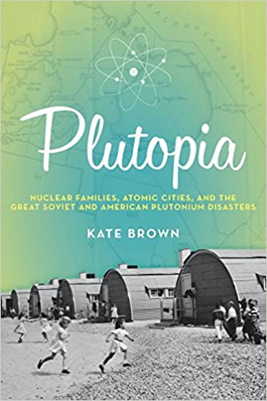
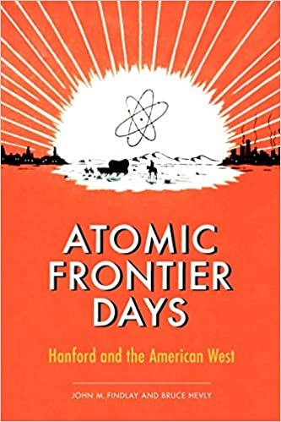
Further reading -- books on Hanford by UW faculty and students!

Slide 23
A recent photo of the Enola Gay at the Smithsonian Air and Space Museum, Udvar-Hazy center, Northern Virginia (near Dulles Airport) (Smithsonian)

Slide 24
death tolls
Hiroshima atomic bombing … 70,000 people right away, an additional 30,000 by the end of 1945
Nagasaki atomic bombing … killed between 35,000 and 40,000 immediately
Tokyo fire bombing … 80,000 to 100,000 killed
Dresden (Germany) fire bombing … 25,000 to 35,000 (estimated)
(source: Britannica)

Slide 25
Truman diary, July 25, 1945
We have discovered the most terrible bomb in the history of the world. It may be the fire destruction prophesied in the Euphrates Valley Era, after Noah and his fabulous Ark.
Anyway we "think" we have found the way to cause a disintegration of the atom. An experiment in the New Mexico desert was startling - to put it mildly. Thirteen pounds of the explosive caused the complete disintegration of a steel tower 60 feet high, created a crater 6 feet deep and 1,200 feet in diameter, knocked over a steel tower 1/2 mile away and knocked men down 10,000 yards away. The explosion was visible for more than 200 miles and audible for 40 miles and more.
This weapon is to be used against Japan between now and August 10th. I have told the Sec. of War, Mr. Stimson, to use it so that military objectives and soldiers and sailors are the target and not women and children. Even if the Japs are savages, ruthless, merciless and fanatic, we as the leader of the world for the common welfare cannot drop that terrible bomb on the old capital or the new.
He and I are in accord. The target will be a purely military one and we will issue a warning statement asking the Japs to surrender and save lives. I'm sure they will not do that, but we will have given them the chance. It is certainly a good thing for the world that Hitler's crowd or Stalin's did not discover this atomic bomb. It seems to be the most terrible thing ever discovered, but it can be made the most useful.

Slide 26
Using the readings (Garon and Kort) plus the Truman diary entry, make an argument about whether it was morally acceptable for the US to use atomic weapons against Japan in 1945.
Write no more than five sentences. You can break this down as you see fit -- you can distinguish ‘ethics’ from ‘military necessity,’ for example, you can argue one bomb was ethical and two were not, you can argue that Garon’s article makes this an even larger question that goes beyond abombs, etc. Have at it.

Slide 27
Using the readings (Garon and Kort) plus the Truman diary entry, make an argument about whether it was morally acceptable for the US to use atomic weapons against Japan in 1945.
Write no more than five sentences. You can break this down as you see fit -- you can distinguish ‘ethics’ from ‘military necessity,’ for example, you can argue one bomb was ethical and two were not, you can argue that Garon’s article makes this an even larger question that goes beyond abombs, etc. Have at it.
Truman diary, July 25, 1945
We have discovered the most terrible bomb in the history of the world. It may be the fire destruction prophesied in the Euphrates Valley Era, after Noah and his fabulous Ark.
Anyway we "think" we have found the way to cause a disintegration of the atom. An experiment in the New Mexico desert was startling - to put it mildly. Thirteen pounds of the explosive caused the complete disintegration of a steel tower 60 feet high, created a crater 6 feet deep and 1,200 feet in diameter, knocked over a steel tower 1/2 mile away and knocked men down 10,000 yards away. The explosion was visible for more than 200 miles and audible for 40 miles and more.
This weapon is to be used against Japan between now and August 10th. I have told the Sec. of War, Mr. Stimson, to use it so that military objectives and soldiers and sailors are the target and not women and children. Even if the Japs are savages, ruthless, merciless and fanatic, we as the leader of the world for the common welfare cannot drop that terrible bomb on the old capital or the new.
He and I are in accord. The target will be a purely military one and we will issue a warning statement asking the Japs to surrender and save lives. I'm sure they will not do that, but we will have given them the chance. It is certainly a good thing for the world that Hitler's crowd or Stalin's did not discover this atomic bomb. It seems to be the most terrible thing ever discovered, but it can be made the most useful.

