Slide 1
1945 and the World the Wars Made: The Cold War, War Crimes Trials and International Law, the UN, the EU, Decolonization HSTCMP 202

Slide 2
How did the two world wars change the world after 1945? Did humans learn anything or OMG are we still f-ed up?
Nuremburg Trials
The United Nations
The Cold War (international war!) and the nuclear arms race
Decolonization and the post-45 critique of racism
“Genocide,” coined by Raphael Lemkin, lawyer
Crimes against humanity
The Cold War (1945-1991 (?))
The Tokyo Trial (Tokyo War Crimes Trial)
The Nuremberg Trials
NATO (North American Treaty Organization) versus Warsaw Pact Nations (USSR-dominated)
The Berlin Wall (fell in 1989)
Crimes against humanity
Decolonization
The European Union (EU)
The United Nations

Slide 3
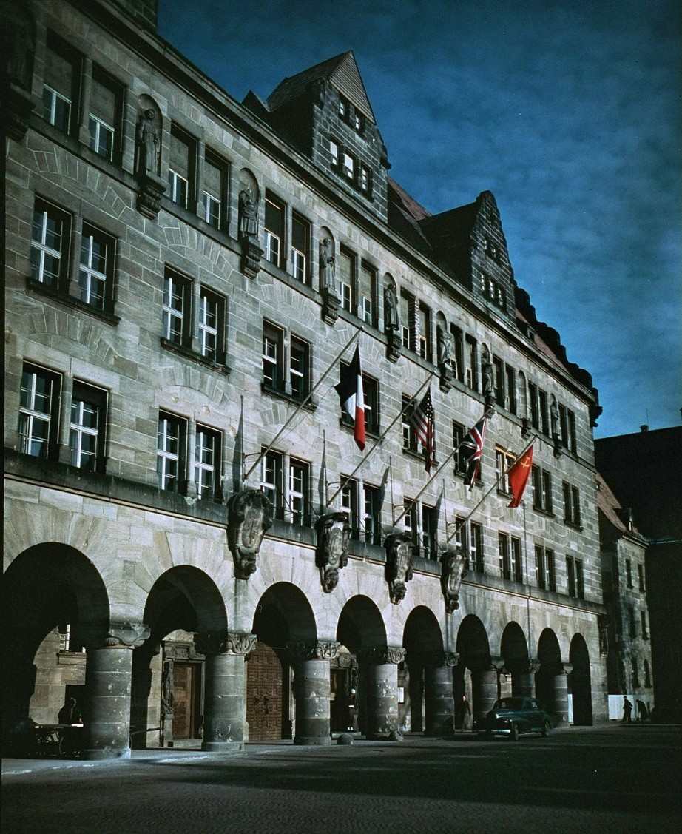
The Nuremberg court house (Palace of Justice) in 1945, with the four flags of the major Allied powers flying
International justice

Slide 4
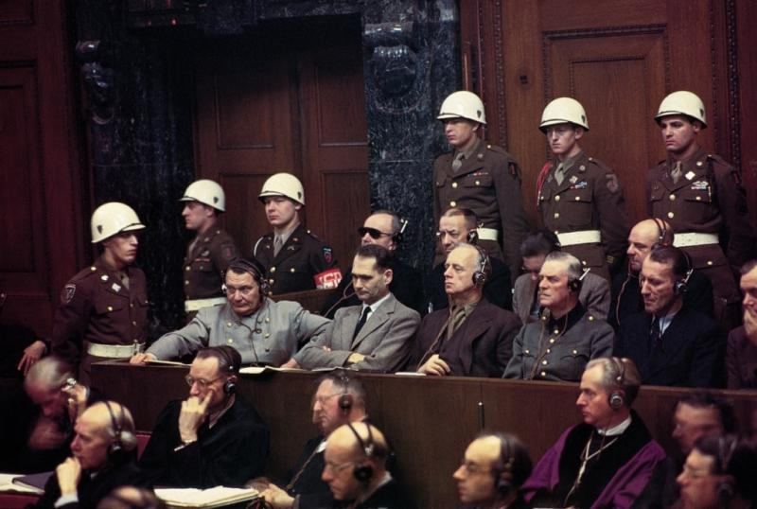
Some of the defendants in the first, “main” Nuremberg Trial (November 1945-January 1946), in the court room. First row, from left: Goering, Hess, Ribbentrop, Keitel, Kaltenbrunner and Rosenberg. Back row: Doenitz, Reaeder, von Schirach and Sauckel (UPI, source here.)

Slide 5
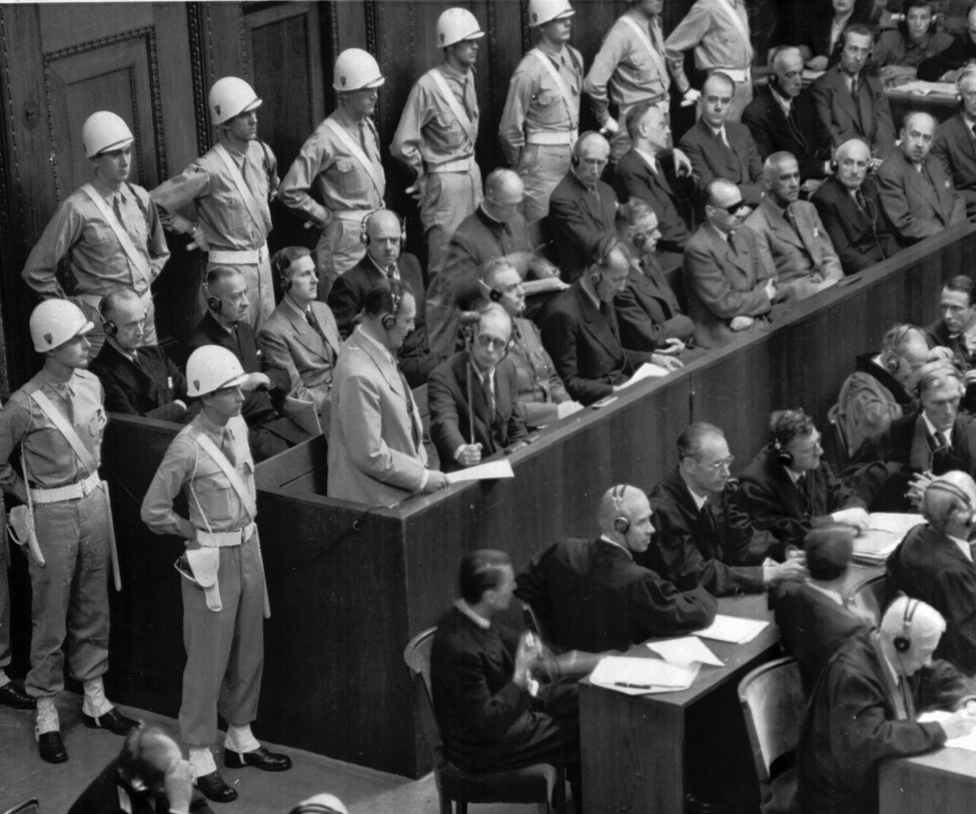
Goering making a statement at the Nuremberg Trial
(source)

Slide 6
The indictments:
(1) crimes against peace (i.e., the planning, initiating, and waging of wars of aggression in violation of international treaties and agreements), (2) crimes against humanity (i.e., exterminations, deportations, and genocide), (3) war crimes (violating the laws of war), and (4) conspiracy to do any of the 3 above.

Slide 7
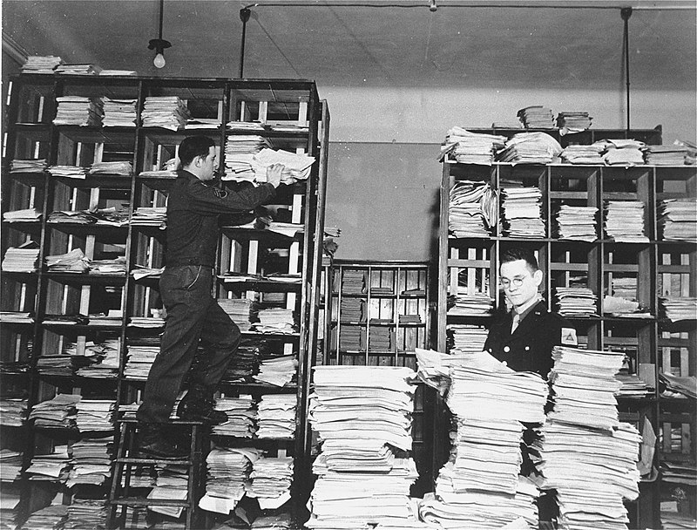
US Army clerks with evidence for the Nuremberg Trials (USHMM)

Slide 8
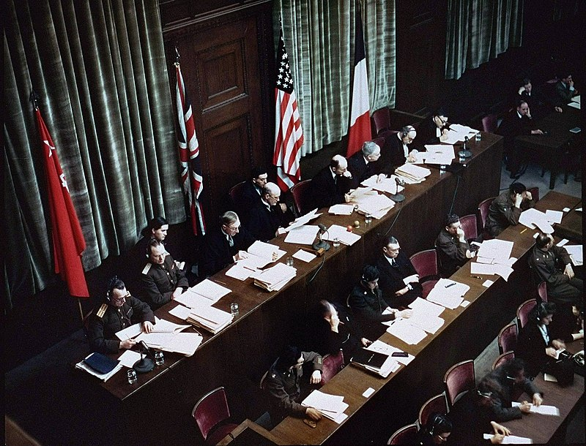
Judges at the first Nuremberg Trial (USHMM collection)

Slide 9
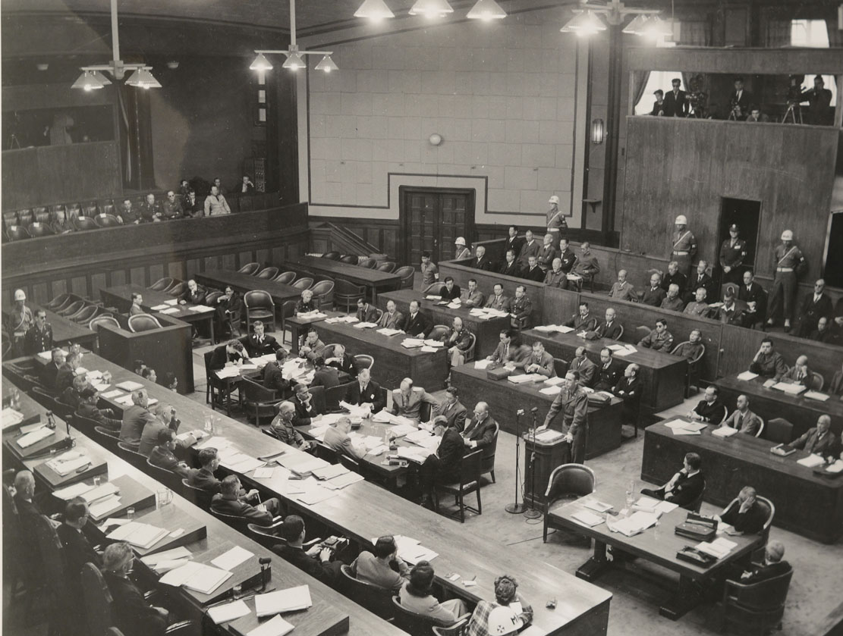
International Military Tribunal for the Far East (Tokyo Trial)

Slide 10
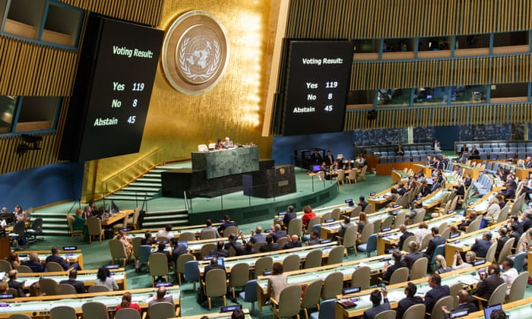
The United Nations General Assembly (Li Muzi/Xinhua Press/Corbis)

Slide 11
UN Charter 1945
The signatories “reaffirm faith in fundamental human rights, in the dignity and worth of the human person, in the equal rights of men and women.”
Article 1: the purpose of the UN is to “promot[e] and encourage[e] respect for human rights and for fundamental freedoms for all without distinction asto race, sex, language or religion.”

Slide 12
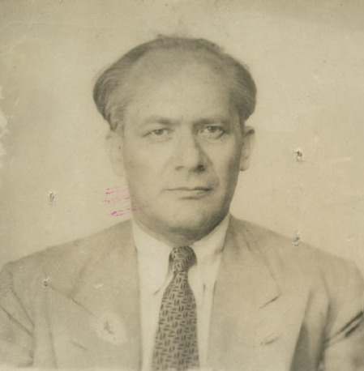
Undated photo of Lemkin, American Jewish Historical Society
“Genocide,” coined by Raphael Lemkin, Polish-American lawyer

Slide 13
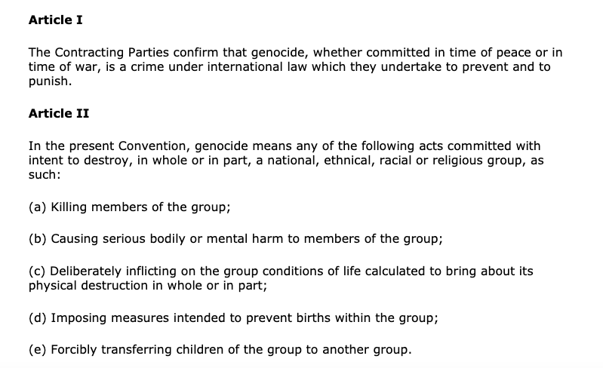

Slide 14
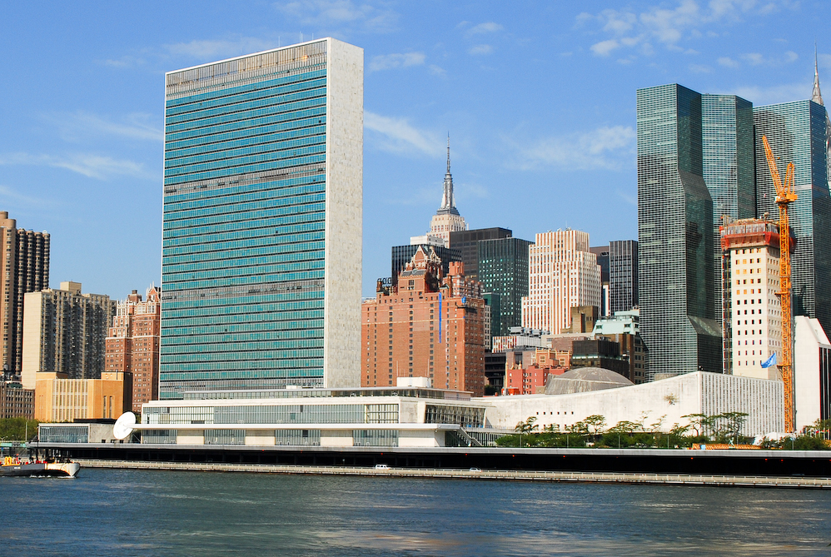
The United Nations headquarters building in New York City

Slide 15
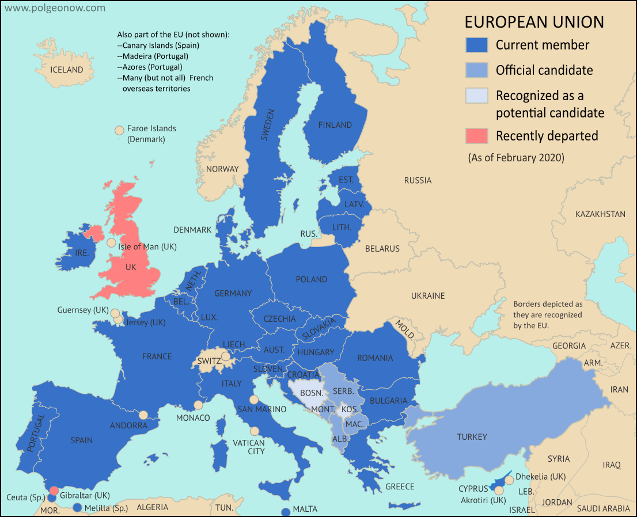
International Institutions – the European Union (EU), the UN, NATO
Map shows the EU as of Feb. 2020, except the UK had not officially departed as of Feb. 2020 but was in the process of negotiating to depart.

Slide 16
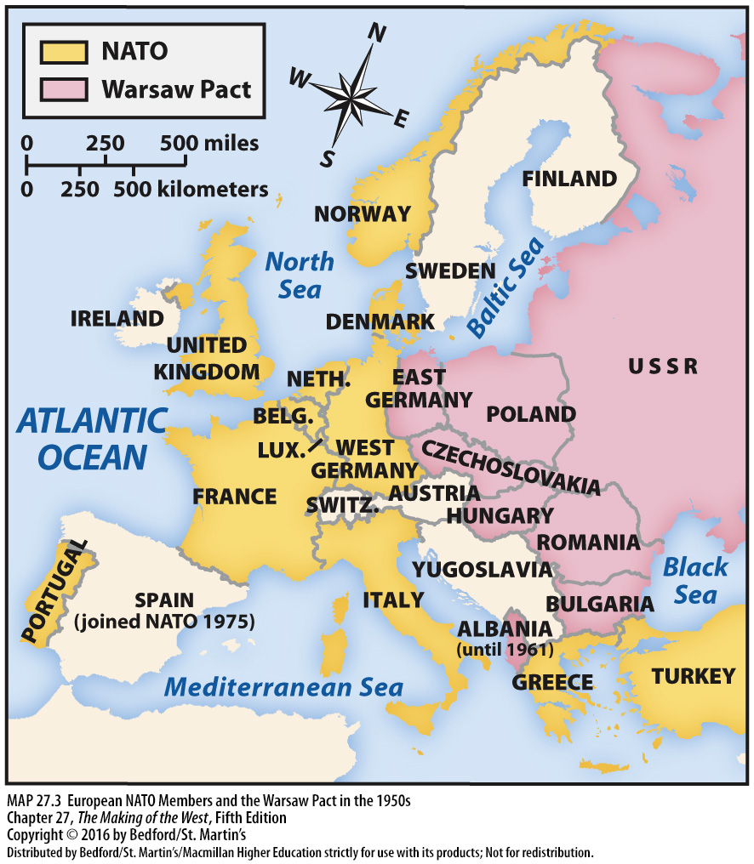

Slide 17
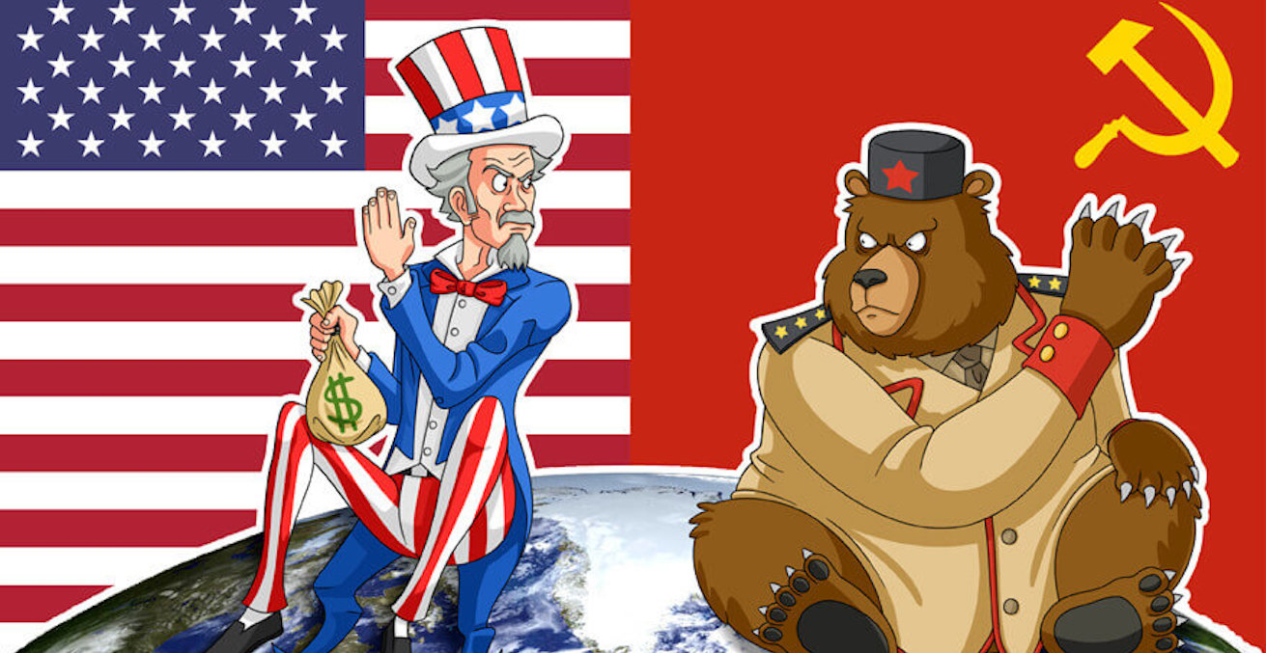
(image courtesy of Australian Institute of International Affairs)
The Cold War
(1945-1991)

Slide 18
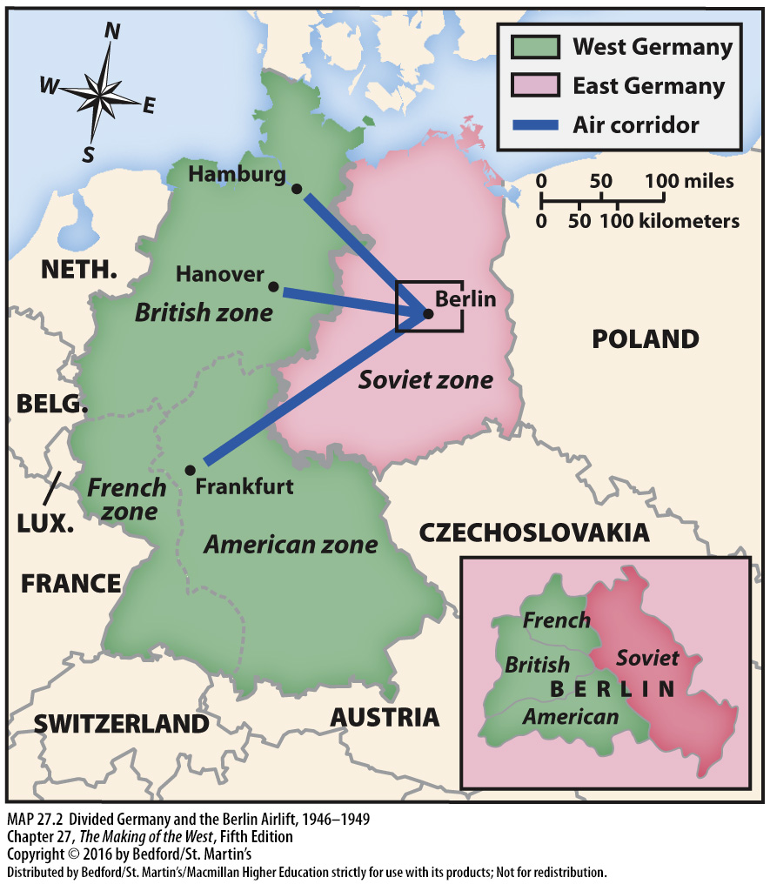

Slide 19
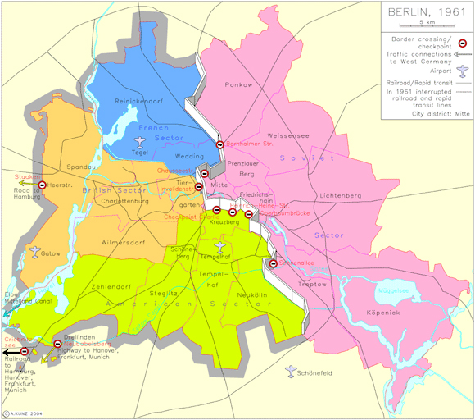
Berlin after the building of the wall in 1961

Slide 20
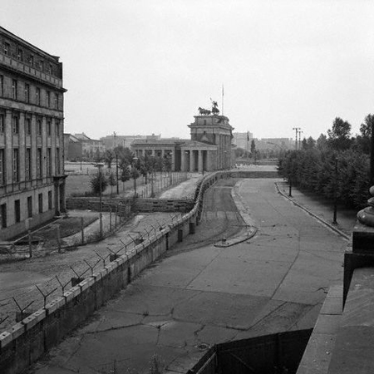
Berlin Wall – Brandenburg Gate visible (BBC)

Slide 21
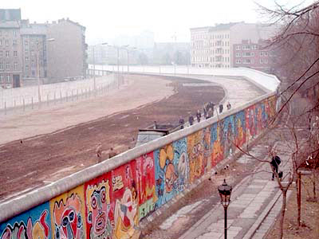
Graffiti on the western side of the wall, 1986, Berlin (Kreuzberg)

Slide 22
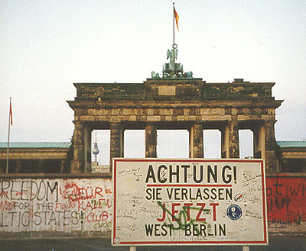
“Caution! You are now leaving West Berlin.”

Slide 25
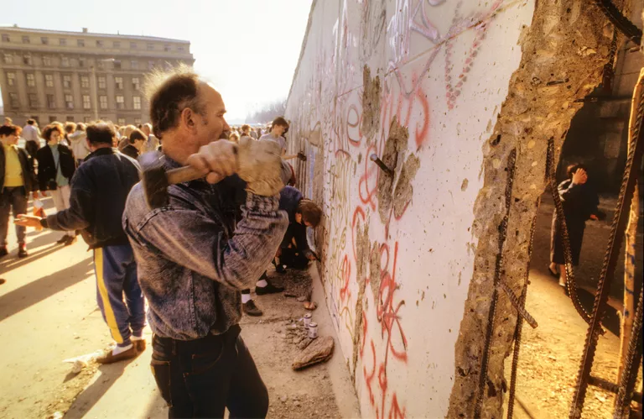
Luis Veiga/Getty Images

Slide 26
DECOLONIZATION (after ‘45)

Slide 27
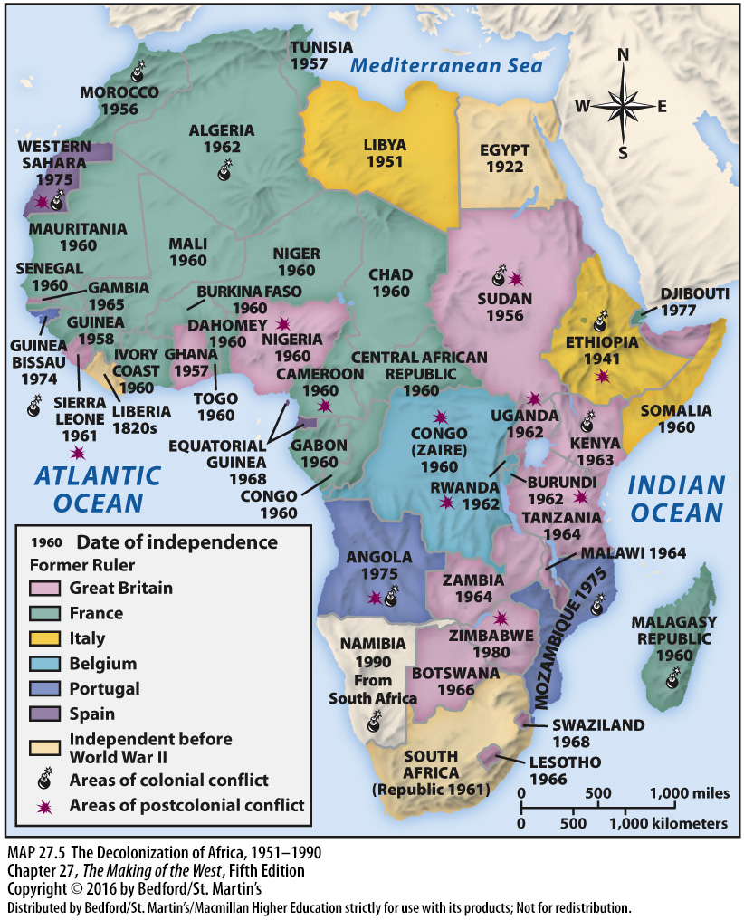

Slide 28
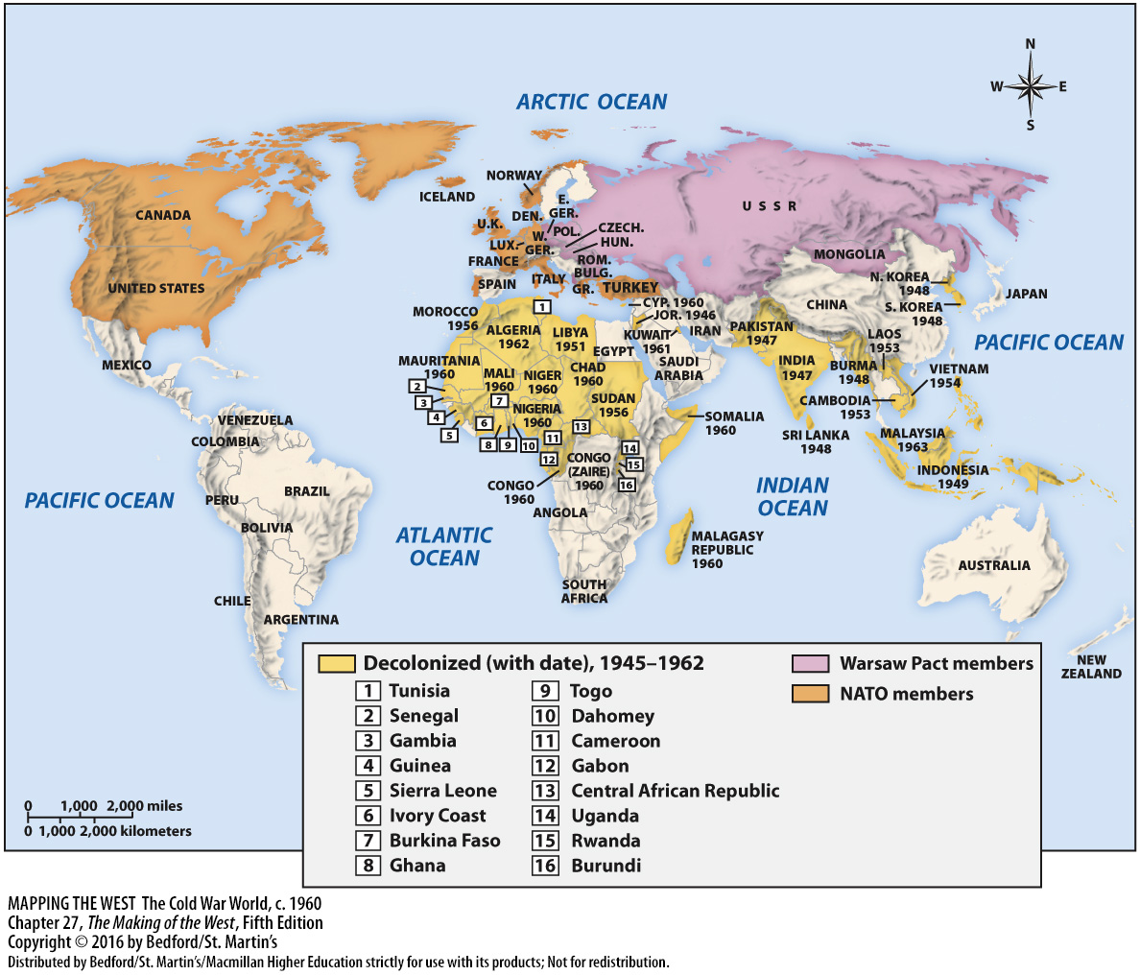

Slide 29
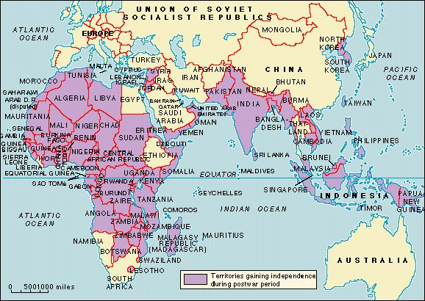
Decolonization, 1945 – present

Slide 30
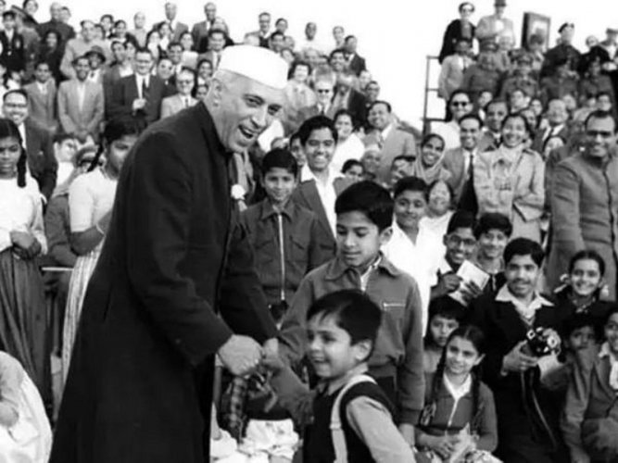
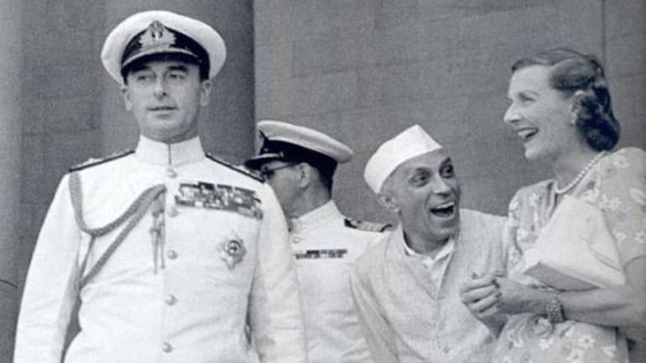
India independent of Great Britain, 1947
Left: Jawaharlal Nehru, center, laughing. He was later India’s first Prime Minister and a leader of the decolonization struggle there. He is pictured here with Louis and Edwina Mountbatten, who were married. Louis Mountbatten was the last head of the colonial British regime in India. Incredibly given the circumstances, Nehru and Edwina Mountbatten probably had a romantic relationship; both were married to other people (the Mountbattens quietly had an open marriage). Photo source and more info on the alleged affair: India Today
Right: Nehru at an event. Photo source here

Slide 31
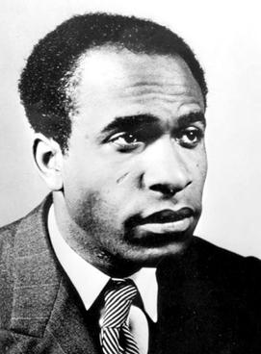
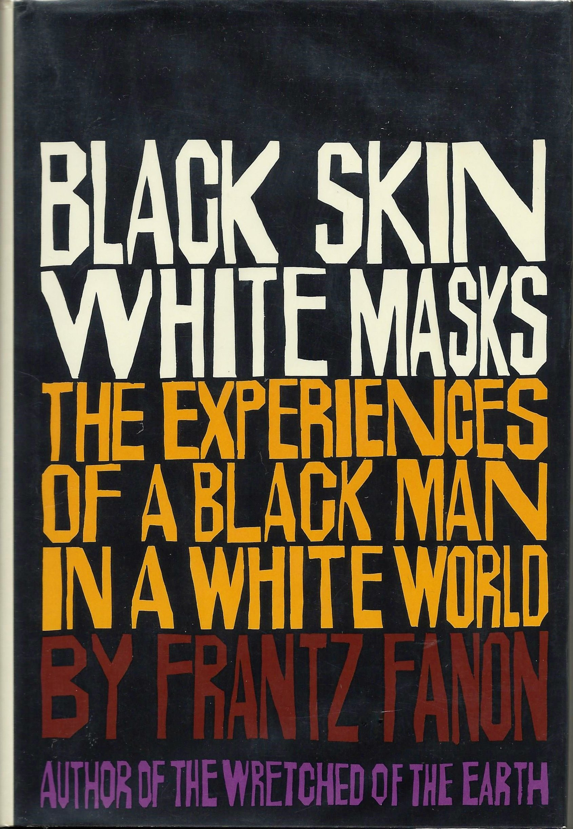
Antiracism, 1950s and beyond – Franz Fanon (a psychiatrist from Martinique and an important theorist of decolonization.) He published Black Skin, White Masks in 1952.

Slide 32
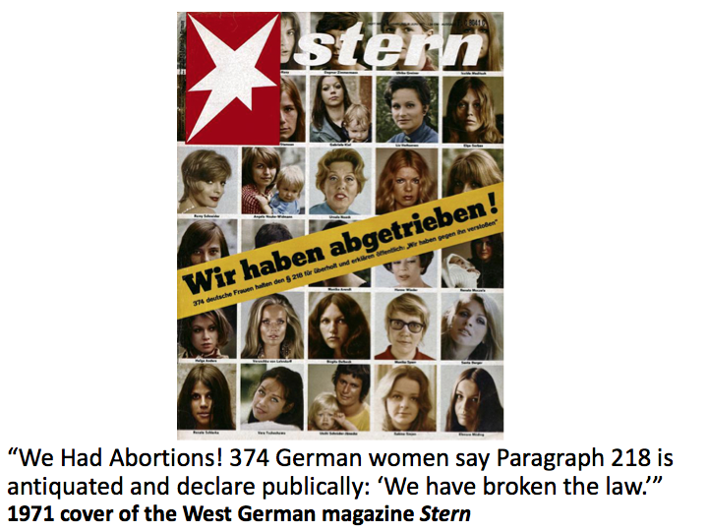

Slide 33
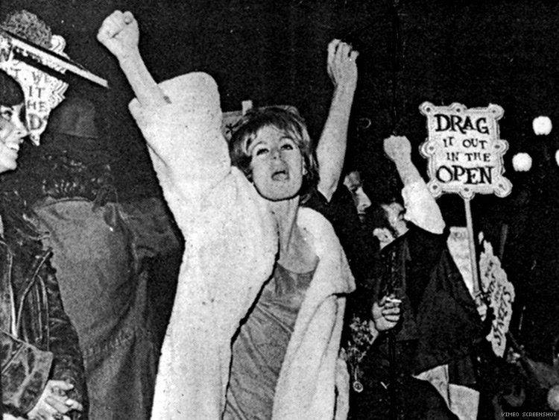
Compton’s Cafeteria riots/protests, 1966, San Francisco -- Trans people resist police brutality

