Slide 1
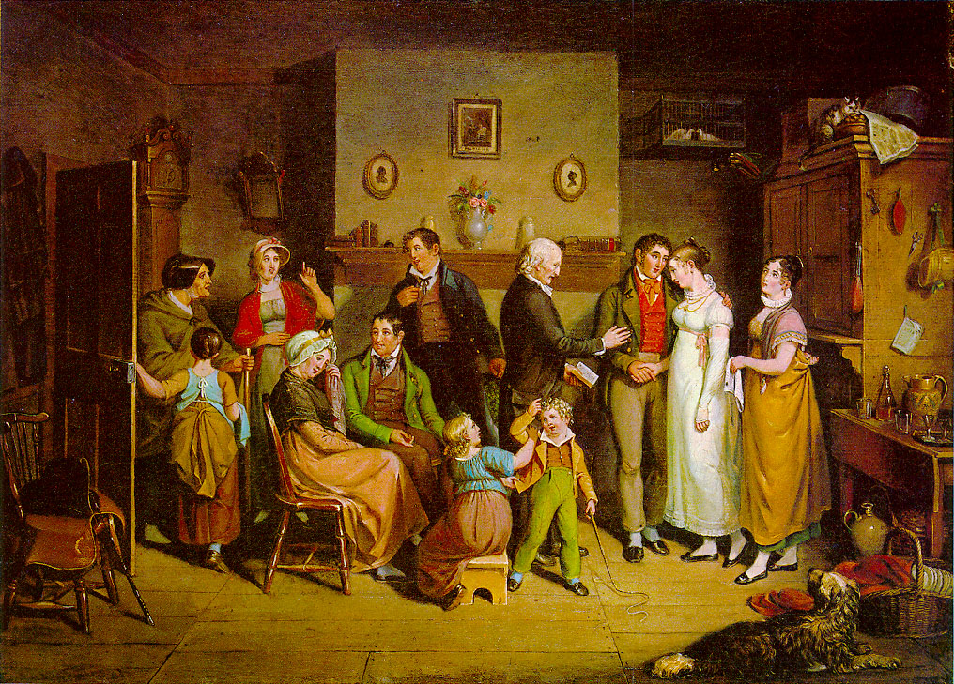
JSIS B 312 A – GWSS 390 D – CLIT 250 B
MONEY, LOVE & MARRIAGE
PROFESSOR KLAPAKI

Slide 2
Marriage payments: Historical and current practices
Marriage payments were payments between families at time of marriage
They occurred in the history of developed countries
Currently, such payments occur in developing world
Marriage payments were connected to arranged marriages
Different forms of marriage payments: dowry, dower, brideprice, groomsprice

Slide 3
Dowry: Historical practices
Transfer of parental property to a daughter at the time of marriage
Dowries date as back as ancient Babylon, ancient Greek (5th BCE) and Roman world, ancient India and China
Dowries were widely practiced in Europe until Germanic observance of brideprice led to disappearance of dowry in Europe
Dowries were reinstated in Europe in Middle Ages when they were transferred to Byzantine Empire via Roman law
Dowry was practiced in England, Russia, the Americas

Slide 4
Roman Law vs. Common Law
Societies under Roman law saw dowries as an indispensable part of marriage: ‘let no marriage be found without a dowry as is possible’
Under Common law there was greater flexibility: dowries were voluntary, not mandatory

Slide 5
Dowry: Current practices
Today, India’s dowry payments are well documented
Dowries are also practiced in other parts of contemporary South Asia, in Middle East and North Africa countries, in Pakistan, Nepal, Sri Lanka, Afghanistan, Iran, Turkey, Azerbaijan, Egypt, Morocco

Slide 6
Functions of dowry
Establishes a type of conjugal fund
Fund may go toward establishing a marital household (linen, furniture, clothes, etc.)
May provide financial security in widowhood
May provide financial security against a negligent husband; dowry is a transfer that remains with the couple but is the formal property of the wife throughout the marriage
May provide for children
Jack Goody considers dowry as devolution, a process whereby property is transmitted between generations

Slide 7
The Dowry by 19th century Russian painter, Vasili Pukirev

Slide 8
Dowry cabinet
Photograph by: Frank C. Müller, Baden-Baden
Hauenstein Museum, Germany

Slide 9
Bride and dowry display Bulgarian Folk museum

Slide 10
Dowry-paying societies
Dowries are connected with complex societal structures with substantial socioeconomic differentiation and class stratification
Existence of dowries in ancient Greece, Rome and contemporary India suggests complexity of these societies
Monogamy (opposite of polygyny) and endogamy (marrying within one’s socioeconomic status) is the norm; divorce is rare
Dowry-societies are patrilineal (children belong to the lineage of the father) and patrilocal (brides join the household of grooms and their families upon marriage)

Slide 11
Dowry-paying societies cont.
In stratified, complex socio-economic, monogamous, endogamous, non-kinship based societies: value of dowries can vary substantially and can rise
Dowry becomes means to maintain social status by attracting a husband of at least equal social standing
Higher-level individuals do not typically intermarry with lower-level individuals (exogamy)

Slide 12
Decline of dowry
Modernization transforms a hierarchical society based on inherited status into a more individualistic based on achievement. When preservation of inherited status through marriage is not important, endogamy (an essential constituent of stratified societies) is not necessary
Industrialization was a turning point in the history of dowry in Europe: dowry first disappeared among members of urban working class, who provided their offspring with the education and training needed for work, instead of giving them dowry

Slide 13
Decline of dowry cont.
That change affected middle class practice towards the end of 19th century in England
France followed suit about 30 years later
By contrast, in some southern European countries dowries continue to be important as a way of establishing a married couple

Slide 14
Dowry and violence
In some southern European countries rural women have murdered their husbands in order to repossess their dowry and remarry
But wives have also been killed by their husbands because they did not bring to the wedding the dowry that had been promised by their families
Women in NW Europe have been less exposed to marital violence than were Mediterranean wives

Slide 15
Dowry and violence cont.
Escalation of violence against women in India, often connected with ‘dowry deaths’, led to Dowry Prohibition Act (1961) outlawing practice of dowry
But practice of dowry and dowry inflation persisted unabated

Slide 16
Brideprice
Payments from the family of the groom to that of the bride
Considered to be a payment owed by husband to bride’s parents for the right to her labor and reproductive capabilities

Slide 17
Brideprice: Historical practices
Brideprice dates as back as 3000 BCE
Brideprice was practiced in tribal, nomadic societies
Ancient Egyptians, Mesopotamians, Hebrews, Aztecs, Incas;
In countries previously under Ottoman Empire (Iraq, Syria, Egypt, Turkey, Iran, Albania, Afghanistan)
Brideprice was and still is prevalent in Africa, esp. in sub-Saharan countries

Slide 18
Brideprice-paying societies
Brideprice-paying societies have been associated with strong female role in agriculture;
They are homogeneous societies without social stratification
Amount of brideprice has been uniform across families of different economic levels
It is directly linked to number of rights transferred, not wealth level of families
Amount of brideprice can depend on expected number of children a woman will bear

Slide 19
Brideprice-paying societies cont.
Brideprice practice has been associated with polygyny (having more than one wife) and the possibility of divorce
Brideprice-paying societies are patrilineal (children belong to the lineage of the father) and patrilocal (brides join the household of grooms and their families upon marriage)

Slide 20
Dower
Payment from the groom’s side that is transferred directly to the bride
It is typical in traditional Islamic marriages
Dower is considered the bride’s insurance in case of divorce
It is a transfer that remains with the couple but is the formal property of the wife throughout the marriage

Slide 21
Groomprice
Payment from the bride’s parents that is transferred directly to the groom and his family

Slide 22
Critique of marriage payments
Marriage payments have been linked with objectification and commodification of women in context of patriarchal systems of exchange
Note though that men are also commodified in these systems
Objectification of women: women as chattel items in the houses of their father or husband

Slide 23
Critique of marriage payments cont.
Philosopher Martha Nussbaum defines objectification as plurality of denials: denial of agency, autonomy, uniqueness and dignity of human subjects
In Marxist theory, commodities is anything that possesses use and exchange value.

