Slide 1
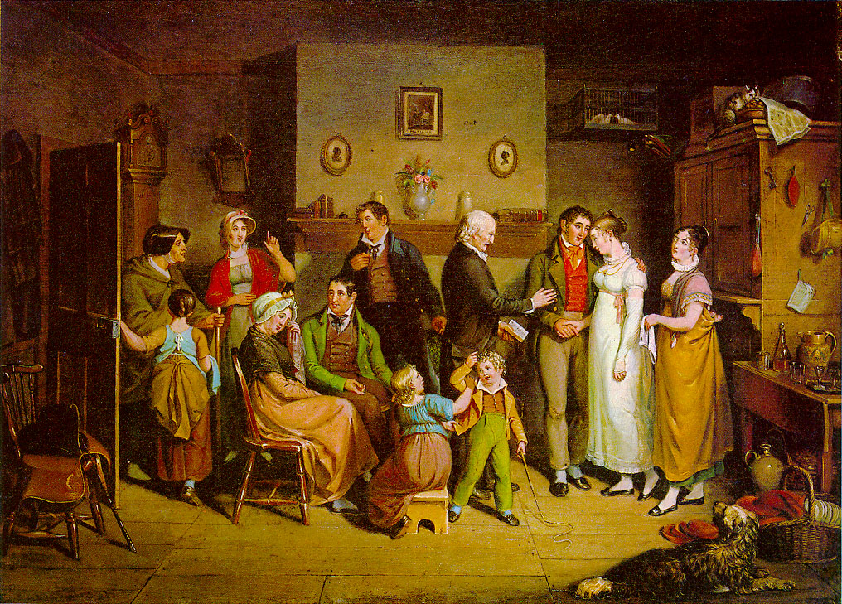
JSIS B 312 A – GWSS 390 D – CLIT 250 B
MONEY, LOVE & MARRIAGE

Slide 2
A woman’s dowry in Regency England
Dowries were considered as means by which a responsible family compensated her future husband for their daughter’s lifelong upkeep
Dowries were used to provide a woman’s lifelong spending money, set her income in widowhood, and provide for her children at the death of one or both parents
Most women did not enjoy big but modest dowries
Mr. Bennet referred to dowries as bribes to worthless young men to marry his daughters

Slide 3
Marriage settlements or articles
Marriage settlements or articles were legal documents that established the financial terms of a marriage when substantial property was involved-–something like today’s prenuptial agreements
Only about 10% of marriages were covered by settlements as drafting them was expensive
In P&P, we learn about Lydia’s settlement with Wickham in which Mr. Bennet is to allow her 100 pounds per year during his lifetime

Slide 4
Pin money
Pin money, a woman’s disposable income, the money she could spend without answering to her husband.
Common law only stipulated that a man should provide his wife’s ‘necessities’, so pin money could supply the ‘luxuries’ that might be required to live the lifestyle to which she was accustomed.
In P&P, Mrs. Bennet gushes over the pin money she expects daughter Jane and Elizabeth to have as a consequence of marrying wealthy men.
Later, Elizabeth notes making gifts to sister Lydia out of that pin money instead of bringing Lydia’s requests for support to her husband.

Slide 5
Dower and jointure
The jointure, the settlement on a bride by her future husband of a freehold estate secured for her widowhood, came into practice with the Statute of Uses (1535). To receive this settlement, the prospective wife had to surrender her dower. With formal repeal of dower in 1833, wives lost the absolute right to inherit. So in the absence of jointure provisions or explicit provisions in a husband’s will, the widow could be left without support at her husband’s death.

Slide 6
Dower and jointure cont.
Jointures were rarely on the same level as the dowry a woman brought to the marriage. They were usually anchored on the amount that a woman brought into a marriage. Generally it was an annuity, payable by the heir of the estate, equal to one tenth of a woman’s dowry. The annuity would be payable by the heir of a man’s estate until the woman’s death upon which time the principle would descend to her children.

Slide 7
Settlements to the children
Marriage settlements also stipulated provisions for a couple’s children, but most children did not inherit vast sums or property from their parents.
The monies a woman brought into the marriage through her dowry and any other settlements on her, would go to her children, both sons and daughters, upon her death.
Additional funds could be settled on the children from the father’s estate. The marriage articles would stipulate the amounts.

Slide 8
Coverture
Marriage settlements were necessary because a woman’s legal position changed dramatically at marriage.
Her existence as a legal individual effectively disappeared and her husband assumed the legal existence of both of them.
Once a woman was engaged and transitioned to the legal state of ‘coverture’, if she owned property, she could not dispose it without the approval of her betrothed.

Slide 9
Coverture cont.
Under legal coverture, women had no legal existence; the husband existed for them both in public life. He owned all property, had custody of the children, conducted all business transactions of the family’s behalf, even owned the wife’s earnings should she have income of her own. He even had the right to physically chastise his wife, divide her from friends and family and severely curtail her movements, if he so wished.
While limiting her legal rights, marriage immediately raised a woman’s social status, no matter her class. A married woman always took precedence over unmarried women.

Slide 10
Coverture cont.
“By marriage, the husband and wife are one person in law: that is, the very being or legal existence of the woman is suspended during the marriage, or at least incorporated and consolidated into that of the husband…and her condition during her marriage is called her coverture” (William Blackstone, 1765)
Coverture remained unchanged until the Married Women’s Property Act of 1884 that gave married women the same property and other legal rights as unmarried women or widows.

Slide 11
Class and marriage in Jane Austen
https://www.bl.uk/romantics-and-victorians/videos/jane-austen-class-and-marriage
https://www.bl.uk/romantics-and-victorians/videos/the-middle-classes

Slide 12
Class and marriage
Arranged marriages lingered longest among upper classes that had the most at stake re: money, property and rank in society.
Even so, though, few high society parents contrived totally mercenary alliances for their children.

Slide 13
Class and marriage cont.
Eldest sons set to inherit family lands and fortunes found themselves subject to more parental sanctions than younger siblings.
Young women with unmarried sisters encountered greater amounts of parental intrusion in their marital choices. (cf. Bennet sisters one of whom had to marry very well).
Unmarried females in need of support would turn first to brothers and sons.

Slide 14
Upper-class women with large fortunes: heiresses and fortune hunters
Upper-class women with large fortunes (non-titled bourgeois heiresses) were expected to learn to love, or at least tolerate, the husband chosen by their father or brother.
Examples of such upper-class heiresses in P&P are Georgiana Darcy and Caroline Bingley
A wealthy woman was not allowed to marry a man of lesser means. Darcy prevents his sister Georgiana from marrying Wickham.

Slide 15
Upper-class women with large fortunes cont.
Often heiresses were sought after by titled men whose families were plagued by declining fortune.
Many young peers sought to marry heiresses to shore up their family’s finances

Slide 16
Upper-class women with modest fortunes
A young lady of an upper-class family might sacrifice herself on the altar of family duty to help pay off family debts.
Elizabeth Bennet faces this pressure from her mother in particular when Mr. Collins, the heir to her father’s estate, proposes to her.

Slide 17
Upper-class men with large fortunes
Upper-class men with large fortunes have to marry wealthy (and perhaps titled) women within their class (endogamously) to maintain their fortune and family name (e.g. Darcy is expected to marry his cousin, the daughter of Lady Catherine de Bourgh)
A wealthy man might be excused for marrying a poorer woman, esp. if she were pretty and had good manners (e.g. Darcy marries Elizabeth)

Slide 18
Upper-class men with modest fortunes
Second-born sons who come from upper-class families but are not set to inherit the family estate or have a large fortune are also under pressure to marry wealthy women or heiresses
This is precisely because they themselves have modest fortunes, so they have to marry wealthy women to maintain their upper-class lifestyle

Slide 19
Marriage proposals
In earlier times, a suitor applied first to the family before speaking with the woman. If the father or guardian did not approve, the suitor dare not approach the woman.
In the enlightened Regency era, such a course was outmoded. Young people had the right to choose their mates themselves—as long as their parents did not veto their choices.
Until age of 21 both parties required parental consent to marry. Even beyond 21, parental approval was highly desirable (since parents often contributed financially to the upkeep of couple) but not essential.

Slide 20
Mr. Collins’ proposal to Elizabeth
In chapter 19, Collins proposes to Elizabeth and is refused
His inability to understand her refusal makes him resort to the marriage market jargon language, which has all along been his measure of the match, reminding Elizabeth of her inadequate bargaining position.

Slide 21
Mr. Darcy’s first proposal to Elizabeth
In ch. 34, Mr. Darcy proposes to Elizabeth.
His proposal is nsuccessful because it also borrows its terms from Lady Catherine—just like Collins’s proposal.
Darcy’s first declaration reveals its insufficiency by a double-voicedness. His love for Elizabeth is sincere but the language of family and class pride suffuses his proposal. Darcy’s ardent love is undercut by the patriarchal considerations that invade his language; his aunt’s voice obtrudes, as it were, on his own sincere passion (cf. Bakhtin’s dialogism).

Slide 22
Mr. Darcy’s first proposal to Elizabeth cont.
Darcy’s suit is a reminder that the language of trade is nor reserved to one class. Like Collin’s, Darcy’s first proposal depends to no small degree on marriage market calculations, on the blazon by which he refers to Lizzy’s connections as ‘inferior’, and on that basis he anticipates her acceptance of the offer.

