Slide 1
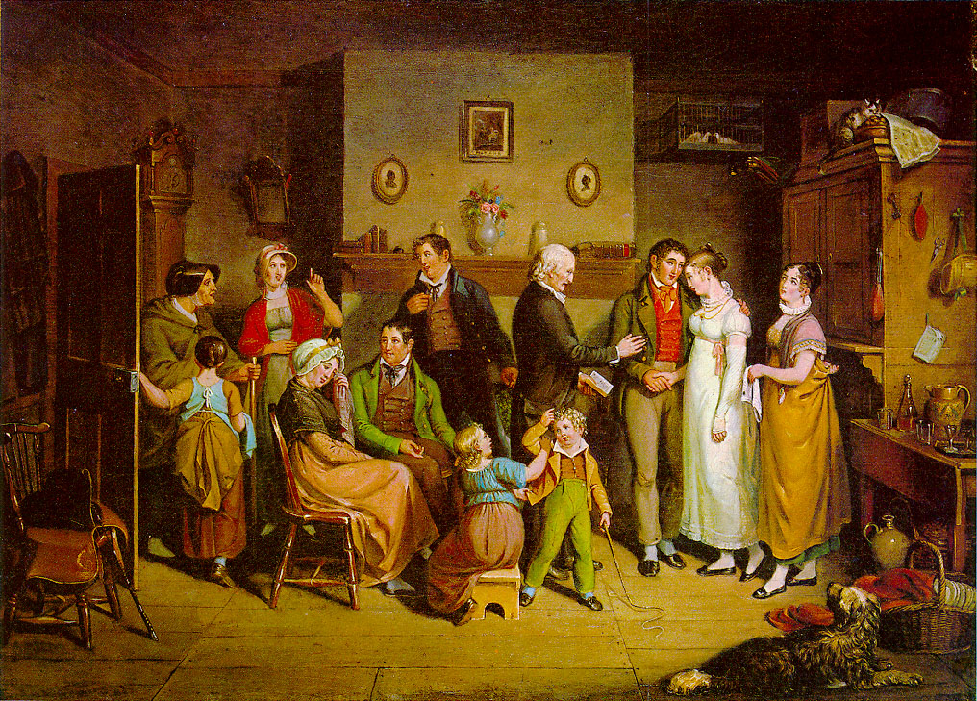
JSIS B 312 A – GWSS 390 D – CLIT 250 B
MONEY, LOVE & MARRIAGE

Slide 2
Michie’s (2011) key arguments
a. The 19C marriage plot of the ‘novel of manners’ makes arguments that are as much about the private and personal realms but also about the social, economic, and political realms. 19C novels of manners engage w/ questions pertaining to the individual but also to large processes of history.
b. The novel has traces of two disciplines-discourses that emerged at the time (and separated from aesthetics in 18C): political economy, anthropology.

Slide 3
Marriage plot of 19C English novel
The most common marriage plot in 19th-century English novel, specifically in the novel of manners: the story of a hero positioned between a wealthy, materialistic, status-conscious woman who might enhance his social position and a poorer, more altruistic, and psychologically independent woman. This narrative structure emerges in Jane Austen’s Pride and Prejudice;

Slide 4
Functions of rich woman
-Vulgarity and wealth the hero must eschew
-Vehicle through which 19th-century novelists articulate cultural anxieties about changing forms of money and their impact on society and individuals
-Economic pressures and materialistic forces the novel seeks to rise above

Slide 5
Previous critical studies on 19C novel of manners
The tendency in literary criticism is to ignore the materialistic forces the rich woman represents as critics distance themselves from the ‘vulgar’ to establish their own thinking as pure. Readers are invited to view the rich woman in the 19th-century novel as a marginal figure that is exorcised from the novel’s main story when it concludes with a hero and a heroine who make a marriage based on values other than financial ones.

Slide 6
Michie’s new approach to 19C novel of manners
What happens when we focus on the materialist strain of 19C novels? Michie’s reading foregrounds money, disgust and vulgarity. This gesture transforms the way the relations between gender, property, desire and exchange have typically been understood to operate in the novel. The heiress is associated with wealth; her presence in the texts makes visible the economic and social arguments that are interwoven into stories of marriage for love rather than money.

Slide 7
Michie’s new approach…cont.
Criticism on the 19C novel’s relation to economics focuses on the dangers of losing rather than having money.
But critics have not addressed the 19C anxiety invoked through the rich woman, the impact the possession of wealth has on the psyche of the possessor and on the society.

Slide 8
The 19C novel and other forms of 19C thought
18C and 19C political economy: examines what wealth represents for the individual
19C anthropology: links property and ownership to evolution of marriage as a social form-institution.
Heiress brings these two concerns together: tension between wealth and marriage as forms of exchange and as forms of accumulation.
Read in light of 19C political economy and anthropology, the heiress becomes a means whereby novelists address anxieties that 19C thinkers wished both to acknowledge and deny about powerful impact of money on 19C society.

Slide 9
Political economy split off from aesthetics at the end of the 18C. While two disciplines separated, they remained haunted by the ghost of the other.
18th- and 19th-C political economists break free from their defense of economic expansion to articulate fears about wealth’s corruption, and 19th-C novelists break free from their celebrations of virtue to acknowledge the engrossing impact of wealth.

Slide 10
Political economy
-Rich woman incarnates fear that haunted Smith, Malthus, John Stuart Mill, et al. political economists that England’s rapid economic development would corrupt the moral sentiments. They argued in favor of capitalism, but they also wrote gloomily about the vitiating power of the economic growth they endorsed.
-Malthus and Smith wanted to imagine a way in which altruism (sympathy, for Smith) might be fostered in a rapidly expanding economy. In fiction the choice of altruism is foregrounded through the non-mercenary, companionate marriages.

Slide 11
Political economy cont.
-In this period, ‘the bourgeoisie find it necessary to take up a ‘pure’ aesthetics supposedly uncontaminated by economic considerations. The novel reaches toward such absolute aesthetic purity in its conclusion, but traces of economic concerns are present in the figure of the rich woman, who incarnates the negative aspects of capitalism in stories about the triumph of individual choice over crass self-interest.

Slide 12
Anthropology
19C anthropologists examined the relation between property, society, the individual; process by which property ceased to be held by a group and passed to individual ownership, which they linked to changes in treatment of women.
19th-C social scientists tried ‘to think through the relations between marriage and capital’; linked development of modern culture to the changing status of property.

Slide 13
Anthropology cont.
19C anthropologists valued modern society for two freedoms: because women could marry whom they wanted and because of the complete individualization of ownership.
This was evolution from a society organized by a tribal structure (property and women were held in common) to a modern one based around the family, (ownership of private property, and a marital system in which free choice figured).

Slide 14
The heiress as a block to exogamy and progress
Heiress posed drawback in narrative of progress: she revealed limits of marital exchange and limits behind freedom of material possession.
Transition from group ownership to patrilineage (lineage based on descent on the paternal line) meant that daughters would inherit if there were no sons.
Yet heiresses posed a problem: if they were exchanged outside of their group, the group’s property would go with them.

Slide 15
The heiress as a block…cont.
Threat to group’s possessions meant that an exception to exogamy had to be made.
To ensure that property remained within the group, the heiress could not be allowed to exchange herself freely (exogamy). She must be made to marry within the group (endogamy).
While all other members of community could be exchanged exogamously, the heiress had to be exchanged endogamously.

Slide 16
19C novel and anthropology on heiress
In the 19C novel and 19C anthropological accounts of development of modern culture, the heiress is associated with endogamy.
Implicit acknowledgement that economic and social advancement—which seemed to be extending the possibility of ownership to all—was accompanied by impulse to prevent circulation by concentrating wealth in the hands of those who already held it.
In fiction and Victorian anthropology, the heiress marks what political economists feared about capitalism: it aimed at amassing, not exchanging or circulating property.

Slide 17
P&P’s critique of endogamy and engrossment
Marriage to the heiress is associated with engrossment that was stigmatized by Hume.
In P&P, Miss Bingley imagines an alliance between her commercial wealth and Darcy’s landed estate, while Lady Catherine expects a union between two cousins whose properties will become one.
The rich women in P&P endorse endogamous marriage; it should consolidate fortunes rather than allowing wealth to pass out of the group to which it has traditionally belonged.

Slide 18
P&P’s critique of endogamy and engrossment cont.
-Opposition between exogamy and endogamy is clear in P&P, where Darcy’s possible marriages to Miss Bingley or Miss De Bourgh are unions that would leave him marrying close to home, wedding the sister of his best friend or his cousin.
Elizabeth is not just a stranger but a woman Darcy finds increasingly attractive the farther she is from her own home, at Netherfield, Rosings, and Pemberley.
P&P is opposed to endogamy (Elizabeth doesn’t wed her cousin Mr. Collins, nor does Darcy his cousin Miss de Bourgh).

Slide 19
P&P’s critique of endogamy and engrossment cont.
If we think of the marriage plot as invoking endogamy and exogamy as economic rather than blood categories, P&P endorses marriage between a propertied man (Darcy) and a poorer woman (Elizabeth) as a form of spiritual, emotional or psychological exogamy.
Their marriage brings nonmaterialist values into the heart of a property-owning family group--the Darcys.

Slide 20
P&P’s critique of endogamy and engrossment cont.
The 19th-century novel thus conforms to McLennan’s observation that ‘the earliest violations of the rule of exogamy would appear to have been called for in the case of female heiresses’.
But in P&P Austen does not endorse this idea, thus using exogamous marriage to critique engrossment and lack of social mobility.

