Slide 1
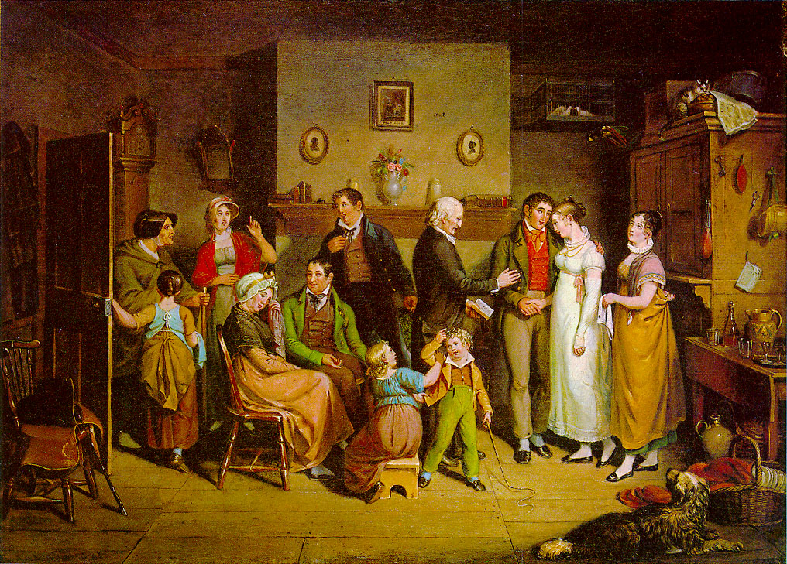
JSIS B 312 A – GWSS 390 D – CLIT 250 B
MONEY, LOVE & MARRIAGE

Slide 2
Commodification of Catherine by Dr. Sloper and Morris Townsend
Dr. Sloper and Morris regard Catherine as a commodity: in their eyes, she is nothing else but an heiress worth a fortune of 10,000 dollars inherited from her late mother, besides the fortune she is expected to receive from her father.
For Dr. Sloper, Catherine ‘was an heiress’ (WS, p. 34).
Cf.: “‘You are sumptuous, opulent, expensive,’ her father rejoined. ‘You look as if you had eighty thousand a year’”.
Cf.: WS, p. 38: ‘It simply appeared to him proper and reasonable that a well-bred young woman should not carry half her fortune on her back’.

Slide 3
Catherine’s commodification and the bourgeois capitalist economy
Catherine’s commodification is not isolated from the language of bourgeois capitalist economy with its references to the New York stock exchange, to capital, and the exchange value of commodities that pervades James’s novel written, as it was, in the shadow of debates about money in late nineteenth-century US.
James’s use of this language is so pervasive that Dr. Sloper and Morris Townsend do not escape its logic either. They, too, have a certain ‘value’, albeit one originating mostly in rhetorical gestures of self-imposed commodification, so to speak.

Slide 4
Catherine between two agents of patriarchy
Materialistic Dr. Sloper and Morris Townsend vs. idealistic Catherine
In the start of WS, Catherine is innocent and submissive, a pawn in the exchange game between the two male agents of patriarchy, her authoritarian, cruel father and her mercenary suitor
Catherine lacks agency in this patriarchal framework but this will change in the course of the novel

Slide 5
Misalliances and mercenary marriages: the heiress and the fortune-hunter
‘Ah, we must be prepared,’ Morris rejoiced; ‘you especially, because for you it must come hardest. Do you know the first thing your father will say to you?’
‘No, Morris; please tell me.’
‘He will tell you I am mercenary.’
‘Mercenary!’
‘It’s a big word, but it means a low thing. It means that I am after your money.’ (WS, ch. 10, p. 80)

Slide 6
Misalliances and mercenary marriages cont.
Catherine looked at her lover a minute, and then she said, ‘I shall persuade him. But I am glad we shall be rich,’ she added.
Morris turned away, looking into the crown of his hat. ‘No, it’s a misfortune,’ he said at last. ‘It is from that our difficulty will come.’ (WS, ch. 10, p. 81)

Slide 7
The stereotype of the American heiress
Characteristics of the American heiress:
Daughter of a rich businessman who had made money since the Civil War.
Is beautiful and was is considered an individual, namely someone with character.
The suitor is usually penniless.
The family is based in NY and moves in fashionable circles.
The women are dressed according to the latest fashion rules.

Slide 8
Transatlantic marriages and the stereotype of the American heiress
When American heiresses (usually brotherless daughters of American businessmen) began to marry into the British peerage in significant numbers after 1870, their marriages were described with the cliché “title-for-money”.
So persistent was the cliche that virtually any marriage to a person outside the landed elite (aristocracy) was categorized as an exchange of the prestige and social status of a title for a large dowry.

Slide 9
Transatlantic marriages and the stereotype of the American heiress cont.
American women were treated with contempt for being uncouth, ill-bred ex-colonials and with dismissal of their ambitiousness and social climbing.
As the number of transatlantic marriages increased, American women became less of a victim of British aristocratic humor and more of a threat to the exclusiveness of aristocratic circles.
The success of American women in capturing titled husbands was viewed with resentment by mothers with daughters of marriageable age on their hands.
.

Slide 10
Transatlantic marriages and the stereotype of the American heiress cont.
By the early 1900s these feelings became sheer hostility. American women were viewed as cold, calculating, marrying not for love but for titles, and as bad mothers.
The theme of American women shirking motherhood led some to claim that American peeresses were having a devastating effect upon British families: the failure of some women to produce male heirs meant that some titles would become extinct.

Slide 11
Intersection of patriarchy with classism
Exogamy as hypergamy (acceptable; e.g. American heiresses marrying British peers) vs. exogamy as hypogamy (non- acceptable)
Even though Dr. Sloper married exogamously (hypergamy), he will not allow an exogamous (hypogamy) marriage for his daughter
Patriarchy intersects with classism to promote same-class endogamous marriages or higher-class exogamous marriages

Slide 12
Intersection of patriarchy with classism cont.
As a commodity whose fate is determined by the logic of the patriarchal system of exchange, Catherine has to be exchanged by her father.
When Dr. Sloper declares that Morris is not a good match for his daughter because he is a mercenary, he lacks a profession and any prospects in life, in reality he objects to the possibility of Catherine’s exchange with him because Morris’s monetary value on the bourgeois marriage market is considerably lower than his daughter’s.
In this case, patriarchy and classism, through their implicit emphasis on same-class endogamy or higher-class exogamy (hypergamy), intersect to consolidate asymmetrical gender and power relations and to advance bourgeois capitalism.

Slide 13
Intersection of patriarchy with classism cont.
‘Did you really expect I would say I was delighted, and throw my daughter into your arms?’
‘Oh no; I had an idea you didn’t like me.’
‘What gave you the idea?’
‘The fact that I am poor.’
‘That has a harsh sound,’ said the Doctor, ‘but it is about the truth—speaking of you strictly as a son-in-law. Your absence of means, of a profession, of visible resources or prospects, places you in a category from which it would be imprudent for me to select a husband for my daughter, who is a weak young woman with a large fortune. In any other capacity I am perfectly prepared to like you. As a son-in-law, I abominate you.’ (WS, ch. 12, p. 89)

Slide 14
Morris’s low value in the marriage market and the double-voice of WS
‘But your daughter doesn’t marry a category,’ Townsend urged, with his handsome smile. ‘She marries an individual—an individual whom she is so good as to say she loves.’
‘An individual who offers so little in return.’
‘Is it possible to offer more than the most tender affection and a life-long devotion?’ the young man demanded.
‘It depends how we take it. It is possible to offer a few things besides, and not only is it possible, but it is the custom. A life-long devotion is measured after the fact; and meanwhile it is usual in these cases to give a few material securities. What are yours? A very handsome face and figure, and a very good manner. They are excellent as far as they go, but they don’t go far enough.’ (WS, ch. 12, p. 90)

Slide 15
The double-voice of WS cont.
‘There is one thing you should add to them,’ said Morris— ‘the word of a gentleman.’
‘The word of a gentleman that you will always love Catherine? You must be a fine gentleman to be sure of that.’
‘The word of a gentleman that I am not mercenary; that my affection for Miss Sloper is as pure and disinterested a sentiment as was ever lodged in a human breast. I care no more for her fortune than for the ashes in that grate.’ (ch. 12, p. 90)

Slide 16
Patriarchal control through disinheritance
Following Catherine’s announcement of her secret engagement with Morris, Dr. Sloper decides to make his daughter a less attractive commodity on the marriage market by disinheriting her, in the hopes that he will thus prevent her exogamous marriage with Morris.
His scheme succeeds, as the gold-digger Morris abandons Catherine now that her fortune—and her value as a commodity on the marriage market—has been reduced in half.
Seemingly, patriarchy, bourgeois capitalism and classism prevail over individualism, feminist ideals of gender equality and progressive, egalitarian ideals of social mobility.

Slide 17
Acts of ‘gender resistance’
While the intersection of the above conservative ideologies with property institutions leads to Catherine’s subjugation and commodification, she attains limited agency by performing a series of acts of gender resistance.
Gender resistance: ‘the refusal to accept or comply with hegemonic norms governing sex, gender and sexuality’.

Slide 18
Catherine’s first act of gender resistance
“‘If I live with you, I ought to obey you.’ ‘If that’s your theory, it’s certainly mine,’ said the Doctor, with a dry laugh.” (WS, p. 146).
Yet Catherine defies her father by way of her secret engagement with Morris

Slide 19
Catherine’s second act of gender resistance
Catherine’s second act of resistance evolves around her decision never to reveal to her father that Morris abandoned her or that she has given him up. Her choice is dictated by the fact that she does not want to allow Dr. Sloper ‘to enjoy the triumph of his empty victory over her’.
Catherine’s coming of age, therefore, involves, among other things, her transformation from an obedient and naïve young girl to a disillusioned, cagey woman, who does not hesitate to behave with cruelty towards her father, just like he used to behave towards her. It seems that Catherine has fully absorbed and espoused certain attributes of patriarchy, which is a reminder of the provisional and unstable nature of ‘gender’. Catherine’s last act of gender resistance is directed against Morris whom she boldly turns down when he returns and proposes to her for a second time many years after her father’s death.
“Catherine rejected Morris’s pathetic attempt to renew his suit years later” (WS 22).

Slide 20
Acts of gender resistance and secrecy
The above acts of gender resistance that Catherine performs have one element in common: all of them are carried out in secret or involve an act of secrecy: Catherine’s clandestine engagement with Morris, her hiding from Dr. Sloper that Morris abandoned her, and that she has given him up.
Catherine’s acts of gender resistance can be characterized as feminist forms of resistance.

Slide 21
Feminist forms of resistance
According to Judith Halberstam, a feminist form of resistance ‘does not speak in the language of action and momentum but instead articulates itself in terms of evacuation, refusal, passivity, unbecoming, unbeing’.
Feminist forms of resistance enable their ‘subjects’ to attain limited agency, which in turn allows them to envisage for themselves new gender roles and identities.

