Slide 1
Auditing and Assurance Services
Seventeenth Edition
Chapter 10
Assessing and Responding to Fraud Risks
Copyright © 2020, 2017, 2014 by Pearson Education, Inc. All Rights Reserved
Notes:
If this PowerPoint presentation contains mathematical equations, you may need to check that your computer has the following installed:
1) Math Type Plugin
2) Math Player (free versions available)
3) NVDA Reader (free versions available)

Slide 2
Learning Objectives (1 of 2)
10.1 Define fraud and distinguish between fraudulent financial reporting and misappropriation of assets
10.2 Describe the fraud triangle and identify conditions for fraud
10.3 Understand the auditor’s responsibility for assessing the risk of fraud and detecting material misstatements due to fraud
10.4 Identify corporate governance and other control environment factors that reduce fraud risks
Notes:
Slide 2 is list of textbook LO numbers and statements

Slide 3
Learning Objectives (2 of 2)
10.5 Develop responses to identified fraud risks
10.6 Recognize specific fraud risk areas and develop procedures to detect fraud
10.7 Understand interview techniques and other activities after fraud is suspected
10.8 Describe information about the fraud risk assessment that must be documented in the working papers
Notes:
Slide 2 is list of textbook LO numbers and statements

Slide 4
Learning Objective 10.1
Define fraud and distinguish between fraudulent financial reporting and misappropriation of assets

Slide 5
Types of Fraud (1 of 2)
Fraud is defined as an intentional misstatement of financial statements. The two main categories are:
Fraudulent financial reporting
Misappropriation of assets

Slide 6
Types of Fraud (2 of 2)
Fraudulent financial reporting
Intentional misstatement or omission of amounts or disclosures with the intent to deceive users
Misappropriation of assets
Involves theft of an entity’s assets
Normally perpetrated at lower levels of the organization hierarchy

Slide 7
Learning Objective 10.2
Describe the fraud triangle and identify conditions for fraud

Slide 8
Conditions for Fraud
Three conditions for fraud arising from fraudulent financial reporting and misappropriations of assets are referred to as the fraud triangle:
Incentives/Pressures
Opportunities
Attitudes/Rationalization

Slide 9
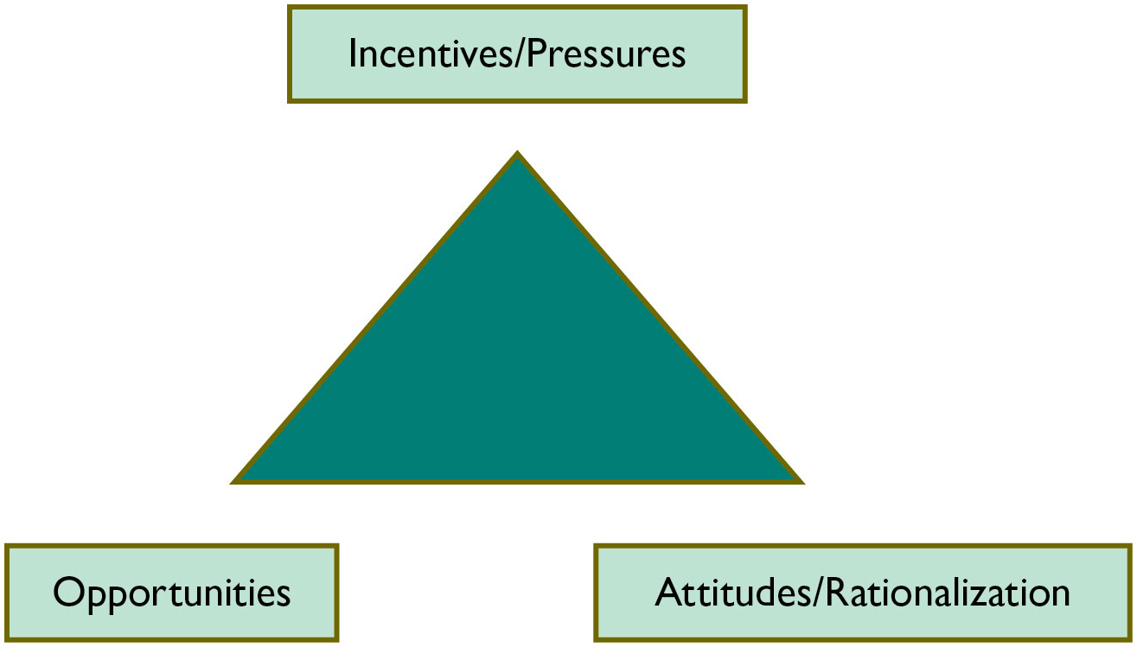
Figure 10.1 The Fraud Triangle

Slide 10
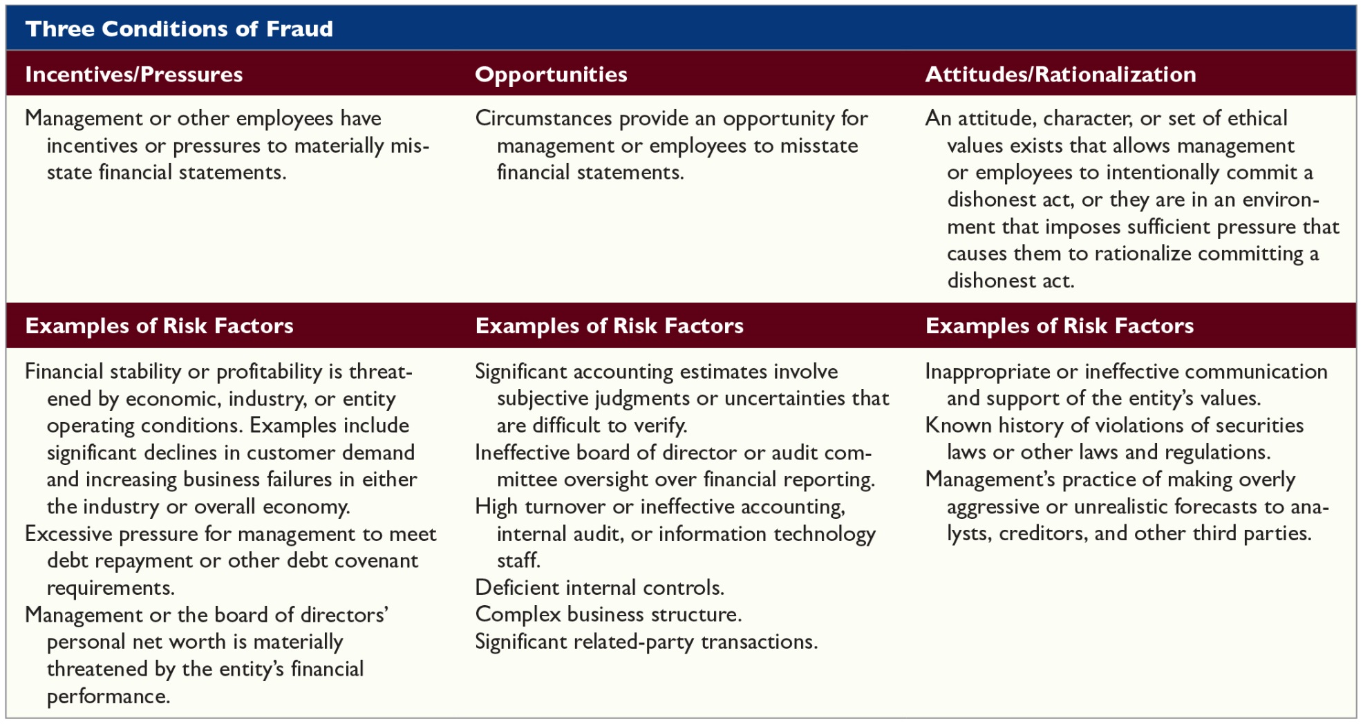
Table 10.1 Examples of Risk Factors for Fraudulent Financial Reporting

Slide 11
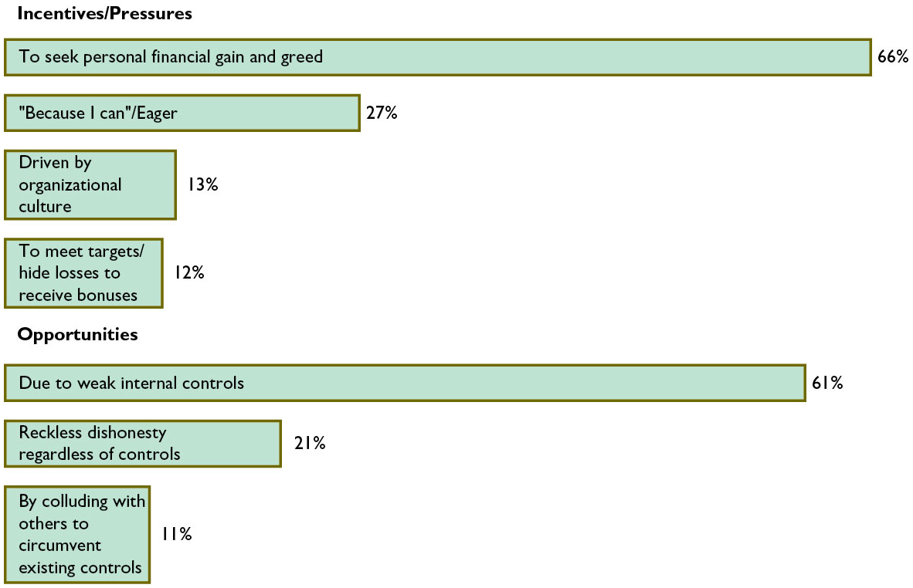
Figure 10.2 Most Commonly Cited Fraud Risk Conditions
Source: Global Profiles of the Fraudster, KPMG, 2016.

Slide 12
Figure 10.3 Characteristics of Fraud Perpetrators
Source: Global Profiles of the Fraudster, KPMG, 2016.

Slide 13
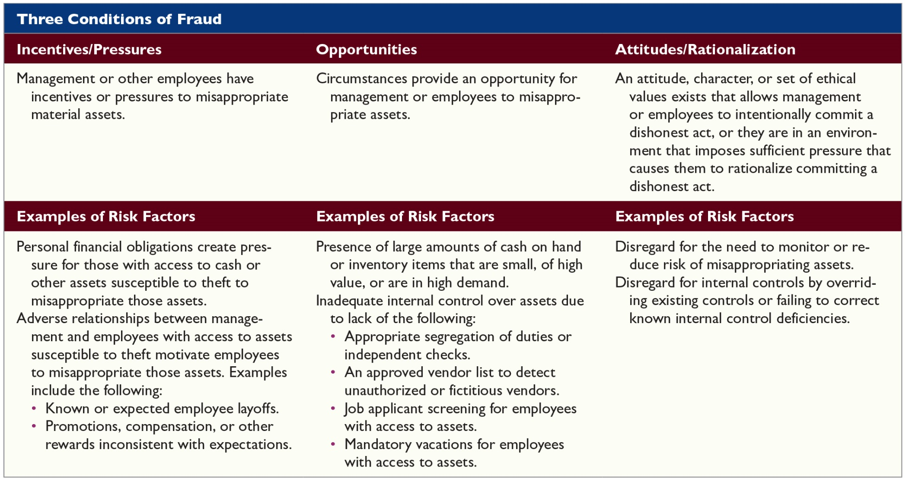
Table 10.2 Examples of Risk Factors for Misappropriation of Assets

Slide 14
Let’s Discuss (1 of 6)
What are the three conditions of fraud often referred to as “the fraud triangle”?
Define misappropriation of assets and give two examples of misappropriation of assets.
Give examples of risk factors for fraudulent financial reporting for each of the three fraud conditions: incentives/pressures, opportunities, and attitudes/rationalization.

Slide 15
Learning Objective 10.3
Understand the auditor’s responsibility for assessing the risk of fraud and detecting material misstatements due to fraud

Slide 16
Assessing the Risk of Fraud
Auditing standards require the auditor to assess the risk of material misstatement due to fraud
As auditors consider a broad set of information, including fraud risk factors, they must maintain a level of professional skepticism, which consists of:
Questioning mind
Critical evaluation of audit evidence

Slide 17
Sources of Information to Assess Fraud Risk
There are five sources of information that help auditors to assess fraud risks:
Communications among audit team
Inquiries of management
Risk factors
Analytical procedures
Other information

Slide 18
Identified Risks of Material Misstatement Due to Fraud
Auditors evaluate all the sources of information gathered to assess the risk of material misstatement due to fraud as part of audit planning
While the assessment of fraud is conducted as part of audit planning, the auditor’s assessment of fraud risk should be ongoing throughout the audit

Slide 19
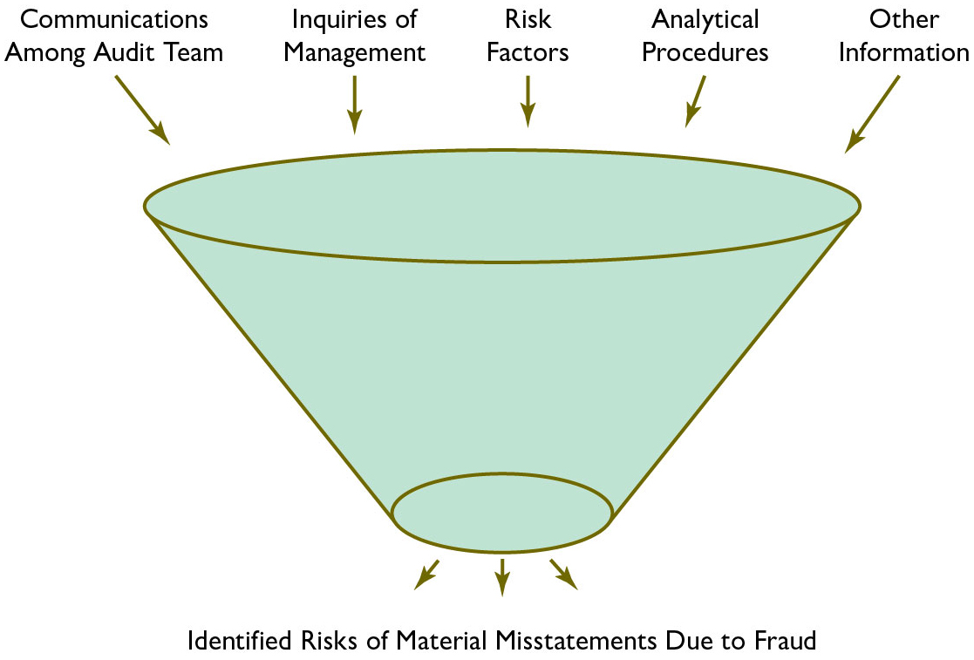
Figure 10.4 Sources of Information Gathered to Assess Fraud Risks

Slide 20
Learning Objective 10.4
Identify corporate governance and other control environment factors that reduce fraud risks

Slide 21
Corporate Governance Oversight to Reduce Fraud Risk (1 of 2)
Management is responsible for implementing corporate governance and control procedures to:
Minimize the risk of fraud, which can be reduced through a combination of
Prevention
Deterrence
Detection measures

Slide 22
Corporate Governance Oversight to Reduce Fraud Risk (2 of 2)
Guidance developed for auditors by the AICPA identifies three elements to prevent, deter, and detect fraud:
Culture of honesty and high ethics
Management’s responsibility to evaluate risks of fraud
Audit committee oversight

Slide 23
Table 10.3 COSO Fraud Risk Management Guide (1 of 2)
Fraud Risk Management Component | Principle
Fraud risk governance | Principle 1: The organization establishes and communicates a Fraud Risk Management Program that demonstrates of the board of directors and senior management and their commitment to high integrity and ethical values regarding managing fraud risk.
Fraud risk assessment | Principle 2: The organization performs comprehensive fraud risk assessments to identify specific fraud schemes and risks, assess their likelihood and significance, evaluate existing fraud control activities, and implement actions to mitigate residual fraud risks.
Fraud control activity | Principle 3: The organization selects, develops, and deploys preventive and detective fraud control activities to mitigate the risk of fraud events occurring or not being detected in a timely manner.

Slide 24
Table 10.3 COSO Fraud Risk Management Guide (2 of 2)
Fraud Risk Management Component | Principle
Fraud investigation and corrective action | Principle 4: The organization establishes a communication process to obtain information about potential fraud and deploys a coordinated approach to investigation and corrective action to address fraud appropriately and in a timely manner.
Fraud risk management monitoring activities | Principle 5: The organization selects, develops, and performs ongoing evaluations to ascertain whether each of the five principles of fraud risk management is present and functioning and communicates Fraud Risk Management Program deficiencies in a timely manner to parties responsible for talking corrective action, including senior management and the board of directors.
Source: Committee of the Sponsoring Organizations of the Treadway Commission, Fraud Risk Management Guide, Executive Summary (September 2016).
Used with permission.

Slide 25
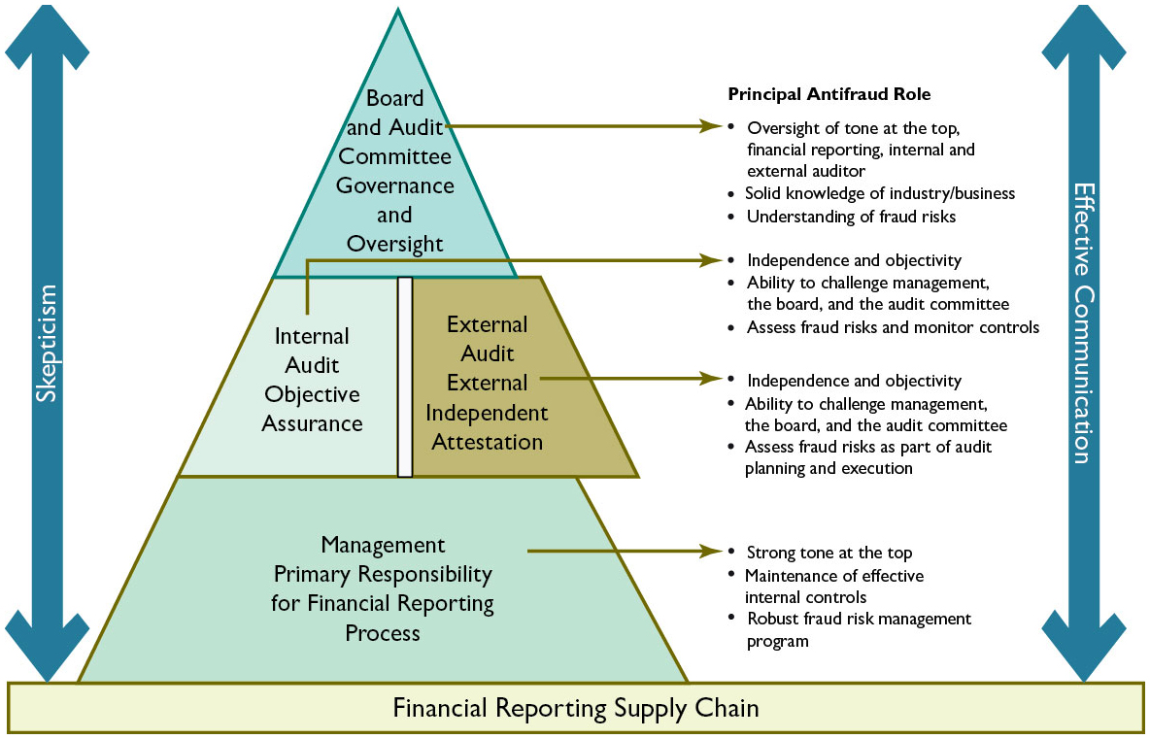
Figure 10.7 Responsibility for Mitigating Fraud Risk
Sources: 1. The Fraud Resistant Organization: Tools and Techniques to Deter and Detect Financial Reporting Fraud, The Center for Audit Quality, 2014; 2. Deterring and Detecting Financial Reporting Fraud: A Platform for Action, The Center for Audit Quality, 2010. Provided courtesy of The Center for Audit Quality. Reprinted with permission.

Slide 26
Let’s Discuss (2 of 6)
What sources are used by the auditor to gather information to assess fraud risk?
Distinguish management’s responsibility from the audit committee’s responsibility for designing and implementing antifraud programs and controls within a company.

Slide 27
Let’s Discuss (3 of 6)
The two components of professional skepticism are a questioning mind and a critical assessment of the audit evidence.
How do these components help an auditor distinguish an unintentional misstatement from an intentional (fraudulent) misstatement?

Slide 28
Learning Objective 10.5
Develop responses to identified fraud risks

Slide 29
Responding to the Risk of Fraud (1 of 3)
When the auditor identifies risks of material misstatements due to fraud, auditing standards require the auditor to develop responses to those risks at three levels:
Overall responses
Responses at the assertion level
Responses related to management override

Slide 30
Responding to the Risk of Fraud (2 of 3)
The auditor’s assessment of the risks of material misstatement due to fraud should be ongoing throughout the audit and coordinated with the auditor’s other risk assessment procedures
Auditors should be alert for the following conditions when doing the audit (1 of 2):
Discrepancies in the accounting records
Conflicting or missing audit evidence

Slide 31
Responding to the Risk of Fraud (3 of 3)
Auditors should be alert for the following conditions when doing the audit (2 of 2):
Problematic or unusual relationships between the auditor and management
Results from substantive or final review stage analytical procedures that indicate a previously unrecognized fraud risk
Responses to inquiries made throughout the audit that are vague or implausible or that produce evidence that is inconsistent with other information

Slide 32
Learning Objective 10.6
Recognize specific fraud risk areas and develop procedures to detect fraud

Slide 33
Specific Fraud Risk Areas (1 of 4)
Revenue and accounts receivable fraud risks (1 of 2)
Three main types of revenue manipulations are:
Fictitious revenues
Premature revenue recognition
Manipulation of adjustments to revenues
Warning signs
Two of the most useful are analytical procedures and documentary discrepancies

Slide 34
Specific Fraud Risk Areas (2 of 4)
Revenue and accounts receivable fraud risks (2 of 2)
Misappropriation of receipts involving revenue include:
Failure to record a sale
Theft of cash receipts after a sale is recorded
Warning signs
Internal controls, analytical procedures and other comparisons may be useful

Slide 35
Specific Fraud Risk Areas (3 of 4)
Inventory fraud risks
Inventory is susceptible to:
Manipulation by managers who want to achieve certain financial reporting objectives
Misappropriation because it is usually readily saleable
Warning signs
Analytical procedures are one useful technique for detecting inventory fraud

Slide 36
Specific Fraud Risk Areas (4 of 4)
Purchases and accounts payable fraud risks
The most common fraud in the acquisitions area:
Perpetrator issues payments to fictitious vendors and deposit the cash in a fictitious account
Other areas of fraud risk:
Fixed assets
Intangible assets
Payroll expenses

Slide 37
Let’s Discuss (4 of 6)
Describe the types of overall responses by auditors to address fraud risk.
You go through the drive-through window of a fast food restaurant and notice a sign that reads, “Your meal is free if we fail to give you a receipt.”
Why would the restaurant post this sign?

Slide 38
Learning Objective 10.7
Understand interview techniques and other activities after fraud is suspected

Slide 39
Responsibilities When Fraud Is Suspected (1 of 3)
Frauds are often detected through:
The receipt of an anonymous tip
Management review
Internal audit
Accident

Slide 40
Responsibilities When Fraud Is Suspected (2 of 3)
When fraud is suspected, the auditor often begins by
Making additional inquiries to determine whether fraud actually exists
Auditors can use one or more of the following inquiry categories depending on their objectives:
Informational inquiry
Assessment inquiry
Interrogative inquiry

Slide 41
Responsibilities When Fraud Is Suspected (3 of 3)
Auditing standards require the auditor to obtain additional evidence to determine whether material fraud has occurred
In addition to inquiry, auditors often:
Apply data analytics
Expand other substantive testing

Slide 42
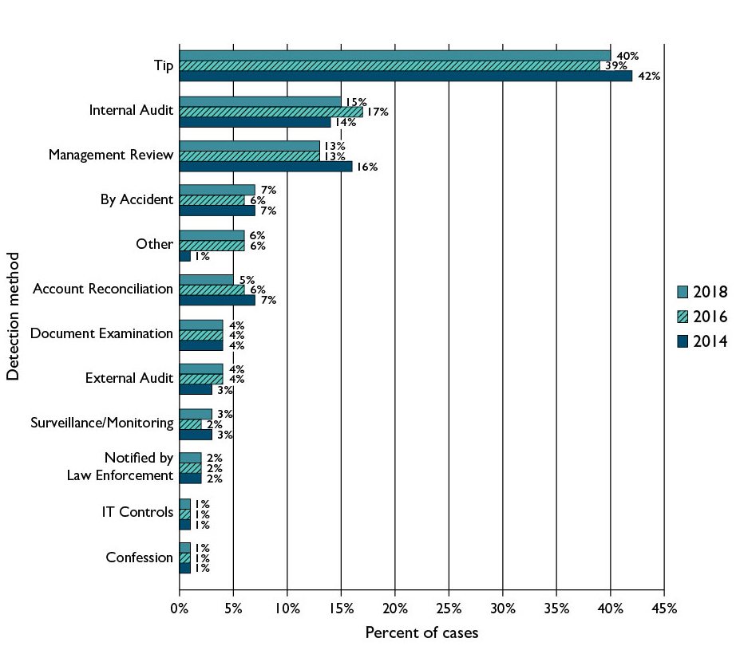
Figure 10.8 Fraud Detection Methods
Source: Report to the Nations on Occupational Fraud and Abuse, Association of Certified Fraud Examiners, 2018, 2016, 2014.

Slide 43
Let’s Discuss (5 of 6)
What are the three ways auditors respond to fraud risks?
Describe the three main techniques used to manipulate revenue.

Slide 44
Learning Objective 10.8
Describe information about the fraud risk assessment that must be documented in the working papers

Slide 45
Documenting the Fraud Assessment (1 of 3)
Auditors are required to document the following matters related to their consideration of material misstatements due to fraud (1 of 3):
Significant decisions made during the discussion among engagement team in planning the audit
Procedures performed to obtain information necessary to identify and assess the risks of material fraud
Reasons supporting a conclusion that there is not a significant risk of material improper revenue recognition

Slide 46
Documenting the Fraud Assessment (2 of 3)
Auditors are required to document the following matters related to their consideration of material misstatements due to fraud (2 of 3):
Specific risks of material fraud that were identified at both the overall financial statement level and the assertion level and the auditor’s response to those risks
Results of procedures performed to address the risk of management override of controls

Slide 47
Documenting the Fraud Assessment (3 of 3)
Auditors are required to document the following matters related to their consideration of material misstatements due to fraud (3 of 3):
Other conditions and analytical relationships indicating that additional auditing procedures or other responses were required, and the actions taken by the auditor in response
The nature of communications about fraud made to management, the audit committee, or others

Slide 48
Let’s Discuss (6 of 6)
You have identified a suspected fraud involving the company’s controller.
What must you do in response to this discovery?
How might this discovery affect your report on internal control when auditing a public company?
Describe the types of information that should be included in the auditor’s working papers as evidence of the auditor’s fraud assessment procedures.

Slide 49
Copyright
This work is protected by United States copyright laws and is provided solely for the use of instructors in teaching their courses and assessing student learning. Dissemination or sale of any part of this work (including on the World Wide Web) will destroy the integrity of the work and is not permitted. The work and materials from it should never be made available to students except by instructors using the accompanying text in their classes. All recipients of this work are expected to abide by these restrictions and to honor the intended pedagogical purposes and the needs of other instructors who rely on these materials.

