Slide 1
PolS/LSJ 363 Law in Society M&W 11:30-12:50 Professor Michael McCann mwmccann@uw.edu Office Hours: M 10:30-11:20 (Gowen 47) Tu 1-2 (https://washington.zoom.us/j/2063991881) Teaching Assistants: Lauren Collins Yulenni Venegas Lopez

Slide 2
We all need to help one another….
We hope that you are well and safe.
We realize that your situations are diverse and unequal.
We have tried to organize the class in ways that make it simple, flexible, adaptable to possible changes.
We the instructors figured it out before and will do so again.
We will do our best to adapt and to be flexible, and we ask the same of you.
Communicate how we can help you!
Please do your part to reduce infection while participating in class (mask, distance, vaccinate)

Slide 3
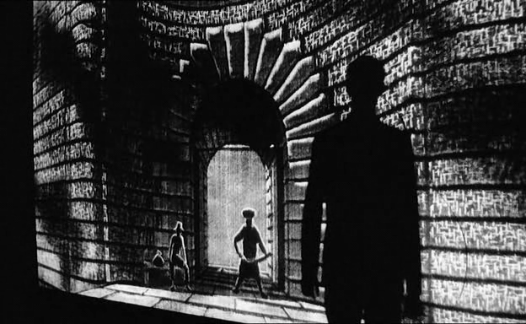
Kafka, “Before the Law” (The Trial, 1925)
What is law?
Where/who is law?
How does law matter? What does law do?
For whom does law matter/work?
Before, With, & Against the law

Slide 4
Kafka’s parable → paradoxes of law
Paradox #1 Law’s dual manifestations (what is law?)
A) Law provides the language, words, and symbols that are constitutive of community
Aspirational promise of equal rights & justice Law & rights must be mobilized by subjects who have unequal resources, capacities. Law → both formal equality & social inequality

Slide 5
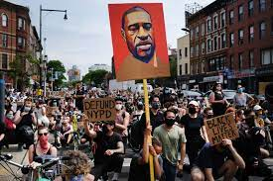
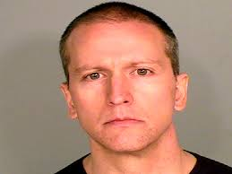
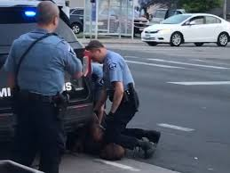
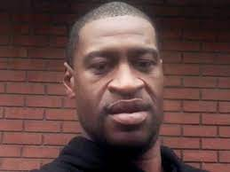
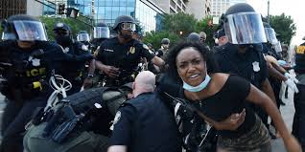
Kafka’s parable → paradoxes of law
B) Law is inherently violent, manifest in force
When is & is not law’s violence legitimate?
Is the violence of law different & better relative to other violence?

Slide 6
Kafka’s parable → two paradoxes of law
# 1: What is the complex relationship between law’s “words” and law’s necessary “violence?”
Law’s violence must be justified by words
But law’s violence undermines meanings and power of words → cycles of violence
Less violence if words mean more….but words
must be backed by threat/reality of violence
(We will begin with second paradox on Wednesday)

Slide 7
This class→ sociolegal approach to law
Professor McCann – an interdisciplinary scholar of law and society
Not a J.D., but a Ph.D. in Political Science
Study law as engaged citizens, not as lawyers
Original architect & director of LSJ 2000-2010
Underline paradoxes of law as/and power/politics
Requires different types of knowledge, analysis, evidence to see complexity
Law is “all over” – news/social media; pictures, video; music; street politics; social practice
Kafka: aim is to view familiar images of law as strange, to see law in new ways and places

Slide 8
Course Materials & Requirements
Canvas website: https://canvas.uw.edu/courses/1545514
Readings – all texts on Canvas website syllabus
Lectures – Power Point format, numbered, daily
Zoom protocols – video/audio off; use chat button
Films (Central Park Five) streamed
Lecture and discussion format; TA quiz sections
Goal: deep & complex analysis, making the familiar seem strange; minimizing opinion trading
Mid-term (in-class) and Final (remote) essays
Participation via weekly discussion papers

