Slide 1
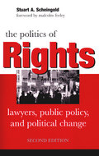
Lecture #3, April 4
Scheingold: Law’s Paradoxical Power
1. Law – is real, but also a figment of our
imagination. How can this be?
a) Law = institutionalized practices & ideology
Ideology: law’s narrative, a myth of rights
b) Law must be studied at both levels of power
c) Politics of Rights – people mobilize law as resource to close gap of promise and reality
Make the myth of rights “real” in practice
d) Courts, litigation, and lawyers matter
for challenging “illiberal” law and
unequal institutional relations
Notes:
Analogy of music to musician. Knowledge, skills, practices. Indeterminate – variations on themes. Difference is: music is not backed up by violence. Law is words/conventions and violent enforcement.

Slide 2
2. But are courts an effective resource advance liberal egalitarian law?
Rosenberg: NO!! Law is a “hollow hope”
a) Law only “protects privilege” (property, race & gender inequalities)
Throughout history…again now
b) “Myth of Rights” obscures that law’s promises (esp. equality) are not realized by or through litigation
Citizens are “beguiled,” duped by legal ideology
“Haves” use myth to delude & divide have-nots
Myth of rights impedes politics of rights
“Politics of rights” is feeble

Slide 3
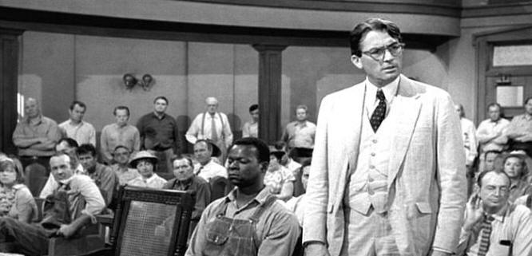
Example of Myth: To Kill a Mockingbird Atticus Finch delivers his closing argument. Now, gentlemen, in this country our courts are the great levelers. In our courts, all men are created equal. I'm no idealist to believe firmly in the integrity of our courts and of our jury system. That's no ideal to me. That is a living, working reality! Now I am confident that you gentlemen will review without passion the evidence that you have heard, come to a decision, and restore this man to his family. In the name of God, do your duty. In the name of God, believe Tom Robinson.

Slide 4
c) Legal institutions fail to deliver on promises of advancing equality, inclusion
Courts tend to be conservative, pro-order,
bound to past, tolerant of social inequality
Liberal “procedure” masks illiberal aims
Even when courts promote change, lack capacity to implement decisions and compel compliance
Brown v. Bd, Roe v Wade, Obergefell
Litigation diverts struggles, generates “backlash.”
Litigation = “hollow hope.” Extra-legal
social movements key to egalitarian change

Slide 5
3. Assessing Rosenberg
He is not wrong, but is highly simplistic
a. Unrealistic standard of impact – rapid fundamental change, by single causal factor
b. Conflates law/litigation w/ judicial impact Litigation and legal mobilization involve many actors, many sites (e.g. media)
c. His histories of “impact” are selective Ex.: Japanese internment
d. Is “backlash” sign of (in)effectiveness?
e. It is patronizing to call litigants “deluded” He does not study motives, strategies of legal action by movements & lawyers
Notes:
Need to discuss “radiating effects” Bowling: ball knocks over pins. But effects radiate – impress, educate, model, influence, hiding from police. Building friendships, community. That is often the reason for bowling in the first place. Why bowl at all? What does it mean? To whom?

Slide 6
The “Politics of Rights” is more subtle, complex, political…
a) “Decenters” courts in rights contestation
Litigation is historical process in & beyond courts
Legal mobilization = rights advocacy by many actors in many institutional sites (media, street protests, legislatures, etc), with and
without court action or litigation threats
Law does support hierarchy, but litigation can supplement, catalyze egalitarian action
Rights advocacy in society – bottom-up approach
Law and political activists/movements are interactive, mutually constitutive
Rights have power as symbols (Meyer/Boutcher)
Notes:
Brown: radiating effects. Indirect. Critical to build support, motivate movement, leverage change.
Rosenberg: court decisions symbolic, not real. But M&B: symbols matter, powerful. Communicate, signal. Rosenberg does not study movements to which he attributes causal power.

Slide 7
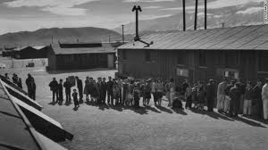
Historical Example: Gordon Hirabayashi
Challenged Japanese American curfew, incarceration
in 1942
Believed in rights myth –went to court for rights
When my case was before the Supreme Court in 1943, I fully expected
that as a citizen the Constitution would protect me.
Military denied rights, Supreme Court upheld internment in 1943 (Hirabayashi v US, Korematsu v US)
There was a time when I felt that the
Constitution failed me…..I began to
to distinguish between the Constitution
and the people entrusted to uphold it.
GH became teacher & advocate of human rights…Mobilized
movement to challenge decision. Court declared was
mistake, won reparations and official apology 1987.
As fine a document as the Constitution is….it is nothing
but a scrap of paper if citizens are not willing to defend it.

Slide 8
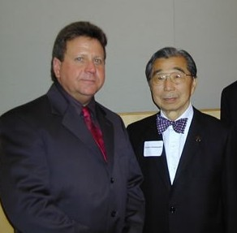
Historical Example: Gordon Hirabayashi

Slide 9
Rosenburg: Top-Down Linear Impact of Judicial Impact
Social Movement
Court
Plaintiffs
Media
Govt.
Rights Opponents
(Defendants)

Slide 10
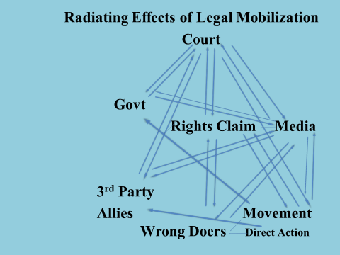

Slide 11
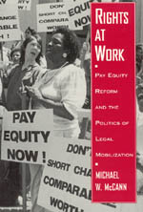
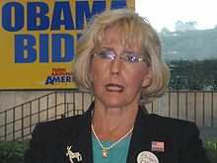
Example : Equitable Pay for Women
1. 1960s: Women earned 59 cents to $1.00 for men
Why? Unequal pay for same work; fewer hours worked; segregated job markets
2) Lawsuits under 1964 CRAct challenged discriminatory
intent and impact in hiring, promotion, wages
3. 1970s lawsuits challenging pay disparities → women organized in unions & women’s rights movement
Lobbying, protest, bargaining → change to 77cents
4) Pay equity litigation killed by courts in late 1980s
Equity movement faded away
5) 2009 Lilly Ledbetter Fair Pay Act
6. 2011 Walmart class action case
Litigation w/o politics → failed

