Slide 1
Lecture #4 Law and Social Change
Scholarly debates about the role of law in advancing social change turn on different models of law……
Scheingold: law is real (institutional coercion), but law is also a figment of our imagination (words, ideology, myth).
Legal words and coercion protect privilege
But “politics of rights” can mobilize myth of rights to contest law’s unjust coercive power
(Meyer/Boutcher agree)
Rosenberg: law matters only as coercive commands; words (e.g. rights) convey little power. Must prove direct causal force.
“Critical realism”: law protects privilege, litigation is hollow hope for challenging privilege.
Myth of rights only deludes actors, impedes politics necessary to advance change
.

Slide 2
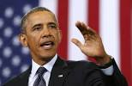
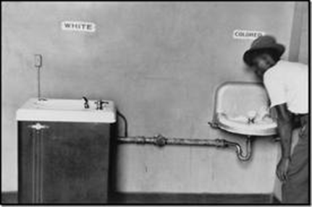
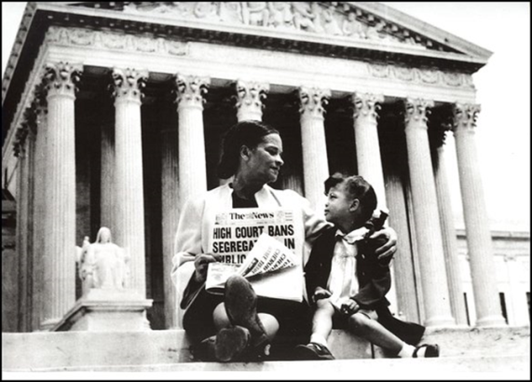
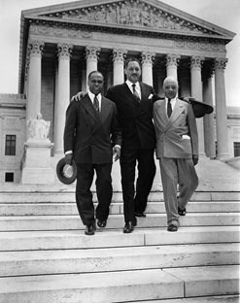
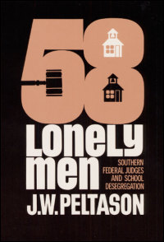
The U.S. Civil Rights Movement: 3 Paradigms of Analysis
1) “Myth of rights” interpretation
A. Southern racism, segregation were illiberal
Black people “left out” of social contract
B. Heroic story of Brown v Bd. (1954)
i. NAACP lawyers/lawsuits → desegregation
ii. South nationalized, state racism illegal
iii. Lawyers and judges abolished racism → post-racial America of legal equality
iv. Atticus Finch as romantic hero

Slide 3
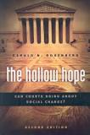
2. Rosenberg’s “Critical Realism” exposes myth of progressive legal change
A. Constitution & Courts protected white supremacy
Slaves were 3/5 of a citizen, less than human
B. After Civil War, amended constitution and courts protected Jim Crow racial segregation
Plessy (1896): “separate” was not “unequal”
C. Litigation for change = “Hollow Hope”
Brown v Bd. →little direct change.
Scant public or media attention
Courts did not outline plans for
implementation of rights
Atticus Finch failed in civil rights cause

Slide 4
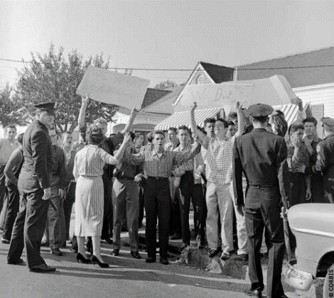
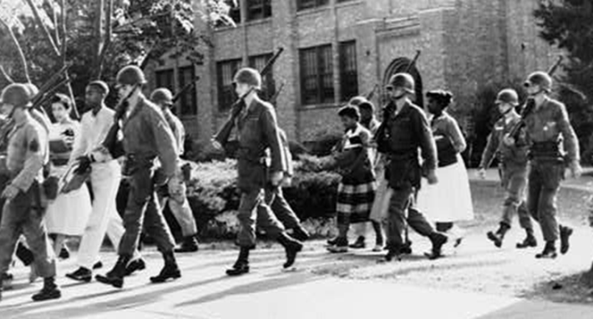
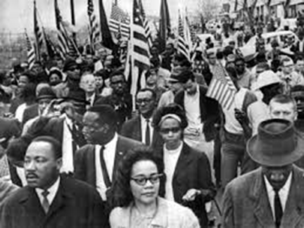
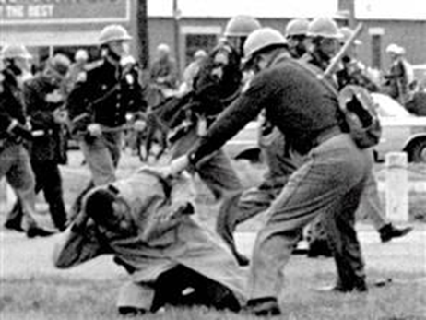
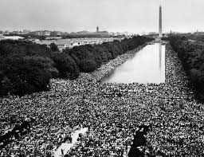
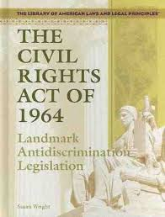
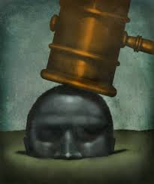
Rosenberg’s critical angle (continued)
D. Mix of resistance, evasion, cooptation in South
E. CR peaceful protest → white violence → turned non-southern opinion into pressure for change
F. March on Washington →1964 CR Act, Voting Rights Act (not Brown) – movement direct action key to change
G. Backlash → Courts rolled back civil rights laws

Slide 5
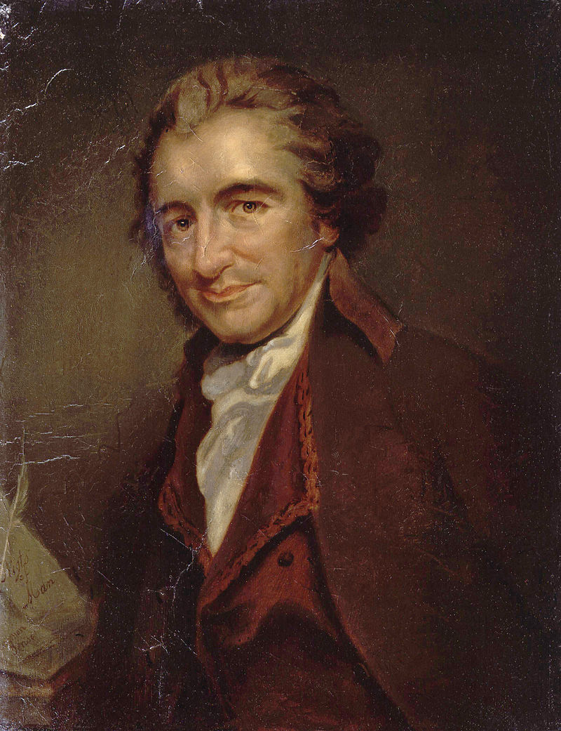
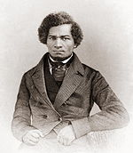
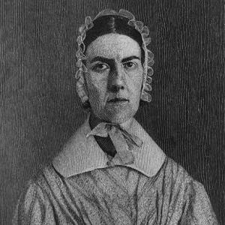
3. Civil rights struggles = classic “politics of rights” (legal mobilization)
A. Courts did protect white privilege, slavery, Reconstruction “new” slavery, Jim Crow
B. But…liberal promise of equal rights contested illiberal law enforcing racial hierarchy →
long history invoking rights as resource
for aspirational struggle
Slavery abolitionism movement
First women’s rights movement
C. Dred Scott → civil war, slavery abolished 14th Amend.→ equality in constitution
D. Plessy – case contesting segregation motivated early NAACP struggle
Notes:
John Brown, abolitionist; Frederick Douglass, abolitionist. Angelina Grimke, abolitionist and women’s rights activist.

Slide 6
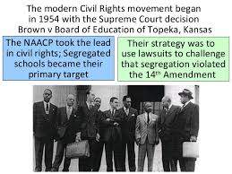
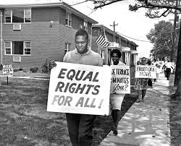
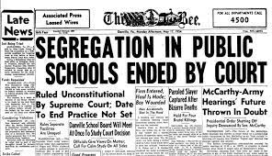
E. WWII – new global context of civil rights
Black lawyers & labor leaders appealed to world, UN in 1940s ↔ human rights claims
F. Brown v Bd ↔ “indirect effects” on movement symbols, language, opportunity, hope, leverage
G. Litigation success catalyzed boycotts, marches, protests, lobbying, inter/national attention ↔ power for the “rights” movement

Slide 7
H. Brown → southern resistance, violence ↔ increased support outside South for change
I. Brown → 1964 Civil Rights Act in “private” economic realm, 1965 Voting Rights Act
J. Court followed conservative backlash in society and politics (sign that rights changes mattered)
K. Legal mobilization and counter mobilization = long historical process of rights claiming in & beyond courts (courts often illiberal)
In short: Law protects privilege, but legal rights mobilization by movement actors in out of court produced egalitarian change.
Treating courts as separate, top-down causal force is highly misleading about complex, interactive rights politics.

Slide 8
The Legacy of Civil Rights: (Meyer & Boutcher)
Take legal rights “symbols” seriously – rights
claims signal, inspire, influence, leverage
Rights are “resources” for political actors
Civil rights movement ended Jim Crow, also provided personnel & models for other subsequent rights struggles
No guarantee of “success”…but aspirational struggle mobilizes energies for change
Movements and law are mutually constitutive
Power of rights claiming contingent on context
(Are M&B too court/litigation centered?)

Slide 9
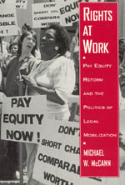
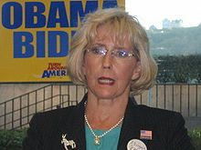
Example : Equitable Pay for Women
1. 1960s: Women earned 59 cents to $1.00 for men
Why? Unequal pay for same work; fewer hours worked; segregated job markets
2) Lawsuits under 1964 CRAct challenged discriminatory
intent and impact in hiring, promotion, wages
3. 1970s lawsuits challenging pay disparities → women organized in unions & women’s rights movement
Lobbying, protest, bargaining → change to 77cents
4) Pay equity litigation killed by courts in late 1980s
5) 2009 Lilly Ledbetter Fair Pay Act
6. 2011 Walmart class action case
Litigation w/o politics → failed http://www.youtube.com/watch?v=qMP8ADExpig&feature=related

Slide 10
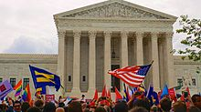
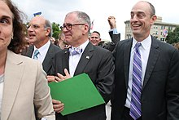
Same Sex Marriage Rights
2010 Gerald Rosenberg: litigating for same sex marriage was naïve, a “hollow hope”
Obergefell v. Hodges, 2015…Supreme Ct heralded for endorsing rights of same sex marriage. Court was the “pinnacle of justice.”
But struggle for gay rights goes back 100 years
Long history of rights based protests (Stonewall),
legislation, referenda, initiatives, lawsuits.
Losing in court/legislature often key to winning (WA)
Obama – views on same sex marriage “evolved”
Battle won in popular culture decades earlier. Supreme Court declared the change as “final.” (Or is it?)
Was a core inclusionary rights issue, but required many types of politics over long time to leverage change.
Hardly the end of LGBTQ struggles….

Slide 11
The rhetoric and rules of a society are something a great deal more than sham…They may disguise the true realities of power, but, at the same time, they may curb that power and check its intrusions. And it is often from within that rhetoric that a radical critique of the practice of the society is developed.
E. P. Thompson, Whigs & Hunters (1975)

