Slide 1
Lecture #5
The Civil Rights Movement:
General Lessons about Rights Politics
Three approaches analyzing law, movements, & change
a) Romantic myth of rights and how litigation advances equal rights….
b) Judicial impact – courts weak, movements matter
Rosenberg: courts isolated as causal agents
c) Legal mobilization – focuses on rights based activism by movements in society & in courts
Litigation’s “radiating effects,” symbolic power in political process

Slide 2
Linear Impact of Judicial Impact
Social Movement
Court
Plaintiffs
Media
Govt.
Wrong Doers
(Defendants)

Slide 3
Radiating Effects of Legal Mobilization
Court
Govt
Legal Mobilization Media
3rd Party
Allies Movement Iliberal Opponents Direct Action

Slide 4
The rhetoric and rules of a society are something a great deal more than sham…They may disguise the true realities of power, but, at the same time, they may curb that power and check its intrusions. And it is often from within that rhetoric that a radical critique of the practice of the society is developed.
E. P. Thompson, Whigs & Hunters (1975)

Slide 5
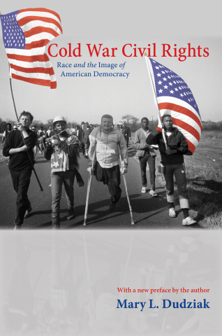
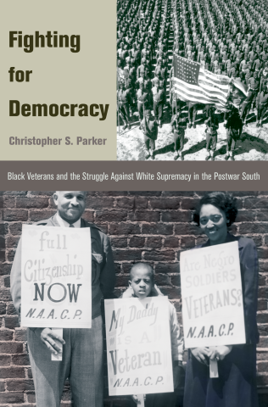
Additional complexities of civil rights legal tactics
a) Contingent contextual forces matter greatly
Bell: historically, interests of whites in South served by segregation and hierarchy
Three social forces led to “racial interest
convergence” (p. 523) after WWII
i. Cold War symbolism
ii. Returning WWII Black soldiers
iii. Economic advantages for South
The ‘opportunity structure” changed
As white/black interest convergence declined → retrenchment in civil rights “tolerance”

Slide 6
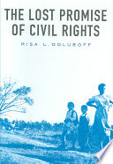
b) Appeals to law/courts narrowed the
rights agenda
Early NAACP focused on two issues: white/state violence; black economic access
Shift in 1930s to focus on school desegregation
Litigation against white violence achieved little
Red Scare deterred black socialists
Goal to overturn “separate as equal” in state action/policy was elevated
Courts held out opportunities/response on education, while backtracked on economic access in 1940s→incentives changed
Goluboff: “lost (economic) promise” of civil rights
Courts pulled NAACP toward desegregation

Slide 7
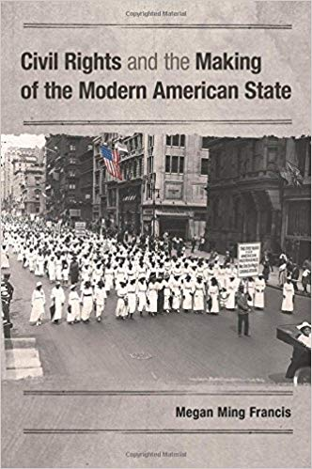
c) Reliance of lawyers on white liberal charitable funding narrowed agenda
Lawyer groups for minority populations need outside funding → vulnerable to “capture”
Early NAACP focus on violence shifted due to dependence on Garland Fund (Frances article)
White funders pushed for desegregation agenda Garland Fund also moderated ACLU
Pushed for “consumer” focus over “producer” issues (jobs, income, loans)
Specter of “socialism” in Red Scare era
Education focus→ opportunities in capitalism
Notes:
Francis interrogates changing movement agenda and goals resulting from coalition changes, funding pressures. Rosenberg takes for granted that what courts rule is “real” movement aim…..very problematic.

Slide 8
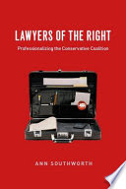
d) Galanter: the “haves” come out ahead Dominant groups prevail in litigation and politics
Have more resources than movements and
their lawyers
“Repeat players” play to change rules
Activist rights lawyers often start out as “one shotters,” playing by RP rules
Rights lawyers often become RPs, but
still lack resources
NAACP no match for big business and conservative groups

Slide 9
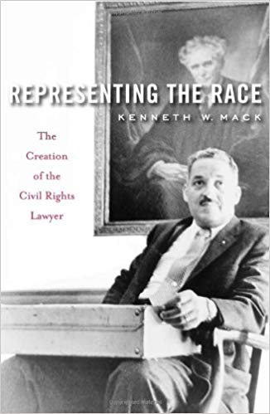
e) The “tail-wagging” of lawyers – formal fairness and professional stature
Black lawyers faced dilemma – to prove they could compete w/ white lawyers
Anti-violence cases → won due process, but did little to stop violence
Lawyers needed “bigger fish to fry”
Victories that produced tangible results
Lawyers dominated NAACP agenda by 1930s Union workers & Left were marginalized
Scheingold: legal education & profession
privileged litigation & diverted lawyers from from bottom–up “politics” of rights

Slide 10
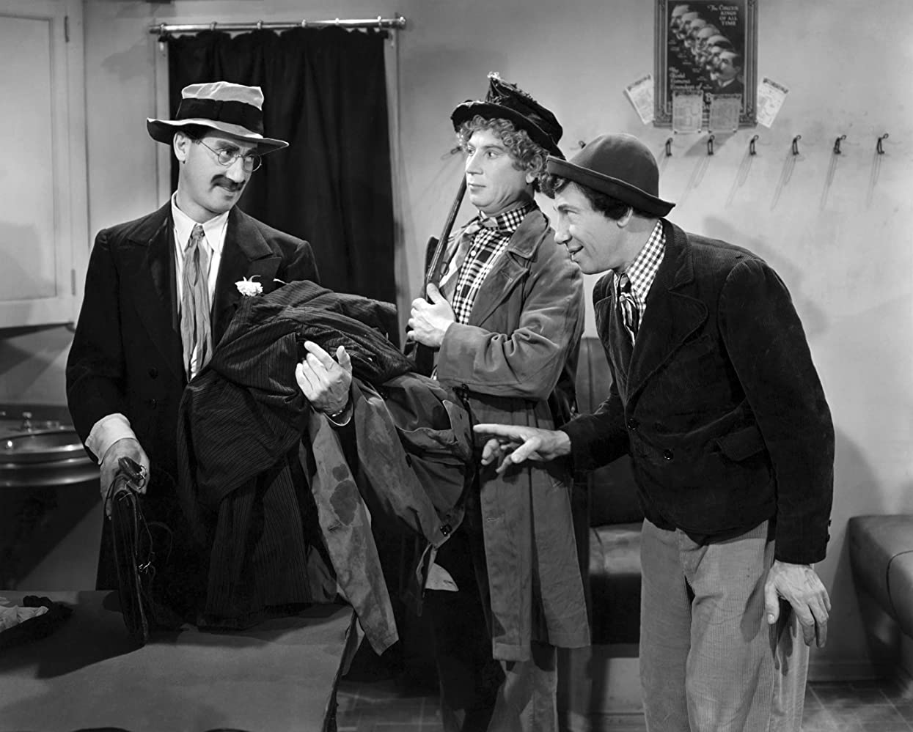
Lawyers as “tail-wagging” the movement
Whenever you got trouble,
the best thing to do is to get a lawyer.
Then you got more trouble….
but at least you got a lawyer.
Chico Marx,
At the Circus

Slide 11
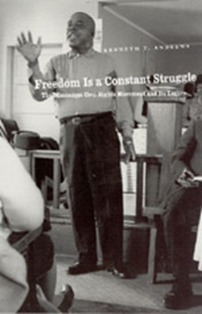
f) Local lawyers did contribute – “little battles” beyond test-case litigation
Embedded legal activity:
i. Legal defense of movement infrastructure
Ex: criminal defense of protestors; fought state harassment; free speech protections
ii. Coordinated lawyers & activists (finance)
iii. Responded to constituent needs (legal aid)
Andrews & Jowers: study of Mississippi 1960s
50+% criminal litigation; 10+% protest and 10% workplace discrimination/harassment
Most of 1700 cases by local lawyers (not NAACP)

Slide 12
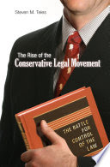
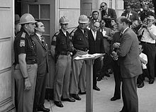
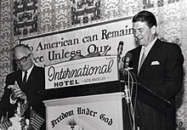
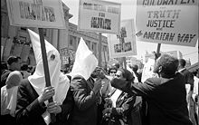
g) White counter-mobilization, backlash
Rosenberg – litigation generates backlash
Always is counter-mobilization to any advances: law cuts “multiple ways”
Southern white resistance, protest
Governors, politicians refused to comply
National political backlash
Criminalization of protest
Mass incarceration
Anti-affirmative action
Resistance to reparations
Does this suggest weakness of legal action?

Slide 13
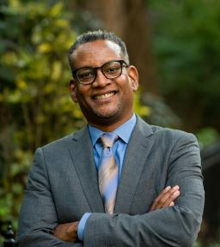
Overall, struggles to renegotiate legal community, especially in egalitarian directions, are difficult
Litigation and lawyers limited in effect, can divert
But what are alternatives? Legal claims and tactics hot-wire and support social movements in variable ways/degrees
If you have an activist, a lawyer, and a
storyteller, you can change the world.
Vince Warren (CCR)
But you need much more -- favorable context, receptive courts, money, powerful allies, creative & experienced leaders, a fair amount of luck….

