Slide 1
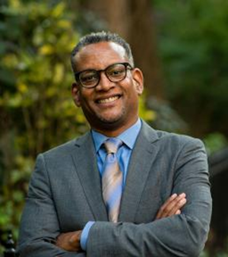
Lecture #6
Overall, struggles to renegotiate legal community, especially in egalitarian directions, are difficult
Litigation and lawyers limited in effect, can divert
But what are alternatives? Legal claims and tactics hot-wire and support social movements in variable ways & degrees
If you have an activist, a lawyer, and a
storyteller, you can change the world.
Vince Warren (CCR)
But you need much more -- favorable context, receptive courts, money, organization, powerful allies, creative & experienced leaders, a fair amount of luck….
Notes:
Ven cut aish

Slide 2
Can legal mobilization win civil rights for undocumented immigrants?
Meyer and Boutcher – Brown → symbolic
inspiration and model for other rights struggles
Undocumented immigrants are hard case
US is land of immigrants. Govt’ subsidized white, Northern European immigration
Africans imported for rightsless slave labor → granted
citizenship, then formal rights, but….many still second class citizens w/ limited rights today
c) Non-white migrant “aliens” (3 waves of Asians, Hispanics) granted equal protection & due process since 1880s, but limited resources/status
d. Immigrants needed for low wage work, but not welcome as rightful community members
e. Venkatesh – can non-citizens mobilize rights?
Notes:
Ven cut aish

Slide 3
3) Example: Filipino colonial “nationals”
conscripted as rightsless migrant workers
1898: US invaded Philippines, imposed colonial rule
Filipinos recruited for low wage, semi-slave labor in West Coast extraction industries (canneries)
Violent repression by state & vigilantes 1920-50s
Criminalized, denied rights → legal struggles
Unionized in 1930s → organizational
power, aided by white liberal lawyers
WWII → independence, citizenship
Notes:
Criminalized. Depression and wars actually helped them in some aggregative ways.

Slide 4
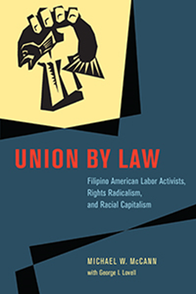
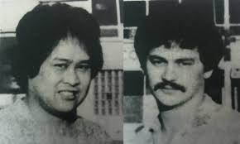
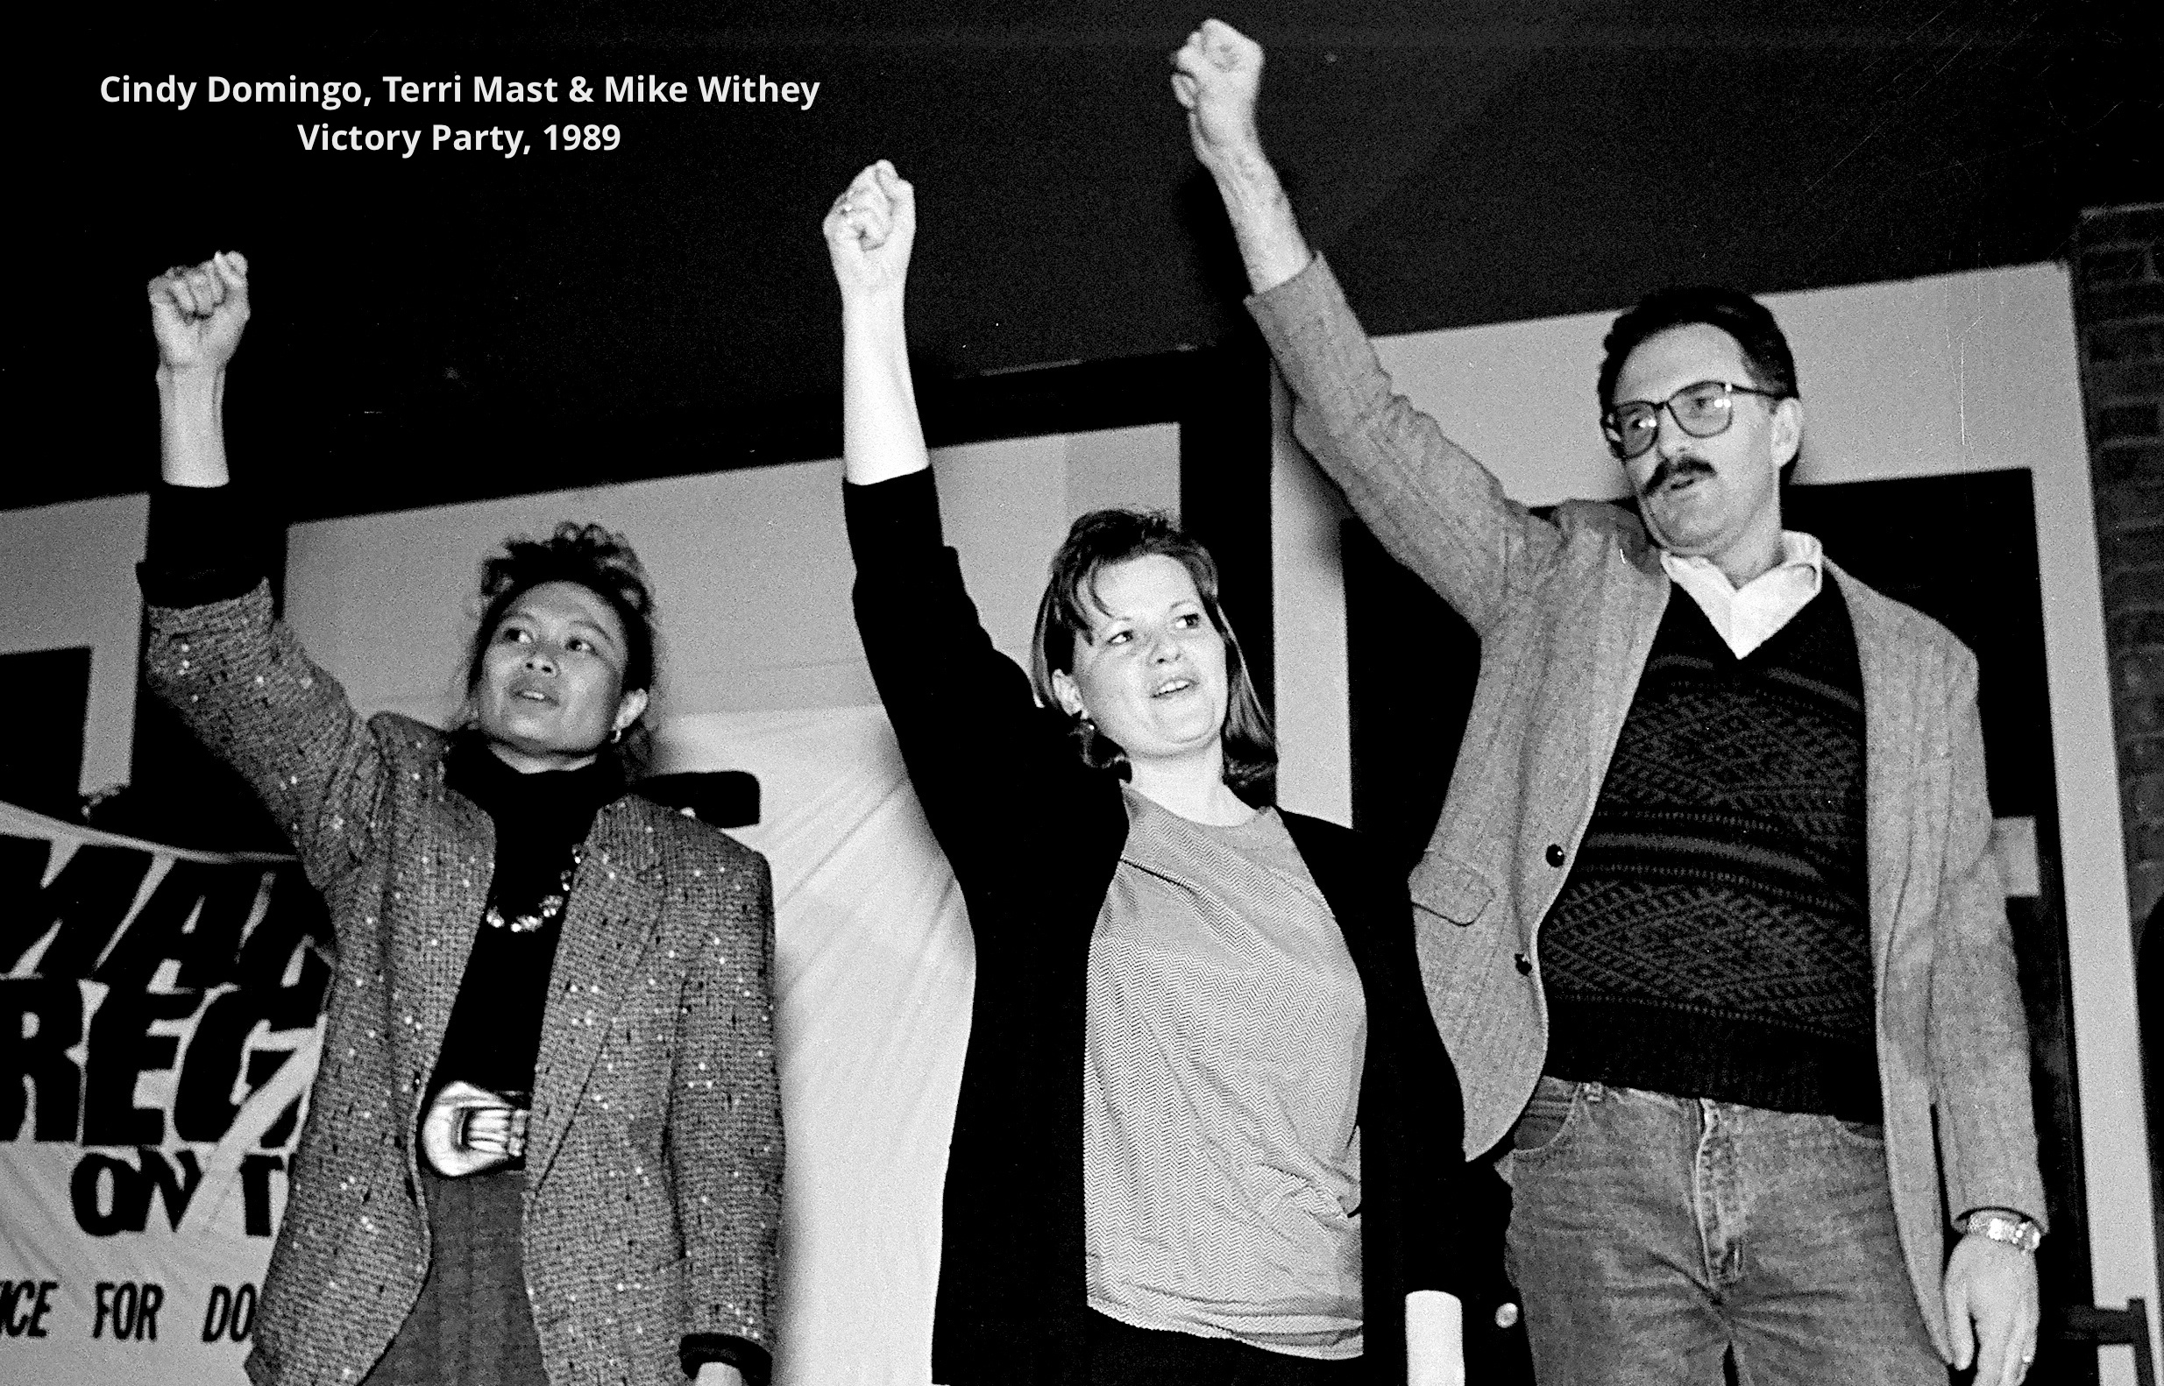
1950s Cold War Red Scare purged leadership
in union ( ILWU Local 37)
1970s – young activists aimed to revitalize union
Filed three workplace civil rights lawsuits
Favorable context morphed into civil rights backlash
SCOTUS eviscerated impact-based civil rights
Two young leaders assassinated for activism
Won wrongful death lawsuit vs Marcos, US govt.
Overall, a complex history of rights mobilization, tragedy, mixed achievements in efforts to fight racism, predatory capitalism, militarism
Silme Domingo Gene Viernes

Slide 5
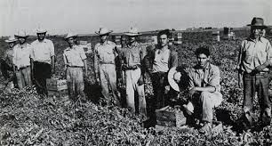
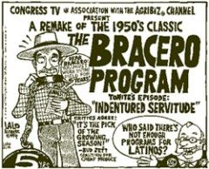
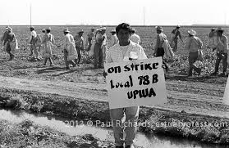
4) Paradoxes of (non-white) immigrants: needed for low-wage labor, but unwanted
and stigmatized racially (criminals)
Bracero program – 1943-60s. Mexican workers
“contracted” for work, regulated by US govt
But employers circumvented rules & rights,
employed rightsless undocumented migrants
Mexican workers exploited greatly in semi-
slave conditions, revolving door, illiberal law
Notes:
Manual labors. Bracero: “one who works using arms.” 350,000 per year. United Packinghouse Workers Assoc.

Slide 6
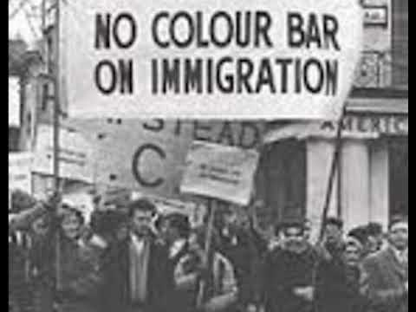
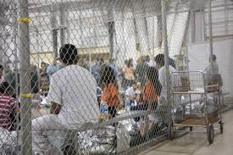
5. 1965 Immigration Act – opened US to
non-white, non-European immigrants
Quotas for Mexicans → many workers made “illegal” by new law (criminalized)
14th Amendment: all persons guaranteed equal protection, need not be citizens
But undocumented workers’ rights are very uncertain, limited, ignored in practice
Subjected to arbitrary stops, detention, deportation, criminalization
Non-citizen status→ stigmatized, racialized
Limited resources (lawyers, money, allies)
Varies with skills/incomes

Slide 7
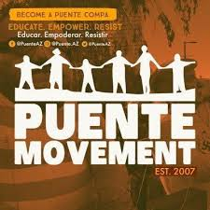
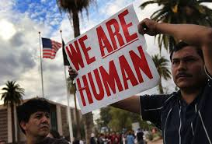
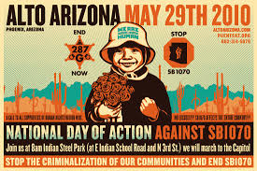
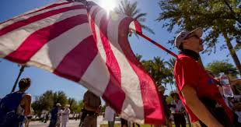
6) Venkatesh on Arizona (2016)
` Illiberal Arizona law represses poor undocumented migrants (SB 1070), while liberal law for citizens facilitates rights contestation
Legal mobilization offers resources to challenge
abuses (comparative culpability) and violations of due process (stops, detention, deportation)
Exploit tensions in law – defensive, offensive
Puente parallel to LGBT movement. “Coming out” → visibility, “recognition”
Similar “opponents” → coalitions of LGBTQ
and immigrant rights in Arizona, WA state
Notes:
Puente movement. Puente=bridge. Walls vs bridges. Derivative rights are more privileges than strong rights.

Slide 8
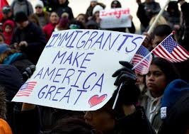
Legal mobilization in and out of courts → a “forum for winning respect and support”
Civil Rights Movement: model & motivation
“[The] concept of rights . . . is the marker
of our citizenship, our relation to others….
[Rights] is the magic word of visibility
and invisibility, of inclusion and exclusion, of power and no power.”
Patricia Williams

Slide 9
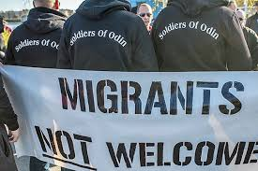
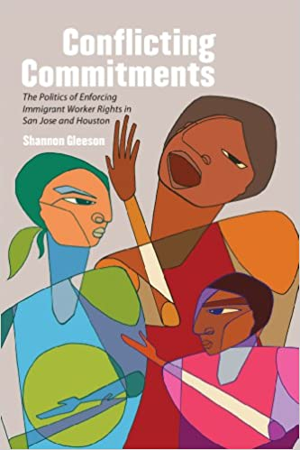
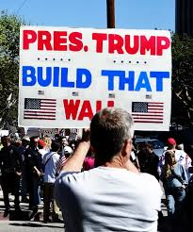
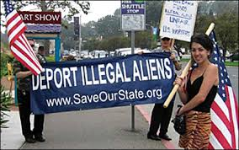
7) Serious constraints for Puente movement
Counter-mobilization by anti-immigrant groups (locally)
Timidity of process-focused courts
Lack of judicial power to compel compliance
Hostile political context of Trump nationalism
Gleeson study: high rights consciousness but fear sustains inaction among undocumented
Are hopes for Court action and effective legal mobilization well founded?

Slide 10
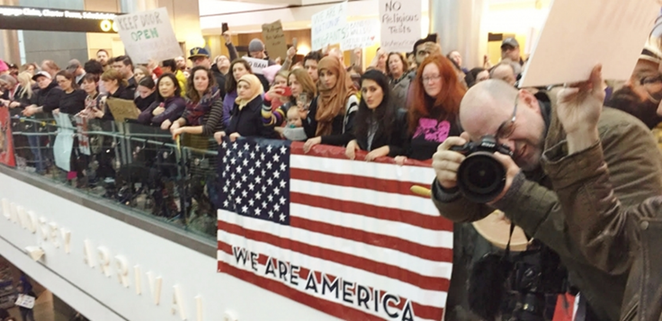
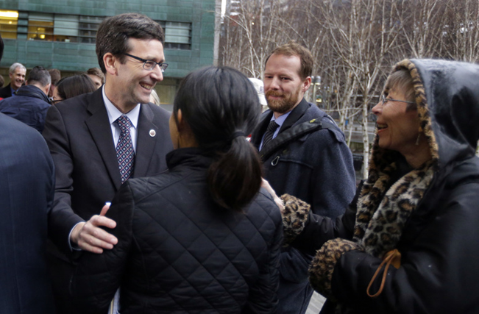
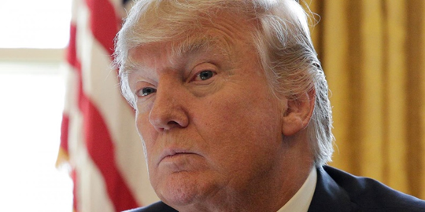
7) Trump’s “Muslim Travel Ban”
Jan. 27, 2017 – Pres Trump issued travel ban for travelers from seven Muslim-majority nations
Jan. 28, 2017 – Protests erupted in airports around the nation and beyond
Jan. 30, 2017 – WA State Att. General Bob Ferguson filed federal lawsuit
“This is un-American…, wrong, and will not stand.”
Feb. 3, 2017 – US District Judge Robart ruled for WA State & ordered halt to enforcement of ban

Slide 11
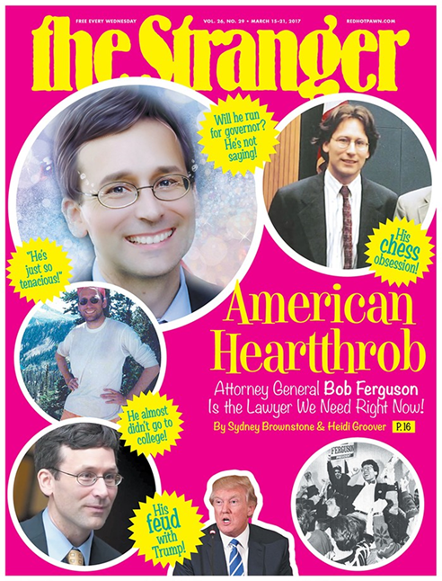
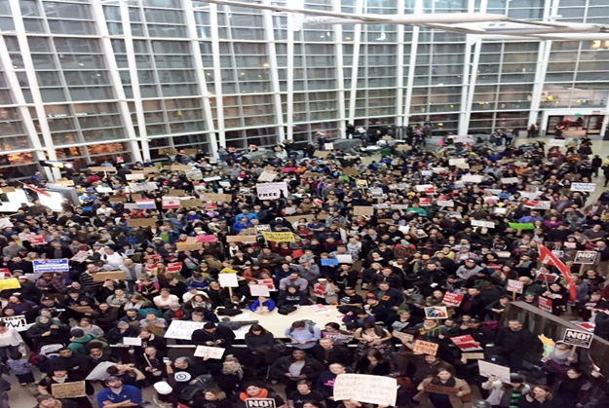
Litigation generated great publicity →
airport protests, public support
Press conferences, media coverage followed…
Att. Gen. drew all attention, amplified his voice –
immigrants & activists largely ignored,
Lawsuit severed from long history of ongoing activism by airport workers that shaped the struggle, & the judge

Slide 12
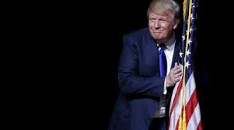
President Trump revised ban → upheld by Court
Classic case of rights litigation without broad political mobilization
Oppositional Lawyers/litigation alone limited in power
Notes:
Law is contested terrain. Law creates community of rights bearing citizens, but also is resource for contesting who gets what, when, where, and how. Including excluding many, marginalizing others.

Slide 13
Opportunity Structures, Interest Convergence….
Official talk of immigrants and rights matters: Obama vs Trump vs Biden (?)
How does present pandemic affect context?
Previous crises (depression, war) often gave leverage to working class immigrants, opportunities for egalitarian change
Virus → scarcity of low wage workers
But crisis and long-term demographic shifts
feed white resentment, fear of “replacement”
Immigrant low wage labor still needed but not wanted → insecure rights status
Notes:
Law is contested terrain. Law creates community of rights bearing citizens, but also is resource for contesting who gets what, when, where, and how. Including excluding many, marginalizing others.

Slide 14
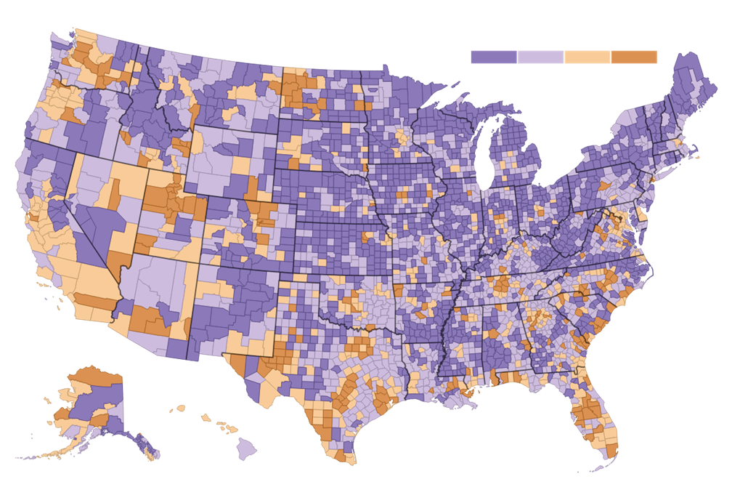
Fewer Working Adults, 2007-2017
-10 0 +10

Slide 15
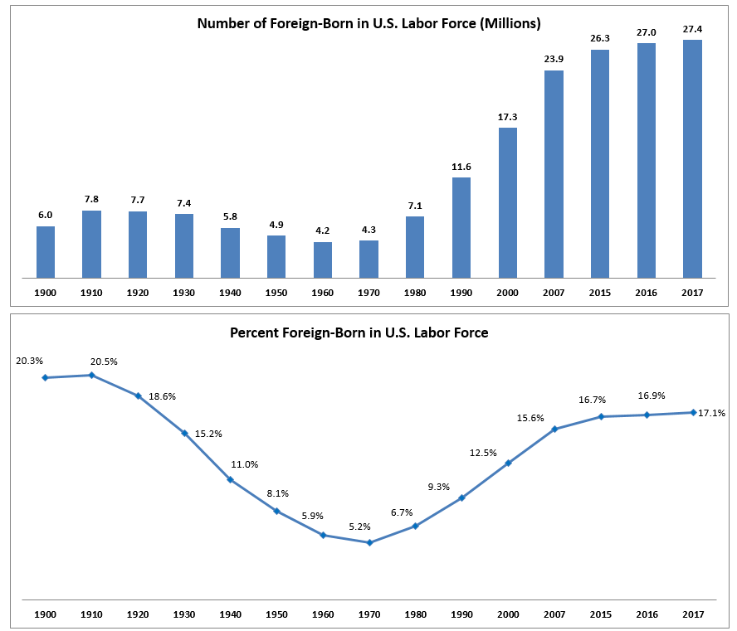

Slide 16
